Slide 1
Customer Virtual Roundtable
Topic: BrassRing Talent Gateways – Skip Sign-In

Slide 2

Agenda
It’s up to you to make this session valuable!
Please speak up, ask questions and network with your fellow customers!
Short demo
Polling questions and discussion!

Slide 3
Demo (3:26-23:38)
Chat Q&A
How long is the create an account link valid for in the email?
  This link does not expire. They can use this to access and create a profile at any time.
For custom email confirmations is there a link that can be inserted?
  No, at this moment no such token available to be used inside comm templates. It's a standard candidate ref email.
Can you report on “date of last login” ?
  At present, it cannot be reported in DIT.
Is there any roadmap to allow for the subject line to be updated?
  Not at this time

Slide 4
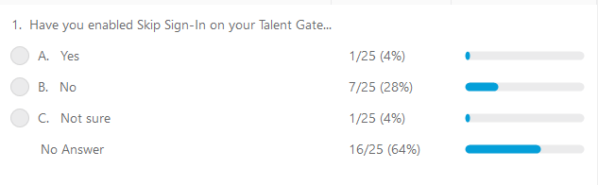
Have you enabled Skip Sign-In on your Talent Gateway?

Slide 5
Has your organization seen an uptick in applications due to enabling this feature (29:30).
Clients with high volume and hard to fill roles have found that the Skip Sign-on feature beneficial in filling the role because the reduction in steps creates an increase in candidate flow!
Q&A:
Would it benefit roles that may not require a Resume. The idea of Skip Sign-on is to reduce the amount of work to apply so if you don’t require resume for a role the skip sign-on would increase the ease even more.
(38:00) Is there any significant time savings for the applicant by enabling skip? Yes absolutely this will reduce the amount of information and clicks required by the clients.
(39:00) If you have someone that has applied in the past and they utilize skip sign-on later what is the experience? If they try to create with the same email as before they would receive a message. If they create with a different email but same profile information stack logic would come into play.
(41:30) Is the email invitation to create a profile manual or can it be automated? Candidate reference email is automated. If you choose not to enable the candidate reference email RAM could be used but you’d want to be aware of sequence.

Slide 6
Agency Manager and Agency Candidates(45:00)
We have been Looking for a solution to provide agency candidates with forms …Could you use this process to invite agency candidates to create a profile and then apply our forms to the candidate zone?
Yes, this would be a great way to overcome the challenge with the renderings issues you’re referring to.
(48:45)- Client shares how they manage candidates and forms coming through Agency manger by using RAM triggered by candidate type and HR status.
(53:45) Is it the forms themselves going to the candidates or the formatting? When we send links and they access them outside the Talent Gateway they render improperly. So we’re looking for a way to get them to access the forms via the TG.

