Slide 1
Migrating to the Responsive Talent Gateways
IBM Kenexa BrassRing on Cloud
—
Client Training and Enablement Session
IBM Watson Talent
April 30th, 2020

Slide 2
Agenda
Important Dates
High-Level Demo of Responsive Talent Gateways
Example Project Path and Preparation
Configuration Steps (Full Talent Gateways)
Configuration Steps (Basic Talent Gateways)
FAQs
Resources

Slide 3
Important Dates:
IBM sunset of support for Classic Talent Gateways: December 31st, 2017
Classic Full Talent Gateways will be auto-converted in STAGING with this May 2020 release.
The Classic Talent Gateways (Full and Basic) will no longer be available with the June 2020 release. (Full Talent Gateways will be auto-converted.)

Slide 4
Demo of Full Responsive Talent Gateway
–

Slide 5
Example Project Path and Preparation
Source: If applicable, describe source origin
3. Configuration
Workbench admin configures GQs and TGs.
5. Go Live
Reqs are updated and go live tasks are completed.
1. Kickoff and Prep
Branding discussion and review of current set up.
Self-service implementation
Pull in additional teams/vendors that will be critical to completion of the project (listed on following slide)
Which Talent Gateways do you have to convert?
Where do your external BrassRing Talent Gateways connect with your corporate site? How are your internal Talent Gateways accessed?
What vendors currently scrape your Talent Gateway(s)?
2. Design/Branding
Branding worksheet is completed or CSS is developed.
4. UAT
Testing is completed in Staging.
Do you use iFrames?
Do your Classic Talent Gateways have any tracking codes on them?
Do you use a posting partner?
Do you currently use the Classic referral functionality?
Notes:
Master Draft 1
Master Draft 1
5

Slide 6
Example Steps to Implement
Kick-off Call
Configuration items
Branding
Your marketing team should provide branding details for the Talent Gateways (via the design sheet and/or CSS).
Initial Configuration
WB Admin will complete the initial configuration in Workbench. Additional feedback may be needed by the Recruitment and Marketing teams during configuration.
Roles & responsibilities
High-level timelines
Send design sheet to marketing/corporate communications team.
Make your legal team aware of the review they will be asked to complete.
Start reaching out to your vendors that may be scraping your Talent Gateway(s).
Review
Test
Initial review will be completed by all teams and configuration changes will be completed by the WB Admin.
Test reqs should be posted to the Responsive Talent Gateways to allow for testing to occur.
UAT
Recruitment team: responsible for UAT.
Marketing team: review the branding on the Talent Gateways.
Scraping Vendors: test the Jobs API
Configuration changes will be completed as needed throughout UAT.
UAT sign-off
Go-live date is set
Go Live
Pre go-live: Move Responsive GQs to Production, Configure Responsive Layout Page in WB
Day of Go-Live: Enable TG settings (Responsive Setting, etc), Activate GQs (Update associations if the client is already using GQs), Remove Default Questions (if needed), Configure branding in Visual Branding Tool, Refresh/Repost reqs postings
Client’s marketing/corporate communications teams will complete URL changes if necessary.
Vendor(s) start utilizing the jobs API to pull jobs.

Slide 7
Roles and Responsibilities
Project Team
Workbench Admin
–
  Will be responsible for configuration throughout the project. This includes the Responsive Gateway Questionnaires and Responsive Talent Gateways.
Recruitment / Talent Acquisition Team
–
  Provide insight on process improvements during User Acceptance Testing and may want to provide feedback on current functionality.
Legal
–
  Review the application process, especially the VEVRAA and 503 Disability forms (if presented to candidates during the submission process).
Marketing / Corporate Communications / Vendor
–
  Will be responsible for providing branding details (including potential CSS), will review the gateways to ensure branding compliance, and may be needed to make the appropriate corporate career site changes.
Job Board Vendors that may be scraping the Talent Gateway(s)
–
  Scraping is not supported on the Responsive Talent Gateways. Vendors that scrape will need to move to the IBM Jobs API to pull requisition information.

Slide 8

Configuration Steps
Full Talent Gateways
–
1. Configure Responsive Gateway Questionnaires
2. Configure Responsive Layout for Talent Gateway
Synchronize your Talent Gateways!
3. Enable Responsive setting on Talent Gateway
4. Configure Branding for the Talent Gateway
Synchronize your Talent Gateways!
5. Update GQ associations or repost requisitions.
Convert your existing Talent Gateways, do not create new Talent Gateways.
Configure and test your Responsive Talent Gateways in Staging before you make changes to your Production Talent Gateways.
Don’t forget to map your HR Statuses to the appropriate HR Status Categories.

Slide 9
Demo of Configuration Steps
–

Slide 10
Configuration Steps
Basic Talent Gateways
–
1. Configure Standalone Responsive Gateway Questionnaire
2. Create a new Full Talent Gateway
Synchronize your Talent Gateways!
3. Configure Branding for the Talent Gateway
Synchronize your Talent Gateways!
4. Select Standalone Gateway Questionnaire on Responsive TG Settings
5. Inactivate old Basic Talent Gateways
You must create NEW FULL Talent Gateways for the Add Candidate and Add Contact processes. (Replacing the existing Basic TGs.)
Configure and test your Responsive Talent Gateways in Staging before you make changes to your Production Talent Gateways.

Slide 11
Configuration Steps
Social Referral Talent Gateways
–
1. Configure new Responsive Gateway Questionnaire for Referral
2. Create a NEW Full Talent Gateway (Employee-facing Gateway) or enable Social Referral on your current Internal Talent Gateway.
Synchronize your Talent Gateways!
3. Configure Social Media, Branding, and Comms for the Talent Gateway
Synchronize your Talent Gateways!
4. Configure RAMs that will be needed for your process
5. Remove postings from existing Employee Referral TG and post reqs to new TG.

Slide 12
Configuration Steps
–

Slide 13
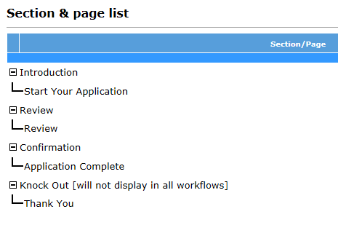
Responsive Gateway Questionnaires
The 4 new standard sections of the Responsive Gateway Questionnaires are:
Introduction > Start Your Application (which must always be first)
Review > Review (Review page doesn’t include a widget)
Confirmation > Application Complete
Knock Out > Thank You
These sections and pages are automatically added when the “Responsive” setting is enabled on the GQ Properties page.

Slide 14
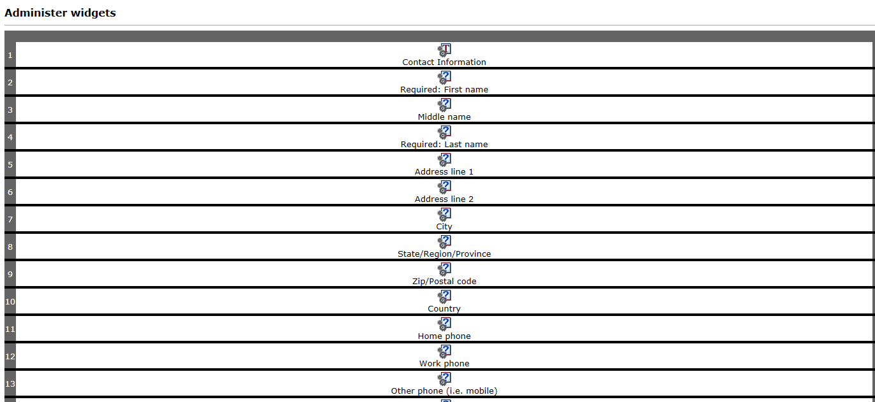
Responsive Gateway Questionnaires
Widgets within the pages are now all in a single column, to accommodate responsive screens of smaller devices without horizontal scrolling.
When you add or delete a widget, it now automatically adds or deletes the row – no more need to create a row, then the widget.
You can cut-and-paste widgets before or after the selected widget.

Slide 15
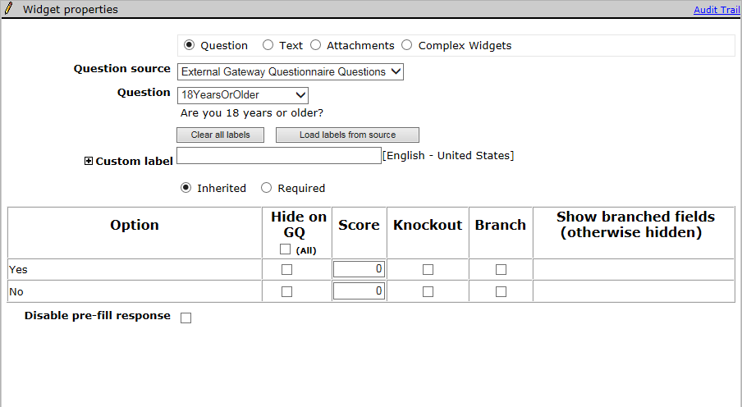
Responsive Gateway Questionnaires
The scoring, knockout, and branching functionality are all configured on the Widget properties page for the Question widgets.
The Disable pre-fill setting is hidden for candidate contact fields. In classic GQs, you can disable pre-filling of fields with responses from prior applications for any question widget, including contact fields. In Responsive Apply, you can disable pre-filling for candidate form questions only. This restriction improves the candidate experience by pre-filling more of the candidate’s information from their current application.

Slide 16
Responsive Gateway Questionnaires
Notes:
To avoid confusion for BrassRing users, have one page per section for responsive questionnaires, and use the same title for both section and page. Standard sections/pages can have different name. Since BrassRing users see only section titles, and candidates see only page titles in the candidate experience, keep the names the same to minimize confusion.
The “Introduction/Start Your Application” section/page MUST be the first section/page of the Responsive Gateway Questionnaire.
The “Estimate time to complete” field on the “Start Your Application” page sets the time estimate that the candidate sees before they start filling out their application. Leave this field blank to have the system calculate the estimate time using an advanced algorithm based on the number and type of questions and widgets in the application. You can also enter your own estimate manually, should you prefer that method.

Slide 17
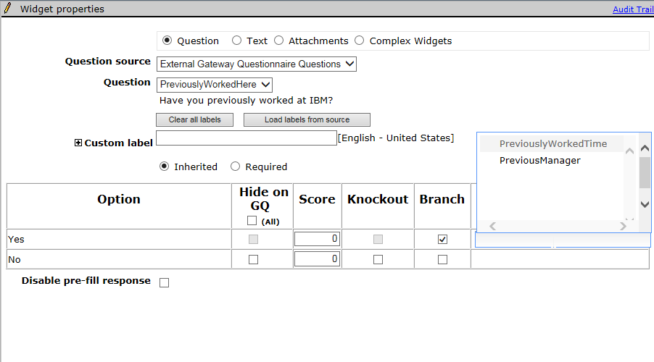
Responsive Gateway Questionnaires
Branching Configuration:
Add all questions that may be branching questions or questions that will need to be shown as a result of a selection to the page.
In the widget properties page for the ‘parent’ question choose the fields that will show based on the option selected. Select “Branch” for the option you want to show the branched fields, then under the “Show branched fields” section select the fields you want to be visible if the option is selected. The Show branched fields section will autocomplete as you type. Fields shown are the database field names so it is important to know which field you are selecting.

Slide 18
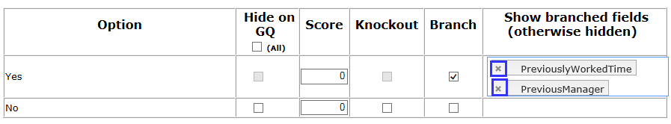
Responsive Gateway Questionnaires
Branching Business Rules
You can branch only from question to question – you cannot branch to a text widget. However, to display variable text, you can create a label for that text in the candidate form, and branch to that label – and the corresponding text.
Branching must be linear. You cannot branch to a widget that precedes the question widget in the widget order. Thus, if you select the first widget on the page, you can choose to branch to any of the following fields on the page. If you select the last widget on the page, no fields will be available to branch to.
A child field can’t be reused on the same page as the branched-to field after being used on the page already for a different widget.
You can branch across forms, as long as the fields are pulled on to one GQ page.
Classic GQ page-level branching is not inherited when you create a responsive GQ. Branching must be re-configured.
To remove branches, select the X in the branch label tag.

Slide 19
Responsive Gateway Questionnaires
The following high-level steps should be followed if your organization is NEW to using the Gateway Questionnaire functionality:
Determine how many Responsive GQs you will need. This could be based on:
  The number of Responsive Talent Gateways you have. (One GQ per TG)
  The number of different application workflows you have. (One GQ per Job Family/Position)
  The number of countries your organization operates in. (One GQ per country.)
Map out your application process/flow. Most organizations that have not used GQs in the past will implement one GQ per TG. Examples: Internal, External
In Workbench, go to Tools > Gateway Questionnaires > Add new Gateway Questionnaire > Name your GQ (we recommend you use versioning such as “External v1”) > Set your other GQ properties > Save
The 4 standard responsive sections will automatically be visible. Next, add the Sections, Pages, and Widgets that will make up your application process.
Activate the Responsive Gateway Questionnaire.
While posting your requisitions to the Responsive Talent Gateway, be sure to select your Responsive Gateway Questionnaire.

Slide 20
Responsive Gateway Questionnaires
The following high-level steps should be followed if your organization is NOT NEW to using the Gateway Questionnaire functionality:
In Workbench, go to Tools > Gateway Questionnaires > Click the Active tab > Select the Classic GQ you’d like to convert a responsive GQ > “Save Gateway Questionnaire as New” > Name your GQ and make sure the “Responsive” setting is selected > Click OK
The 4 standard responsive sections will automatically be added to your existing GQ sections. Some reconfiguration may be required to ensure your application process flows properly.
  Pages have been updated to the 1 column format which may require you to re-configure the order of your questions.
  Branching and knock-out questions will have to be reconfigured.
  Text throughout the Gateway Questionnaire should be re-reviewed.
Activate the Responsive Gateway Questionnaire.
Select your existing Classic Gateway Questionnaire > Click “Update Gateway Questionnaire associations” > Select your new Responsive Gateway Questionnaire > Inactivate the old/classic GQ.

Slide 21
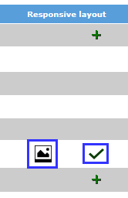
Responsive Talent Gateways
Responsive job search and apply can be enabled in Workbench for Full and Global Talent Gateways that are WCAG compliant. Basic Talent Gateways cannot be converted to responsive.
Visual Branding Tool:
  Screen fonts, colors, images, and Advanced CSS are controlled via the Visual Branding Tool launched from within Workbench. The Visual Branding Tool will be covered in a subsequent webinar.
“Responsive Layout”:
  Configured per Talent Gateway with sections that allow you to edit the header, footer, links, verbiage of the site, filters, and fields.

Slide 22
Visual Branding Tool
With the Visual Branding Tool (VBT), you can change and save branding elements for responsive Talent Gateways and Gateway Questionnaires: colors, fonts, and stored images. Gateways must be:
Full or Global WCAG-enabled Talent Gateways
Have saved responsive layout (indicated by pencil or checkmark icons)
Be synchronized if new or if responsive layout was recently configured.
To Access the VBT you can select Tools > Talent Gateways >

Slide 23
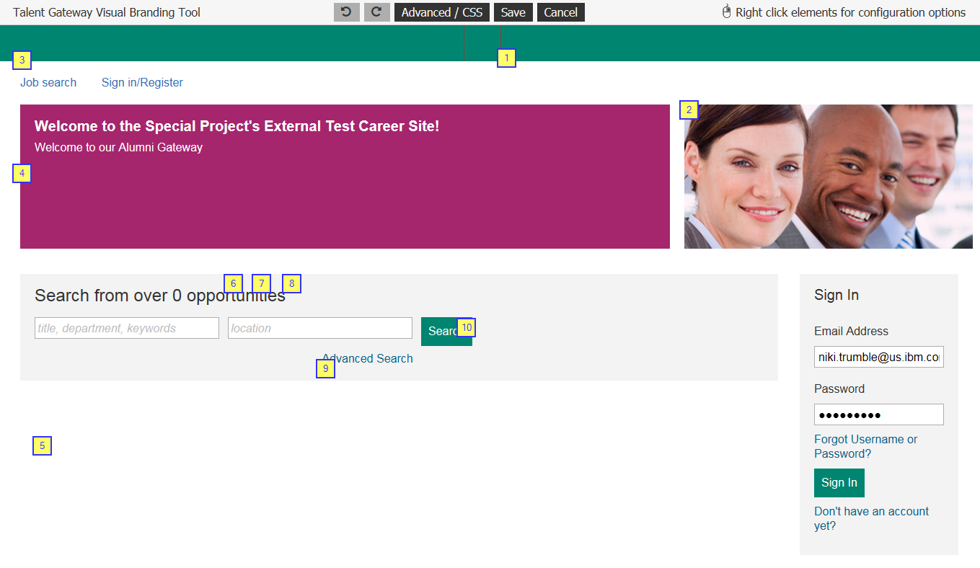
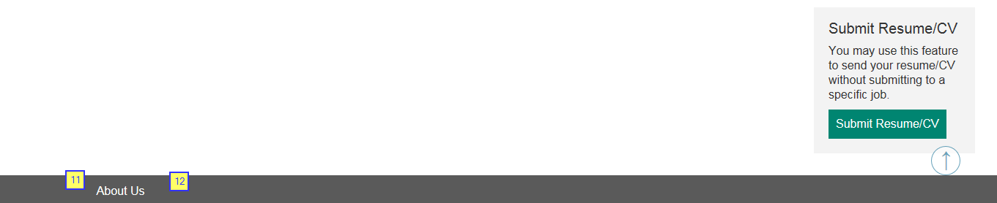
Visual Branding Tool
VBT opens in configuration mode, where you can right-click to change the different elements.
1: Logo – Will appear in the header. Must be a URL and HTTPS hosted. Height 50px, Width 130px, Size 50kb
2: Branded Image – Must be a URL and HTTPS hosted. Height 400px, Width 1100px, Size 600kb
3: Header Link Color
4: Foreground Color
5: Background Color
6: Base Font Size – 16px default
7: Base Font Color
8: Base Font Style: Helvetica Neue/Arial, Verdana, Times New Roman, Tahoma
9: Page Link Color
10: Button Background Color
11: Footer Font Color
12: Footer Background Color

Slide 24
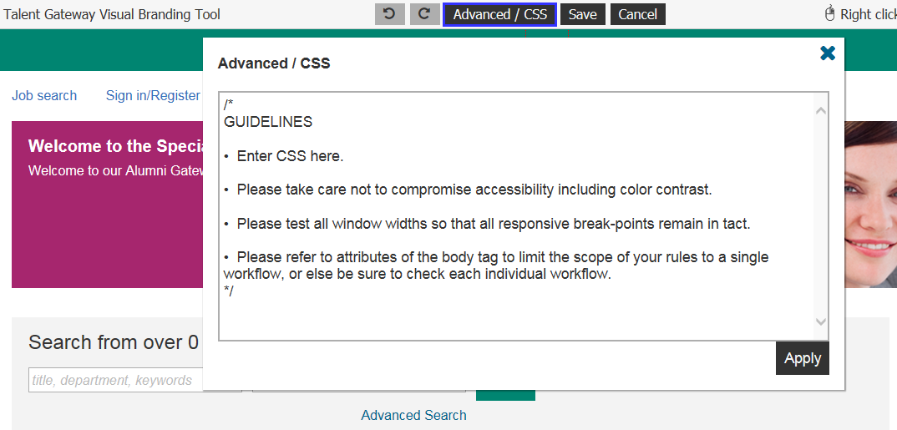
Visual Branding Tool
At a very high level, CSS (Cascading Style Sheets) replaces the formatting of certain HTML tags in page content; you could make a special icon appear for any use of the <li> bullet tag, or you can control the colors of certain elements universally. CSS normally can be used in-page or as a separate HTML document called for each page. To learn more about CSS, you can access this online source.
The Advanced / CSS feature in the visual branding tool was created to allow clients granular control over branding through the direct input of CSS code. Advanced CSS allows you to add CSS scripts to change the look and feel of the responsively designed pages.

Slide 25
Visual Branding Tool
The Advanced CSS feature is very powerful, and as you manipulate the CSS on a page, you may negatively affect the responsiveness or the accessibility of the application pages, so please make sure the CSS script entered is done by someone with deep expertise in CSS. The candidate experience has been coded to adhere to numerous global standards and to accommodate virtually all devices through responsive design. In addition to solid knowledge of CSS, the Advanced CSS option of the visual branding tool requires great care to avoid adversely affecting all of the following:
  Responsive breakpoints
  General usability
  Accessibility
The tool is not intended to re-write the entire CSS, its intended use is for specific changes that need to be made.

Slide 26
Visual Branding Tool
What It Can Do: The Advanced CSS option can control the presentation of every element in the user interface: header, footer, and main body. Such as:
Control colors and fonts
Hide content
Resize content
Reposition content
Add background images
Add and remove scroll bars
Add some content (text, icons, images, etc.) within limitations
Show content that was otherwise hidden
Change the number of columns displayed (within some limitations, excluding IE < 10 and Opera Mini)
What It Cannot Do
It cannot always single out a single element in the user interface to restyle without affecting similar elements
It generally cannot divide content or make any changes that require changes to markup
It generally cannot control user interaction or make any changes that require changes to script.
Note: IBM does not support questions about CSS. CSS should be developed by your internal marketing/branding teams if you would like to use it on your Responsive Talent Gateways. However, we do have some common CSS examples that can be found on the IBM Knowledge Center.

Slide 27
FAQs and Things to Know
Responsive Talent Gateways
Why do my users have to select a Gateway Questionnaire now when posting a req?
–
  With Release 19.02.11 all reqs that a BrassRing user attempts to post (or update a posting) to a Responsive Talent Gateway will require a GQ to be included/selected.
How can I tell what reqs do not have a Gateway Questionnaire selected on the posting options page?
–
  We recommend utilizing the BrassRing Metrics Dashboard to build a visualization to pull this information. An example visualization would be:
  Table Chart type
  Columns: Auto Req ID, Gateway Questionnaire, Posting Options
  Optional Filter: Req Status
Do you have to select a Responsive Gateway Questionnaire when posting to a Responsive Talent Gateway?
–
  Yes.
What should I test when migrating my Talent Gateways to Responsive?
–
  Testing should include (at a minimum): Header and footer links, advanced search fields, job description layout, field branching within the application, WOTC/Assessments/APIs (where applicable), Social Media functionality (Google Drive, Drop box, LinkedIn, Facebook, Twitter), Candidate Zone pages.
Our organization has an Employee Referral TG for our internal employees. This TG houses all reqs that are eligible for referral. This is a TG solely for searching for jobs and referring someone to them. The TG is not used for internal applicants to apply to jobs. What should we do?
–
  The old/classic Employee Referral functionality is not supported on the Responsive TGs. You will need to implement our Social Referral functionality; which is supported on the Responsive TGs. If you do not want internals to apply to jobs on the TG you can use CSS to hide the Apply button. Example CSS for this can be found on our Advanced CSS document.
TIP: It is recommended that you place the education and experience widgets on the same page as the contact fields. The resume/CV widget should follow on the next page. The Import Profile button is what is used to prefill/parse the candidate’s information into the contact fields and education/experience widgets.
TIP: If testing the Saved Search functionality in Staging, please note that emails are not sent.

Slide 28
FAQs and Things to Know
Responsive Talent Gateways
TIP: Job Cards will drop off of a candidate’s submitted applications page if the Req Status = Closed (Cancelled or Deleted) and the candidate’s HR Status hasn’t been updated in 90 days.
CSS is very powerful. As you manipulate the CSS on the page, you may negatively affect the responsiveness or the accessibility of the application pages. Please make sure the CSS entered is done by someone with expertise in CSS. The candidate experience has been coded to adhere to numerous global standards and to accommodate virtually all devices through responsive design.
If you are interested in tracking traffic on your Talent Gateways, please reach out to your IBM representative and they can provide information about our Digital Analytics tool.
Welcome text color is limited to ensure that it contrasts with the color of the foreground color.
TIP: If your Attachments widget page does not have an upload option, this is most likely because you do not have attachment categories selected on your GQ.
The signature widget that was available in Classic GQs is not supported in the responsive GQs. Electronic signatures have not changed with Responsive Apply. Most clients are using a combination of a checkbox and text box for the candidate to type their name. The drawn signature that was available in Classic is not supported in Responsive.
Videos can be added, by using HTML, to the Candidate Zone via the HR Status Category descriptions.
HR Status Categories are displayed to candidates within the Candidate Zone. These HR Status Categories can be customized per Responsive Talent Gateway.

Slide 29
FAQs and Things to Know
Responsive Talent Gateways
If your organization currently uses iFrames, please be aware that iFrames are not technically supported on Responsive Talent Gateways. Adding custom CSS and coding does not guarantee that the Responsive Talent Gateway will render properly on mobile devices. Also, an attempt to implement an iFrame may result in the iFrame taking up too much screen space when candidates are on smaller devices. This then leads to a less than optimal candidate experience.
Jobs pushed to a third party, through a Job Board Aggregator or through the IBM Jobs API, should not be impacted.
If your organization currently uses a Vanity URL, these should not be negatively affected by the conversion to Responsive.
If you would like to remove certain options from a field on the Advanced Search page, edit the Talent Gateway and select the “Choose field options” field.
The “more” option on the job search results page will not render HTML from the formatted descriptions

Slide 30
Resources
Configuring the TGs/GQs
The Overview, Configuration and Documentation page on the Knowledge Center contains a ton of information! Including:
  Project overview
  Configuration overview
  Responsive Apply Design Sheet: This document is referenced in the Project Process Overview and Visual Branding Tool Overview webinars. It is recommended to use this document to collect pertinent information from your Marketing or Corporate Communications team.
  Responsive Upgrade LOE Assessment: This spreadsheet helps you estimate the number of hours that are needed by your Workbench Administrator to make the move to Responsive Apply.
  Advanced CSS Snippets
  Responsive Apply Tracking Codes for Apply Process
Configuring the Add Candidate Standalone GQ (to replace the Basic Add Candidate TG).

Slide 31
Questions?

Slide 32
May VIRTUAL TRAINING SESSIONS
Client-facing training schedule
Sunday | Monday | Tuesday | Wednesday | Thursday | Friday | Saturday
 |  |  |  |  | 1 | 2
3 | 4 | 5 | 6 | 7 Client: BR 20.05.04 and Onboard Release (11:00 AM EST) | 8 | 9
10 | 11 | 12 | 13 | 14 Slack Me Anything! | 15 | 16
17 | 18 Client: Assess May Release (11:00 AM EST) | 19 Client: BrassRing Metrics Dashboard (11:00 AM EST) | 20 | 21 | 22 | 23
24 | 25 | 26 | 27 | 28 | 29 | 30

