Slide 1
Interview Manager Automation
BrassRing on Cloud
—
Client Training and Enablement Session
Talent Management Solutions
October 29th, 2020

Slide 2
Agenda
Overview
Interview Reminder RAM
Invitation Reminder RAM
Demo
Configuring Communication Templates
Recent Enhancements
Resources
Q n A

Slide 3
Overview
Interview Manager:
Automation allows administrators to configure RAM(s).
RAM would automatically send a reminder to candidate & Interviewer(s).
There are 2 types of “Reminder” triggers available to be configured.
It would make sure the intended parties are aware of the upcoming interview.
This also helps the interview coordinators to ensure that the rescheduling or cancellation can be done in a timely manner if required.

Slide 4
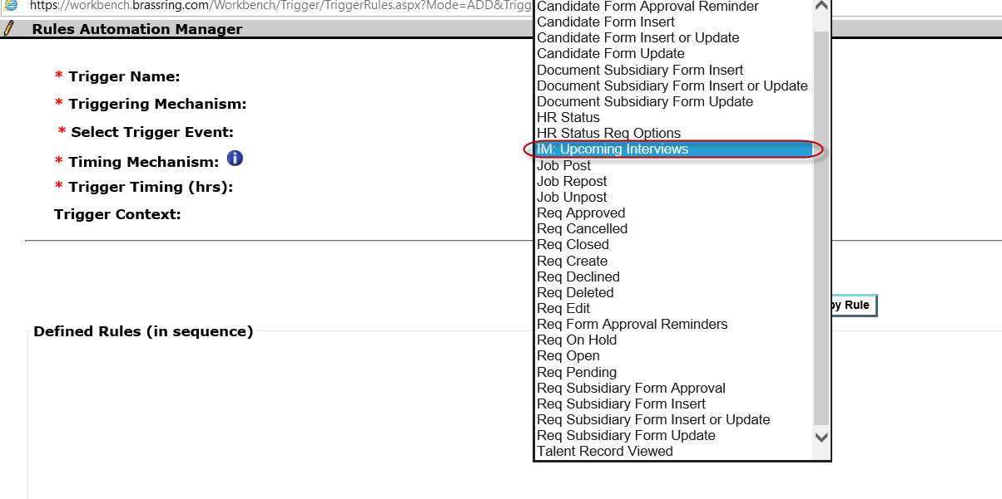
Rules Automation Manager - Interview Reminder
A RAM trigger is available to be used with Interview Manager.
This trigger can be used to send reminders to candidates and interviewers before the scheduled interviews.
Trigger will automatically filter interviews based on Interview Status - Scheduled.

Slide 5
RAM - Interview Reminder
The following attributes for the new trigger:
Trigger Type - RAM Trigger
Triggering Mechanism - IM: Upcoming Interviews
Select Trigger Event - [Disabled]
Timing Mechanism - Before Interview Start [Default value, cannot be customized]
Trigger Timing (hrs) - 48 hrs [2 days in advance, default value, can be customized]
Action – Send Communication -
Select notification template will allow for normal communication templates as well as Interview Manager templates (which have 1 or more interview tokens).
Select recipients includes normal recipient options (such as candidate: "[Talent Record] email") as well as 3 NEW interview options: [Interview Fields] Interviewer, [Interview Fields] Lead Coordinator and [Interview Fields] Coordination Team.
Note: Trigger Timing (hrs) would only accept positive integers (and no max limit). 0 is not allowed.

Slide 6
Demo
–

Slide 7
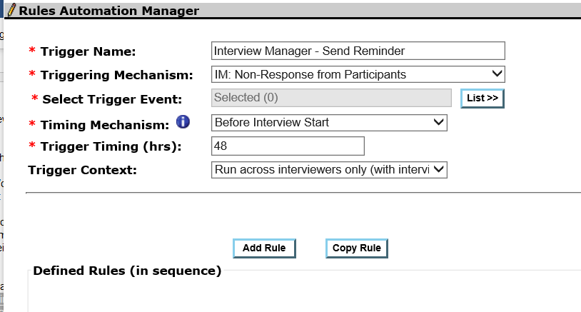
Rules Automation Manager -Invitation Reminder
This trigger can be used to send reminders to candidates and interviewers that did not respond to the interview requests.
This trigger helps the interview coordinator to ensure that the rescheduling or cancellation can be done in a timely manner if required.
The RAM is designed to run for interviews with below statuses:
Candidate Availability Requested
Invitation Sent
Invitation Accepted -Candidate
Invitation Declined -Interviewer

Slide 8
RAM - Invitation Reminder
The following are the attributes for the new trigger.
Trigger Name: Send reminders to candidates or interviewers for aging interview requests.
Trigger Type: RAM Trigger
Triggering Mechanism: Interview Manager: No response from participants
Select Trigger Event: [Disabled]
Timing Mechanism: 2 options:
  – After interview request received
  – Before interview start
Trigger Timing (hrs): 48 hrs [two days in advance, default value can be changed to integer value (no max limit)].
Triggering Context: Two options, as following:
  – Run across candidates only (with interview availability request or invitation).
  – Run across interviewers only (with interview invitation).
Select recipients -Includes normal recipient options (Example "[Talent Record] email") as well as two new interview options: [Interview Fields] Interviewer, [Interview Fields] Lead Coordinator.
Recipients list is filtered based on the triggering context:
  – If candidates only is selected, then interviewer is unavailable.
  – If interviewers only is selected, then, candidate ("[Talent Record] email") is unavailable.

Slide 9
Demo
–

Slide 10
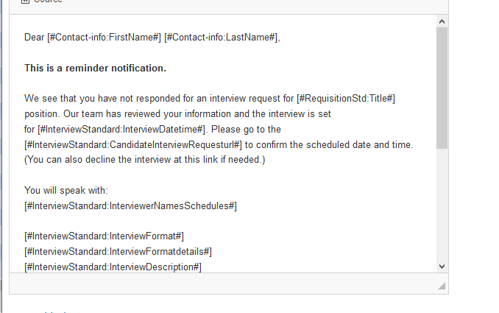
Configuring Communication Templates for RAM
Separate communication templates can be configured for each RAM.
The comms can be used inside RAM –> Actions to notify the individuals.
It is advised to configure separate communications for candidate and interviewers.
The communication template may contain any regular merge tokens along with Standard Interview Manager tokens to appear in the action list.

Slide 11
Recent Enhancements
–

Slide 12


Interview Manager - From Email Address on Automated Email
Previously, the automated conﬁrmation emails received by the interview coordinators from a candidate or an interviewer have a 'From' email display name of the respective person.
This is now changed to donotreply@brassring.com to ensure consistent user experience.

Slide 13
Interview Manager -Response email Subject Enhancement
The subject line of the automated responses is enhanced to ensure they are consistent and provide meaningful information to the coordinator.
Response Email | New Subject
Candidate responds confirming availability | Availability received from candidate [candidate name] for Interview Request[Req Number-Title]
Candidate responds stating "None of these times work for me" | Availability request declined by candidate [candidate name] for Interview Request[Req Number-Title]
Candidate accepts interview invitation | Interview invitation accepted by candidate [candidate name] for[Req Number-Title]
Candidate declines interview invitation | Interview invitation declined by candidate [candidate name] for[Req Number-Title]
Interviewer accepts interview invitation | Interview invitation accepted by interviewer [interviewer name] for[Req Number-Title]
Interviewer declines interview invitation | Interview invitation declined by interviewer [interviewer name] for[Req Number-Title]

Slide 14
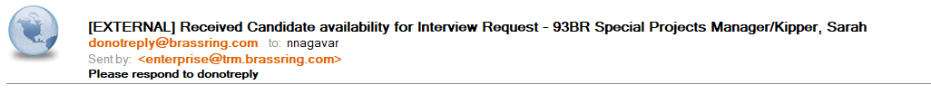
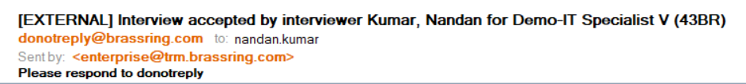
Response email Subject Enhancement
Before
After

Slide 15
Interview Manager -Completed Interview Enhancements
Completed interviews now have the following enhancements based on the client feedback.
  The interview status is updated to "Complete" after the end time of the interview instead of the start time. This change allows room to reschedule the interview if it is a no-show after the start time of the interview.
  A new Cancel action has been added to completed interviews. This addition allows coordinators to cancel the no-show interviews if required.
  The Cancel option is allowed up to 48 hours after the end of interview end time.
  The 48-hour window provides time for communication between the interviewer and the interview coordinator.

Slide 16
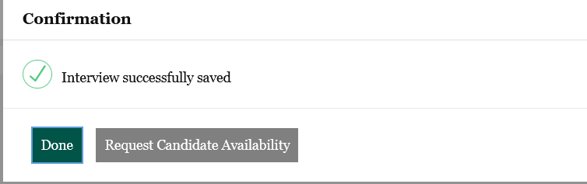
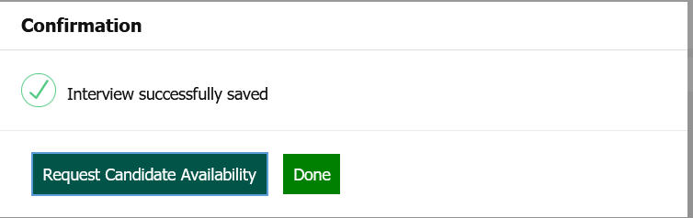
Interview Manager -Button Changes
While creating an interview using interview manager, the users used to see a Confirmation message with the focus on the Done button, which created confusion because of the next available user actions.
To provide better user experience, the button positions have been swapped.
Now, the focus will be on the next available action (Ex: Send Invitations, Request Candidate Availability).
The color coding and tab navigation on the page are updated so that the focus is shifted to the next action before moving to Done.

Slide 17
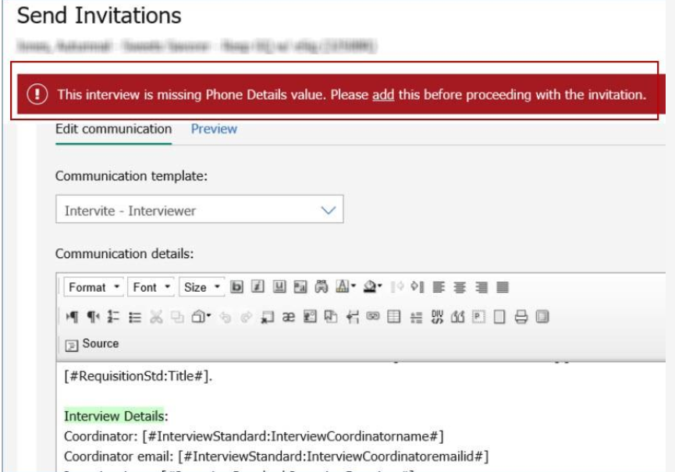
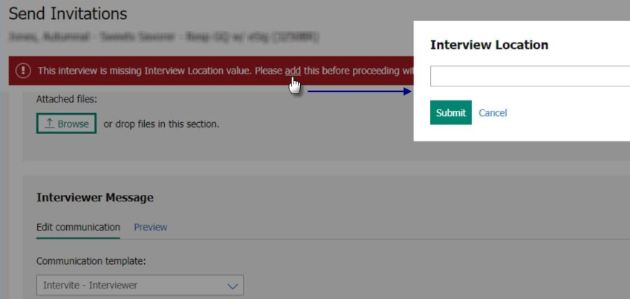
Interview Manager -Validation for Format Details
Now, the system will validate to find if interview format details are available on the Send invitation page.
If the format details are unavailable, then a pop up will appear and user must input the details.
It is to ensure invitation page is not missing the format details. (Ex: Phone Number, Video details, etc.)

Slide 18
Resources
Interview Manager: https://documentation.infinite.com/docs/interview-management
Interview Manager Configuration: https://documentation.infinite.com/docs/interview-management-configuring-interview-manager

Slide 19
Questions & Answers?

