Slide 1
Metrics Dashboard – Advanced User Session
BrassRing on Cloud
—
Client Training and Enablement Session
October 15th, 2019

Slide 2
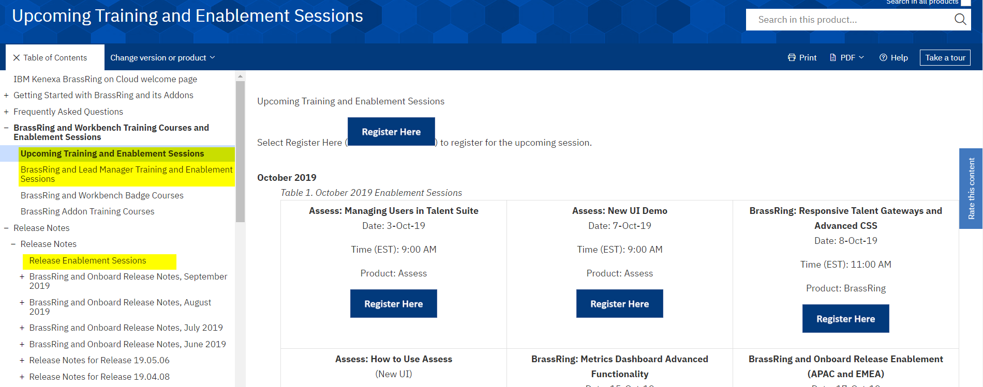
Client Reminders &
Updates
Enablement Session Information Now On The Knowledge Center!
We are moving the enablement sessions from the old Training and Enablement page to the Knowledge Center! The old site’s recordings/content has been removed as of October 14th.
Each product will have a new section for the enablement sessions.
Each session’s recording/content will be included into the content on the Knowledge Center.
ACTION: Update your bookmark!

Slide 3
Agenda
Recap of where you can find documentation
Example Visualizations
Calculations
Display Settings

Slide 4
Documentation Available
Overview, Working with Visualizations, Admin Functions, Example Visualizations
  https://documentation.infinite.com/docs/the-metrics-dashboard-overview | https://documentation.infinite.com/docs/working-with-visualizations | https://documentation.infinite.com/docs/administrator-functions | https://documentation.infinite.com/docs/example-visualizations
Configuring the Metrics Dashboard
https://documentation.infinite.com/docs/configuring-the-metrics-dashboard
Frequently Asked Questions: https://documentation.infinite.com/docs/the-metrics-dashboard-faqs | https://documentation.infinite.com/docs/the-metrics-dashboard-advanced-features-faqs

Slide 5
Demo
–
Example Visualizations

Slide 6
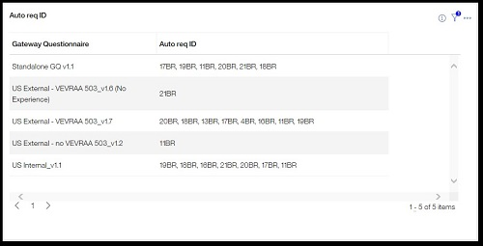
Gateway Questionnaires used in Req Postings
—
Visualization Type: Table
Visualization Pane:
  Columns: Gateway Questionnaire, Auto Req ID
  Filters: Gateway Questionnaire

Slide 7
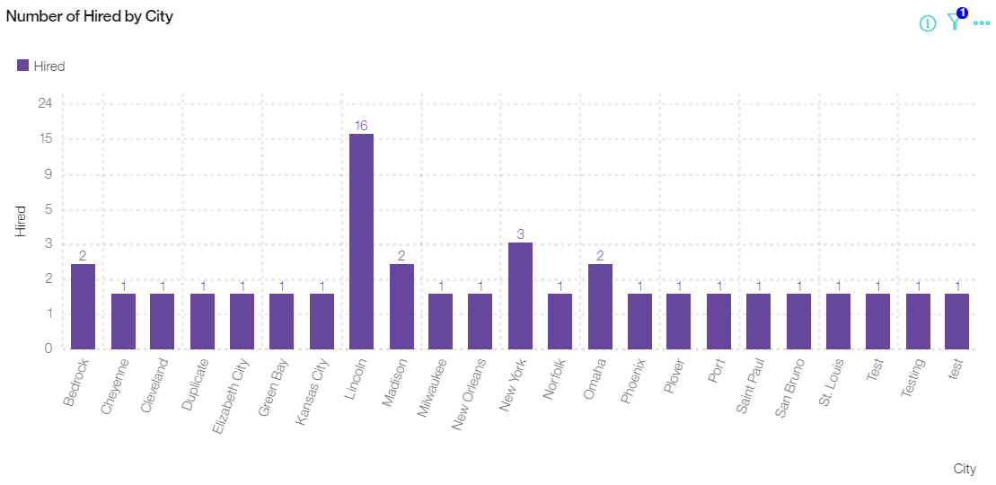
Number of Hired per City/Region
—
Visualization Type: Clustered Bar Chart
Visualization Pane:
  Rows: City/Region
  Columns: Hired
  Filters: Hired Date (select date range)

Slide 8
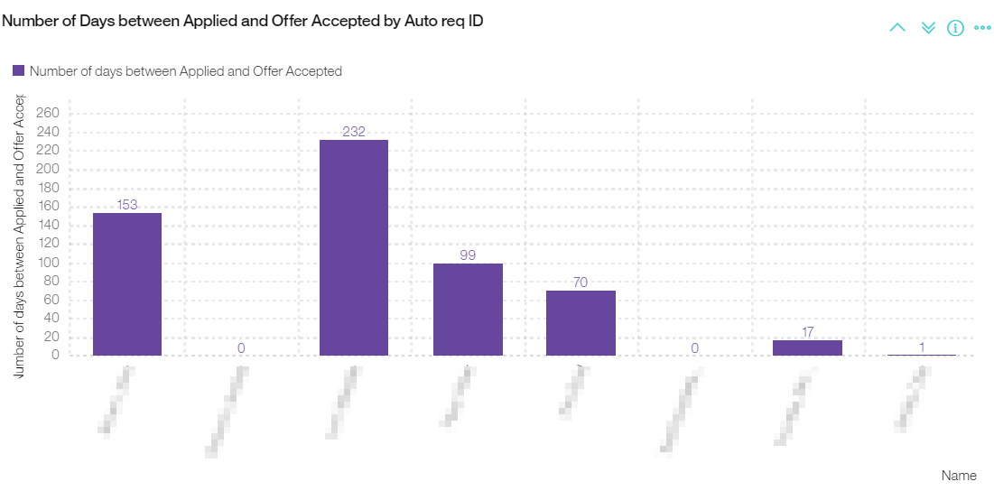
Number of Days to Move from Applied to Offer Accepted
—
Visualization Type: Clustered Column Chart
Visualization Pane:
  Rows: Auto Req ID, Candidate Name
  Columns: Calculation of the Number of days between Date Applied and Offer Accepted (Date Applied and Offer Accepted Date)

Slide 9
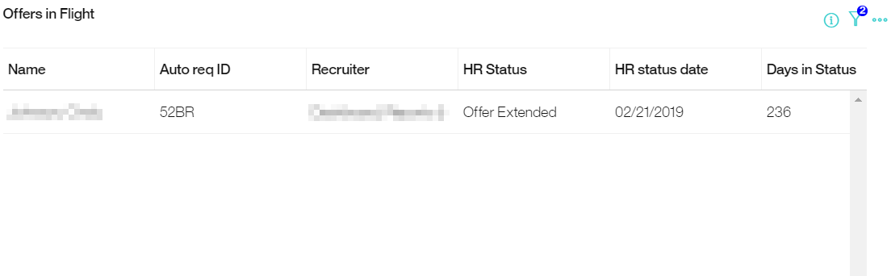
Offers in Flight
—
Visualization Type: Table
Visualization Pane:
  Columns: Candidate Name, Auto Req ID, Recruiter, HR Status, HR Status date, Days in Status
  Filters: HR Status History (Include current statuses only), Offer Extended (Include candidates in this status)

Slide 10
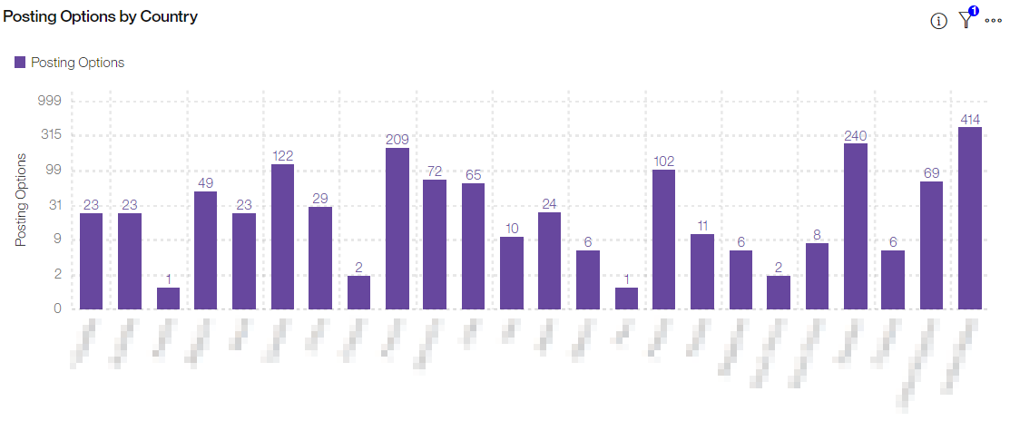
Postings per Country
—
Visualization Type: Clustered Chart
Visualization Pane:
  Rows: Req Country
  Columns: Posting Options

Slide 11
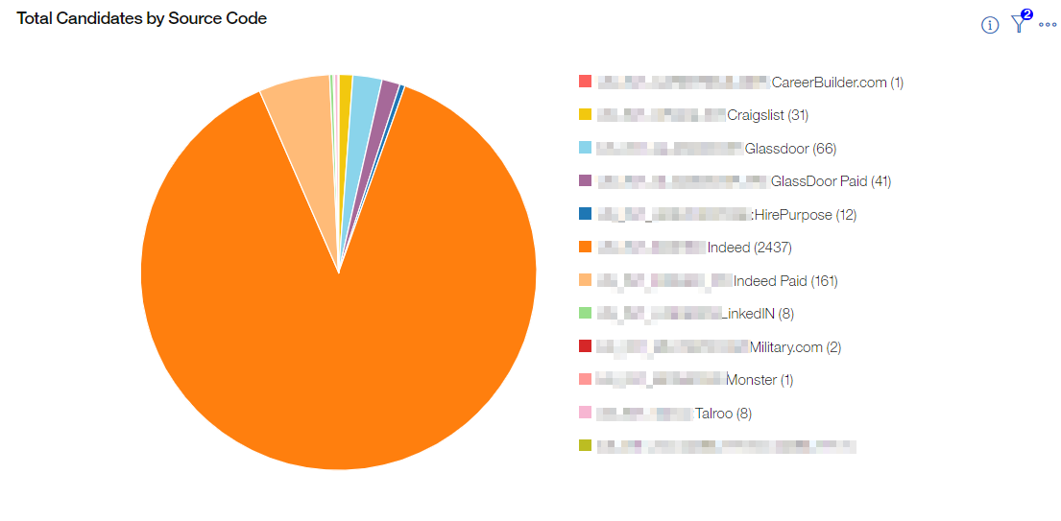
Source for Hired Candidates
—
Visualization Type: Pie
Visualization Pane:
  Slices: Source Code (or Source Field from a candidate form)
  Show slices by: Total Candidates
  Filter(s): Candidates moved to a Hired Status in the last 90 days

Slide 12
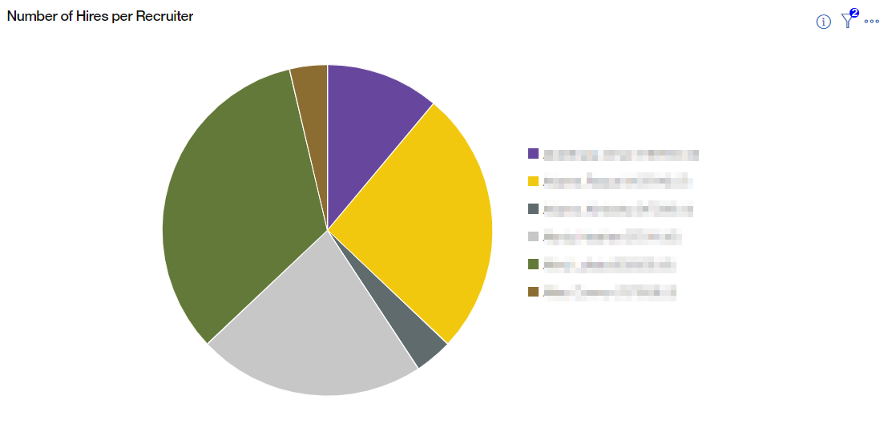
Number of Hires per Recruiter
—
Visualization Type: Pie
Visualization Pane:
  Slices: Recruiter
  Show slices by: Hired (HR Status)
  Filters: Hired Date (selected date range)

Slide 13
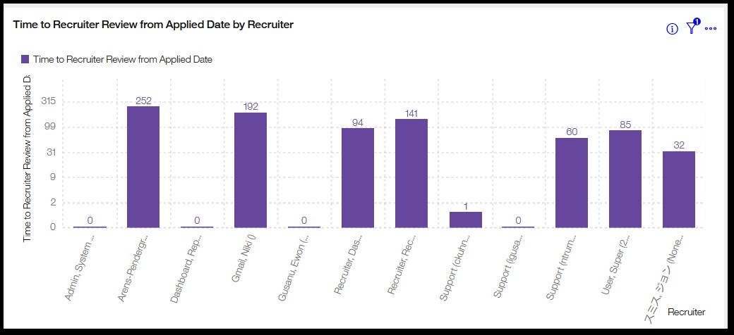
Calculations
BrassRing Metrics Dashboard
Calculations can be beneficial to see the difference between two dates or to find the average between two HR Statuses. For example, a calculation can be used to build a visualization to show time to hire, time to review, or days open by position filled.
Calculations can be:
  Built with numeric or date fields.
  Added to the chart types of Stacked Bar Chart, Stacked Column Chart, Clustered Bar Chart, Clustered Column Chart, Pie, and Donut.
Calculations are built by using Groupings and a visualization can have multiple Groupings.

Slide 14
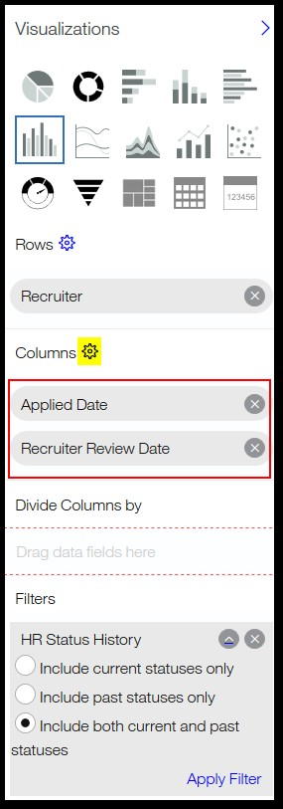
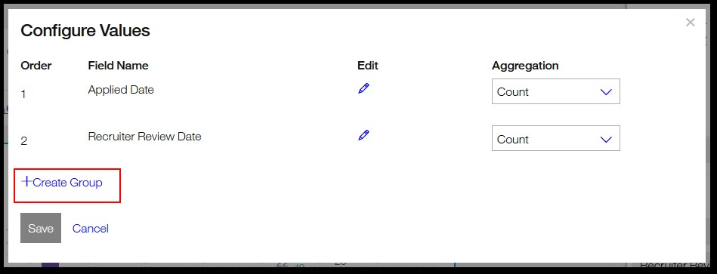
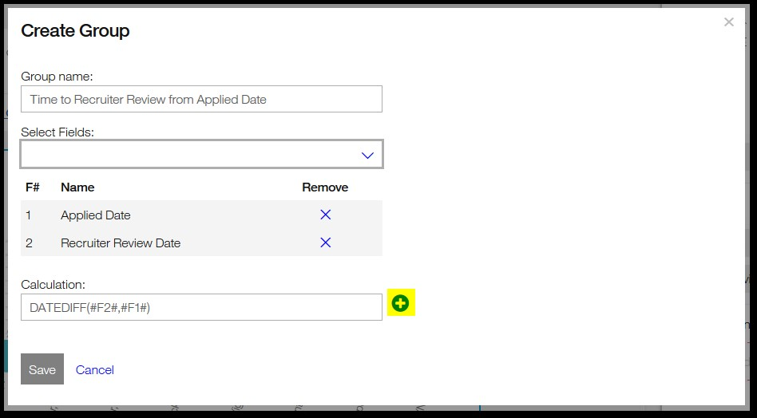
Calculations
BrassRing Metrics Dashboard
2
In the Visualization tab, Add date or numeric fields to the columns section.
Select the Columns gear icon.
Create a Group by selecting +Create Group.
Insert a name for the group.
Add the fields as needed by using the pull-down menu, and selecting the fields for the group.
Insert the calculation into the Calculation field.
3
6

Slide 15
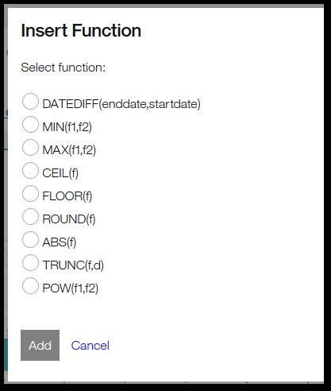
Calculations
BrassRing Metrics Dashboard
Fields in calculations are described by the term #FX# where X is the field number displayed above the calculation. For example, the calculation #F1# + #F2# adds field 1 and field 2 together.
Calculations can include parenthesis to isolate functions in the calculation.
Calculations are available to select by using the plus icon, selecting the calculation, and selecting Add. The insert function provides a description of each calculation, the syntax used and an example for the calculation and result.

Slide 16
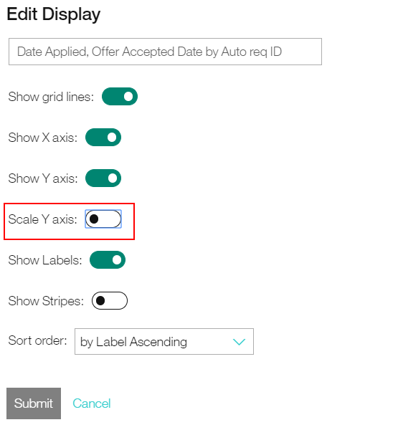
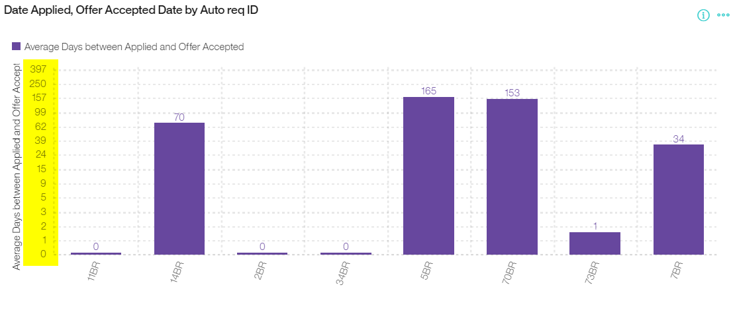
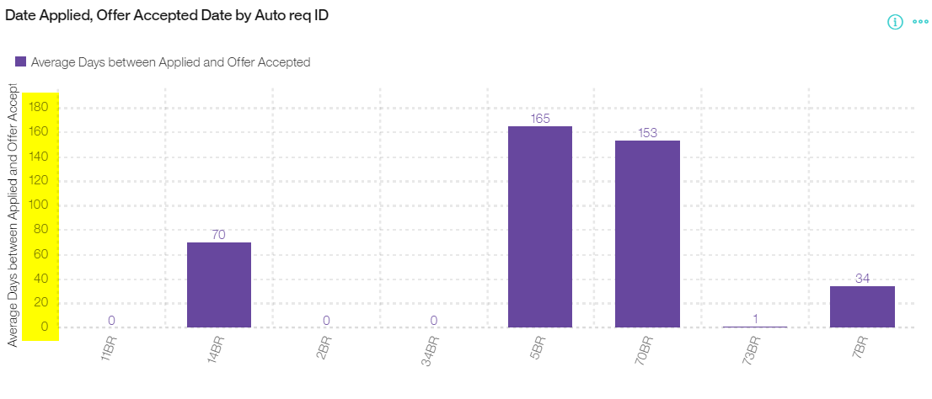
Things to Know: Scale Y Axis

Slide 17
Things to Know / Best Practices / Tips and Tricks
If you get the message “There is no data to display for this visualization.”, re-review your report criteria to ensure correct fields are selected. If you feel like the visualization is correct please put a case in with the Global Support Center and it will be reviewed.
Comparing the Metrics Dashboard data to the Data Insight Tool can sometimes lead to confusion. Note that the DIT refreshes every 8 hours and the Metrics Dashboard refreshes every 1 hour. Filters you’ve selected may differ between the tools and data tables may pull differently.

Slide 18
Questions?

Slide 19
OCTOBER VIRTUAL TRAINING SESSIONS
Client-facing training schedule
If you haven't already, register for the internal sessions now!
Sunday | Monday | Tuesday | Wednesday | Thursday | Friday | Saturday
 |  | 1 | 2 | 3 Client: Assess – Managing Users in TS (9am EDT) | 4 | 5
6 | 7 Client: Assess New UI Demo (9am EDT) | 8 Client: BrassRing Responsive TGs and Advanced CSS (11am EDT) | 9 | 10 | 11 | 12
13 | 14 Client: How to Use Assess (New UI) (11am EDT) | 15 Client: BrassRing Advanced Metrics Dashboard (11am EDT) | 16 | 17 Client: Onboard Release (4am EDT & 11am EDT) | 18 | 19
20 | 21 | 22 Client: Assess New UI Q&A (11am EDT) | 23 | 24 Client: Assess New UI Q&A (9am EDT) | 25 | 26
27 | 28 Client: Assess New Features and Updates (11am EDT) | 29 Client: BrassRing Interview Manager Playback (11am EDT) | 30 | 31 Client: Assess Managing Users in TS (11am EDT)

Slide 20
NOVEMBER VIRTUAL TRAINING SESSIONS
Client-facing training schedule
If you haven't already, register for the internal sessions now!
Sunday | Monday | Tuesday | Wednesday | Thursday | Friday | Saturday
 |  |  |  |  | 1 | 2
3 | 4 | 5 | 6 | 7 Client: Transitioning to the New UI (Phase 4) (11am ET) | 8 | 9
10 | 11 Client: Assess New User Training (11am ET) | 12 | 13 | 14 Client: BrassRing (19.11.11) and Onboard Release (4am ET & 11am ET) | 15 | 16
17 | 18 | 19 Client: Transitioning to the New UI (Phase 4) (9am ET) Client: Talent Acquisition Roadmap (11am ET) | 20 | 21 Client: Assess Managing Users in TS (11am ET) | 22 | 23
24 | 25 Client: Assess New Features and Updates (11am ET) | 26 | 27 | 28 | 29 | 30

