Slide 1
BrassRing Interview Manager – User Experience
IBM Kenexa BrassRing
—
Client Training and Enablement Session
IBM Watson Talent
April 28th,2020

Slide 2
Agenda
Overview of Interview Manager
How to use Interview Manager – User Experience
Resources
Future Enhancements
Q&A

Slide 3
Overview of Interview Manager?
The Interview Manager is a new feature in BrassRing that allows BrassRing users to efficiently and effectively schedule interviews.
Available now in Production since March 16, 2020 (BrassRing Release 20.03.09).
Part of standard feature in BrassRing and requires some configuration.
No additional cost for client to use Interview Manager.
Easy access to interviews that are scheduled, in process, or that need to be scheduled.
Interviews can be created by BrassRing users who have access to Candidates within My Reqs.
By default all BrassRing users have access to create Interviews (My Reqs); user permissions determine the additional access or restriction.
It does not replace Event Manager but rather is used with the single candidate experience.

Slide 4
Overview of Interview Manager?
New Tab “Interviews” on Home page with card and grid view, filtering, and refresh icon.
Multiple interview styles:
    1:1 Interview - single candidate and single interviewer
    Series Interview - single candidate and multiple interviewers, one interview after another
    Panel Interview – single candidate and team of interviewers in the same time slot
Multiple interview formats:
    Phone – interview over the phone
    Video – video call interview where the candidate is required to appear on-screen
    Text/Chat – text only interview that uses a text service
    In person – candidate must attend on site for interview
    Other – other type of interviews where the format of the interview can be entered into the Interview Details
Note: The details of the interview differ depending on the interview format selection.

Slide 5
Overview of Interview Manager?
Candidates and Interviewers will receive an automated meeting invitation once they accept the interview request. This can be added to their calendar directly (if supported) or added manually via downloading the ics. attachment.
Calendar integration with Outlook 365 and Google+ allows for checking and scheduling interviewers’ shared calendars.
Multiple interview scheduling type:
    Confirmed date & time – the timeslot has already been decided on with the candidate and interviewer.
    Verify interviewers availability first – interviewer’s availability is checked first and candidates are provided with the timeslots to pick from based on interviewer’s availability.
    Ask candidate first – provide candidate with a range of dates and times to select specific timeslot that works best for them.

Slide 6
Demo
–
Interview Manager User Experience

Slide 7
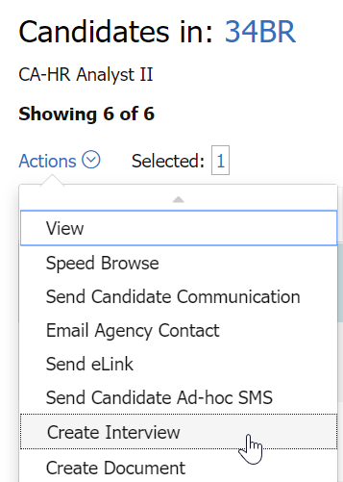
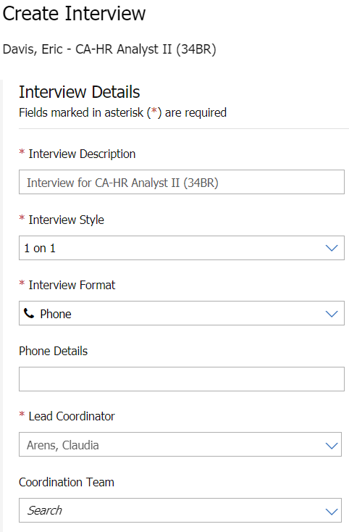
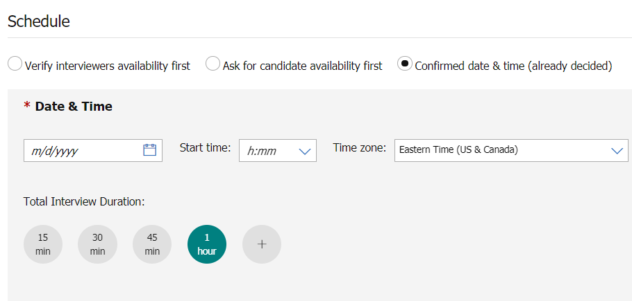
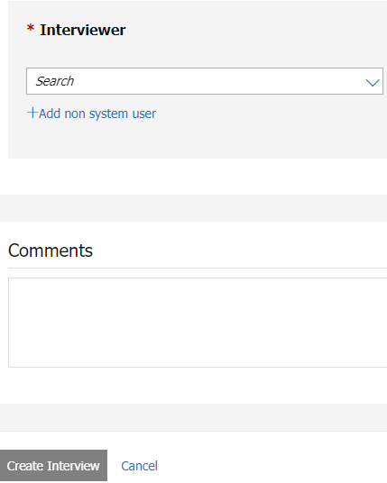
How to use the Interview Manager – User Experience
Create Interview
BrassRing > My Open Reqs > Select Candidate > Action: Create Interview
1.
2.
3.
4.

Slide 8
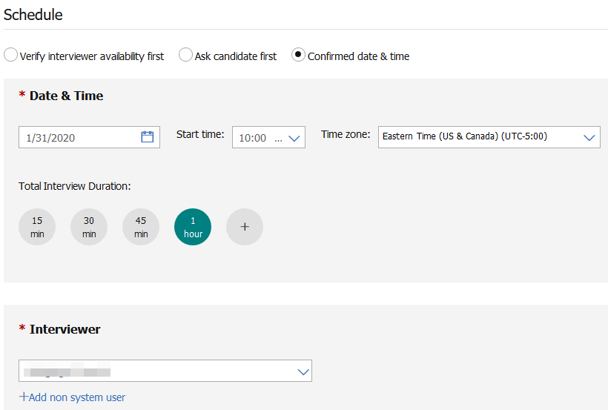
Overview of Interview Manager
Interview Scheduling Type Workflows
Confirmed Date & Time (already decided ) - Schedule has already been worked out with the candidate and interviewer. The candidate and interviewer still need to confirm the interview.

Slide 9
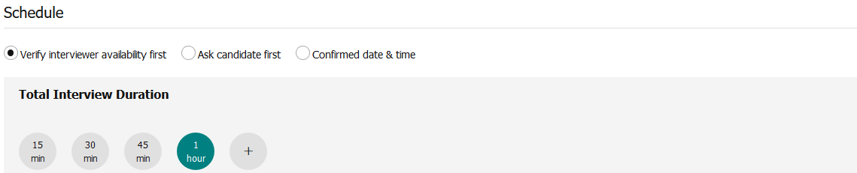
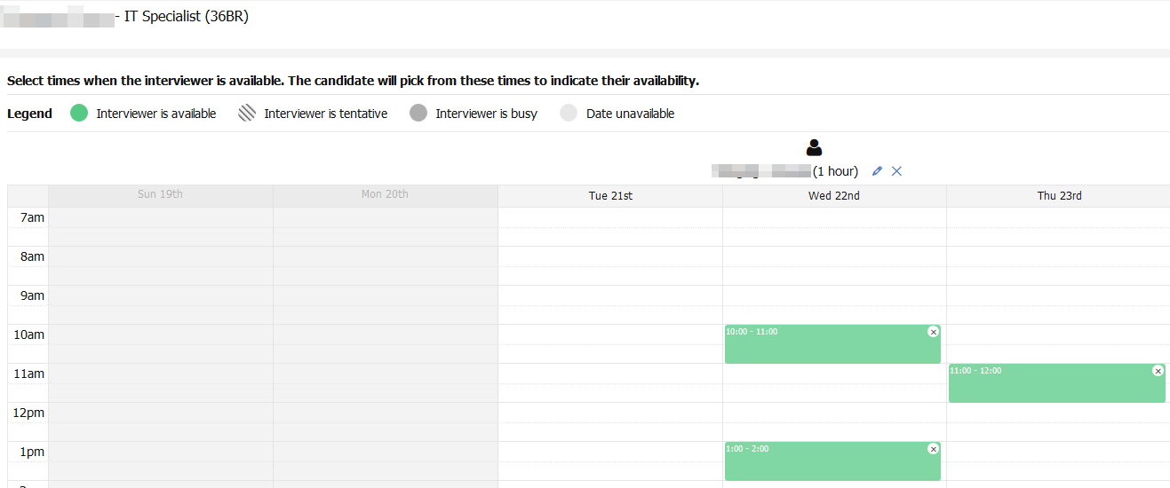
Overview of Interview Manager
Interview Scheduling Type Workflows
Verify interviewers availability first – interviewer’s availability is checked first and candidates are provided with the time slots to pick from based on interviewer’s availability.

Slide 10
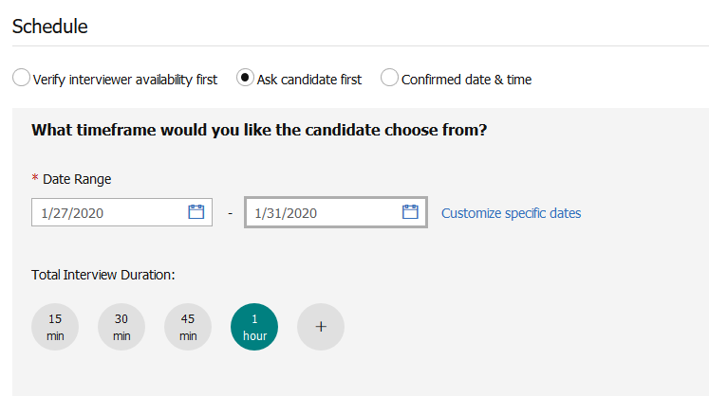
Overview of Interview Manager
Interview Scheduling Type Workflows
Ask for candidate availability first - Provide candidate with a range of dates and times to select specific one that works best for them.

Slide 11

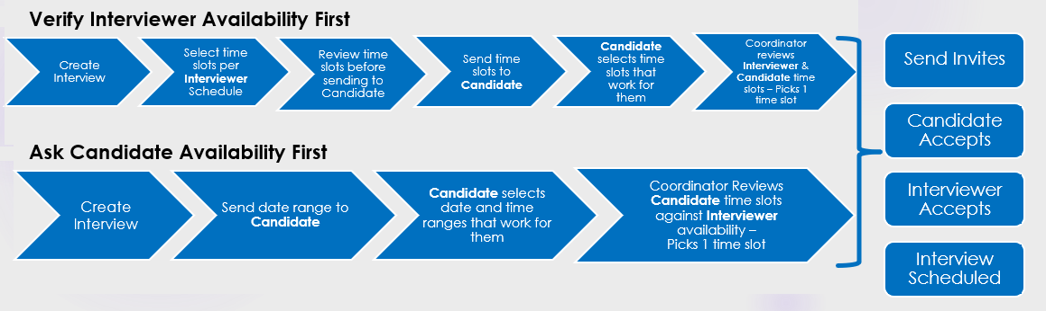
Overview of Interview Manager
Scheduling Type Workflows
Ask Candidate First

Slide 12
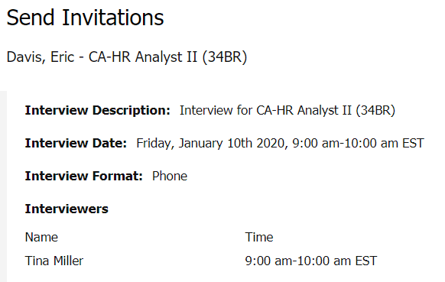
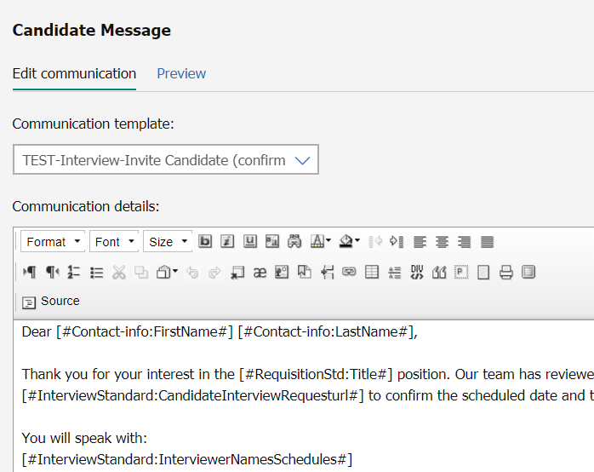
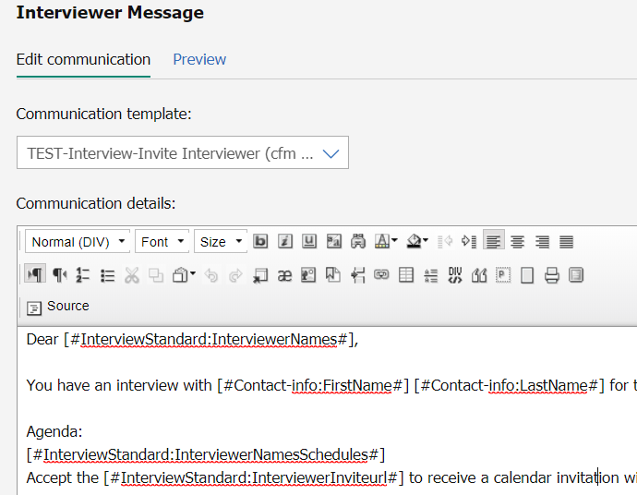
How to use the Interview Manager – User Experience
Send Communication
After creating the interview, the user can send a communication to the candidate and interviewer.

Slide 13
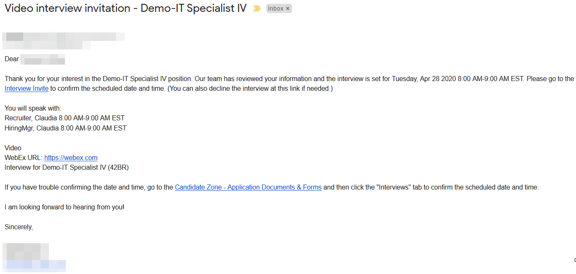
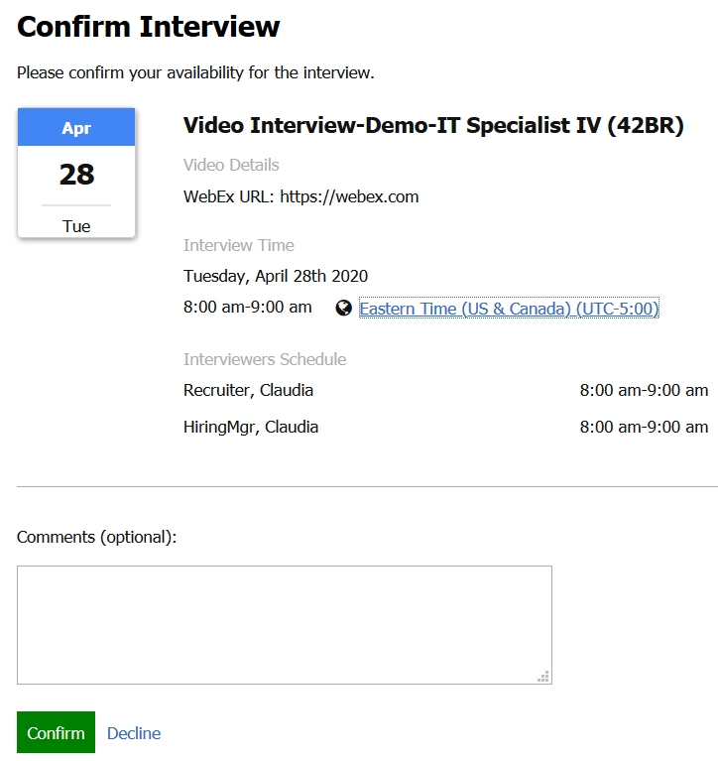
How to use the Interview Manager – User Experience
Receive Communication and Accept Invitation - Candidate
After receiving the email, the candidate can accept or decline the interview invite

Slide 14
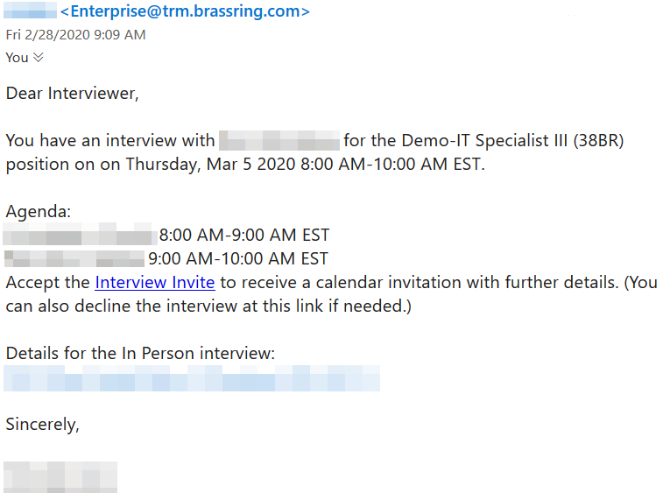
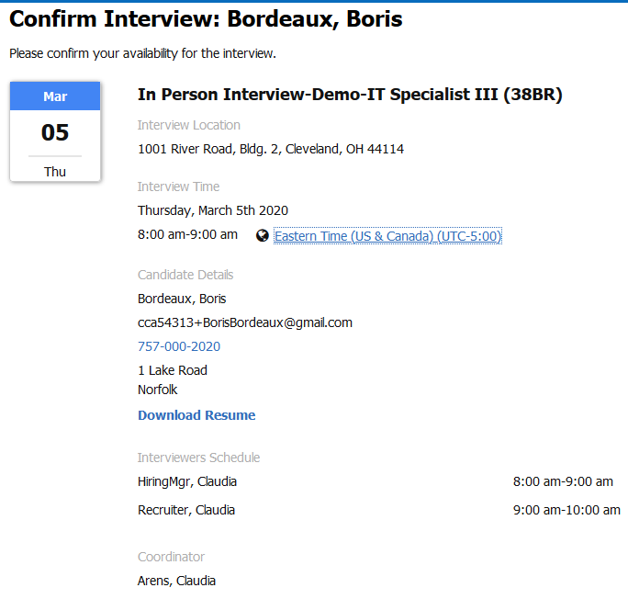

How to use the Interview Manager – User Experience
Receive Communication and Accept Invitation - Interviewer
After receiving the email, the interviewer can accept or decline the interview invite

Slide 15
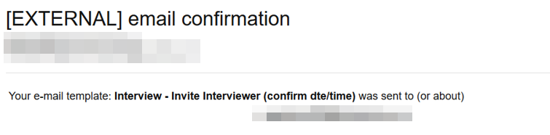
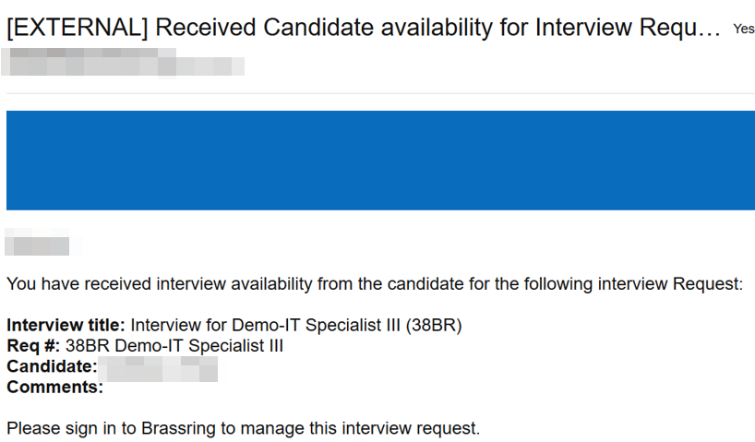
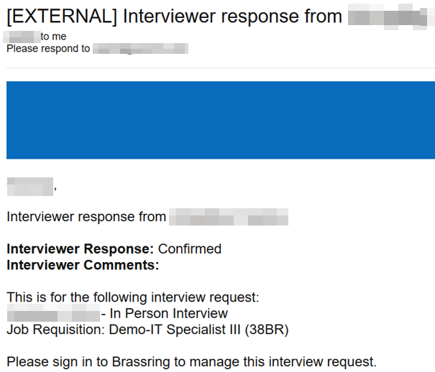
How to use the Interview Manager – User Experience
Send Communication
Examples of Interview Manager Confirmations to Lead Coordinator

Slide 16
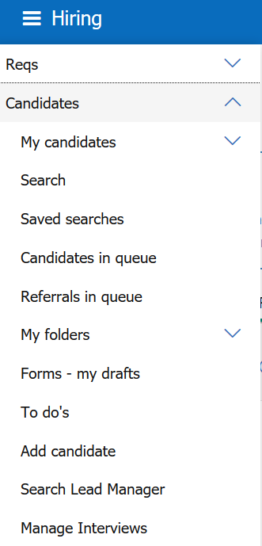
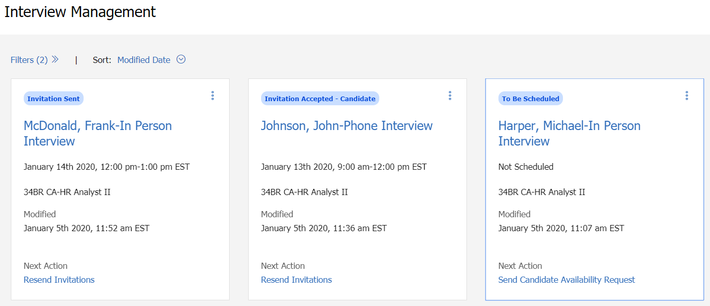
How to use the Interview Manager – User Experience
Manage Interviews
Provides details of the Interviews in a card view (interview status, interview date and time, etc.)
      BrassRing > Candidates > Manage Interviews

Slide 17
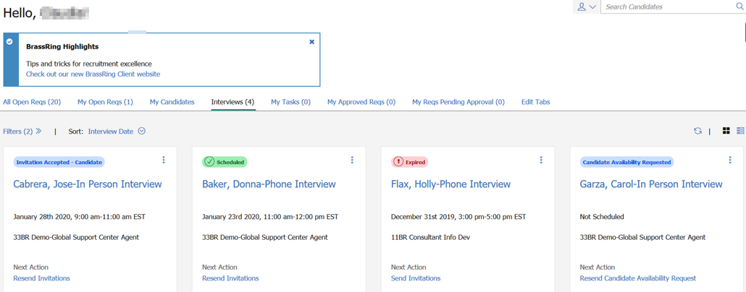
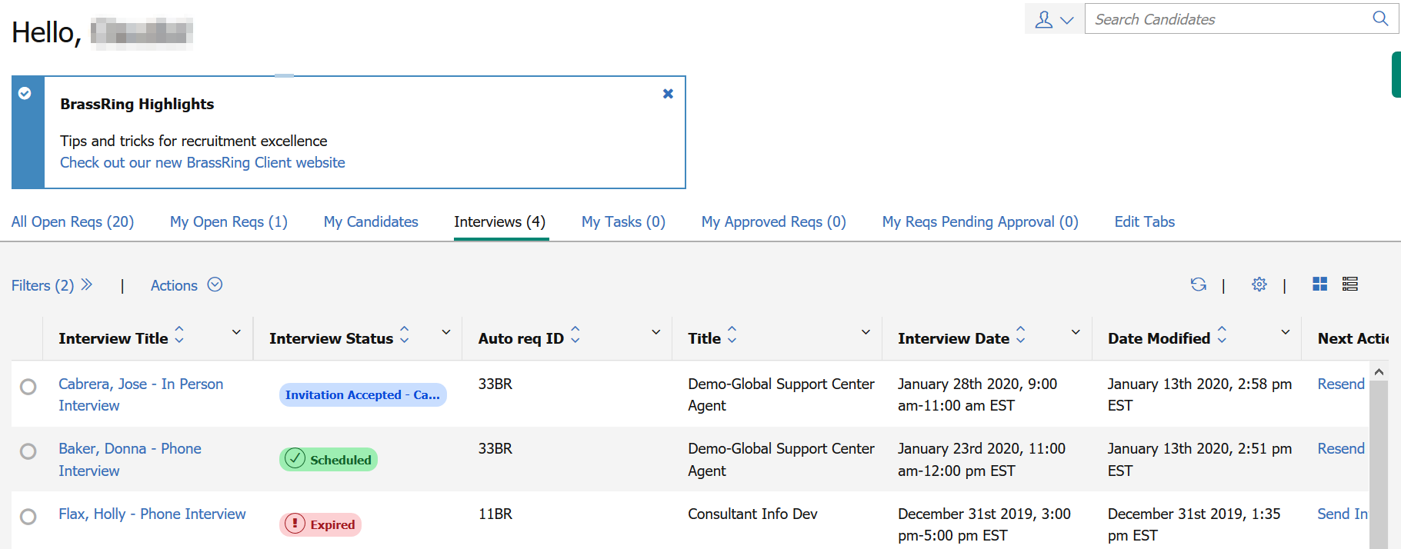
How to use the Interview Manager – User Experience
Home Page
Interview Tab is available on the Home Page – Card View or Grid View

Slide 18
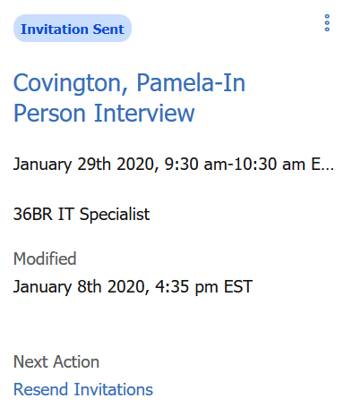
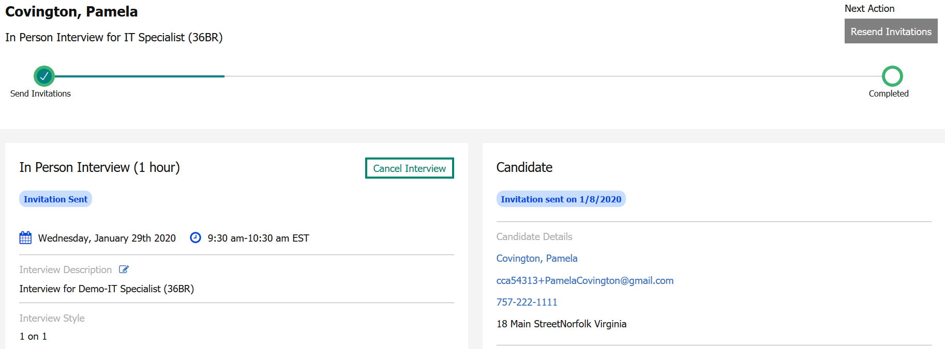
How to use the Interview Manager – User Experience
Manage Interviews
Click on the Candidate’s Name hyperlink to access the Interview Details Page
User can edit basic interview details; view, edit, and cancel interviews; send and resend communication; manage to-dos

Slide 19
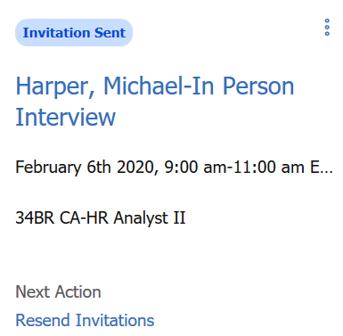
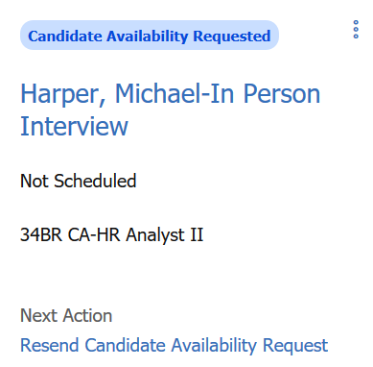
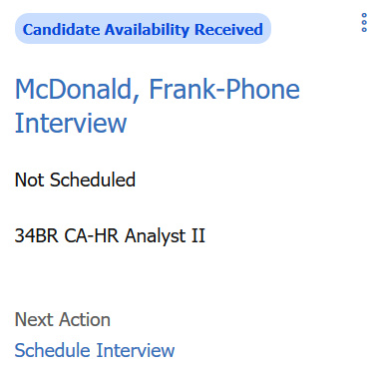
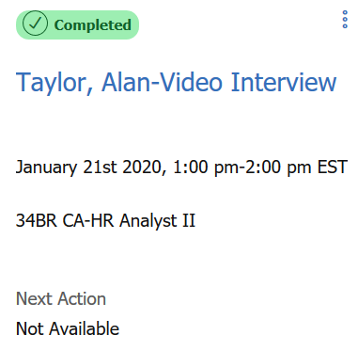
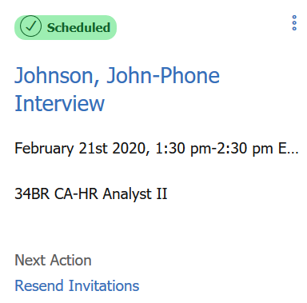
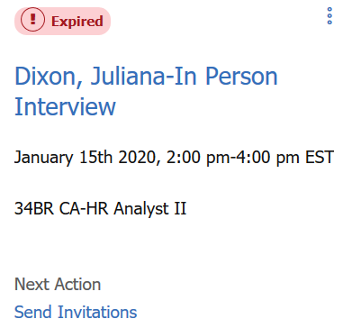
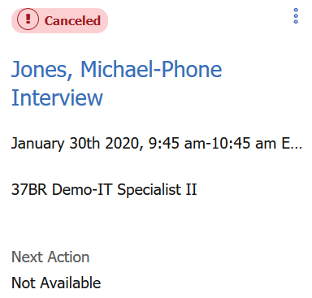
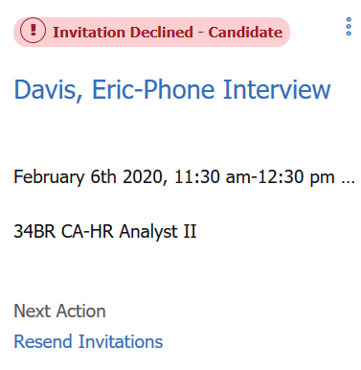
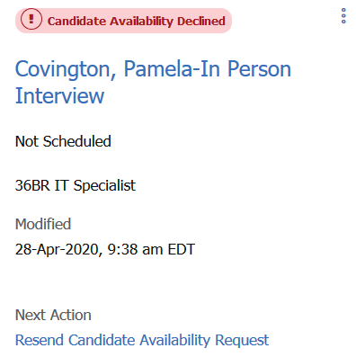
How to use the Interview Manager – User Experience
Interview Status
Each interview is assigned to an interview status depending on where it is in the interview process. The status appears in green – accepted/completed, red – expired/canceled/declined, and blue – pending.
Examples:

Slide 20
Resources
Interview Management
https://www.ibm.com/support/knowledgecenter/SSEUFV/16_InterviewManagement/top.html
Interview Manager Configuration
https://www.ibm.com/support/knowledgecenter/SSEUFV/2_Configuration/17_ConfiguringIM/top.html
Interview Manager FAQs
https://www.ibm.com/support/knowledgecenter/SSEUFV/1a_FAQs/9_InterviewManagerFAQ.html

Slide 21
Future Enhancements
Rules Automation Manager
Reporting (Metrics Dashboard and DIT)
Talent Record Action Log

Slide 22
Client Training & Enablement Sessions
  Register for Client T&E Session on the IBM Knowledge Center (KC):
    IBM Kenexa BrassRing on Cloud >> BrassRing and Workbench Enablement Sessions >> Upcoming Training and Enablement Sessions
      https://www.ibm.com/support/knowledgecenter/SSEUFV/14_Training/1UpcomingEnablements.html
  Access the recordings, presentations, and FAQs from past Client T&E Sessions:
    IBM Kenexa BrassRing on Cloud >> BrassRing and Workbench Enablement Sessions >> Past Training and Enablement Sessions
    https://www.ibm.com/support/knowledgecenter/SSEUFV/14_Training/2EnablementSessions.html

Slide 23
April VIRTUAL TRAINING SESSIONS
Client-facing training schedule
Check your skills here!
Sunday | Monday | Tuesday | Wednesday | Thursday | Friday | Saturday
 |  |  | 1 | 2 | 3 | 4
5 | 5 | 7 | 8 | 9 Internal: Assess Development Focus Areas (10:00 AM EST) Client: BrassRing 20.04.06 and Onboard Release Enablement (11:00 AM EST) | 10 | 11
12 | 13 | 14 | 15 | 16 | 17 | 18
19 | 20 | 21 Client: Rules Automation Manager (RAM) Session (11:00 AM EST) | 22 | 23 | 24 | 25
26 | 27 | 28 Client: BrassRing: Interview Manager – User Session (11:00 AM EST) | 29 | 30 Client: Convert Classic TG to Responsive (11:00 AM EST)

Slide 24
May VIRTUAL TRAINING SESSIONS
Client-facing training schedule
Sunday | Monday | Tuesday | Wednesday | Thursday | Friday | Saturday
 |  |  |  |  | 1 | 2
3 | 4 | 5 | 6 | 7 Client: BR 20.05.04 and Onboard Release (11:00 AM EST) | 8 | 9
10 | 11 | 12 | 13 | 14 | 15 | 16
17 | 18 Client: Assess May Release (11:00 AM EST) | 19 Client: BrassRing Metrics Dashboard (11:00 AM EST) | 20 | 21 | 22 | 23
24 | 25 | 26 | 27 | 28 | 29 | 30

Slide 25
Questions?

