Slide 1
Interview Manager
BrassRing
—
Virtual Roundtable
September 22nd, 2020

Slide 2


Slide 3
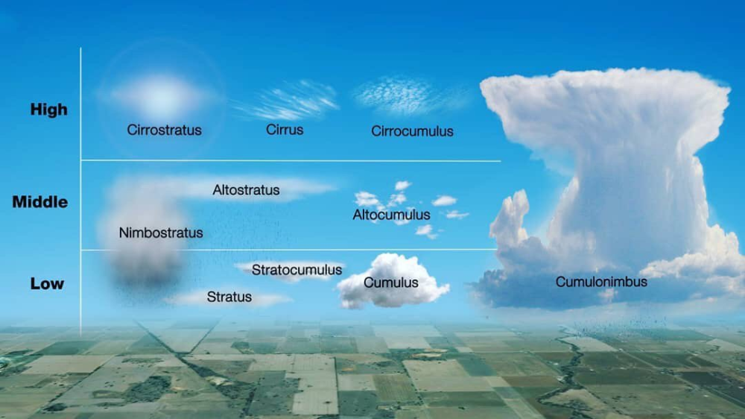
What type of cloud can form a tornado?
A. Stratus
B. Cumulonimbus
C. Nimbostratus
D. Cumulus
Answer: B (Cumulonimbus)
Latin Origins: Cumulus = heaped, Nimbus = rainstorm

Slide 4


Which continent is the natural habitat of the Ostrich?
Africa
Australia
South America
Asia
Answer: A (Africa)

Slide 5
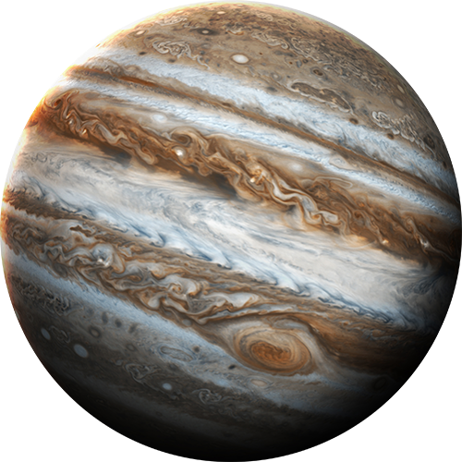
Which planet has the shortest day of all the planets?
(Which planet completes a full turn on its axis the fastest?)
A. Neptune
B. Saturn
C. Venus
D. Jupiter
Answer: D (Jupiter)
It turns on it’s axis once every 9 hours 55 minutes!

Slide 6

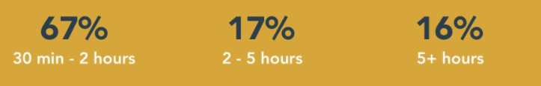
__% of respondents say it takes between 30 minutes and 2 hours to schedule a single interview.
A. 35%
B. 87%
C. 21%
D. 67%
Answer: D (67%)!!
According to a study done by Yello.

Slide 7



Let’s Make this Interactive!
On the left of your screen, select the Annotate icon:
Annotate Tool Bar:
Adds an arrow with your name
Allows you to add text
Draw lines
Add a shape
Freehand draw
Change the color of your text/icon
Erase your annotation
Undo your last annotation
Save the annotation

Slide 8
Test Out Your Annotation Skills!
Say Hi!
(By using the text annotation option.)

Slide 9
Test Out Your Annotation Skills!
I’m a morning person!
Tell us if you’re more of a morning person or a night owl!
(By using the shape annotation option.)
I’m a night owl!

Slide 10
On the path to implement Interview Manager!
What does your organization use?
Using Interview Manager! ☺
Not using any interview scheduling tool. ☹
Using a tool other than Interview Manager.
Notes:
If your organization does not use Interview Manager, what system do you use?

Slide 11
In 1-3 words, describe your Interview process or software…

Slide 12
49% of recruiters don’t use any interview scheduling software
Top tools used instead of interview scheduling software:
*Reference: Yello Interview Scheduling Survey*
Notes:
Email
Phone
Employee calendar
Text document

Slide 13
What is the most commonly used Interview Style within your organization?
1:1
Series
Panel
Other
(Non Interview Manager)

Slide 14
Do you…
Verify the Interviewer’s availability first?
Ask the candidate for their availability first?
Already have a confirmed date in mind?
Other
(Non Interview Manager)

Slide 15
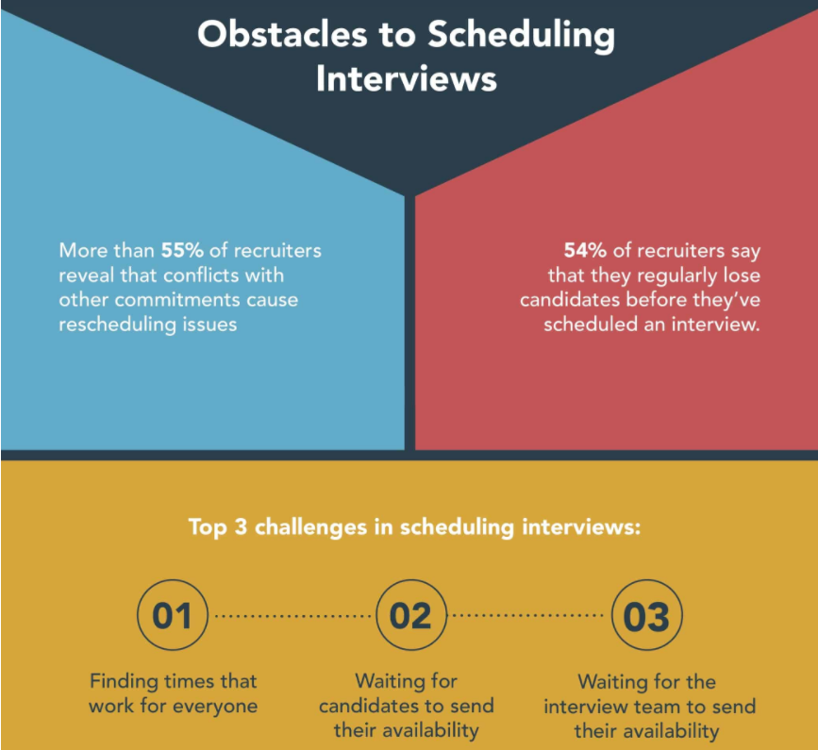
*Reference: Yello Interview Scheduling Survey*

Slide 16
No matter what system you use, what do you find as being the most difficult part of the interview process?

Slide 17
OPEN DISCUSSION

Slide 18
Most recruiters reveal that interviewing takes up the most time in their hiring process. On average, recruiters are spending two-thirds of their overall hiring process on interview scheduling.
From first interview to offer extended, more than 40% of recruiters are spending 2+ weeks on the interview process.
The time wasted on scheduling means time taken away from more meaningful tasks like building relationships with candidates, building talent communities, and improving your employer brand.
Interview scheduling software can take the process from an average of 60 minutes to 60 seconds!
*Reference: Yello Interview Scheduling Survey*

Slide 19
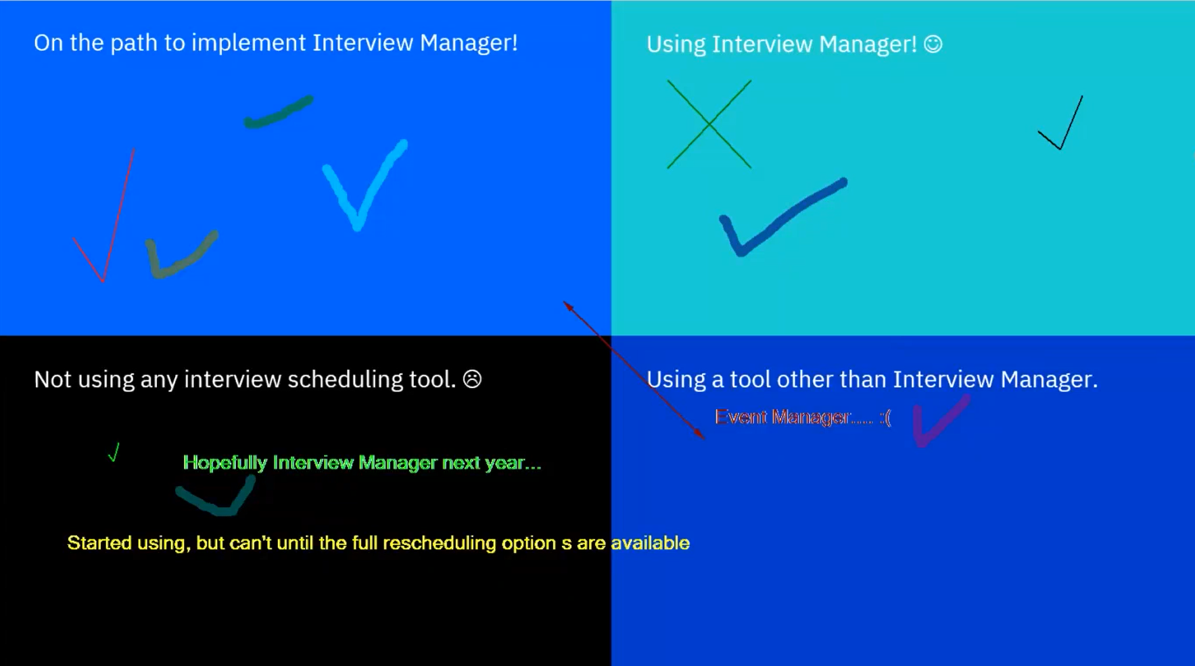
What Does your organization Use?
28:33- Do you think that approval will come through?
Yes I think we’re going to be able to get through. A real turning point for us was that we had someone from join a security call to reinforce that there is no data stored.
29:44- Has anyone implemented it globally and do the communication templates work for all countries/ regions?
No one on the call had an answer for this.
23:30- When should I use Interview Manager vs Event Manager?
Event Manager is best suited for hosting large scale events such as job fairs, virtual recruiting efforts, virtual job fairs.
Interview Manager is best suited for 1 on 1 interviewing.
24:44- Is there something specific holding you back from Interview Manager?
We had planned to do interview manager and other project just took priority over it.
26:46 Is there anything holding you back from using interview manager?
We are working with our Microsoft exchange team to get approval to leverage the calendar for our recruiters. We’d like them to be able to use the calendar integration.
34:48 Having the calendar integration is a nice to have but we have been using Interview Manager without the integration as it is working well without it. It doesn’t necessarily improve the experience significantly.

Slide 20
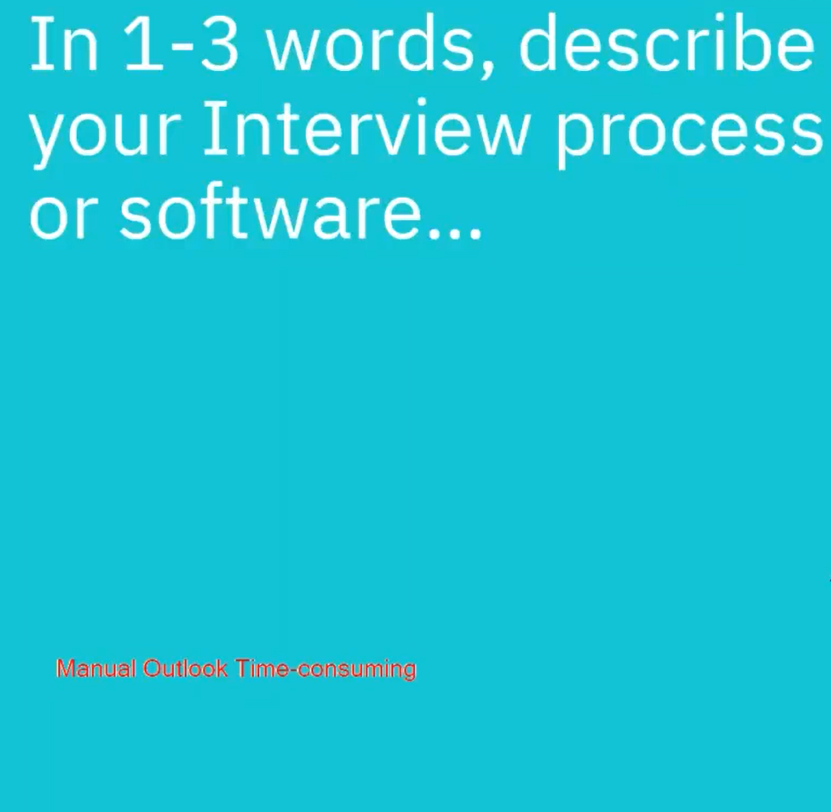
Describe your Interview Process or Software

Slide 21
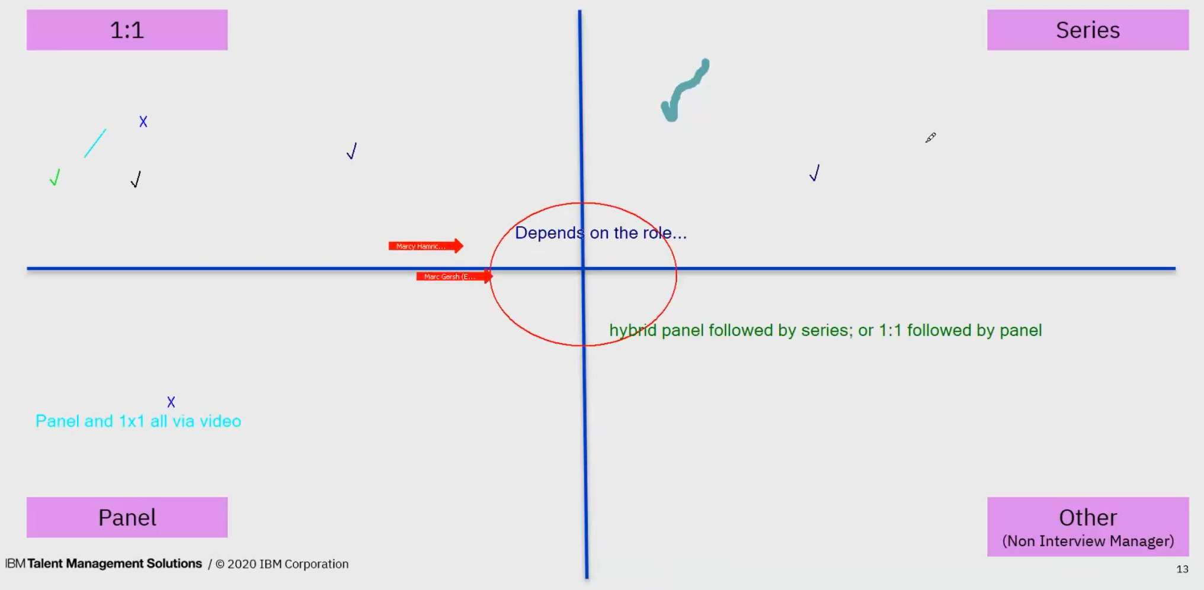
What is the most used Interview Style within your organization ?
46:24- Any interview styles that we are missing?
We want to see more of a mixed bag, between panel and series. There are times that we want to put in a break for lunch and the series has been good for that but there are other times where we might have them seeing 2 people followed by 1 person and then they go back to another panel. Having the mix between series and panel would be ideal.

Slide 22
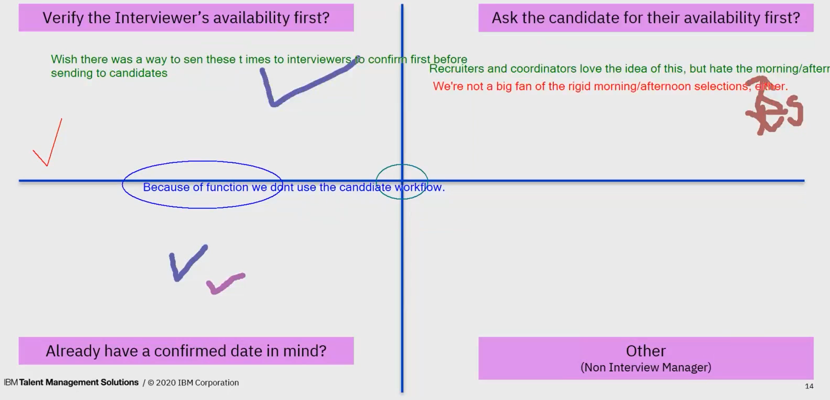
What is your process?
53:07- Instead of morning/afternoon selection what would your ideal look like?
From our perspective we’d want to see something like what’s in Event Manager (but not Event Manager):
  A spot to indicate 30, 45, 60 min interval
  Ability to block off availability
  Ability to not select specific times during the day so it’s easier for the candidate to see that the person isn’t available
Notes:
Instead of morning/afternoon selection what would your ideal look like?
From our perspective we’d want to see something like what’s in Event Manager (but not Event Manager):
A spot to indicate 30, 45, 60 min interval
Select specific times that the interview can begin
Ability to not select specific times during the day so it’s easier for the candidate to see that the person isn’t available

Slide 23
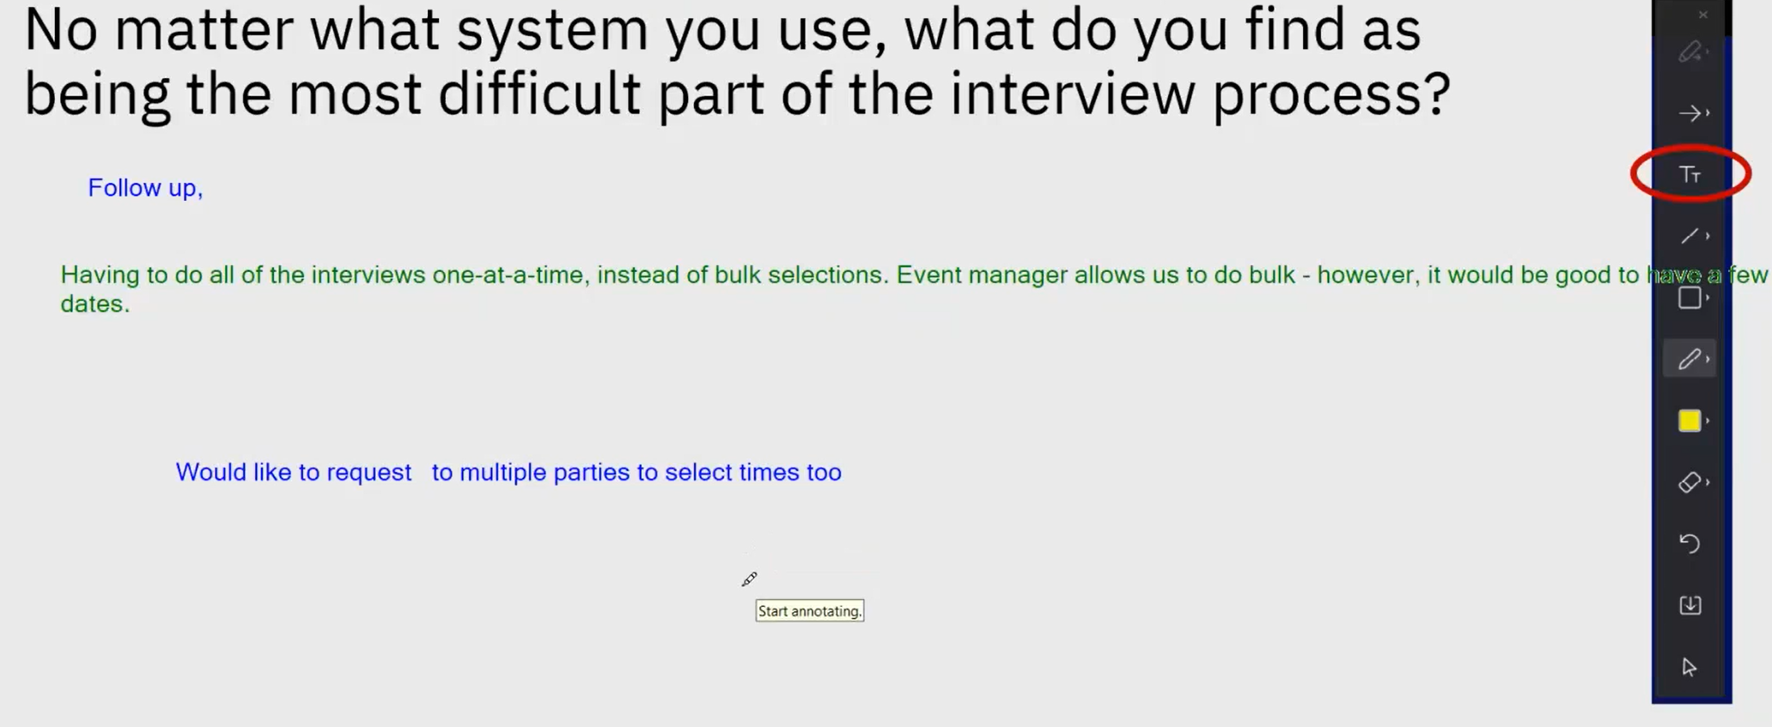
Challenges?
56:00- What part of follow up is difficult?
Post interview follow up to drive the hiring manager to interact with the recruiter.
The follow up emails “please don’t forget about your interview/ Accept your interview was delivered.

