Slide 1
The eLink Dashboard
BrassRing on Cloud
—
Client Training and Enablement Session
Talent Management Solutions
November 19th, 2020

Slide 2
Agenda
Overview & Benefits
Demo
Configuration
Things to Know
Resources
Q & A

Slide 3

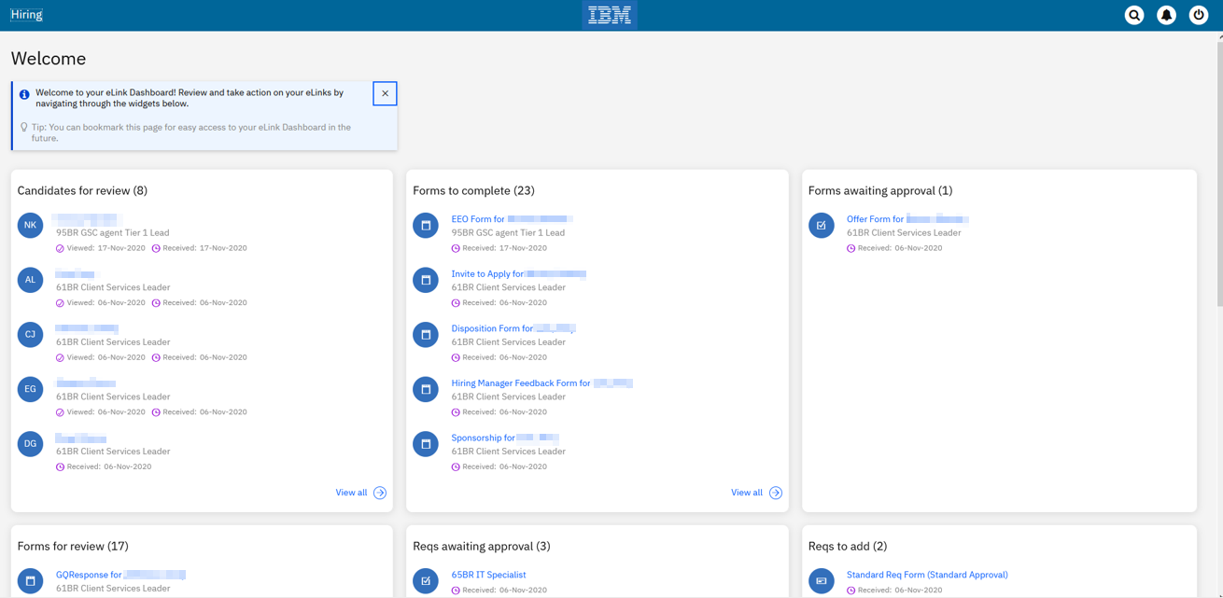



eLink Dashboard Timelines
We’re excited to announce the
Dark Launch to STAGING ONLY Planned for BR 20.12.01 (Dec 1st)!
No planned date for Production yet.
Note: This feature will only be available in the Staging environment with the December release. It will be pushed to production in a future release. Watch for updates in our Release Notes!
We want your feedback!

Slide 4
Overview
The eLink Dashboard is an all-encompassing, single access point meant primarily for Hiring Managers to review and act on all their tasks! This view can also be very helpful for other users that are looking to action on their req/candidate form approvals, review candidates, complete candidate forms, etc. from a dashboard instead of having to login to BrassRing.
Benefits:
  Modern, responsive user interface
  Single dashboard view of actionable items
  Simplifies user’s view to only those things they need to act on.
    Training Hiring Managers will be simplified due to the focused view they will get in the dashboard of only their actionable items. No more difficulty navigating BrassRing, a system they may not log into often!
    Users will no longer have to dig through their emails to find candidates/reqs/forms that were sent to them.)

Slide 5
eLink Dashboard
Below functions are available inside eLink Dashboard:
Review Candidates
Complete Candidate Forms
View Candidate Forms
Add a Req
View a Req
Edit a Req
Approve or Decline Reqs
Approve or Decline Candidate Forms
Note: The cards on the eLink dashboard can be reordered by dragging to arrange as needed.

Slide 6
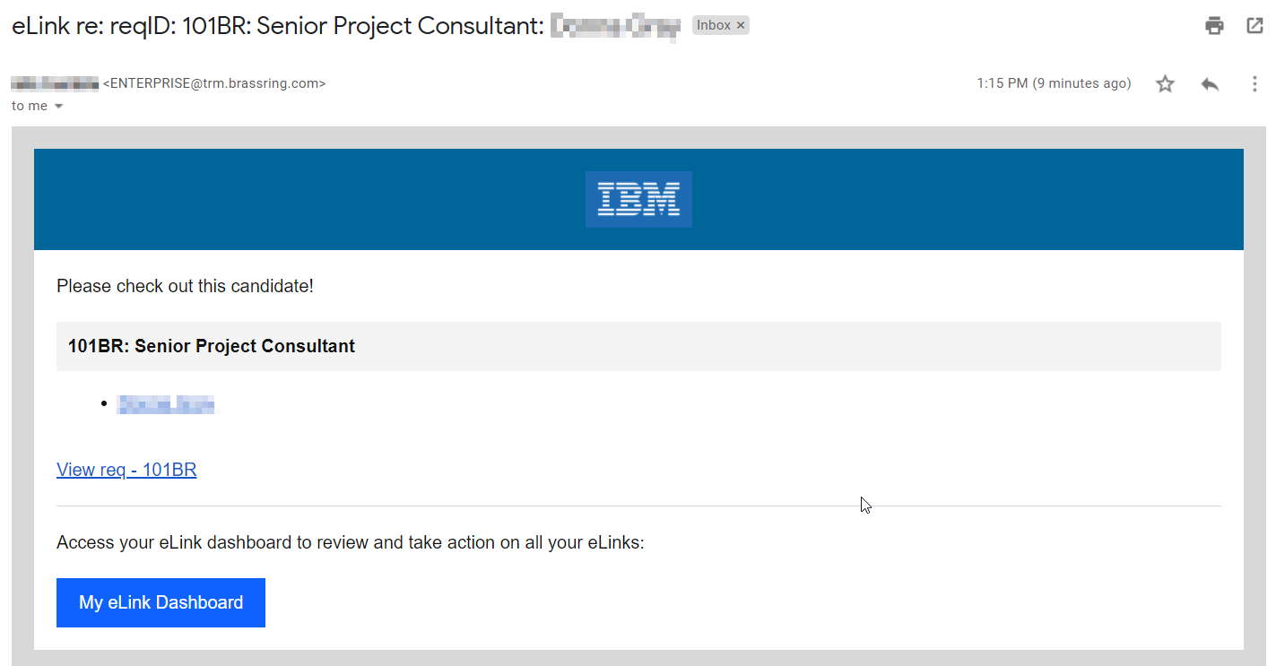
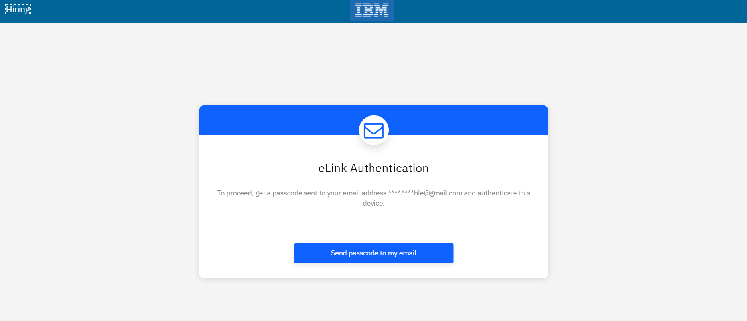
eLink Dashboard
Clicking on the link in the email requires the user to authenticate. (This will display if they haven’t already authenticated or have chosen not to have the browser remember the computer they’re on.)
The user can also click the My eLink Dashboard to access the site. The page the user is taken to can be bookmarked for future access.

Slide 7
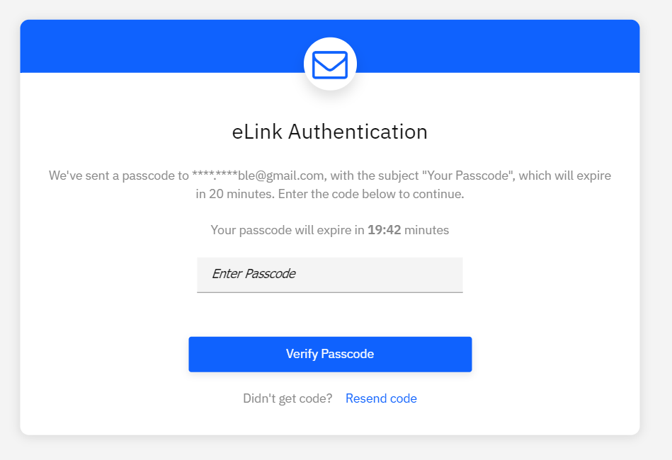
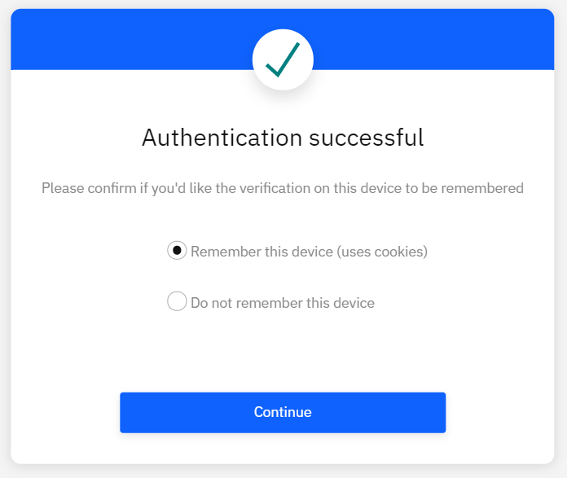
eLink Dashboard
When authenticating, the user will receive an email with the code. They then have 20 minutes to use that code to authenticate.
After the code is entered, the user will have the option to:
Remember this device – If selected, the user will not have to authenticate each time. However, if they clear their cache and cookies or use a different browser, they will have to authenticate again.
Do not remember this device – If selected, the user will have to authenticate each time accessing the eLink Dashboard.

Slide 8

eLink Dashboard

Slide 9
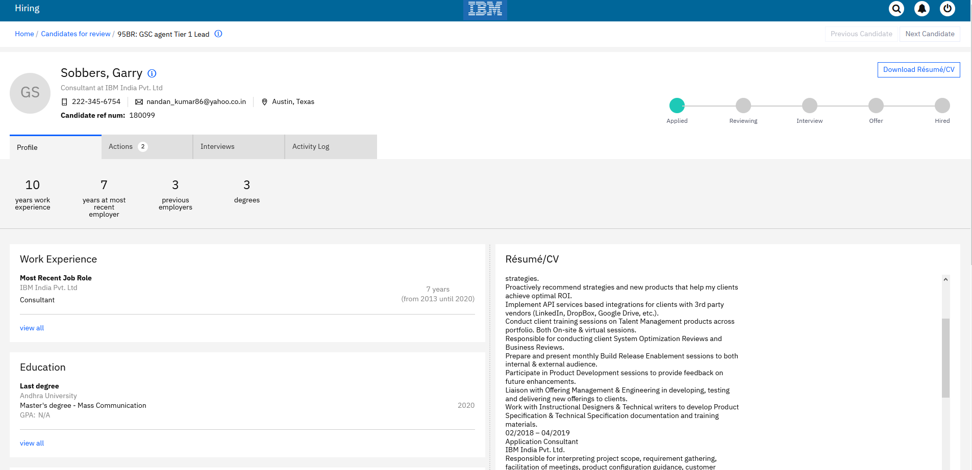
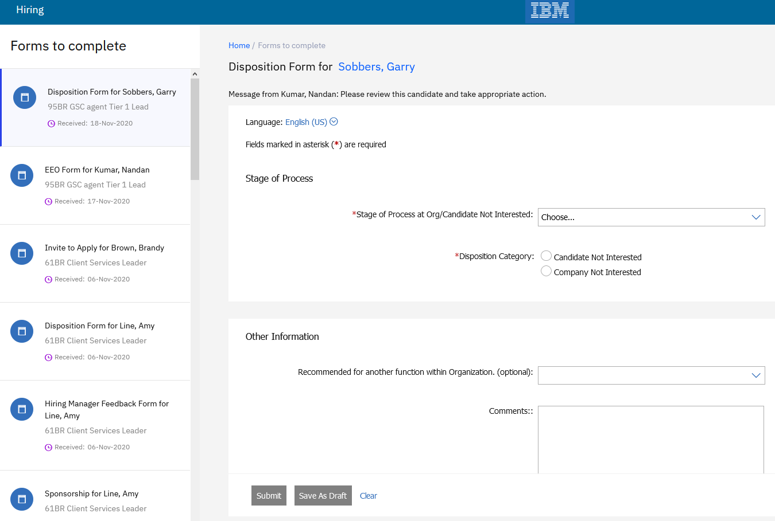
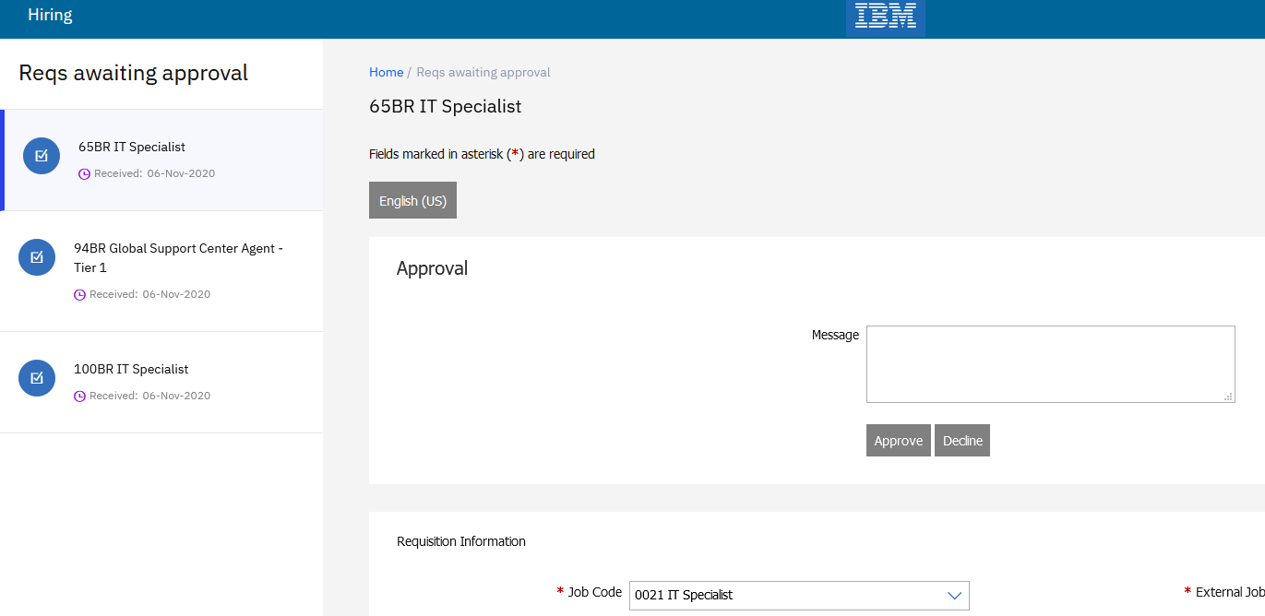
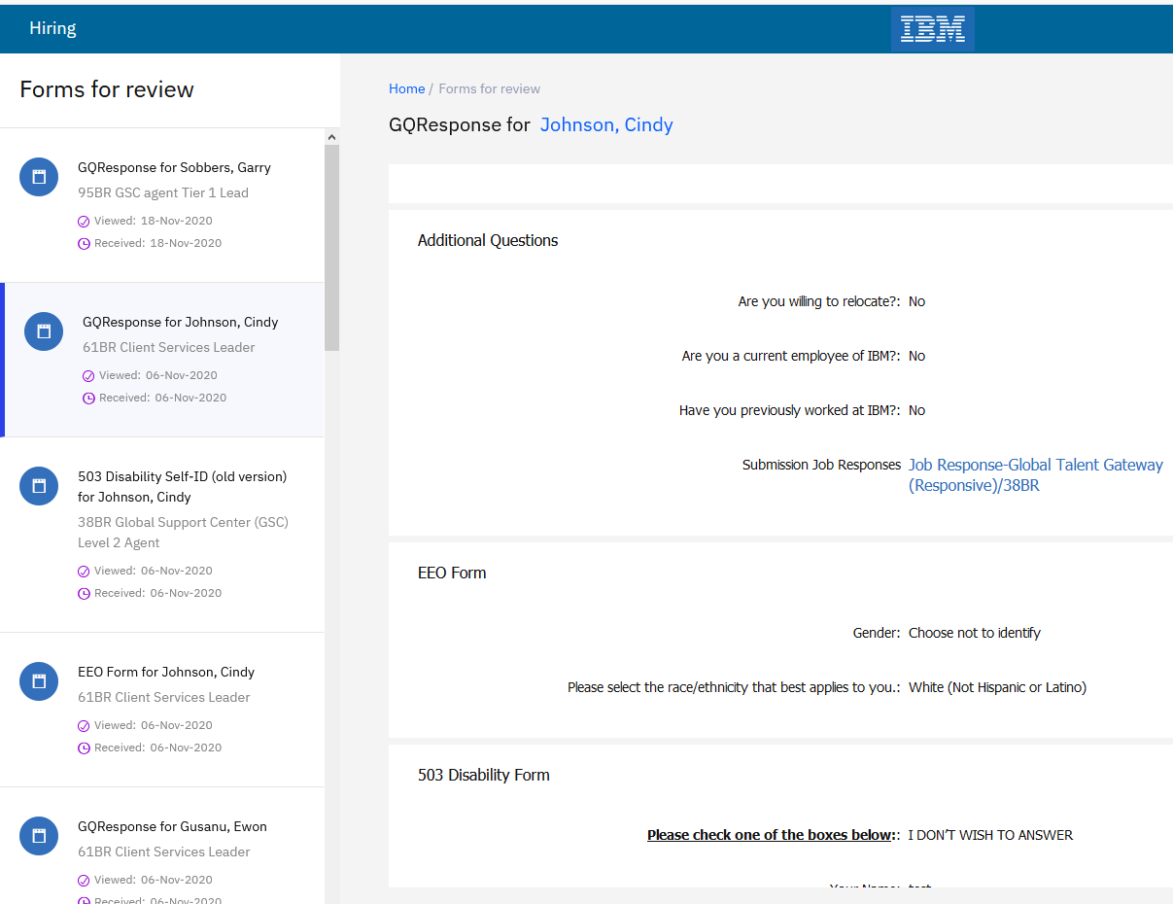
eLink Dashboard

Slide 10
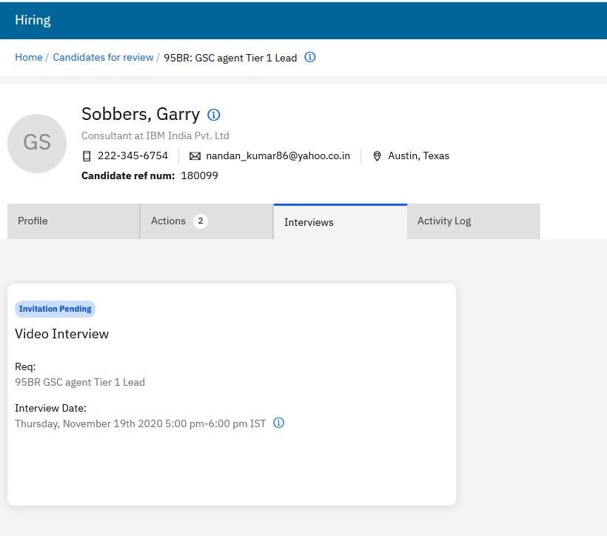
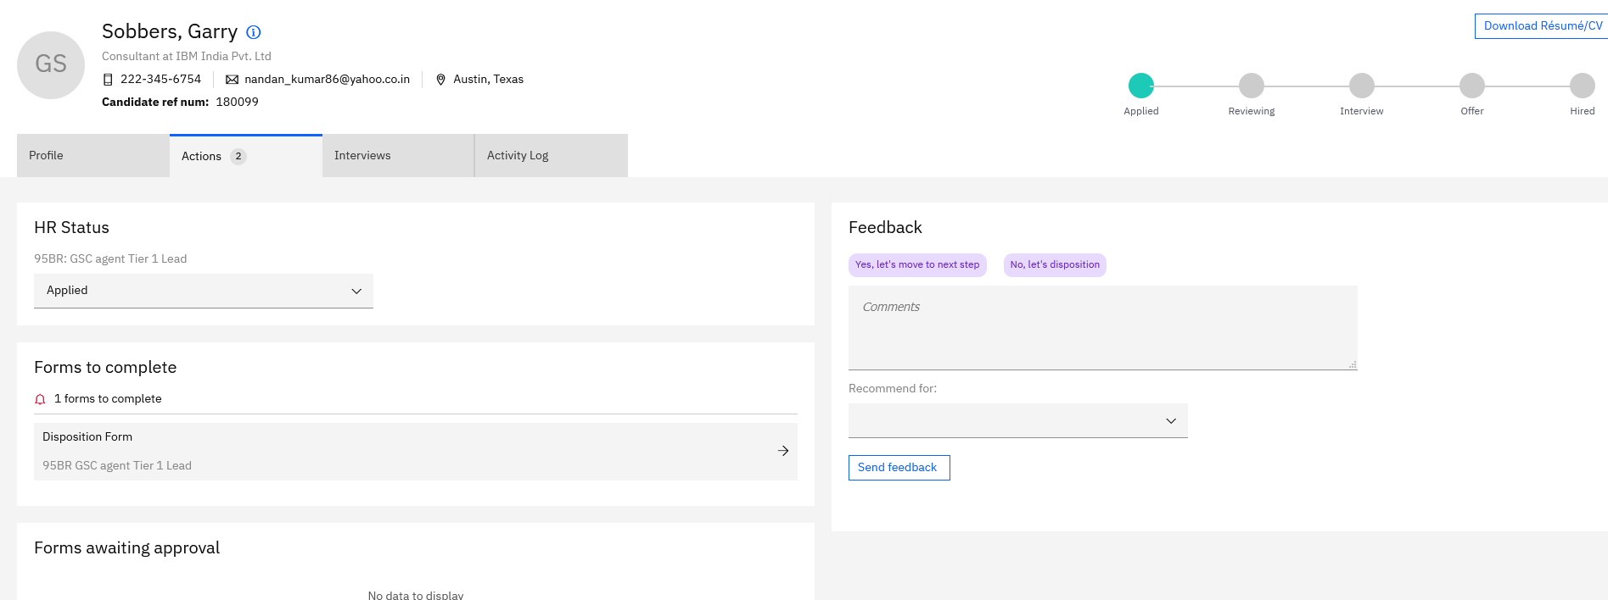
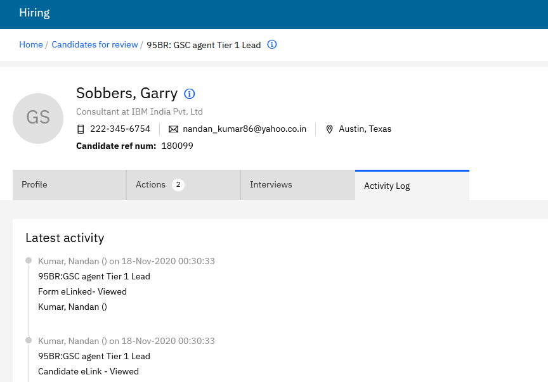
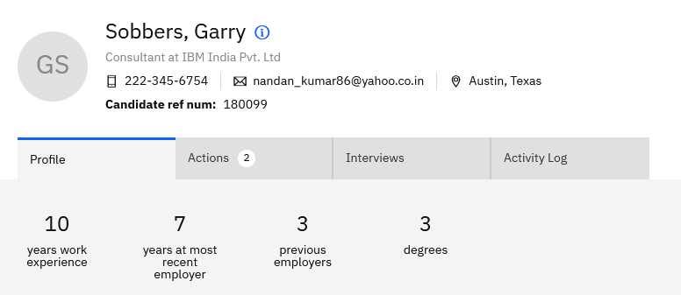
eLink Dashboard

Slide 11
Demo
–

Slide 12
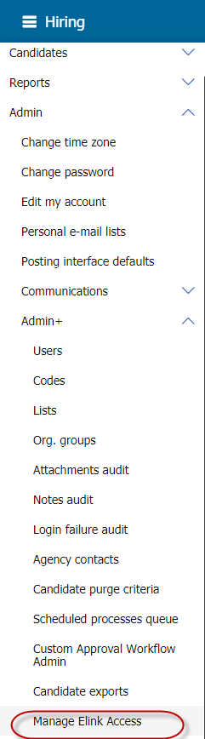
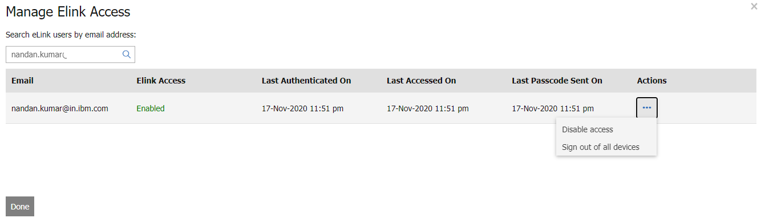
Configuration
eLink dashboard access can be controlled from inside BrassRing by an Administrator.
A specific user’s access to dashboard can be disabled.
Admins can sign-out a specific user from all logged in devices.
Access can be re-enabled at any point of time.

Slide 13
Things to Know
The eLink dashboard is not applicable to candidate facing communications or eLinks.
Candidates do not see any change in how they access their eLinks.
eLink dashboard gets enabled by default.
eLink dashboard shows eLinks sent to the user in the last 180 days by default.
The URL to access the dashboard is unique for each user. Users can bookmark the URL to access it in the future instead of having to navigate to their email.
The eLink dashboard is deactivated if the user is removed (purged as well) from the system.

Slide 14
Things to Know
All existing user type access restrictions will be respected inside the dashboard.
Each passcode is valid for 20 minutes. There is no restriction on the number of passcodes a user can request.
Once closed, the welcome message will not appear again. It is not possible to get it back.
The passcode email cannot be customized.
When “Incognito browser mode” is used, user must authenticate each time they would be to access the dashboard.
The session remains active till the browser is closed and/or cache/cookies are cleared.
If SSO is enabled for eLink authentication, it will be honored.

Slide 15
Resources
eLink Dashboard: https://documentation.infinite.com/docs/the-elink-dashboard

Slide 16
Questions & Answers?

