Slide 1

The eLink Dashboard
IBM Kenexa BrassRing on Cloud
—
Client Training and Enablement Session
IBM Talent Management Solutions
January 14th, 2021

Slide 2
Agenda
Overview & Benefits
Demo
Configuration
Things to Know
FAQs
Upcoming Enhancements
Resources
Q & A

Slide 3

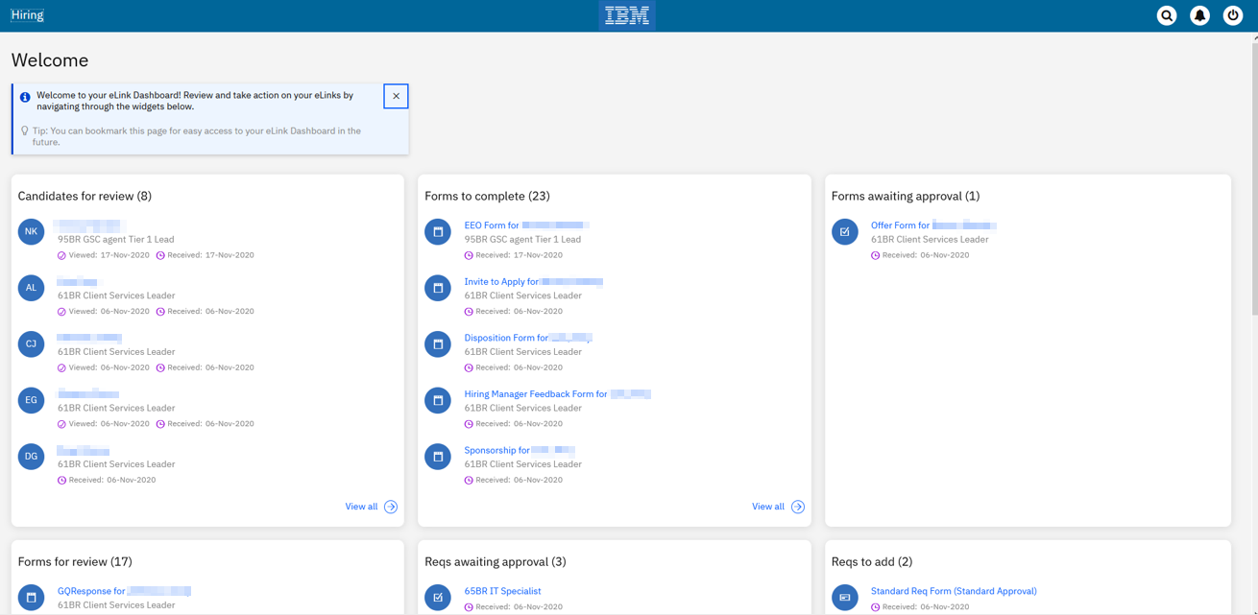



eLink Dashboard Timelines
We’re excited to announce that the
eLink Dashboard was Dark Launched to STAGING ONLY with release 20.12.01 (Dec 1st)!
Production release planned for March*.
Note: This feature is only available in the Staging environment. It will be pushed to production in a future release. Watch for updates in our Release Notes!
*Subjected to successful testing.
We want your feedback!

Slide 4
Overview
The eLink Dashboard is an all-encompassing, single access point meant for Hiring Managers to review and act on all their tasks! This view can also be very helpful for other users that are looking to action on their req/candidate form approvals, review candidates, complete candidate forms, etc. from a dashboard instead of having to login to BrassRing.
Benefits:
  Modern, responsive user interface
  Single dashboard view of actionable items
  Simplifies user’s view to only those things they need to act on.
    Training Hiring Managers will be simplified due to the focused view they will get in the dashboard of only their actionable items. No more difficulty navigating BrassRing, a system they may not log into often!
    Users will no longer have to dig through their emails to find candidates/reqs/forms that were sent to them.)

Slide 5
eLink Dashboard
Below functions are available inside eLink Dashboard:
Review Candidates
Complete Candidate Forms
View Candidate Forms
Add a Req
View a Req
Edit a Req
Approve or Decline Reqs
Approve or Decline Candidate Forms
Note: The cards on the eLink dashboard can be reordered by dragging to arrange as needed.

Slide 6
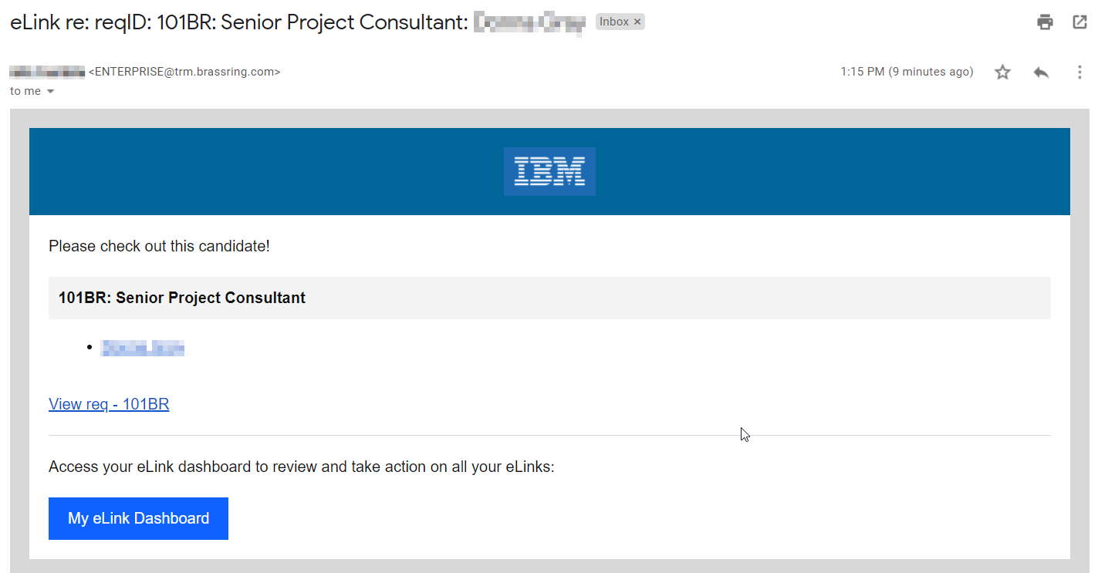
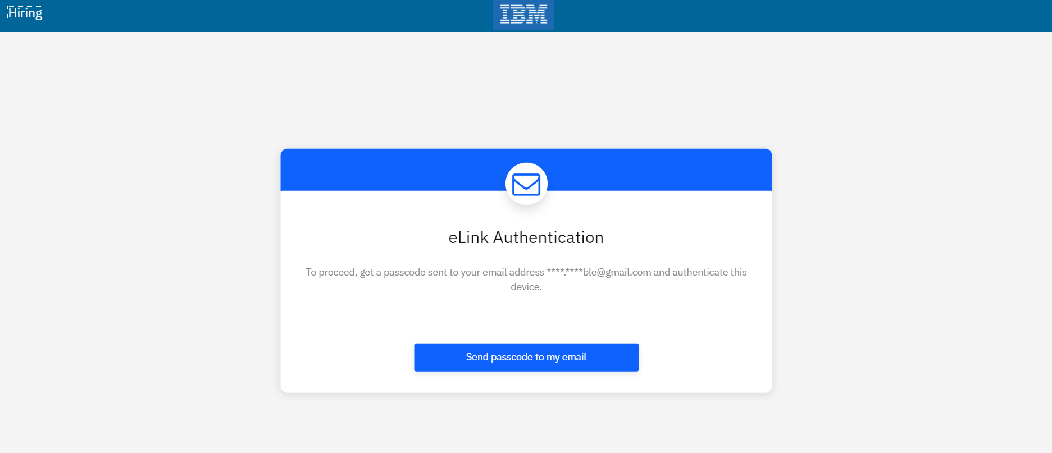
eLink Dashboard
Clicking on the link in the email requires the user to authenticate. (This will display if they haven’t already authenticated or have chosen not to have the browser remember the computer they’re on.)
The user can also click the My eLink Dashboard to access the site. The page the user is taken to can be bookmarked for future access.

Slide 7
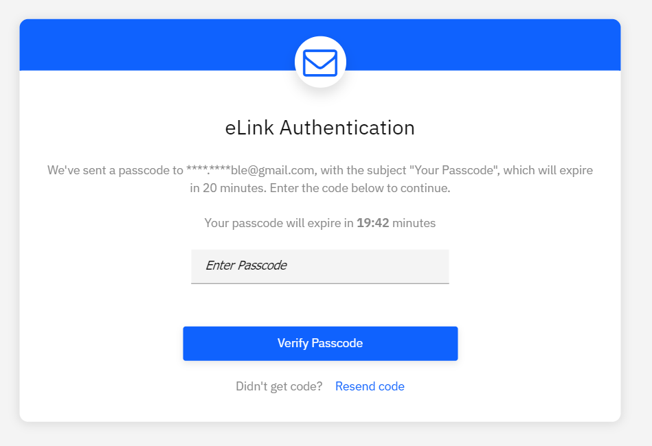
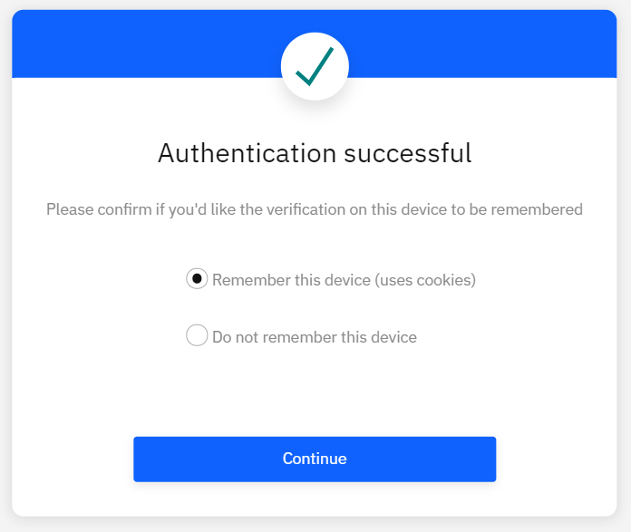
eLink Dashboard
When authenticating, the user will receive an email with the code. They then have 20 minutes to use that code to authenticate.
After the code is entered, the user will have the option to:
Remember this device – If selected, the user will not have to authenticate each time. However, if they clear their cache and cookies or use a different browser, they will have to authenticate again.
Do not remember this device – If selected, the user will have to authenticate each time accessing the eLink Dashboard.

Slide 8

eLink Dashboard

Slide 9
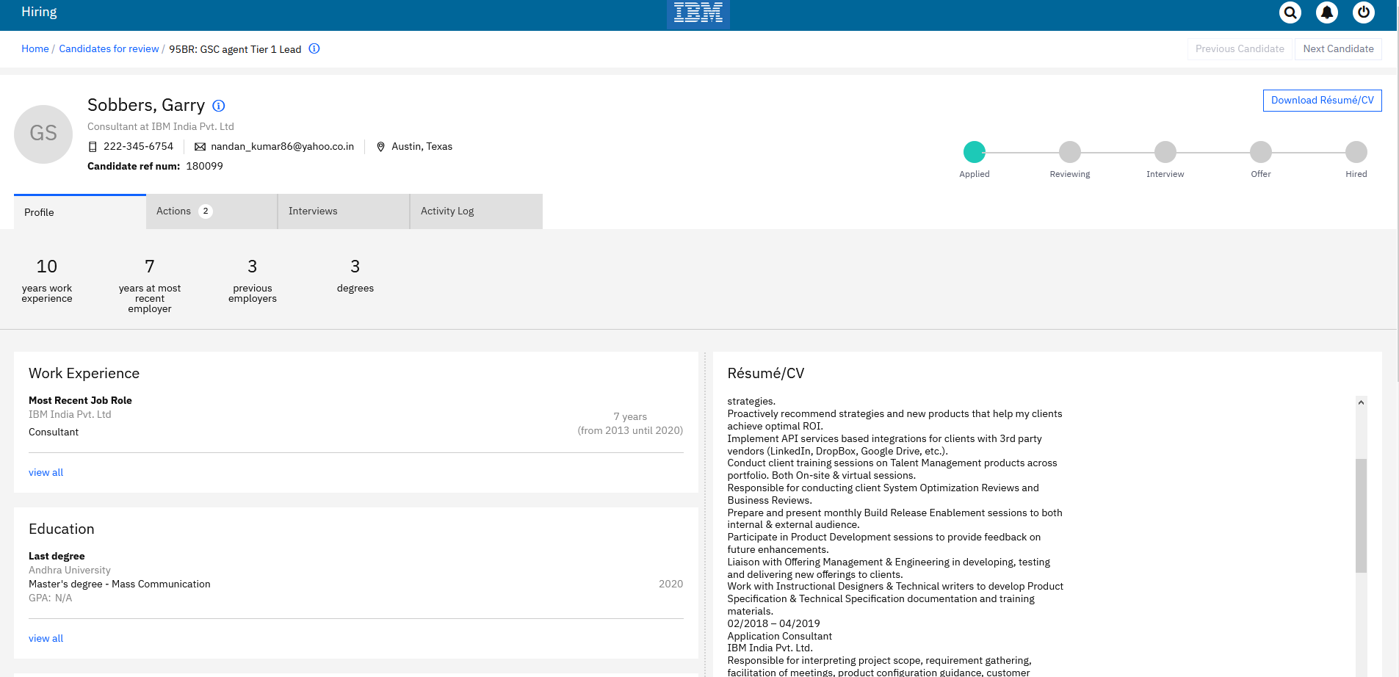
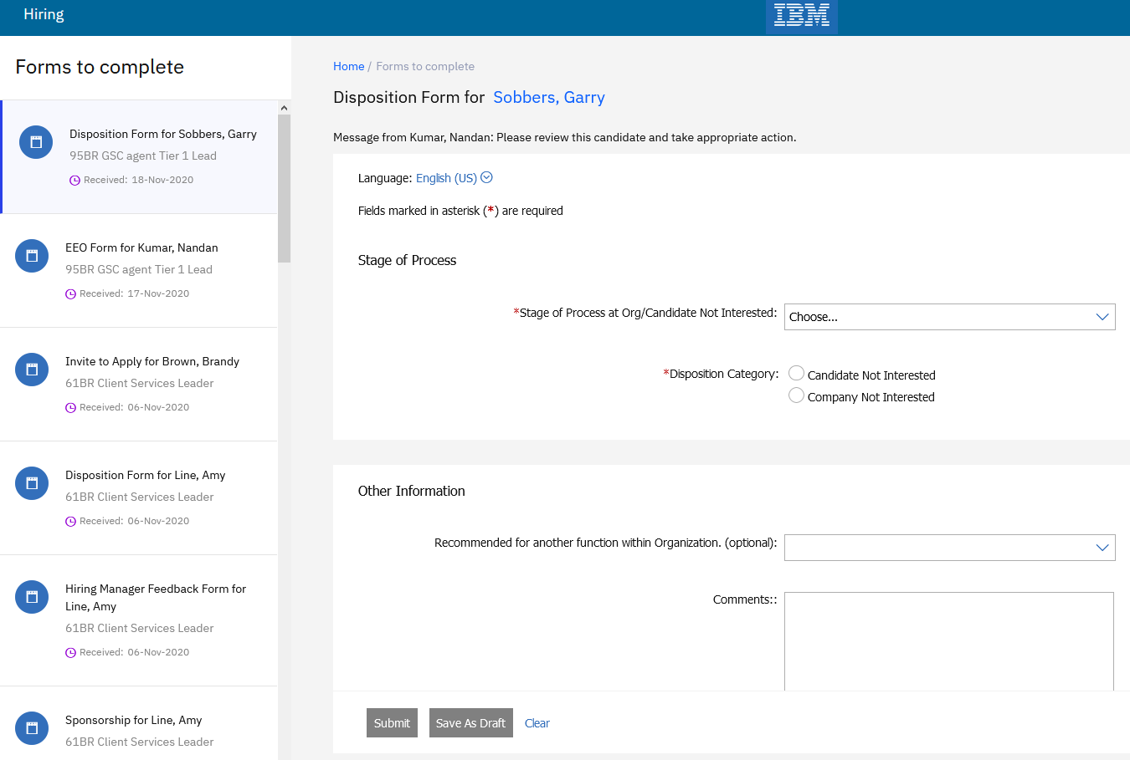
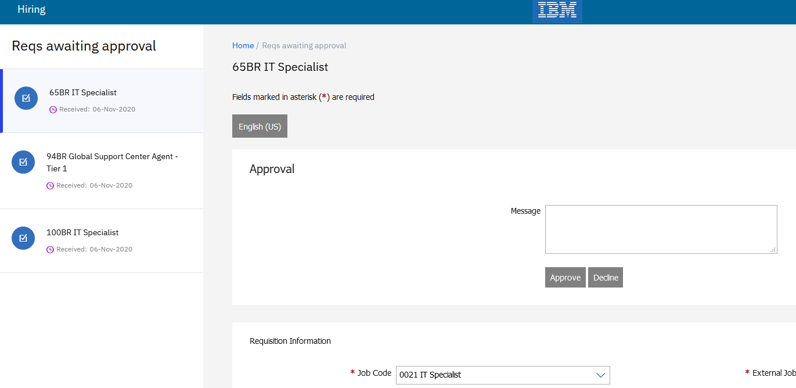
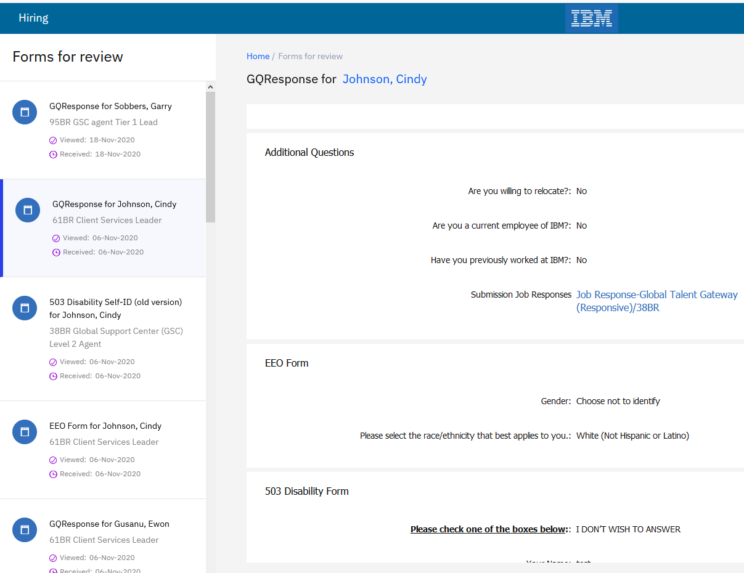
eLink Dashboard

Slide 10
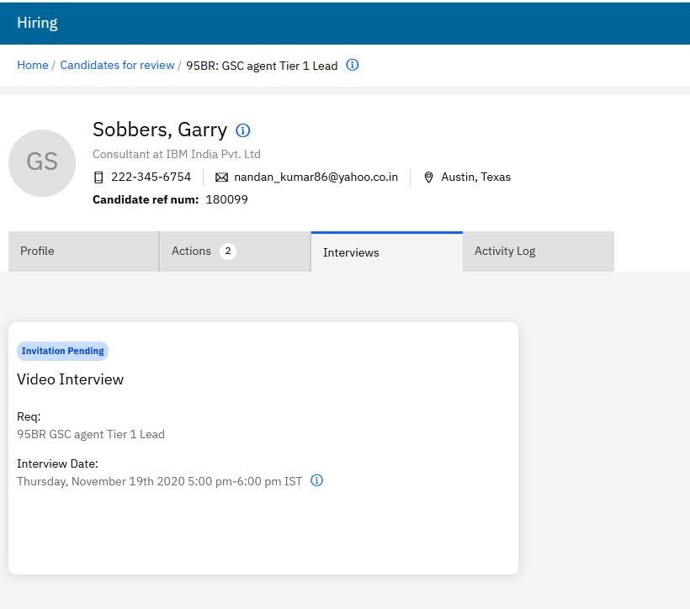
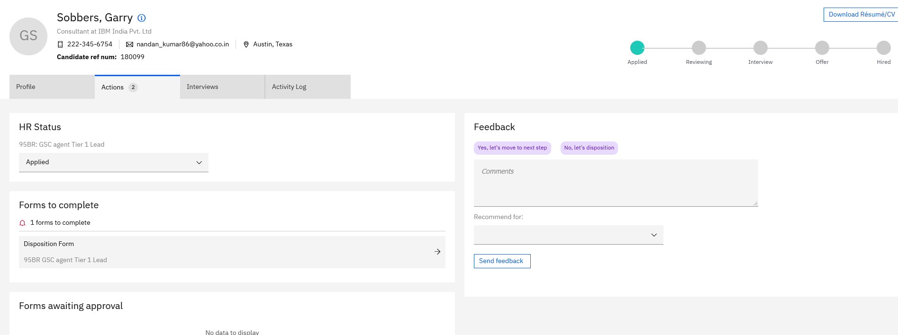
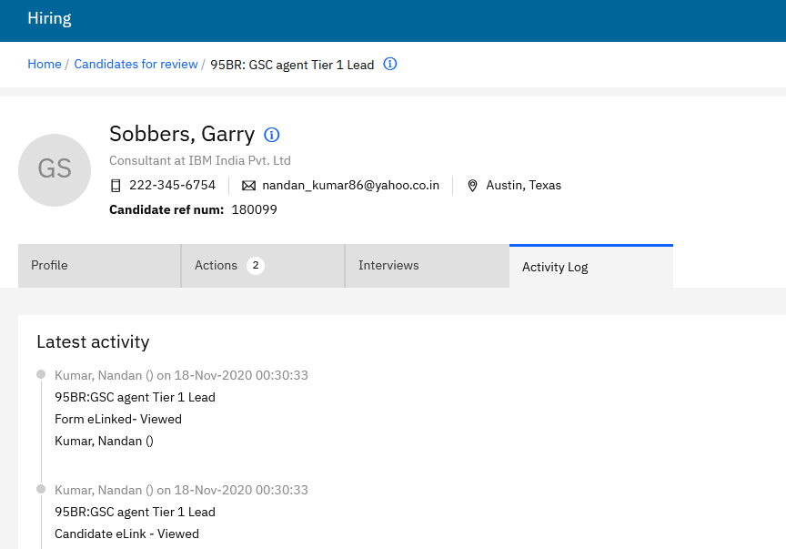
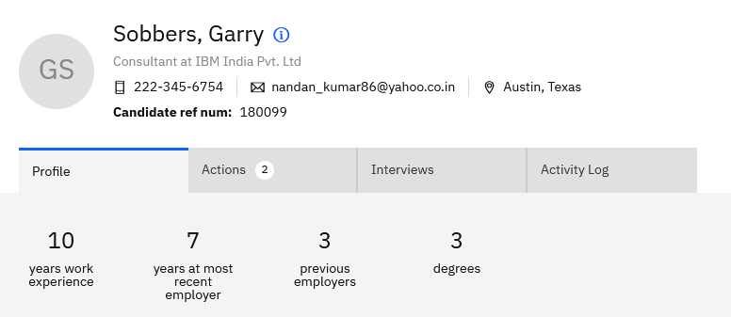
eLink Dashboard

Slide 11
Demo
–

Slide 12
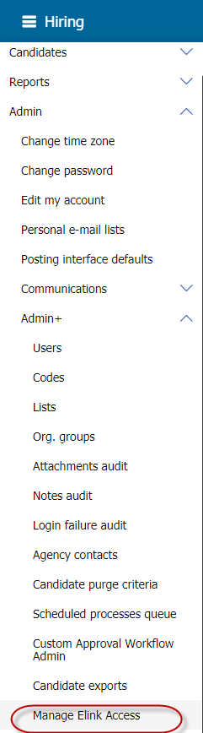
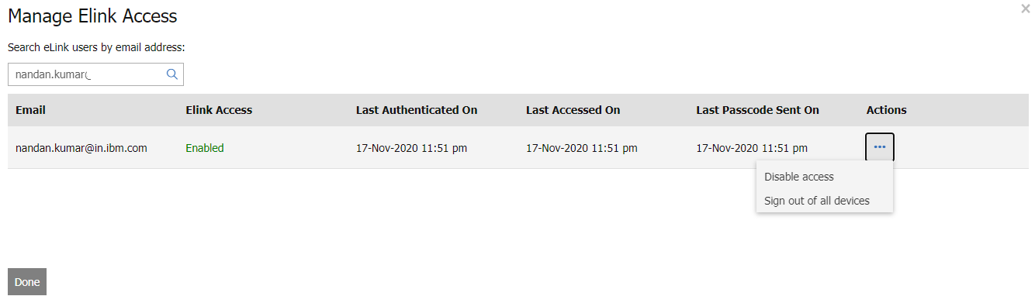
Configuration
eLink dashboard access can be controlled from inside BrassRing by an Administrator.
A specific user’s access to dashboard can be disabled.
Admins can sign-out a specific user from all logged in devices.
Access can be re-enabled at any point of time.

Slide 13
Things to Know
The eLink dashboard is not applicable to candidate facing communications or eLinks.
Candidates do not see any change in how they access their eLinks.
eLink dashboard gets enabled by default.
eLink dashboard shows eLinks sent to the user in the last 180 days by default.
The URL to access the dashboard is unique for each user. Users can bookmark the URL to access it in the future instead of having to navigate to their email.
The eLink dashboard is deactivated if the user is removed (purged as well) from the system.

Slide 14
Things to Know
All existing user type access restrictions will be honored inside the dashboard.
Each passcode is valid for 20 minutes. There is no restriction on the number of passcodes a user can request.
Once closed, the welcome message will not appear again. It is not possible to get it back.
The passcode email cannot be customized.
When “Incognito browser mode” is used, user must authenticate each time they would be to access the dashboard.
The session remains active till the browser is closed and/or cache/cookies are cleared.
If SSO is enabled for eLink authentication, it will be honored.

Slide 15
Frequently Asked Questions:
Q: Can users get locked out of the eLink Dashboard?
A: No there is no login process, so there is no lock out.
Q: How much history is stored on the home page? Can the amount of history showing on the home page be configured?
A: 180 days is the default. This period can't be configured right now.
Q: Any additional user type privileges to access this eLink dashboard feature for users?
A: No additional user type privileges required. It is enabled by default.
Q: Is that "Feedback" section tied to the "eLink talent record -show 'respond' button?" client setting?
A: Yes, if the client setting is turned off, there will be no feedback section.
Q: Disabling a user in BR disables eLink dashboard access?
A: Yes, the eLink dashboard is deactivated if the user is removed from the system.
Q: Does this mean that the eLink dashboard doesn't expire after 10 days?
A: The user can bookmark their eLink Dashboard and that link never expires.
Q: Will a new passcode be sent, and the previous passcode expire if a user requests it more than once?
A: No, once a user requests a password the system will not send a new password until the 20-minute period has passed.
Q: What is the case when we use SSO authentication for eLinks? Is this then as well the case for the eLink Dashboard?
A: The eLink Dashboard does work with SSO. The user doesn't have to re-authenticate because technically SSO is an authentication.

Slide 16

Upcoming Enhancements:
Here is a glimpse of some upcoming configuration features:
Days back setting.
Passcode Frequency.
Default/Optional eLink Dashboard.
Token for Communication and System Email templates.
Show/Hide Years of Experience.
Show/Hide Download Resume/CV.

Slide 17
Resources
Documentation:
https://www.ibm.com/support/knowledgecenter/en/SSEUFV/6_CommsAndElinks/5c_eLinkDashboard.html#ID-1122-00000002__3
Recording:
https://ibm.box.com/s/892vd4yuzdfhe0e60k7rmg3k4v2y3fs1
FAQs:
https://ibm.box.com/s/bo3q0hpjqicvnqduofm9lc5npspmytlo
Presentation:
https://ibm.box.com/s/7q72c6hwrtfamjf9178wfmvpldq9mc69

Slide 18
Questions & Answers?

