Slide 1
IBM Kenexa BrassRing, Onboard and Lead Manager on Cloud Release 20.12.01
—
Client Training and Enablement Session
IBM Talent Management Solutions
December 3rd, 2020

Slide 2
Onboard Release Features
–
Staging: December 03rd , 2020
Production: December 12th , 2020

Slide 3

Dark Launch Features
There are no Dark Launch features for this release.

Slide 4
Features Being Released this Month
–

Slide 5



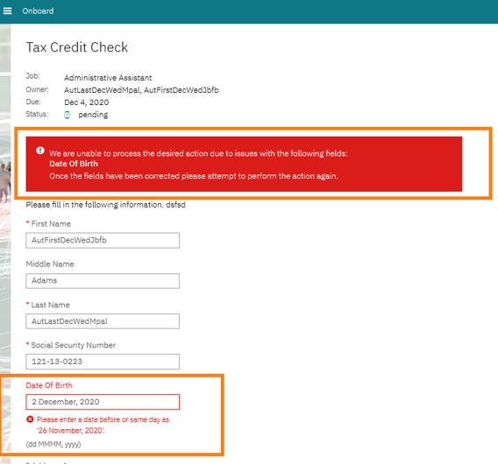
WOTC: New validation for DOB Field
How do you get it?
Visible Change
Who does it affect?
New hire
Description:
Date of Birth (DOB) field was updated for WOTC (Work Opportunity Tax Credit) activity.
Field doesn’t allow:
Date older than 130 years.
Today.
Future Date.

Slide 6
Manage New Hires: Select All Across Pages
How do you get it?
Visible Change
Who does it affect?
Onboarding Manager
Description:
User can select all new hires across Manage New Hires pages and perform bulk action. So, they don’t need to perform this action for each page individually.
When performing this task, below message is displayed.
You are about to complete the task “activity name)” for “n” new hire(s). Are you sure you are ready to proceed?
Benefits:
Performs bulk action across pages.

Slide 7
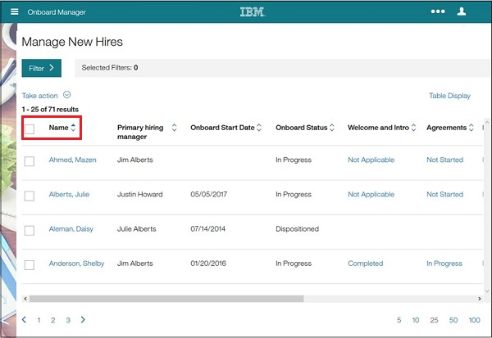
Manage New Hires: Select All Across Pages (Before)

Slide 8
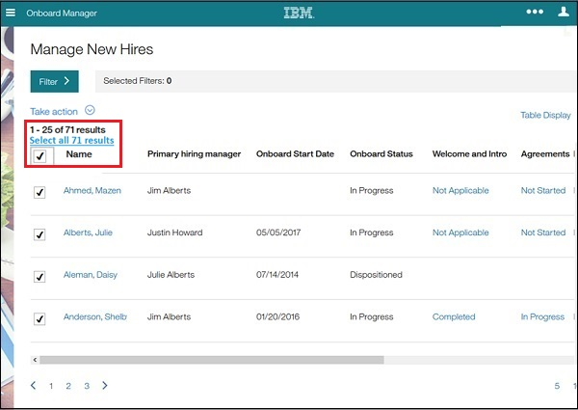
Manage New Hires: Select All Across Pages (After)

Slide 9
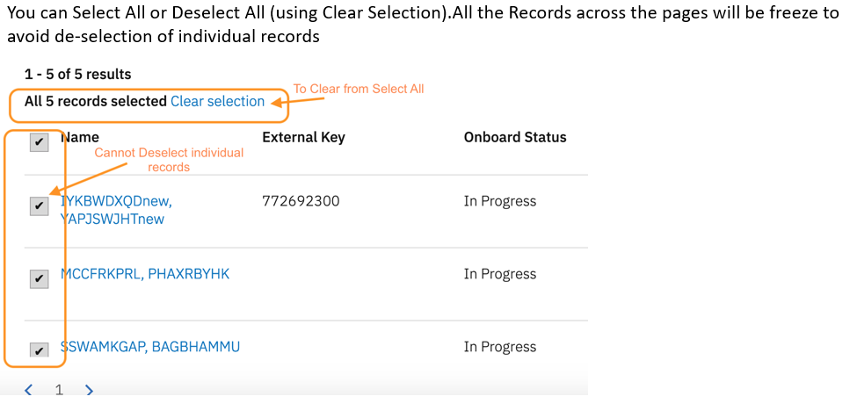
Manage New Hires: Select All Across Pages (After)

Slide 10
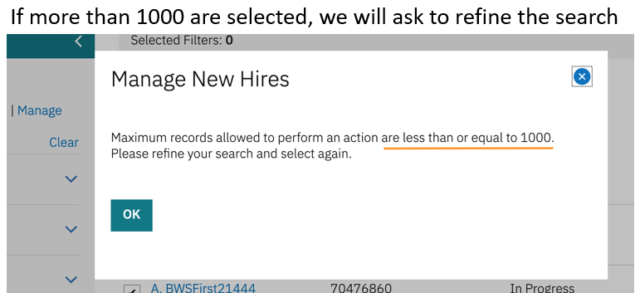
Manage New Hires: Select All Across Pages (After)

Slide 11
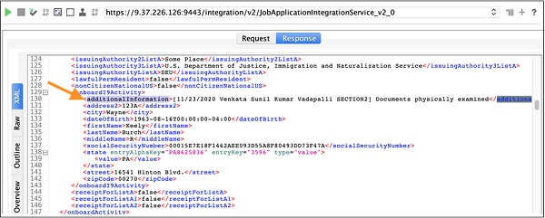
Addition of Additional Information Tag for V2 Export
How do you get it?
Configurable Change
Who does it affect?
Onboarding Manager
Description:
Additional Information provided in I-9 Section 2 is now available in the V2 export of JobApplication Integration Service with the tag additionalInformation under onboardI9Activity.

Slide 12
I-9 Section 2: I-9 Approver Name and Completion Date
How do you get it?
Visible Change
Who does it affect?
Onboarding Manager
Description:
I9 Approver Name and Completion Date is added to Manage New Hires Dashboard when approved.
Users can filter using I9 Approver name, I9 Section One Date, I9 Section Two Date, I9 Section Three Date.
I9 Approver Name field contains the full name of the approver in the format "FirstName LastName".
If the same job application has multiple I9's, the details of the latest I9 will be shown in MNH
Benefits:
Helps users to filter and review candidates.

Slide 13
I-9 Section 2: I-9 Approver Name and Completion Date
If section 2 approver is third party user, then “I9 Approver type” will be displayed as “Third Party User”.
If section 2 approver is Onboard user, then “I9 Approver type” will be displayed as “Standard User”.
“I9 Section One Date” displays completion date of “I9 Section One” task. Similarly, “I9 Section Two Date & I9 Section Three Date” displays completion date of “I9 Section 2 & 3” tasks.
I9 Approver details will be displayed in MNH only after I9 Section one is saved/completed

Slide 14
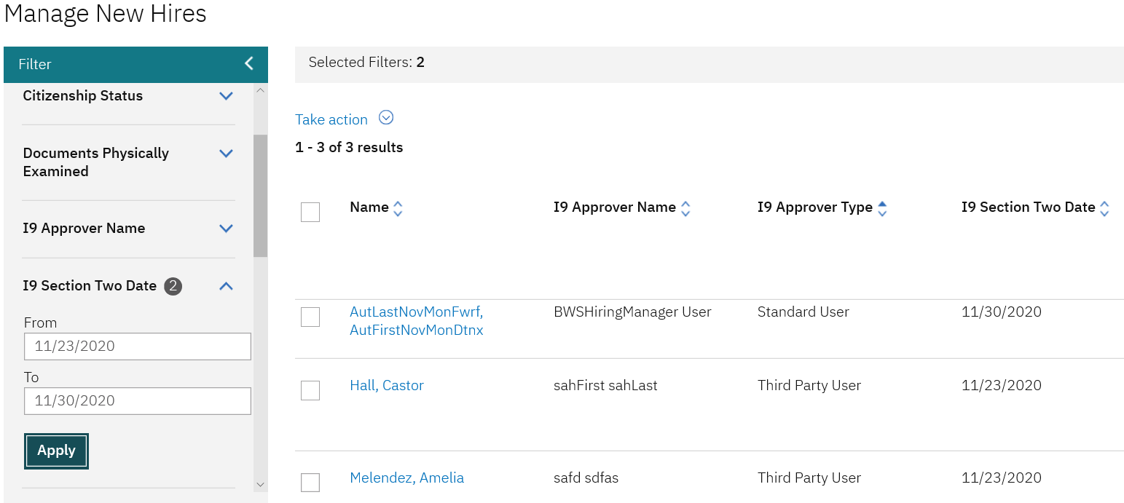
I-9 Section 2: I-9 Approver Name and Completion Date

Slide 15
I-9: Auto-Complete Third Party Approver Assignment
How do you get it?
Configurable Change
Who does it affect?
Onboarding Manager
Description:
An admin can configure the Onboard I-9 Third Party Approver Assignment template to be auto-completed when an approver is passed through the B-O integration so that the admin doesn't need to manually complete the task with V2 services.
If there is no data, or if the data found does not have a user associated with the correct user group, then no auto-completion is performed.
Onboard I-9 Third Party Approver Assignment could be auto-completed with Config setting.
Enable I-9 ThirdPartyApprover Assignment Auto-Completion in Onboard Settings.
Benefits:
Allows activity to be completed automatically.
Reduces time in completing the “Onboarding Process” for “New Hire”.

Slide 16
I-9: Auto-Complete Third Party Approver Assignment
Moving the Assign I-9 Approver to the second level in workflow would make it auto-completed.
The Third Party Approver tag is needed for Auto Completion of Assign I-9 Approver task, which must be sent through B2O integration.
Assign I-9 Approver would show completed by System User.
For any reason if the above default config needs to be overridden for specific cases (i.e. if Assign I-9 Approver has to be manually completed) then onboard XSLT mapping should be updated.
Onboard Start completion is needed for autocompletion of Assign I-9 Approver
If onboard start is completed through V2 service, then Assign I-9 Approver will be autocompleted only if the activity defined at Level 2 of the workflow.

Slide 17
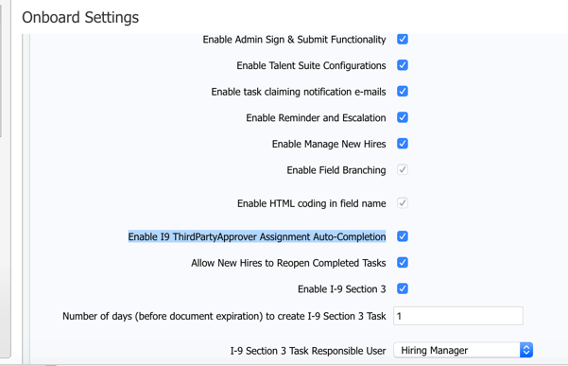
I-9: Auto-Complete Third Party Approver Assignment

Slide 18
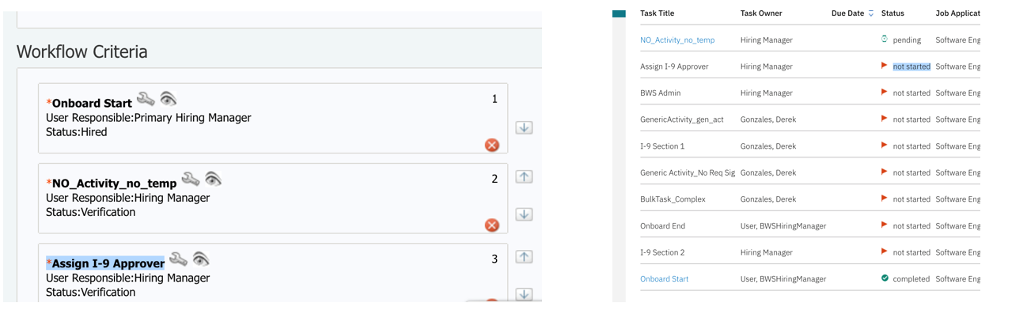
I-9: Auto-Complete Third Party Approver Assignment

Slide 19
User Types: Prevent Task View/Edit/Completion
How do you get it?
Configurable Change
Who does it affect?
Onboarding Manager
Description:
System administrator can prevent user types from completing tasks they can see but are not responsible.
This can be configured per task, per workflow.
All user types are displayed for selection in “Prevent user type(s) from view/edit/completion of this task” setting.
Multiple user types can be selected.
When user types are prevented from viewing/editing/completing tasks, they cannot claim those tasks, even if not configured.
Current Onboard functionality is not affected until the client configures this feature.
Benefits:
Restricts user types from view, edit and complete tasks.

Slide 20
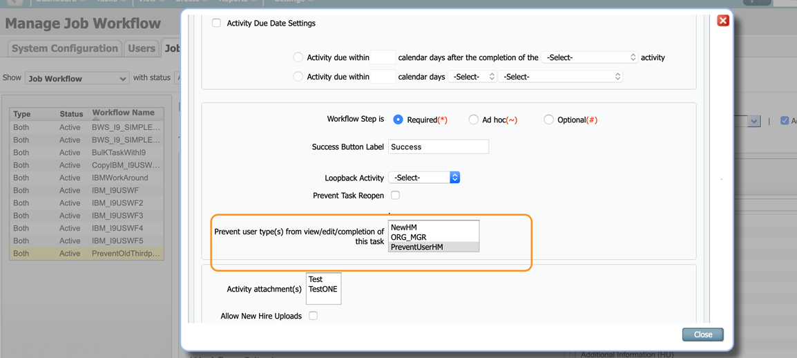
User Types: Prevent Task View/Edit/Completion

Slide 21
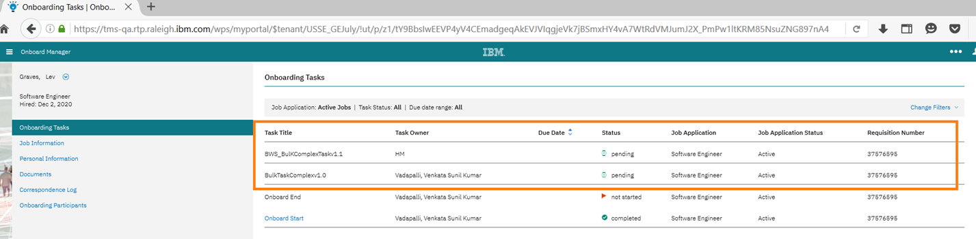
Restrict accessing tasks for prevented user types
How do you get it?
Visible Change
Who does it affect?
Onboarding Manager
Description:
Tasks will be displayed read only (not clickable), for the user types configured in “Prevent user type(s) from view/edit/completion of this task” setting.

Slide 22
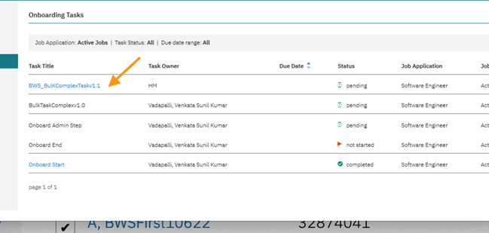
Restrict accessing tasks for prevented user types
Task will be available to view and complete for the user types not configured and Role Responsible for completion.
Note: Prevented user type user is able to complete Tasks through Bulk Actions if he has unrestricted capability.

Slide 23
Upcoming Builds
Date Picker
Bulk Action Email
Access to New Hire Experience through candidate zone – SSO
New Public Filter for Activities in Progress
Add Quick Search to Onboard Pages
Mass Job Update for Participants

Slide 24
Questions?

Slide 25
BrassRing Release Features
–

Slide 26






Feature
BrassRing UI | Candidates - eSignature
 | eLinks - eLink Dashboard
 | Candidates - Document Source Req Information of Copied Candidates
 | Interview Manager - Reschedule Interview - Schedule type Interviewer First
 | Interview Manager - Response Email Content Update
 | Talent Gateways - Google Sign In Branding Updates
 | CK Editor - Updated Version
Feature | Description
Workbench | Recruiter Branding Tool - Update to Display Responsive Settings
 | Candidates - eSignature - Workbench Changes
 | Recruiter Branding Tool - Background Image Conﬁguration Enhancement
 | RAM - Interview Manager - Send Reminders to Coordinators
 | Workbench Power Users - Assessment Branding Privileges
Lead Manager | Lead Manager Login Page - Default Background Image
Icon Key
Configurable Feature
Visible Feature
Requires IBM to Enable
Recruiters Affected
Candidates Affected
Accessibility Update
RELEASE DATES
Staging:
December 1st, 2020
Production:
December 8th, 2020
Dark Launch Feature
Information
RFE Feature
NPS Feature
RFE
NPS

Slide 27

Dark Launch Features

Slide 28



Who’s Affected:
Recruiters, Candidates, Workbench Admins
Configurable or Visible?
CONFIGURABLE
BrassRing UI/Talent Gateways
Candidates - eSignature
RTC #: 131192, 131415
Description:
The new eSignature is now available to start testing in Staging!
Candidates can add, edit and view an eSignature on candidate forms and document subsidiary forms.
A new Signature ﬁeld with the link Create signature will be presented where candidates can Draw, Upload and/or Type a signature.
It is also available to be used inside a Gateway Questionnaire (GQ).
This feature is released to STAGING ONLY with December release.
It will NOT go to PRODUCTION with this release.

Slide 29
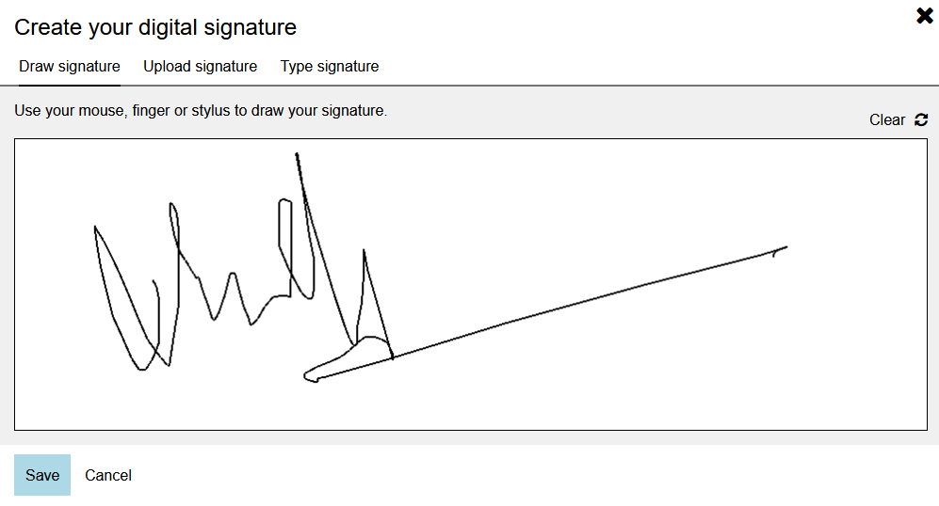
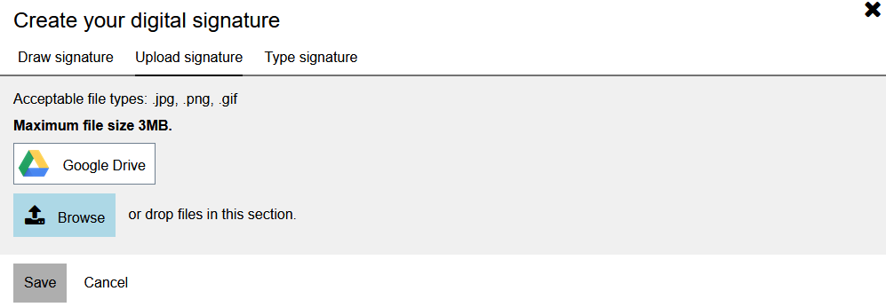
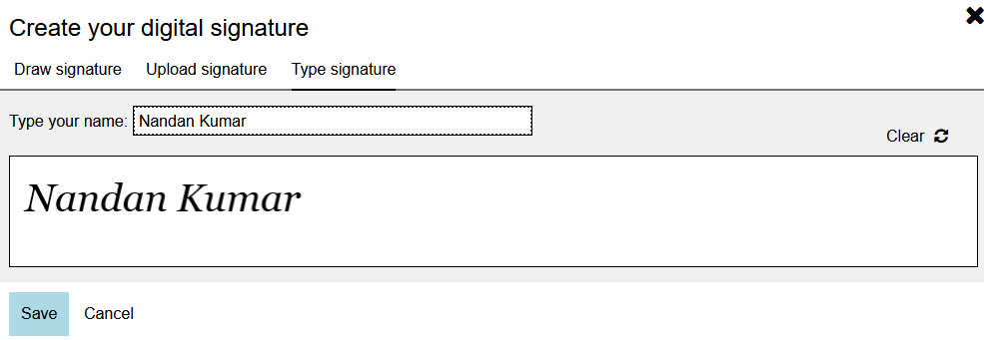
Candidates - eSignature
Draw Signature:
  Depending on the device the candidates use, they can draw a signature in the ﬁeld either using a mouse or similar input device or with their ﬁnger if it is a touch enabled device.
  The drawn signature is stored in the system (database) as a .png format ﬁle.
Upload signature:
  Candidates can upload an existing signature that is available in one of the permitted formats. The Upload signature modal displays the list of permitted formats.
  The uploaded ﬁle is saved in the same format in the system. If candidate attempts to upload a ﬁle of a type that is not permitted, an error message is displayed.
Type signature:
  Candidates that do not have an input device that enables them to draw a signature can simply type in their signature.
  Signature is again stored in .png format in the system (database).

Slide 30
Candidates - eSignature
BrassRing users with appropriate privileges see the ﬁeld depending on the conﬁguration.
The ﬁeld is available for editing only for candidates.
The existing Workbench settings are updated to enable conﬁguration for the signature ﬁelds in the candidate forms and document subsidiary forms.
When the form is in view-only mode and eSignature has saved value, the form will display the corresponding image.
This field will only work for candidate facing e-links.
The field will also work inside Candidate Zone -> Forms section, when the respective candidate forms or document subsidiary forms are sent.
The field cannot be used inside JSQs (Job Specific Questions).

Slide 31
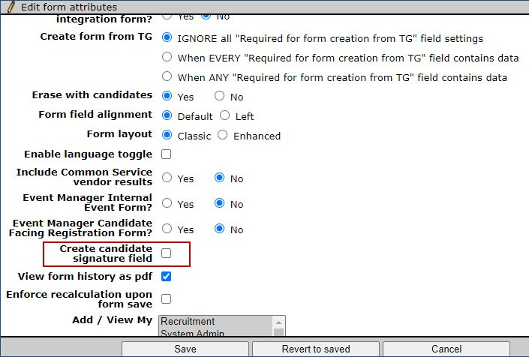
Who’s Affected: Workbench Admin
Configurable or Visible? CONFIGURABLE
Workbench
Candidates - eSignature - Workbench Changes
RTC #: 131654
Description:
The eSignature configuration can be done at form level.
Existing attribute "Create Candidate Signature Field(for use in Gateway Questionnaires only)” has been renamed to "Create Candidate Signature Field“.
Turning on this attribute will automatically create a standard eSignature field on the form.
Only supported in Candidate forms and Doc Subsidiary forms.
Only one eSignature field is allowed per form.
GQ can be configured with eSignature with a new complex widget.

Slide 32
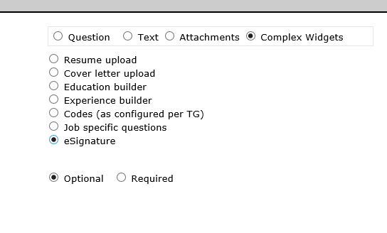
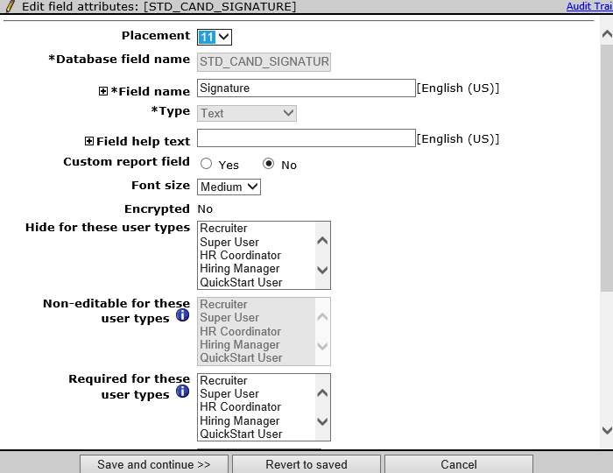
Candidates - eSignature
Gateway Questionnaire changes:
The eSignature ﬁeld is implemented in Gateway Questionnaires in the form of a complex widget.
A new complex widget named eSignature is available in Gateway Questionnaires.
When the eSignature complex widget is enabled and rendered on Talent Gateway Questionnaire, the response is captured into all the eSignature ﬁelds associated to the forms on the Gateway Questionnaire.
Only one signature can be added per Gateway Questionnaire.
Restrictions:
Field cannot be made searchable & outputable.
Field cannot be made encrypted.
Field cannot be inactivated or deleted.
Database name cannot be changed. By default, “non-editable” for all user types as this is explicitly for candidates use.
Form preview and field preview will display the field in add mode (icon/link), like candidate would see, but cannot click to launch the esignature. widget/modal.
eSignature Field will NOT be available to be Auto filled from.
Field cannot be configured as a CHILD for Field Associations, unlike a regular text field type.

Slide 33
Who’s Affected:
Hiring Managers
Configurable or Visible?
VISIBLE
BrassRing UI
eLinks - eLink Dashboard
RTC #: 129145, 129148
Description:
The all new eLink Dashboard is an all-encompassing, single access point meant for Hiring Managers to review and act on all their tasks.
Single dashboard view of actionable items.
The dashboard is unique to the recipient of the eLink and linked to their email address.
The eLink dashboard includes:
Candidates for review.
Forms to complete, approve, or view.
Reqs to approve, add, edit, or view.
This feature is released to STAGING ONLY with December release.
It will NOT go to PRODUCTION with this release.

Slide 34
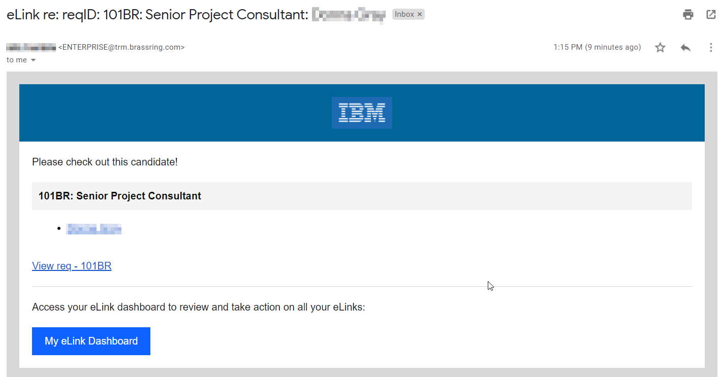
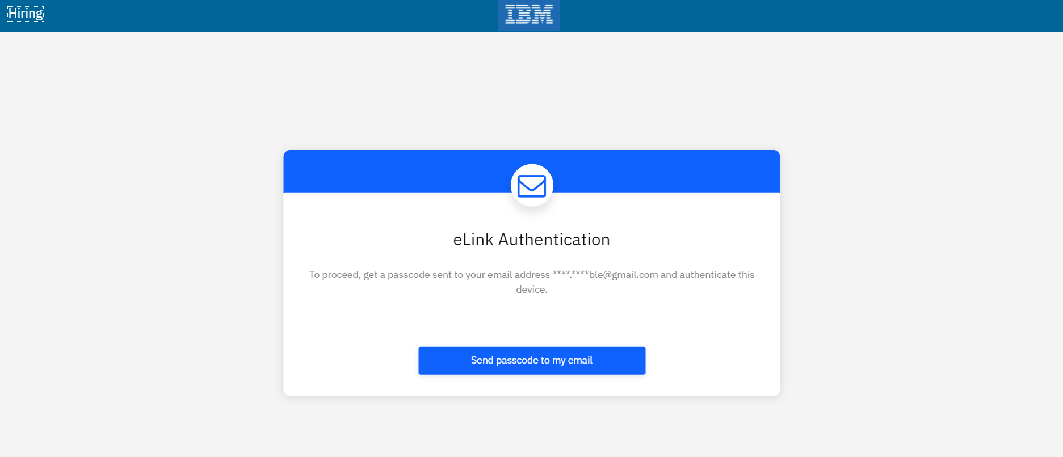
Clicking on the link in the email requires the user to authenticate. (This will display if they haven’t already authenticated or have chosen not to have the browser remember the computer, they’re on.)
The user can also click the My eLink Dashboard to access the site. The page the user is taken to can be bookmarked for future access.

Slide 35
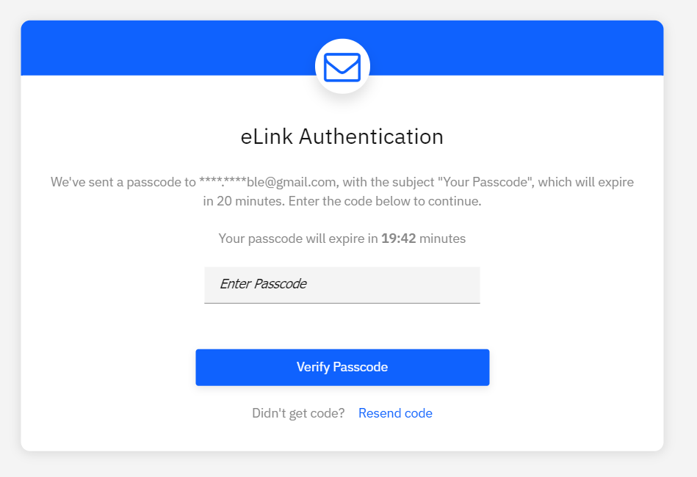
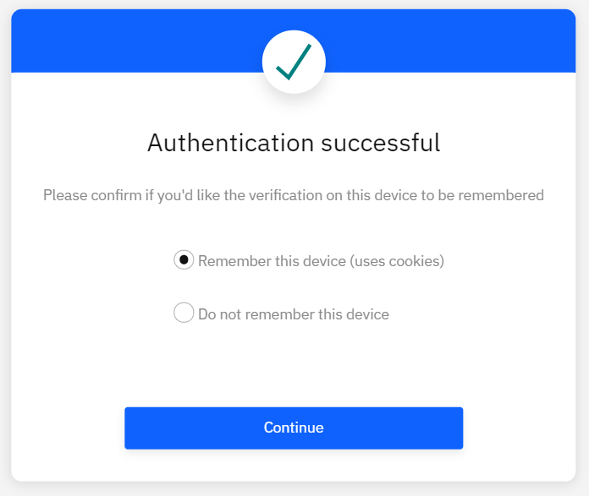
When authenticating, the user will receive an email with the code. They then have 20 minutes to use that code to authenticate.
After the code is entered, the user will have the option to:
Remember this device – If selected, the user will not have to authenticate each time. However, if they clear their cache and cookies or use a different browser, they will have to authenticate again.
Do not remember this device – If selected, the user will have to authenticate each time accessing the eLink Dashboard.

Slide 36
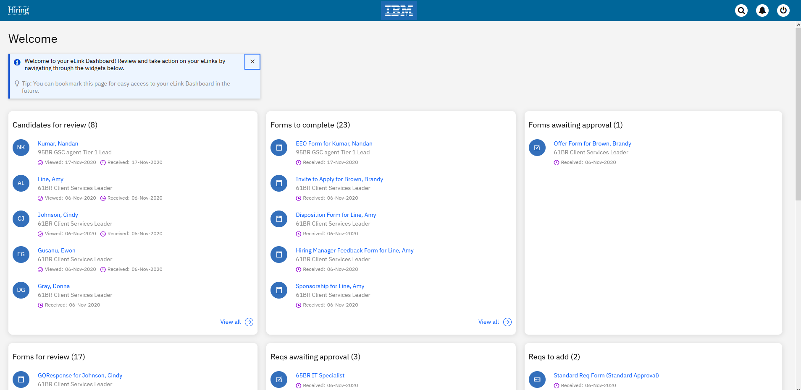
Resources: https://www.ibm.com/support/knowledgecenter/en/SSEUFV/6_CommsAndElinks/5c_eLinkDashboard.html
https://www.ibm.com/links?url=https%3A%2F%2Fibm.box.com%2Fs%2F892vd4yuzdfhe0e60k7rmg3k4v2y3fs1
https://www.ibm.com/links?url=https%3A%2F%2Fibm.box.com%2Fs%2Fbo3q0hpjqicvnqduofm9lc5npspmytlo

Slide 37
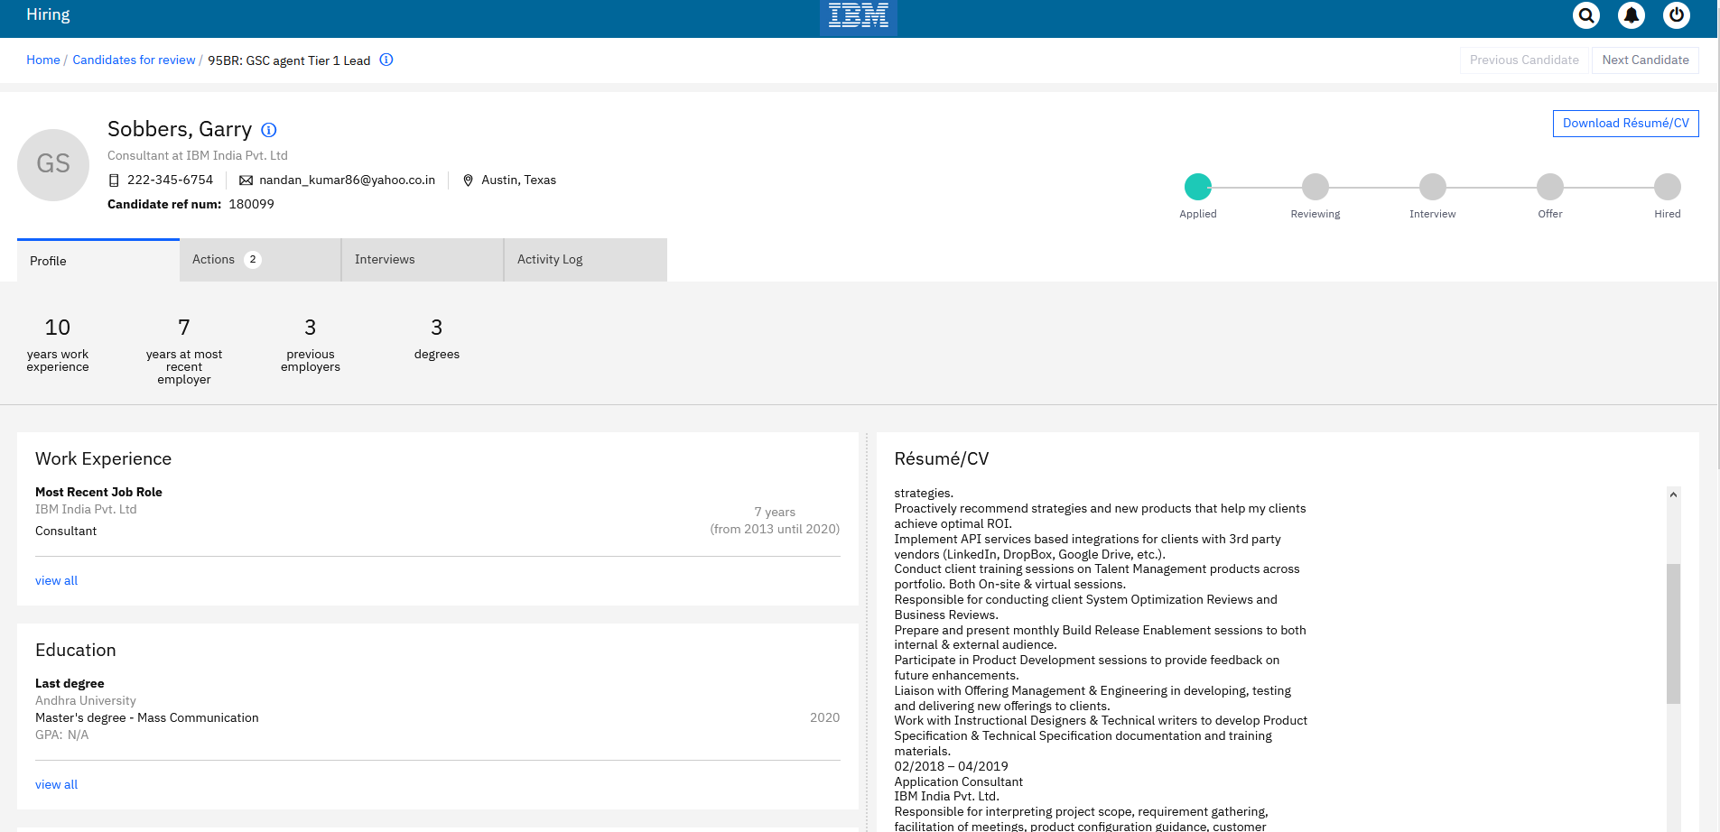
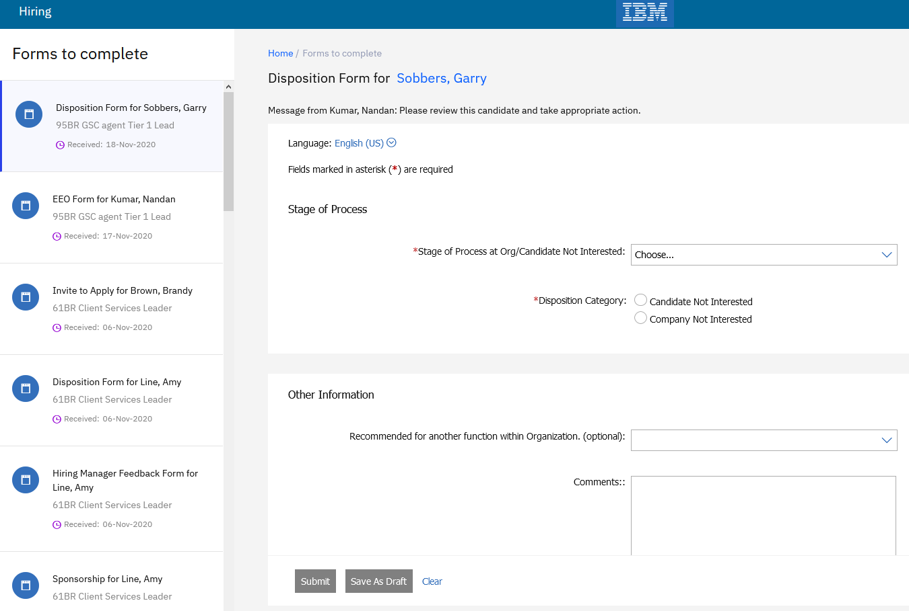
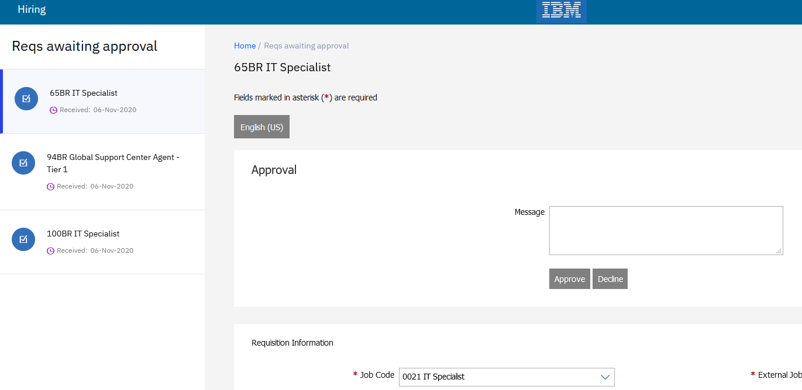
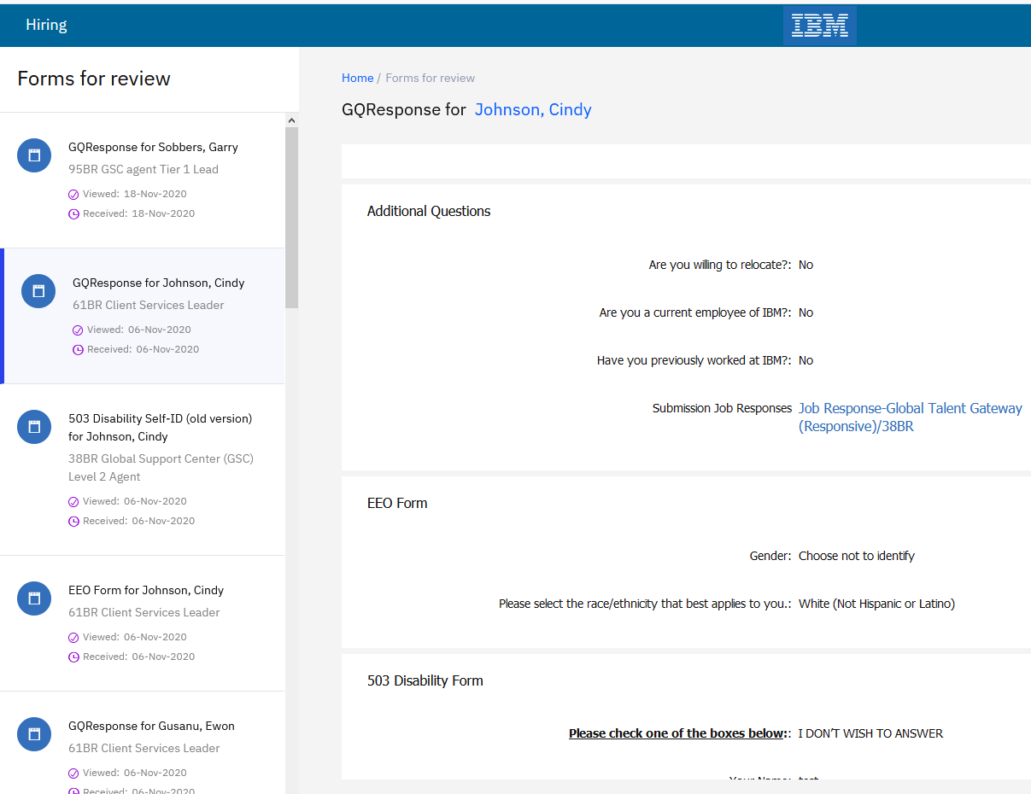

Slide 38
Features Being Released this Month

Slide 39
Who’s Affected:
Recruiters
Configurable or Visible?
VISIBLE
Interview Manager
Reschedule Interviews – Verify interviewer availability first
RTC #: 129489
Description:
Interviews that are of Schedule Type Verify interviewer availability first can be now rescheduled.
Rescheduling can be done from the section level button on the Interview details page, Card level action or grid level action on the interview listing page.
For interviews meeting the criteria, a Reschedule Interview button is displayed in the Interview details section.
This feature was released to STAGING ONLY with October release.
It will go to PRODUCTION with December release.
Benefits:
Easy way to reschedule interviews.
We highly recommend to start testing this new feature in Staging!

Slide 40
Reschedule Interviews – Verify interviewer availability first
Rescheduling is available in the following statuses:
    Candidate availability received
    Candidate availability declined
    Invitation Pending
    Invitation Sent
    Invitation Accepted -Candidate
    Invitation Declined - Interviewer
    Invitation Declined - Candidate
    Interview Scheduled
    Candidate availability requested
Rescheduling is Not Available in the following statuses:
    To Be Scheduled (edits allowed, but no reschedule because nothing has been sent)
    Canceled (no edits allowed at this status)
    Completed (no edits allowed at this status)
    On-Hold (no edits allowed at this status)

Slide 41
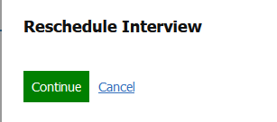
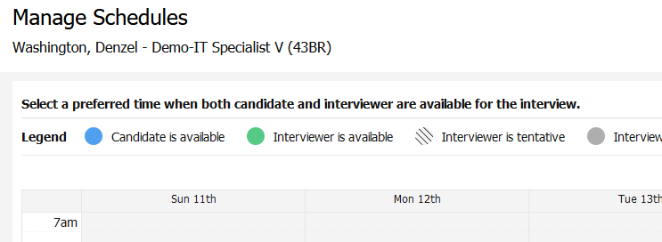
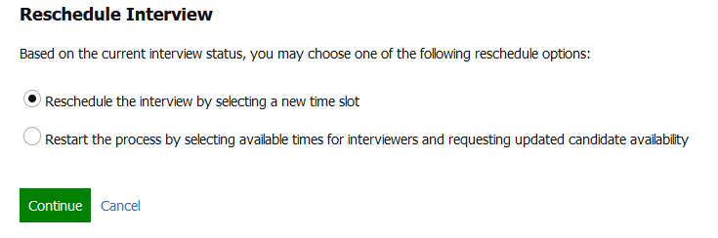
Reschedule Interviews – Verify interviewer availability first
Selecting Reschedule Interview in any of the screens displays the appropriate “Reschedule Interview” page depending upon the Interview Status.
On the Reschedule Interview screen, 2 workflows can be followed:
  Reschedule the interview by selecting a new timeslot
  Restart the process of requesting candidate availability by selecting interviewer available times
The interviewer name, interview duration, time slots, can be changed.
Details like the type of interview, and schedule type cannot be changed.
Based on the changes made to the interview schedule, a communication must be sent to the impacted interviewers and candidates.
Similarly, based on the actions taken by the user, alert messages are displayed to the user on screen.

Slide 42
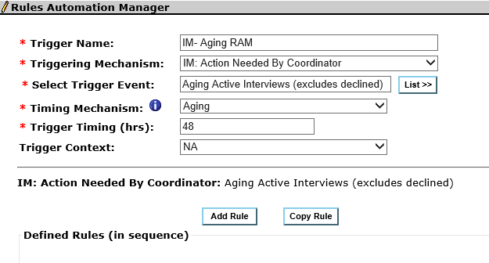
Who’s Affected: Workbench Admin
Configurable or Visible? CONFIGURABLE
Workbench
RAM -Interview Manager Send Reminders to Coordinators
RTC #: 128224
Description:
A new Aging Interview RAM Trigger Mechanism with associated attributes is added to the Rules Automation Manager.
This trigger sends reminder emails to the interview coordinators when an interview is aging, needs review as there was no deﬁnitive action was taken on its status.
Interviews where the interview date is not scheduled or canceled or rescheduled in a timely manner must trigger an email to the coordinator so that the required attention is received.
This will ensure that coordinators are reminded of interviews where their action is needed.

Slide 43
RAM -Interview Manager Send Reminders to Coordinators
The following are the attributes for the new trigger.
Trigger Name: Send reminders to Coordinators for Aging Interviews or Declined interviews based on Trigger event
Trigger Type: RAM Trigger
Triggering Mechanism: IM: Action Needed By Coordinator
Select Trigger Event: 3 options, 1. Aging Active Interviews (excludes declined) 2. Interviewer Declined 3. Candidate Declined
Timing Mechanism: Aging (only option, default selection)
Note: Based on last interview action, not on interview creation
Trigger Timing (hrs): 48 hrs [2 days in advance, default value can be changed to integer value (Min 1, Max no limit)].
Triggering Context: NA [only value, selected by default]
Deﬁned Rules: [blank by default, user can Add Rule as normal, with a few modiﬁcations]
Actions: Normal Options. If Action is selected as “Send Communication”:
Select notiﬁcation template allows for normal communication templates as well as Interview Manager templates (that contains one or more interview tokens).
Select recipients includes normal recipient options as well as two new interview options:
[Interview Fields] Lead Coordinator
[Interview Fields] Coordination Team
Recipients list is ﬁltered to exclude [Interview Fields] Interviewer and [Talent Record] email for this trigger type, regardless of context.
Recipients list automatically selects [Interview Fields] Lead Coordinator(by default).

Slide 44
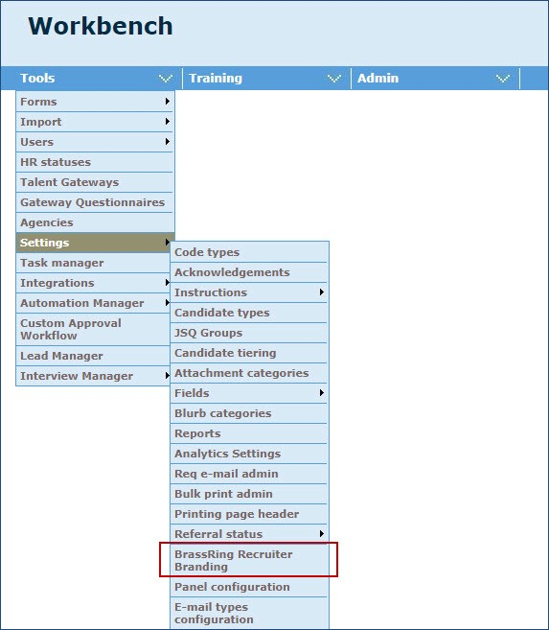
Who’s Affected: Workbench Admin
Configurable or Visible? CONFIGURABLE
Workbench
Recruiter Branding Tool - Update to Display Responsive Settings
RTC #: 131390
Description:
The menu option for accessing the Recruiter Branding tool is updated.
It is updated from BrassRing UI Colors to BrassRing Recruiter Branding.
When users select this option, the Recruiter Branding tool is displayed in a new window.
Users can configure font, font size, color and background image in this section.

Slide 45
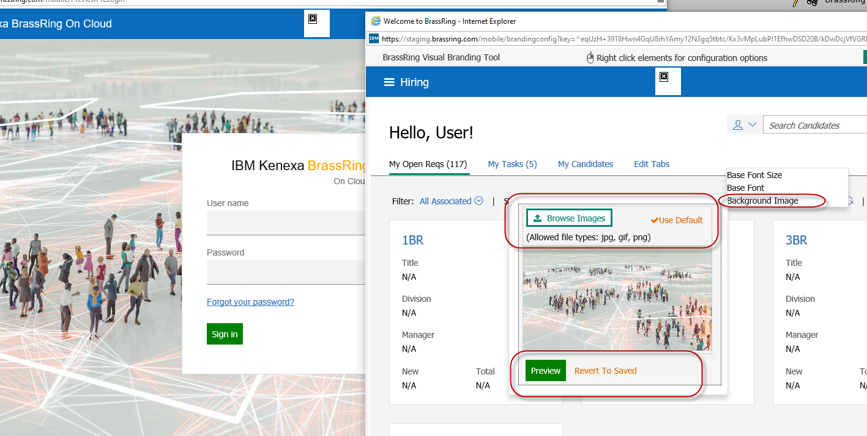
Who’s Affected: Workbench Admin
Configurable or Visible? CONFIGURABLE
Workbench
Recruiter Branding Tool - Background Image Conﬁguration Enhancement
RTC #: 131603
Description:
The background image selection modal in the BrassRing recruiter branding tool has been enhanced.
Users can now conﬁgure the background image of the landing page by uploading a new image.
When users upload the new image, they have the option to preview the landing page with the new image.
Users can also select the Use Default option and if this option is selected, a check mark is displayed next to the Use default link to indicate that the default image is being displayed.

Slide 46
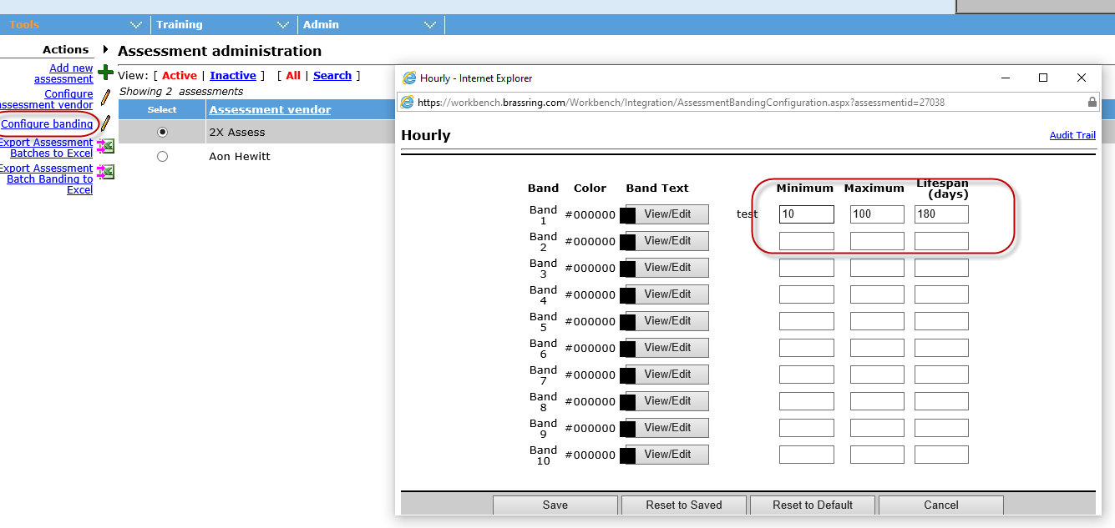
Who’s Affected: Workbench Admin
Configurable or Visible? CONFIGURABLE
Workbench
Workbench Power Users - Assessment Banding Privileges
RTC #: 132435
Description:
Previously, Workbench Power users were able to conﬁgure banding for batch assessments.
However, they were unable to edit banding (Max & Min scores) for individual assessments.
Starting this release, Power users get the privilege to edit banding for individual assessments.

Slide 47

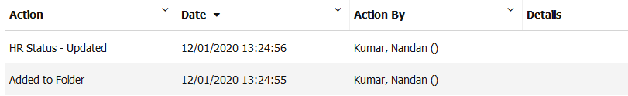
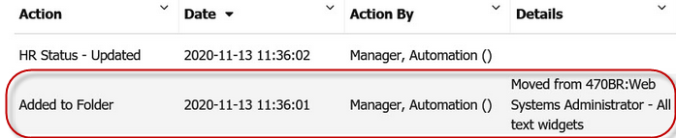
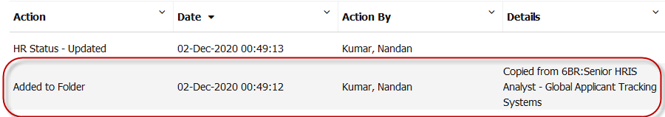
RFE
Who’s Affected: Recruiters
Configurable or Visible? VISIBLE
BrassRing UI
Candidates - Document Source Req Information of Copied Candidates
RTC #: 129968
Description:
Currently, a BrassRing user can move/copy a candidate from one req to another.
However, there is no record from which req a candidate was copied or moved to the current req.
Starting this release, a log is maintained indicating the source requisition from which a candidate is copied or moved to the current req.
The candidate’s Talent Record Action log captures the below information:
Source folder or req details
Date of copy or move action
Note: All (including RAM action) copy and move action details post this release will be available. Historical copy and move action information will be unavailable.
Before
After

Slide 48
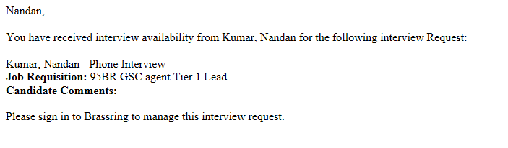
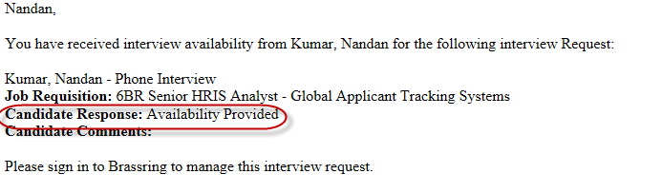
Who’s Affected: Recruiters
Configurable or Visible? VISIBLE
BrassRing UI
Interview Manager - Response Email Content Update
RTC #: 126448
Description:
The content of the “Candidate availability” response email has been enhanced.
The content of the automatic email received by an interview coordinator in response to the Candidate Availability Request is updated.
The email provides information about the candidate's availability in the email body.
A new field “Candidate Response” has been added to the body which will show whether a candidate has “provided” or “declined” their availability.
Before
After

Slide 49
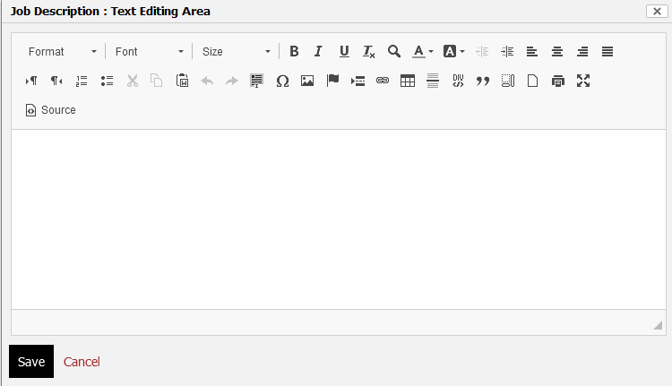
Who’s Affected: Recruiters
Configurable or Visible? VISIBLE
BrassRing UI
CK Editor - Updated Version
RTC #: 132804
Description:
The CK Editor previously used on BrassRing is now being replaced with a new version.
Starting this release, CK Editor v4 is available in BrassRing.

Slide 50
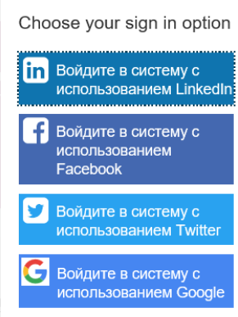
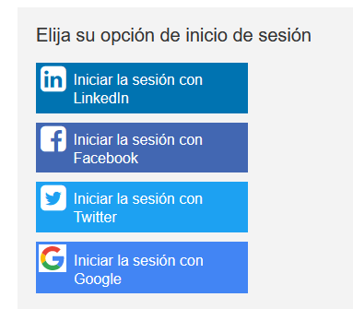
Who’s Affected: Recruiters
Configurable or Visible? VISIBLE
Talent Gateways
Google Sign In Branding Updates
RTC #: 132039
Description:
During the previous build, the Google Sign in and Sign-up options present on the Talent Gateways were updated.
It was observed that when the text on these buttons were translated, the text was wrapping to next line.
The buttons are now updated to dynamically resize.
This will ensure better screen usage and improved user experience.
Before
After

Slide 51
Lead Manager Release Features
–

Slide 52
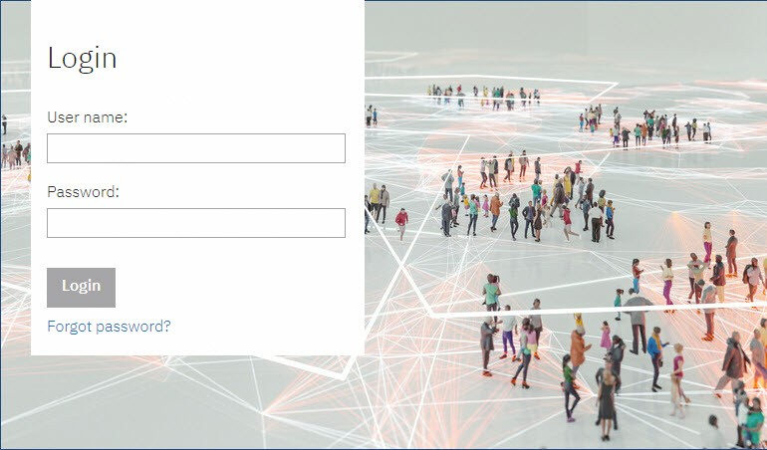
Who’s Affected: Sourcers
Configurable or Visible? VISIBLE
Lead Manager
Login Page - Default Background Image
RTC #: 131891
Description:
The default background image of the Lead Manager login page is updated to an image that is inclusive.
This change is to the default image only. Also, applicable to Standalone Lead Manager.
Clients can always choose a different image for their landing page according to their requirement.
Currently if a custom image is used, that remains UNCHANGED.

Slide 53
Upcoming Builds
RAM - Send reminders based on date field on any form.
DIT Renewal Expiration
Communication Templates for Candidate Form eLinks
E-link Dashboard
E-Signature
Lead Manager – Manual Stacking

Slide 54
December VIRTUAL TRAINING SESSIONS
Client-facing training schedule
Sunday | Monday | Tuesday | Wednesday | Thursday | Friday | Saturday
 |  | 1 | 2 | 3 Client: BR 20.12.01 and Onboard Release (11AM EST) | 4 | 5
6 | 7 | 8 | 9 | 10 Client: Slack Me Anything (11 AM EST) | 11 | 12
13 | 14 | 15 Client: eLink Dashboard Configuration & Usage (11AM EST) | 16 | 17 | 18 | 19
20 | 21 | 22 | 23 | 24 | 25 | 26
27 | 28 | 29 | 30 | 31

Slide 55
January VIRTUAL TRAINING SESSIONS
Client-facing training schedule
Sunday | Monday | Tuesday | Wednesday | Thursday | Friday | Saturday
 |  |  |  |  | 1 | 2
3 | 4 | 5 | 6 | 7 | 8 | 9
10 | 11 | 12 | 13 | 14 Client: eLink Dashboard Config and Usage (11AM EST) | 15 | 16
17 | 18 | 19 | 20 | 21 Client: BR 21.01.20 Release Enablement (11AM EST) | 22 | 23
24 | 25 | 26 | 27 | 28 Client: Slack Me Anything (11 AM EST) | 29 | 30
31

Slide 56
Questions?

