Slide 1
Ameriprise Financial
Recruiting Solutions Team
Internal Release and Communication Planning
Christine Dornbusch
Recruiting Solutions Manager

Slide 2
AGENDA
Team structure and scope
Intake process
Project management approach
Communication strategy

Slide 3
Team structure and scope

Slide 4
Recruiting Solutions Team Scope
Human Resources
Global Talent Acquisition
Recruiters
Recruiting Solutions
BrassRing and Lead Manager system administration
Recruitment advertising
Recruiting Support & Sourcing
TA programs/vendor management
Project management

Slide 5
Intake process

Slide 6
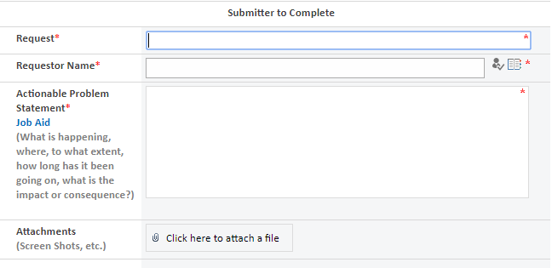
Intake process
Sources
End user (recruiter)
Recruiting Solutions Team
Legal / Compliance
Release notes

Slide 7
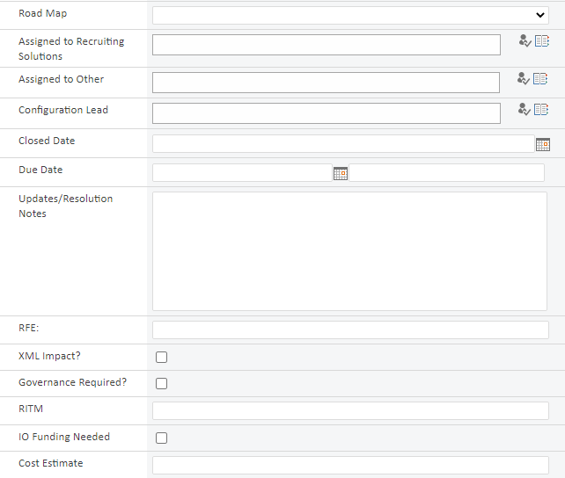
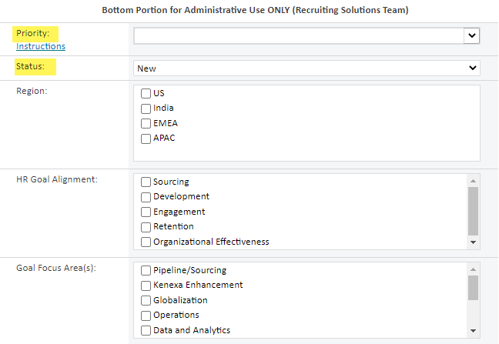
SharePoint intake form

Slide 8
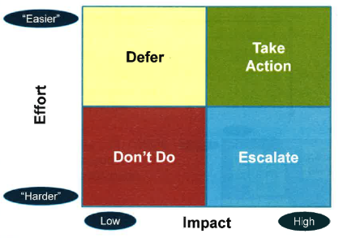
Intake process
Lean terminology
Status
  New
  Assigned
  Define
  Assess
  Design
  Pilot
  Implementation
  Complete
Priority

Slide 9
Project management approach

Slide 10
Project management approach
Use weekly Recruiting Solutions Team meetings to review new intakes, brainstorm, and align on configuration and/or process changes
Everything is first configured and tested in Staging environment
Update SharePoint intakes with configuration notes and document progress as it occurs
Discuss priorities in quarterly “Roadmap Review” meetings
Log and maintain intakes for recurring items such as reviewing/updating offer letter verbiage

Slide 11
Communication strategy

Slide 12
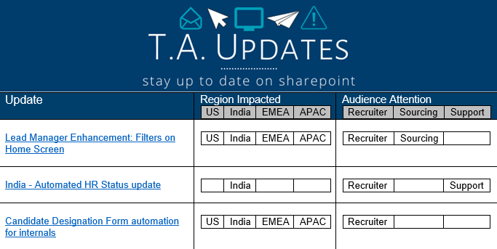
Communication strategy
Weekly “TA Updates” email linked to SharePoint list

Slide 13
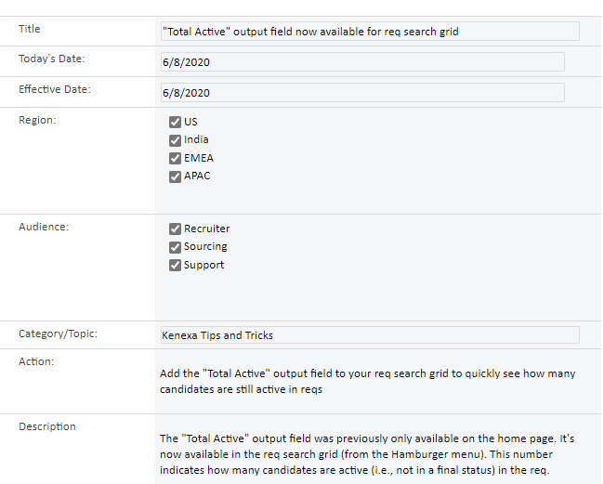
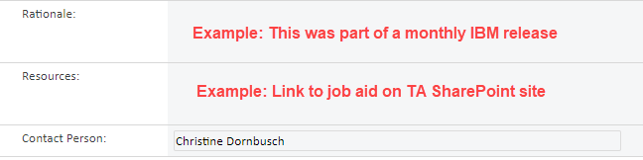
Example TA Update

Slide 14
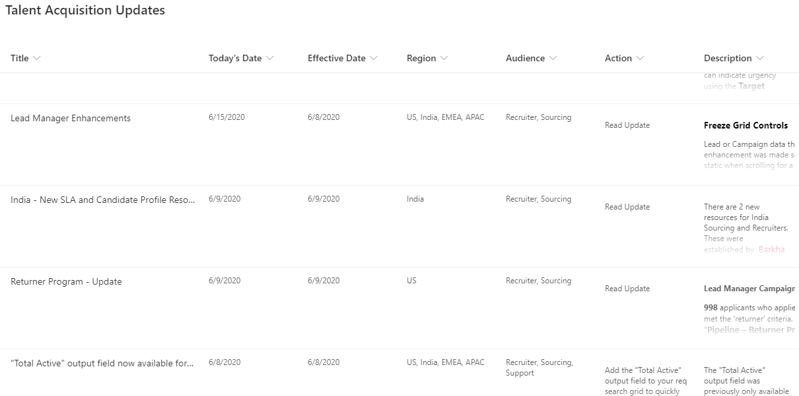
TA Update SharePoint list

