Slide 1
Interview Manager
BrassRing ATS
—
External Training and Enablement Session
Talent Management Solutions
June 29th, 2021

Slide 2
Agenda
Overview
Basic Features
Rescheduling
Communication Template
Automation (RAM)
Calendar Integration
Additional Features
Q&A

Slide 3
Overview
The Interview Manager is a feature in BrassRing ATS that allows BrassRing ATS users to efficiently and effectively schedule interviews.
Available now in Production since March 16, 2020.
Part of standard feature in BrassRing ATS and requires some configuration.
Easy access to interviews that are scheduled, in process, or that need to be scheduled.
Interviews can be created by BrassRing ATS users who have access to Candidates within My Reqs.
By default, all BrassRing ATS users have access to create Interviews (My Reqs); user permissions determine the additional access or restriction.
It does not replace Event Manager but rather is used with the single candidate experience.

Slide 4
Basic Features
New Tab “Interviews” on Home page with card and grid view, filtering, and refresh icon.
Multiple interview styles:
    1:1 Interview - single candidate and single interviewer
    Series Interview - single candidate and multiple interviewers, one interview after another
    Panel Interview – single candidate and team of interviewers in the same time slot
Multiple interview formats:
    Phone – interview over the phone
    Video – video call interview where the candidate is required to appear on-screen
    Text/Chat – text only interview that uses a text service
    In person – candidate must attend on site for interview
    Other – other type of interviews where the format of the interview can be entered into the Interview Details
Note: The details of the interview differ depending on the interview format selection.

Slide 5
Basic Features
Multiple interview scheduling type:
    Confirmed date & time – the timeslot has already been decided on with the candidate and interviewer.
    Verify interviewer availability first – interviewer’s availability is checked first and candidates are provided with the timeslots to pick from based on interviewer’s availability.
    Ask candidate first – provide candidate with a range of dates and times to select specific timeslot that works best for them.
Candidates and Interviewers will receive an automated meeting invitation once they accept the interview request.
This can be added to their calendar directly (if supported) or added manually via downloading the attachment.
Calendar integration with Outlook 365 and Google+ allows for checking and scheduling interviewers’ shared calendars.

Slide 6

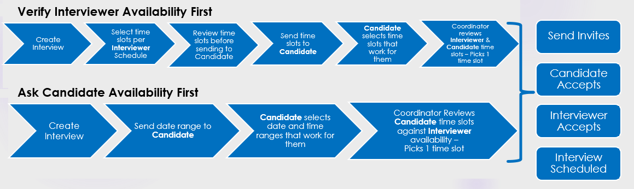
Basic Features
Scheduling Type Workflows
Ask Candidate First

Slide 7
Rescheduling Interviews
–

Slide 8
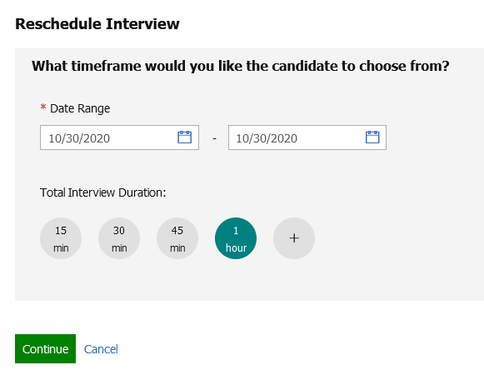
Rescheduling Interviews
Rescheduling allows users to reschedule an existing interview without cancelling it.
It saves time & effort of interview coordinators.
All the 3 interview types can now be rescheduled.
A new communication must be sent to the affected candidate/interviewers.

Slide 9
Rescheduling Interviews
Rescheduling can be done from the section level button on the Interview details page, Card level action or grid level action on the interview listing page.
For interviews meeting the criteria, a Reschedule Interview button is displayed in the Interview details section.
Rescheduling also depends upon the Interview status.
Based on “Interview Type” the appropriate reschedule workflow will be displayed.

Slide 10
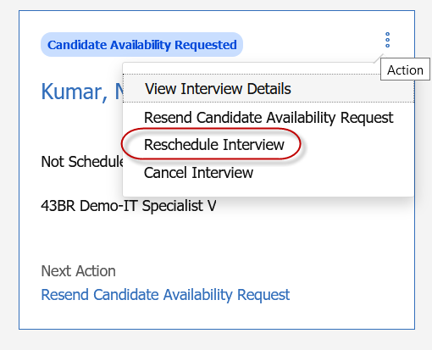
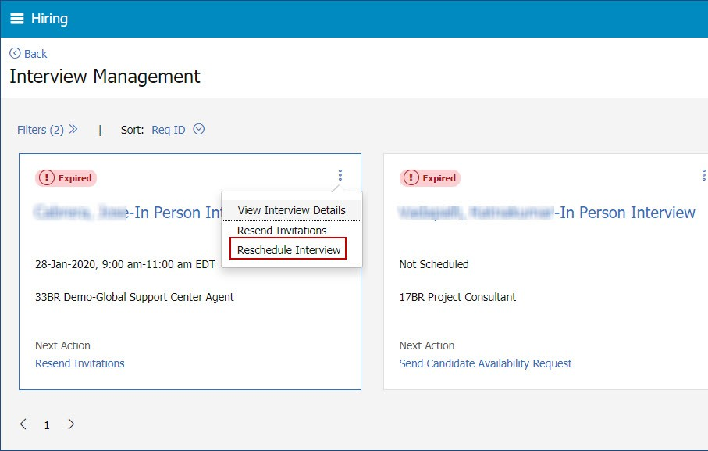
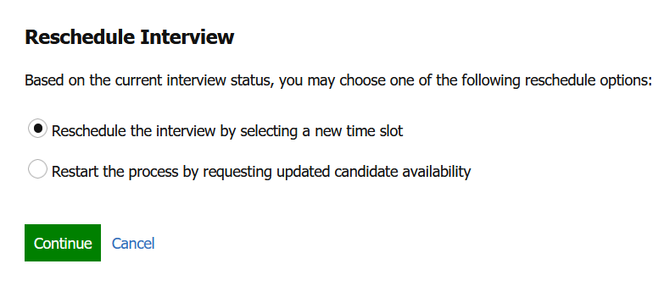
Ask Candidate First
Selecting Reschedule Interview in any of the screens displays the appropriate “Reschedule Interview” page depending upon the Interview Status & Interview Type.
On the Reschedule Interview screen, 3 workflows would be displayed:
  Reschedule the interview by selecting a new timeslot
  Restart the process by requesting updated candidate availability
  Restart the process of requesting candidate availability by selecting interviewer available times
The interviewer's name, interview duration, time slots, can be changed.
Details like the type of interview, and schedule type cannot be changed.
Based on the changes made to the interview schedule, a communication must be sent to the impacted interviewers and candidates.

Slide 11
Confirmed Date & Time
Rescheduling is available in the following statuses:
    Invitation Sent
    Invitation Accepted - Candidate
    Invitation Declined - Candidate
    Invitation Declined - Interviewer
    Invitation Declined
    Interview Scheduled
Rescheduling is Not Available in the following statuses:
    Invitation Pending (in this case, "Manage Schedules" action displays instead)
    Canceled (no edits allowed at this status)
    Completed (no edits allowed at this status)
    On-Hold (no edits allowed at this status)

Slide 12
Ask Candidate First
Rescheduling is available in the following statuses:
    Candidate availability received
    Candidate availability declined
    Invitation Pending
    Invitation Sent
    Invitation Accepted -Candidate
    Invitation Declined - Interviewer
    Invitation Declined - Candidate
    Interview Scheduled
    Candidate availability requested
Rescheduling is Not Available in the following statuses:
    To Be Scheduled (edits allowed, but no reschedule because nothing has been sent)
    Canceled (no edits allowed at this status)
    Completed (no edits allowed at this status)
    On-Hold (no edits allowed at this status)

Slide 13
Verify interviewer availability first
Rescheduling is available in the following statuses:
    Candidate availability received
    Candidate availability declined
    Invitation Pending
    Invitation Sent
    Invitation Accepted -Candidate
    Invitation Declined - Interviewer
    Invitation Declined - Candidate
    Interview Scheduled
    Candidate availability requested
Rescheduling is Not Available in the following statuses:
    To Be Scheduled (edits allowed, but no reschedule because nothing has been sent)
    Canceled (no edits allowed at this status)
    Completed (no edits allowed at this status)
    On-Hold (no edits allowed at this status)

Slide 14
Communication Templates
–

Slide 15
Communication Templates
Used to send communication from Interview Manager to candidates and interviewers about interviews.
Recommended communication templates:
    Candidate Availability Request
    Candidate Invitation
    Interviewer Invitation
Communication templates must contain at least 1 interview standard field token so that it is available for selection in the Send Invites window.
Instructions should be part of the candidate communication to direct them to select the Interview Link and to confirm their attendance.
Communication template can include other links (e.g., Candidate Zone) and/or forms (to complete or view).

Slide 16
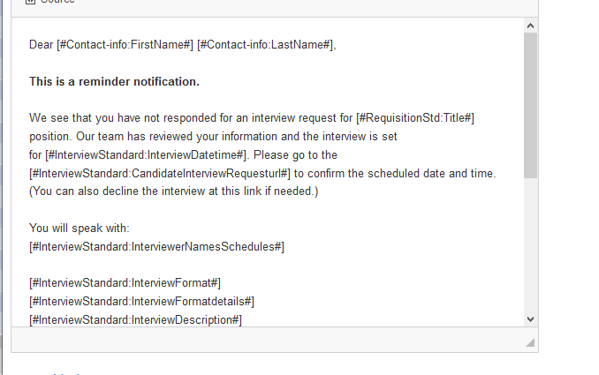
Communication Templates
Separate communication templates can be configured for each RAM.
The comms can be used inside RAM –> Actions to notify the individuals.
It is advised to configure separate communications for candidate and interviewers.
The communication template may contain any regular merge tokens along with Standard Interview Manager tokens to appear in the action list.

Slide 17
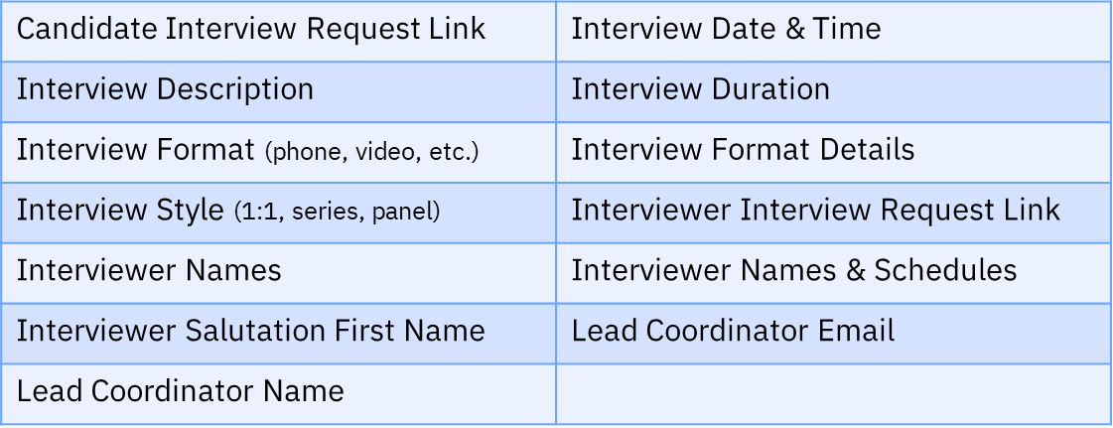
Communication Templates
Interview Manager Communication Standard Field Tokens:

Slide 18
Automation (RAM)
–

Slide 19

Automation (RAM)
Automation allows administrators to configure RAM(s).
RAM would automatically send a reminder to candidate & Interviewer(s).
There are 4 types of RAM triggers available to be configured.
It would make sure the intended parties are aware of the upcoming interview.
This also helps the interview coordinators to ensure that the rescheduling or cancellation can be done in a timely manner if required.
It also reminds interview coordinators to take action on pending interviews.

Slide 20
Automation (RAM)
Available RAM Triggers:
IM: Upcoming Interviews - This trigger can be used to send reminders to candidates and interviewers before the scheduled interviews.
IM: No response from participants - This trigger can be used to send reminders to candidates and interviewers that did not respond to the interview requests.
IM: Expiring Interviews - This trigger can be used to send reminders to interview coordinators about the interviews that are about to expire.
IM: Action Needed by Coordinator - This trigger sends reminder emails to the interview coordinators when an interview is aging, needs review as there was no deﬁnitive action was taken on its status.

Slide 21
Automation (RAM)
RAM Configuration examples:
https://documentation.infinite.com/docs/common-ram-examples

Slide 22
Calendar Integration
–

Slide 23
Calendar Integration
The Interview Manager allows users to look up the real-time availability of BrassRing ATS users based on their calendars.
The Calendar Integration can be configured in Workbench for Office 365 and Google.
The Calendar Integration is not required in order to use Interview Manager.
Coordinators can view if interviewers are scheduled for other interviews from within BrassRing ATS.
Three different Calendar Integration options in Workbench:
    None – No access to users’ calendars.
    Basic - BrassRing ATS provides an inbuilt Office 365 or Google app to validate the integration. For Staging use, it is only intended for testing and validating the integration by connecting to the organization’s Office 365 or Google calendar, giving consent to the BrassRing ATS app, and getting the free or busy schedule of the users in their organization.
    Advanced - For Production use, clients should register their own app in Microsoft Azure Portal and then enter the App Key and App Secret in Workbench. With the Advanced configuration, the client has an option to decide between User Consent or Admin Consent for the app.

Slide 24
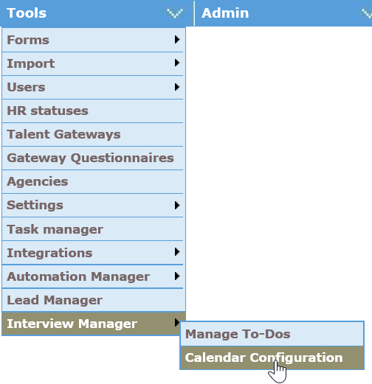
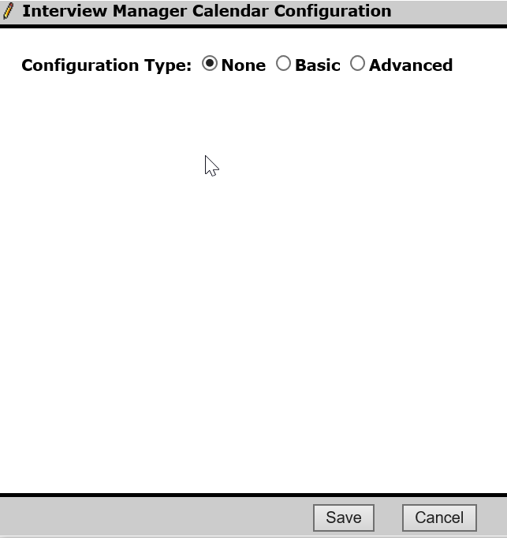
Calendar Integration
Calendar Integration
Workbench > Tools > Interview Manager > Calendar Integration

Slide 25
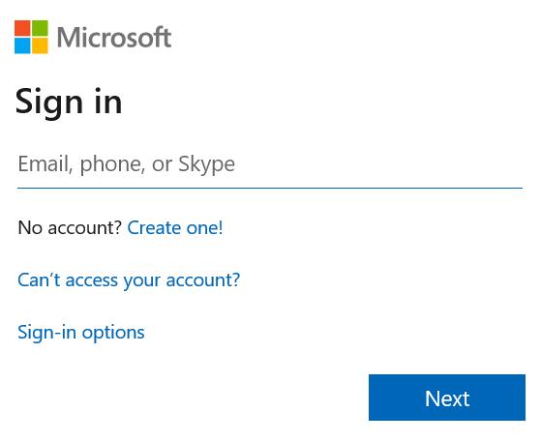
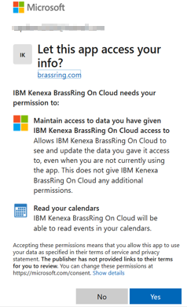
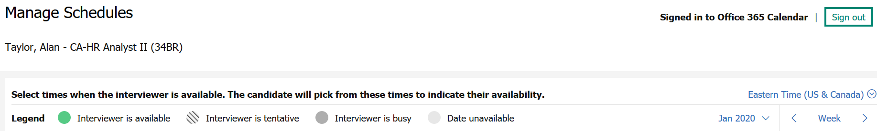
Calendar Integration
Calendar Integration – Basic (for Office 365)
1.
User logs in using Office 365 credentials. This login URL can be configured in Workbench with the Advanced configuration.
2.
User gives consent to allow to read calendar from BrassRing ATS.
Connect your calendar label changes to Signed in to Office 365 Calendar.
3.

Slide 26
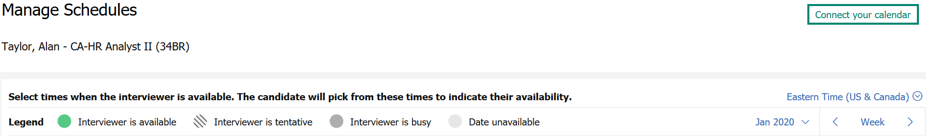
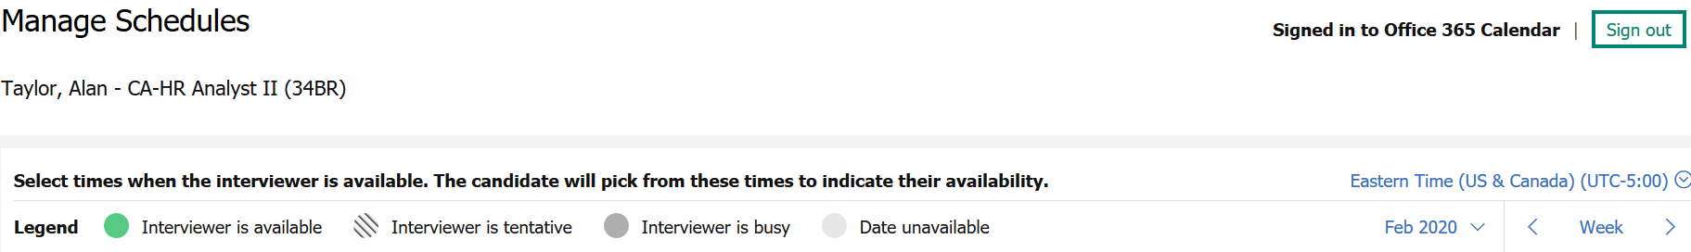
Calendar Integration
Calendar Integration
Example of Basic Calendar Integration set-up:
The “Connect your calendar” link from the Manage Schedules page allows the users to access their
account (Office 365 or Google) and give consent to the BrassRing ATS application to access their calendars.

Slide 27
Additional Features
–

Slide 28
Additional features
Add Interviewers - Multi-Select:
Interviews of the style Panel provide the capability of selecting multiple interviewers from system users list.
Candidate Talent Record Action Log:
When users or candidates take interview-related actions, a log entry is added to the Action log of the candidate's Talent Record. This log entry provides information about the interview action including date, details, from, to, action taken by, etc..
Scheduling on Interviewer's External Calendar Busy Slots:
Based on a new client setting configuration, interview coordinators can be enabled to select a busy slot. If the interview slot is busy for interviewer based on an external calendar integration (with Google calendar or Outlook 365 calendar), the interview coordinators can select such slots. Such slots are displayed in gray and selection is allowed.

Slide 29
Additional features
Metrics Dashboard:
All the Interview Manager related data can be pulled into dashboard visualizations. Multiple different visualizations can be created using the available data. It would be helpful for companies to identify the status of interviews by format and style.
eLinks/Candidate Zone:
All the Interview information is available in eLink candidate profile page as well as inside Candidate Zone.
Validation for Format Details: The system will validate to find if interview format details are available on the Send invitation page. If the format details are unavailable, then a pop up will appear and user must input the details.
Completed Interview Enhancements: The interview status is updated to "Complete" after the end time of the interview instead of the start time. This change allows room to reschedule the interview if it is a no-show after the start time of the interview.

Slide 30
Resources
Interview Management
https://documentation.infinite.com/docs/interview-management
Interview Manager Configuration
https://documentation.infinite.com/docs/interview-management-configuring-interview-manager
Interview Manager FAQs
https://documentation.infinite.com/docs/interview-manager-faqs
Metrics Dashboard Visualizations
https://documentation.infinite.com/docs/working-with-visualizations
Rescheduling Interviews:
https://documentation.infinite.com/docs/interview-management-create-and-manage-interviews

Slide 31
Questions?

