Slide 1
BrassRing, Onboard and Lead Manager on Cloud Release 21.02.15
—
Client Training and Enablement Session
February 18th, 2021

Slide 2
Onboard Release Features
–
Staging (US): February 11th , 2021
Production (US): February 20th , 2021
There are no Dark Launch features for this release.

Slide 3
Features Being Released this Month
–

Slide 4

Activity Field Name With HTML Coding
How do you get it?
Configurable Change
Who does it affect?
Onboarding Manager, New Hire
Description:
Users will now be able to configure supported HTML tags in Field Labels for the Activities created with NO_TEMPLATE.
Enable HTML coding in field name from Onboard settings.
By default, this setting is disabled.
When this setting is enabled the following warning/error message is displayed.
    Using HTML codes can make your activity or site vulnerable to security breaches. Do you want to continue?
Benefits:
Format field names using HTML tags.
HTML Tags can be configured for the following Activities:
  NO_TEMPLATE
  STATE_FORM_ACTIVITY
  GENERIC_FORM_ACTIVITY

Slide 5
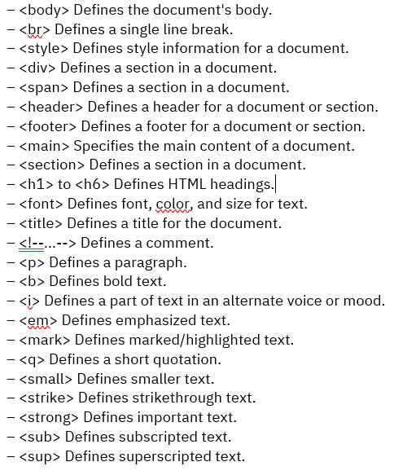
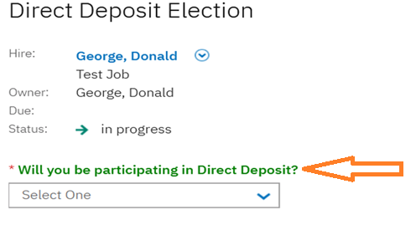
Activity Field Name With HTML Coding
Below is the list of Supported HTML Codes when the new setting is enabled.

Slide 6
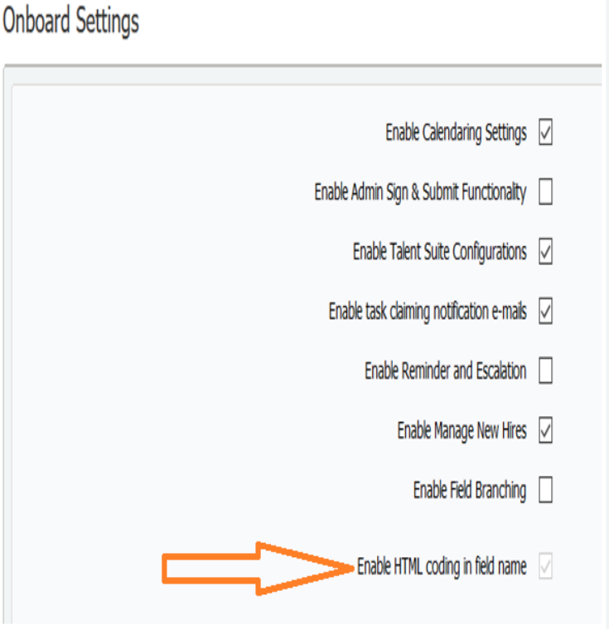
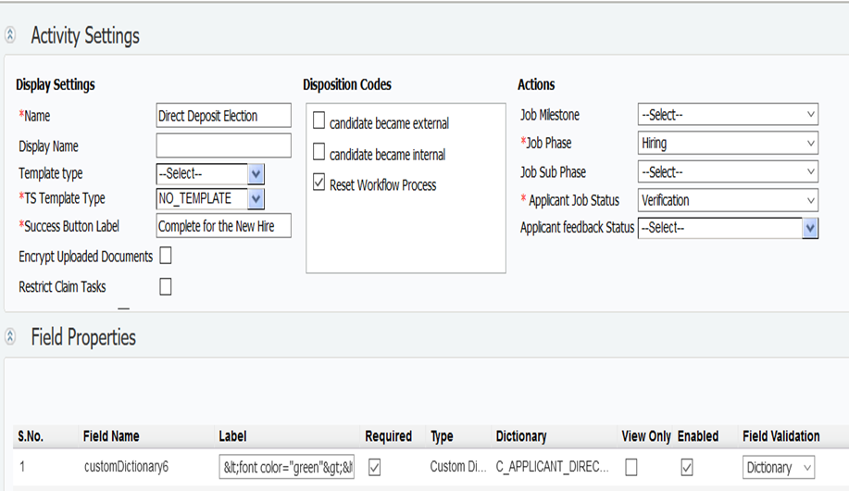
Activity Field Name With HTML Coding

Slide 7
Upcoming Builds
Date Picker
Bulk Action Email
Access to New Hire Experience through candidate zone – SSO
New Public Filter for Activities in Progress
Add Quick Search to Onboard Pages
Mass Job Update for Participants

Slide 8
Questions?

Slide 9
BrassRing Release Features
–

Slide 10



Feature
BrassRing UI | eLink Dashboard - Merge Token for URL
 | Data Insight Tool - Scheduling and Communication Enhancements
 | eLink Dashboard - CC and BCC Users
 | My Tasks - New Filters
 | Talent Gateway - Offer Notiﬁcations
 | Req Filters - Candidate Results
 | Candidate Forms - Field Filtering and Mandatory Forms
Feature | Description
Workbench | Client Settings - eLink Dashboard
Icon Key
Configurable Feature
Visible Feature
Requires SignalLabs to Enable
Recruiters Affected
Candidates Affected
Accessibility Update
RELEASE DATES
Staging:
February 16th, 2021
Production:
February 23rd, 2021
Dark Launch Feature
Information
RFE Feature
NPS Feature
RFE
NPS

Slide 11

Edge Support
Edge is now a supported browser

Slide 12
Dark Launch Features

Slide 13
Who’s Affected:
Recruiters
Configurable or Visible?
VISIBLE
BrassRing UI
Data Insight Tool - Scheduling and Communication Enhancements - UPDATE
This feature was released to STAGING ONLY with January release.
It will NOT go to PRODUCTION with February release.
RTC #: 58959
Description:
There were 2 new enhancements introduced inside DIT.
End date selection.
Schedule expiry and communication.
Why this change:
This will help in optimal usage of resources and smooth delivery of reports.
To ensure a periodic review of the scheduled jobs/templates, a new default expiration frequency is introduced.
Queue time of reports will be reduced, and delivery would be faster.
Update:
The Time Frame of expiration period has been increased for 2 schedule types based on client feedback.

Slide 14
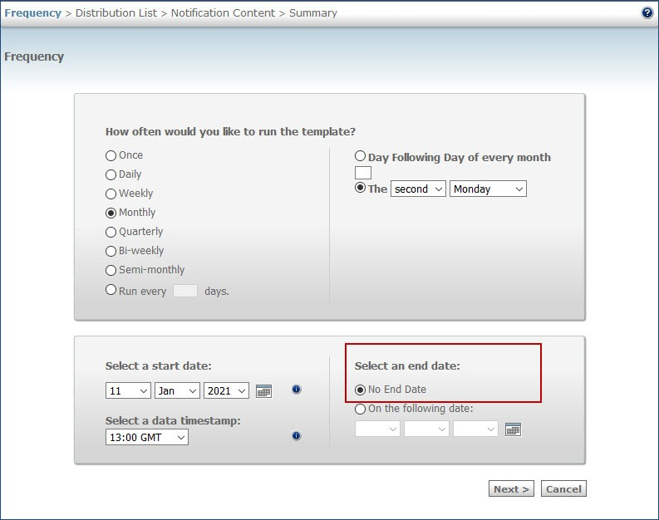
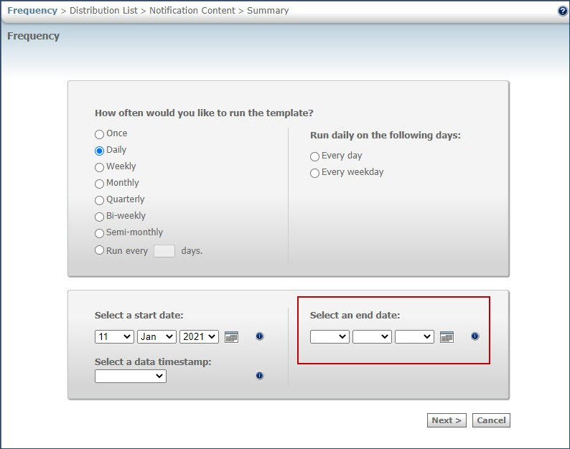
DIT – End Date Selection
Before
After
Note: If a user tries to select Next without selecting an end date, an alert message is displayed stating that an end date needs to be selected.

Slide 15
DIT - End Date Selection
Criteria:
The end date cannot exceed a timeframe that is determined based on the schedule frequency.
End date selection can be done based on the following criteria:
Templates that are scheduled with a frequency of daily, weekly, bi-weekly, or semi-monthly must have an end date less than 12 months from the start date or the current system date.
Templates that are scheduled with a frequency of monthly, and quarterly must have an end date less than 24 months from the start date or the current system date.
Templates that are scheduled with the frequency of run every 'X' days must have an end date less than 6 months + 2X days selected from the start date or the current system date. (Unchanged)
The new feature applies to schedules that are newly created and any schedules that are edited after the release of this feature.
A migration activity is planned to set an end date for the existing schedules that do not have a user-deﬁned end date.

Slide 16
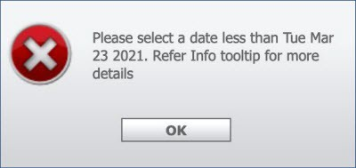
DIT - End Date Selection
Examples for calculating the expiry date when users schedule new jobs:
Schedule Type | Max Allowed Limit | Start Date | Max Possible End Date
Daily, Weekly, Bi-weekly, or Semi-monthly | 12 Months | 15 January 2021 | 14 January 2022
Monthly or Quarterly | 24 Months | 15 January 2021 | 14 January 2023
Run every “X” days (e.g.: 5 days) | 6 Months + 2X Days | 1 February 2021 | 10 August 2021
If a user sets an end date that exceeds the timeframe set for the respective schedule, an alert message is displayed.
The alert message displays the farthest date and users can refer to the tooltip message that provides the criteria.

Slide 17
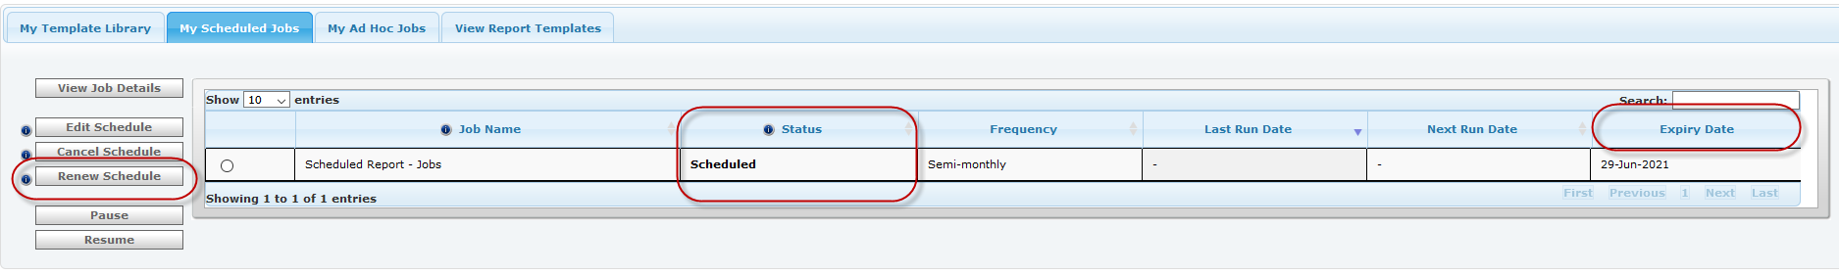
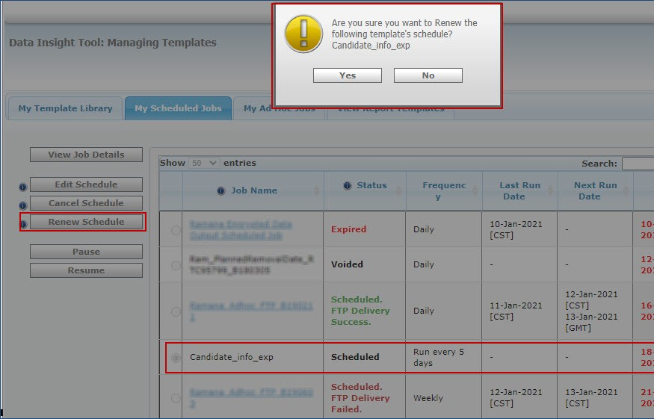
DIT - End Date Selection
A new column Expiry Date is added to the My Scheduled Jobs table.
This column displays the expiry date of the user's job that is approaching expiry.
Status column displays the status of expired jobs as Expired in red.
This status is displayed for 14 days from the date of expiry.
Users can renew the schedule of the job during this renewal window using the new button Renew Schedule.
Renewal window for a scheduled job is opened 14 days before the date of expiry and up to 14 days after the expiry.
This button is enabled for a scheduled job only during the 28 days of the renewal window and is disabled during all other time.
When users select Renew Schedule, the schedule is renewed based on the criteria and the next expiry date is displayed.

Slide 18
DIT - Schedule Expiry & Communication
A new setting has been introduced for notifying users for their scheduled jobs.
The owners of the respective templates receive notiﬁcation emails based on the conﬁguration that is available in the Workbench client settings.
Clients can conﬁgure the frequency at which they might receive the schedule expiry notiﬁcations.
The client-setting DIT schedule expiration notiﬁcation frequency is available with the following frequencies of notiﬁcation:
14 days and 1 day (default)
7 days and 1 day
1 day
No notiﬁcation
When users receive a notiﬁcation, they can verify and decide to let the scheduled job expire or validate and renew.
A user receives a single email that lists all their schedules getting expired in 1, 7 & 14 days (based on the expiration notification setting)
Note: This is a client setting. Please reach out to your SignaLabs representative for any changes to this setting.

Slide 19
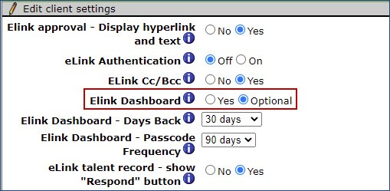
Who’s Affected: Workbench Admin
Configurable or Visible? CONFIGURABLE
Workbench
Client Settings - eLink Dashboard
RTC #: 133392
Description:
A new client setting is available for eLink Dashboard.
ELink Dashboard: Yes and Optional. (Default Optional)
This client setting will determine if the links in the eLink email redirect users to eLink Dashboard or not.
If the conﬁguration is set to Yes, users that click a link in the eLink email are always redirected to eLink dashboard.
If Optional, users that select links in the eLink email are directed to the eLink profile page not to the eLink dashboard.
Users can always launch the Dashboard by clicking on the link at the bottom of the email.
This feature is released to STAGING ONLY with February release.
It will NOT go to PRODUCTION with February release.
Note: This is a client setting. Please reach out to your SignalLabs representative for any changes.
*In optional mode, elinks would expire as per current days/clicks configuration.

Slide 20
Who’s Affected:
Recruiters, Workbench Admins
Configurable or Visible?
CONFIGURABLE
BrassRing UI
eLink Dashboard - Merge Token
RTC #: 133367
Description:
As a part of the eLink dashboard development project, a new merge token is now available.
The new token “Add eLink Dashboard placeholder token” is available inside template page.
Token can be used inside Communication templates & System templates.
Communication templates can now be branded as per client’s requirement.
The merge token is replaced with a hyperlink "eLink Dashboard" in the email as recipient speciﬁc URL.
The text of the hyperlink (eLink Dashboard) cannot be changed.
This feature is released to STAGING ONLY with February release.
It will NOT go to PRODUCTION with February release.
Why this change:
This will help clients to add branding to the eLink emails.
Multiple templates can be used for different actions.
Communications can be sent manually or Rules Automation Manager workflow.

Slide 21
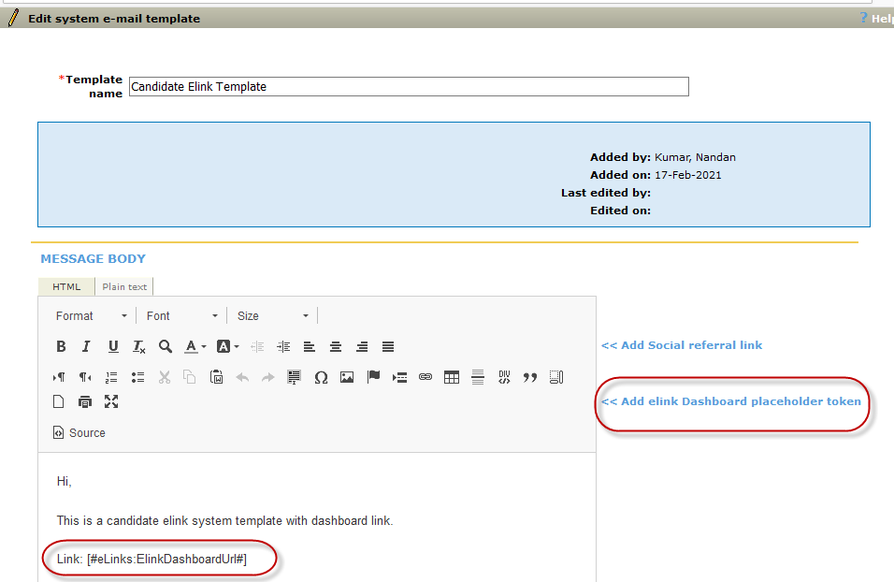
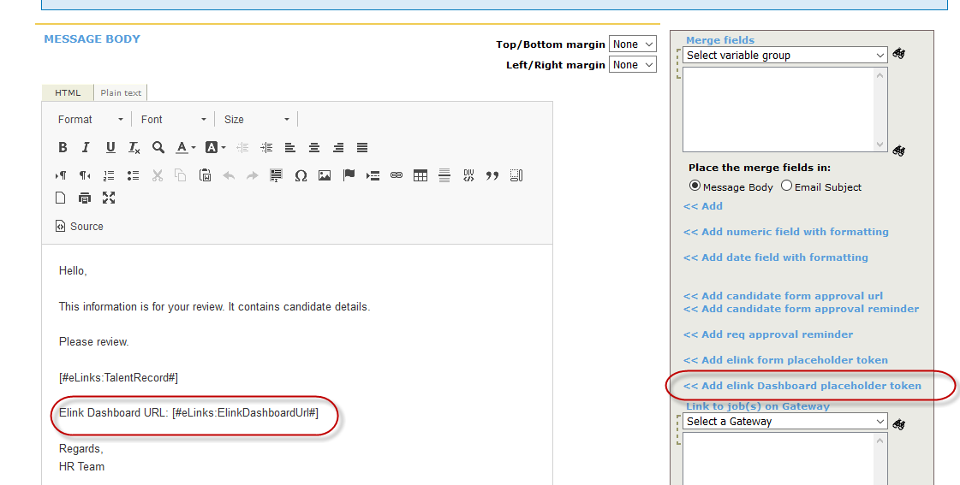
eLink Dashboard - Merge Token for URL
Note:
The system email templates can be conﬁgured only when the client setting email type conﬁguration is set to Yes AND the user type privilege System E-mail templates - administer is turned on.
As per the existing system email templates functionality, the text conﬁgured in the system email templates is appended to eLinks. This text is not available for any additional branding. For full control over branding, clients must use regular communication templates and use them for eLinks.

Slide 22
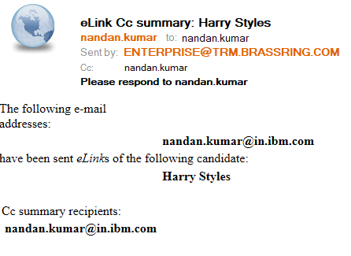
Who’s Affected:
Recruiters, Workbench Admins
Configurable or Visible?
CONFIGURABLE
BrassRing UI
eLink Dashboard - CC and BCC Users
RTC #: 133826
Description:
Based on conﬁguration, recipients that are copied in CC and BCC receive a summary of the eLink email.
Only the main recipient receives the eLinks for the eLink dashboard.
However, it was recently observed all types of recipients are receiving the eLinks for the eLink dashboard.
This behavior is restored to the original design during the current release.
Starting this release, the CC and BCC recipients receive a summary of the eLink email.
This feature is released to STAGING ONLY with February release.
It will NOT go to PRODUCTION with February release.

Slide 23
Features Being Released this Month

Slide 24
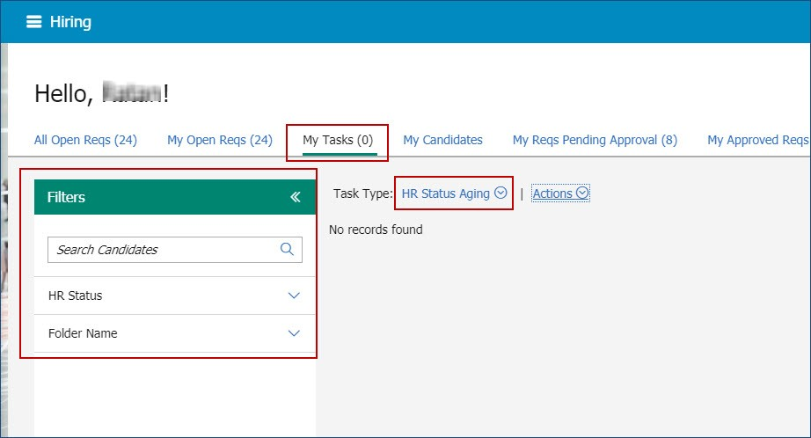
Who’s Affected: Workbench Admin
Configurable or Visible? VISIBLE
BrassRing UI
My Tasks - New Filters
RTC #: 132348
Description:
The My Tasks page in the BrassRing home page now has a new set of ﬁlters available.
Three new ﬁlters are available when users select the task type HR Status Aging.
The following ﬁlters are displayed in the My tasks pane:
Candidates
HR Status
Folder Name

Slide 25

Who’s Affected: Candidates
Configurable or Visible? VISIBLE
Talent Gateways
Talent Gateway - Offer Notiﬁcations
RTC #: 132549
Description:
The Talent Gateway notiﬁcations feature is enhanced to display a notiﬁcation when a new offer is posted to a candidate's proﬁle.
The number that is displayed with the notiﬁcation bell is incremented by one for each offer the candidate receives.
The notiﬁcation drop-down displays a new offer card in the list of cards.
The latest card is displayed at the beginning of the drop-down.
A different card is displayed for each offer that is posted to the candidate's proﬁle.

Slide 26
Talent Gateway - Offer Notiﬁcations
Each card displays the following information:
Date Posted
Card title – As per Talent Gateway layout configuration.
Job details
Expiry – when form should be completed
Action items: Review and Dismiss
Review: When candidates select this link, the document with subsidiary form new page is displayed.
Dismiss: When candidates select this link, the card is permanently removed from the notiﬁcation list.
Note:
When a candidate submits the offer (document subsidiary form), the card is automatically removed from the notiﬁcation list.
If an offer form is removed from the candidate proﬁle based on the setting post for # days, the notiﬁcation card is also removed from the list after the form expires.
If a candidate receives multiple offers for the same job, the notiﬁcation card for the offer to which the candidate has not submitted yet is displayed.

Slide 27
Who’s Affected:
Recruiters
Configurable or Visible?
VISIBLE
BrassRing UI
Req Filters - Candidate Results
RTC #: 133643, 133643
Description:
It was observed that candidate records were not being displayed (candidate results with in a req) when a candidate ﬁeld speciﬁc ﬁlter is applied and then the grid is sorted based on the column Last Comm Date.
This behavior is addressed, and candidate records are displayed accurately starting this release.
It was observed that when candidate results are ﬁltered in a speciﬁc way, the ﬁeld content was being displayed in HTML format.
This behavior is displayed when a candidate form that has a single- select ﬁeld is added to a candidate record and icons are conﬁgured for its options.
This behavior is addressed during this release, so that the options are displayed without any HTML content.

Slide 28
Who’s Affected: Recruiters
Configurable or Visible? VISIBLE
BrassRing UI
Candidate Forms - Field Filtering and Mandatory Forms
RTC #: 132641
Description:
It was observed that at a speciﬁc HR status, if a candidate form is made mandatory, the form ﬁeld ﬁltering was not honouring the HR status.
When a candidate form is marked as mandatory at a speciﬁc HR Status XYZ AND there is a ﬁeld option ﬁltering conﬁgured at the same HR Status XYZ, then the pop-up form while updating HR status honors the current HR Status (neither XYZ nor the to be HR Status).
This behavior is because the HR status does not get updated until the form is ﬁlled as its marked as mandatory for the HR status XYZ.
Starting this release, the pop-up form honors the to-be HR status (XYZ in this scenario) while ﬁltering the list options for a ﬁeld if the options are conﬁgured against that HR Status.

Slide 29
Upcoming Builds
RAM - Send reminders based on date field on any form.
DIT – Renew multiple schedules
ELink Dashboard – Show/Hide Years of Experience, Show/Hide Download PDF button
Interview Manager – Talent Record Action Logs
Lead Manager – Manual Stacking

Slide 30
FEBRUARY VIRTUAL TRAINING SESSIONS
Client-facing training schedule
Sunday | Monday | Tuesday | Wednesday | Thursday | Friday | Saturday
 | 1 | 2 | 3 | 4 | 5 | 6
7 | 8 | 9 | 10 | 11 | 12 | 13
14 | 15 | 16 | 17 | 18 Client: BR 21.05.15 Release Enablement | 19 | 20
21 | 22 | 23 Client: TAS Roadmap (11AM EST) | 24 | 25 Client: Slack Me Anything (11 AM EST) | 26 | 27
28

Slide 31
MARCH VIRTUAL TRAINING SESSIONS
Client-facing training schedule
Sunday | Monday | Tuesday | Wednesday | Thursday | Friday | Saturday
 | 1 | 2 Client: Learning Series: BrassRing Web/Jobs API (11AM EST) | 3 | 4 Client: New Idea Portal - Migration of RFEs (11AM EST) | 5 | 6
7 | 8 | 9 | 10 | 11 Client: Slack Me Anything (11 AM EST) | 12 | 13
14 | 15 | 16 | 17 | 18 Client: BR 12.03.15 Release Enablement | 19 | 20
21 | 22 | 23 | 24 | 25 Client: RESCHEDULED TAS Roadmap Session | 26 | 27
28 | 29 | 30 | 31

Slide 32
Questions?

