Slide 1
June Onboard, BrassRing, & Lead Manager 21.06.08 Release
–
Client Training and Enablement Session
Date: 10th June 2021

Slide 2




Onboard Release Features
–
Release Dates
Staging: 10th June 2021
Production: 19th June 2021
Icon Key
Configurable Feature
Visible Feature
Requires SignalLabs to Enable
Onboard Managers Impacted
New Hires Impacted
Accessibility Update
Dark Launch Feature
RFE
NPS
RFE
NPS

Slide 3
Features Being Released this Month

Slide 4

Area of System (Job Workflow - Activity)
Document Upload – Required
Who’s Impacted:
Configurable or Visible:
Benefits / Use Case:
Task can be completed only after uploading an attachment.
Description:
After this release, New Hire Upload Required setting is displayed in activity configuration page of Job Workflow.
Setting will be visible only when the option Allow New Hire upload is selected.
User with Admin access will be able to enable the new setting.
This setting is not applicable for Onboard Start activity.

Slide 5
Area of System (Job Workflow - Activity)
Document Upload – Required
Who’s Impacted:
Configurable or Visible:
If activity configured with New Hire Upload Required, it can’t be completed through Bulk Task Completion.
When this setting is enabled, activity can’t be completed through V2 service. Following message is displayed in response.
This activity requires a document upload and cannot be completed. Please login to the app directly, upload the required document and try again

Slide 6
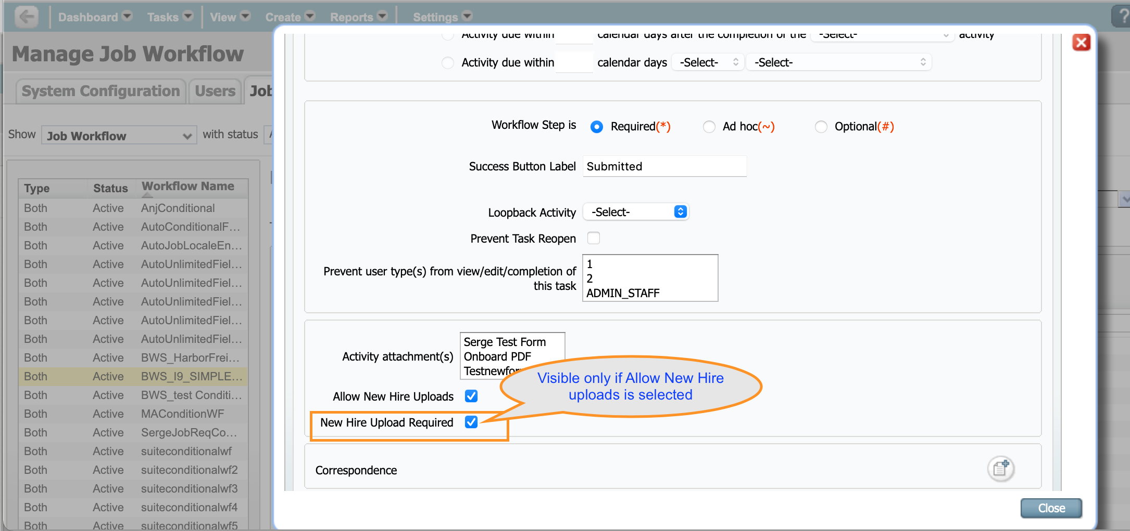
Document Upload - Required

Slide 7
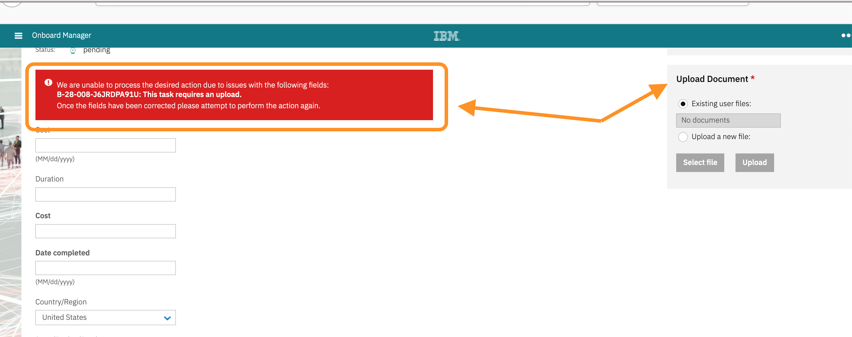
Document Upload - Required

Slide 8
Area of System (State Form Activity)
Updates to State Forms
Who’s Impacted:
Configurable or Visible:
Benefits / Use Case:
Latest version of state forms available for new hires to complete.
Description:
Below state forms are updated in current release.
Oklahoma W4
Indiana WH 47
California DE 4

Slide 9
Upcoming Onboard Builds
Access to New Hire Experience through candidate zone – SSO.
Manage New Hires – Enhancements.
Add Quick Search to Onboard Pages.
Mass Update Job Participants.

Slide 10
Questions?

Slide 11
BrassRing Release Features
–
Feature Area | Feature
TGs | Talent Gateway Search API - New Field
Recruiter Experience | Data Insight Tool - View and Renew Other User Schedule
 | Candidate Purge - Enhancements
 | Metrics Dashboard – Target Lines
 | eLink Dashboard - Card Display Customization
Workbench | Rules Automation Manager - Automation Manager Trigger Migration
 | New Client Setting - eLink Dashboard Default Resume Format
 | New Client Setting - eLink Dashboard Card Customization
 | BrassRing Homepage - Override User Configuration
 | HR Status Actions- Email Field Validation
 | Rules Automation Manager - Run Trigger on Open Reqs
 | New User Type Setting - Candidate Purge Criteria
Lead Manager | User Interface Enhancements
Release Dates
Staging-EU: 8th June 2021
Staging-US: 9th June 2021
Production-EU: 15th June 2021
Production-US: 16th June 2021
Icon Key
Configurable Feature
Visible Feature
Requires SignalLabs to Enable
Recruiters Impacted
Candidate Impacted
Accessibility Update
Dark Launch Feature
RFE
NPS
RFE
NPS

Slide 12
Dark Launch Features

Slide 13
DIT
DIT- View and Renew Other User Schedule
Who’s Impacted:
Configurable or Visible:
Dark Launch:
Benefits:
Easy way to renew other user’s schedules
View other user’s scheduled templates at one place.
RTC #: 134097
Description:
At present, the schedules that a user creates are accessible only by that user.
No other user can edit, renew or take any other action on the schedules.
Starting this release, the DIT Administrator can access the schedules created by the users.
They can view and renew the schedules created by other DIT users.

Slide 14
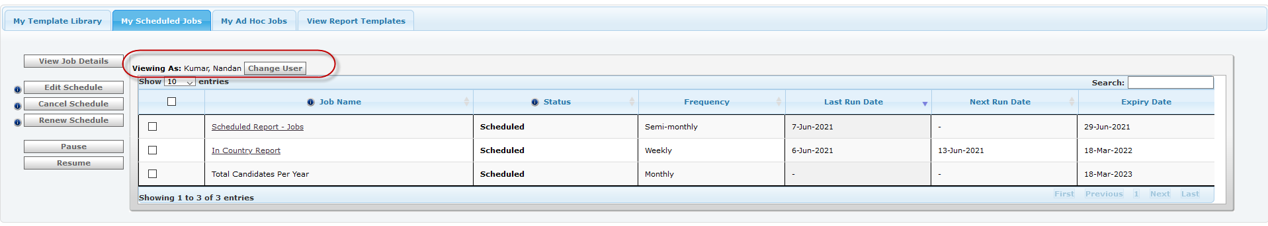
DIT- View and Renew Other User Schedule
BrassRing UI/Workbench
Administrators see a new section in the My Scheduled Jobs tab of DIT. This section has the following two ﬁelds:
Viewing as: Displays the name of the DIT user that the administrator selects to view.
Change user DIT Administrator selects this button to select the user to view or renew the respective user's scheduled templates.
When Change user selected, a new page is displayed containing a list of all the active and inactive users. Inactive users are sufﬁxed with “[Inactive]”.
The list will show only users who have at least one active schedule.
The name of the tab is updated to Scheduled Jobs from My Schedules Jobs.
A new button View My scheduled jobs is displayed when the administrator views other user's schedules.
The administrator can switch to their scheduled jobs by selecting the new button or selecting the tab title.

Slide 15
Features Being Released this Month

Slide 16
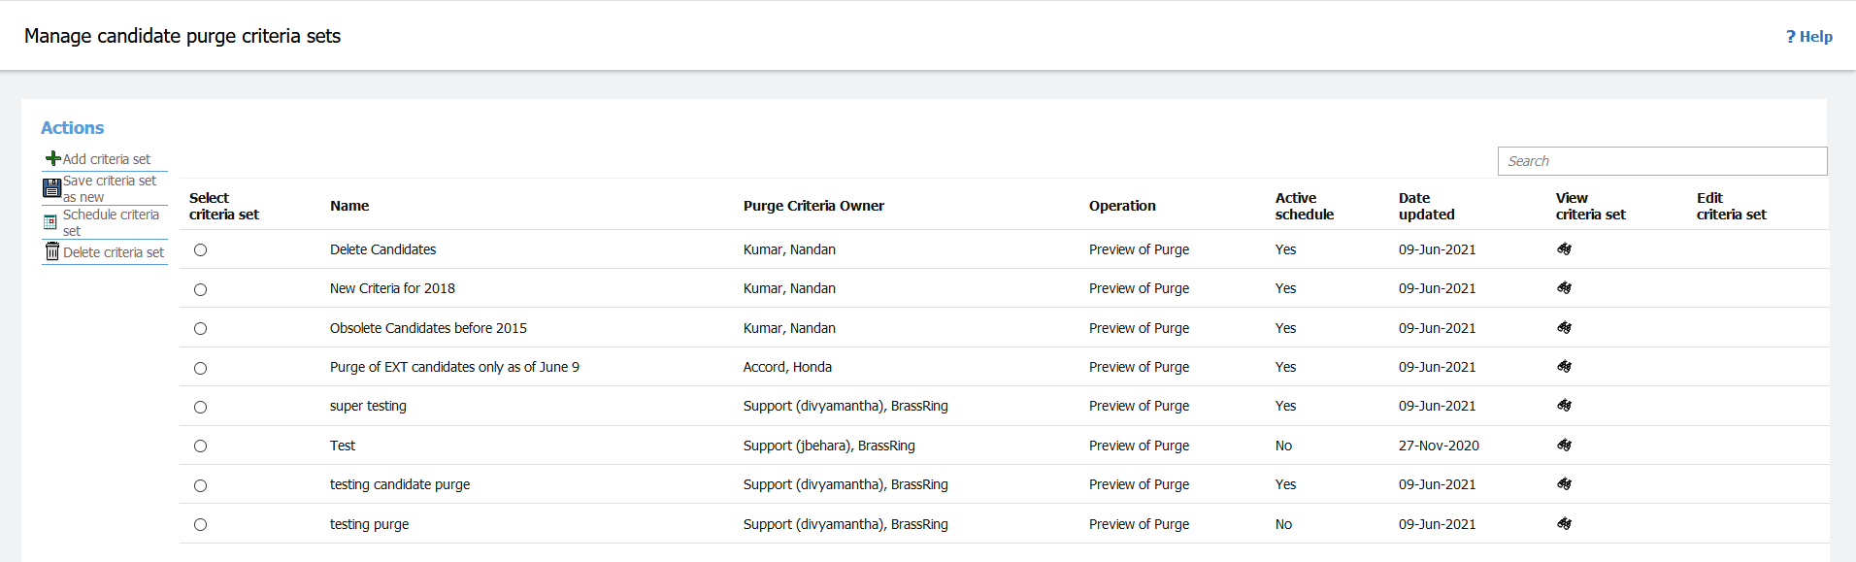
BrassRing UI
Candidate Purge - Enhancements
Who’s Impacted:
Configurable or Visible:
Dark Launch: No
Benefits:
View another user’s purge setup
Better user experience
RFE
RTC #: 134809
Description:
Two new enhancements have been introduced.
The user interface of the Candidate Purge screens is enhanced to match the new responsive user interface of BrassRing.
This is applicable to the following screens:
Manage Purge Criteria
Scheduled Process Queue
Any subsequent action/results page

Slide 17
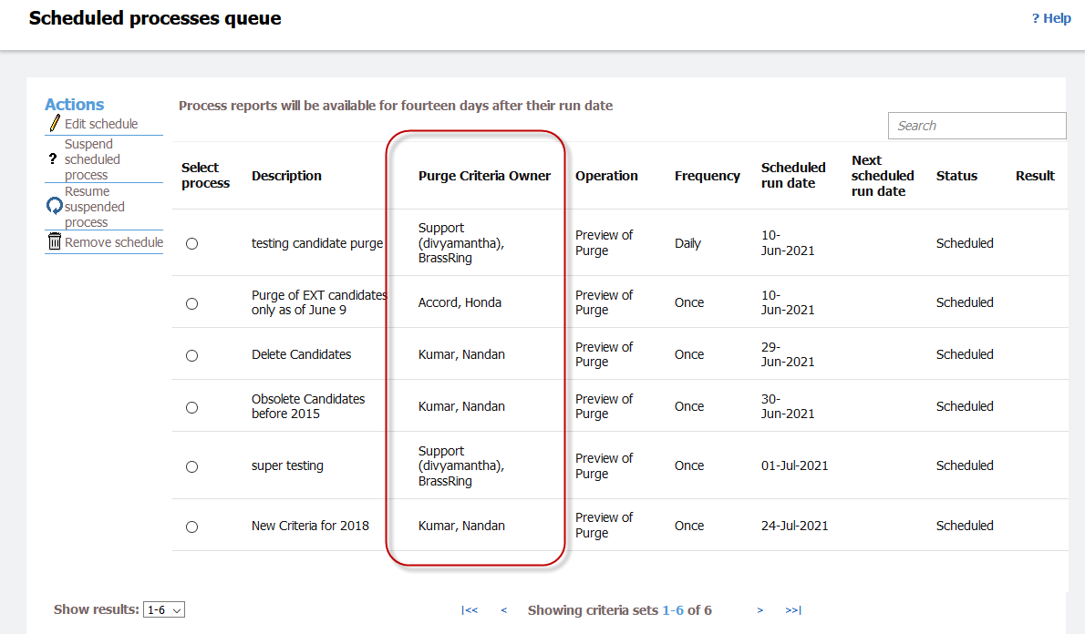
Candidate Purge - Enhancements
Previously, only the owners of purge criteria were able to view the criteria.
No other users including other administrators were unable to view the purge created by a different user.
Based on a new user type privilege, users can now view purge criteria set up by other users.
Starting this release, a new column Purge Criteria Owner is added to display the name of the owner of the purge criteria.
This column is displayed in the following BrassRing pages:
  Manage Purge Criteria
  Scheduled Process Queue
Note: Users can sort through the available columns but cannot take any action on other user’s criteria or schedule.

Slide 18
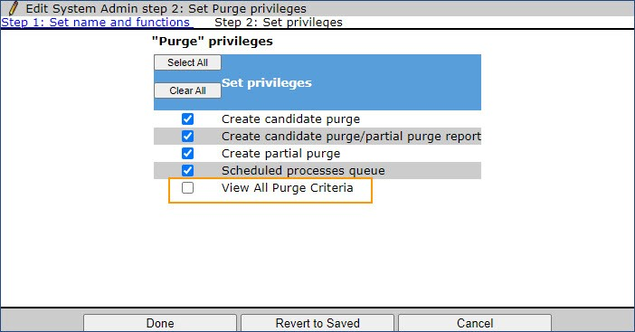
Workbench
New User Type Setting - Candidate Purge Criteria
Who’s Impacted:
Configurable or Visible:
Dark Launch: No
RFE
RTC #: 134809
Description:
A new user type privilege is added to the list of Purge privileges in workbench.
Tools > Users > User types > [select user type] > Edit Type permissions > Purge > View All Purge Criteria
This setting allows the selected user type to view all the purge criteria in the system.
The privilege provides view-only access to all the purge criteria.

Slide 19
BrassRing UI eLink Dashboard - Card Display Customization
Who’s Impacted:
Configurable or Visible:
Dark Launch: No
Benefits:
Add/Remove cards easily.
Visibility of cards can be restricted.
RFE
RTC #: 135013
Description:
Starting this release, eLink Dashboard cards feature two levels of customization.
User level control - Users have an option to choose from the available cards (based on the above client level setting) to be displayed.
Client level setting - Clients can use this setting to customize the display of cards on the eLink Dashboard home page.

Slide 20
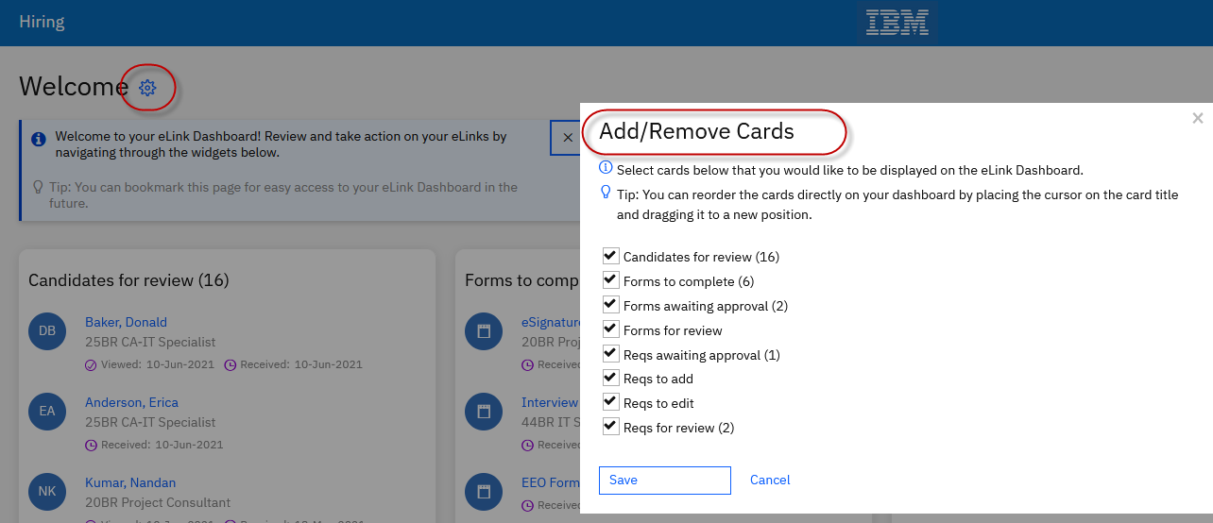
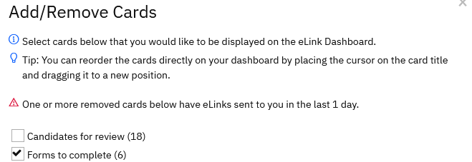
eLink Dashboard - Card Display Customization
A gear icon is displayed next to the Welcome title on the eLink Dashboard homepage.
Users can select the gear icon to open the card customization pop-up screen.
This screen displays the list of available cards based on the client conﬁguration.
By default, all the available cards are selected for display.
If users select a card to be hidden from display, and the card currently has an eLink sent in the last one day, an appropriate message is displayed.

Slide 21
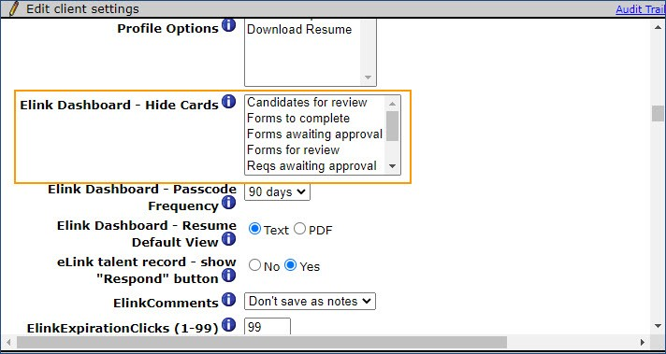
Workbench eLink Dashboard - Card Display Customization - New Client Setting
Who’s Impacted:
Configurable or Visible:
Dark Launch: No
RFE
RTC #: 135013
Description:
A new client setting eLink Dashboard - Hide Cards is added in the Workbench.
This setting has a multi-select ﬁeld that allows clients to select one or more cards to be hidden from the eLink Dashboard.
Selected cards are only hidden from the view on the eLink Dashboard Homepage.
There will be no change in Quick search and Listing page.
Note: This is a client setting and by default nothing is selected. Please reach out to SignalLabs representative for any changes to this setting.

Slide 22
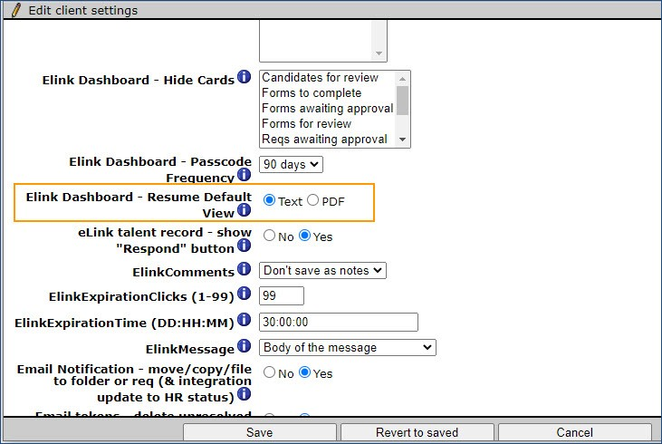
BrassRing UI eLink Dashboard - Default Resume Format - New Client Setting
Who’s Impacted:
Configurable or Visible:
Dark Launch: No
Benefits:
Show the Resume in desired format.
Easy view of Resume info.
RFE
RTC #: 135005
Description:
The new setting eLink Dashboard - Resume Default View allows clients to conﬁgure the user's default view of a candidates resume in desktop view.
Currently, the resume is shown in Text format by default.
Now, clients can choose between Text & PDF format to be the default view.
It will be applicable even if the eLink Dashboard setting is optional. However, in mobile view Text will still be the default format.
Note: This is a client setting and by default “Text” is selected. Please reach out to SignalLabs representative for any changes to this setting.

Slide 23
BrassRing UI/Workbench
BrassRing Homepage - Override User Configuration
Who’s Impacted:
Configurable or Visible:
Dark Launch: Dark launched in May Build
Benefits:
Enforce changes across all existing users.
Automatically updates the homepage view.
RFE
RTC #: 134519, 134752
Description:
At present if a workbench admin updates the homepage persona configuration, it doesn’t affect the existing users view. It only applies to new users.
Now, through a new configuration option admins can override the current view for all existing users of that persona.
It is controlled by client setting and can be turned on or off.
The existing option “not” to override (Save) would still remain.
Update: A new check box is added to the Quick Links pane.
Workbench admins can override the quick links set up of a persona by conﬁguring the new check box.

Slide 24
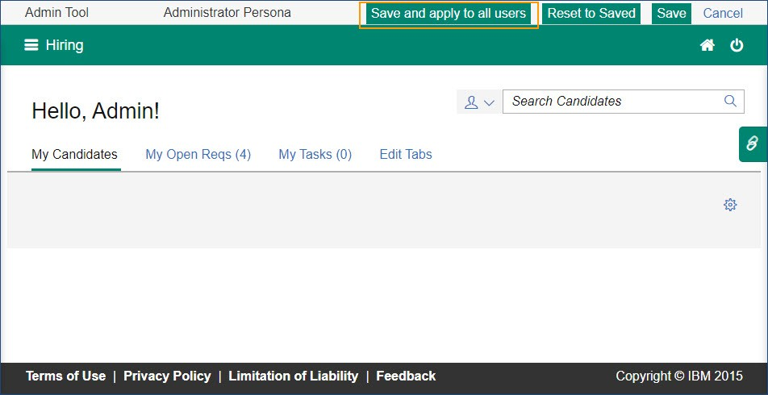
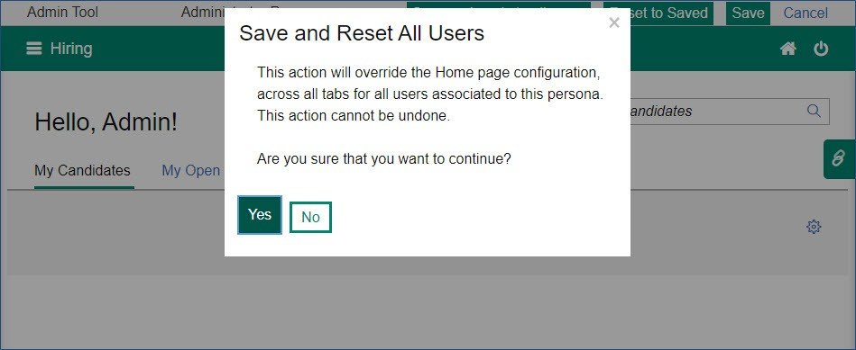
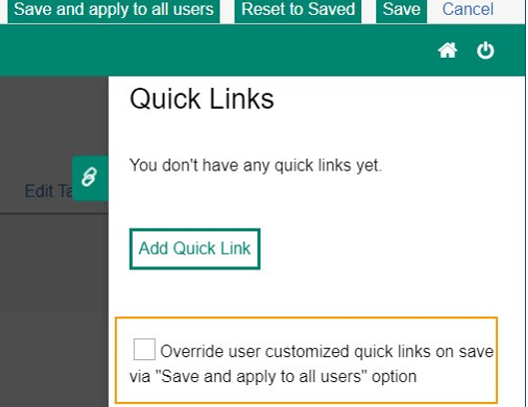
BrassRing Homepage - Override User Configuration
BrassRing UI/Workbench
Note: This is a client setting and by default it “No” is selected. Please reach out to IBM representative for any changes to this setting.

Slide 25
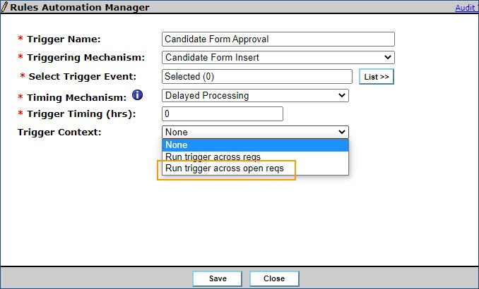
Workbench
RAM- Run Trigger across Open Reqs
Who’s Impacted:
Configurable or Visible:
Dark Launch: No
Benefits:
Action taken only for Open reqs.
Reduces system resources that are utilized.
RTC #: 134084
Description:
At present, when running a RAM there is only context available to run the trigger across reqs, which includes closed reqs.
A new option is now available for the trigger to run across only open reqs.
This new option is available ONLY for Candidate Form insert/update/insert update & HR Status Req Options trigger mechanisms.
No changes to Rules/Actions/Conditions which remain same for "Run trigger across reqs" for this new option as well.

Slide 26
RAM- Run Trigger on Open Reqs
Attributes for the new trigger:
  Trigger Name: Any custom name can be used
  Trigger Type: RAM Trigger
  Triggering Mechanism: Candidate form insert/update/insert & update AND/OR HR Status Req options
  Select Trigger Event: Any Candidate form AND/OR HR Status
  Timing Mechanism: Any available option can be selected
  Trigger Timing (hrs): Any value depending upon the selection above
  Triggering Context: Run trigger across open reqs
  Rules: [blank by default, user can Add Rule as normal]
  Actions: Normal Options.

Slide 27
BrassRing UI
Metrics Dashboard – Target Lines
Who’s Impacted:
Configurable or Visible:
Dark Launch: No
Benefits:
Specific target/goal lines can be configured for each view.
Compare with up to 5 target lines.
RFE
RTC #: 127222
Description:
A new visualization level attribute for Bar/Line/Area/Scatter type charts, just like grid lines is now available.
This will help display an independent line on Y axis based on a specific or computed value.
Path: Visualization->Edit Display->Target lines->Configure.
Up to 5 target lines can be added for each visualization of type bar/line/area/scatter.

Slide 28
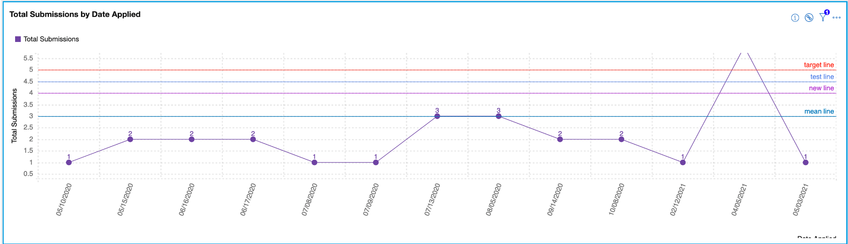
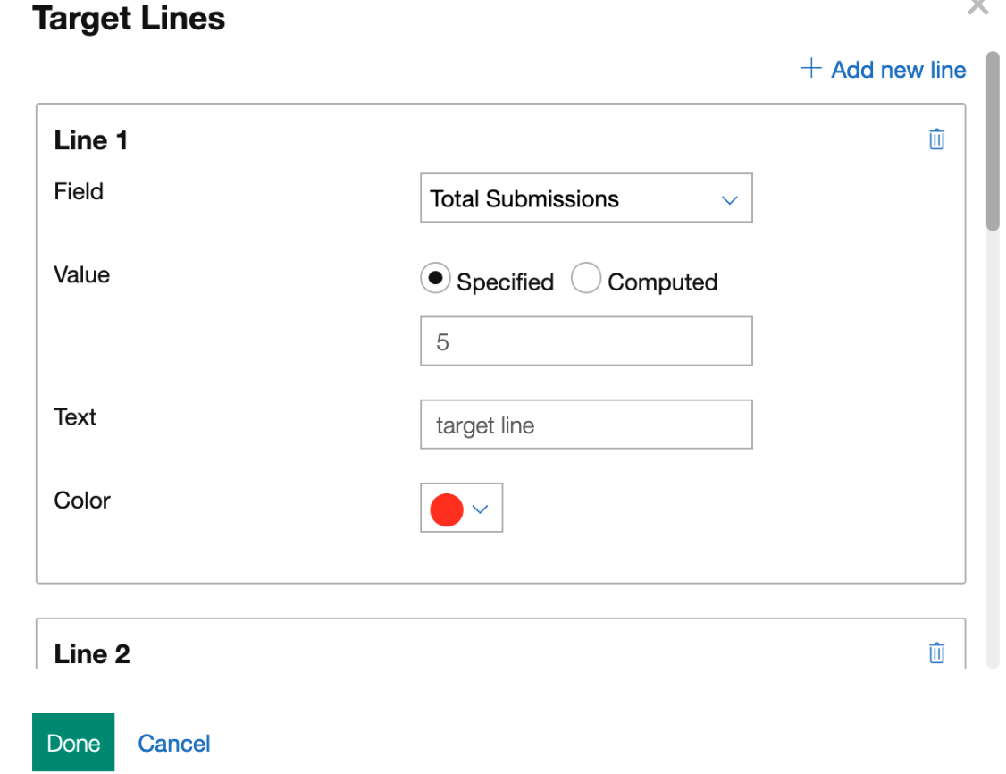
Metrics Dashboard – Target Lines
Each target line will have the following options:
1. Text
2. Color
3. Value
  Specified - user can enter a specific float value (ex 50 or 70.5)
  Computed - mean/median/mode.
4. Field - determines which column to consider for computing the value. This is especially useful when the chart has multiple columns say Total Reqs and Total Candidates.
Note: For stacked bar charts, the calculations are done based on the total of each bar.

Slide 29
Talent Gateway
Job Search API - New Output field
Who’s Impacted:
Configurable or Visible:
Dark Launch: No
Benefits:
Most recent updated time can be extracted via API along with date
Useful for delta jobs
RTC #: 134697
Description:
At present in Job Search API, only last updated date is captured.
Based on client request, a new ﬁeld and additional information is provided as output to the TG Job Search API.
The output ﬁeld LastIndexedDateTimeUTC will fetch the last updated “time” for each req in this node.
This is returned by default when the Talent Gateway Setting Hide “Date Updated” is unchecked.
No change to existing node “Date last updated”.

Slide 30
Workbench
Automation Manager (AM) Trigger Migration
Who’s Impacted:
Configurable or Visible:
Dark Launch: Dark Launched in March Build
Benefits:
RAMs can be used
More configuration options
RTC #: 127222
Description:
As a part of the product enhancements, with this release the existing Automation Manager (AM) trigger is being converted to Rules Automation Manager (RAM) trigger.
The Trigger is HR Status update - notify candidate
The AM will be made inactive, and RAM will be automatically activated with the release.
This migration is now going to happen in Production.

Slide 31
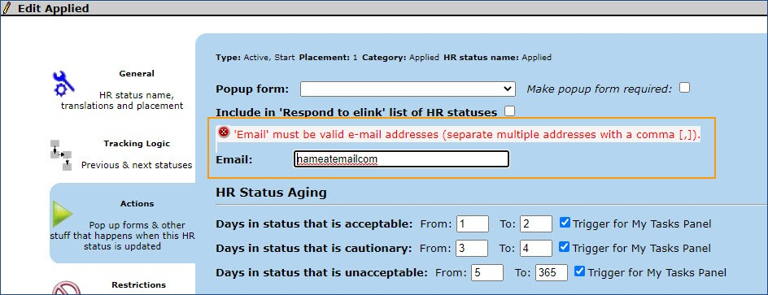
Workbench
HR Status Actions- Email Field Validation
Who’s Impacted:
Configurable or Visible:
Dark Launch: No
RTC #: 134946
Description:
It was observed that the email ﬁeld in the HR Status actions screen is not validating the input.
Any text that does not have proper email format was being accepted without validation including multiple email addresses were accepted without proper separator.
This behavior has now adjusted.
An email ﬁeld validation is in place for the speciﬁed ﬁeld. Multiple emails are accepted only when separated with a comma.

Slide 32
Lead Manager
Release Features
–

Slide 33
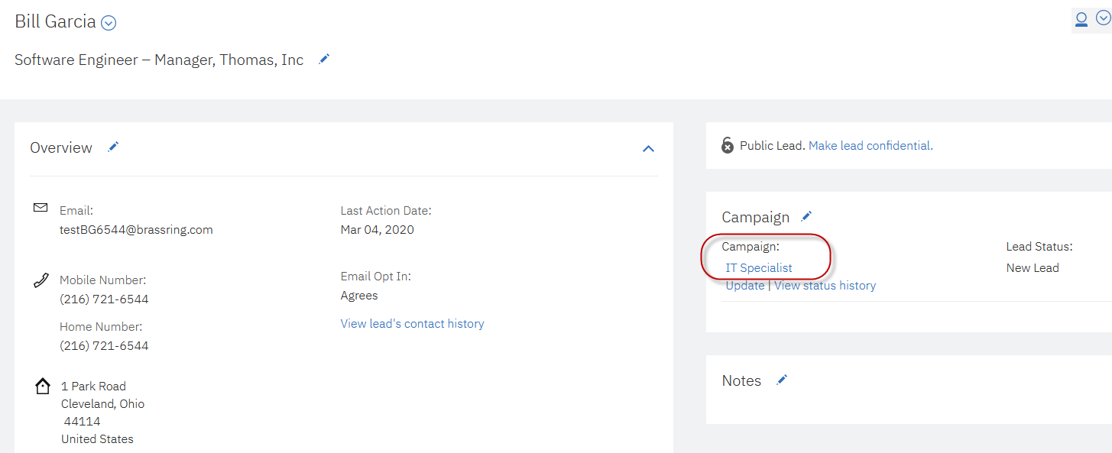
Lead Manager
User Interface Enhancements
Who’s Impacted:
Configurable or Visible:
Dark Launch: No
RFE
RTC #: 134490
Description:
Starting this release, the Campaign names visible in the Lead Proﬁle view are displayed as links to the respective campaigns.
This will allow Lead Manager users to access the campaigns from the Lead Proﬁle directly.
When users directly access the campaign overview page there are multiple beneﬁts:
Easy access to the full Campaign details.
Efﬁcient access to the list of leads within the same campaign for review and comparison.
Consistency between Lead Manager and BrassRing

Slide 34
Upcoming Builds
DIT – Ability to perform cancel/pause/edit action on other’s schedules
TG – View Similar Jobs function
BrassRing – Responsibilities added to Talent Record
Skip Sign on - Ability to customize the subject line of the submission email.
Lead Manager - Add Lead as a recipient when configuring RAM

Slide 35
JUNE VIRTUAL TRAINING SESSIONS
Client-facing training schedule
Sunday | Monday | Tuesday | Wednesday | Thursday | Friday | Saturday
 |  | 1 | 2 | 3 | 4 | 5
6 | 7 | 8 | 9 | 10 Client: BR 21.06.16 Release Enablement | 11 | 12
13 | 14 | 15 Client: Education Series: Non-TG application process | 16 | 17 | 18 | 19
20 | 21 | 22 | 23 | 24 | 25 | 26
27 | 28 | 29 | 30

Slide 36
Questions?

