Slide 1
April Onboard, BrassRing, & Lead Manager 21.04.13 Release
–
Client Training and Enablement Session
Date: 15th April 2021

Slide 2
Reminders & Updates
UPDATES
IMPORTANT UPDATE!
MORE IMPORTANT UPDATES
IMPORTANT UPDATES
Docs, new and improved Knowledge Center
Network with fellow TMS Customers using Forums

Slide 3




Onboard Release Features
–
Release Dates
Staging: 08th April 2021
Production: 17th April 2021
Icon Key
Configurable Feature
Visible Feature
Requires SignalLabs to Enable
Onboard Managers Impacted
New Hires Impacted
Accessibility Update
Dark Launch Feature
RFE
NPS
RFE
NPS

Slide 4
Features Being Released this Month

Slide 5
Area of System (Onboarding Tasks)
Onboard Tasks - Rename Job Application Status
Who’s Impacted:
Configurable or Visible:
Benefits / Use Case:
Column header is updated for better user experience.
Description:
After this release, Job Application Status column in Onboard Tasks Screen is renamed to Active.
Active Column displays values as Yes or No

Slide 6
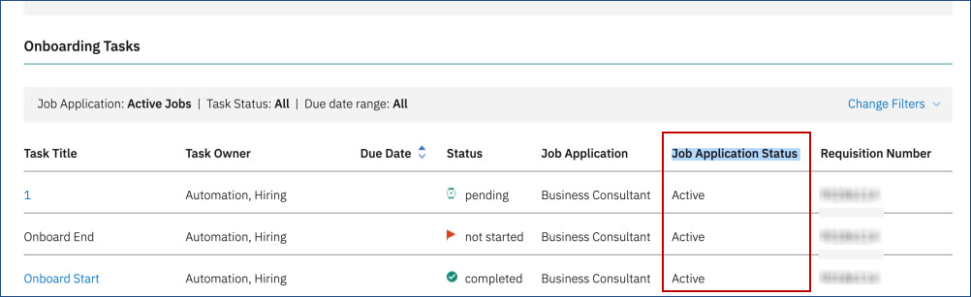
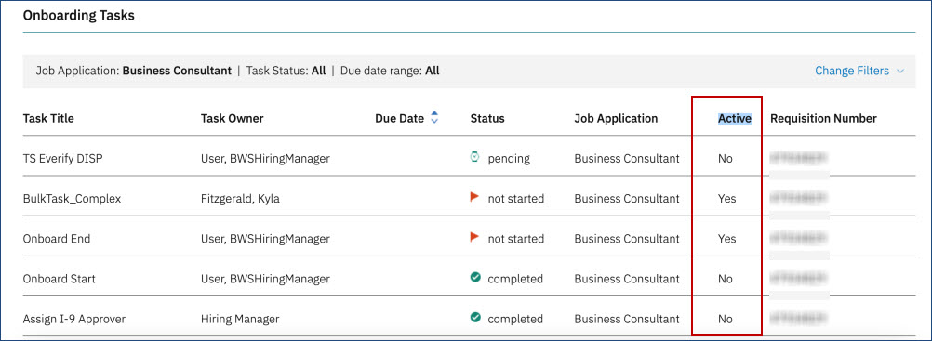
Onboard Tasks - Rename Job Application Status
Before
After

Slide 7

Area of System (Onboard Dictionary)
Marital Status Dictionary Update
Who’s Impacted:
Configurable or Visible:
Benefits / Use Case:
Dictionary updated with latest and appropriate values.
Description:
D_ONBOARD_MARITAL_STATUS dictionary is updated with latest W-4 values.
When W-4 Activity is saved, Marital Status (Applicant Entity) in personal information is updated with the value selected in W-4.

Slide 8
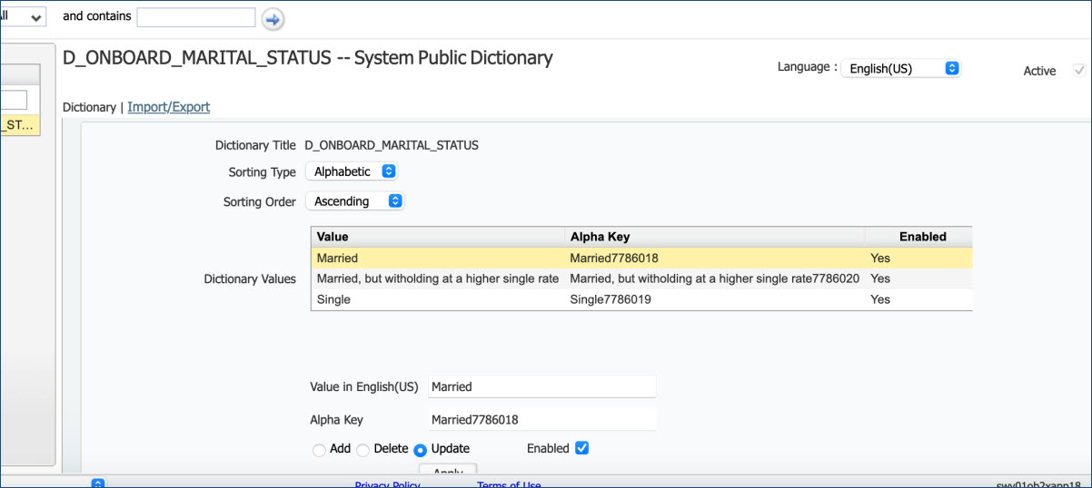
Marital Status Dictionary Update
Before

Slide 9
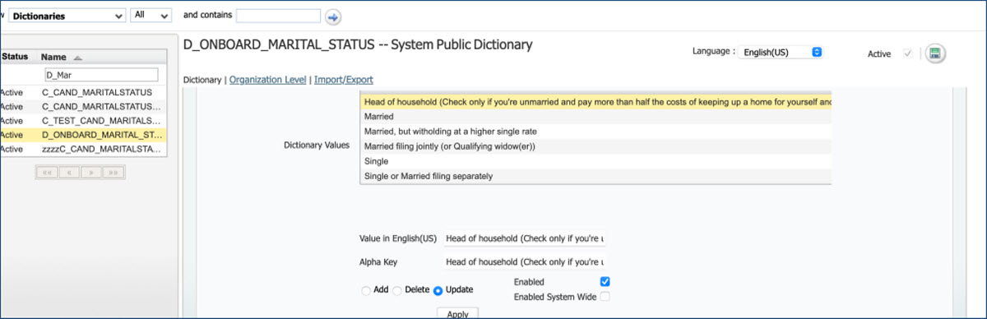
Marital Status Dictionary Update
After

Slide 10
Upcoming Onboard Builds
Date Picker
Bulk Action Email
Access to New Hire Experience through candidate zone – SSO
New Public Filter for Activities in Progress
Add Quick Search to Onboard Pages
Mass Job Update for Participants

Slide 11
Questions?

Slide 12
BrassRing Release Features
–
Feature Area | Feature
TGs | Parse Resume for Contact Information
Recruiter Experience | DIT - Renewal Expiration Update
 | Reqs - New Skills Fields
 | Interview Manager - Interview Scheduling on Busy Slots
 | eLink Communications - Name Placement Update
 | eLink Forms - Include Req Information
 | Post to Candidate Zone - Form Title Language
Workbench | New Client setting - Interview Manager Busy Slot Scheduling
Lead Manager | Remove Lead from Speed Browse
 | Boolean Indicator for Fields
Release Dates
Staging: 13th April 2021
Production: 20th April 2021
Icon Key
Configurable Feature
Visible Feature
Requires SignalLabs to Enable
Recruiters Impacted
Candidate Impacted
Accessibility Update
Dark Launch Feature
RFE
NPS
RFE
NPS

Slide 13
Dark Launch Features

Slide 14
Data Insight Tool - DIT
Renewal Expiration (Update)
Who’s Impacted:
Configurable or Visible:
Dark Launch:
Benefits:
This will help users to “Renew” multiple schedules per page.
RTC #: 133997
Description:
During last release (March), the capability of renewing multiple Scheduled Jobs was introduced.
It was observed that, after selecting multiple scheduled jobs, if the user navigates away from that page, the selection persisted.
Based on feedback, this is changed in the current release.
It’s now ensured that the selection is cleared when the user navigates away from one page to another using pagination.

Slide 15
Features Being Released this Month

Slide 16
BrassRing UI
Reqs – New “Skills” Fields
Who’s Impacted:
Configurable or Visible:
Dark Launch: March build (21.03.16)
Benefits:
Skills can be published along with the job on the TG.
Candidates would be able to see the skills necessary for the job.
If skills are enabled for GQ, then they can provide their skills matching to the job.
RFE
RTC #: 132346
Description:
Starting this release, two new custom req ﬁelds are added in the custom req ﬁelds screen.
Required Skills
Recommended Skills
These ﬁelds can be added to any req templates.
Users can select multiple skills at the same time for each field.
The fields will be available based on a new Workbench client setting.
Note: RFA is now supported along with JCDD.

Slide 17
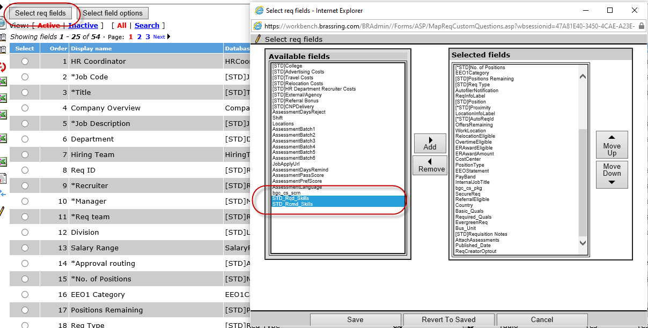
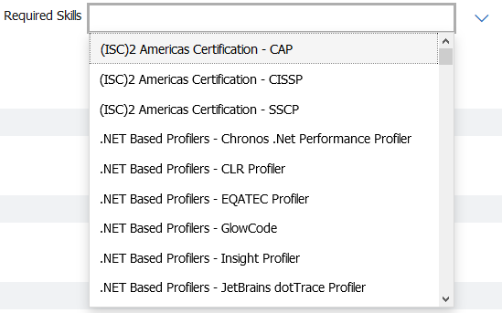
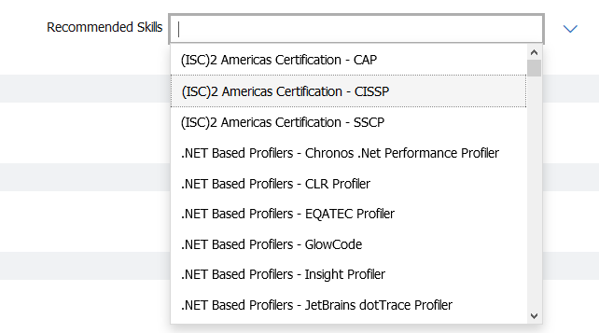
Reqs - New Skills Fields
BrassRing - UI

Slide 18
Interview Manager
Interview Scheduling on Busy Slots
Who’s Impacted:
Configurable or Visible:
Dark Launch: No
Benefits:
Interview coordinators can now select busy slots in Interviewer's calendar.
RTC #: 133676
Description:
Previously, interview coordinators were unable to select a busy slot from an interviewer's calendar.
Starting this release, based on a new client stetting conﬁguration, interview coordinators can be enabled to select a busy slot.
If the client setting is set to allow scheduling a busy slot, based on a set criteria and color coding, interview coordinators can identify and schedule an interview even on a busy slot.

Slide 19
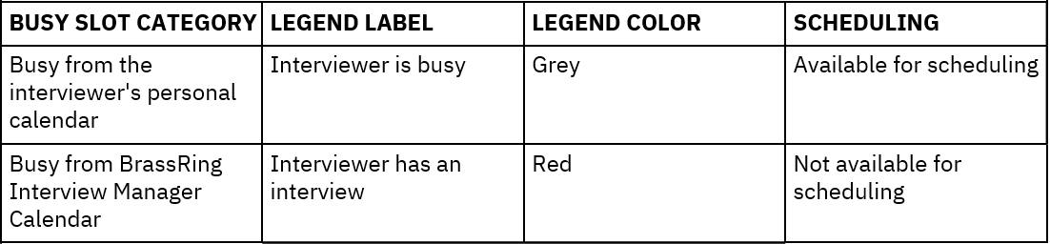
Interview Scheduling on Busy Slots
If the interview slot is busy based on an external calendar integration (O365/Google Calendar, etc.), the interview coordinators can select such slots. Such slots are displayed in Grey and selection is allowed.
If the interview slot is busy due to a different interview scheduled by the BrassRing Interview Manager, such slots can not be selected. The slot is displayed in Red, and selection is not possible.

Slide 20
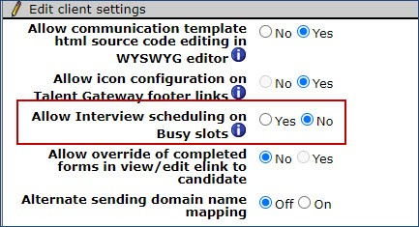
Workbench
Interview Scheduling on Busy Slots
Who’s Impacted:
Configurable or Visible:
Dark Launch: No
RTC #: 133676
Description:
A new client setting related to Interview Manager is added to the Workbench.
The setting Allow Interview scheduling on Busy slots is added with Yes and No as options. By default, No is selected.
When No is selected, interview coordinators can not schedule an interview in a calendar slot that is marked busy by an interviewer.
When this conﬁguration is set to Yes, the interview coordinators can select a slot that is marked busy based on additional criteria.
Note: This is a client setting and can be turned on by SignalLabs representative only.

Slide 21
Talent Gateways
Parse Résumé for Contact Information
Who’s Impacted:
Configurable or Visible:
Dark Launch: No
Benefits:
Information is parsed automatically from a previous page.
Candidates do not have to import the info again.
Data is automatically pre-populated.
RTC #: 132105
Description:
In the current Gateway Questionnaire process, the candidate’s contact information is not parsed automatically if the Résumé/CV widget is used before contact info fields.
Starting this release, in any Gateway Questionnaire, if the Résumé/CV widget appears prior to the contact information ﬁelds page or on the same page, the ﬁle is automatically parsed and the contact information is populated in the ﬁelds.
If the parsing is automatically completed, Import proﬁle is not displayed.
Import Proﬁle is displayed if the candidate does not upload a Résumé/CV ﬁle or the widget is optional.

Slide 22
BrassRing UI eLink Forms - Include Req Information
Who’s Impacted:
Configurable or Visible:
Dark Launch: No
Benefits:
Access the req info via eLinks
RTC #: 133828
Description:
It was observed that when multiple forms are attached and the Include Req information check box is checked, the email does not have View Req link.
Starting this release, the following updates are made to ensure smooth workflow and avoid confusion:
Select: Single Per Candidate, Single per candidate per req, Multiple per candidate and Multiple per candidate per req form - Include Req information check box is enabled.
Select all Forms - Include Req Information check box is disabled.

Slide 23
BrassRing UI eLink Communications - Name Placement Update
Who’s Impacted:
Configurable or Visible:
Dark Launch: No
Benefits:
Better visibility
RTC #: 134003
Description:
It was observed that the name of the candidate is incorrectly placed when an eLink email.
When an eLink is sent along with two different forms, the candidate's name is displayed in between the conﬁgured message with forms token.
This is now addressed to ensure that the name is correctly placed and the eLink can be accessed.

Slide 24
BrassRing UI
Post to Candidate Zone - Form Title Language
Who’s Impacted:
Configurable or Visible:
Dark Launch: No
RTC #: 134478
Description:
It was observed the in the Post to Candidate Zone workflow, the form title was being displayed in incorrect locale.
Non-English locale forms are displaying form title in English.
This is addressed in the current build.
Starting this release, form title is displayed in appropriate locale.

Slide 25
Lead Manager
Release Features
–

Slide 26
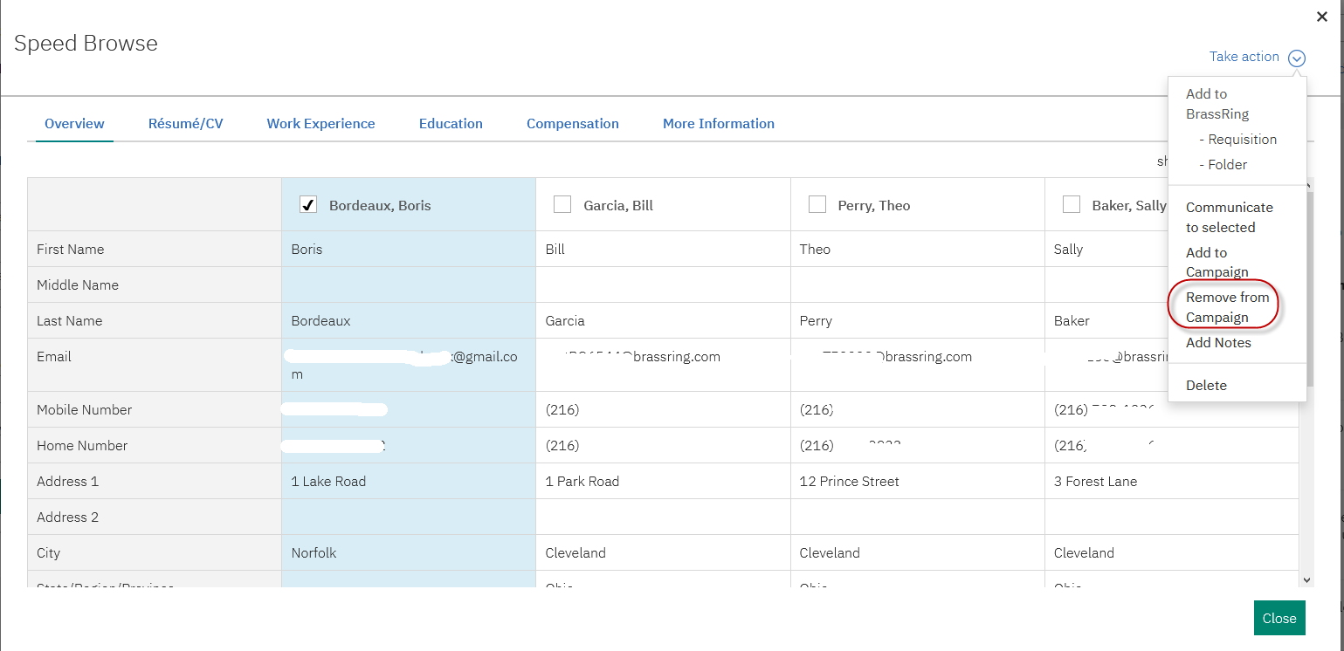
Lead Manager
Remove Lead from Speed Browse
Who’s Impacted:
Configurable or Visible:
Dark Launch: No
Benefits:
Lead coordinators would be able to remove leads easily from a campaign.
RTC #: 129299
Description:
A new action, Remove from Campaign is available in the Speed browse list of actions starting this release.
Lead Manager users can remove a lead from a campaign while they are on the speed browse screen.

Slide 27
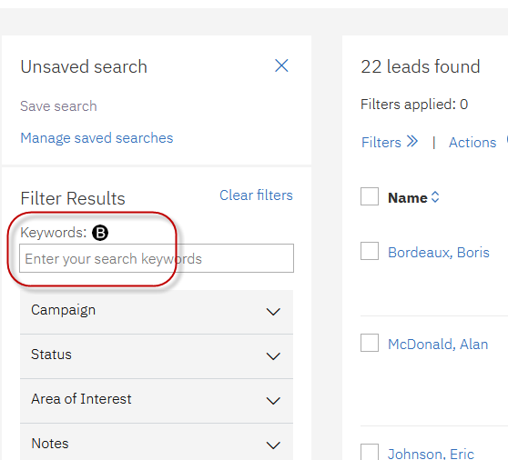
Lead Manager
Boolean Indicator for Fields
Who’s Impacted:
Configurable or Visible:
Dark Launch: No
Benefits:
Provides better search ability
Search results are more refined
RFE
RTC #: 133093
Description:
Starting this release, ﬁelds that accept entry of Boolean values display an indicator.
They also display hovering text suggesting that Boolean values are accepted upon mouse hover.
This is to ensure that users can easily identify the ﬁelds that accept the Boolean values, and there by provide better user experience.

Slide 28
Upcoming Builds
RAM - Send reminders based on date field on any form.
DIT – Ability to perform renew action on other’s schedules
Workbench - Ability for admins to override card/grid configurations
BrassRing UI - A new section for Req Posting History
Lead Manager - Link to Campaign Overview within Lead Profile

Slide 29
APRIL VIRTUAL TRAINING SESSIONS
Client-facing training schedule
Sunday | Monday | Tuesday | Wednesday | Thursday | Friday | Saturday
 |  |  |  | 1 | 2 | 3
4 | 5 | 6 | 7 | 8 | 9 | 10
11 | 12 | 13 | 14 | 15 Client: BR 21.04.12 Release Enablement | 16 | 17
18 | 19 | 20 | 21 | 22 Client: TAS Roadmap | 23 | 24
25 | 26 | 27 | 28 | 29 | 30

Slide 30
May VIRTUAL TRAINING SESSIONS
Client-facing training schedule
Sunday | Monday | Tuesday | Wednesday | Thursday | Friday | Saturday
 |  |  |  | 1 | 2 | 3
4 | 5 | 6 | 7 | 8 | 9 | 10
11 | 12 | 13 | 14 | 15 Client: BR 21.05.10 Release Enablement | 16 | 17
18 | 19 | 20 | 21 | 22 | 23 | 24
25 | 26 | 27 | 28 | 29 | 30

Slide 31
Questions?

