Slide 1
Talent Management Solutions
March Onboard, BrassRing, & Lead Manager 21.03.16 Release
–
Client Training and Enablement Session
Date: 18th March 2021

Slide 2




Onboard Release Features
–
Release Dates
Staging: 11th March 2021
Production: 20th March 2021
Icon Key
Configurable Feature
Visible Feature
Requires SignalLabs to Enable
Onboard Managers Impacted
New Hires Impacted
Accessibility Update
Dark Launch Feature
RFE
NPS
RFE
NPS

Slide 3
Features Being Released this Month

Slide 4
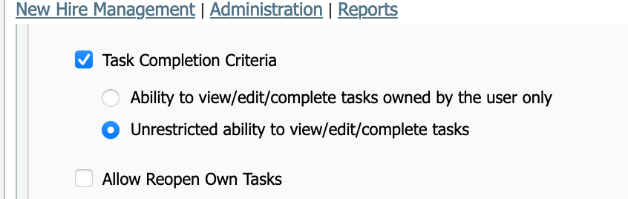
Area of System (State Forms Activity)
State forms view changes for unrestricted and prevented users
Who’s Impacted:
Configurable or Visible:
Benefits / Use Case:
Restricts user types from viewing the state form activity.
Description:
After this release, Below message is displayed when prevented users access State Form activity.
You are unable to view this task until it has been completed by the owner because it requires their signature. Once the owner has completed the task you will be able to view the signed and completed form.
User Type Capability

Slide 5
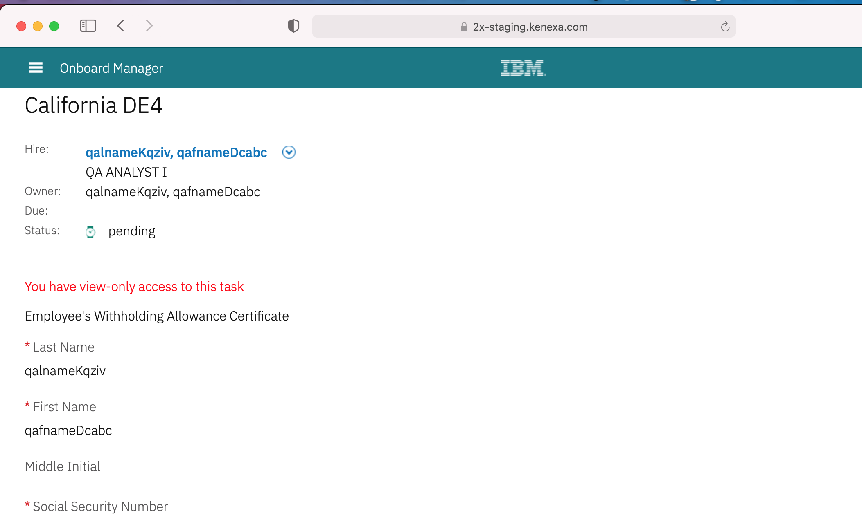
State forms view changes for unrestricted and prevented users
Before

Slide 6
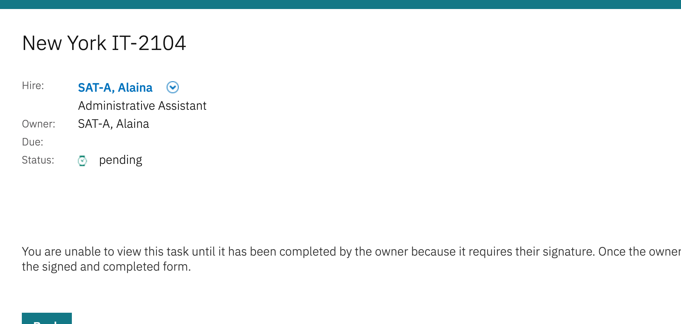
State forms view changes for unrestricted and prevented users
After

Slide 7
Area of System (Manage New Hires)
Disable Sorting in MNH
Who’s Impacted:
Configurable or Visible:
Benefits / Use Case:
Users will be able to use sort capability on supported fields in MNH.
Description:
After this release sorting icon is disabled for unsupported fields in Manage New Hires Page.
Unsupported fields:
  All custom fields
  I9.I9AdditionalInformation
  I9.documentsPhysicallyExamined
  I9.I9ApproverPhone
  I9.I9ReceiptSectionName
  I9.I9ReceiptName
  I9.I9ReceiptExpiryDate
  JobApplication.Dispositionedby
  JobApplication.Dispositioncode

Slide 8
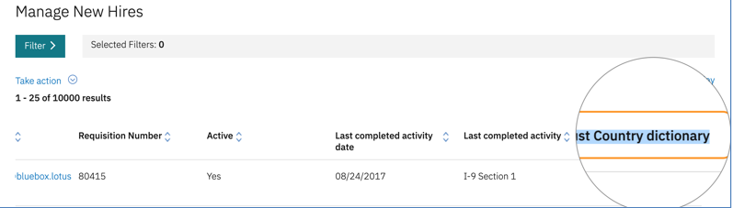
Disable Sorting in MNH
Before
After

Slide 9
Area of System (Bulk Actions in MNH)
Change in Bulk Actions Process
Who’s Impacted:
Configurable or Visible:
Benefits / Use Case:
Performance improvement
Description:
After this release, Bulk Actions will not display list of selected records when
Bulk Discontinue, Bulk Task Completion, Bulk Revert Discontinue process is executed.
Manual selection of New hire records will follow the same approach as Select All feature.

Slide 10
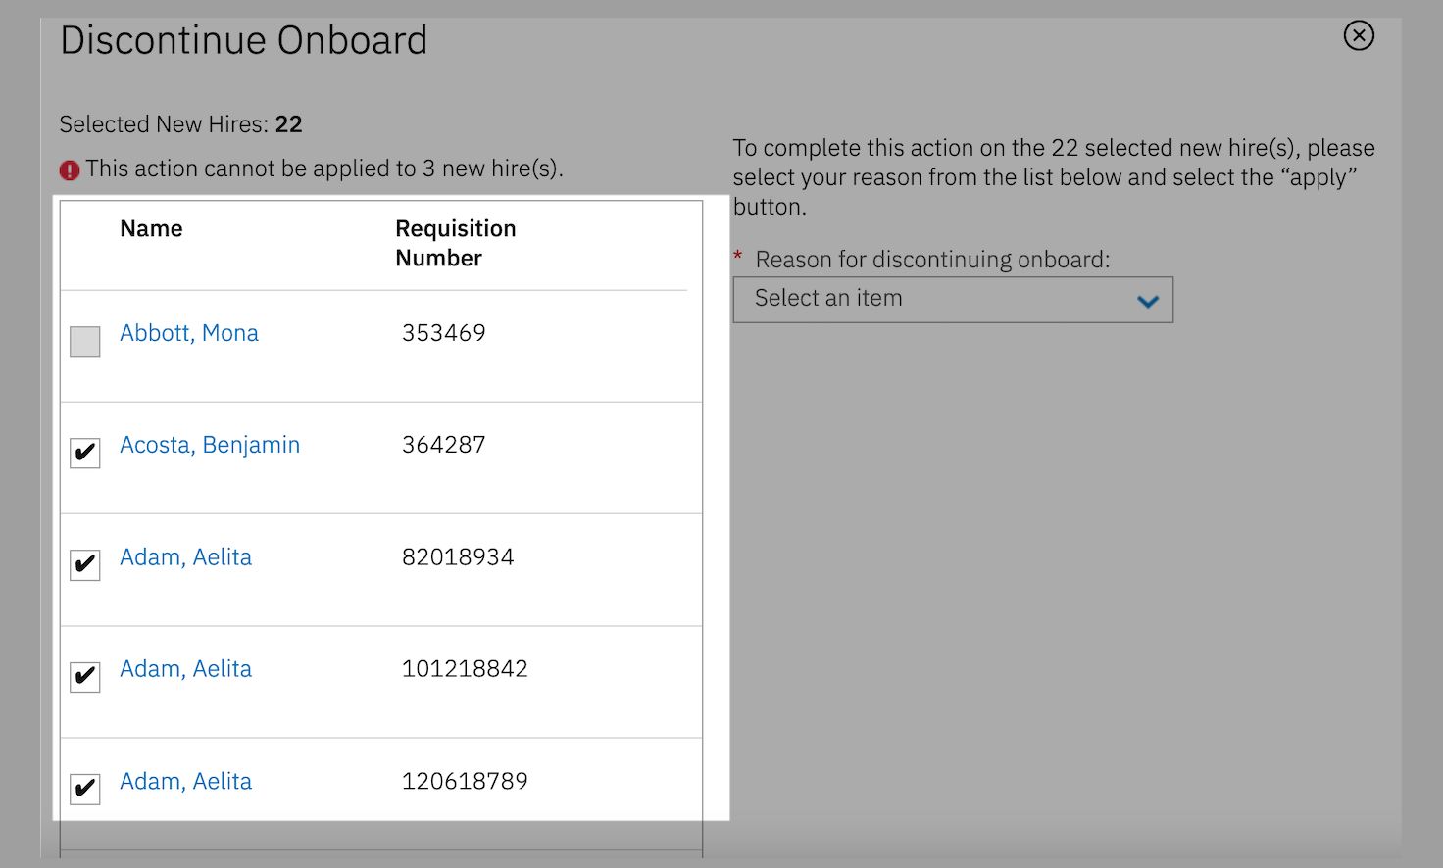
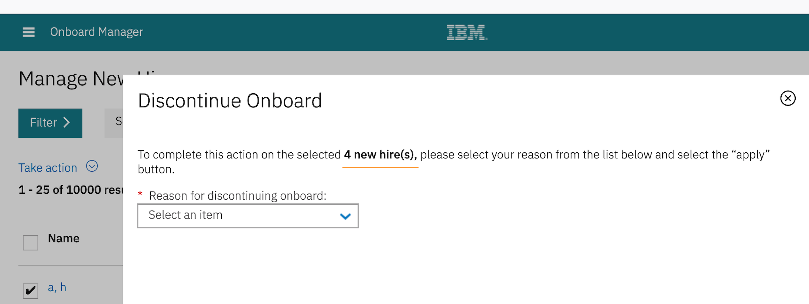
Change in Bulk Action Process
Before
After

Slide 11

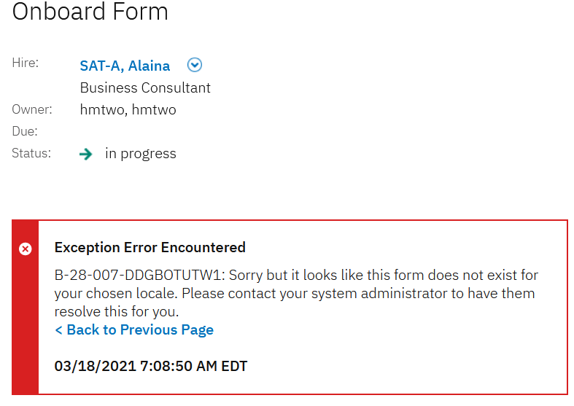
Area of System (Task)
Form doesn’t exist for logged in user locale
Who’s Impacted:
Configurable or Visible:
Benefits / Use Case:
Displays meaningful error message
Description:
After this release, When user with English(US) locale tried to complete the form created in English(GB) locale, it will display meaningful error message.
Sorry but it looks like this form does not exist for your chosen locale. Please contact your system administrator to have them resolve this for you.

Slide 12
Upcoming Onboard Builds
Date Picker
Bulk Action Email
Access to New Hire Experience through candidate zone – SSO
New Public Filter for Activities in Progress
Add Quick Search to Onboard Pages
Mass Job Update for Participants

Slide 13
Questions?

Slide 14
BrassRing Release Features
–
Feature Area | Feature
TGs | Social Referral - Resend Referral
Recruiter Experience | DIT - Renew Multiple Scheduled Jobs
 | Reqs - New Skills Fields
 | Interview Manager Actions - Candidate Talent Record Action Log
 | Candidate Form Approval - First Approver Comments
 | Candidate Import - Update Deleted Candidate
 | Document Subsidiary Forms - Restrict Repost
 | eLink Dashboard
Workbench | Automation Manager Trigger Migration
 | eLink Dashboard - eLink Respond Instructions
 | Document Subsidiary Forms - New Form Attribute
Lead Manager | Stack Duplicates
 | User Permission Update
Release Dates
Staging: 17th March 2021
Production: 23rd March 2021
Icon Key
Configurable Feature
Visible Feature
Requires SignalLabs to Enable
Recruiters Impacted
Candidate Impacted
Accessibility Update
Dark Launch Feature
RFE
NPS
RFE
NPS

Slide 15
Dark Launch Features

Slide 16
Data Insight Tool - DIT
Renew Multiple Scheduled Jobs
Who’s Impacted:
Configurable or Visible:
Dark Launch:
Benefits:
This will help users to “Renew” multiple schedules (expiring or expired) at one go.
RTC #: 133997
Description:
Previously, the My Scheduled Jobs featured radio buttons for the list of scheduled jobs.
Users were required to select each job to renew.
With this release, users can select multiple scheduled jobs at the same time and renew them in a single action.
The radio buttons are replaced by check boxes.
Users can select multiple schedule jobs that are near expiration and renew them all in a single action.
Note: Only Renew action available upon selecting multiple scheduled jobs. Other actions are being considered for future releases.

Slide 17
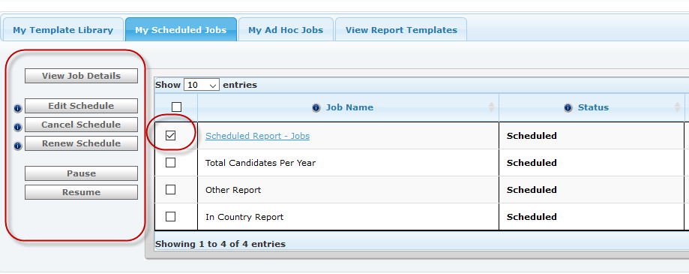
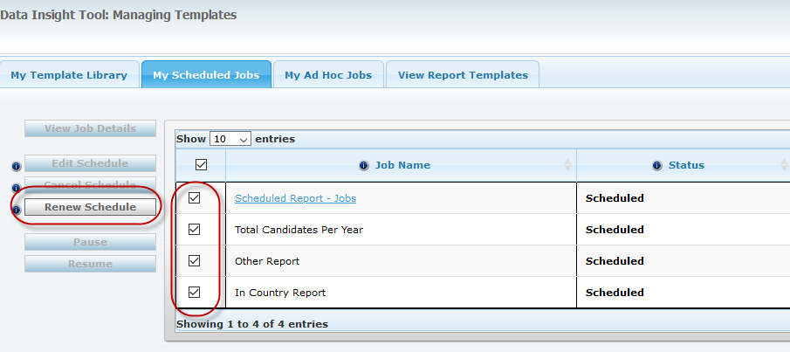
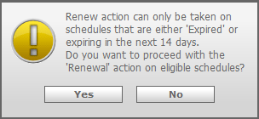
Renew Multiple Scheduled Jobs
Data Insight Tool - DIT
Note: If multiple schedules are selected for “Renew” action , then the system will display an alert message. It will only renew the schedules which either expired or are going to expire within next 14 days. Rest all selected jobs will be ignored.
The renewal date would be calculated based on “Schedule type”.

Slide 18
BrassRing UI
Reqs – New “Skills” Fields
Who’s Impacted:
Configurable or Visible:
Dark Launch:
Benefits:
Skills can be published along with the job on the TG.
Candidates would be able to see the skills necessary for the job.
If skills are enabled for GQ, then they can provide their skills matching to the job.
RFE
RTC #: 132346
Description:
Starting this release, two new custom req ﬁelds are added in the custom req ﬁelds screen.
Required Skills
Recommended Skills
These ﬁelds can be added to any req templates.
Users can select multiple skills at the same time for each field.
The fields will be available based on a new Workbench client setting.
Note: RFA is currently not supported. It is being considered for future releases.

Slide 19
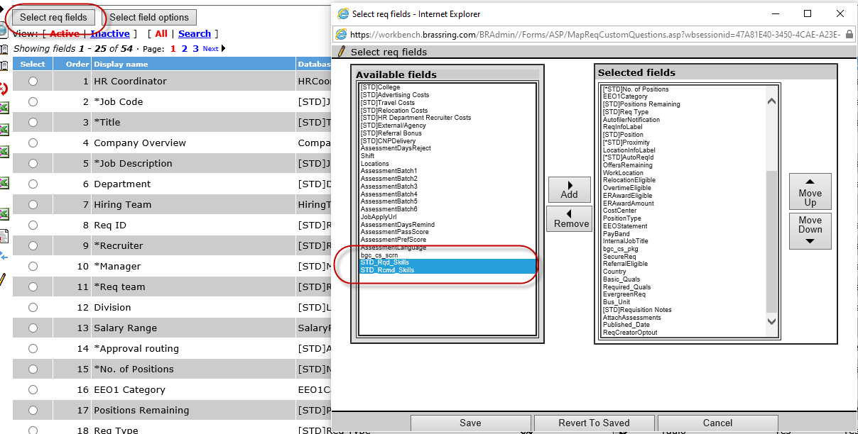
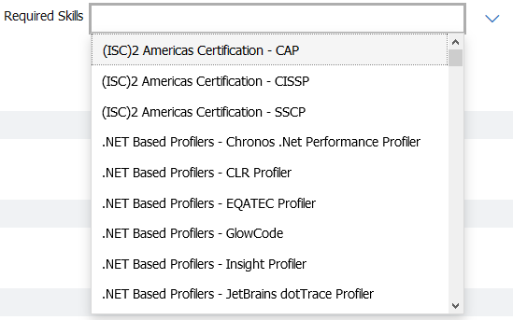
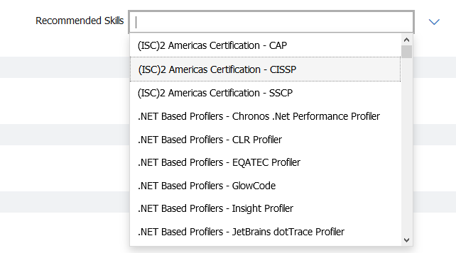
Reqs - New Skills Fields
BrassRing - UI

Slide 20
Workbench
Automation Manager (AM) Trigger Migration
Who’s Impacted:
Configurable or Visible:
Dark Launch:
Benefits:
RAMs can be used
More configuration options
RTC #: 127222
Description:
As a part of the product enhancements, with this release the existing Automation Manager (AM) trigger is being converted to Rules Automation Manager (RAM) trigger.
The Trigger is HR Status update - notify candidate
The AM will be made inactive, and RAM will be automatically activated with the release.
Clients can test and verify the RAM trigger functions after the staging release.
This migration is happening only in Staging.

Slide 21
Features Being Released this Month

Slide 22
BrassRing UI eLinks - eLink Dashboard
Who’s Impacted:
Configurable or Visible:
Dark Launch: Dark Launched in December 2020.
Benefits:
Users can access all the eLinks at one place.
No need to dig through old emails to access the eLink data.
Easy authentication & secure.
Data visibility inside dashboard can be controlled.
Dashboard URL can be bookmarked and never expires.
RTC #: 129145, 129148
Description:
The all new eLink Dashboard is an all-encompassing, single access point to review and act on all tasks.
Single dashboard view of actionable items.
The dashboard is unique to the recipient of the eLink and linked to their email address.
Dashboard can be made optional.
The eLink dashboard includes:
Candidates for review.
Forms to complete, approve, or view.
Reqs to approve, add, edit, or view.

Slide 23
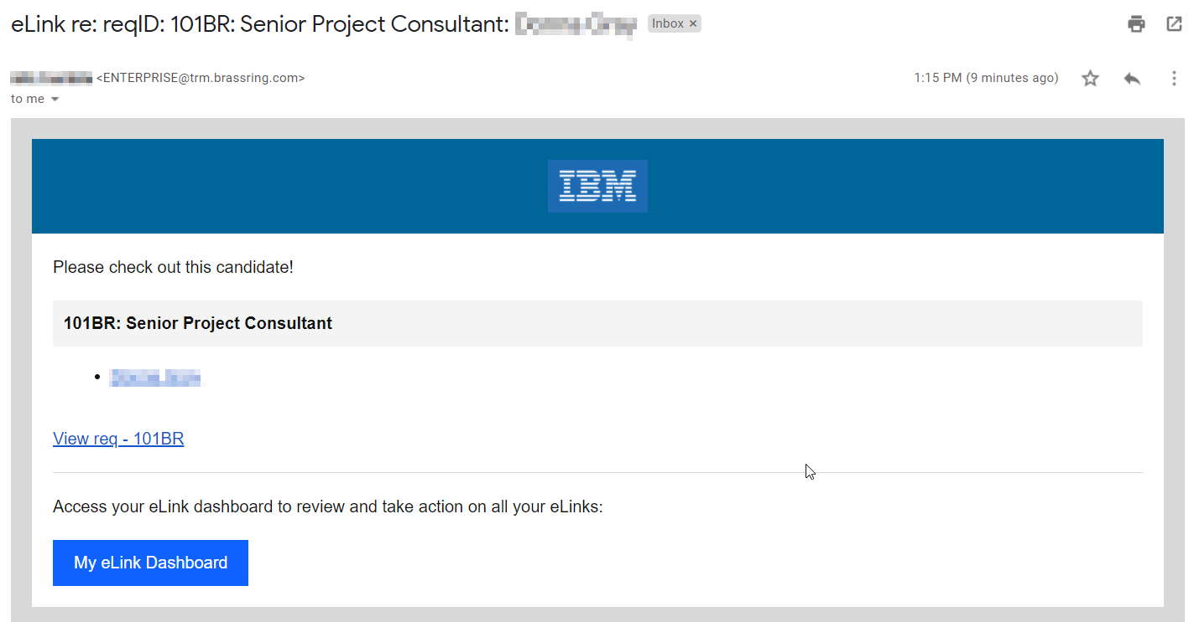
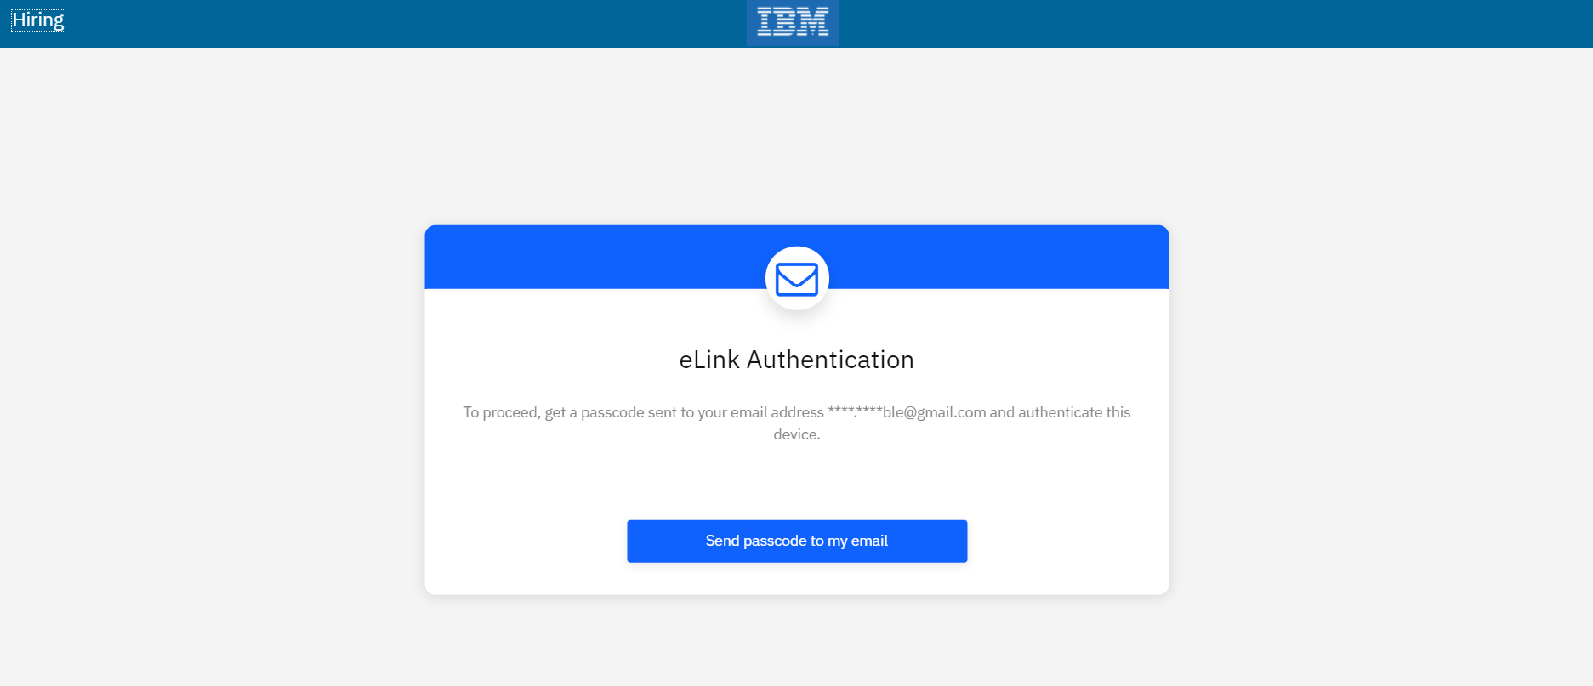
Clicking on the link in the email requires the user to authenticate. (This will display if they haven’t already authenticated or have chosen not to have the browser remember the computer, they’re on.)
The user can also click the My eLink Dashboard to access the site. The page the user is taken to can be bookmarked for future access.

Slide 24
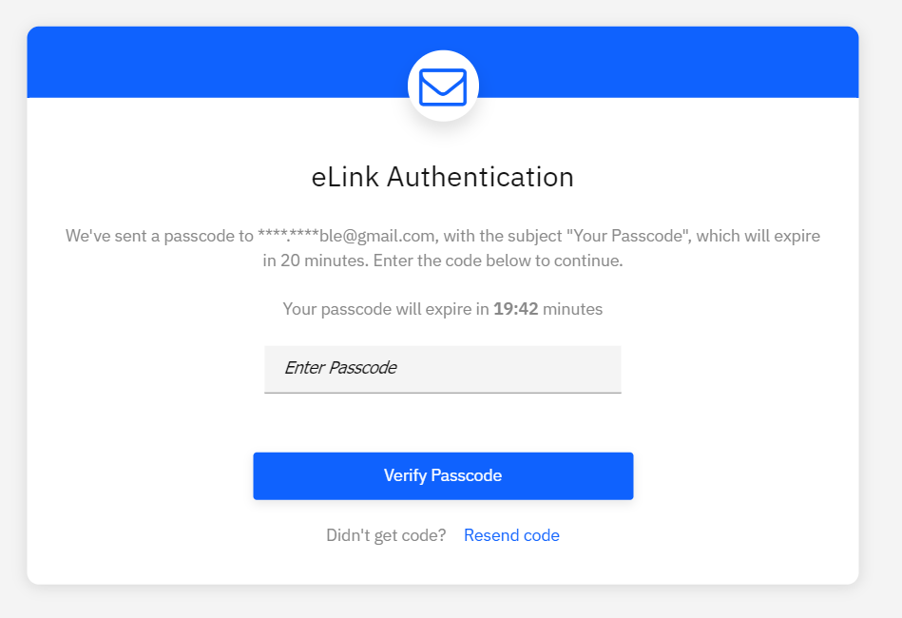
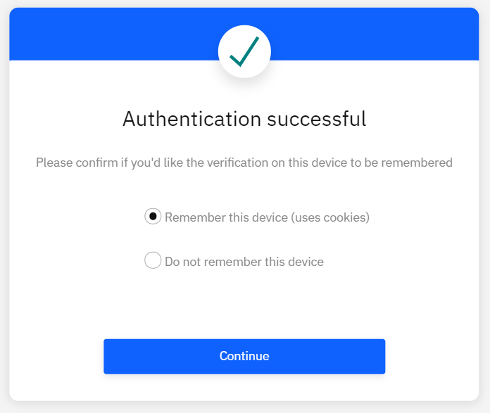
When authenticating, the user will receive an email with the code. They then have 20 minutes to use that code to authenticate.
After the code is entered, the user will have the option to:
Remember this device – If selected, the user will not have to authenticate each time. However, if they clear their cache and cookies or use a different browser, they will have to authenticate again.
Do not remember this device – If selected, the user will have to authenticate each time accessing the eLink Dashboard.

Slide 25
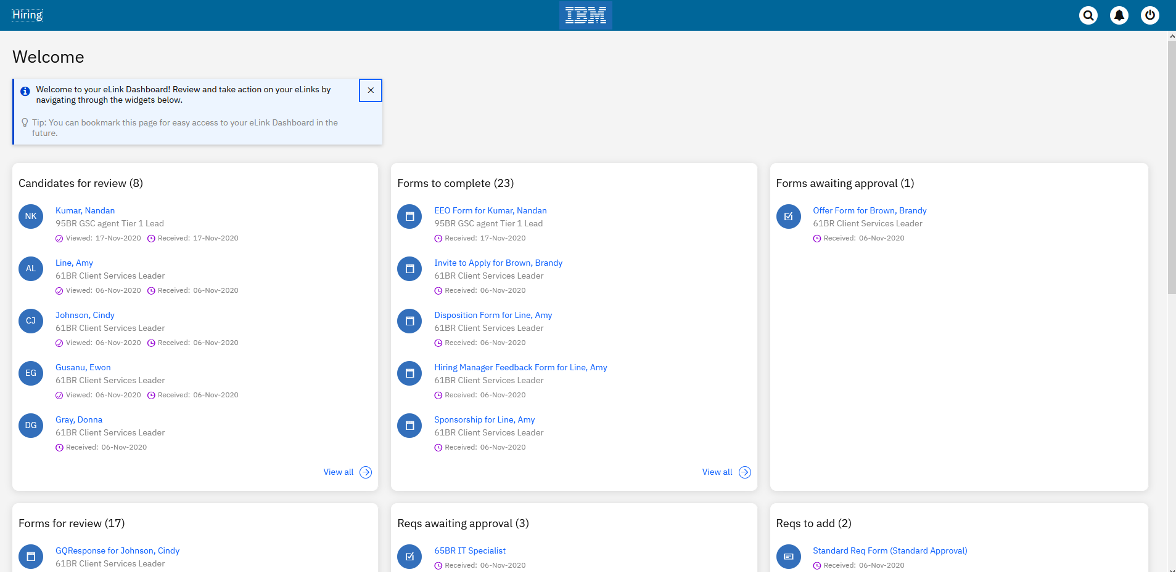
Resources:
https://documentation.infinite.com/docs/the-elink-dashboard

Slide 26
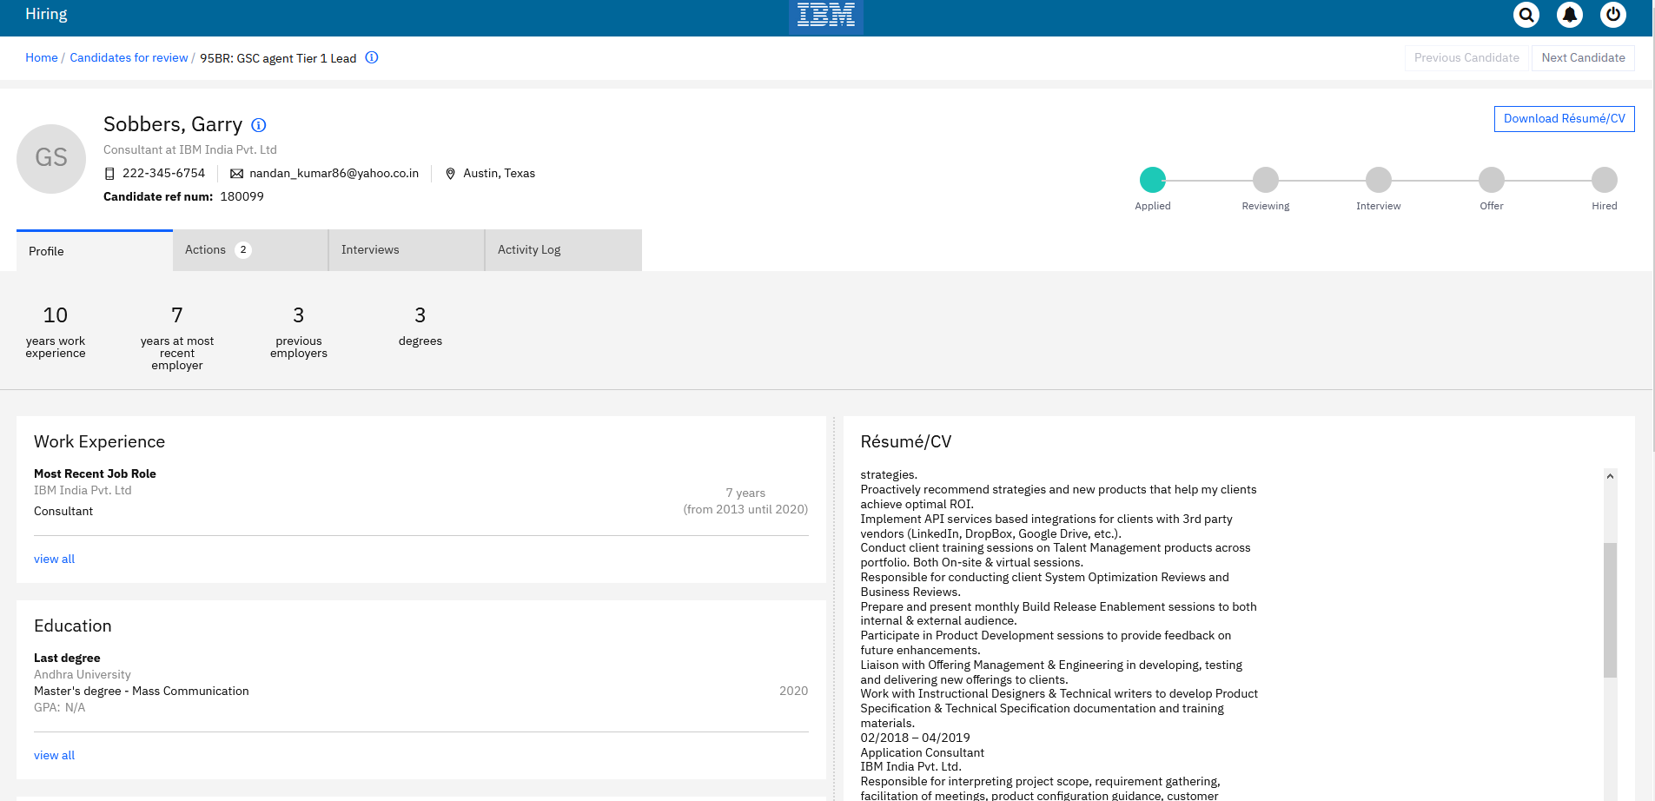
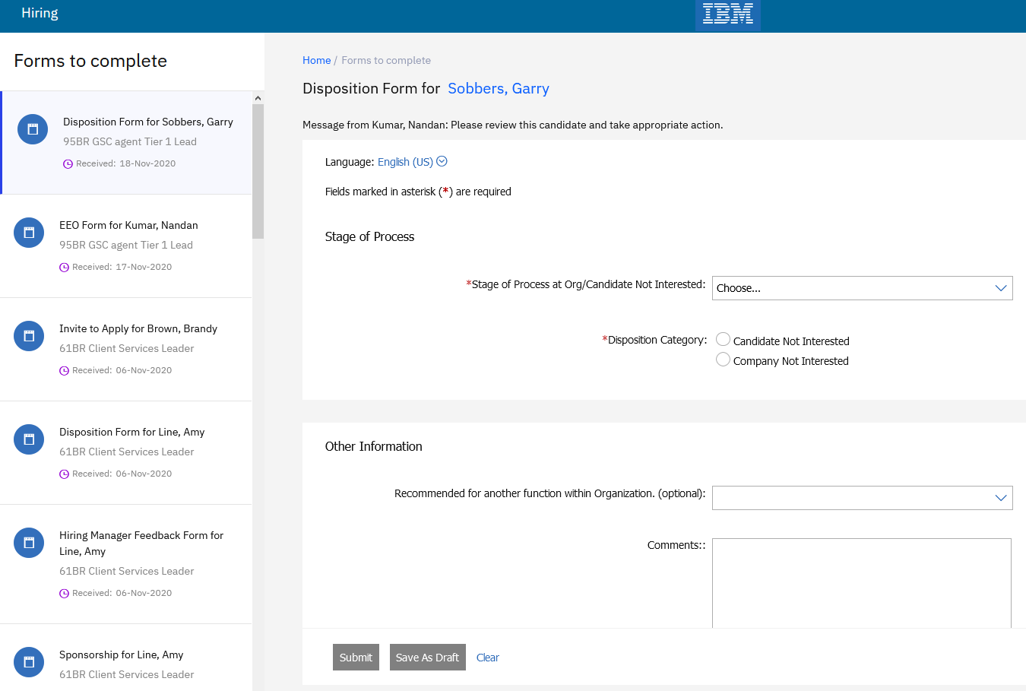
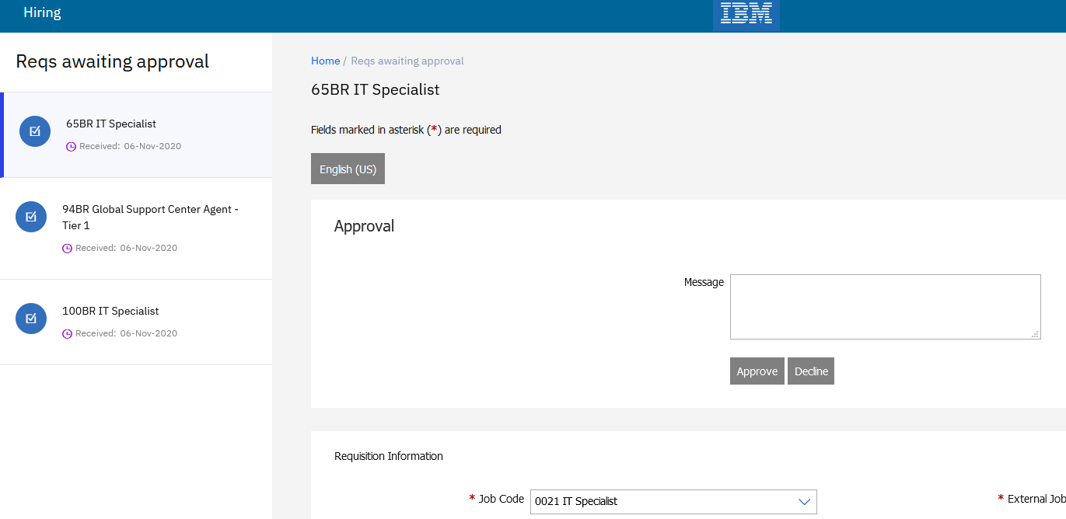
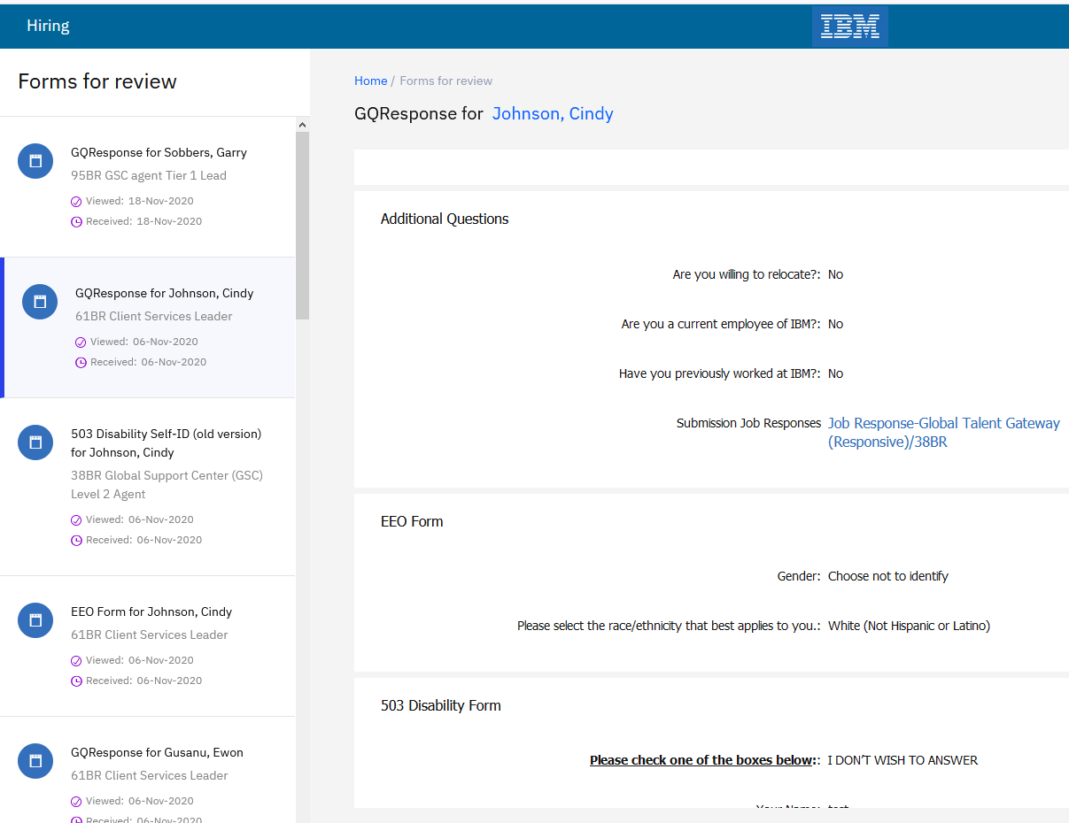

Slide 27
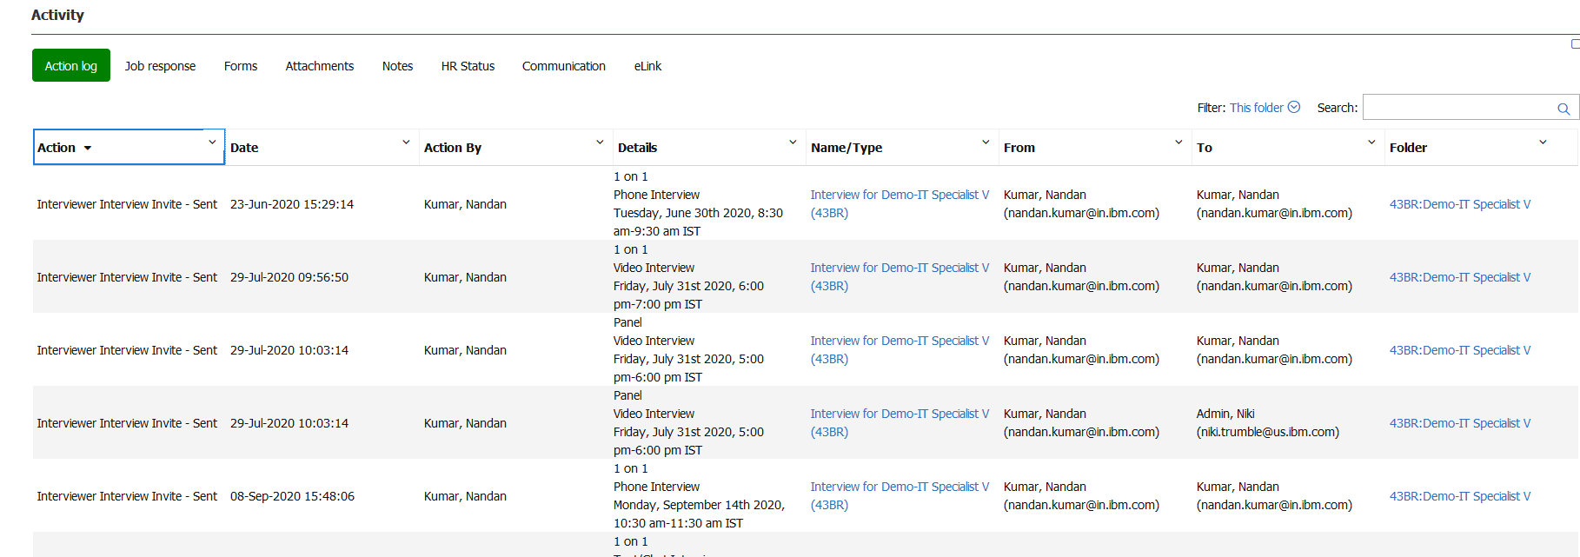
Interview Manager
Interview Manager Actions - Candidate Talent Record Action Log
Who’s Impacted:
Configurable or Visible:
Dark Launch: No
Benefits:
Interview coordinators can easily view Interview related information and navigate to the respective pages from Talent Record.
RTC #: 132855
Description:
Starting this release, when users or candidates take interview-related actions, a log entry is added to the Action log of the candidate's Talent Record.
The Activity log will display all the info related to a particular interview/candidate.
This includes: Interview creation, Availability requests sending & responding, Interview invitations sending & responding, Interview rescheduling, Declining, Scheduling & Canceling.
Users can navigate to respective page by clicking on the hyperlink under Name/Type.

Slide 28
Interview Manager Actions - Candidate Talent Record Action Log
Privileges:
All users who can see the current talent record action log will be able to see the interview manager logs as well.
Their access to see the hyperlink to view/edit interview details is based on the user's privilege to the interview.
If they have "View - "All Req" Interviews" privilege enabled, they can see the hyperlink and get to the interview details in VIEW mode for Interviews associated to the candidate on "All Reqs".
If the current user has the privilege "Restrict Manage Interviews for "My Reqs" (does not apply to My Interviews)" turned on, then the user can see the hyperlink and get to the interview details in VIEW mode for Interviews associated to the candidate on "My Reqs".
If the current user has "My Interview" access (interview creator/coordinator/coordination team) to the specific interview in context, then they can see the hyperlink and get to the interview details in EDIT mode.

Slide 29
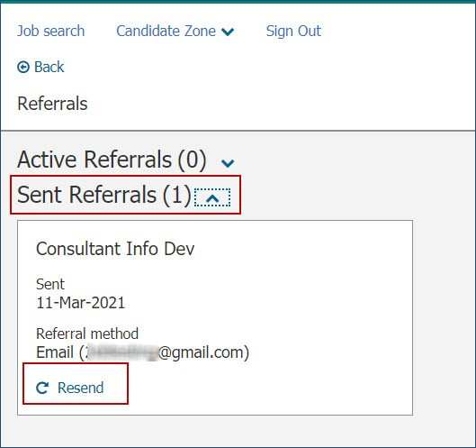
Talent Gateways
Social Referral - Resend Referral
Who’s Impacted:
Configurable or Visible:
Dark Launch: No
Benefits:
Employees will be able to resend the email with single click.
RFE
RTC #: 133095
Description:
Previously, resending an email reminder was available only through RAM triggers.
Now the resend option allows the referrer to resend an email.
Referred candidate information is available in the Referrals section of the Candidate Zone menu.
The referral card now displays a resend option if the referred candidate did not already apply for the job.
When the referrer selects Resend, a Send via email modal is displayed with the email address of the referred candidate.
The text of the resend action, remains non-editable.
Note: This action is available only for Referral methods "Send via email" and "Upload resume”.

Slide 30
BrassRing UI
Document Subsidiary Forms - Restrict Repost
Who’s Impacted:
Configurable or Visible:
Dark Launch: No
Benefits:
You can track the number of times a form (an offer) was declined or responded to.
Tracking and analyzing data is now easy.
RFE
RTC #: 133817
Description:
Previously, users were able to repost the same offer document (document template) with the same document subsidiary form (offer response) to a candidate.
Candidate had already provided the response through that form (accept/reject).
Starting this release, a new setting is added in the
Workbench for clients to restrict users from reposting the same form if a response is received from the candidate.
If a candidate already responded to the form, and if the BrassRing user tries to re the form, an error message is displayed.
Error message: You cannot repost this attachment as the form has already been completed.

Slide 31
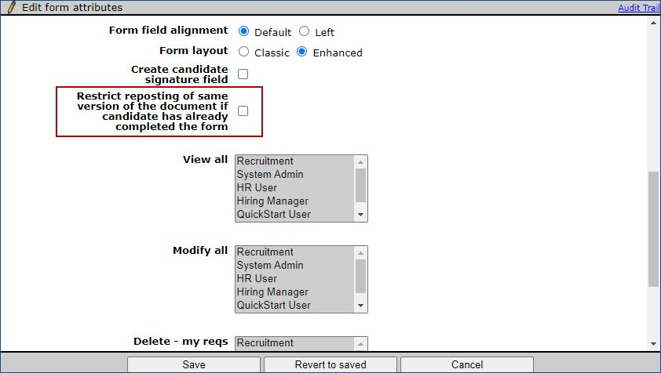
Workbench
Document Subsidiary Forms - Restrict Repost
Who’s Impacted:
Configurable or Visible:
Dark Launch: No
Benefits:
Can restrict the user to post the same form again.
RFE
RTC #: 133817
Description:
A new attribute is added to the document subsidiary forms during this release.
The new attribute Restrict reposting of same version of the document if candidate has already completed the form is added in the Edit form attributes screen.
Clients can disallow users from posting the same version of the form if it already has a response from the candidate.
Users must post a new version of the same form if this setting is checked.

Slide 32
Workbench
"Workbench Integration Log Search Updates
Who’s Impacted:
Configurable or Visible:
Dark Launch: No
Benefits:
Searching integration logs made faster.
Search is more refined.
RTC #: 133549
Description:
The search for integration logs in Workbench is done by using SOLR starting this release.
To support this search, and provide better user experience, three radio buttons are added next to the ﬁeld containing text in the Retrieve client posts screen.
Exact match - Looks for text blobs that contain ALL the words that are entered in the search text in the same sequence.
Match all words - Looks for text blobs that contain ALL the words that are entered in the search text, not necessarily in the same sequence.
Match any word - Looks for text blobs that contain at least ONE of the words that are entered in the search text.

Slide 33
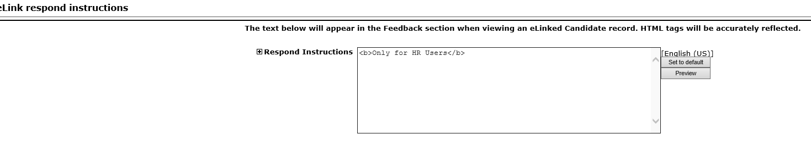
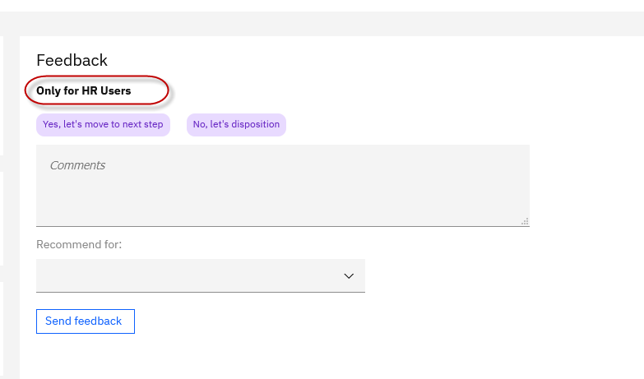
Workbench – eLink Dashboard eLink Respond Instructions
Who’s Impacted:
Configurable or Visible:
Dark Launch: No
Benefits:
Specific instructions can be provided for users in the feedback section
RTC #: 134073
Description:
The text on the eLink respond instructions page is updated.
Previously the text used to read: "The text below will appear to the left of the Respond button when viewing an eLinked Candidate record. HTML tags will be accurately reflected."
This text is now updated to “The text below will appear in the Feedback section when viewing an eLinked Candidate record. HTML tags will be accurately reflected.”
The text would be presented in the feedback section inside eLink Dashboard view & New eLink view.

Slide 34
Workbench – eLink Dashboard
Conﬁgure or Edit Privilege for Code Access Groups - Workbench Self-Service Tier 5
Who’s Impacted:
Configurable or Visible:
Dark Launch: No
Benefits:
Provides configurational access inside Workbench
RTC #: 134073
Description:
Starting this release, the Workbench Self-Service Tier 5 users can access, conﬁgure, and edit the Code Access Groups in Workbench.
Users can go to Tools > Users > Code access groups.

Slide 35
BrassRing UI
Candidate Form Approval - First Approver Comments
Who’s Impacted:
Configurable or Visible:
Dark Launch: No
RTC #: 132624
Description:
It was previously observed that when candidate form is sent for approval to the second approver, the ﬁrst approvers comments are missing.
This behavior is adjusted in the current release.
The ﬁrst approver comments are now displayed to the second approver.

Slide 36
BrassRing UI
Candidate Import - Update Deleted Candidate
Who’s Impacted:
Configurable or Visible:
Dark Launch: No
RTC #: 133755
Description:
It was observed that when a Candidate import is carried out, candidate records that are previously deleted were also getting updated.
This behavior is addressed in the current release.
If related to a candidate with a deleted resume key is presented in a candidate import, such record and information are rejected by the system.

Slide 37
Lead Manager
Release Features
–

Slide 38
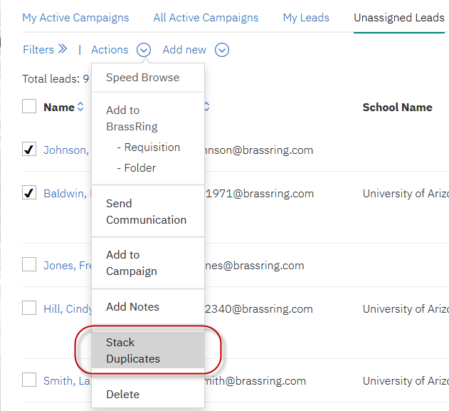
Lead Manager
Stack Duplicates
Who’s Impacted:
Configurable or Visible:
Dark Launch: No
Benefits:
Lead coordinators can stack duplicate leads manually
Removes duplicate leads from the system
Merges the info of the deleted lead with the lead profile that’s retained
RFE
RTC #: 124966
Description:
Starting this release, Lead Manager users can select, and stack duplicate leads manually.
A new menu action Stack Duplicates is now available in Lead Manager in the following menus:
My Leads in the Lead Manager home page.
Unassigned Leads in the Lead Manager home page.
Campaign Lead listings (Standard and Advanced views.
Lead Search results.
The users must select exactly two leads before they select the Stack duplicates action.

Slide 39
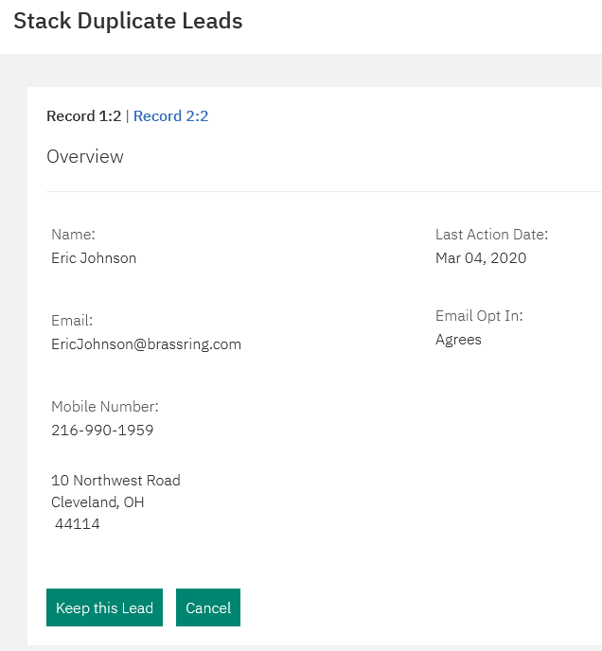
Lead Manager - Stack Duplicates
When two leads are selected for stacking, a new modal is displayed with the summaries of the selected leads.
Two floating buttons are displayed at the start of each lead with labels Keep this lead Cancel.
When users select Keep this lead, a warning modal is displayed with the message
Please note that by clicking 'OK', the system will keep the overview information for this record. The overview of the previous record will be deleted, and all other data will be merged into this record.
Note: If the lead did not provide consent for GDPR, the following warning modal is displayed - You cannot select a lead to keep if the lead has not consented. Select OK to close the modal and take no further action. If the user selects Cancel, the grid in which they selected the leads for stacking is displayed.

Slide 40
Lead Manager - Stack Duplicates
When users proceeds with stacking, the following rules are applicable regarding the two leads:
The primary overview information from the lead that is selected is retained in full.
All the Talent Record associations with the lead that is retained are retained in full.
Any responses to any questions associated with the lead that is retained are retained in full.
Responses for the lead that is stacked are removed.
If a Talent Record association is present with the lead that is stacked (not being retained), this association is removed (deleted).
Any campaigns associated with the lead that is stacked are updated to reflect the lead that is retained.
For any campaigns that the two leads share, the lead that is stacked is deleted from the campaign and the status of the lead that is retained prevails.
Any notes that are associated with the stacked lead are retained.
Any attachments (including resumes) associated with the stacked lead are retained.
If either of the leads is tagged as conﬁdential, that attribute is carried over regardless of which lead is stacked.
Any teams conﬁgured to access the conﬁdential leads can access the stacked lead.

Slide 41
Lead Manager
User Permission - Update
Who’s Impacted:
Configurable or Visible:
Dark Launch: No
RTC #: 132941
Description:
Based on conﬁguration, if users have access to view all the campaigns, they see all the campaigns.
If the users do not have access to view all campaigns, they should be able to access only the campaigns with which they have My Campaign relationship.
However, it was found that the users were able to view campaigns with which they do not have the My campaign relation.
When Lead Manager users search for campaigns, they were able to access other campaigns even when they do not have the View all access.
This behavior is addressed in the current release.
Starting this release, users that have the appropriate permissions can view a campaign.

Slide 42
Upcoming Builds
RAM - Send reminders based on date field on any form.
ELink Dashboard – Show/Hide Years of Experience, Show/Hide Download PDF button
DIT – Ability to perform renew action on other’s schedules
TG – Parse resume info from previous page
Interview Manager - Allow scheduling on busy slots
Lead Manager - Speed Browse - Add remove lead from campaign option

Slide 43
Questions?

Slide 44
MARCH VIRTUAL TRAINING SESSIONS
Client-facing training schedule
Sunday | Monday | Tuesday | Wednesday | Thursday | Friday | Saturday
 | 1 | 2 Client: Learning Series: BrassRing Web/Jobs API (11AM EST) | 3 | 4 Client: New Idea Portal - Migration of RFEs (11AM EST) | 5 | 6
7 | 8 | 9 | 10 | 11 Client: Slack Me Anything (11 AM EST) | 12 | 13
14 | 15 | 16 | 17 | 18 Client: BR 12.03.15 Release Enablement | 19 | 20
21 | 22 | 23 | 24 | 25 Client: RESCHEDULED TAS Roadmap Session | 26 | 27
28 | 29 | 30 | 31

Slide 45
APRIL VIRTUAL TRAINING SESSIONS
Client-facing training schedule
Sunday | Monday | Tuesday | Wednesday | Thursday | Friday | Saturday
 |  |  |  | 1 | 2 | 3
4 | 5 | 6 | 7 | 8 | 9 | 10
11 | 12 | 13 | 14 | 15 Client: BR 21.04.12 Release Enablement | 16 | 17
18 | 19 | 20 | 21 | 22 Client: TAS Roadmap | 23 | 24
25 | 26 | 27 | 28 | 29 | 30

