Slide 1
BrassRing, Onboard and Lead Manager on Cloud Release 21.01.20
—
Client Training and Enablement Session
Talent Management Solutions
January 21st, 2021

Slide 2
Onboard Release Features
–
Staging (US): January 14th , 2021
Production (US): January 23rd , 2021
There are no Dark Launch features for this release.

Slide 3
Features Being Released this Month
–

Slide 4


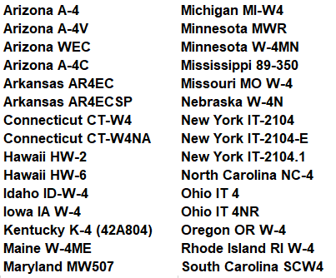
Updates to State and Federal Forms
How do you get it?
Visible Change
Who does it affect?
New Hire
Description:
Below state tax forms have been updated in the January Release.
United States Forms:
Benefits:
Latest version of state tax forms available for new hires to complete
Latest version of 2021 W-4 Federal form available for new hire to complete

Slide 5
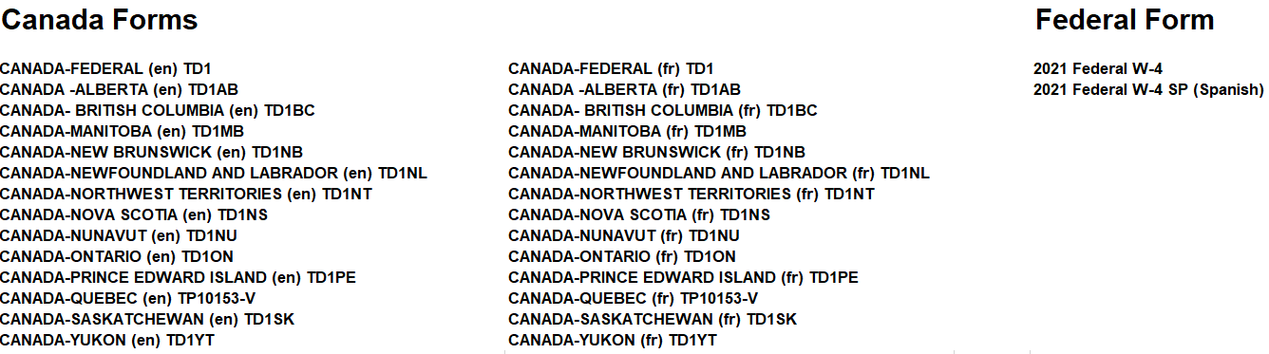
Updates to State and Federal Forms

Slide 6
WOTC: Handling of Two Error Codes Has Changed
How do you get it?
Visible Change
Who does it affect?
New Hire
Description:
The handling of two WOTC (Work Opportunity Tax Credit) error codes has changed.
InvalidVendorRefID: This is returned from Ernst & Young whenever an SSN mismatch occurs.
Note: When this error displays, it indicates the same Vendor Reference ID (VRID) has been submitted for different SSNs.
Previously, there was a generic error message: S-27-000: A system error has occurred. For assistance, please contact your system administrator and mention error code.
With this release, it will display an error message related to SSN mismatch.
InvalidApplicantData: This is returned when the respective VRID record is not found in Ernst & Young.

Slide 7
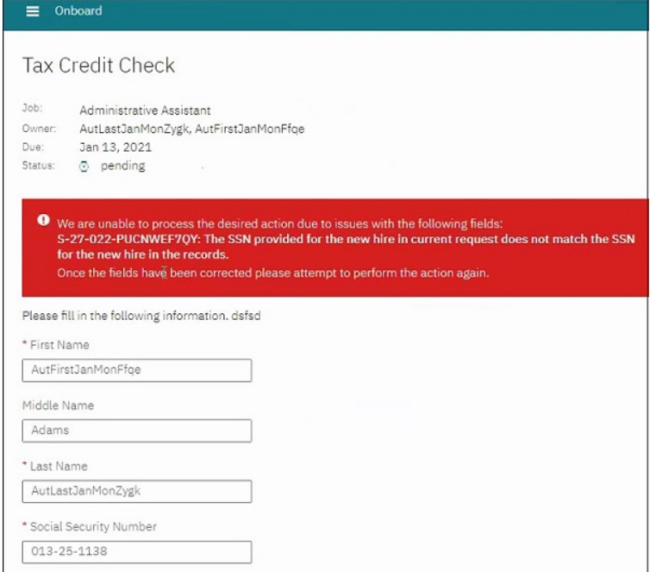
WOTC: Handling of Two Error Codes Has Changed
How do you get it?
Visible Change
Who does it affect?
New Hire
As per E&Y, it is returned from AURT, AORT and ASRT (new hire update and request).
Under very specific conditions, the AORT can return this error, but it’s very rare and has many conditions.

Slide 8
View-Only Task Implementation for Activities
How do you get it?
Configurable Change
Who does it affect?
Onboarding Manager
Description:
System administrators can prevent user types from completing tasks they can see but are not responsible for.
This can be configured per task, per workflow.
User types can be configured for the setting “Prevent user type(s) from view/edit/completion of this task”.
If the configured user type has unrestricted capability, Task view within the interface will still be hyperlinked, but they can’t complete it.
Benefits:
Restricts user types from view, edit and complete tasks.
View only Task available for the following Activities:
  NO_TEMPLATE
  ONBOARD_START
  ONBOARD_END
  STATE_FORM_ACTIVITY
  GENERIC_FORM_ACTIVITY

Slide 9
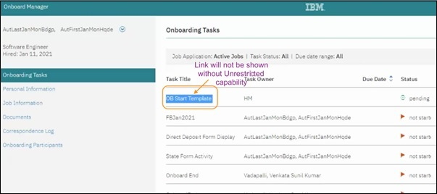
View-Only Task Implementation for Activities
User types must select the task to view it after it is completed, but the user can’t edit or complete the task.
For view-only tasks, When hyperlink is selected the following message “you have view-only access to this task” is displayed.
Below screenshot is for both prevented and unprevented users without the unrestricted task view capability.

Slide 10
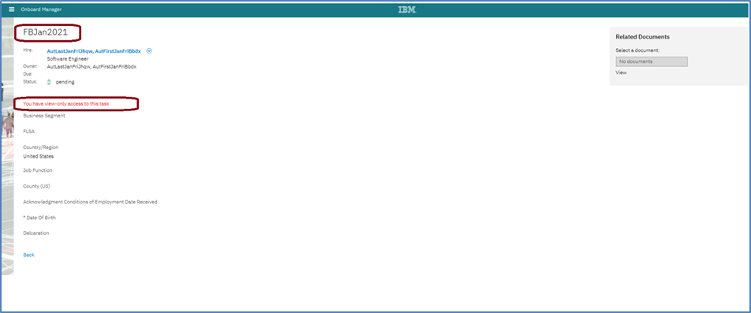
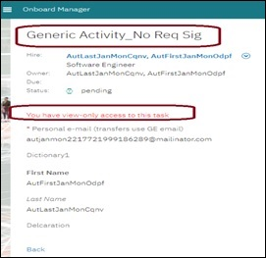
View-Only Task Implementation for Activities

Slide 11
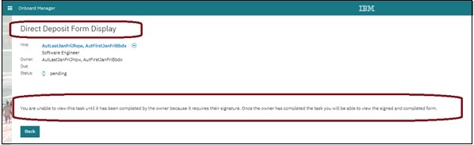
View-Only Task Implementation for Activities

Slide 12
Upcoming Builds
Date Picker
Bulk Action Email
Access to New Hire Experience through candidate zone – SSO
New Public Filter for Activities in Progress
Add Quick Search to Onboard Pages
Mass Job Update for Participants

Slide 13
BrassRing Release Features
–

Slide 14


Feature
BrassRing UI | Candidates - eSignature
 | Data Insight Tool - Scheduling and Communication Enhancements
 | Candidate Search Results - Number of Selected Candidates
 | Communications Templates for eLinks
 | Interview Manager - Add Interviewers - Multi-Select
 | Talent Gateways - Additional Source Code Passing
 | Proximity Information - City Name Update Reversal
 | Talent Gateways - Offer Letter Retrieval for SSO Talent Gateways
Feature | Description
Workbench | Reqs - Prevent Closing if None Hired
 | Talent Gateway - Footer Enhancements
 | Candidates - eSignature - Workbench Changes
 | Panel Conﬁguration Deletion - Invalid User type Data
 | Rules Automation Manager (RAM) - Interview Manager - Interview Expiry Reminder
 | Client Setting - Disable After Conﬁguration
 | Client Settings - eLink Dashboard Conﬁguration
Icon Key
Configurable Feature
Visible Feature
Requires IBM to Enable
Recruiters Affected
Candidates Affected
Accessibility Update
RELEASE DATES
Staging:
January 20th, 2021
Production:
January 27th, 2021
Dark Launch Feature
Information
RFE Feature
NPS Feature
RFE
NPS

Slide 15
Dark Launch Features

Slide 16
Who’s Affected:
Recruiters
Configurable or Visible?
VISIBLE
BrassRing UI
Data Insight Tool - Scheduling and Communication Enhancements
RTC #: 58959
Description:
There are 2 new enhancements introduced inside DIT.
End date selection.
Schedule expiry and communication.
A new default expiration frequency is introduced in Data Insight template scheduling.
All scheduled templates must now have an expiration/end date.
A user cannot schedule a report without selecting an end date.
The owners of the respective templates will receive the notiﬁcation emails.
This feature is released to STAGING ONLY with January release.
It will NOT go to PRODUCTION with this release.
This will help in optimal usage of resources and smooth delivery of reports.

Slide 17
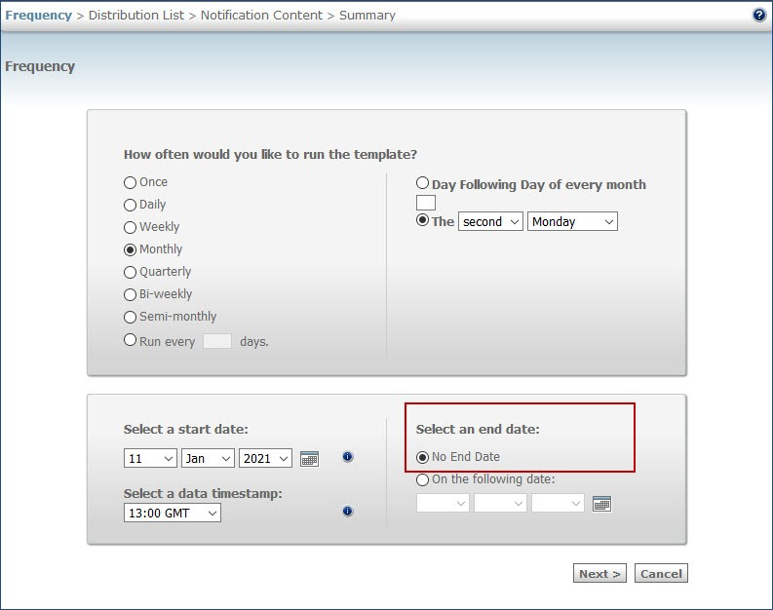
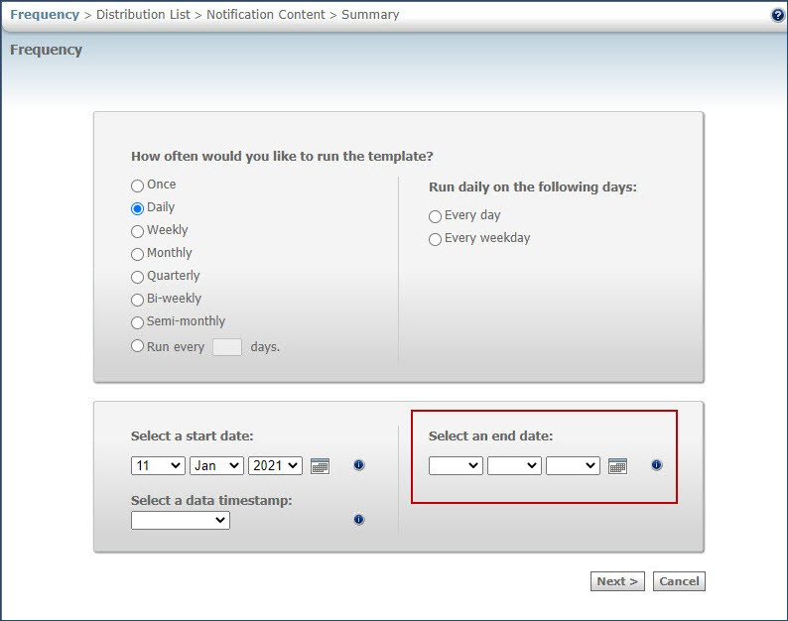
DIT – End Date Selection
Before
After
Note: If a user tries to select Next without selecting an end date, an alert message is displayed stating that an end date needs to be selected.

Slide 18
DIT - End Date Selection
Criteria:
The end date cannot exceed a timeframe that is determined based on the schedule frequency.
End date selection can be done based on the following criteria:
Templates that are scheduled with a frequency of daily, weekly, bi-weekly, or semi-monthly must have an end date less than six months from the start date or the current system date.
Templates that are scheduled with a frequency of monthly, and quarterly must have an end date less than 12 months from the start date or the current system date.
Templates that are scheduled with the frequency of run every 'X' days must have an end date less than 6 months + 2X days selected from the start date or the current system date.
The new feature applies to schedules that are newly created and any schedules that are edited after the release of this feature.
A migration activity is planned to set an end date for the existing schedules that do not have a user-deﬁned end date.
Templates that were previously scheduled without an end date are going to be set up with an end date based on a calculation explained here

Slide 19
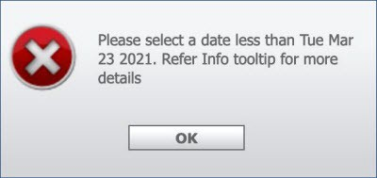
DIT - End Date Selection
Examples for calculating the expiry date when users schedule new jobs:
Schedule Type | Max Allowed Limit | Start Date | Max Possible End Date
Daily, Weekly, Bi-weekly, or Semi-monthly | 6 Months | 15 January 2021 | 14 July 2021
Monthly or Quarterly | 12 Months | 15 January 2021 | 14 January 2022
Run every “X” days (e.g.: 5 days) | 6 Months + 2X Days | 1 February 2021 | 10 August 2021
If a user sets an end date that exceeds the timeframe set for the respective schedule, an alert message is displayed.
The alert message displays the farthest date and users can refer to the tooltip message that provides the criteria.

Slide 20
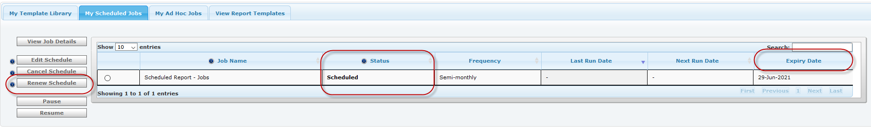
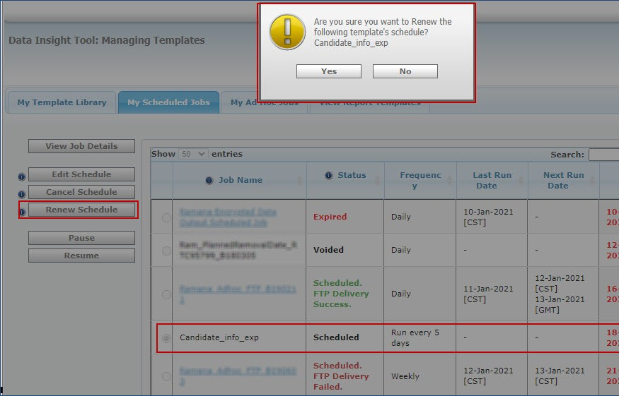
DIT - End Date Selection
A new column Expiry Date is added to the My Scheduled Jobs table.
This column displays the expiry date of the user's job that is approaching expiry.
Status column displays the status of expired jobs as Expired in red.
This status is displayed for 14 days from the date of expiry.
Users can renew the schedule of the job during this renewal window using the new button Renew Schedule.
Renewal window for a scheduled job is opened 14 days before the date of expiry and up to 14 days after the expiry.
This button is enabled for a scheduled job only during the 28 days of the renewal window and is disabled during all other time.
When users select Renew Schedule, the schedule is renewed based on the criteria and the next expiry date is displayed.

Slide 21
DIT - Schedule Expiry & Communication
A new setting has been introduced for notifying users for their scheduled jobs.
The owners of the respective templates receive notiﬁcation emails based on the conﬁguration that is available in the Workbench client settings.
Clients can conﬁgure the frequency at which they might receive the schedule expiry notiﬁcations.
The client-setting DIT schedule expiration notiﬁcation frequency is available with the following frequencies of notiﬁcation:
14 days and 1 day (default)
7 days and 1 day
1 day
No notiﬁcation
When users receive a notiﬁcation, they can verify and decide to let the scheduled job expire or validate and renew.
A user receives a single email that lists all their schedules getting expired in 1, 7 & 14 days (based on the expiration notification setting)
Note: This is a client setting. Please reach out to your IBM representative for any changes to this setting.

Slide 22
Features Being Released this Month

Slide 23

Who’s Affected:
Recruiters, Candidates, Workbench Admins
Configurable or Visible?
CONFIGURABLE
BrassRing UI/Talent Gateways
Candidates - eSignature
RTC #: 131192, 131415
Description:
The eSignature feature is now getting released to Production.
Candidates can add, edit and view an eSignature on candidate forms and document subsidiary forms.
A new Signature ﬁeld with the link Create signature will be presented where candidates can Draw, Upload and/or Type a signature.
It is also available to be used inside a Gateway Questionnaire (GQ).
This feature was released to STAGING ONLY with December release.
It will go to PRODUCTION with January release.

Slide 24
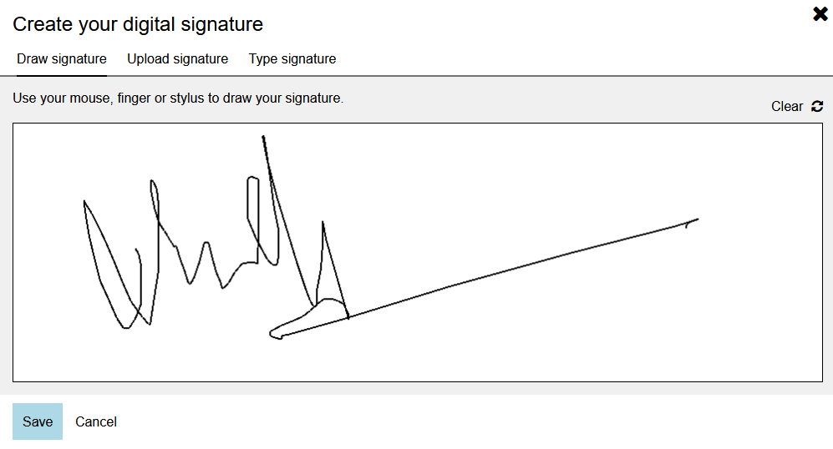
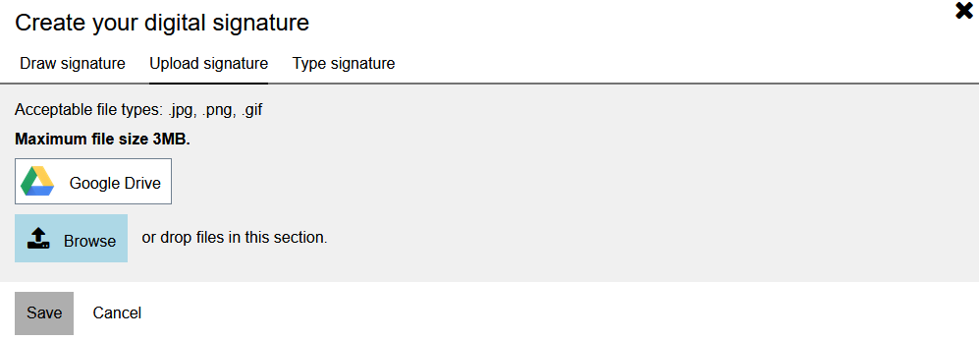
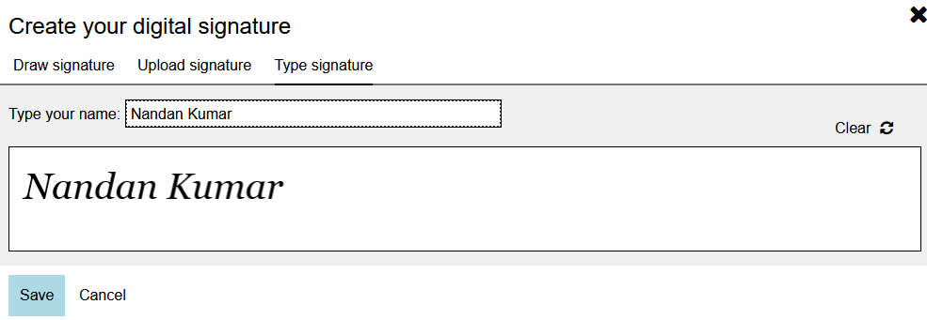
Candidates - eSignature
Draw Signature:
  Depending on the device the candidates use, they can draw a signature in the ﬁeld either using a mouse or similar input device or with their ﬁnger if it is a touch enabled device.
  The drawn signature is stored in the system (database) as a .png format ﬁle.
Upload signature:
  Candidates can upload an existing signature that is available in one of the permitted formats. The Upload signature modal displays the list of permitted formats.
  The uploaded ﬁle is saved in the same format in the system. If candidate attempts to upload a ﬁle of a type that is not permitted, an error message is displayed.
Type signature:
  Candidates that do not have an input device that enables them to draw a signature can simply type in their signature.
  Signature is again stored in .png format in the system (database).

Slide 25
Candidates - eSignature
BrassRing users with appropriate privileges see the ﬁeld depending on the conﬁguration.
The ﬁeld is available for editing only for candidates.
The existing Workbench settings are updated to enable conﬁguration for the signature ﬁelds in the candidate forms and document subsidiary forms.
When the form is in view-only mode and eSignature has saved value, the form will display the corresponding image.
This field will only work for candidate facing e-links.
The field will also work inside Candidate Zone -> Forms section, when the respective candidate forms or document subsidiary forms are sent.
The field cannot be used inside JSQs (Job Specific Questions).

Slide 26
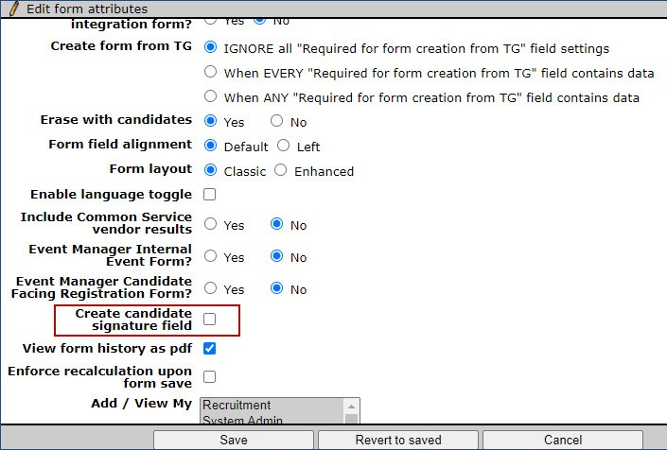
Who’s Affected: Workbench Admin
Configurable or Visible? CONFIGURABLE
Workbench
Candidates - eSignature - Workbench Changes
RTC #: 131654
Description:
The eSignature configuration can be done at form level.
Existing attribute "Create Candidate Signature Field(for use in Gateway Questionnaires only)” has been renamed to "Create Candidate Signature Field“.
Turning on this attribute will automatically create a standard eSignature field on the form.
Only supported in Candidate forms and Doc Subsidiary forms.
Only one eSignature field is allowed per form.
GQ can be configured with eSignature with a new complex widget.

Slide 27
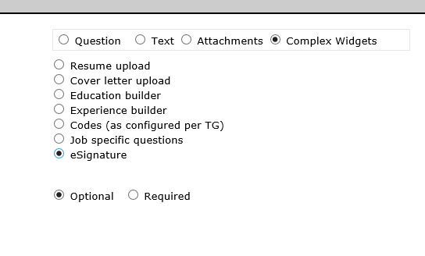
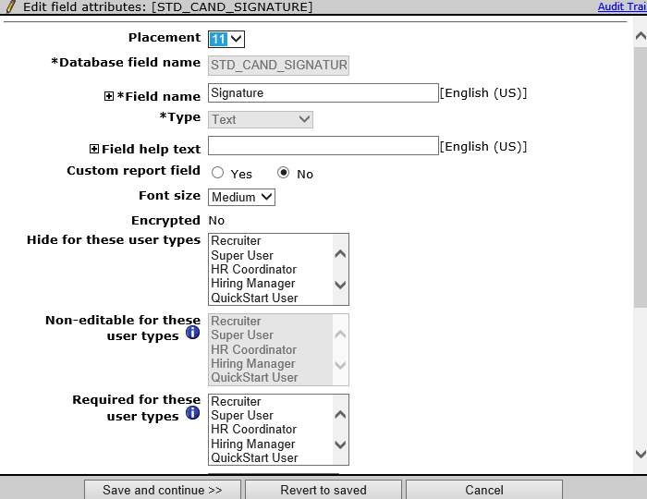
Candidates - eSignature
Gateway Questionnaire changes:
The eSignature ﬁeld is implemented in Gateway Questionnaires in the form of a complex widget.
A new complex widget named eSignature is available in Gateway Questionnaires.
When the eSignature complex widget is enabled and rendered on Talent Gateway Questionnaire, the response is captured into all the eSignature ﬁelds associated to the forms on the Gateway Questionnaire.
Only one signature can be added per Gateway Questionnaire.
Restrictions:
Field cannot be made searchable & outputable.
Field cannot be made encrypted.
Field cannot be inactivated or deleted.
Database name cannot be changed. By default, “non-editable” for all user types as this is explicitly for candidates use.
Form preview and field preview will display the field in add mode (icon/link), like candidate would see, but cannot click to launch the esignature. widget/modal.
eSignature Field will NOT be available to be Auto filled from.
Field cannot be configured as a CHILD for Field Associations, unlike a regular text field type.

Slide 28
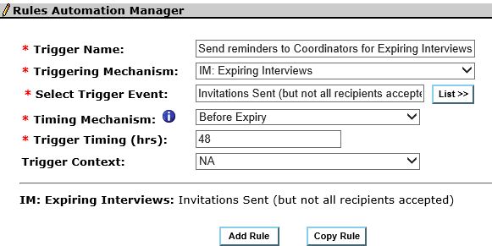
Who’s Affected: Workbench Admin
Configurable or Visible? CONFIGURABLE
Workbench
RAM -Interview Expiry Reminder
RTC #: 128225
Description:
A new Reminder Interview RAM Trigger Mechanism with associated attributes is added to the Rules Automation Manager.
This trigger can be used to send reminders to interview coordinators about the interviews that are about to expire.
This will help the interview coordinator to intervene and ensure that the interview is completed without getting expired.

Slide 29
RAM -Interview Manager Send Reminders to Coordinators
Attributes for the new trigger:
  Trigger Name: Send reminders to Coordinators for Expiring Interviews
  Trigger Type: RAM Trigger
  Triggering Mechanism: Interview Manager: Expiring Interviews
    Select Trigger Event: 3 options
      Invitations Sent (but not all recipients accepted)
      Availability Requested (but not scheduled)
      Scheduled but no communication sent
  Timing Mechanism: Before Expiry (only option, default selection)
  Trigger Timing (hrs): 48 hrs [2 days in advance, default value can be changed to integer value (Min 1, Max no limit)].
  Triggering Context: NA [only value, selected by default]
Rules: [blank by default, user can Add Rule as normal]
Actions: Normal Options. If Action is selected as “Send Communication”:
  Select notiﬁcation template allows for normal communication templates as well as Interview Manager templates (that contains one or more interview tokens).
  Select recipients includes normal recipient options as well as interview options:
    [Interview Fields] Interviewer
    [Interview Fields] Lead Coordinator
    [Interview Fields] Coordination Team

Slide 30
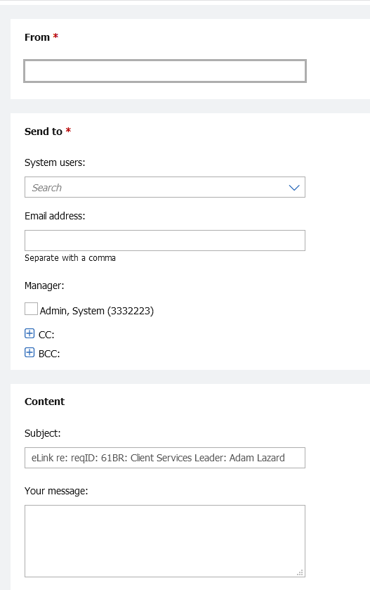
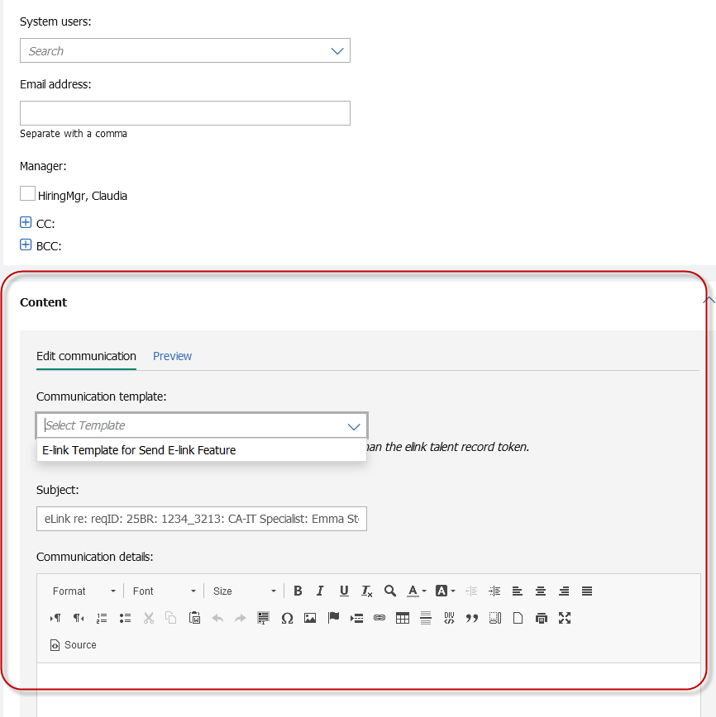
Who’s Affected:
Recruiters
Configurable or Visible?
VISIBLE
BrassRing UI
Communications Templates for eLinks
RTC #: 126313
Description:
Previously, there was no option to use a communication template while sending eLinks.
Starting this release, the Send eLink screen provides an option to select a communication template.
  The eLink message regular text box is now replaced with CK editor.
  The selected communication template can be edited and previewed by the user before sending it out.
  Users can also add attachments from the local device or the candidate's Talent Record.
  Admins can configure specific communication templates for this purpose inside BrassRing.
This feature was released to STAGING ONLY with October release.
It will go to PRODUCTION with January release.

Slide 31

Who’s Affected: Workbench Admin
Configurable or Visible? CONFIGURABLE
Workbench
eLink Dashboard Conﬁguration
RTC #: 131873
Description:
Based on client feedback and request, 2 new eLink dashboard conﬁguration settings are now available for configuration.
ELink Dashboard - Days Back
Allows to conﬁgure the number of retrospective days for which the users' data is retained inside Dashboard.
ELink Dashboard - Passcode Frequency
Allows to conﬁgure the frequency at which the user is prompted to enter a passcode to authenticate a device (if session is still active) for eLink Dashboard.
ELink Dashboard is available only in Staging.
Options: 10, 20, 30, 60, 90, 120, 180 Days
Options: 30, 60, 90 Days
Note: This is a client setting. Please reach out to your IBM representative for any changes to this setting.

Slide 32
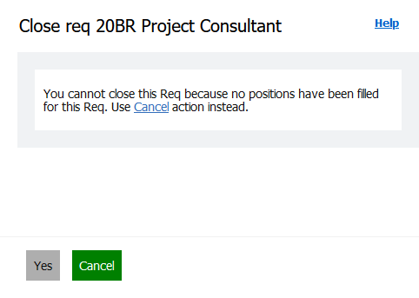
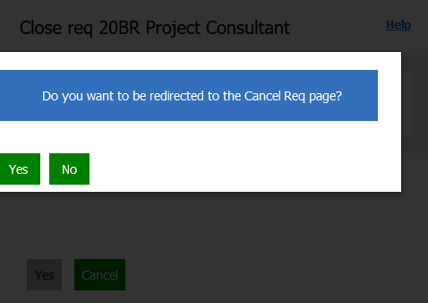
RFE
Who’s Affected: Recruiters, Workbench Admins
Configurable or Visible? CONFIGURABLE
BrassRing UI/Workbench
Reqs - Prevent Closing if None Hired
RTC #: 132347, 132913
Description:
A new client setting has been introduced in Workbench, based on which you can chose to allow or prevent your users from closing a req before no hiring is done in that req.
If you opt to prevent your users from closing a req, a validation message is displayed when they attempt to close a req before hiring a candidate.
Users would be able to close:
If there are candidates in the HIRED HR status category
OR
If the position remaining for the req is less than the number of positions.
Users with appropriate user type privileges can Cancel the req instead.
Note: This is a client setting. Please reach out to your IBM representative for any changes to this setting.

Slide 33
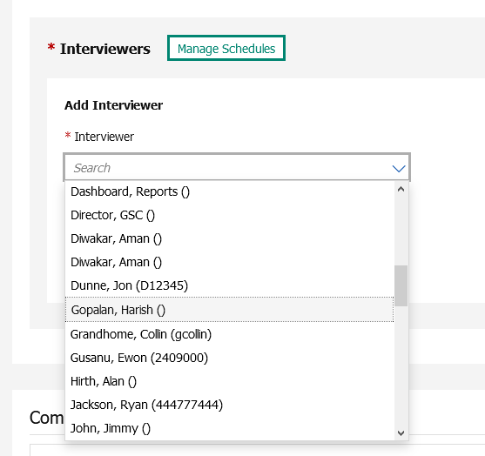
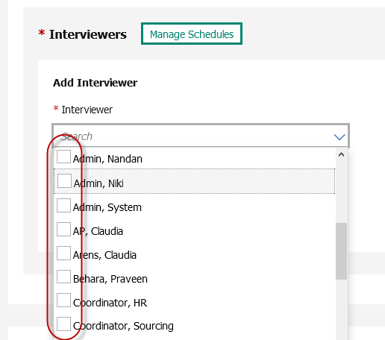
Who’s Affected: Recruiters/Interview Coordinators
Configurable or Visible? VISIBLE
BrassRing UI
Interview Manager - Add Interviewers - Multi-Select
RTC #: 126626
Description:
Previously, interview coordinators were required to add each interviewer (system users) individually even when it was a panel style interview.
Starting this release, interviews of the style Panel provide the capability of selecting multiple interviewers while scheduling or editing an interview.
This change is available in the following areas:
Create Interview
Edit Interview (Manage Schedules page)
Before
After

Slide 34
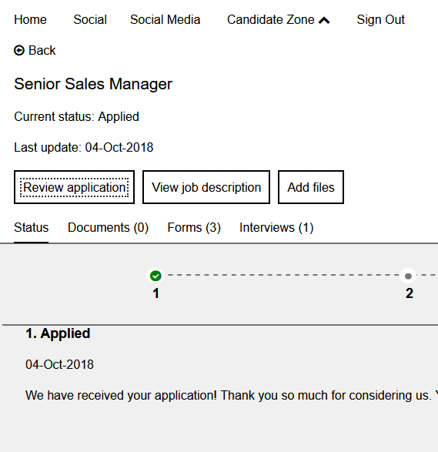
Who’s Affected: Candidates
Configurable or Visible? VISIBLE
Talent Gateways
Offer Letter Retrieval for SSO Talent Gateways
RTC #: 132549
Description:
At present the candidate zone token URL or link in the candidate communication opens the Candidate Zone (Dashboard) page when the candidate authenticates on the SSO Talent Gateway.
Candidates have to further navigate to open the doc sub forms or the posted offer letter.
Starting this release, the candidate zone token link in the candidate communication opens Application Details page for the speciﬁc job along with posted documents and forms.
They directly see the Application details page where the offer letter notiﬁcation is displayed.
This change is beneficial if you are using SSO (Single Sign-on) on your Talent Gateway.

Slide 35
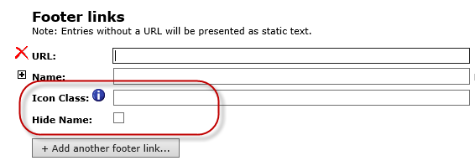
Who’s Affected: Workbench Admin
Configurable or Visible? CONFIGURABLE
Workbench
Client Setting – Footer Links Conﬁguration
RTC #: 131730, 132987
Description:
During the previous release (R 20.12.01), a new hidden client setting Allow icon conﬁguration on Talent Gateway footer links was added to the Workbench.
The setting was added with No as a default option for all clients.
Now the setting is available to be used inside Client Settings with Yes & No options.
Once enabled 2 new fields are displayed for custom TG footer links:
Icon Class: Icon Class" allows display of (limited) icons from Font Awesome.
Hide Name: Hide Name allows showing icon-only.
Note: This is a client setting. Please reach out to your IBM representative for any changes. Once enabled this setting cannot be disabled.

Slide 36
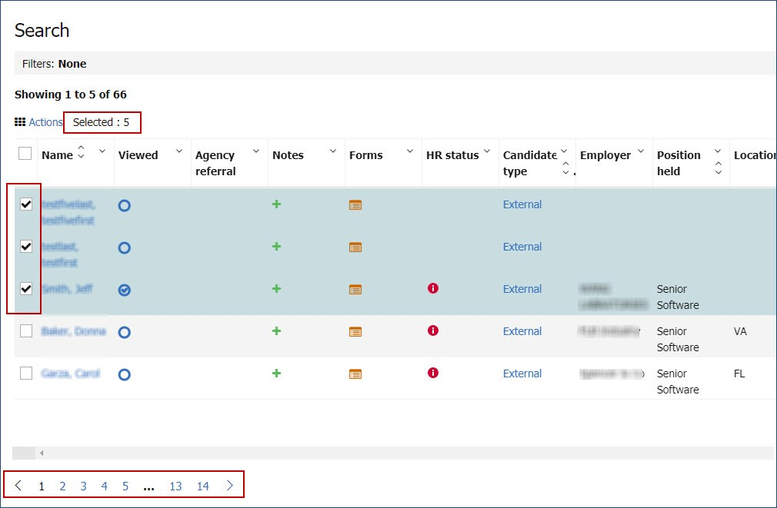
Who’s Affected: Recruiters
Configurable or Visible? VISIBLE
BrassRing UI
Candidate Search Results - Number of Selected Candidates
RTC #: 132048
Description:
Before this release inside Candidate Search results page, number of selected candidates were not displayed.
Starting this release, the candidate search results page displays the number of candidates that are selected by a user across the search result pages.
When users select candidates in ﬁrst page and move over to the next pages, the number of selected candidates is displayed on the search results screen.
This number gets updated as the users further selects candidates.

Slide 37
Who’s Affected: Recruiters
Configurable or Visible? VISIBLE
Talent Gateways
Talent Gateways - Additional Source Code Passing
RTC #: 133154
Description:
It was observed that when candidates open & view multiple jobs on a Talent Gateway which have different source codes appended to them and apply for only one of the viewed jobs, then multiple source codes were getting captured inside BrassRing for that one job.
This behavior has been changed.
Starting this release, only code(s) of the jobs to which the candidates have applied are added to the candidates Talent Record.

Slide 38
Who’s Affected: Workbench Admin
Configurable or Visible? VISIBLE
Workbench
Panel Conﬁguration Deletion - Invalid User type Data
RTC #: 131552
Description:
When a Workbench user attempts to delete a panel conﬁguration, a validation message is displayed if there are any user types that are associated with the panel conﬁguration.
If there are no user types associated with the panel conﬁguration, then the delete action is permitted even if the conﬁguration exists for some users.
Starting this release, a new warning message is displayed while deleting the panel conﬁguration if there are no user types associated, but there are users with the panel conﬁguration.
The validation message asks if the user is okay to proceed with the deleting the panel conﬁguration by deleting all the user level conﬁgurations.

Slide 39
Who’s Affected: Recruiters
Configurable or Visible? VISIBLE
BrassRing UI
Proximity Information - City Name Update Reversal
RTC #: 133323
Description:
The names of a group of cities were updated previously.
However, some clients found this change to be conflicting with their existing information.
Therefore, the updated names are being reverted to the original spellings.
PREVIOUSLY UPDATED NAME | REVERTING TO ORIGINAL NAME
St. Augustine | Saint Augustine
St. Charles | Saint Charles
St. Louis | Saint Louis
St. Peters | Saint Peters
Lake St. Louis | Lake Saint Louis

Slide 40
Upcoming Builds
RAM - Send reminders based on date field on any form.
E-link Dashboard – Client Setting & Communication Template Token
Interview Manager – Talent Record Action Logs
Lead Manager – Manual Stacking

Slide 41
JANUARY VIRTUAL TRAINING SESSIONS
Client-facing training schedule
Sunday | Monday | Tuesday | Wednesday | Thursday | Friday | Saturday
 |  |  |  |  | 1 New Years Day- IBM Offices Closed | 2
3 | 4 | 5 | 6 | 7 | 8 | 9
10 | 11 | 12 | 13 | 14 Client: eLink Dashboard Config and Usage (11AM EST) | 15 | 16
17 | 18 MLK Day- US Office Closed | 19 | 20 | 21 Client: BR 21.01.20 Release Enablement (11AM EST) | 22 | 23
24 | 25 | 26 | 27 | 28 Client: Slack Me Anything (11 AM EST) | 29 | 30
31

Slide 42
FEBRUARY VIRTUAL TRAINING SESSIONS
Client-facing training schedule
Sunday | Monday | Tuesday | Wednesday | Thursday | Friday | Saturday
 | 1 | 2 | 3 | 4 | 5 | 6
7 | 8 | 9 Client: Virtual Round Table: BR Talent Gateways Skip Sign-On | 10 | 11 | 12 | 13
14 | 15 | 16 | 17 | 18 Client: BR 21.05.15 Release Enablement | 19 | 20
21 | 22 | 23 Client: Q1: TAS Roadmap Session | 24 | 25 | 26 | 27
28

Slide 43
Questions?

