Slide 1
BrassRing, Onboard and Lead Manager on Cloud Release 20.10.12
—
Client Training and Enablement Session
Talent Management Solutions
October 15th, 2020

Slide 2
Onboard Release Features
–
Staging: October 08th , 2020
Production: October 17th , 2020

Slide 3
Dark Launch Features
There are no Dark Launch features for this release.

Slide 4
Features Being Released this Month
–

Slide 5


Updates to State and Federal Forms
How do you get it?
Visible Change
Who does it affect?
Onboarding Manager, New hire
Description:
New Delaware – DE W-4 state form is available from October Release.
Benefits:
New state tax form is available for new hires to complete

Slide 6
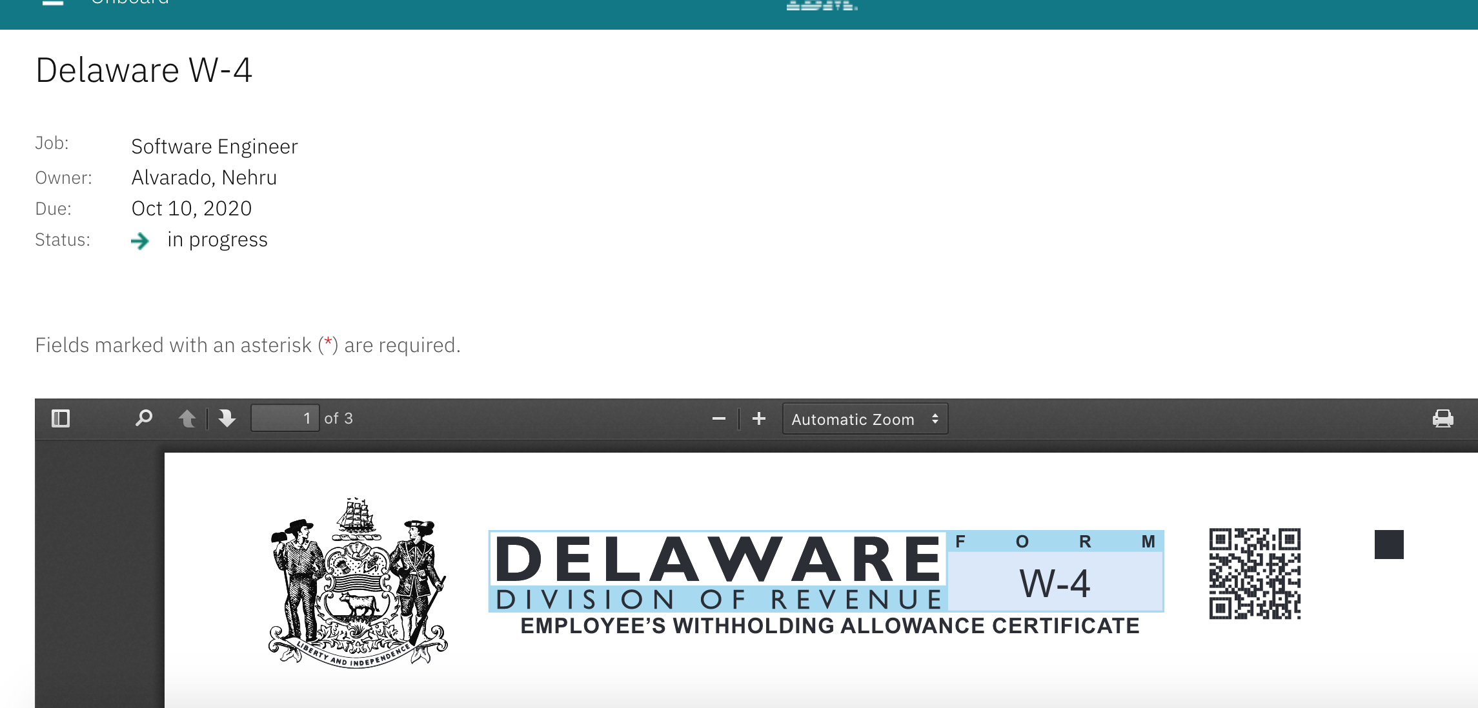
Updates to State and Federal Forms

Slide 7
User Page Performance Improvement
How do you get it?
Visible Change
Who does it affect?
Onboarding Manager
Description:
Reduced Load time of Users Page in Manage Users Screen which will display the user information quickly.
Benefits:
Performance Improvement

Slide 8
Citizenship Status from I-9 Is Available for Search/Output in MNH
How do you get it?
Configurable Change
Who does it affect?
Onboarding Manager
Description:
Citizenship Status field from I-9 Section 1 activity is now available in Manage New Hires page.
Below values should be used to filter the data.
Alien Authorized to Work
Permanent Resident
Non Citizen National
Citizen
Benefits:
Filter and review information.

Slide 9
Citizenship Status from I-9 Is Available for Search/Output in MNH

Slide 10
I-9: Auto-Complete Third Party Approver Assignment Template
How do you get it?
Configurable Change
Who does it affect?
Onboarding Manager
Description:
An admin can configure the Onboard I-9 Third Party Approver Assignment template to be auto-completed when an approver is passed through the B-O integration so that the admin doesn't need to manually complete the task.
If there is no data, or if the data found does not have a user associated with the correct user group, then no auto-completion is performed.
Onboard I-9 Third Party Approver Assignment could be auto-completed with Config setting.
Enable I-9 ThirdPartyApprover Assignment Auto-Completion in Onboard Settings.
Benefits:
Allows activity to be completed automatically.
Reduces time in completing the “Onboarding Process” for “New Hire”.

Slide 11
I-9: Auto-Complete Third Party Approver Assignment Template
Moving the Assign I-9 Approver to the second level in workflow would make it auto-completed.
The Third Party Approver tag is needed for Auto Completion of Assign I-9 Approver task, which must be sent through B2O integration.
Assign I-9 Approver would show completed by System User.
For any reason if the above default config needs to be overridden for specific cases (i.e. if Assign I-9 Approver has to be manually completed) then onboard XSLT mapping should be updated.
Onboard Start completion is needed for autocompletion of Assign I-9 Approver.
If Onboard Start is auto completed through HRIS. Then Assign I-9 Approver activity must be manually completed if it is configured at second level of the workflow.

Slide 12
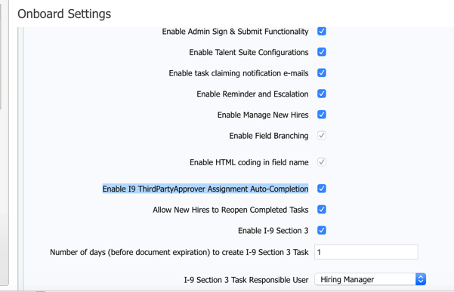
I-9: Auto-Complete Third Party Approver Assignment Template

Slide 13
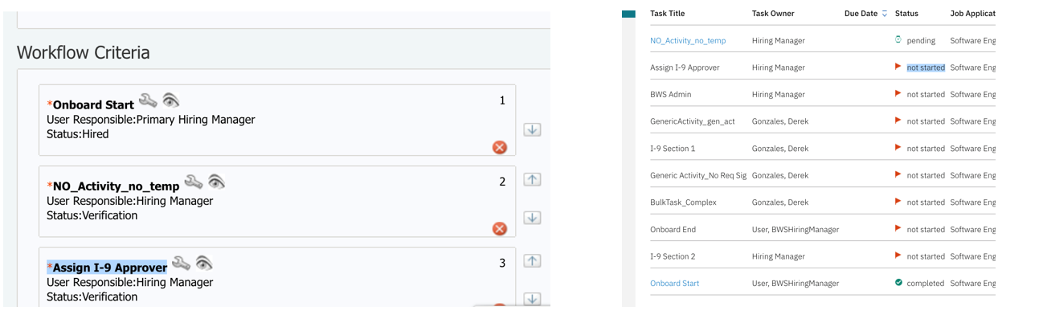
I-9: Auto-Complete Third Party Approver Assignment Template

Slide 14
Discontinue Onboarding Option display for New Hires Is Based on New Capability
How do you get it?
Configurable Change
Who does it affect?
Onboarding Manager
Description:
Discontinue Onboarding option is displayed for New Hire only when User type privilege Enable Global Discontinue is enabled.
By Default this privilege is not turned on for any User type.
Discontinue Onboarding option will persist for users who have it enabled even when there aren't any open job applications. In this case if the user selects Discontinue Onboarding, Message “No active job applications” is displayed.
In Manage New Hires, Discontinue Onboarding option is displayed even when the user type privilege is not enabled.
Benefits:
Restricts users from performing this action when New hire is accessed

Slide 15

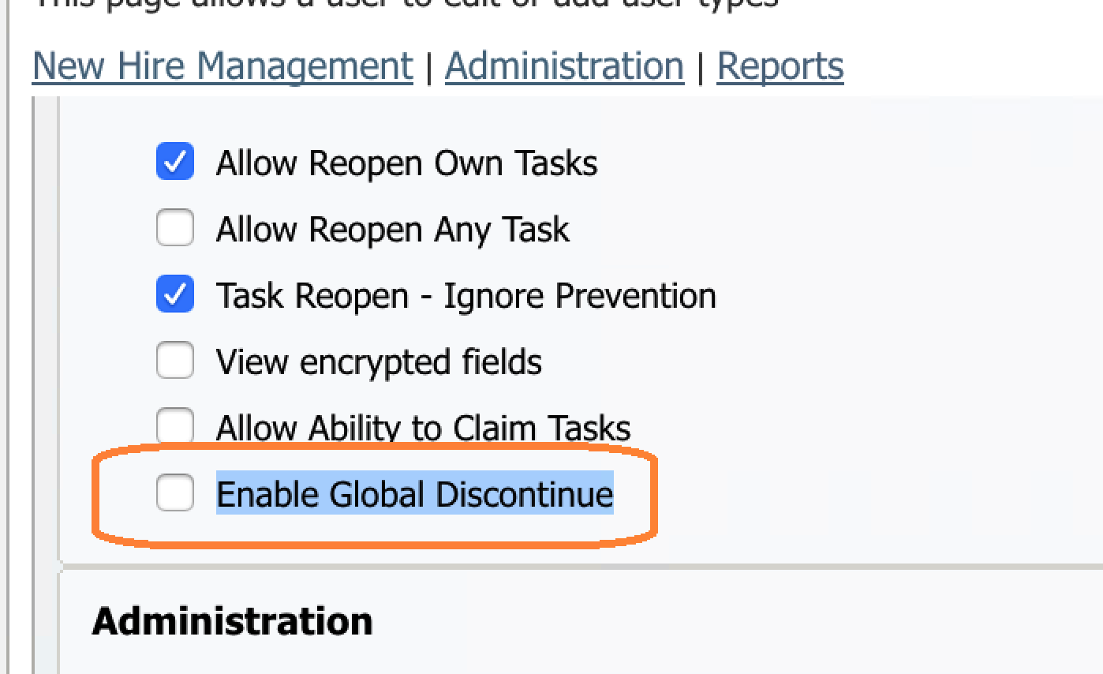
Discontinue Onboarding Option display for New Hires Is Based on New Capability

Slide 16
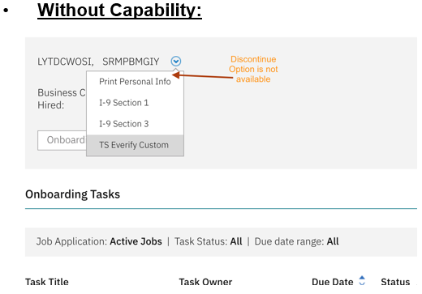
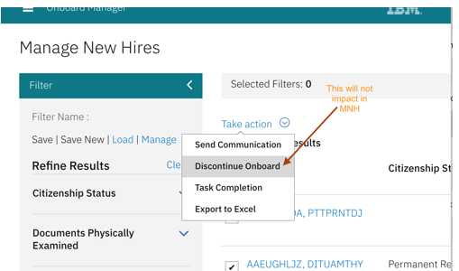
Discontinue Onboarding Option display for New Hires Is Based on New Capability

Slide 17
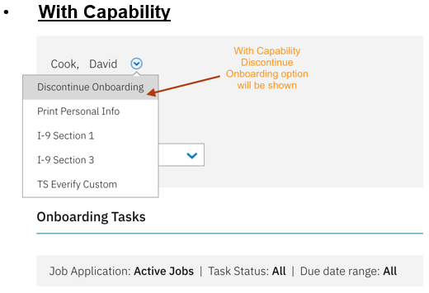
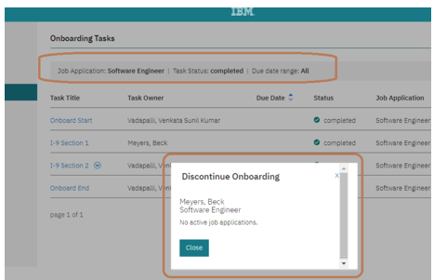
Discontinue Onboarding Option display for New Hires Is Based on New Capability

Slide 18
Upcoming Builds
Date Picker
Bulk Action Email
Access to New Hire Experience through candidate zone – SSO
New Public Filter for Activities in Progress
Add Quick Search to Onboard Pages
Mass Job Update for Participants

Slide 19
Questions?

Slide 20
BrassRing Release Features
–

Slide 21


Feature
BrassRing UI | BrassRing -Communications Templates for eLinks
 | Interview Manager -Reschedule Interview -Schedule type Interviewer First
 | BrassRing -Login Page -Default Background Image
 | Interview Manager -Reschedule Interview -Schedule type Ask Candidate First
 | Interview Manager -Validation for Format Details
 | Candidate Forms -Copy Forms To Reqs
 | Candidate Search -Export to Excel
 | Candidate Forms -Form Field Display Names Truncated
 | BrassRing -State Code of Guam
 | Talent Gateways -Basic Date Field Validation Missing
 | Candidate Account Retrieval -Talent Gateway Username Display for Account Bypass
 | Talent Gateways -Communications -Line Break
 | Background Check Common Services (BGCS)-New Mapping Fields for Choice Point
 | Talent Gateways -Google Sign In Branding Updates
 | Talent Gateways -Twitter Unavailable on Internet Explorer 11
 | Communication Templates -Upload Image Button
 | Talent Gateway Forms -Date Field Validation
Feature | Description
Workbench | Forms -Text Fields -Custom Validations
 | Talent Gateway -Footer Enhancements
 | Gateway Questionnaire -Message Update
Lead Manager | Lead Manager -Action Log
Icon Key
Configurable Feature
Visible Feature
Requires IBM to Enable
Recruiters Affected
Candidates Affected
Accessibility Update
RELEASE DATES
Staging:
October 12th, 2020
Production:
October 19th, 2020
Dark Launch Feature
Information
RFE Feature
NPS Feature
RFE
NPS

Slide 22
Dark Launch Features

Slide 23
Who’s Affected:
Recruiters
Configurable or Visible?
VISIBLE
Interview Manager
Reschedule Interviews – Verify interviewer availability first
RTC #: 129489
Description:
Interviews that are of Schedule Type Verify interviewer availability first can be now rescheduled.
Rescheduling can be done from the section level button on the Interview details page, Card level action or grid level action on the interview listing page.
For interviews meeting the criteria, a Reschedule Interview button is displayed in the Interview details section.
This feature is released to STAGING ONLY with October release.
It will NOT go to PRODUCTION with this release.
Benefits:
Easy way to reschedule interviews.
We highly recommend to start testing this new feature in Staging!

Slide 24
Reschedule Interviews – Verify interviewer availability first
Rescheduling is available in the following statuses:
    Candidate availability received
    Candidate availability declined
    Invitation Pending
    Invitation Sent
    Invitation Accepted -Candidate
    Invitation Declined - Interviewer
    Invitation Declined - Candidate
    Interview Scheduled
    Candidate availability requested
Rescheduling is Not Available in the following statuses:
    To Be Scheduled (edits allowed, but no reschedule because nothing has been sent)
    Canceled (no edits allowed at this status)
    Completed (no edits allowed at this status)
    On-Hold (no edits allowed at this status)

Slide 25
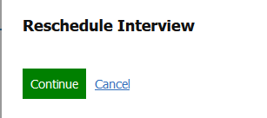
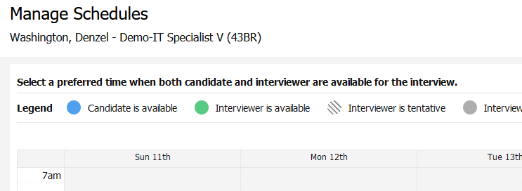
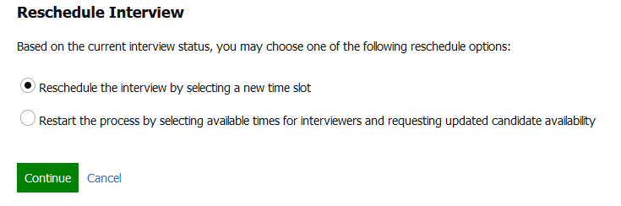
Reschedule Interviews – Verify interviewer availability first
Selecting Reschedule Interview in any of the screens displays the appropriate “Reschedule Interview” page depending upon the Interview Status.
On the Reschedule Interview screen, 2 workflows can be followed:
  Reschedule the interview by selecting a new timeslot
  Restart the process of requesting candidate availability by selecting interviewer available times
The interviewer name, interview duration, time slots, can be changed.
Details like the type of interview, and schedule type cannot be changed.
Based on the changes made to the interview schedule, a communication must be sent to the impacted interviewers and candidates.
Similarly, based on the actions taken by the user, alert messages are displayed to the user on screen.

Slide 26
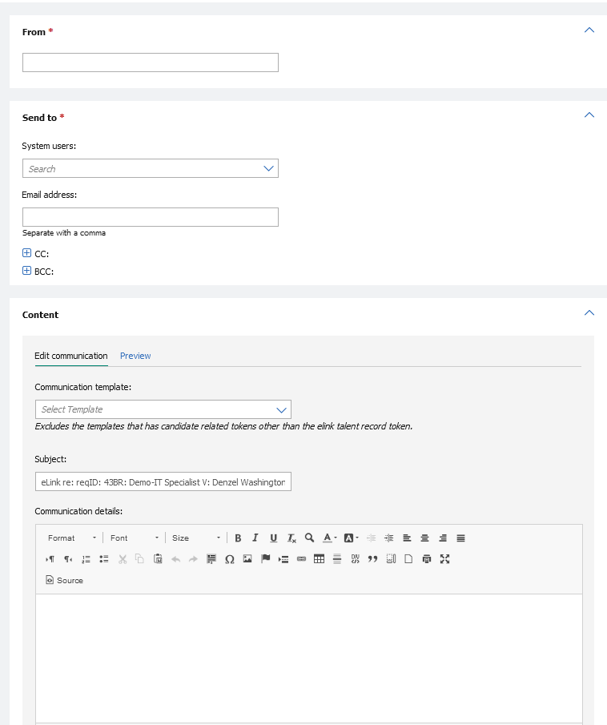
Who’s Affected:
Recruiters
Configurable or Visible?
VISIBLE
BrassRing UI
Communications Templates for eLinks
RTC #: 126313
Description:
Starting this release, the Send eLink screen provides an option to select a communication template from a drop-down menu.
The eLink message text box is now replaced with CK editor.
Users can add attachments from the local device or the candidate's Talent Record.
The selected communication template can be edited and previewed by the user before sending it out.
This feature is released to STAGING ONLY with October release.
It will NOT go to PRODUCTION with this release.

Slide 27
Features Being Released this Month

Slide 28
Who’s Affected:
Recruiters
Configurable or Visible?
VISIBLE
BrassRing UI
Interview Manager - Reschedule Interviews – Ask Candidate First
This feature was released to STAGING ONLY with September release.
It will go to PRODUCTION with this release.
RTC #: 12948
Description:
Interviews that are of Schedule Type Ask candidate first can be now rescheduled.
Rescheduling can be done from the section level button on the Interview details page, Card level action or grid level action on the interview listing page.
For interviews meeting the criteria, a Reschedule Interview button is displayed in the Interview details section.
Benefits:
Easy way to reschedule interviews.
We highly recommend to start testing this new feature in Staging!

Slide 29
Interview Manager: Reschedule Interviews – Ask Candidate First
Rescheduling is available in the following statuses:
    Candidate availability received
    Candidate availability declined
    Invitation Pending
    Invitation Sent
    Invitation Accepted -Candidate
    Invitation Declined - Interviewer
    Invitation Declined - Candidate
    Interview Scheduled
    Candidate availability requested
Rescheduling is Not Available in the following statuses:
    To Be Scheduled (edits allowed, but no reschedule because nothing has been sent)
    Canceled (no edits allowed at this status)
    Completed (no edits allowed at this status)
    On-Hold (no edits allowed at this status)

Slide 30
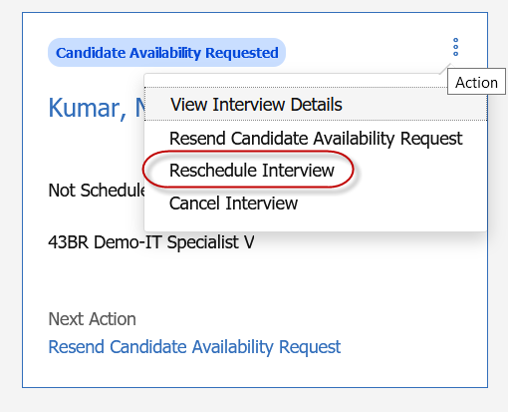
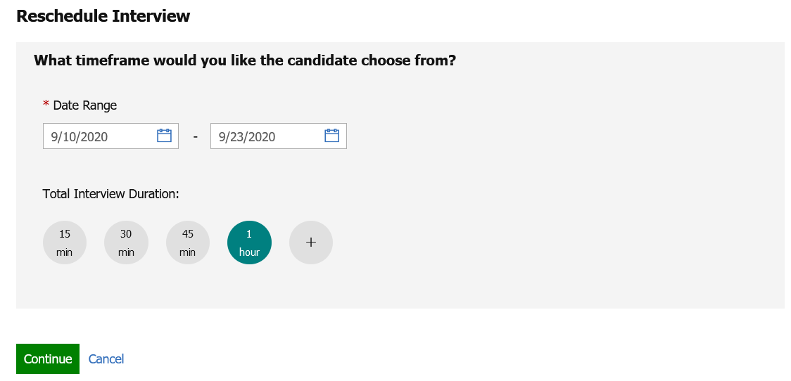
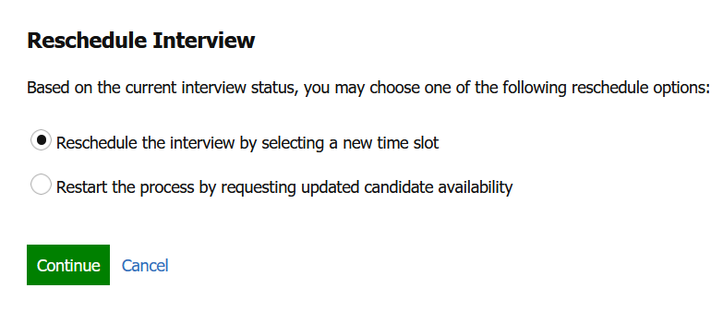
Interview Manager: Reschedule Interviews – Ask Candidate First
Selecting Reschedule Interview in any of the screens displays the appropriate “Reschedule Interview” page depending upon the Interview Status.
On the Reschedule Interview screen, 2 workflows can be followed:
  Reschedule the interview by selecting a new timeslot
  Restart the process by requesting updated candidate availability
The interviewer name, interview duration, time slots, can be changed.
Details like the type of interview, and schedule type cannot be changed.
Based on the changes made to the interview schedule, a communication must be sent to the impacted interviewers and candidates.
Similarly, based on the actions taken by the user, alert messages are displayed to the user on screen.

Slide 31
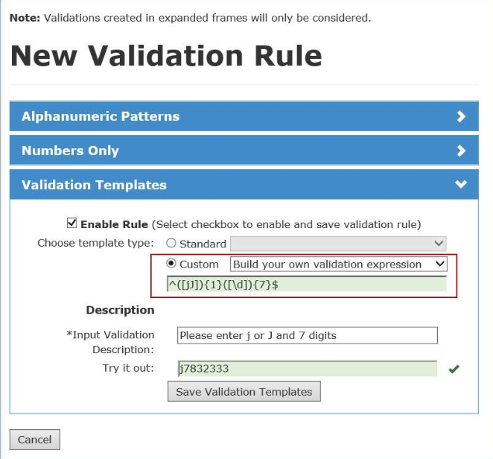
Who’s Affected: Workbench Admin
Configurable or Visible? CONFIGURABLE
Workbench
Forms -Text Fields -Custom Validations
RTC #: 130982
Description:
Currently, for Text fields, we offer several preconfigured validation rules with limited customization options.
Starting this release, the text fields in forms can be configured with client-defined custom validations.
A Regex validation rule can be written and added by the Workbench Admin to apply a custom validation to a text field.
This feature is available inside Candidate Forms, Document Subsidiary Forms & Req Subsidiary Forms.
Note: IBM does not support the writing of custom Regex rules. This is a responsibility of the client. Documentation can be found by searching the internet for Regex (Regular Expression).

Slide 32
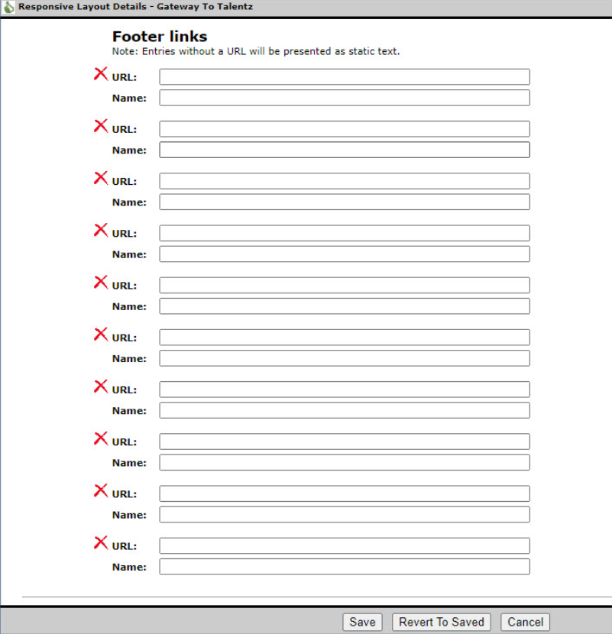
Who’s Affected: Workbench Admin
Configurable or Visible? CONFIGURABLE
Talent Gateway
Footer Enhancements
RTC #: 127166, 127452, 131718
Description:
Prior to this release, organizations could have up to 4 footer links on the Talent Gateway.
Starting this release the footer can now be configured to accommodate up to 10 links (Excluding IBM Standard Privacy Policy) in up to 3 rows.
The number of rows and the number of links displayed per row depends the display device.
Workbench > Tools > Talent Gateways > Responsive Layout > Header/Footer section

Slide 33
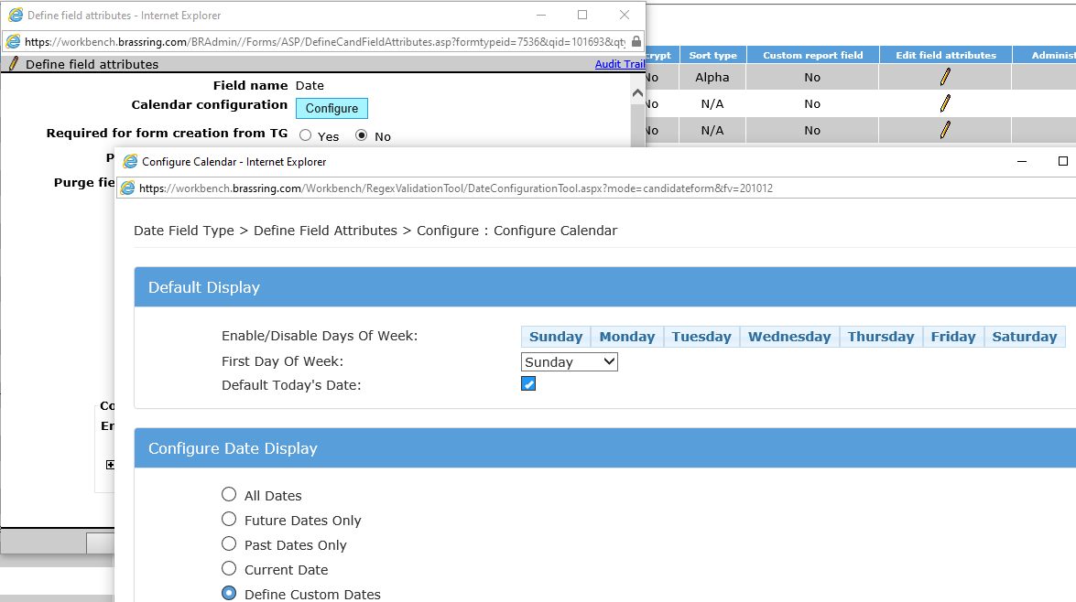
Who’s Affected: Workbench Admin
Configurable or Visible? CONFIGURABLE
Workbench
Forms - Date Field Validation for Talent Gateways
RTC #: 129821
Description:
Starting this release, date ﬁelds present in the candidate forms, req forms, and document subsidiary forms provide custom validation.
When Workbench users edit req form ﬁeld attributes in Workbench, a new Calendar conﬁguration is available using which, the date ﬁeld can be customized.
The conﬁguration of this ﬁeld is NOW AVAILABLE for date ﬁelds on the Talent Gateway and Gateway Questionnaire.
Applicable on GQ flow, JSQ widgets and Social Referral Questions.

Slide 34
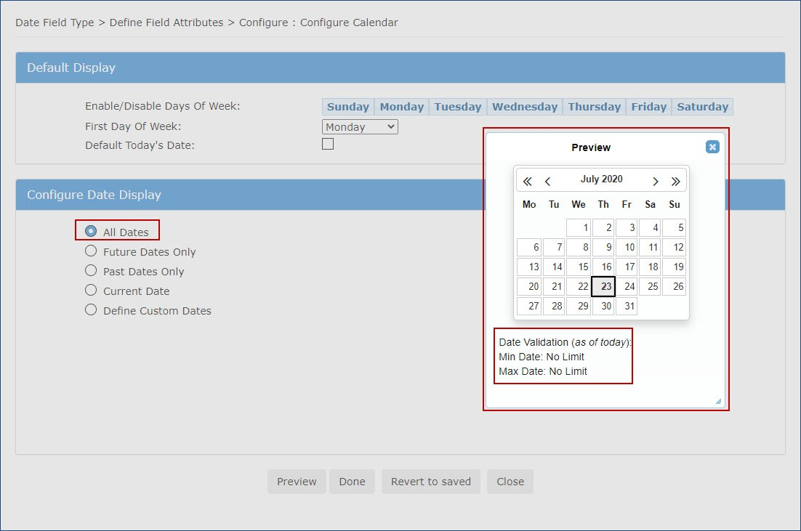
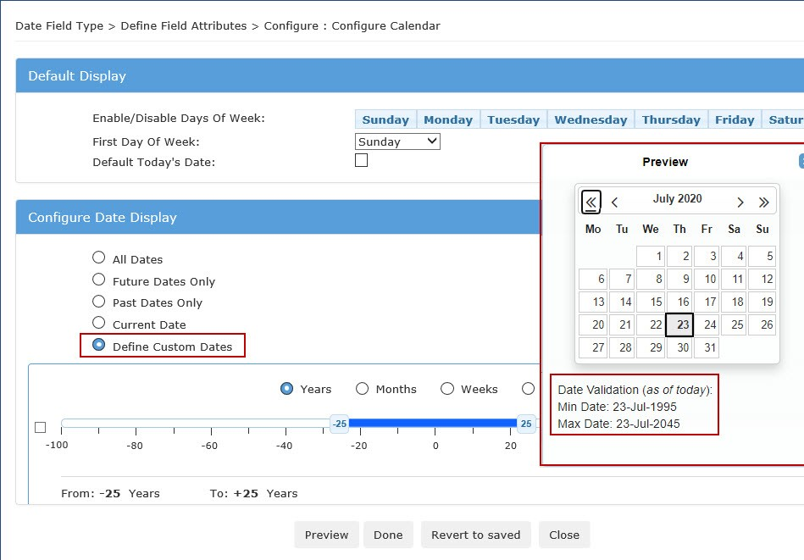
Forms - Date Field Validation for Talent Gateways
Note: Client Administrators that configure the calendars must configure the date question label and the helper text ( i button) that clearly explains the expected input dates.

Slide 35
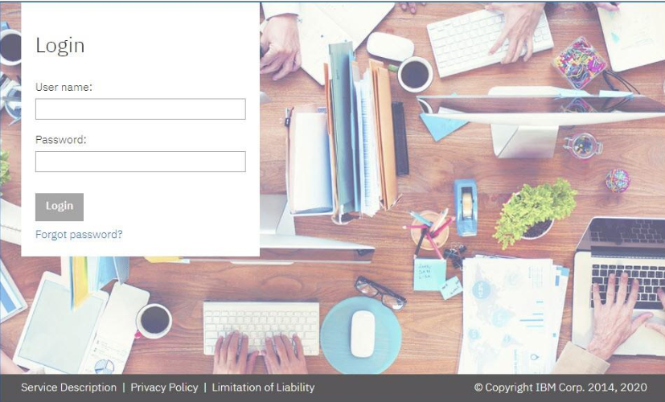
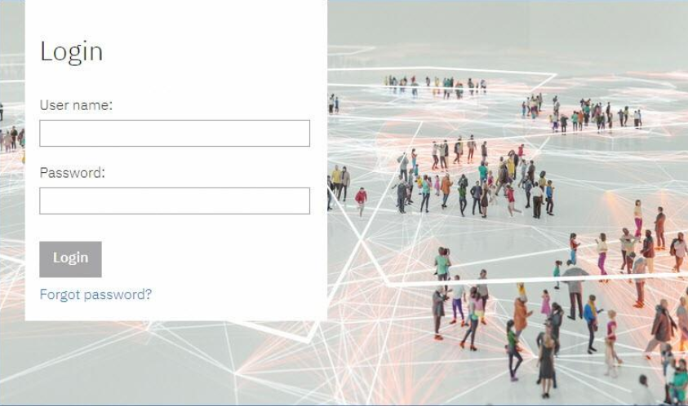
Who’s Affected: Recruiters
Configurable or Visible?
VISIBLE
BrassRing UI
BrassRing -Login Page -Default Background Image
RTC #: 131684
Description:
The default background image of the BrassRing login page is updated to an image that is inclusive.
This change is to the default image only.
You can choose a different image for the landing page as per your requirements.
This change is only for Standalone BrassRing clients (not TAS).
Lead Manager, Onboard, and the Talent Suite login enhancements will follow soon.

Slide 36
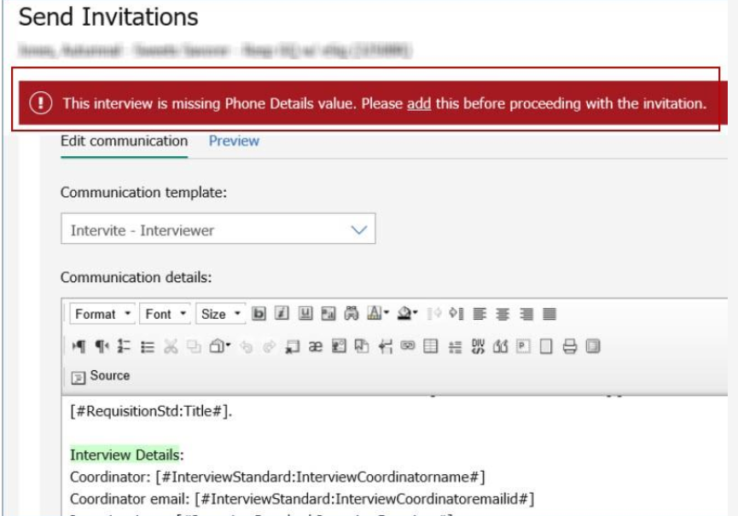
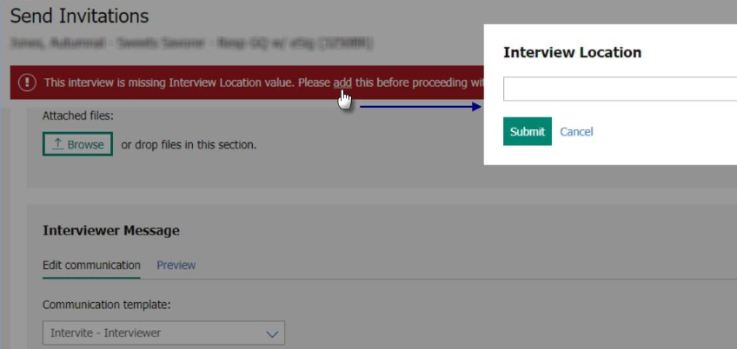
Who’s Affected: Recruiters
Configurable or Visible?
VISIBLE
BrassRing UI
Interview Manager -Validation for Format Details
RTC #: 128501
Description:
Starting this release, the system will validate to find if interview format details are available on the Send invitation page.
If the format details are unavailable, then a pop up will appear and user must input the details.
It is to ensure invitation page is not missing the format details. (Ex: Phone Number, Video details, etc.)

Slide 37
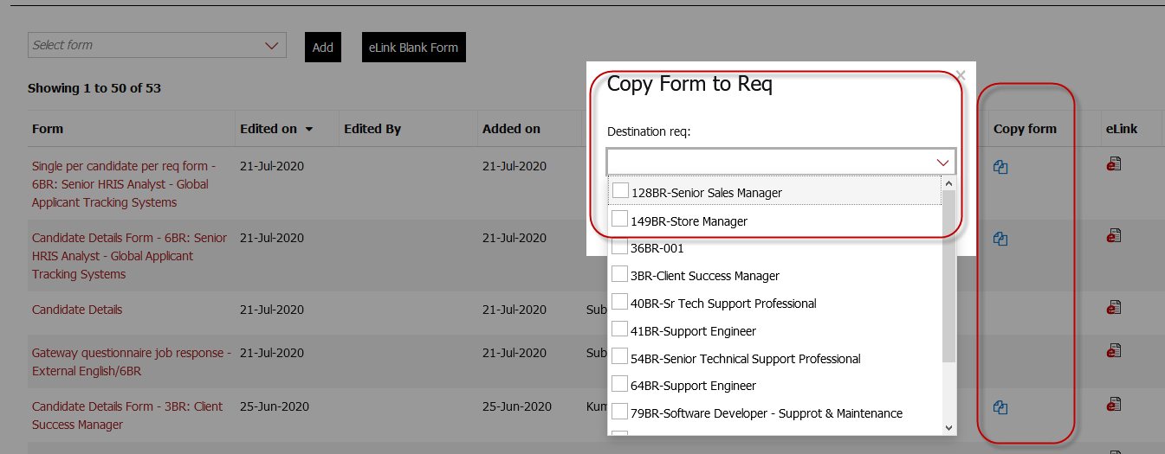
RFE
Who’s Affected: Recruiters
Configurable or Visible?
VISIBLE
BrassRing UI
Candidate Forms -Copy Forms To Reqs
RTC #: 130937
Description:
Existing functionality allowed users, with the appropriate privilege, to copy per req candidate forms when a candidate was being moved or copied from one requisition to another.
The copy per candidate forms feature was not available after the candidate had already been moved/copied.
Starting this release, per req candidate forms can be copied from one req to another at any time.
A new column Copy Form is added next to the eLink column to the Forms List page.
Note: Only Per/Req forms are eligible for this action.
Job response forms/TG/GQ forms are not eligible to be copied.
When the user selects the copy icon, a pop-up opens.
Users can select the reqs from a list of reqs presented in a multi-select control.
This column is displayed only when the user has the user type privilege Candidates -copy per req forms available.
Reqs are displayed where the candidate is already filed, and the form does not exist.

Slide 38
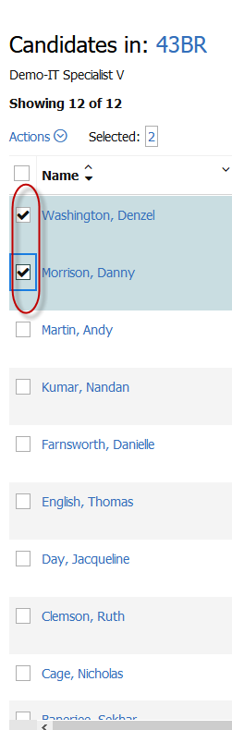
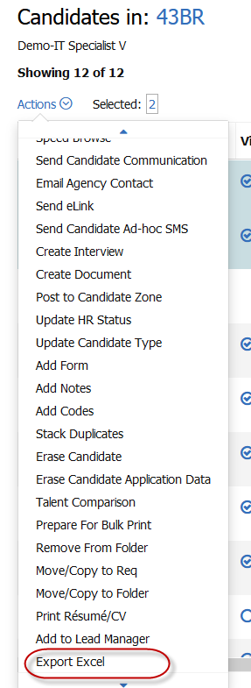
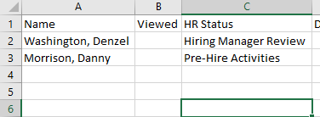
Who’s Affected: Recruiters
Configurable or Visible?
VISIBLE
BrassRing UI
Candidate Search -Export to Excel
RTC #: 132219
Description:
In candidate search, it was observed that even when a limited number of candidates were selected for export to excel, all the candidates displayed in the page were being exported.
This behavior is corrected during this release.
Only the selected candidates are now exported to the excel file while performing an export to excel.

Slide 39
Who’s Affected: Recruiters
Configurable or Visible?
VISIBLE
BrassRing UI
Candidate Forms -Form Field Display Names Truncated
RTC #: 131656
Description:
The maximum length for a form field's display name is 4000 characters.
However, it was observed that in some screens, the display name is truncated at 500 characters.
This behavior is observed on the Filter section of the req folders -> candidate’s grid.
Starting this release, the filter section displays the form field display name in full text up to 4000 in the Filters section of the Req folder.

Slide 40
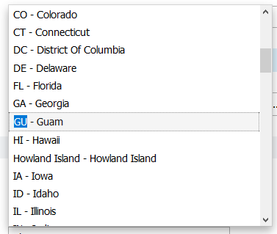
Who’s Affected: Recruiters
Configurable or Visible?
VISIBLE
BrassRing UI
BrassRing -State Code of Guam
RTC #: 131065
Description:
Previously, the state code for the state of Guam was displayed as Guam instead of a two-letter code.
Based on a customer request, the state code is updated to GU starting this release.
It is recommended to update any existing integrations that have the state code set to Guam to the updated state code.

Slide 41
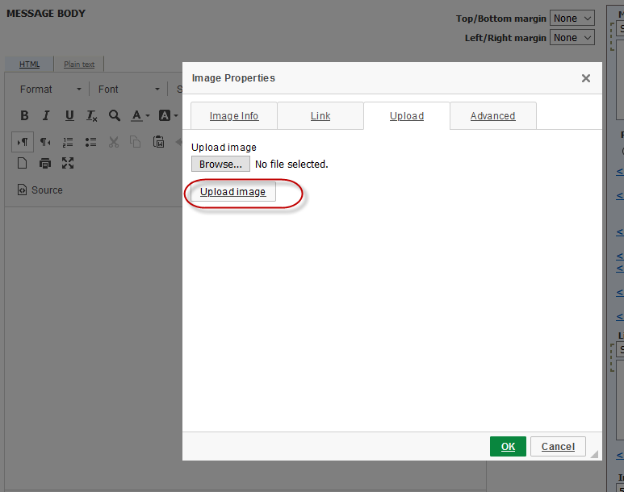
Who’s Affected: Recruiters
Configurable or Visible?
VISIBLE
BrassRing UI
Communication Templates -Upload Image Button
RTC #: 131327
Description:
In the Add new communication template screen, it was observed that the image upload button's label text is changed to Send to server.
To avoid ambiguity and ensure clarity, this button label is changed to Upload Image.

Slide 42

Who’s Affected: Candidates
Configurable or Visible?
VISIBLE
Talent Gateways
Basic Date Field Validation Missing
RTC #: 131400
Description:
Previously, if Talent Gateway referral questions contained date fields, input validations were missing for these fields.
The system accepted invalid dates (like 02-31-2020) and out of range dates that did not meet the field's criteria without displaying any error messaging.
These date fields are updated to accept only accurate dates.
When candidates enter invalid dates like 31 Feb 2020, or dates out of acceptable range, the date field now displays an appropriate error message.
The date fields now display an error message when an invalid date is entered.

Slide 43
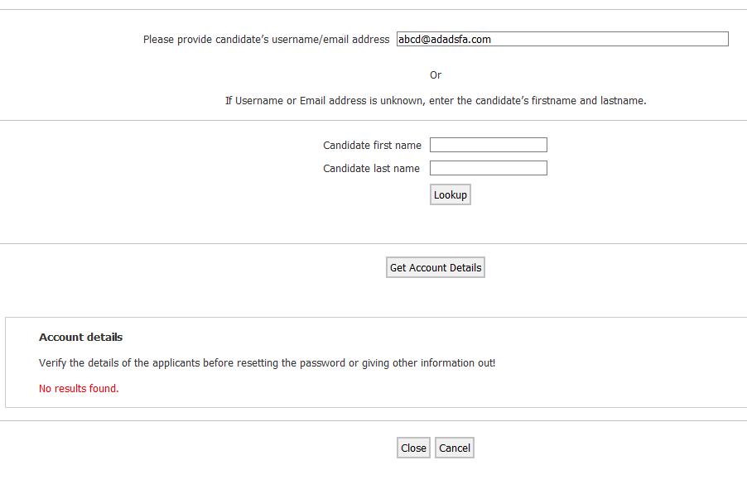
Who’s Affected: Candidates
Configurable or Visible?
VISIBLE
BrassRing UI
Candidate Account Retrieval -Talent Gateway Username Display for Account Bypass
RTC #: 131493
Description:
During the release 20.09.08, the display of GUID (an automatically created candidate number) instead of username is updated.
An appropriate message was displayed stating the possible reasons for unavailability of the username for candidates that skip account creation on the Talent Gateways.
A similar update is made in the candidate account retrieval tool used by BrassRing administrators.
The display of GUID is replaced by an appropriate message.
This is applied for candidates that skip sign in and do not create accounts during the application process on the Talent Gateway.

Slide 44
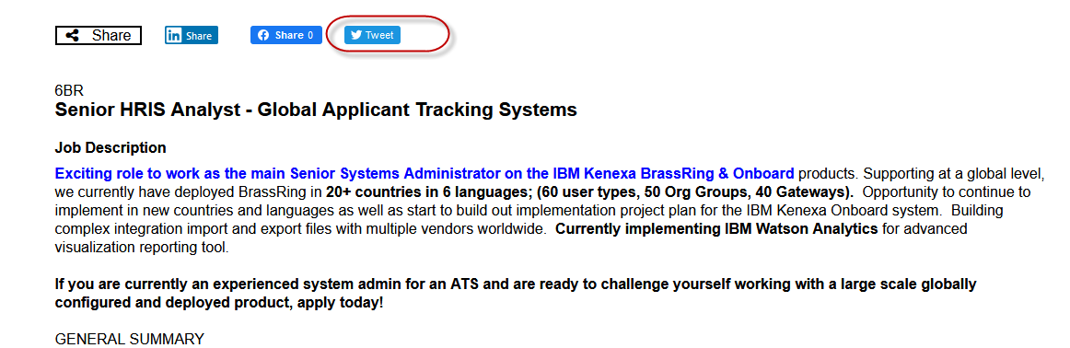
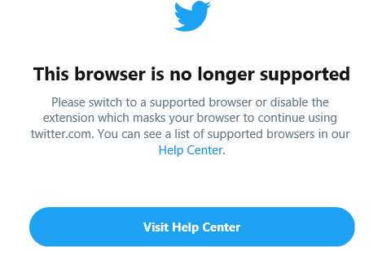
Who’s Affected: Candidates
Configurable or Visible?
VISIBLE
Talent Gateways
Twitter Unavailable on Internet Explorer 11
RTC #: 131534
Description:
Twitter is no longer available on the Internet Explorer 11 browser.
When a candidate accesses one of the Talent Gateways using this browser and selects the Twitter share icon from the job description page, a message is displayed stating that the browser is not supported.
To avoid further inconvenience to the candidates, starting this release, if a candidate accesses a Talent Gateway using the Internet Explorer11 browser, the job description page does not feature the Twitter share icon.

Slide 45
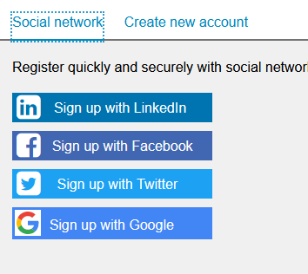
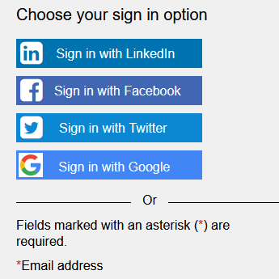
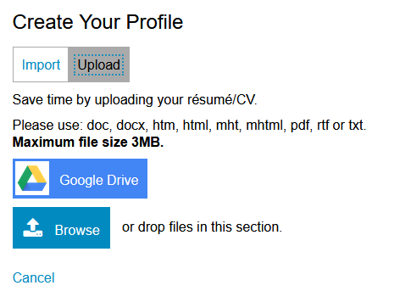
Who’s Affected: Candidates
Configurable or Visible?
VISIBLE
Talent Gateways
Talent Gateways -Google Sign In Branding Updates
RTC #: 131066
Description:
Based on the branding updates from Google, the Google Sign in and Sign up options present on the Talent Gateways are updated.
The buttons on the following pages are updated:
•Talent Gateway Home page: Sign-In Side bar
•Any page (sign in header link): Sign-in modal
•Apply: Sign in page (full page)
•Create account (bypass/agree to privacy policy): Social media tab.
•Import Profile Page: Google Drive Button

Slide 46
Who’s Affected: Candidates
Configurable or Visible?
VISIBLE
Talent Gateways
Communications -Line Break
RTC #: 131833
Description:
When a candidate applies to job without creating a profile (Skip Sign in), a candidate communication is sent with a candidate reference number.
A line break is added between the main message and the additional text that is added suggesting the candidate to sign up.
It was observed that a line break was being added to candidate communications where it was not necessary.
Based on a client request, this additional line break is removed starting this release.

Slide 47
Who’s Affected: Workbench Admin
Configurable or Visible? CONFIGURABLE
Workbench
Background Check Common Services (BGCS)-New Mapping Fields for Choice Point
RTC #: 131788
Description:
Based on a client request, two new mapping fields are added to the BGCS for the Background check vendor Choice Point.
Email address in employment screening and Additional items in license are the new field requested by the client to be added for the integrations to be successful.

Slide 48
Who’s Affected: Workbench Admin
Configurable or Visible? VISIBLE
Workbench
Gateway Questionnaire -Message Update
RTC #: 131951
Description:
A validation message is displayed when a Workbench administrator attempts to create a duplicate widget in a Gateway Questionnaire.
This message is now updated to add a new upcoming feature.
Here is the updated message:
There can be no more than one instance of each of the following types of widgets: Attachments, Resumeupload,Coverletterupload,Educationbuilder,Experiencebuilder,Codes,Jobspecific questions, eSignature, Work Opportunity Tax Credit.

Slide 49
Lead Manager Release Features
–

Slide 50
Who’s Affected: Recruiters
Configurable or Visible? VISIBLE
Lead Manager
Lead Manager -Action Log
RTC #: 130499
Description:
Starting this release, the Lead Manager lead profiles feature an Action Log.
All the actions taken by Lead Manager users on a profile are recorded and presented in the action log.
Users with appropriate privileges can access and view the action log to understand what were the actions that were previously taken on a profile.
When any action taken upon a profile, a log entry is made and displayed in the profile.
Add lead profile
Edit lead profile
Set lead confidential
Delete lead confidential
Add attachment
Delete attachment
Add notice
Delete notice
Add note
Delete note
Add lead to campaign
Remove lead from campaign
Add lead to BR folder
Add lead to BR req
Update lead status
Send communication
Unlink lead from BR

Slide 51
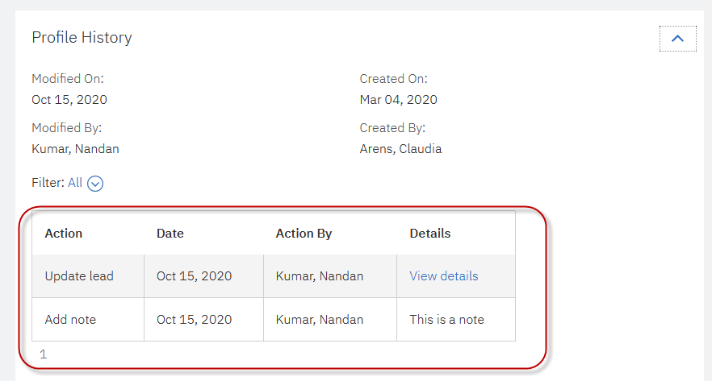
Action Log
Lead Manager –> Lead Profile –> Profile History -> Action Log

Slide 52
Upcoming Builds
RAM - Send reminders based on date field on any form.
Candidate e-Signature
BrassRing - eLink Dashboard
DIT Enhancements
RAM – More Interview Manager triggers

Slide 53
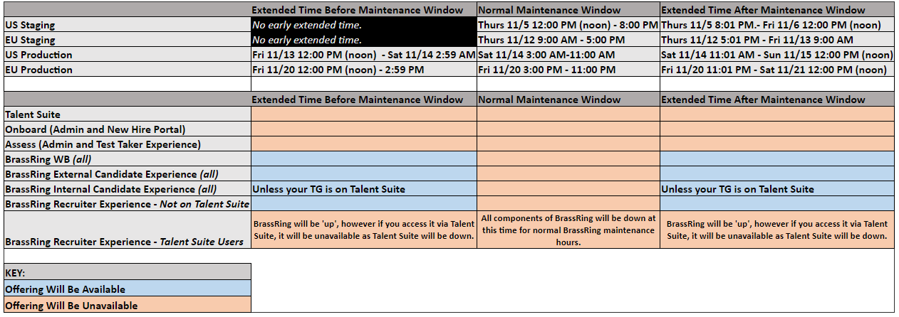
Client Reminders & Updates
Extended November Maintenance Hours:
An extended maintenance window is required for an Oracle database upgrade. Concurrently, the normal monthly window will run as expected. The impacts to these two windows vary.
The following graphic outlines the planned hours of 'Normal' Monthly Maintenance, along with the extended hours before and after this window needed for the data base upgrade. It then displays which products/components will be impacted during each phase of maintenance:
The extended maintenance window impacts:
Talent Suite
Onboard
Assess
Any part of BrassRing intertwined with Talent Suite, including:
  Common services integrations
  Onboard/Assess integrations
  Internal Talent Gateways if they are accessed via Talent Suite
  The BrassRing Recruiter Experience if accessed via Talent Suite.
The extended maintenance window will NOT impact:
BrassRing Talent Gateways (except for internal talent gateways accessed via Talent Suite)
BrassRing Workbench
BrassRing Recruiter Experience if accessed as a standalone offering
RFE Migration Project
IBM-wide project to migrate all RFEs to a new system. To ensure the best data will be migrated we were asked to review all RFEs. While IBM asked for al RFEs over 60 days to be rejected we, as a business, decided on 2 years.
Hard decisions had to be made and all RFEs in a Submitted status, over 2-years old, were rejected. Any RFE less than 2-years old were moved to under consideration or rejected after review. Most RFEs in an “Under Consideration” status that were over 2-years old were rejected and some less than 2-years old were updated as well.

Slide 54
October VIRTUAL TRAINING SESSIONS
Client-facing training schedule
Sunday | Monday | Tuesday | Wednesday | Thursday | Friday | Saturday
 |  |  |  | 1 | 2 | 3
4 | 5 | 6 | 7 Client: Slack Me Anything (10 AM EST) | 8 Client: Slack Me Anything (11 AM EST) | 9 | 10
11 | 12 | 13 | 14 | 15 Client: BR 20.10.12 Release Enablement (11AM EST) | 16 | 17
18 | 19 | 20 | 21 | 22 | 23 | 24
25 | 26 | 27 Client: Interview Manager Additional Training (Rescheduling) | 28 | 29 Client: Interview Manager Additional Training (Automation + Q&A) | 30 | 31

Slide 55
Questions?
Your feedback matters!!!

