Slide 1
BrassRing ATS
Common Services Integrations
—
May 22nd, 2019

Slide 2
Reminders & Updates
Product Expert Team Update!
The product expert team will now be able to help you with integration questions and get on calls to answer your technical questions about existing or future integrations you are considering.
Enablement Sessions:
Please test your knowledge and provide your feedback!
Client Enablement Sessions
BrassRing ATS and Workbench Badges
NUF, Admin Tools and WB were relaunched in the new LMS on May 13th!
The NUF and Admin Tools have new and updated content.
The WB content will be revised later this year.
For Workbench access, once the user completes the courses, they will enter a case to the GSC to have a WB user created.
New add-on training courses: Agency Manager (for Agencies), Data Insight Tool, Digital Analytics, and Event Manager!

Slide 3
JUNE VIRTUAL TRAINING SESSIONS
Client-facing training schedule
Sunday | Monday | Tuesday | Wednesday | Thursday | Friday | Saturday
26 | 27 | 28 Client: New Features and Updates for Assess (11am EDT) | 29 | 30 | 31 | 1
2 | 3 | 4 | 5 | 6 Client: BrassRing ATS Release 19.06.03 (4am EDT & 11am EDT) | 7 Client: Talent Suite and Onboard June Release (10am EDT) | 8
9 | 10 Client: How to use Assess (11am EDT) | 11 | 12 | 13 | 14 | 15
16 | 17 | 18 Client: BrassRing ATS New UI Client Panel (11am EDT) | 19 Client: BrassRing ATS New UI (11am EDT) | 20 | 21 | 22
23 | 24 Client: Assess New Features and Updates (11am EDT) | 25 | 26 | 27 | 28 | 29
30

Slide 4
Agenda
–
Today we will dive into common services integrations and the integrations dashboard.
What is a Common Services Integration?
Types of Common Services Integrations
1-Step vs 2-Step Integration
Configuration Steps (Background Check and Video Interviewing)
  We will schedule subsequent sessions to cover WOTC, Assessment and Job Board Aggregator integrations.
Using the Integration log to troubleshoot
Integrations Dashboard

Slide 5
What is a Common Services Integration and what types does offer?
—
Common services indicates two partners (e.g. BrassRing ATS and vendor) are using a common schema to interact. This common platform allows for a more streamlined integration which can be offered to you in a more cost effective and quick manor. While custom integrations require our engineers to write new scripts, common services already have a script written eliminating the need for engineer involvement during configuration.
Types of CS Integrations:
  Background Checks
  Video Interviewing
  WOTC
  Assessments
  Job Board Aggregators
Which vendors does integrate with?
  This list is ever changing so please reach out to your representative for the most up to date list of vendors!

Slide 6
1-Step vs 2-Step
1-Step Overview:
System users can trigger a pre-selected Background Check, Drug Screen or Video Interview by updating a candidate’s HR Status.
All necessary information is sent to the vendor and a real time response will be received by the user verifying Success or Failure.
  If Successful, no further action is required. The vendor will process the request and send back results when available.
  If Unsuccessful, the user will need to undo the HR Status on the candidate and update the necessary form/field with the missing or invalid information (or may not be a valid user with the vendor). Then the candidate can be updated to the HR Status again.
RAMs can also be utilized to initiate 1-step integrations by updating the candidate to the applicable HR Status.
This integration type saves time when all of the details for the integration have already been collected within BrassRing ATS.
2-Step Overview
Upon updating the HR status for a candidate, the Vendor user interface (UI) is shown and the system user will complete any additional information (such as package or account) before submitting the request.
RAMs cannot be utilized to initiated 2-step integrations.
This integration type is useful when necessary details are not known in advance or are not collected within BrassRing ATS.

Slide 7
Background Check and Video Interview Workflows
1-Step vs 2-Step
1-Step Workflow
2-Step Workflow
BGC Package is selected on the Req form or Candidate Form
HR Status is Updated
HR Status is Updated
BGC Vendor UI
Select package
Fill in remaining fields
Submit request
No
Required Data Available?
Vendor sends results into BrassRing ATS Candidate Form
Data sent to BGC vendor
Yes
Vendor sends results into BrassRing ATS Candidate Form

Slide 8
Configuration Steps
–
(Background Check and Video Interview Integrations)

Slide 9


Workbench Configuration Steps: Client Settings
Enable the Common Service Integration Type Client Setting:
Enable the Power user edit access (Integrations – Administration) Client Setting:
Client settings must be enabled by an team member. If you would like either of these settings enabled, please reach out to your representative or the Global Support Center.

Slide 10
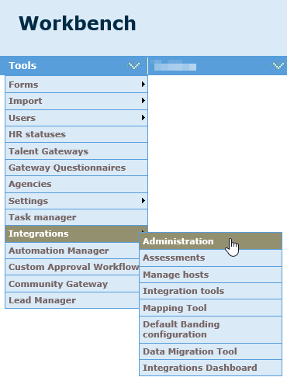
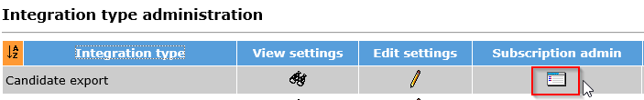
Access Candidate Export Integration Type
Workbench > Click Tools > Integrations > Administration
- You will most likely see an Integration type already listed for Candidate Export.
- If you do not see this Integration Type, Select Add
Integration type under Actions
- Chose the Candidate export Integration Type and Continue
- Ensure HR status is checked and Talent record launch is unchecked
- Click Save
- Click the Subscription admin for the Candidate export Integration
Workbench Configuration Steps

Slide 11
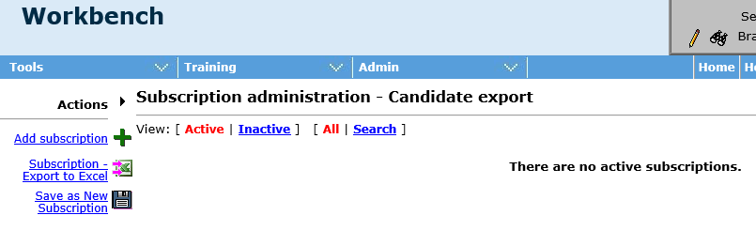
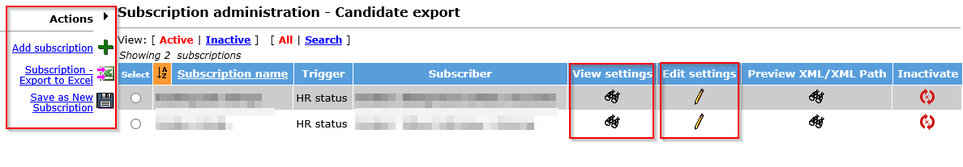
Workbench Configuration Steps
Manage Subscriptions
Select Add Subscription
Notes:
In the Subscription administration – Candidate export screen, you will see Common Service Candidate export Subscriptions that have been set up for your organization.
To work with existing Subscriptions, you can use the View Settings or Edit Settings icons
Within the Actions menu, additional actions are available.
  Add Subscription: create a new subscription
  Subscription – Export to Excel: provides a blank template to gather subscription details
  Save as New Subscription: create a new subscription copied from an existing (very helpful when using multiple requisition templates but mapping the same fields to the vendor)

Slide 12
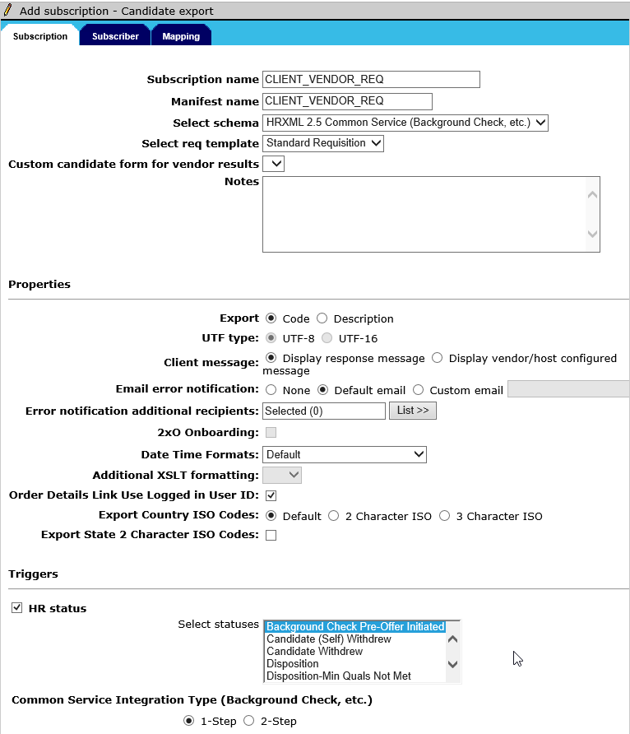
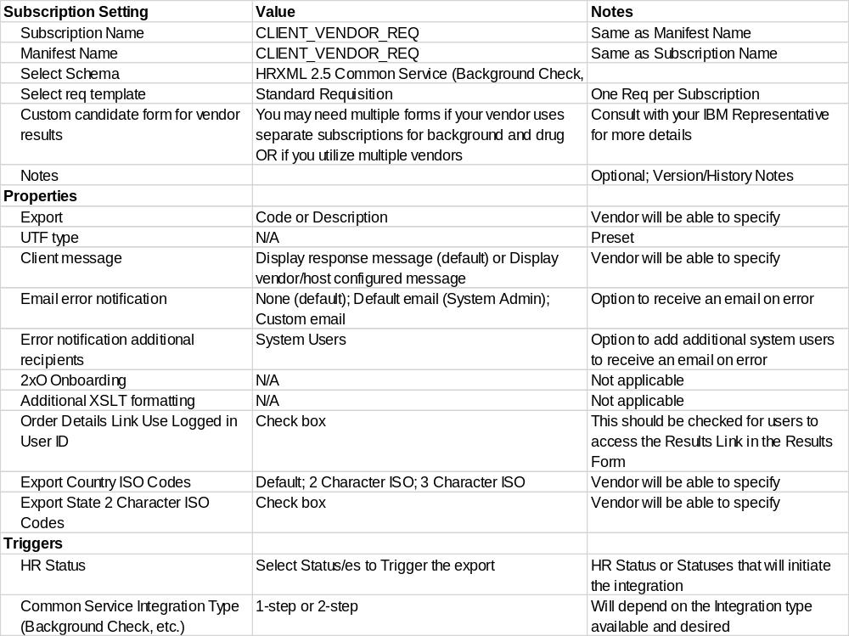
Subscription Settings
Workbench Configuration Steps
Notes

Slide 13
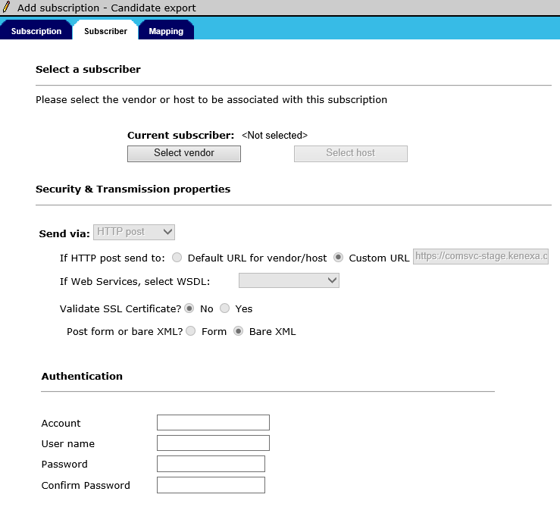
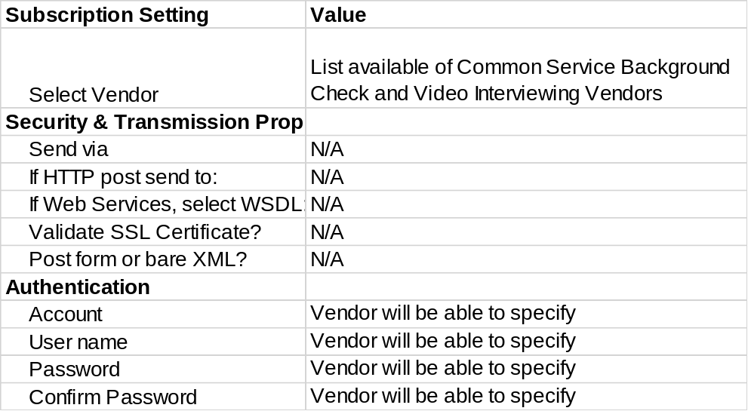
Subscriber Tab
Workbench Configuration Steps
Notes

Slide 14
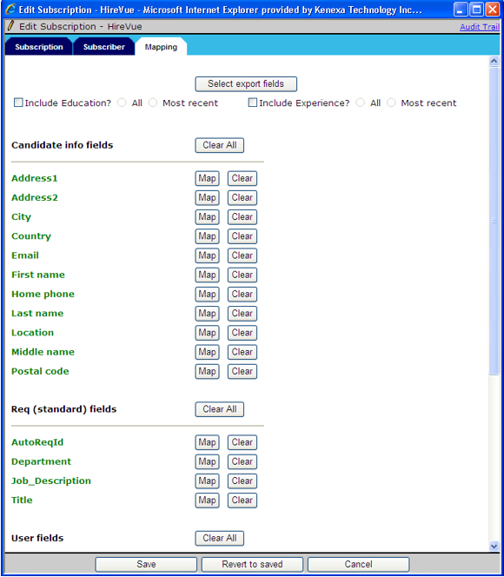
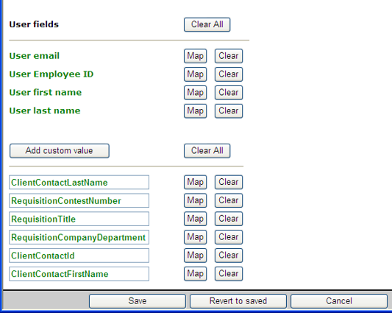
Mapping Tab
Workbench Configuration Steps
Sample Mapping provided by vendor
Address1 BGC31
Address2 BGC32
City BGC30
Country BGC27
Email BGC47
First name BGC17
Middle name BGC18
Last name BGC19
Home phone BGC41
Location BGC29
Postal code BGC28
[Req fields (standard)] Auto req ID BC130
[Req fields (standard)] Title BGC132
[Req fields (standard)] Department BGC134
[Req fields (standard)] Job description BGC60
[User] User email BGC7
[User] Employee ID BGC55
[User] first name BGC57
[User] last name BGC128
ClientContactLastName BGC127
RequisitionTitle BGC131
RequisitionCompanyDepartment BGC133
ClientContactId BGC54
ClientContactFirstName BGC56

Slide 15
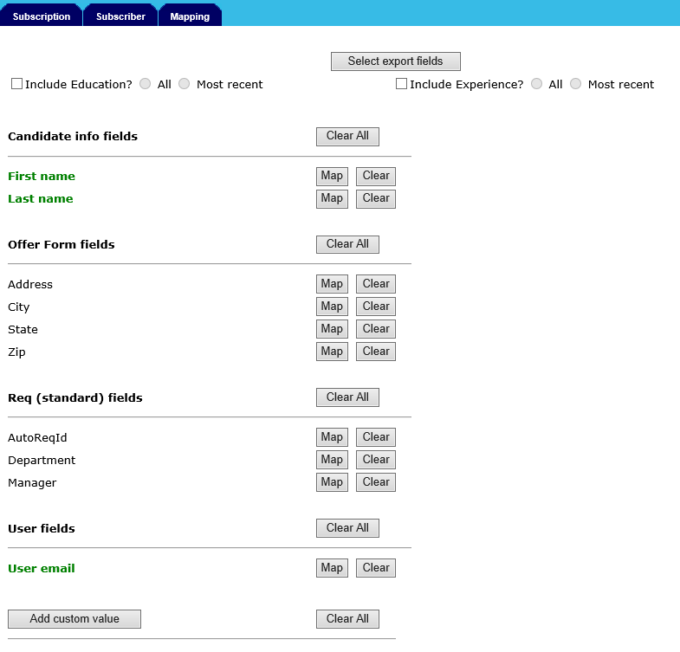
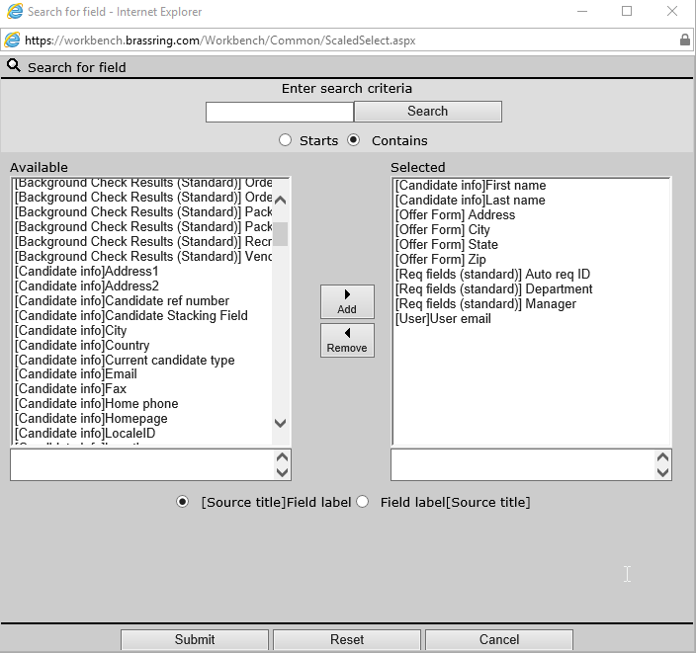
Workbench Configuration Steps
Select export fields
Opens window to select the fields from candidate forms, candidate profile, Req Standard/Custom, and User Profile fields to be included in the subscription to the vendor
Helpful tips:
Talent Record fields found as [Candidate info]
Talent Record State/Region/Province listed as [Candidate info]Location
[User] fields pertain to the User initiating the transaction via HR Status update
Document Sub Form (Offer Acceptance Form) fields are not available for mapping

Slide 16
Workbench Configuration Steps
Include Education? / Include Experience?
Maps the Talent Record Standard Education and/or Experience fields to the vendor pre-mapped to the corresponding BGC#s
Helpful tips:
All will send all supplied Education and/or Experience fields
Most recent will send only the Education and/or Experience fields marked as “most recent”
Selection of these Standard fields will replace any manually mapped Education and/or Experience fields below

Slide 17
Workbench Configuration Steps
Mapped fields
Selected export fields display grouped by type
Typical groups include:
Candidate info fields
Offer (or other) Form fields
Req (standard or custom) fields
User fields
Helpful tips:
Fields in green have been mapped
Fields in black have not been mapped
Some fields will be automatically mapped by the tool for convenience but should be validated
All fields should be mapped (green) prior to saving
Clear all will clear the mapping for all fields within the group
Clear will clear the individual field mapping
Map will open a new window explained next

Slide 18
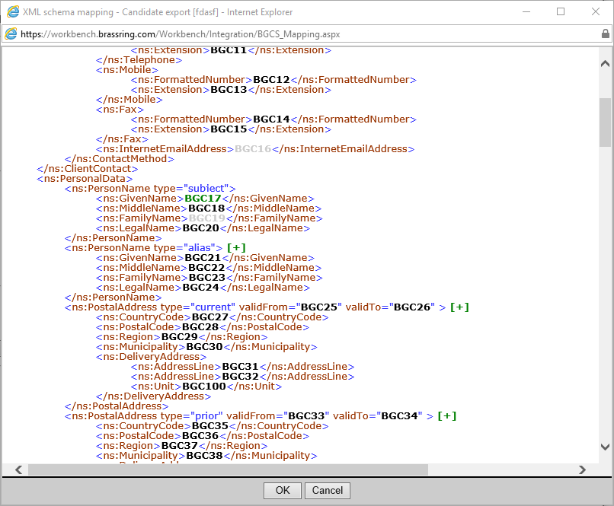
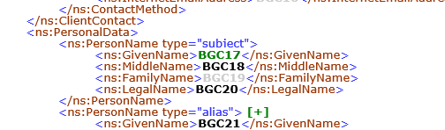
Workbench Configuration Steps
Mapped fields – Mapping
Selecting the Map button next to a field will open the xml schema mapping window
Typical groups include:
Candidate info fields
Offer (or other) Form fields
Req (standard or custom) fields
User fields
Helpful tips:
BGC## in green is the field being edited
BGC## in grey have been mapped to another field and are not available for selection
BGC## in black have not been mapped
The specific mapping details should be provided by your vendor

Slide 19
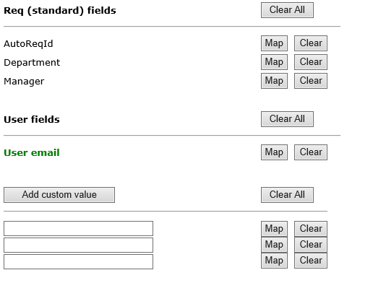
Workbench Configuration Steps
Add custom value
Some custom tags or values may be needed for your vendor that do not already exist in your BrassRing ATS system
Examples include:
CandidateRefNumber Tag
Company Code Value
Helpful tips:
Any specific custom mapping details should be provided by your vendor

Slide 20

Workbench Configuration Steps
Save Subscription
Once all Subscription, Subscriber and Mapping information is complete > Save as active to make immediately available
Upon Save, you may see a warning message about Disabling SSL certification validation
The SSL certificate validation settings for Common Service Integrations are pre-set and not editable via the screens
This notification can be ignored (Select Yes)
You can now begin testing your subscription or Save as New Subscription to create a duplicate for another Requisition Template!

Slide 21
Troubleshooting Integrations and Reviewing the Integrations Dashboard

Slide 22
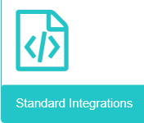
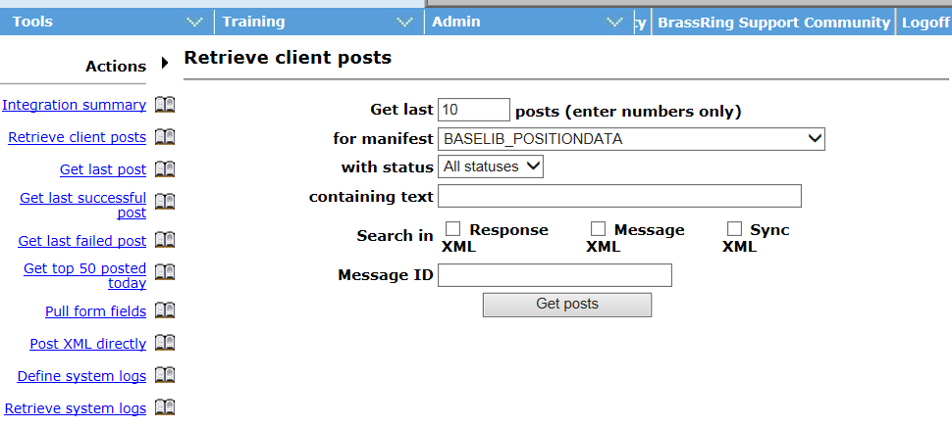
XML Integrations – Integration Tools
  For XML Integrations, you can go to Workbench – Integrations - Integration Tools
  This way, you can search XML logs for past transactions.

Slide 23
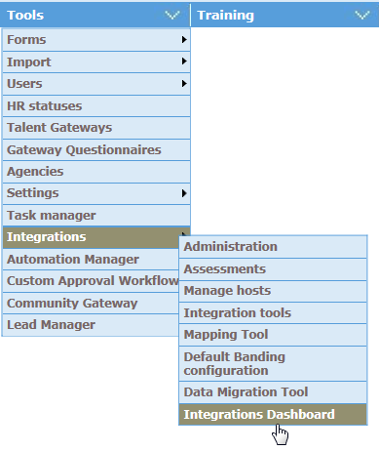
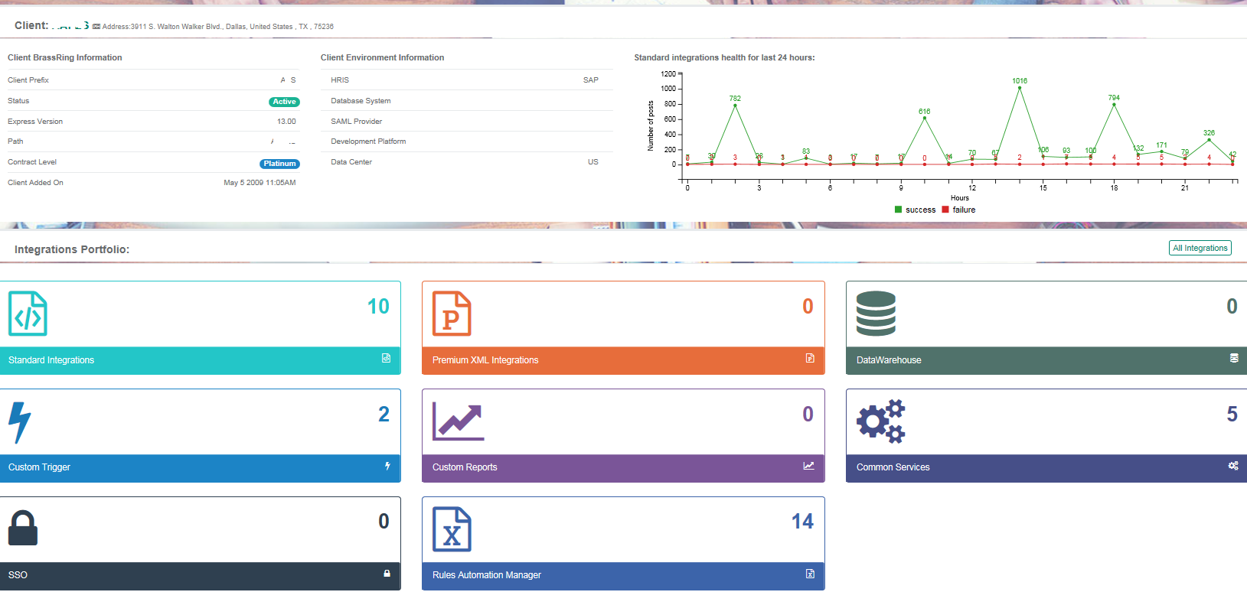
XML Integrations – Integration Tools
The Dashboard provides a comprehensive view of the integrations and transaction logs, including your Onboard integrations!

Slide 24
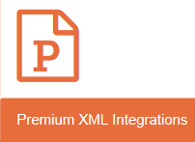
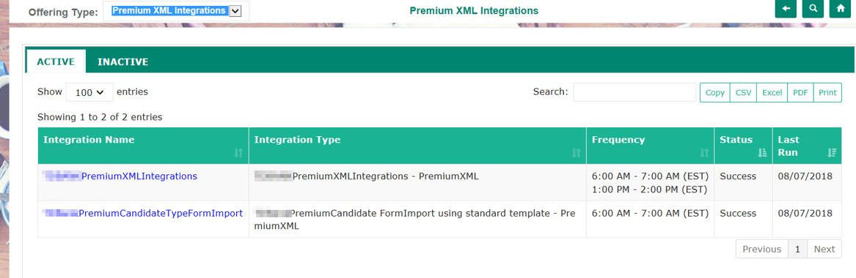
Premium XML Integrations
Premium XML Integrations are those where input data is provided over FTP in XML or Flat File format. Then, the data is transformed into XML and processed.

Slide 25
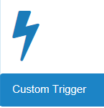
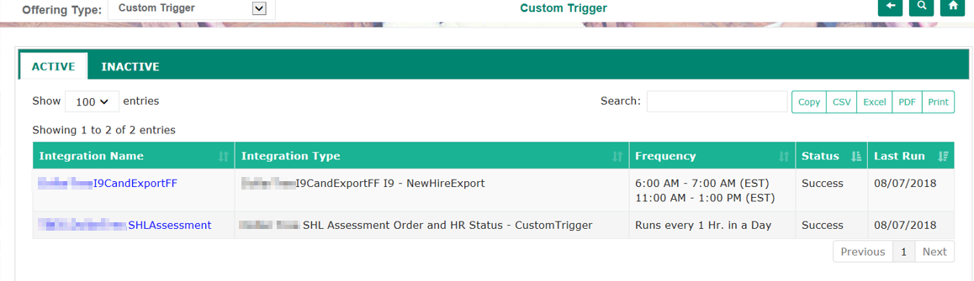
Custom Integrations
You can utilize the Integrations Dashboard to drill down specific Custom Trigger integrations and see individual transaction datetime, status, etc.

Slide 26
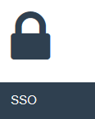
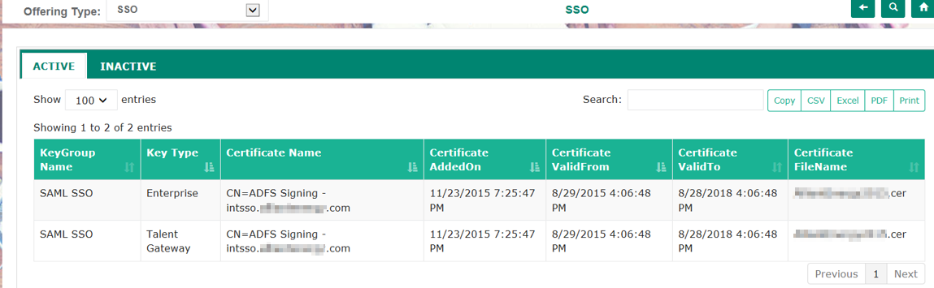
SSO Integrations
The SSO Dashboard lists the client’s current certificates and their expiration dates. You can check if the expiration date is coming up. PSE requires 30 days heads up to staff a certificate change request.

Slide 27
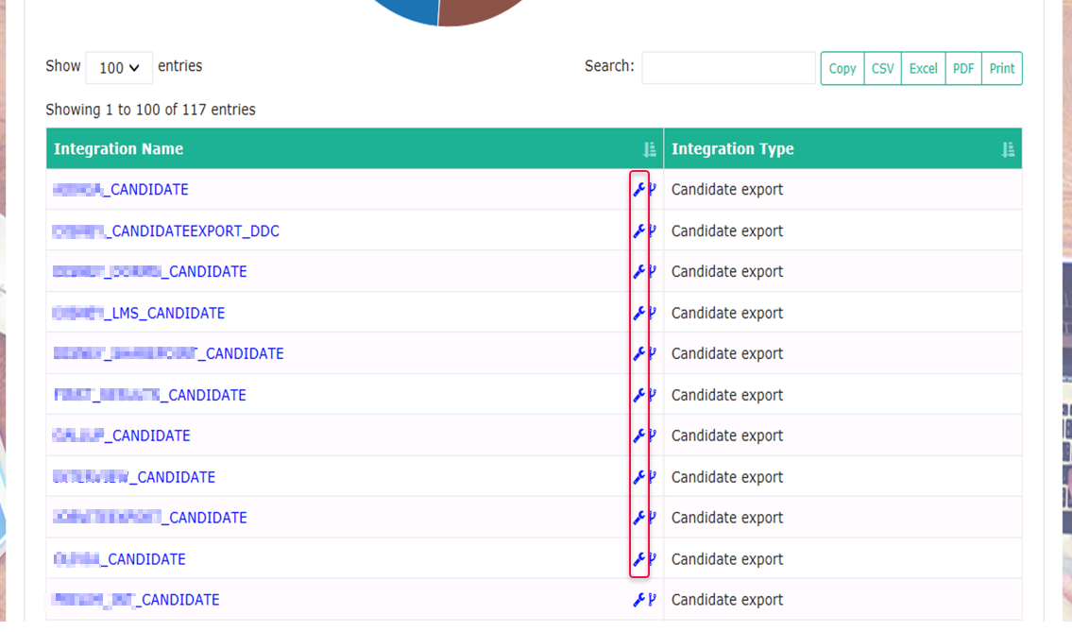
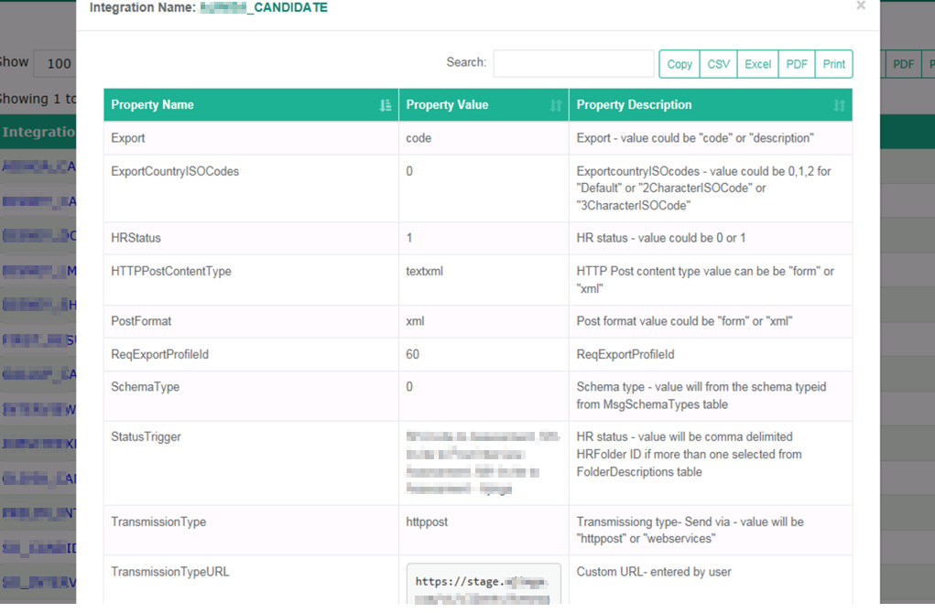
Candidate Export Integrations
The settings for candidate export integrations are now viewable in the integrations dashboard.

Slide 28
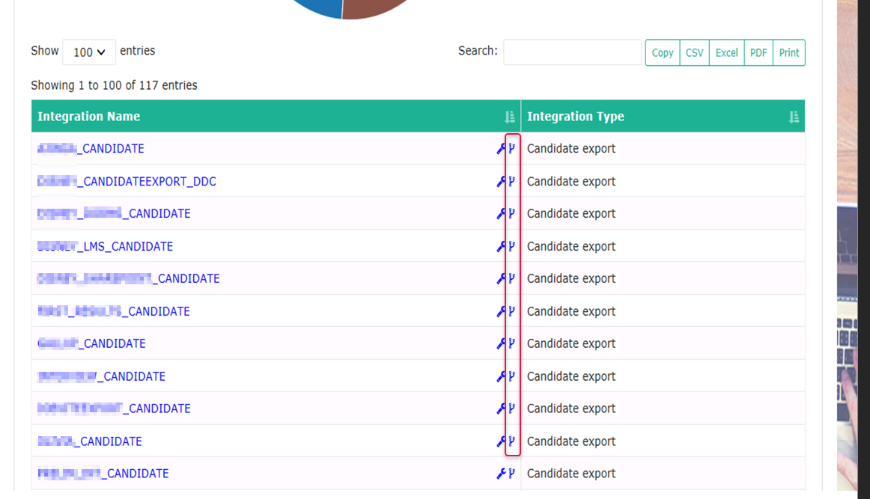
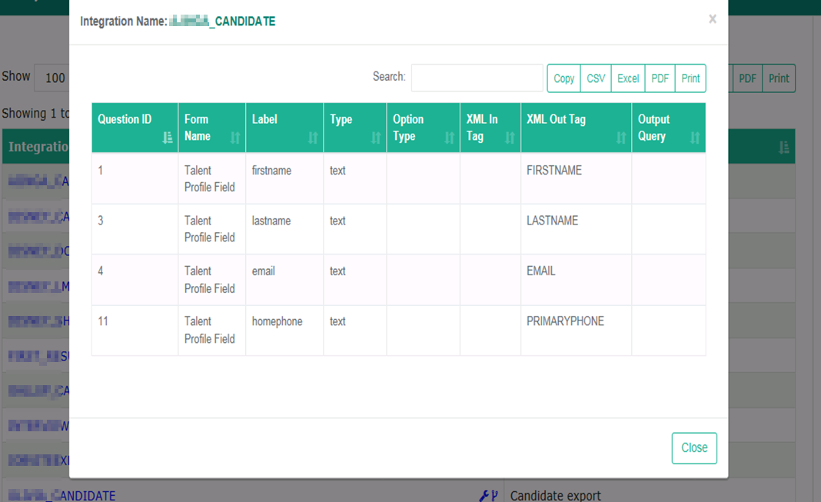
Candidate Export Integrations
The settings for candidate export integrations are now viewable in the integrations dashboard.

Slide 29
Required Log Review
The following integration components require involvement as their logs are restricted to specialized tools.
Layer 7 (2-way SSL Certificate, TLS, XML Transformation)
Message Level Encryption (RSA, AES)
TG profile Import

Slide 30
Questions?

