Slide 1
Manage Email Templates
Talent Suite
—
Client Training and Enablement Session
IBM Watson Talent
March 24, 2020

Slide 2
Agenda
Overview
Previewing Email Templates
Editing Email Templates
Sending Test Emails
Resources
Q&A

Slide 3
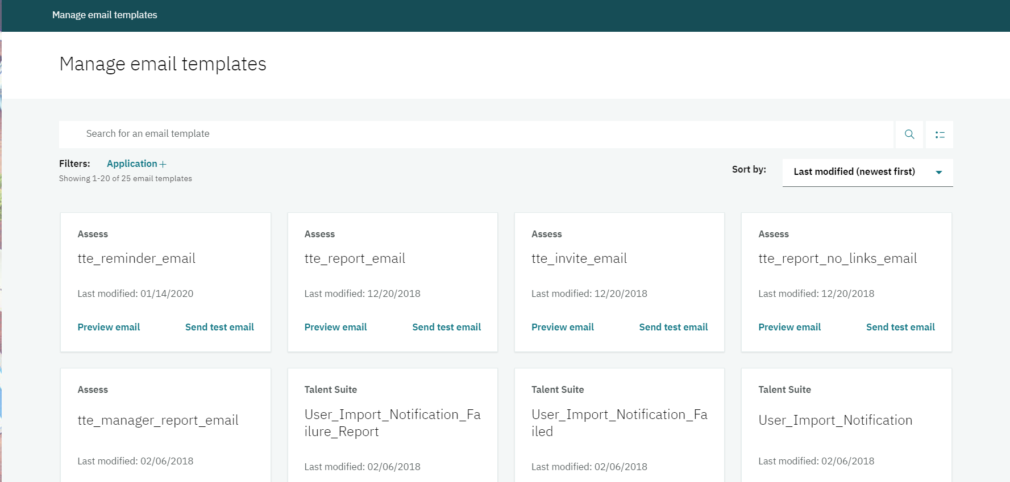
Overview
Manage Email Templates is a self-service feature that allows the user to manage their correspondence email templates.
Available for Talent Suite, Onboard, and Assess email templates. The templates are determined by what you have purchased. (Available Templates)
Access is based on the user type CT_Admin within the Talent Suite Application.
You can preview, edit, test, and publish email templates that are sent out by the system.
Markers are available to pull specific information from the system into the email template. (i.e. username, clientname, etc.)
Templates can be created in different languages. The languages available depend on the languages associated to the site.
Once published, the email template is live.

Slide 4
Overview
Action | Description
Preview | Allows you to preview the template prior to editing. Provides the details of the email template. This includes all markers and languages that have been selected for the template.
Send Test Email | Allows you to send a test email to a specific email address to view how the email appears for the end user.
Edit | Allows you to make changes to the email template. Markers are available to be used to create a more personalized experience for your users. The available markers depend on the email template.
Publish | After editing an email template, you will need to publish it to save. You can publish in different languages if needed. Once published, that template is live and will be the one sent to users.

Slide 5
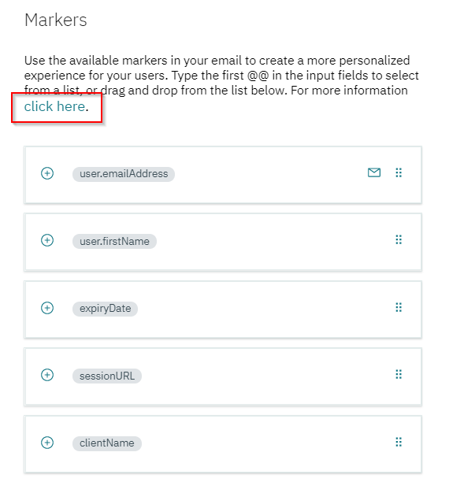
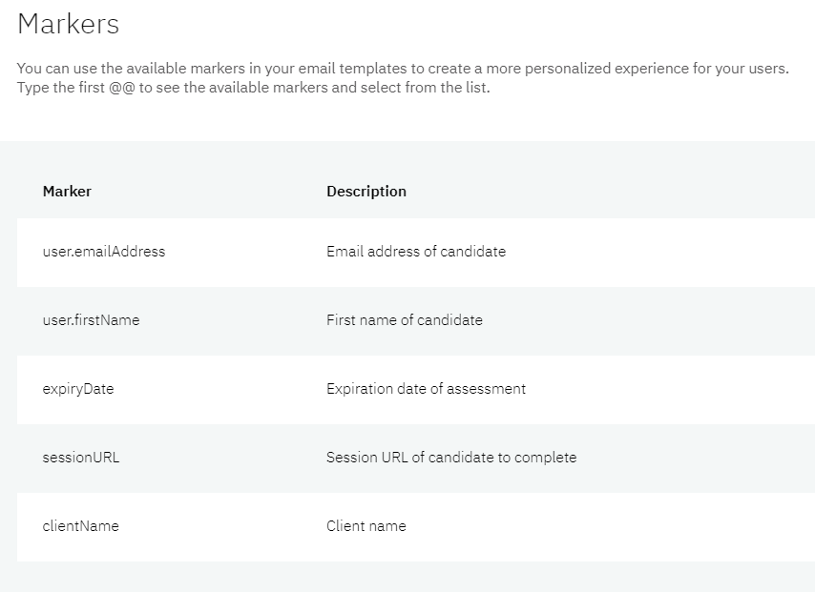
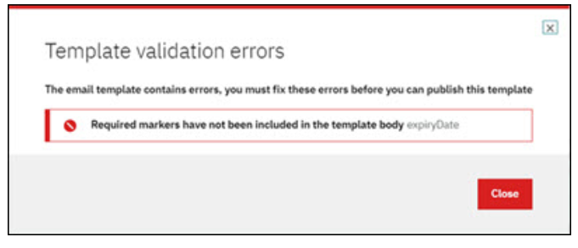
Overview
Markers are available as placeholders that will be replaced with the specific user data for that Marker.
Markers may differ for each template depending on the content of the email.
They can be dragged and dropped from the Marker list OR by selecting the plus icon for the Marker. The Marker will be placed based on where your cursor is located.
In the Markers section, you can select click here to view descriptions of each Marker.
Markers CANNOT be edited.
Some Markers are required. An error message displays when trying to save the template if there are problems with a Marker in a field.

Slide 6
Demo
–
Navigating Manage Email Templates

Slide 7
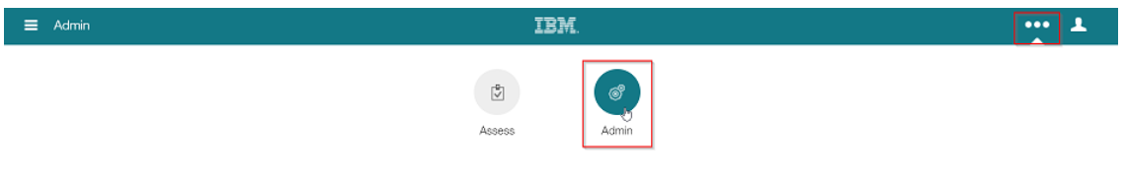
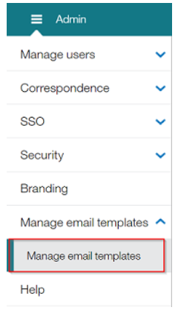
Accessing Manage Email Templates
Expand the Primary Navigation menu and navigate to the Talent Suite Admin application.
Select the Admin Main Menu->Manage Email Templates->Manage Email Templates.

Slide 8
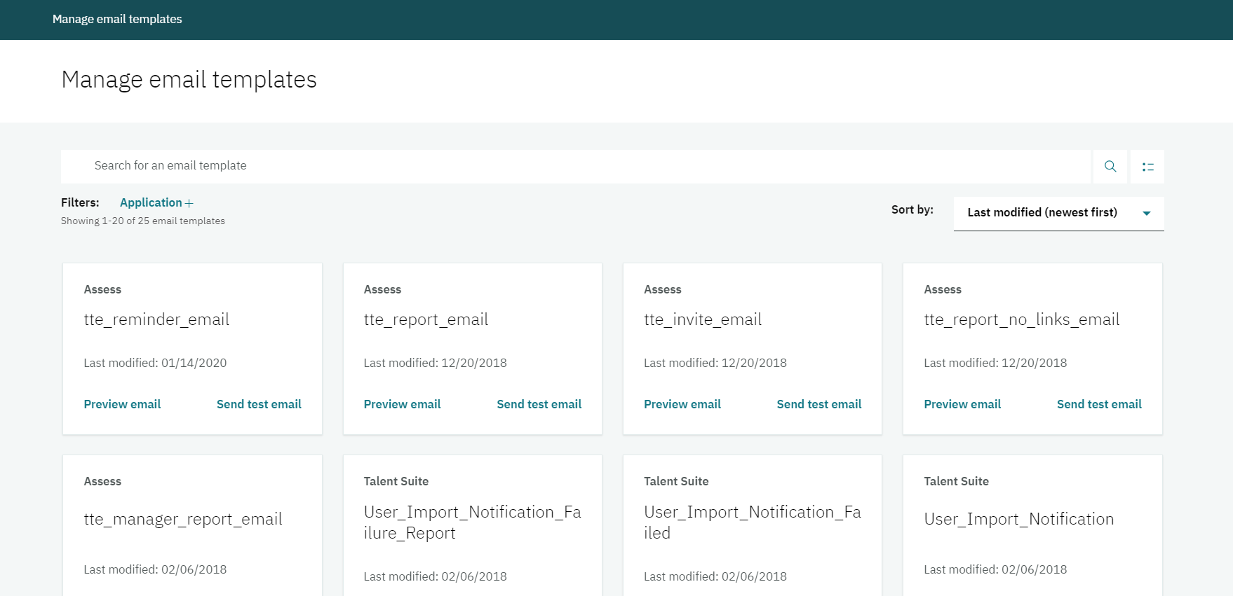
Navigation
The Manage Email Templates page displays up to 20 email templates in the default card view.
Here you can change the email template view, search email templates, sort templates, filter by Application, and access the email template to edit, preview, or send a test email.

Slide 9
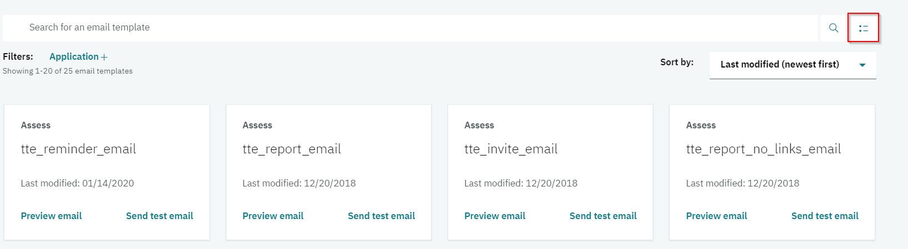
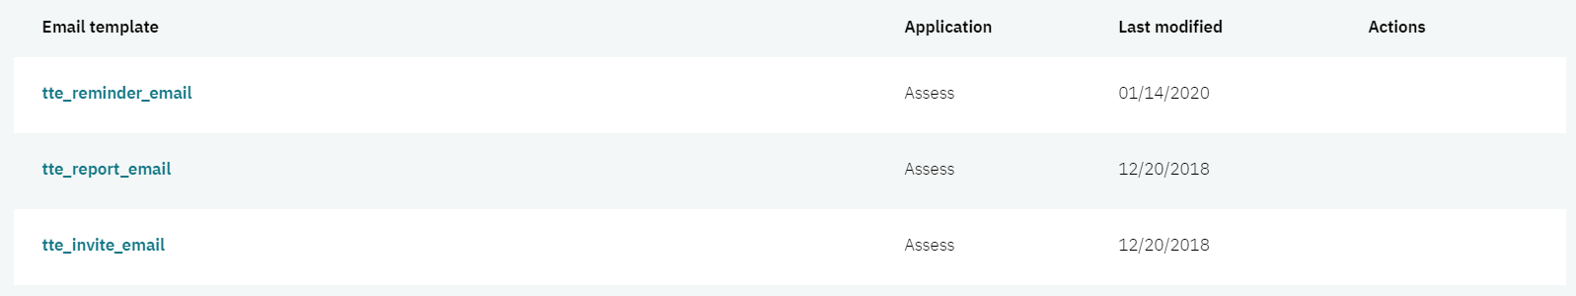
Switching to List View
Select the Template view toggle icon.
1.
2.

Slide 10
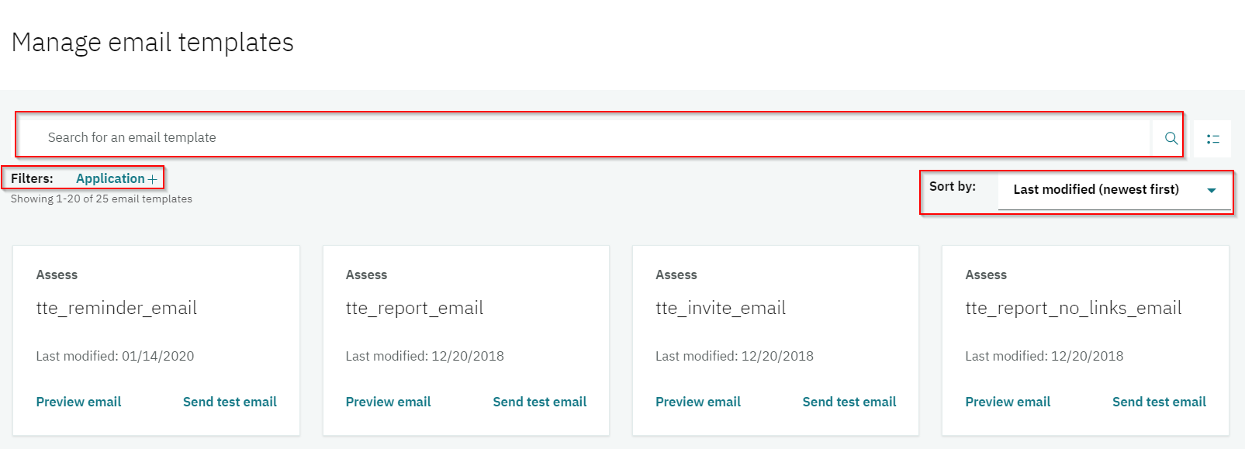
Locating Templates
You can Search for a specific email template, Filter by application, and Sort the email template view to locate an email template you wish to work with.

Slide 11
Demo
–
Preview Email Template

Slide 12
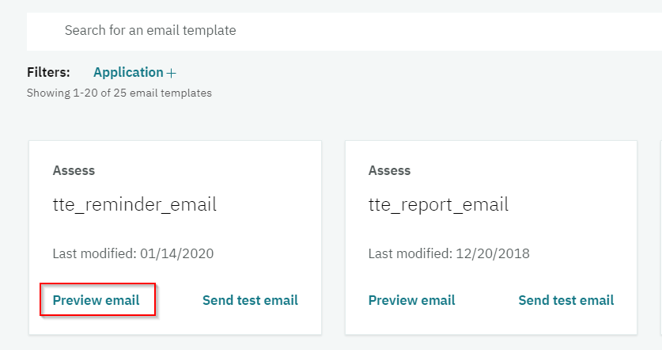
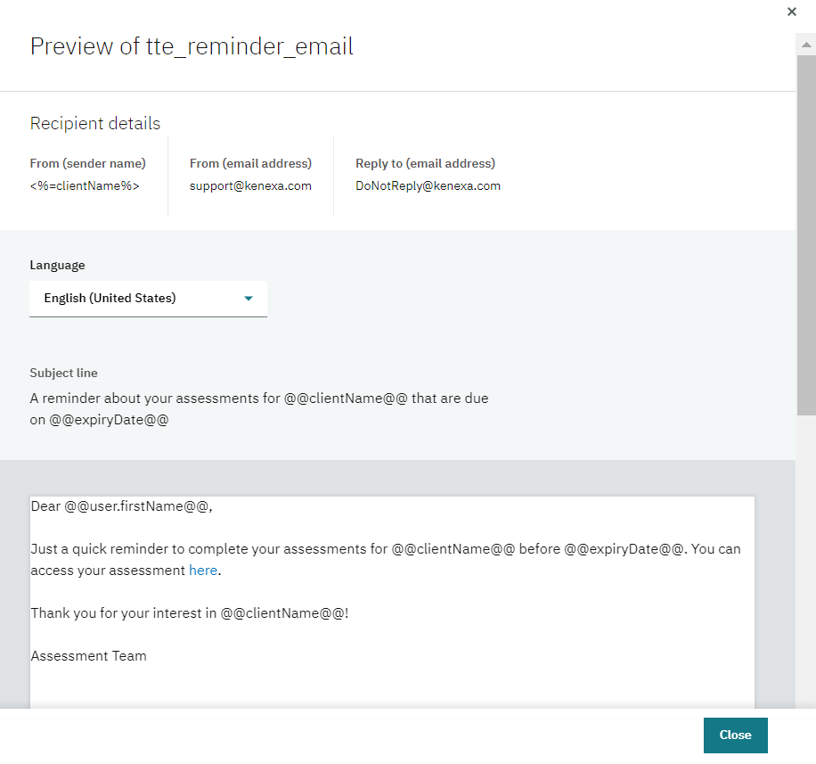
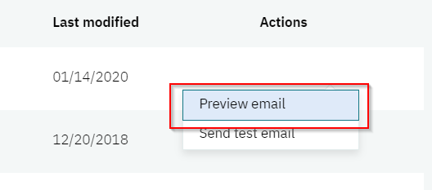
Preview Email Template
Locate the email template->select Preview email from the Card view OR select Actions->Preview email from the List view.

Slide 13
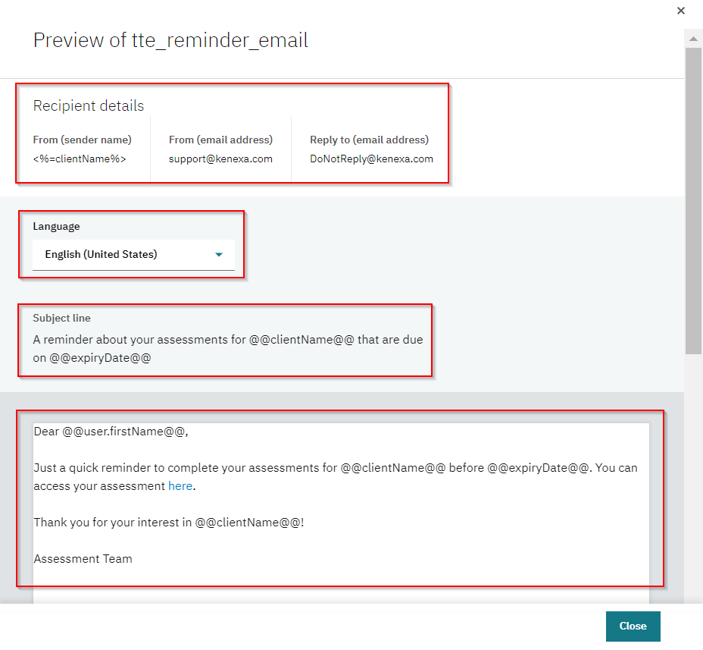
Preview Email Template
Review the content:
Recipient Details: From (sender name), From (email address), and Reply to (email address)
Language: Select the drop down list in the Language section to preview the email in a different language.
Subject line
Body: Includes any images, links, markers, and text for the email.

Slide 14
Demo
–
Edit Email Template

Slide 15
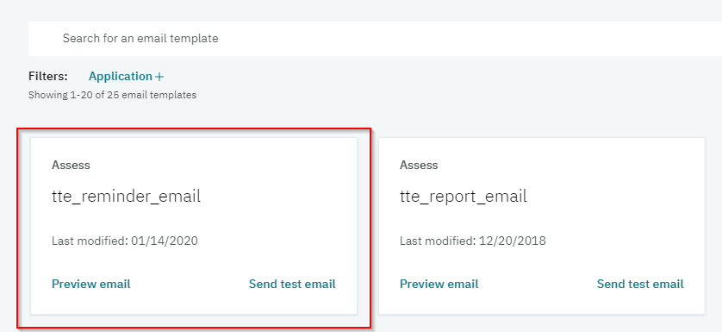
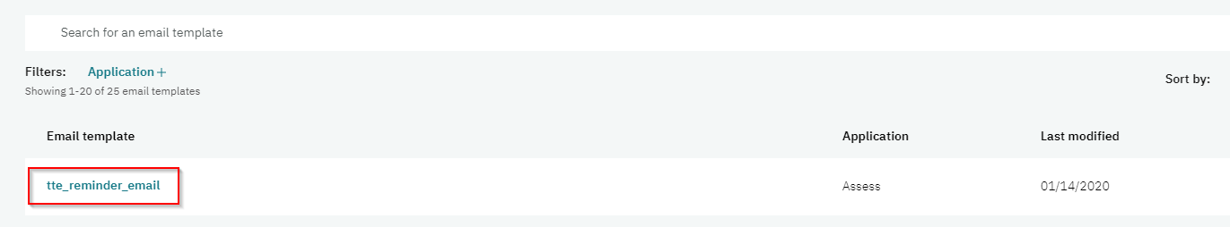
Edit Email Template
Locate the email template->select the Template Card from the Card view OR select the Template Name from the List view.

Slide 16
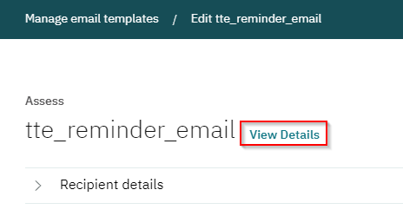
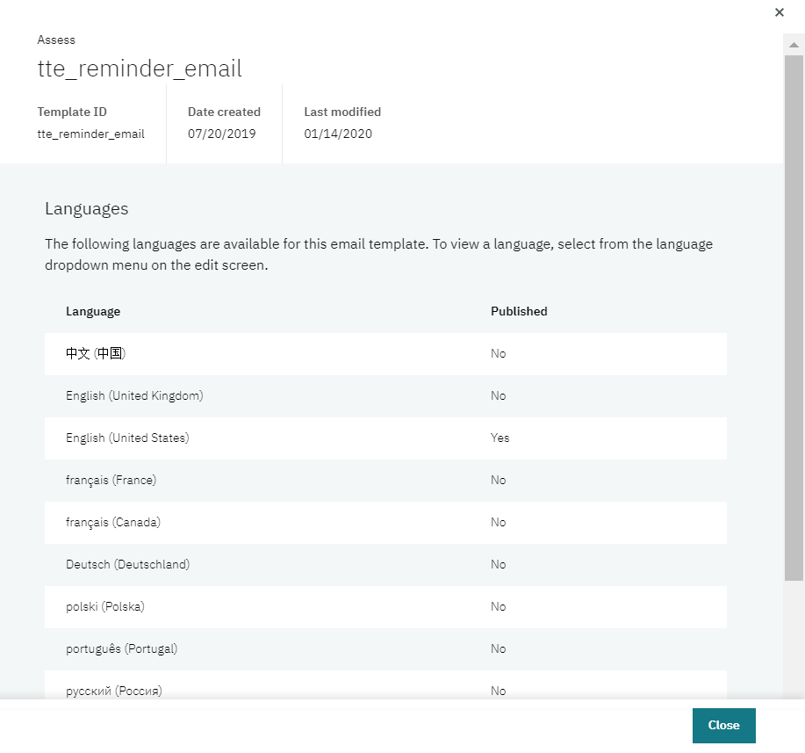
Edit Email Template
Select View Details to review:
Template ID
Date Created
Date Last Modified
Available Languages

Slide 17
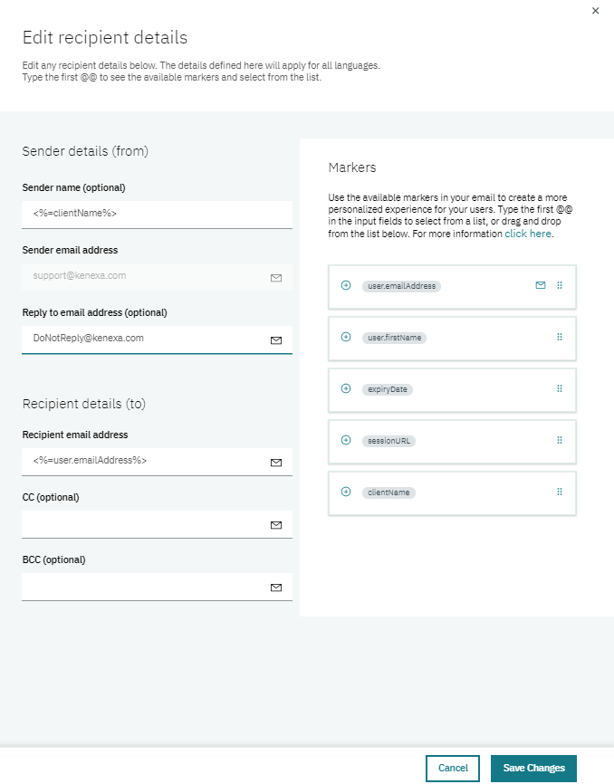
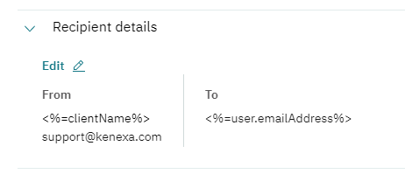
Edit Email Template
Expand the Recipient details to review and edit the following:
Sender name (optional)
Sender email address: A required field and is defaulted to an email address that cannot be changed.
Reply to email address (optional)
Recipient email address: A required field. A marker or valid email address must be used.
CC and BCC email address (optional)

Slide 18
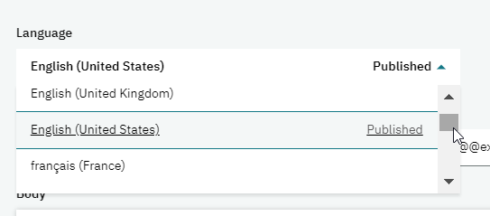
Edit Email Template
Select the Language drop down to see the list of available languages. These languages are based on languages enabled for your site in the Talent Suite. The languages will have a Published status if that specific template is already published in that language.

Slide 19
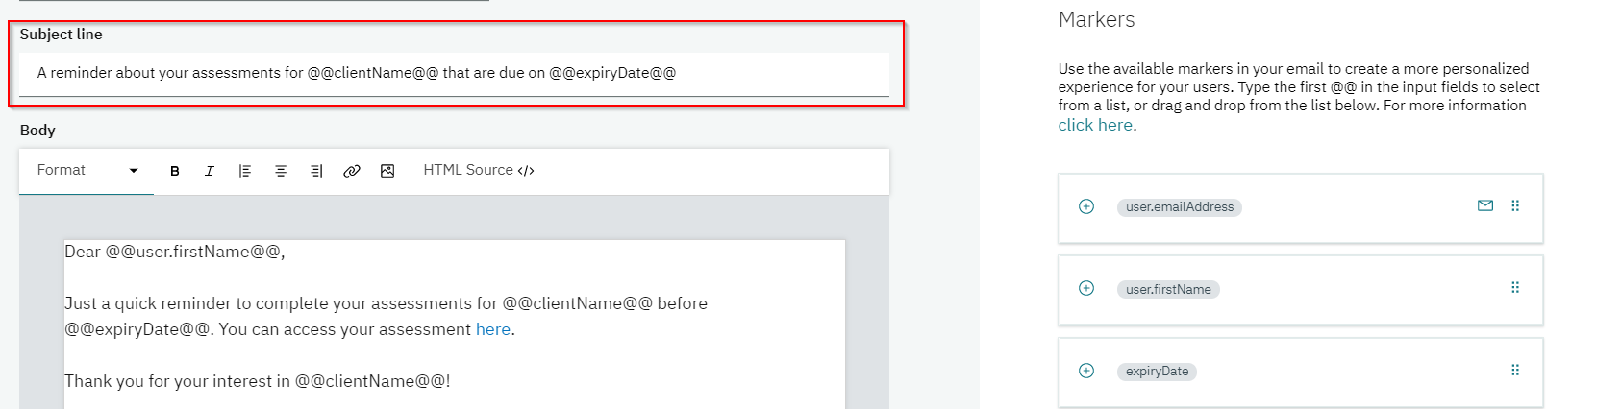
Edit Email Template
Enter a subject description and/or add the desired Markers from the Markers section.

Slide 20
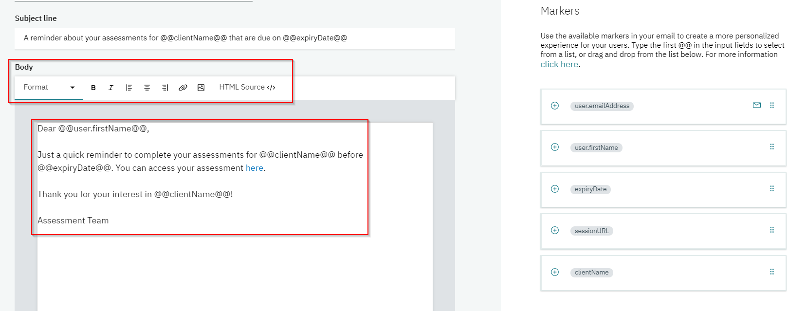
Edit Email Template
Enter the text content, images, and links for the body of the email. Use the Text Editor to format your text and add images or links. Use the Markers section to drag and drop any desired Markers into the body of the email.

Slide 21
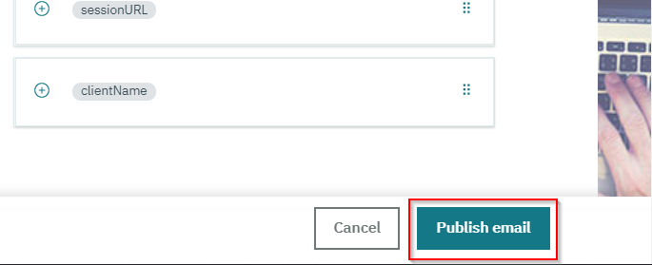
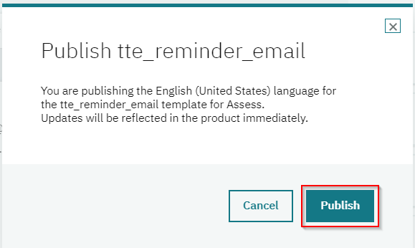
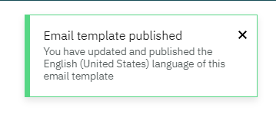
Publish Email Template
Once your updates have been completed, select Publish email. Once published, the email template will be live and will be reflected in the product immediately. Select Publish again to confirm and finalize.

Slide 22
Demo
–
Send Test Email

Slide 23
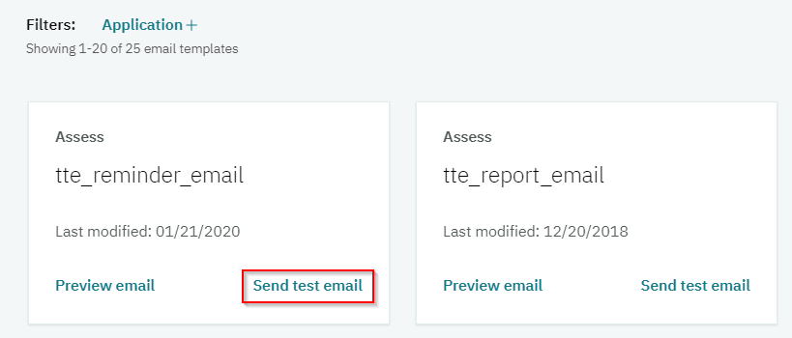
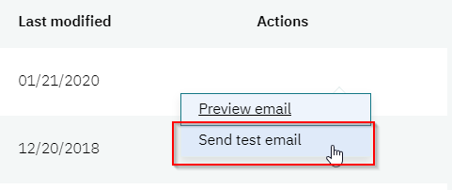
Send Test Email
Locate the email template->select Send test email from the Card view OR select Actions->Send test email from the List view.

Slide 24
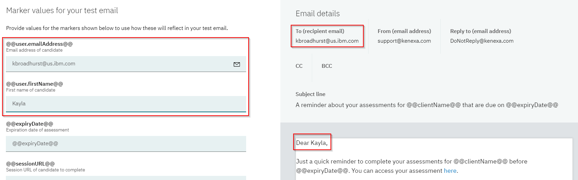
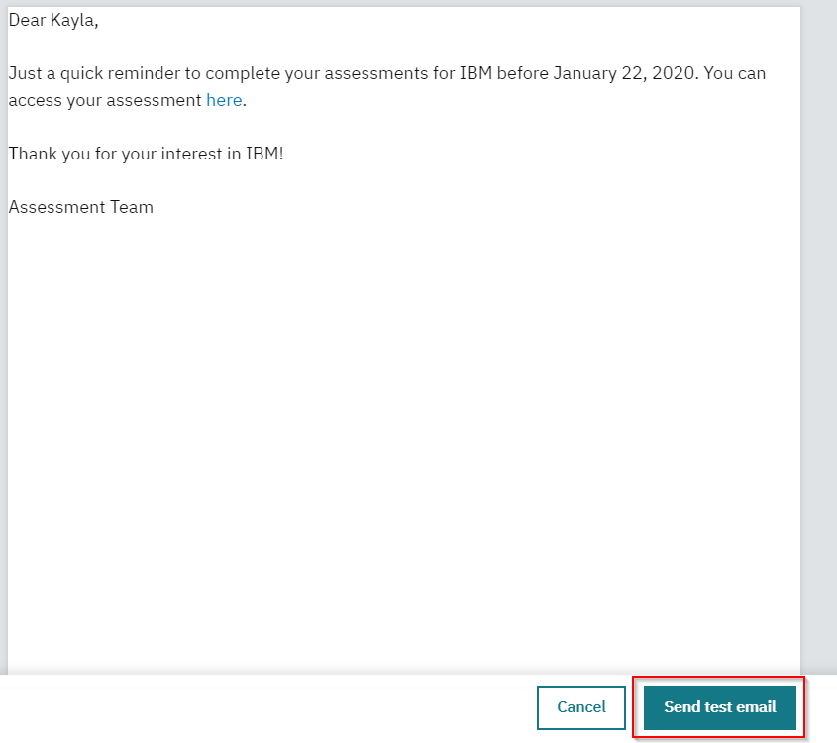
Send Test Email
Provide values for the Markers that will reflect in your test email. The Recipient email will determine where the test email is sent to.
Select Send test email.

Slide 25
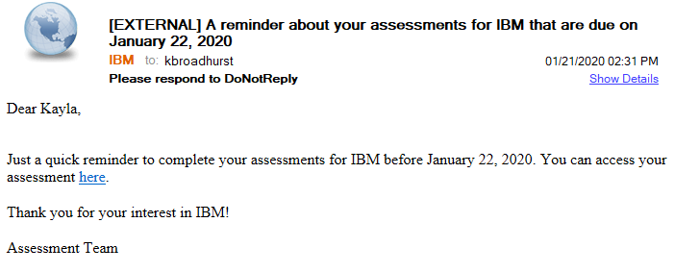
Send Test Email
Review the test email. If any corrections are needed, return to Manage Email Templates and edit the template.

Slide 26
Resources
Manage Email Templates Admin Guide
https://www.ibm.com/support/knowledgecenter/SS7MHN/Administration_Application_Guide/manage_email_templates.html
Manage Email Templates eLearning Video
https://media.kenexa.com/Training/TSAdmin/Sims/12ManageEmailTemplates/12ManageEmailTemplates.html

Slide 27
April VIRTUAL TRAINING SESSIONS
Client-facing training schedule
Sunday | Monday | Tuesday | Wednesday | Thursday | Friday | Saturday
 |  |  | 1 | 2 | 3 | 4
5 | 5 | 7 | 8 | 9 Client: BrassRing 20.04.06 and Onboard Release Enablement (11:00 AM EST) | 10 | 11
12 | 13 | 14 | 15 | 16 | 17 | 18
19 | 20 | 21 Client: Rules Automation Manager (RAM) Session (11:00 AM EST) | 22 | 23 | 24 | 25
26 | 27 | 28 | 29 | 30

Slide 28
Questions?

