Slide 1
Rules Automation Manager (RAM)
—
Client Training and Enablement Session
IBM Watson Talent
April 21st, 2020

Slide 2
Agenda
What is Rules Automation Manager (RAM)?
New Triggering Mechanisms
Delay Mechanism
RAM Trigger Examples
RAM Log
RAM Reports
Things to know
Resources
Q&A

Slide 3
What is Rules Automation Manager (RAM)?
RAM is very flexible and can solve many business problems by using automation.
It manages rules associated to an HR status update or form insert/update.
Rules contain sets of conditions from which to check data and perform various actions based on the conditions being met.
Actions can include for example: populating candidate forms, req form, or talent record fields. They can also include updating to a different HR status and/or sending communications.
The process to create a RAM trigger is the same for all triggers; however, each trigger can have multiple settings associated with them. Trigger Settings include:
    Trigger Mechanism which defines what triggers the RAM to run.
    Trigger Event which is the specific occurrence that dictates what causes the trigger to run.
    Rules which are made of conditions and actions. Conditions evaluate data in the system to produce a true or false result and Actions perform automated tasks in the system when those conditions are true.

Slide 4
New Triggering Mechanisms
Trigger Mechanism can be considered as a Category that defines what triggers the RAM to run.
Here are some new additions to the list of available Trigger Mechanisms:
  Candidate Form Approval Reminder - Identifies the user with whom the approval is pending and sends them an email communication after a preset delay. The candidate form approval link is added in the communication that is sent to the system user whose approval is pending.
  Req Form Approval Reminders - Identifies the user with whom the approval is pending and sends them an email communication after a preset delay. The req form approval link is added in the communication that is sent to the system user whose approval is pending.
  Lead Campaign Status - When a Lead has been updated to a Status in a campaign, the trigger runs.
  Lead Creation - When a new Lead is created, the trigger runs.

Slide 5
Demo
–
Creating Approval Reminder Trigger

Slide 6
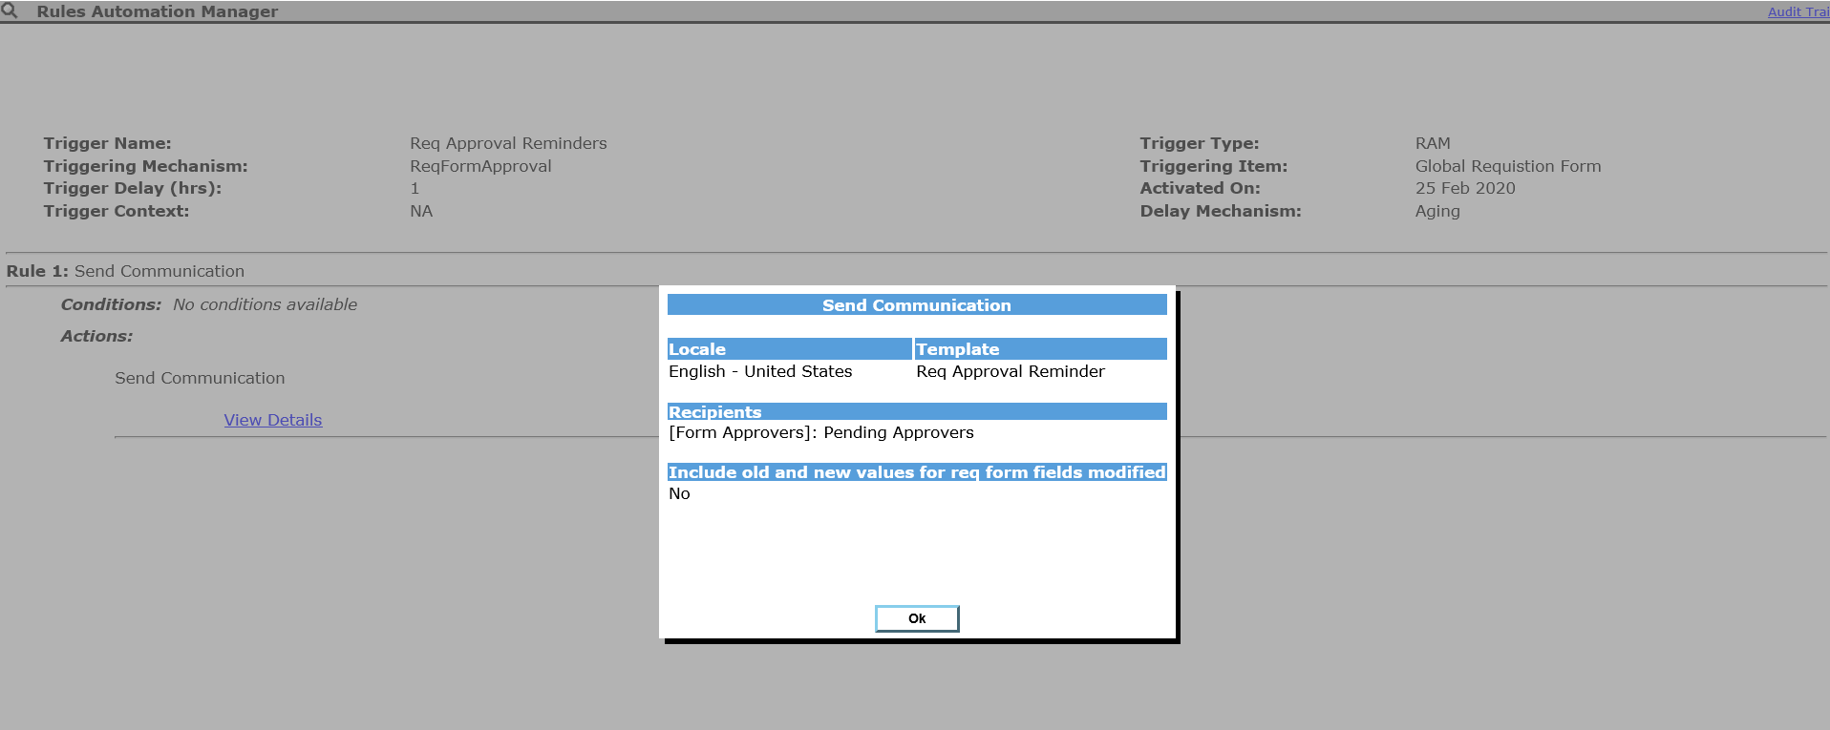
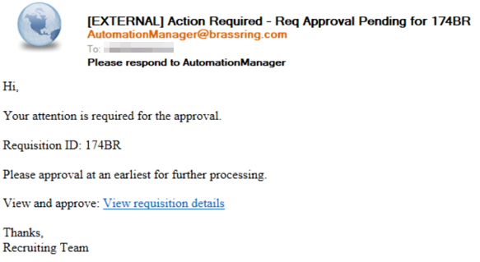
Req Approval Reminders Trigger Example

Slide 7
Delayed Mechanism
The Delay Mechanism available on the RAM Trigger Add/Edit screen determines the type of delay.
The following options are available:
    Delayed Processing
    Delayed Triggering
    Aging
    Delay Processing (Field Value)

Slide 8
Delay Mechanism
Delayed Processing - This mechanism is used commonly for triggers where there is no delay period required and if the action has to be taken instantly.
    It can accept delay however it is suggested to use this mechanism only if delay period is less than 1 hour and it accepts decimal values. The maximum delay value accepted is 190 days or 4560 hours.
    With this mechanism the trigger is fired & queued up for processing after the delay time has elapsed.
    Multiple triggers CANNOT be configured using the same triggering event/item.
    Example: Send a communication when a candidate’s HR status is updated to “Interview Scheduled”.
Delayed Triggering – This mechanism should be used when there is a delay required for action.
    It will accept minimum delay of 1 hour (integer values only and no decimals accepted) and there is no maximum limit of delay period. Multiple triggers can be setup using the same trigger event, but different values for 'Trigger delay (hrs)’ is required.
    Through this mechanism RAM will wait for the delay time to elapse after the event has occurred and then fires the trigger. Thus, the trigger will be fired and executed at the same time.
    Example: Send a survey communication 1 year after candidate has accepted an offer.

Slide 9
Delay Mechanism – Continued
Aging – This mechanism is commonly used for reminders or aging actions.
    It will accept minimum delay of 1 hour (integer values only & no decimals accepted) and there is no maximum limit of delay period.
    Through this RAM engine will check if the triggering event is the same after the delay period has expired. Only if it is still the same, the trigger is fired & executed. Thus, the trigger will be fired & executed at the same time.
    Multiple triggers can be setup using the same trigger event, but different values for 'Trigger delay (hrs)’ is required.
Example: Send an assessment reminder notification after 10 days once the HR status is updated to
“Assessment Pending”.
Delayed Processing (Field Value) – Used to pick the delay from a req sub form or candidate form field.
    It will function the same as 'Delayed Processing' type, i.e. RAM trigger will be fired & it will be processed after the delay has elapsed.
    Value can be selected from Candidate form field, a Req form field, or a Req sub form field. Only Numeric, or Single-Select, field types can be used. The numeric value will only support whole numbers which represent amount of days (NOT hours). Maximum value allowed is 190 days.
    Example: Send a disposition notification to candidate after X days. Value X is selected from the disposition form of the candidate.

Slide 10
RAM Trigger Examples
HR Status Update - Post to Candidate Zone
Doc Sub Form Insert – Update HR Status and Send a communication to Recruiter
HR Status Update – Unpost and Close the req
Req Declined – Send Communication to Recruiter and Hiring Manager
HR Status Update – Send reminder e-mails after 7 days
Candidate Hired – Update all other Reqs

Slide 11
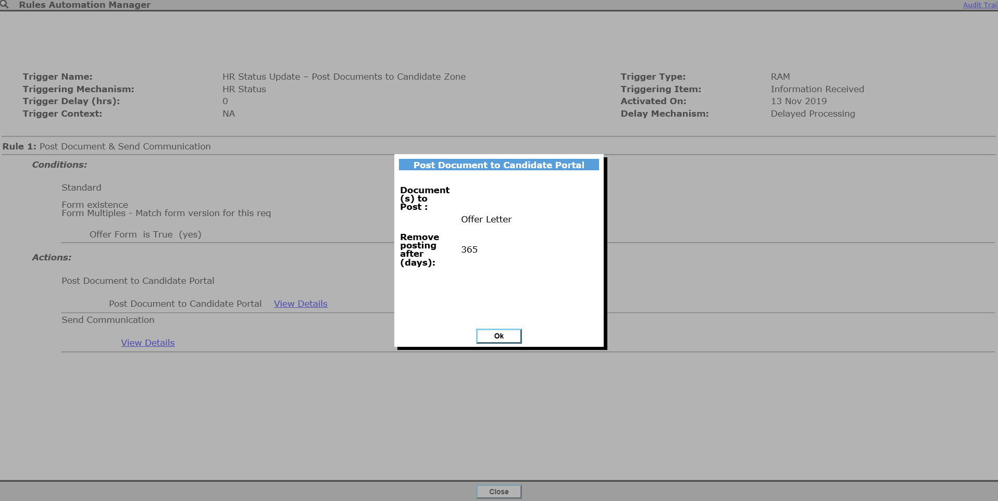
RAM Trigger Examples
HR Status Update – Post Documents to Candidate Zone

Slide 12
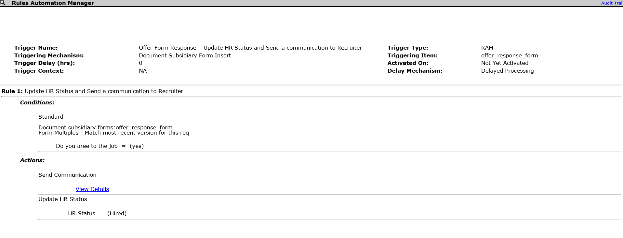
RAM Trigger Examples
Doc Sub Form Insert – Update HR Status and Send Communication to Recruiter

Slide 13
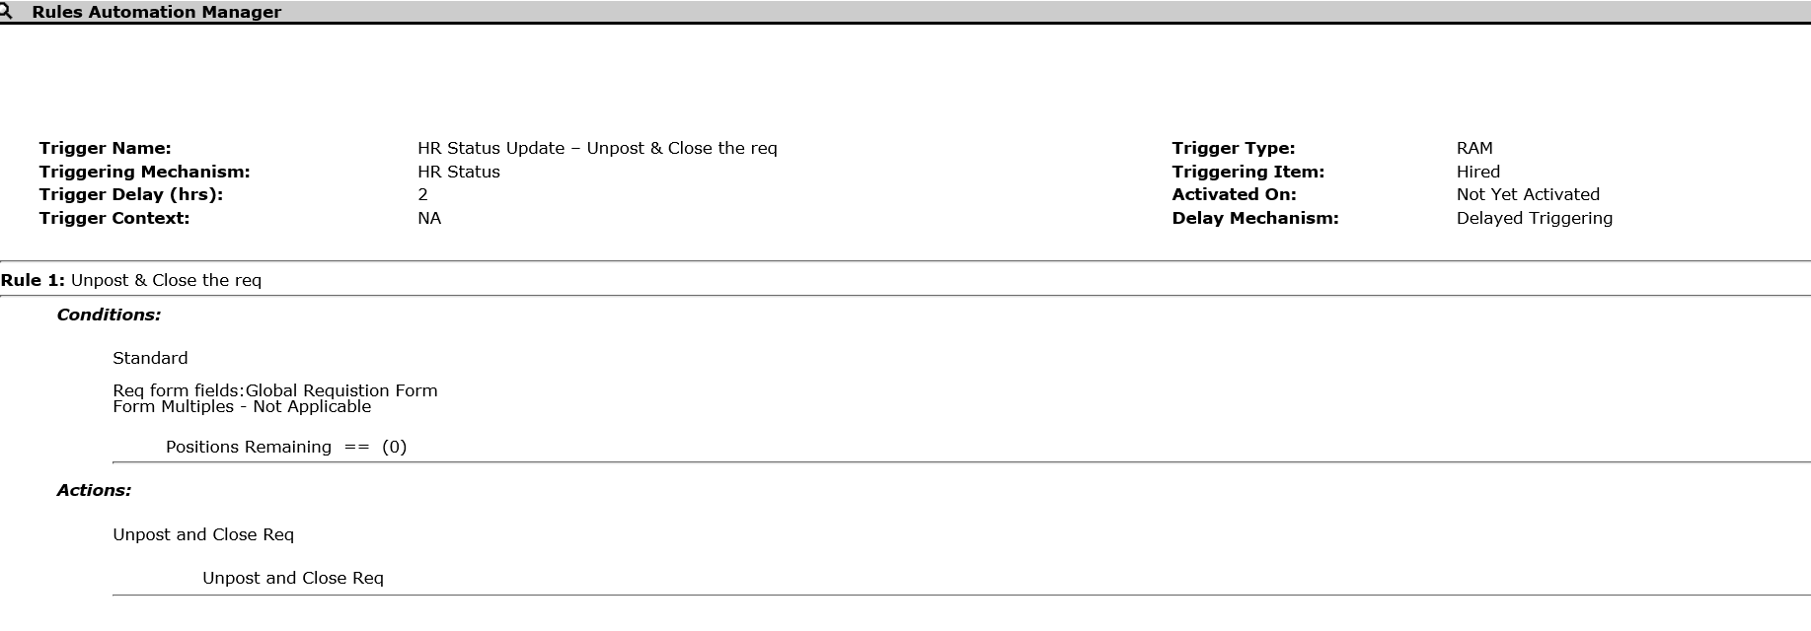
RAM Trigger Examples
HR Status Update – Unpost and Close the Req

Slide 14
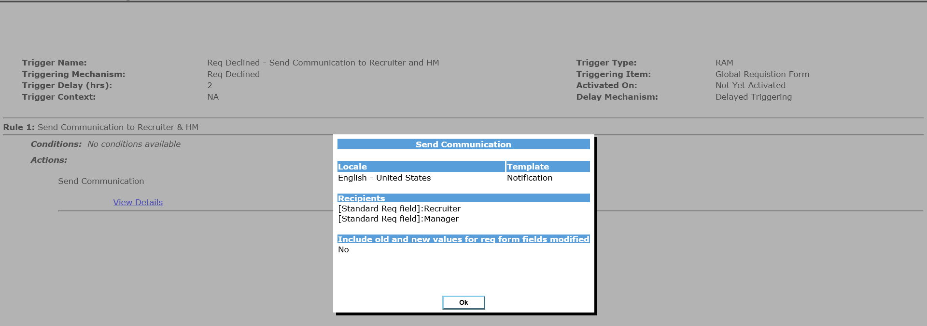
RAM Trigger Examples
Req Declined – Send Communication to Recruiter and Hiring Manager

Slide 15
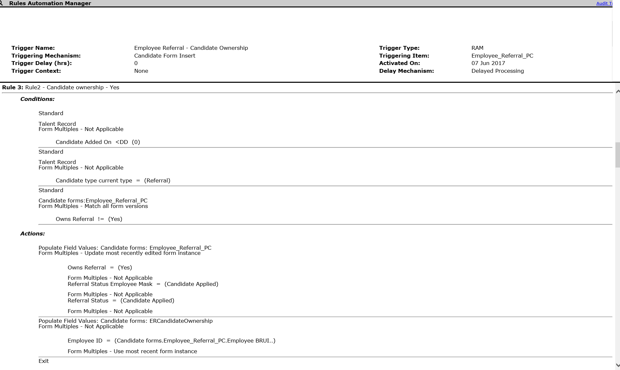
RAM Trigger Examples
Req Declined – Send Communication to Recruiter and Hiring Manager

Slide 16
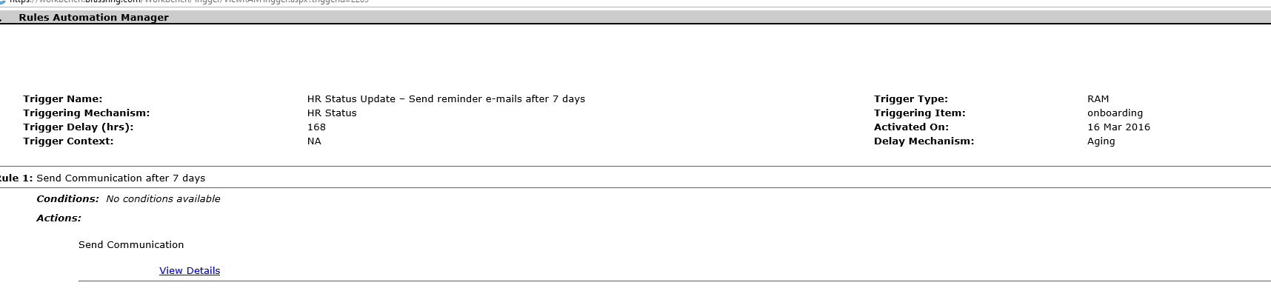
RAM Trigger Examples
HR Status Update – Send reminder e-mails after 7 days

Slide 17
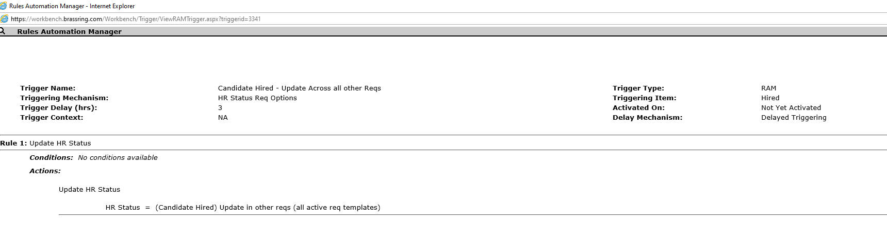
RAM Trigger Examples
Candidate Hired – Update Across all other Reqs

Slide 18
Demo
–
Create RAM trigger:
Candidate Hired - Update Across all other Reqs

Slide 19
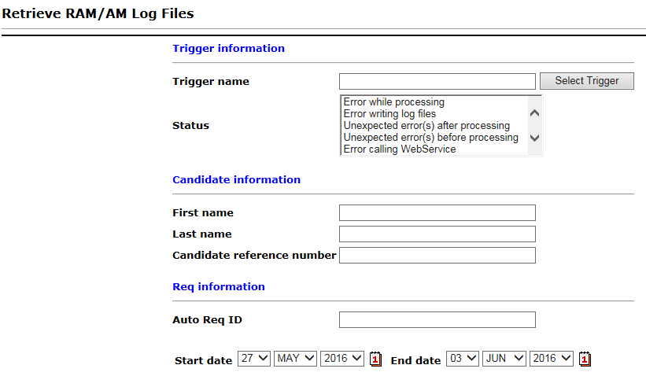
RAM Log
Tools > Automation Manager > RAM/AM Log Files
RAM log allows Workbench users to troubleshoot and review RAM activity within the system. RAM log information is stored for 6 months.
When using the RAM log to troubleshoot, it is helpful to take a screenshot of your RAM trigger (rules, conditions, actions), or have the RAM trigger open in a separate browser window, in order to easily compare the results to the configuration.
The RAM log is not always easy to read or intuitive, so being able to view the configuration at the same time can be very beneficial.
Retrieve log files by:
    Searching by one or more triggers
    Searching for a specific candidate
    Searching by a specific requisition

Slide 20
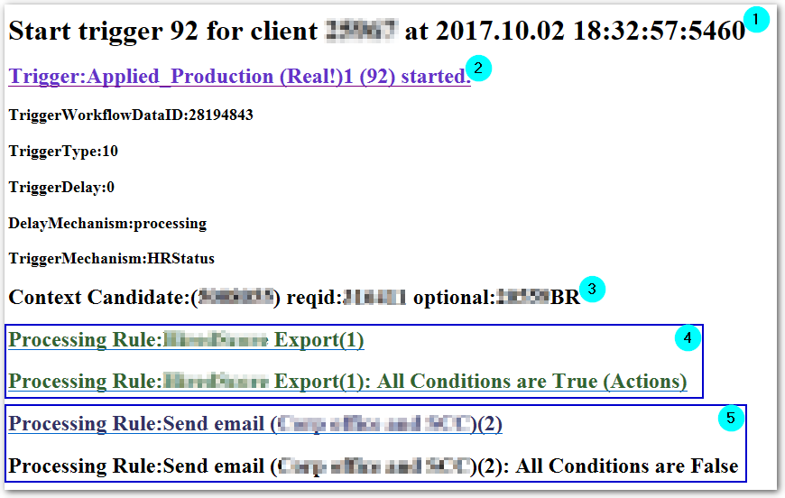
RAM Log
Reviewing a RAM Log Entry
(1) Each log will start with “Start trigger …”. This line indicates the trigger number, the Client ID, and when the trigger ran (not when it was triggered). (Time is in EST.)
(2) Clicking on the light blue hyperlink will display the trigger delay, delay mechanism, and trigger mechanism.
(3) This line depends on the type of trigger, but in this example shows the Candidate Reference Number and Req IDs (both ‘custom’ and BR/standard).
The log will then display 2 lines for each rule:
The first one for the rule will be green if all the conditions are true or dark blue if at least one condition is not true.
The second line will also be green when the rule is true and the action was taken. Clicking on that link will extend and display all actions taken. (Each action can also be extended to see, for example, email address used in the Send Communication action.)
(4) This rule is the first rule in the trigger, indicated by the (1), and shows a green link for both lines, meaning all conditions were true and an action was carried out.
(5) This rule shows a dark blue color for the first link because at least one condition was found to be not true. The second link for the rule is not hyperlinked because no actions were carried out.
Notes:
This slide is difficult to read and see? Is there a reason why we don't use the site and then you talk to this stuff?. Number 1: Did you want all of those extra periods? #5 –Dark blue color for the first link because at least one condition was found to be false.

Slide 21
RAM Log
RAM Log Statuses
Currently the RAM log has 25 statuses, broken down into 4 categories:
  Success
  Error
  Warning
  Pending

Slide 22
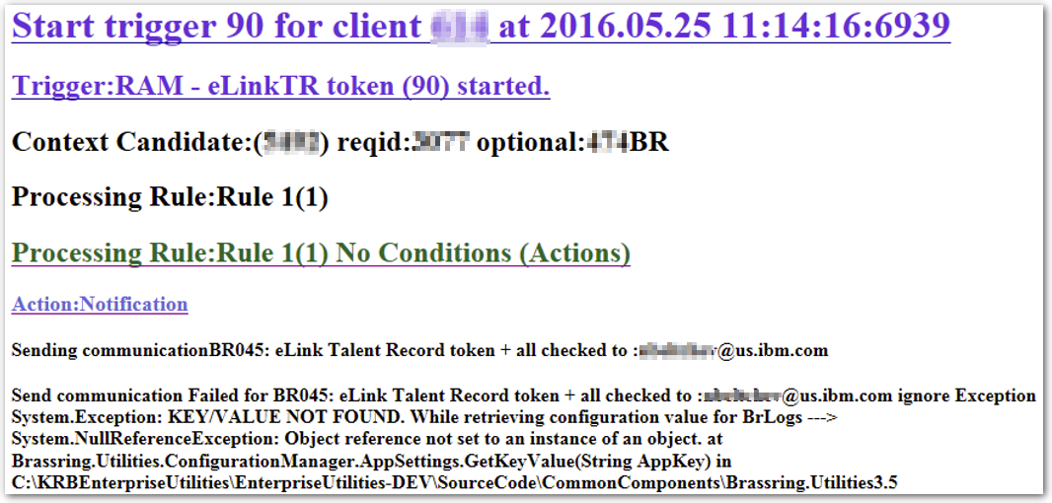
RAM Log Statuses
Error Statuses
Errors are usually found at the end of the log after clicking on the last rule link.
Not all errors are user friendly.
When an error is received from another application, RAM will display that error. This example error is due to server misconfiguration.

Slide 23
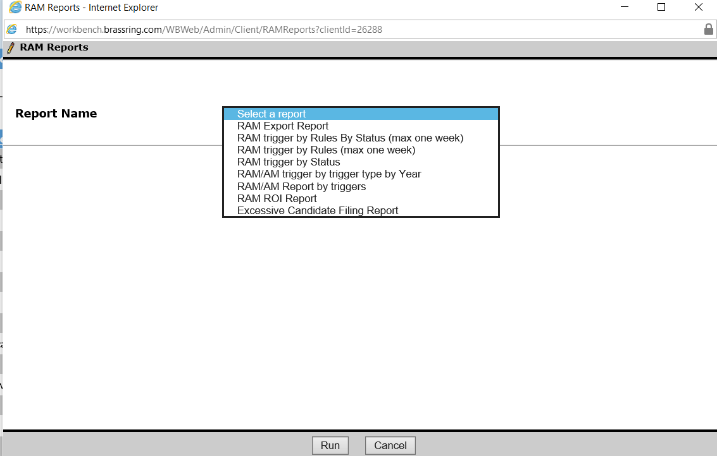
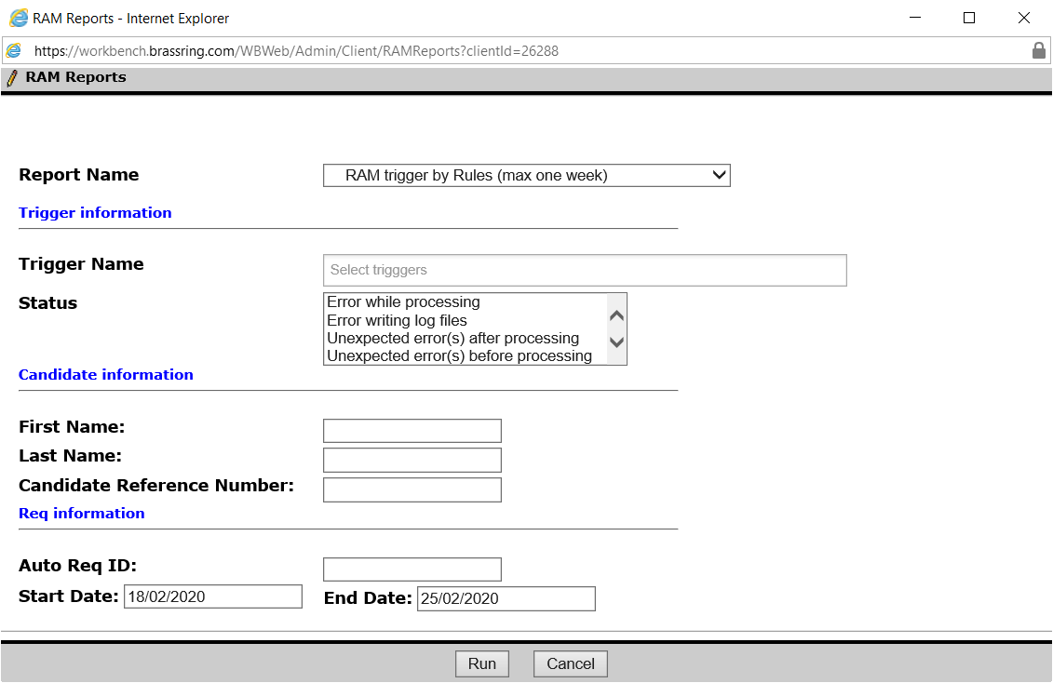
RAM Reports
These RAM reports can be run to see the health of the client’s RAM triggers and can also factor in to RAM ROI calculations.
Tools > Automation Manager > Admin > RAM Reports
Notes:
Use of periods on bullets, remember "stem rules".

Slide 24
RAM Reports
The following RAM Reports are available:
RAM Export Report – provides a list and details of draft and active RAM triggers.
RAM trigger by Rules by Status (max one week) – analyzes performance of RAM trigger than have run in previous week.
RAM trigger by Rules (max one week) – analyzes rules that have been processed in the previous week.
RAM trigger by Status – groups triggers by statuses and is used to identify common trigger errors.
RAM/AM trigger by trigger type per Year – outputs historical data per trigger type, per year.
RAM/AM Report by triggers – outputs volume of usage of RAM/AM triggers.
RAM ROI Report – describes the number of triggers and rules processed within a set time period.
Excessive Candidate Filing Report - This report provides a list and info of candidates that apply for more than a normal number of requisitions
Click here for more details about RAM Report Details on IBM Knowledge Center.
Notes:
Use of periods on bullets, remember "stem rules".

Slide 25
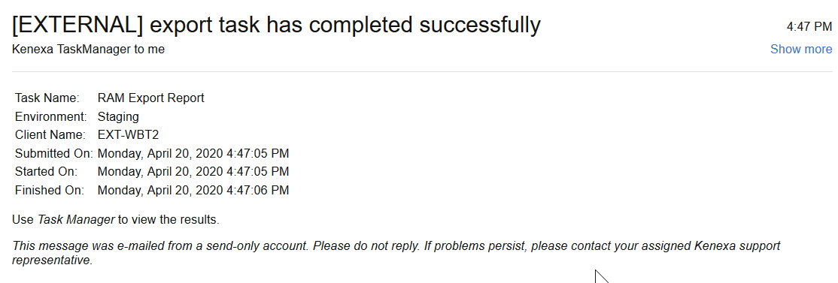
RAM Reports
Report results are available:
Tools > Task Manager
In addition, user receives an email.
Notes:
Use of periods on bullets, remember "stem rules".

Slide 26
Things to Know
ALWAYS create triggers in Staging before you create the trigger in Production.
Clients can activate RAM triggers in Staging but not in Production. Make sure that the client’s trigger is in STAGING (and tested) first before you activate in Production.
Conditions inside a Rule always follow AND logic not OR logic.
Rules within RAM run sequentially. So order them properly.
Once HR Status update happens, RAM will exit and no further rules will be processed. Hence keep it towards the end of trigger. Also, use EXIT whenever you want no subsequent rules to be executed.
For “not equals” (!=) – selecting multiple values for the “not equal” operation doesn’t mean that the condition will fail; however, it could behave differently in scenarios that were overlooked. That’s why it’s very important to test RAM triggers in staging before creating them in Production and activating them. That way you assure that a RAM trigger behaves as expected in all possible scenarios.
RAM does not trigger instantly. The minimum reaction time is .30s to 1 min.
Notes:
Use of periods on bullets, remember "stem rules".

Slide 27
Resources
Creating and Activating RAM Triggers
      https://www.ibm.com/support/knowledgecenter/SSEUFV/2_Configuration/8_Automation_RAM_Guide/1_2CreatingAndActivatingaRAMTrigger.html
RAM Trigger Settings
      https://www.ibm.com/support/knowledgecenter/SSEUFV/2_Configuration/8_Automation_RAM_Guide/1_3RAMTriggerSettings.html
RAM Log
    https://www.ibm.com/support/knowledgecenter/SSEUFV/2_Configuration/8_Automation_RAM_Guide/1_8RAMLog.html
RAM Reports
      https://www.ibm.com/support/knowledgecenter/SSEUFV/2_Configuration/8_Automation_RAM_Guide/1_10RAMReports.html

Slide 28
Resources
RAM FAQs
      https://www.ibm.com/support/knowledgecenter/SSEUFV/2_Configuration/8_Automation_RAM_Guide/1_12FrequentlyAskedQuestions.html
RAM Trigger Examples
      https://www.ibm.com/support/knowledgecenter/SSEUFV/2_Configuration/8_Automation_RAM_Guide/1_13CommonRAMExamples.html

Slide 29
April VIRTUAL TRAINING SESSIONS
Client-facing training schedule
Test Your Skills Here!
Sunday | Monday | Tuesday | Wednesday | Thursday | Friday | Saturday
 |  |  | 1 | 2 | 3 | 4
5 | 5 | 7 | 8 | 9 Client: BrassRing 20.04.06 and Onboard Release Enablement (11:00 AM EST) | 10 | 11
12 | 13 | 14 | 15 | 16 | 17 | 18
19 | 20 | 21 Client: Rules Automation Manager (RAM) Session (11:00 AM EST) | 22 | 23 | 24 | 25
26 | 27 | 28 Client: BrassRing: Interview Manager – User Session (11:00 AM EST) | 29 | 30 Client: Convert Classic TG to Responsive (11:00 AM EST)

Slide 30
May VIRTUAL TRAINING SESSIONS
Client-facing training schedule
Tests Your Skills Here!
Sunday | Monday | Tuesday | Wednesday | Thursday | Friday | Saturday
 |  |  |  |  | 1 | 2
3 | 4 | 5 | 6 | 7 Client: BR 20.05.04 and Onboard Release (11:00 AM EST) | 8 | 9
10 | 11 | 12 | 13 | 14 | 15 | 16
17 | 18 Client: Assess May Release (11:00 AM EST) | 19 Client: BrassRing Metrics Dashboard (11:00 AM EST) | 20 | 21 | 22 | 23
24 | 25 | 26 | 27 | 28 | 29 | 30

Slide 31
Questions?

