Slide 1
Offer Process/Forms - Responsive Candidate Zone
IBM Kenexa BrassRing on Cloud
—
Client Training and Enablement Session
IBM Talent Management Solutions
June 23rd,2020

Slide 2
Agenda
Overview of Candidate Zone
Posting Forms
Posting Offer Documents
Non – TG Applicants
Communication/Document Template Configuration
Usage of RAM
Resources
Q&A

Slide 3
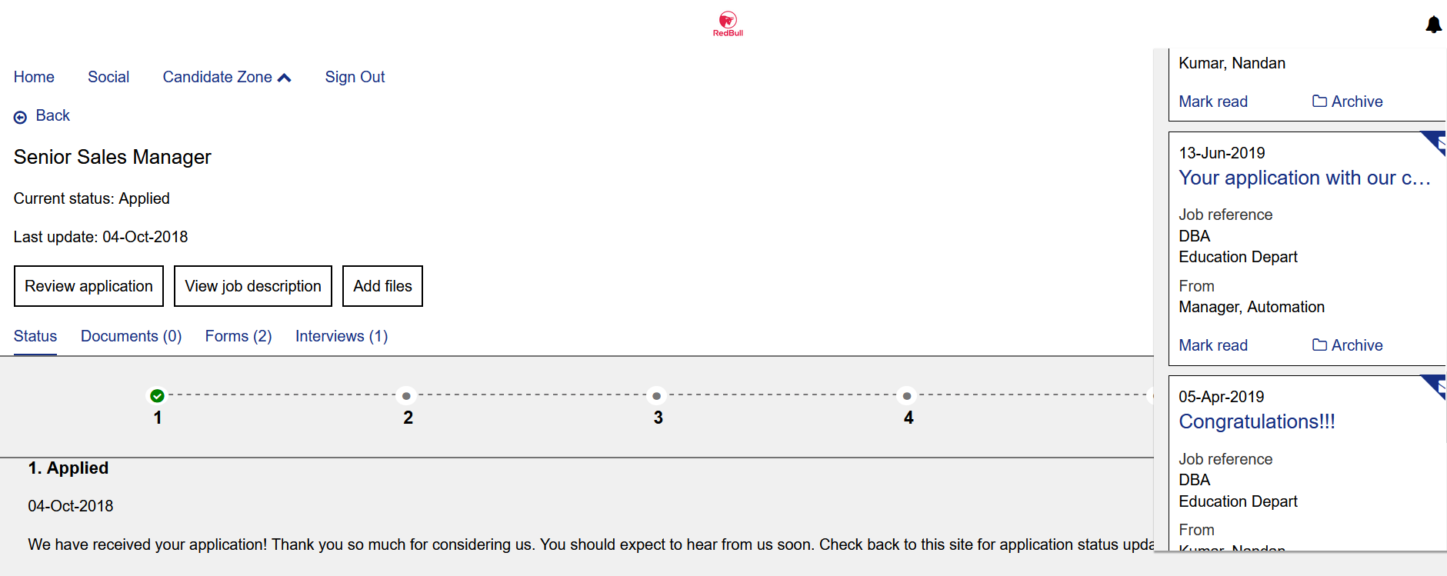
Overview of Candidate Zone
Provides a secure offer process and location where candidates can retrieve, review, and respond to forms & offer documents.
Stores a link to the PDF version of the Offer Letter and to the corresponding response form (Document Subsidiary From) to record the acceptance or decline of the offer.
Can be used to display candidate forms to the candidate for completion, and other attachments specific to your organization’s hiring process.
Candidates that receive an offer also have an alert on the screen. Selecting the alert takes the candidate directly to the offer posted to the Candidate Zone.

Slide 4
Demo
–
Demo of Candidate Zone

Slide 5
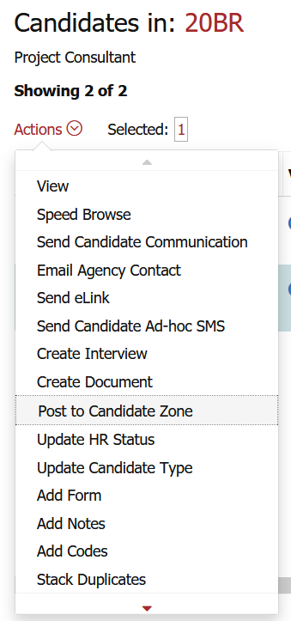
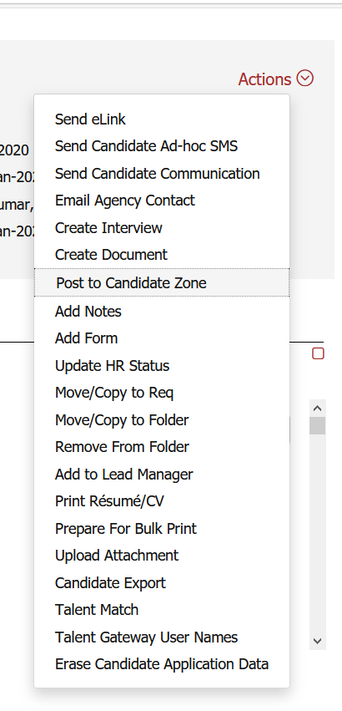
Posting Forms to Candidate Zone
BrassRing -> Req -> Candidate’s Talent Record -> Actions -> Post to Candidate Zone
Forms can be posted to candidate zone from the Talent Record or from the candidate listing page.
They can be posted for a specific period and will then get automatically unposted.
Rules Automation Manager (RAM) can be built to post Forms to the Candidate Zone automatically.

Slide 6
Demo
–
Posting Forms to Candidate Zone

Slide 7
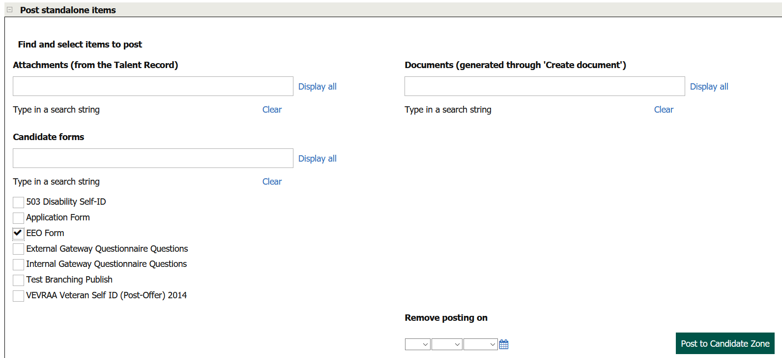
Posting Forms to Candidate Zone
Search by the name of the form or click on “Display all” to show all the forms that are available to post to the Candidate Zone.
Select the form(s).
A removal date can be selected if the Form(s) has to be completed within a specific period or else can be left blank.
Post to Candidate Zone.

Slide 8
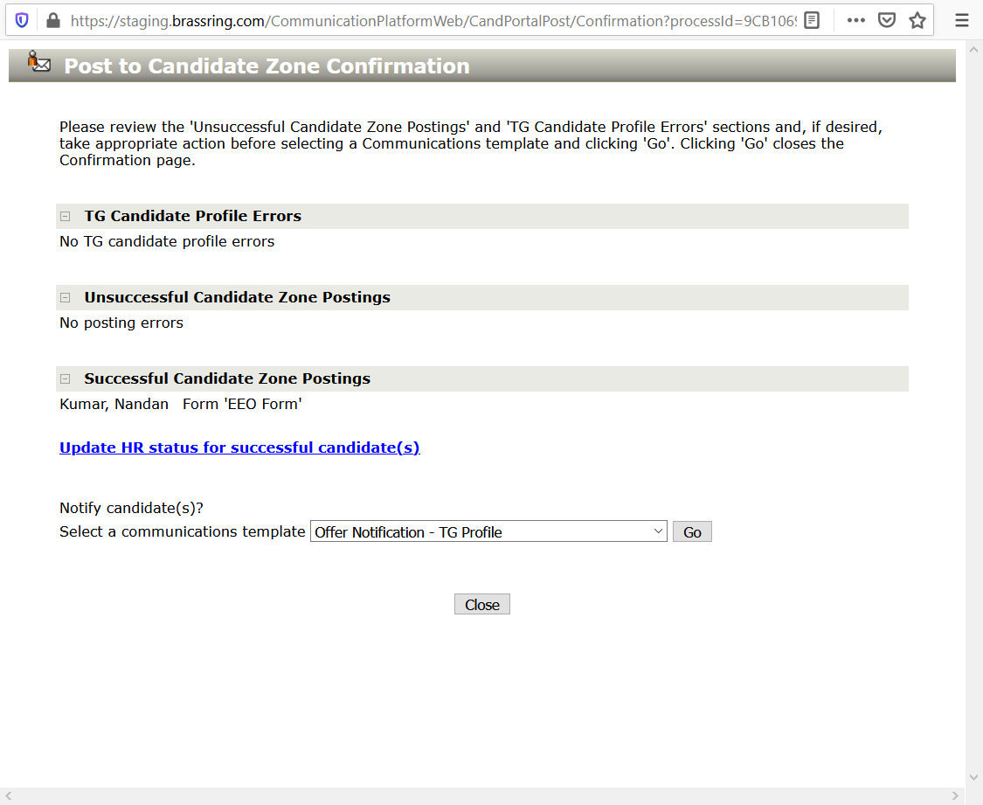
Posting Forms to Candidate Zone
Once the form is posted it would display a message under “Successful Candidate Zone Postings” tab.
If there are any errors, it would display under the respective section/tab.
The user can send a communication (optional) to let the candidate know about the posting.
Select the designated communication template and click on “Go”.
Edit/preview the template as necessary and click on “Send”.

Slide 9
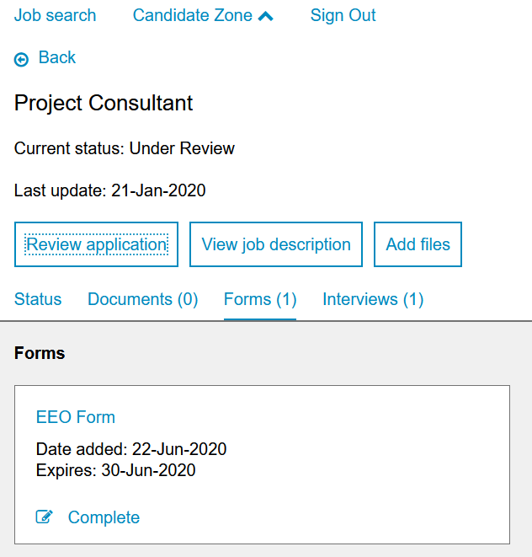
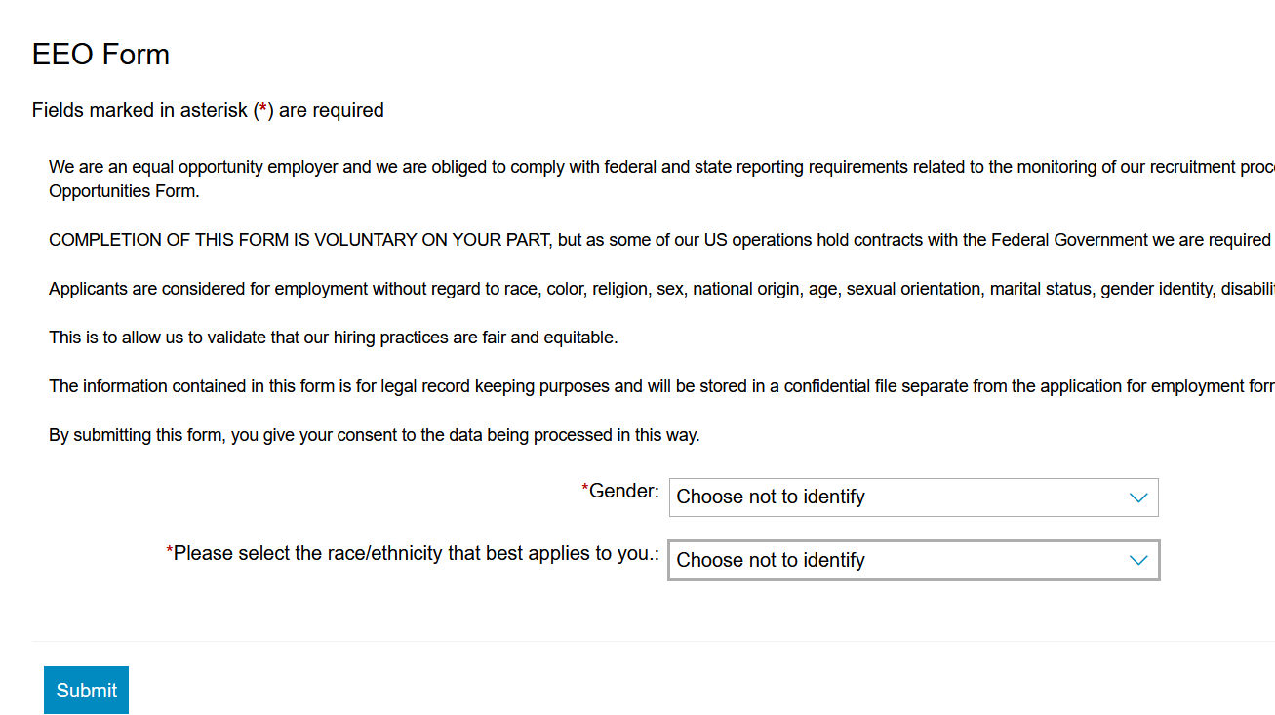
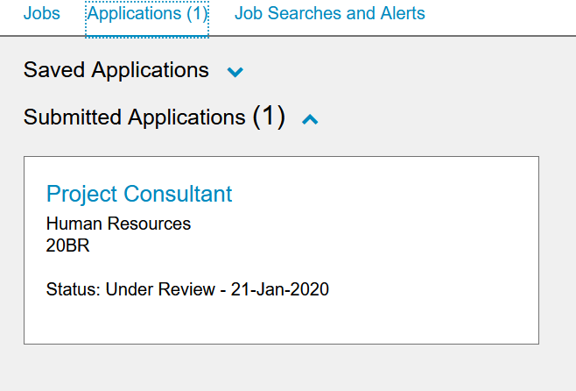
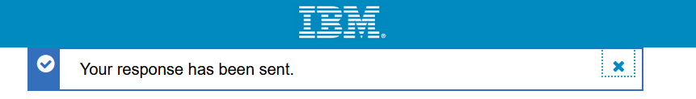
Candidate Accessing Forms in Candidate Zone
Candidate can navigate through the dashboard -> submitted applications to access the posted forms.
Candidate can also use the link the communication template to access the posted forms.
If a removal date is assigned, it will be displayed (if enabled).
They can click on the Form name or Complete button to launch the form and complete.
Once completed, the form will be automatically removed (if enabled) from the list/tab.

Slide 10
Demo
–
Candidate accessing Forms in Candidate Zone

Slide 11
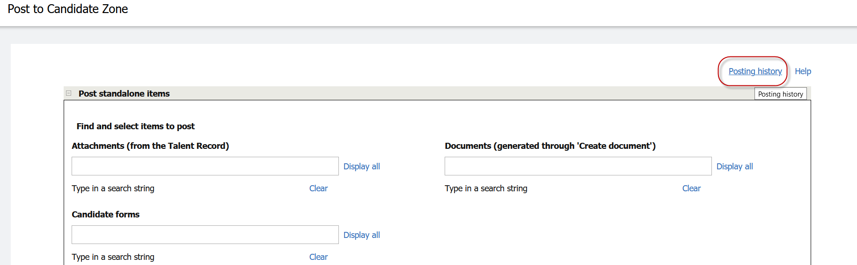
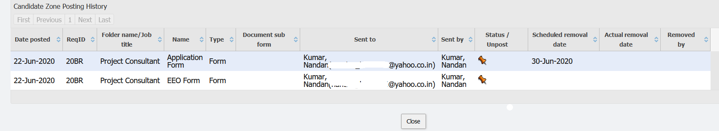
UnPosting Forms from the Candidate Zone
BrassRing -> Req -> Candidate’s Talent Record -> Actions -> Post to Candidate Zone -> Posting History
Once the form is posted it can also be unposted.
Click on the Pushpin (orange) to unpost the form.
It also shows history of the previous postings to candidate zone.

Slide 12
Demo
–
Unposting Forms from Candidate Zone

Slide 13
Posting Offer Documents to Candidate Zone
BrassRing -> Req -> Candidate’s Talent Record -> Actions -> Post to Candidate Zone
Offer Documents/Offer Letters that are created using “Document templates” inside BrassRing system can be posted to the Candidate Zone.
Can be posted to the candidate zone from the Talent Record or from the candidate listing page.
Can be posted for a specific period and will then get automatically unposted.
Rules Automation Manager (RAM) can be built to post Documents/Offer Letters to Candidate Zone automatically.
Note: The Offer Letters/Documents which are created by using “Create Document” process only can be posted through this method.

Slide 14
Demo
–
Posting Documents/Offers to Candidate Zone

Slide 15
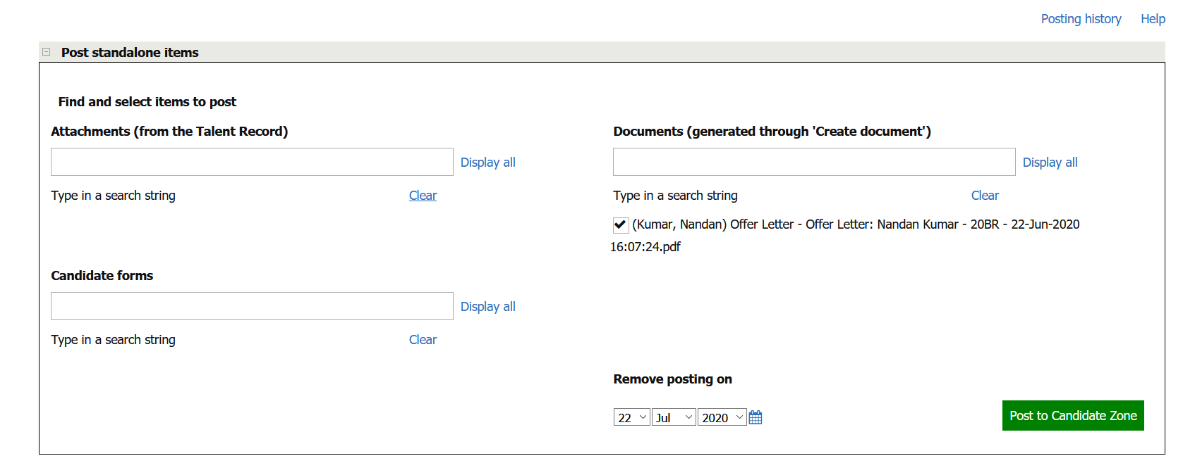
Posting Offer Documents to Candidate Zone
Search by the name of the Offer Document or click on “Display all” to show all the list of Documents that are available to posted to the Candidate Zone.
Select the Document.
A removal date can be selected if the Document has to be completed within a specific period or else can be left blank.
Post to Candidate Zone.

Slide 16
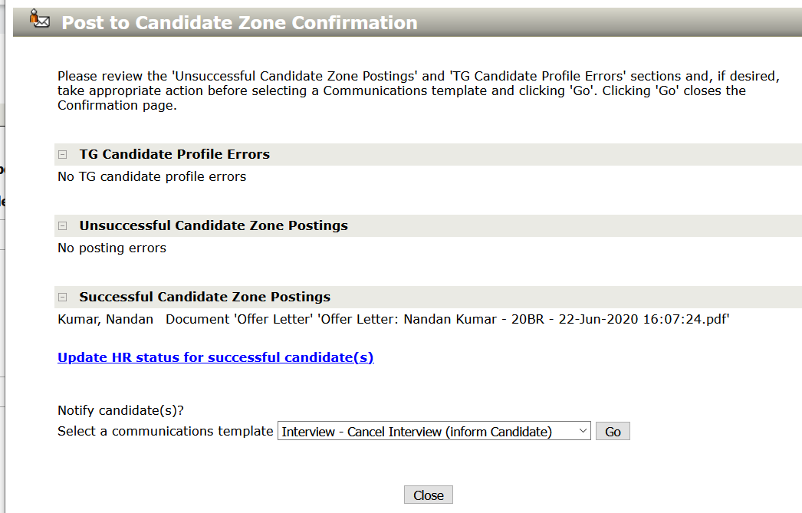
Posting Offer Documents to Candidate Zone
Once the document is posted it will display a message under the “Successful Candidate Zone Postings” tab.
If there are any errors, they will display under the respective section/tab.
Users can send a communication (optional) to let the candidate know about the posting.
Select the designated communication template and select “Go”.
Edit/preview the template as necessary and click on “Send”.

Slide 17
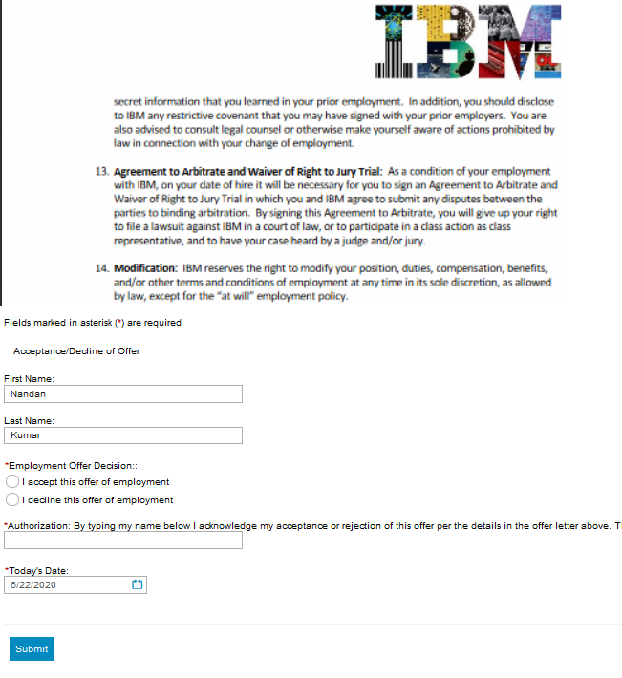
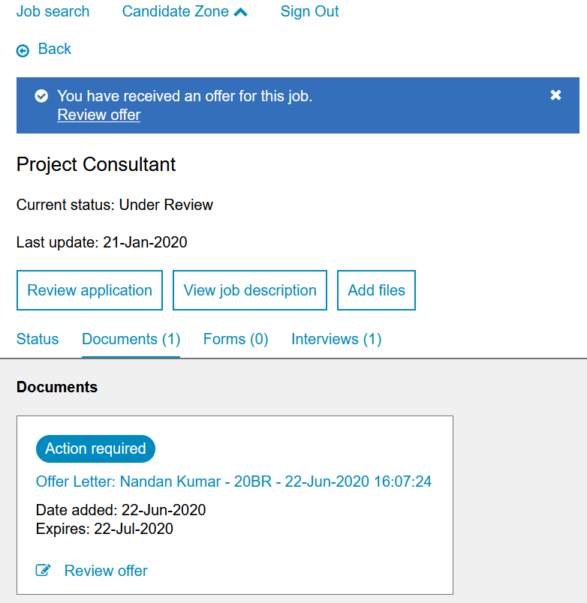
Candidate Accessing Documents in Candidate Zone
Can navigate through the dashboard -> submitted applications to access the posted documents.
Use the link the communication template to access the posted forms.
If a removal date is assigned, it will be displayed (if setting is enabled).
Click on the Offer document name or Review offer button to launch the offer document.
View the offer in PDF format and complete the document subsidiary form to accept or decline the offer.
Once completed, the offer document will be available in “View only” mode for future reference.

Slide 18
Demo
–
Candidate accessing Documents/Offers in Candidate Zone

Slide 19
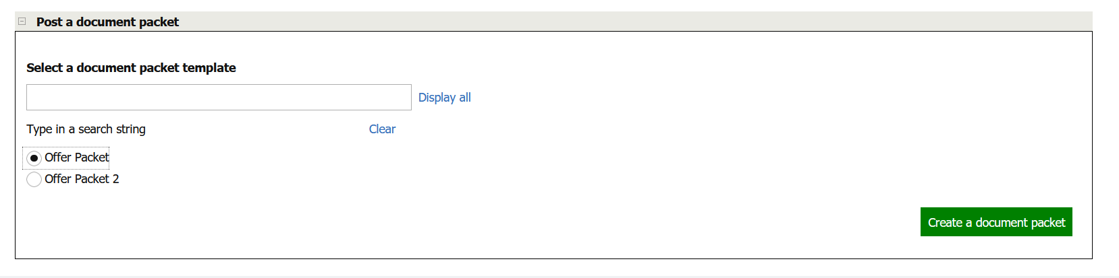
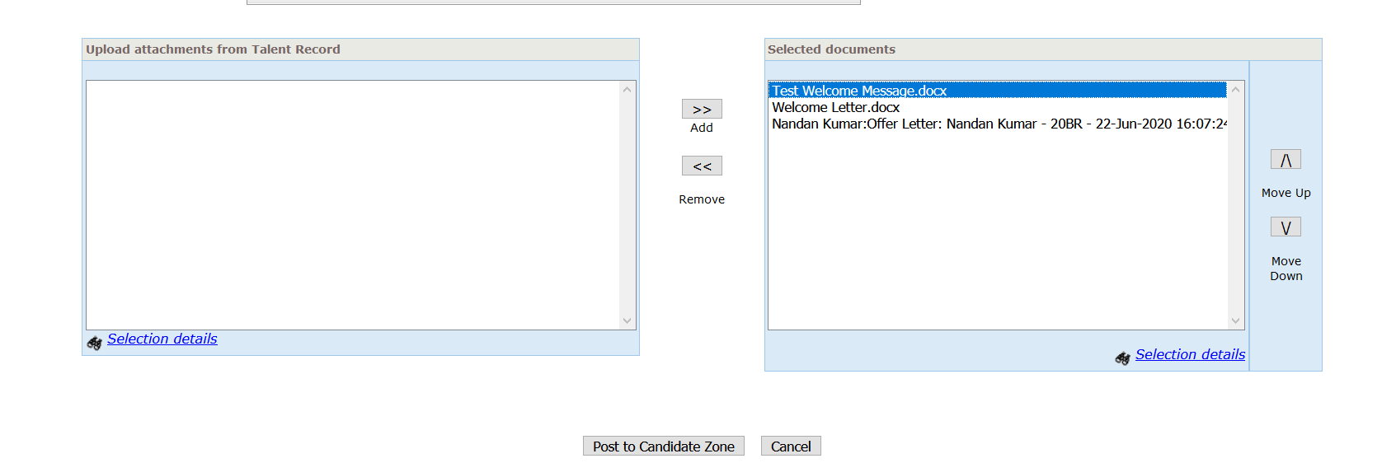
Posting Document Packet Templates to Candidate Zone
BrassRing -> Req -> Candidate’s Talent Record -> Actions -> Post to Candidate Zone
Once an offer letter/document is created inside BrassRing system, the document packet can also be created & posted to Candidate Zone.
The Document Packet has to be created in the “Post to candidate zone” screen.
It will show the list of available Document Packet Templates.
Select a packet template and click on “Create a document packet”.
Preview the details, select the required attachments to make it a packet and click on “Post to candidate zone”.
They can be posted for a specific period and will then get automatically unposted.
Once posted it will display success message and will give an option to send communication & update HR status as well.

Slide 20
Demo
–
Posting Document Packets to Candidate Zone

Slide 21
Non-TG Applicants accessing Candidate Zone
Forms/Offer documents can also be posted to candidates who do not have a TG profile. (examples: candidates submitted by an agency or manually added into BrassRing)
Your organization can allow candidates to log in to the TG with other criteria, such as their email address as their user name and their postal code might be their password.
  User creates a document/form and posts them to candidate zone.
  Send a communication to the candidate informing about the posting.
  Inside the communication template the Candidate Zone URL should be placed.
  Also their username and password should be included.
  Candidate clicks on the URL and logs in successfully.
  System would prompt for a password reset immediately after successful login.
  Candidate should follow the process outlined in the communication to access the posted form or document.
HR status: Should be configured to be displayed on TG, so that the req would be automatically mapped onto candidate’s profile.
Talent Gateway: Should be configured in order to be used as a gateway for Non-TG applicants.
Advanced Client settings: It can be used to define default username & password.

Slide 22
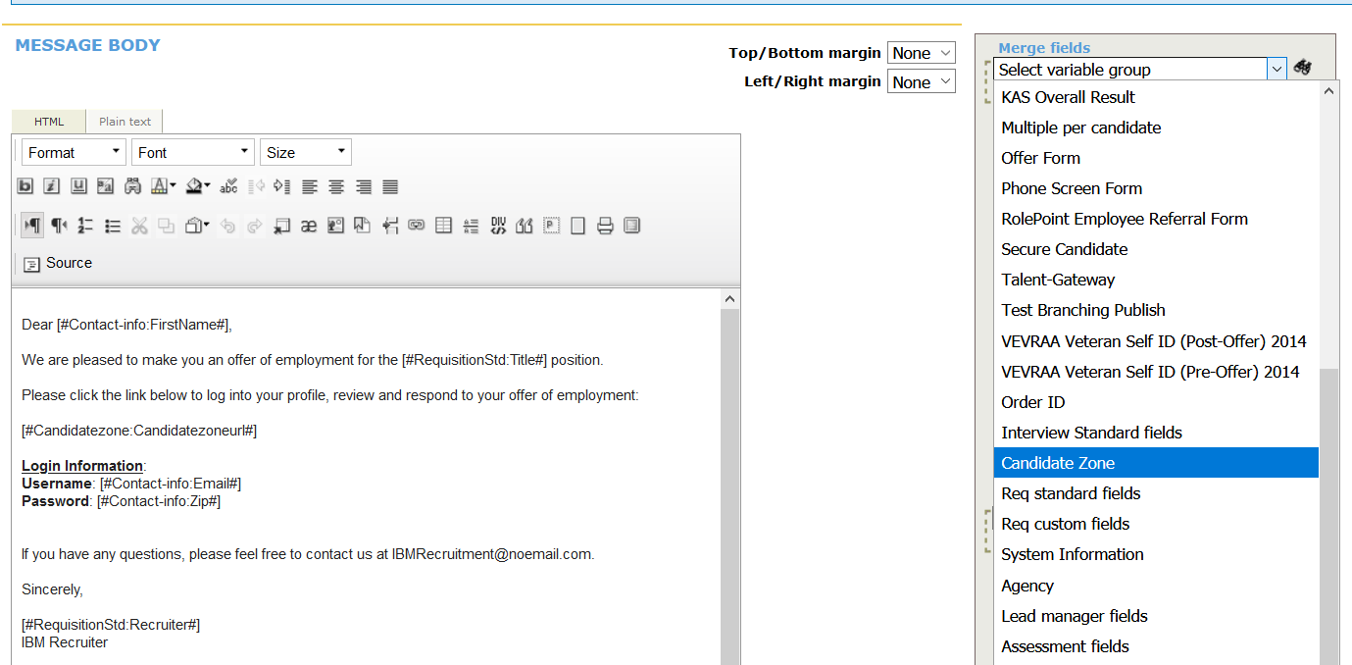
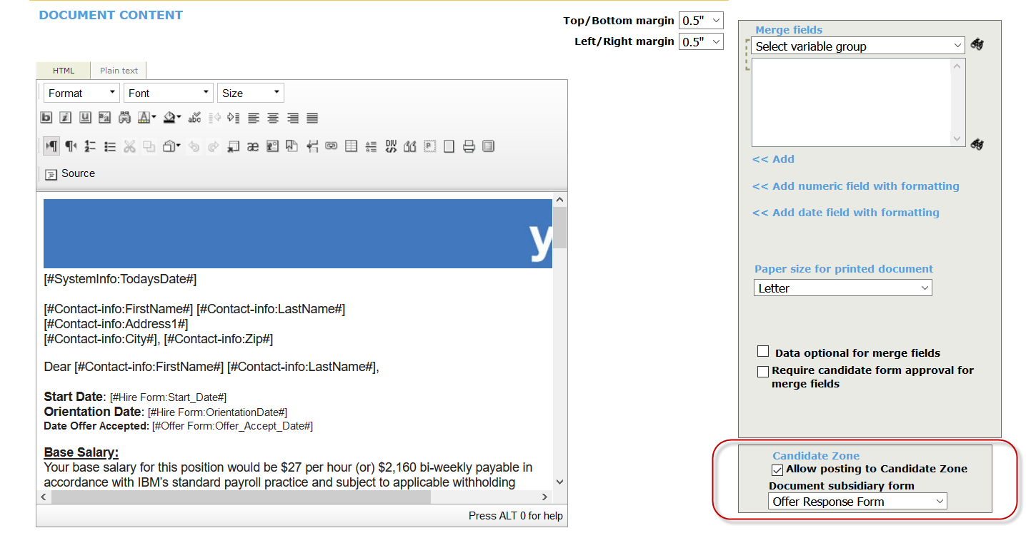
Configuring Communication Template/Document Template
BrassRing -> Admin -> Communications
Communication template can be configured to include Candidate Zone URL.
Separate communication templates should be configured for TG profile and Non-TG applicants.
Document templates can be configured to include “Document subsidiary forms” to capture offer response.

Slide 23
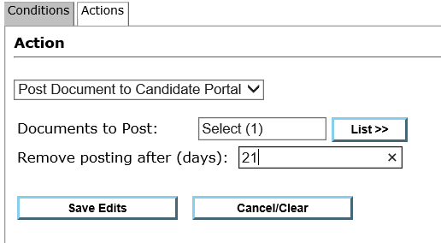
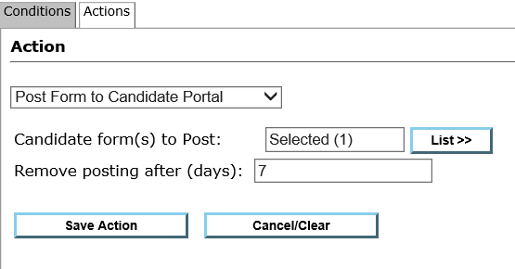
RAM
Workbench -> Tools -> Automation Manager -> Admin
RAM can be used to automate the process of posting forms and/or offer documents to candidate zone.
A removal date can also be configured as when the form/document should be unposted.
If multiple versions or a form or multiple documents are available for the req and candidate, then the latest one would be posted.
RAM can also be configured to update HR status and/or notify users once a candidate responds to the posted offer or fills out the posted form.
HR status can be used as a trigger mechanism for posting forms/documents.
Form Insert can be used as a trigger mechanism for HR status update and/or to send notification.

Slide 24
Resources
The Candidate Zone Overview: https://www.ibm.com/support/knowledgecenter/en/SSEUFV/5_CandMgt/13_CandidateZone.html
The Candidate Zone Process:
https://www.ibm.com/support/knowledgecenter/en/SSEUFV/5_CandMgt/13a_CandidateZoneProcesses.html
Candidates Experience with the Candidate Zone
https://www.ibm.com/support/knowledgecenter/en/SSEUFV/5_CandMgt/15_CandsUseOfCandZone.html
Post to the Candidate Zone Overview
https://www.ibm.com/support/knowledgecenter/SSEUFV/6_CommsAndElinks/4_PostToCanZone.html
Post to the Candidate Zone Process
https://www.ibm.com/support/knowledgecenter/SSEUFV/6_CommsAndElinks/4a_PostToCanZoneProcess.html
Sending Document Templates
https://www.ibm.com/support/knowledgecenter/en/SSEUFV/6_CommsAndElinks/3_DocTemplates.html#ID-1122-00000002

Slide 25
July VIRTUAL TRAINING SESSIONS
Client-facing training schedule
Sunday | Monday | Tuesday | Wednesday | Thursday | Friday | Saturday
 |  |  | 1 | 2 Client: BR 20.06.29 Release Enablement (11 AM EST) | 3 | 4
5 | 6 | 7 | 8 | 9 | 10 | 11
12 | 13 | 14 | 15 Client: Slack Me Anything (11 AM EST) | 16 Client: Slack Me Anything (10 AM EST) | 17 | 18
19 | 20 | 21 Client: Virtual Roundtable – Hiring Remotely (11 AM EST) | 22 | 23 | 24 | 25
26 | 27 | 28 | 29 | 30 Client: BR 20.07.27 and Onboard Release Enablement (11 AM EST) | 31

Slide 26
Questions?

