Slide 1
BrassRing Interview Manager – Admin Experience
IBM Kenexa BrassRing on Cloud
—
Client Training and Enablement Session
IBM Watson Talent
January 21st, 2020

Slide 2
Agenda
Overview of Interview Manager
How to use Interview Manager – Admin Experience
    Communication Template
    User Type Access
    Home Page Interview Manager Tab
    To-do List
    Calendar Integration
FAQs
Resources
Client Training & Enablement Sessions
Future Enhancements
Q&A

Slide 3
Overview of Interview Manager?
The Interview Manager is a new feature in BrassRing that allows both BrassRing users and candidates to efficiently and effectively schedule interviews.
Part of standard feature in BrassRing and requires some configuration.
No additional cost for client to use Interview Manager.
Early client adopter phase completed.
Ready to launch in staging only for all BrassRing on Cloud clients with February Release – tentatively February 10th, 2020.
Interviews can be created by BrassRing users who have access to Candidates within My Reqs. Interview Participants cannot choose to set-up their own interviews.
Easy access to interviews that are scheduled, in process, or that need to be scheduled.
By default all users have access to create Interviews; user permissions determine the additional access or restriction.
It does not replace Event Manager but rather is used with the single candidate experience.

Slide 4
Overview of Interview Manager?
New Tab on Home page with card and grid view, filtering options and refresh icon.
Multiple interview styles:
    1:1 Interview - single candidate and single interviewer
    Series Interview - single candidate and multiple interviewers, one interview after another
    Panel Interview – single candidate and team of interviewers in the same time slot
Multiple interview formats:
    Phone – interview over the phone
    Video – video call interview where the candidate is required to appear on-screen
    Text/Chat – text only interview that uses a text service
    In person – candidate must attend on site for interview
    Other – other type of interviews where the format of the interview can be entered into the Interview Details
Note: The details of the interview differ depending on the interview format selection.

Slide 5
Overview of Interview Manager?
Calendar integration with Outlook 365 and Google+ allows for checking and scheduling interviewers shared calendars.
Candidates will receive an automated meeting invitation as soon as they accept the interview request. This meeting request allows the candidates to add it to their calendars directly (if supported) or download the ics attachment and add it manually to their calendars.
Multiple interview scheduling type:
    Confirmed date & time (already decided) – when the schedule has already been worked out with the candidate and interviewer.
    Verify interviewers availability first – interviewer’s availability is checked first and candidates are provided with the time slots to pick from based on interviewer’s availability.
    Ask for candidate availability first – provide candidate with a range of dates and times to select specific one that works best for them.

Slide 6
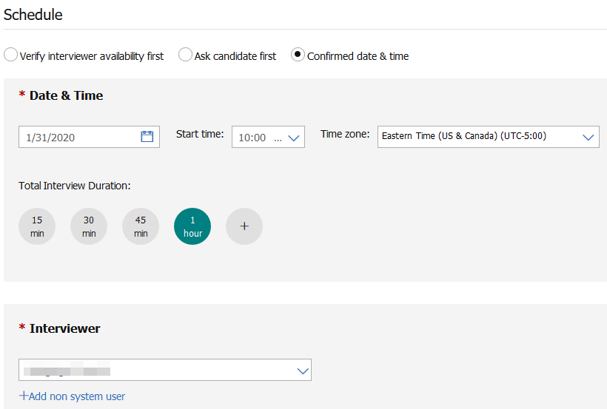
Overview of Interview Manager
Interview Scheduling Type Workflows
Confirmed Date & Time (already decided ) - Schedule has already been worked out with the candidate and interviewer. The candidate and interviewer still need to confirm the interview.

Slide 7
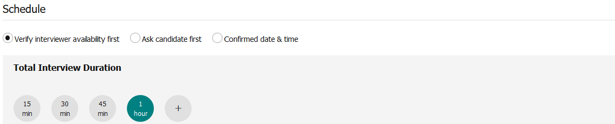
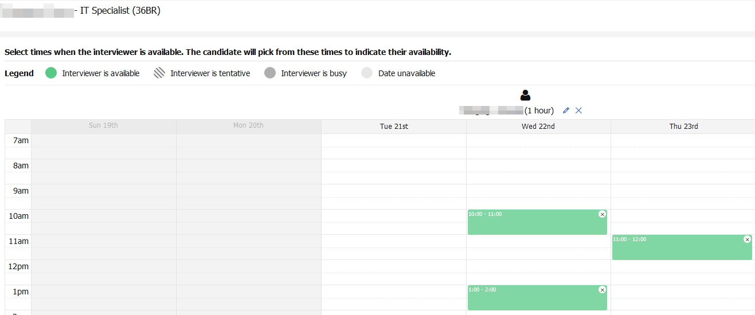
Overview of Interview Manager
Interview Scheduling Type Workflows
Verify interviewers availability first - schedule an interview based on the interviewer’s availability.

Slide 8
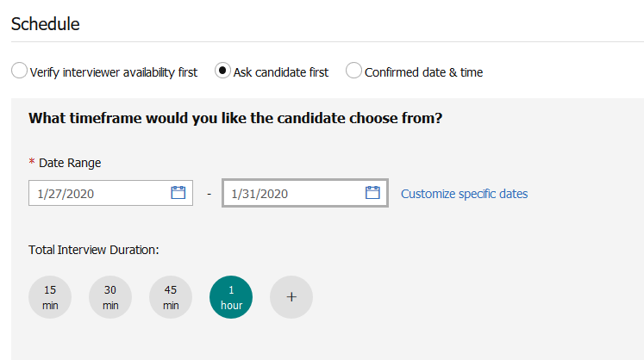
Overview of Interview Manager
Interview Scheduling Type Workflows
Ask for candidate availability first - Provide candidate with a range of dates and times to select specific one that works best for them.

Slide 9

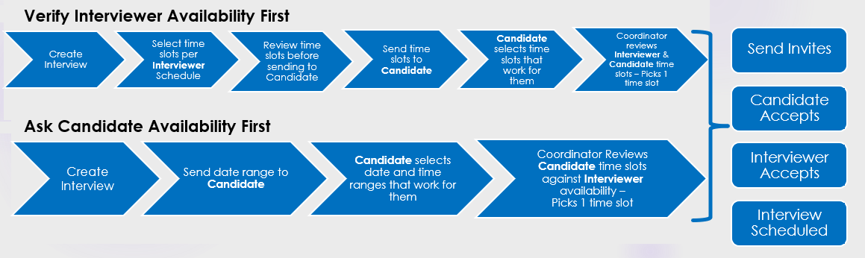
Overview of Interview Manager
Scheduling Type Workflows

Slide 10
Interview Manager – Admin Experience
Communication Templates
Used to send communication from Interview Manager to candidates and interviewers about interviews.
Recommended communication templates (available on IBM KC ):
    Candidate Availability Request
    Candidate Invitation
    Interviewer Invitation
Communication templates must contain at least 1 interview standard token to appear for selection in the Send Invites window.
Instructions should be part of the candidate communication to direct them to select the Interview Link and to confirm their attendance.
Candidates and Interviewers will receive an automated meeting invitation as soon as they accepted the interview request. This meeting initation allows the recipients to add it to their calendars directly (if supported) or download the ics attachment and add it manually to their calendar.
If an invitation was not received, the user can resend the invitation.

Slide 11
Interview Manager – Admin Experience
Communication Templates
Interview Manager Communication Standard Field Tokens:
Candidate Interview Request Link | Interview Date & Time
Interview Description | Interview Duration
Interview Format | Interview Format Details
Interview Style | Interviewer Interview Request Link
Interviewer Names | Interviewer Names & Schedules
Interviewer Salutation First Name | Lead Coordinator Email
Lead Coordinator Name

Slide 12
Demo
–
Create Communication Template

Slide 13
Interview Manager – Admin Experience
User Type Access
By default, all users have access to create interviews for candidates in ‘My Req’.
If the user is part of the Interview Team (i.e. interview creator, lead coordinator, coordination team) then they have access to Manage Interviews.
New User Type Function: Interview Manager.
New User Type Privileges:
    Restrict Interview Creation - Users are not able to create interviews
    Restrict Manage Interviews for ‘My Reqs’ - Users are not able to manage interviews for ‘My Reqs’ association
    View – ‘All Req’ Interviews - gives users permission to view interviews that are part of ALL the reqs that the user has access to (based on the ALL Req privilege)

Slide 14
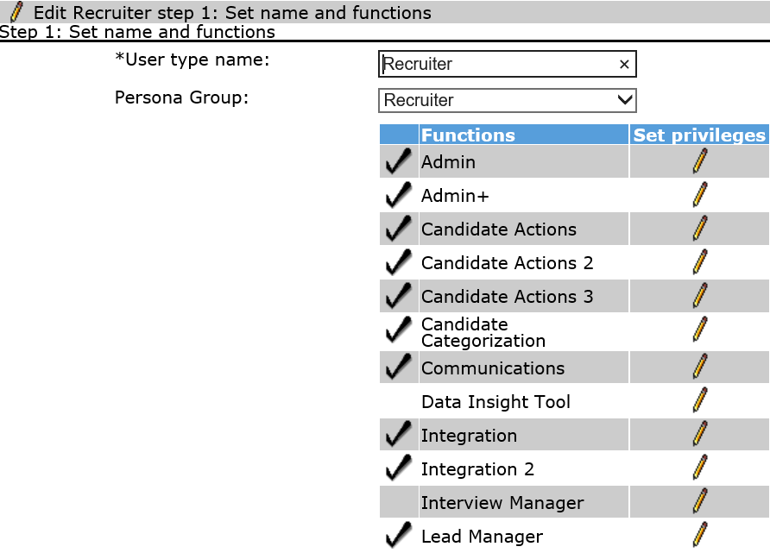
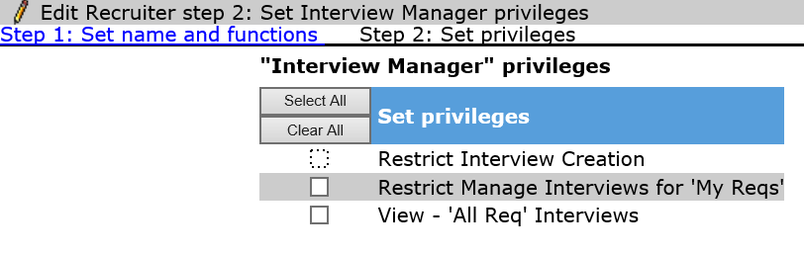
Interview Manager – Admin Experience
User Type Access
Workbench > Tools > Users > User Types > Edit Type permissions for User Type

Slide 15
Demo
–
Manage User Type Access

Slide 16
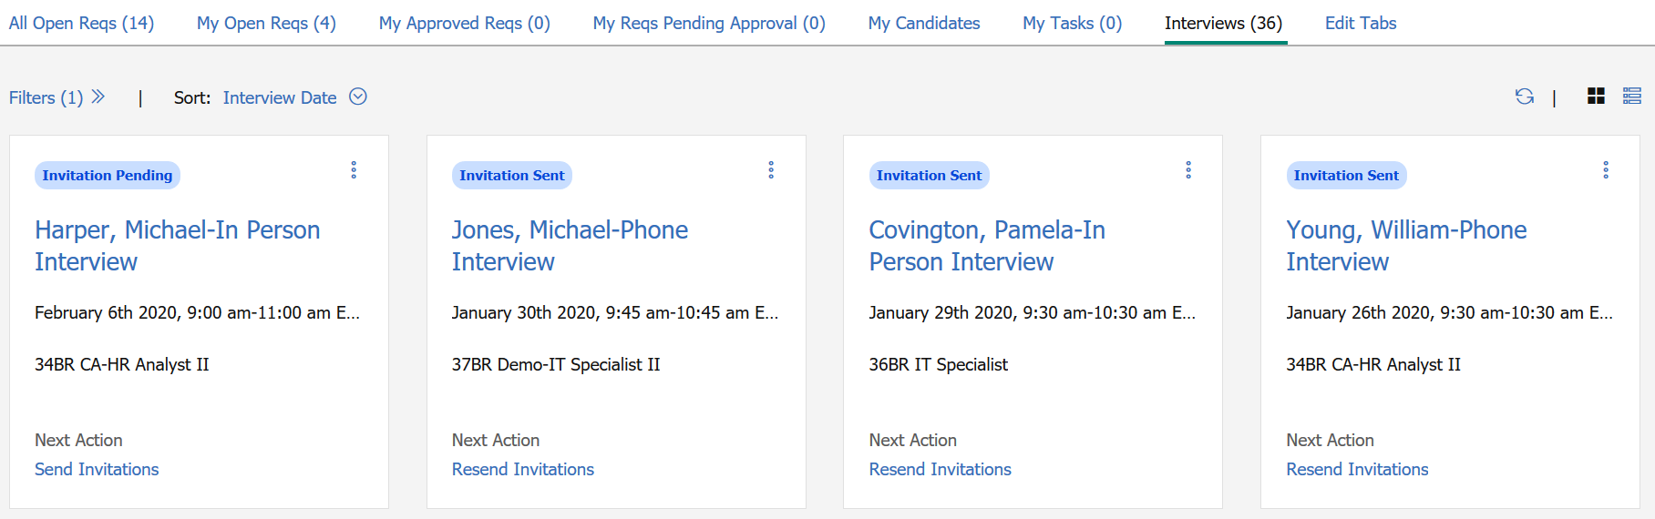
Interview Manager – Admin Experience
Home Page Tab
An Interview Tab is available on the BrassRing home page.
The Interview Tab can be configured in Workbench for each persona.
New users can have the tab automatically appear on their home page.
Existing users will need to add the tab to their home page from the Edit Tab.

Slide 17
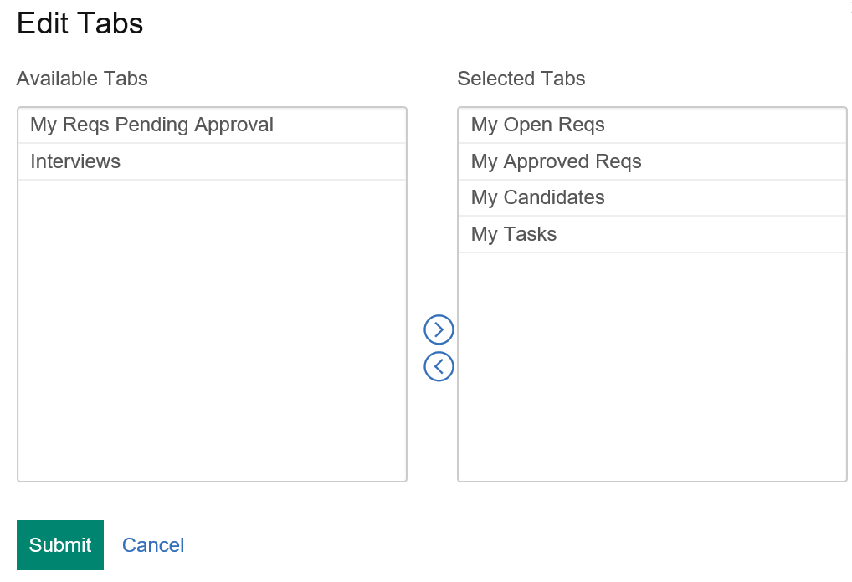
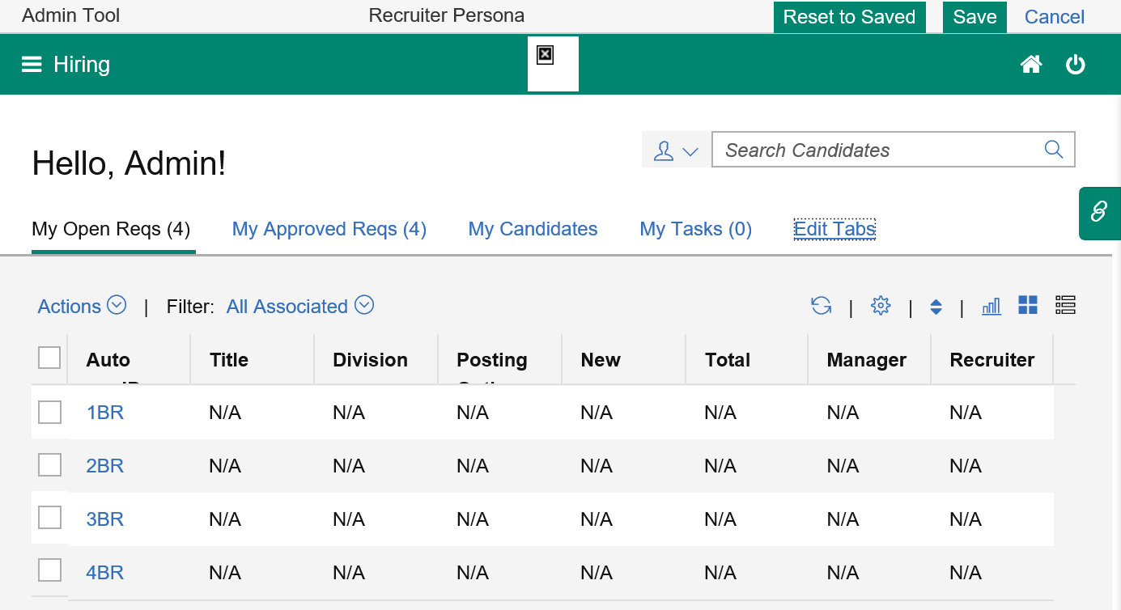
Interview Manager – Admin Experience
Home Page Tab
Workbench > Settings > Home page administration > Select Administer Homepage for specific Persona
Note: Use the configure display icon to choose the fields that should display in the grid view.
Select the Interviews tab and use the arrow key to add the tab to the Selected Tabs section. Click Submit.

Slide 18
Demo
–
Set-up Home Page Tab

Slide 19
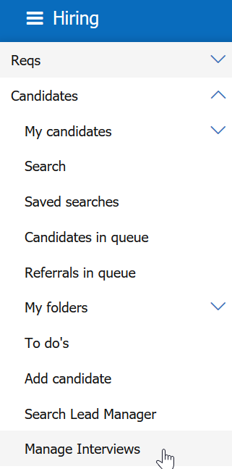
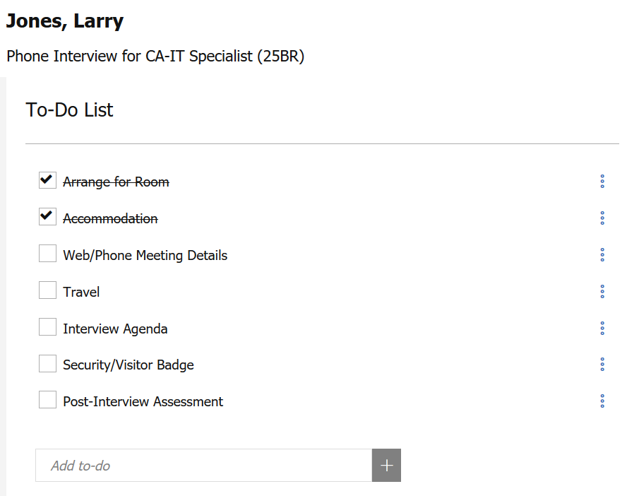
Interview Manager – Admin Experience
To-dos
A user can create, manage, and track To-Dos associated with each interview.
      BrassRing > Candidates > Manage Interviews
Default To-Do list:
    Arrange for Room
    Accommodation
    Web/Phone Meeting Details
    Travel
    Interview Agenda
    Security/Visitor Badge
    Post-Interview Assessment
The To-Do list can be customized.

Slide 20
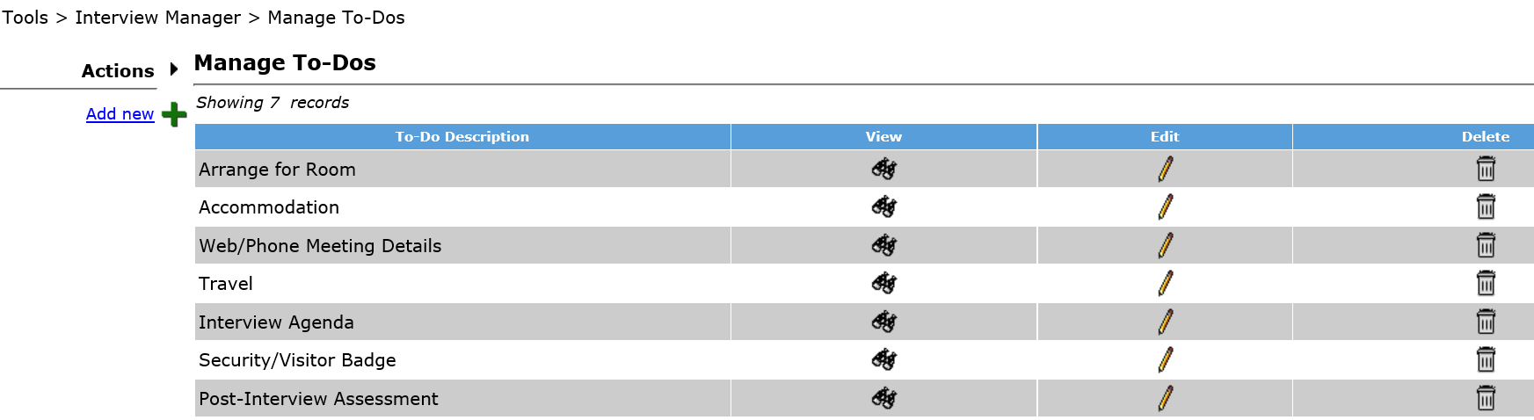
Interview Manager – Admin Experience
To-dos
To customize the To-Dos list so that we can optimize our interview manager workflow:
      Workbench > Tools > Interview Manager > Manage To-Dos

Slide 21
Demo
–
Configure To-Dos

Slide 22
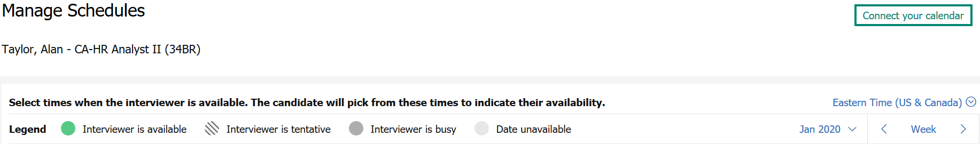
Interview Manager – Admin Experience
Calendar Integration
The Interview Manager allows users to look up the real-time availability of BrassRing users based on their calendars.
Calendar Integration can be configured in Workbench
If Basic Calendar Integration is set-up, the “Connect your calendar” link from the Manage Schedules page allows the users to access their Office 365 account and give consent to the BrassRing application to access their calendars.
Note: The calendar integration is not required in order to use Interview Manager.

Slide 23
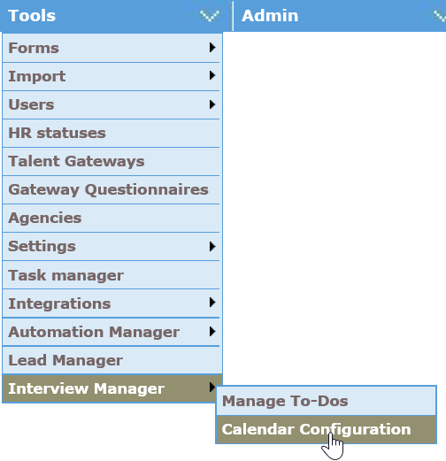
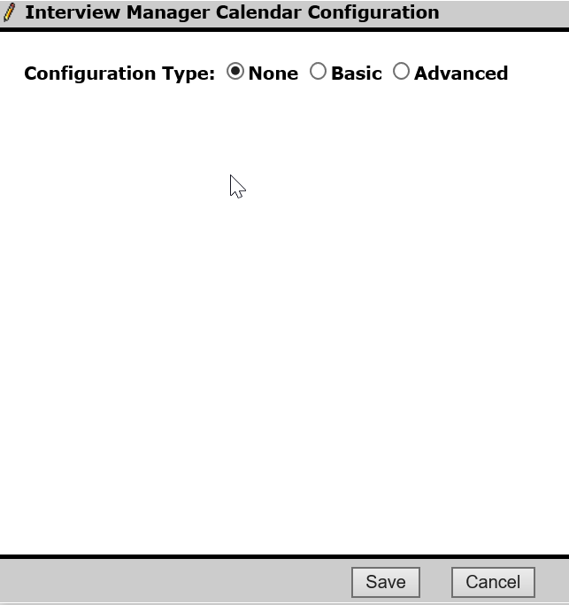
Interview Manager – Admin Experience
Calendar Integration
Workbench > Tools > Interview Manager > Calendar Integration
None – No access to users’ calendars.
Basic –BrassRing provides an inbuilt Office 365 app to validate the integration. For Staging use, it is only intended for testing and validating the integration by connecting to the organization’s Office 365 calendar, giving consent to the BrassRing app, and getting the free or busy schedule of the users in their organization.
Advanced - For Production use, clients should register their own app in Microsoft Azure Portal and then enter the App Key and App Secret in Workbench. With the Advanced configuration, the client has an option to decide between User Consent or Admin Consent for the app.

Slide 24
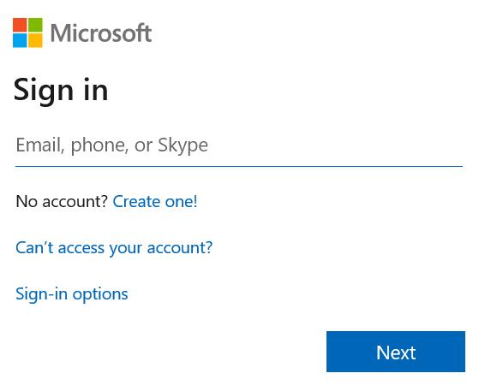
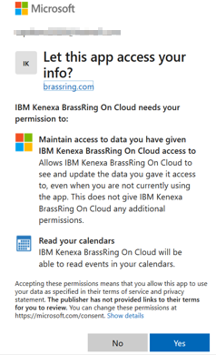
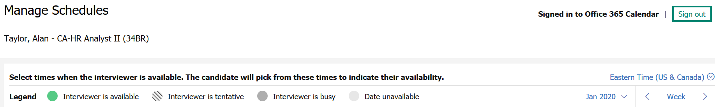
Interview Manager Admin
Calendar Integration - Basic
1.
User logs in using Office 365 credentials. This login URL can be configured in Workbench with the Advanced configuration.
2.
User gives consent to allow to read calendar from BrassRing.
Connect your calendar label changes to Signed in to Office 365 Calendar.
3.

Slide 25
Demo
–
Configure Calendar Integration

Slide 26
FAQs
Is it possible to use the interview manager without the calendar integration? Yes, the calendar is not required in order to use Interview Manager.
  If the interview is with a hiring manager, do they need to have access to BrassRing? No, they do not need to have access to BrassRing.
  Does the Interviewer need to be a BrassRing user? No, the interviewer can be a non-system user.
  When creating an interview, does the ‘Done’ button save the interview in draft mode? No. It saves the interview details. It doesn’t send the interview communication.
  Can the file attachment feature be turned off? No, not at this time.
  Can the optional comments be turned off? No, this is part of the standard Interview Manager screen.
If the interview is expired, does that mean the interview date has come and gone? Yes, and there were also no responses to the invite.
Can you have a mix of phone and in-person interviews? No, you can’t mix interview types at this time.
Do all Interviewers need the Office 365 or only the coordinator? All users would need Office 365 or Google to use the calendar integration. Typically an organization consistently uses the same email client.
Does the video interview selection integrate with a video interview tool? No, but it is on our long-term roadmap.

Slide 27
FAQs
Can the email that goes to the interviewer/manager include a link to the resume? Yes, you can include a link to the talent record in the communication template.
  Can the user include in the interview invite any candidate forms that need to be completed by the candidate prior to the day of the interview? Yes, you can include candidate forms in the communication template.
  If it’s a video interview, can all the Skype or Zoom details be included in the interview details? Yes, you can include the details for Skype or Zoom video interviews.
  Will this be integrated with Office 365 to reflect a meeting on calendars? Yes - Office 365 and Google calendars are included in this project.
Does the feature include rescheduling? Rescheduling is not part of Phase I but we are planning on including it in the next phases.
Will we have the ability to have reports that can track all the interviews for the company? These details are being worked out so that Interview Manager data is available in the DIT and Metrics Dashboard.
Does the Interview Manager have any capabilities to adjust according to time zones and locations? Yes, you can select time zones when creating an interview.

Slide 28
FAQs
Will the email to the hiring manager include the ability to add the interview to the calendar? Yes, the .ics attachment will be available for all scheduling communications, allowing the user to import it into their calendar.
Can the user customize the interview details fields? No, these are standard fields.
How are BrassRing users designated as "Interviewers"? At this time, all users in the system will show in the drop down. The type ahead and "Recently Used" section will allow for common ones to be easily found.
Can you have more than one "interviewer" but all at the same time (not a series)? Yes, the panel interview is the option that allows for an interview team.
Does the Interview Manager allow us to book rooms? No, not at this time. We are considering this for future phases.
Can you preview the email before sending? Yes, a preview option is available.
Do candidates have to "accept" in the candidate zone? or can you set the system up so they do not have to "accept"? Meaning we have already confirmed the time so we don't need the candidate to accept. Candidates can accept either from the Candidate Zone or the email with the invitation link. But they will have to still accept, even for the Confirmed Date & Time.

Slide 29
FAQs
Can we add external Interviewers that are not in the system or will the interviewer need to be an existing user in the system? Yes, in the "Interviewers" section on the interview set up screen, there is an option to add an external interviewer.
Can we default the communications so that users do not need to select the correct template? Not at this time, but we are considering this for future phases.
Will the Interview Manager replace Event Manager? No. The Interview Manager is not used with mass scheduling of interviews but rather with single candidate experience.
Is there documentation available that shows the various steps in each of the different workflow options? We will have details documentation available on the IBM Knowledge Center once the feature is released.
How does this work with agency candidates? Does the email go to the candidate or to the recruitment agency? It is going to pull the email attached to the Candidate Record.
Can users set up their personal time slots in advance without creating an interview? Not at this time, but we are considering this for future phases.
Does the Interview Manager integrate with Lotus Notes? No, it integrates with Outlook 365 and Google.

Slide 30
Resources
Interview Management
https://www.ibm.com/support/knowledgecenter/SSEUFV/16_InterviewManagement/top.html
Interview Manager Configuration
https://www.ibm.com/support/knowledgecenter/SSEUFV/2_Configuration/17_ConfiguringIM/top.html

Slide 31
February VIRTUAL TRAINING SESSIONS
Client-facing training schedule
Sunday | Monday | Tuesday | Wednesday | Thursday | Friday | Saturday
2 | 3 | 4 Client: Interview Manager – User Session (11:00 AM EST) | 5 | 6 Client: Interview Manager – Admin Session (11:00 AM EST) | 7 | 8
9 | 10 Client: Assess New User Training (11:00 AM EST) | 11 | 12 | 13 Client: BrassRing 20.02.10 and Onboard Release (4 AM EST; 11 AM EST) | 14 | 15
16 | 17 Client: Assess Transitioning to the New UI – Phase 4 (11:00 AM EST) | 18 Client: Interview Manager – User Session (11 AM EST) | 19 | 20 | 21 | 22
23 | 24 | 25 Client: TA Roadmap (11:00 AM EST) | 26 | 27 | 28 | 29

Slide 32
Client Training & Enablement Sessions
  Register for Client T&E Session on the IBM Knowledge Center (KC):
    IBM Kenexa BrassRing on Cloud >> BrassRing and Workbench Enablement Sessions >> Upcoming Training and Enablement Sessions
      https://www.ibm.com/support/knowledgecenter/SSEUFV/14_Training/1UpcomingEnablements.html
  Access the recordings from past Client T&E Sessions:
    IBM Kenexa BrassRing on Cloud >> BrassRing and Workbench Enablement Sessions >> Past Training and Enablement Sessions
    https://www.ibm.com/support/knowledgecenter/SSEUFV/14_Training/2EnablementSessions.html

Slide 33
Future Enhancements
Rules Automation Manager
Reporting (Metrics Dashboard and DIT)

Slide 34
Questions?

