Slide 1
BrassRing Interview Manager – Admin Experience
Client Training and Enablement Session
February 6th, 2020

Slide 2
Agenda
Overview of Interview Manager
How to use Interview Manager – Admin Experience
    Communication Template
    User Type Access
    Home Page Interview Manager Tab
    To-do List
    Calendar Integration
Resources
Client Training & Enablement Sessions
Future Enhancements
Google Chrome 80 Update
Q&A

Slide 3
Overview of Interview Manager?
The Interview Manager is a new feature in BrassRing that allows both BrassRing users and candidates to efficiently and effectively schedule interviews.
Part of standard feature in BrassRing and requires some configuration.
No additional cost for client to use Interview Manager.
Early client adopter phase completed.
Ready to launch in staging only for all BrassRing on Cloud clients with February Release – tentatively Monday, February 10th, 2020.
Interviews can be created by BrassRing users who have access to Candidates within My Reqs. Interview Participants cannot choose to set-up their own interviews.
Easy access to interviews that are scheduled, in process, or that need to be scheduled.
By default all BrassRing users have access to create Interviews (My Reqs); user permissions determine the additional access or restriction.
It does not replace Event Manager but rather is used with the single candidate experience.

Slide 4
Overview of Interview Manager?
New Tab on Home page with card and grid view, filtering options and refresh icon.
Multiple interview styles:
    1:1 Interview - single candidate and single interviewer
    Series Interview - single candidate and multiple interviewers, one interview after another
    Panel Interview – single candidate and team of interviewers in the same time slot
Multiple interview formats:
    Phone – interview over the phone
    Video – video call interview where the candidate is required to appear on-screen
    Text/Chat – text only interview that uses a text service
    In person – candidate must attend on site for interview
    Other – other type of interviews where the format of the interview can be entered into the Interview Details
Note: The details of the interview differ depending on the interview format selection.

Slide 5
Overview of Interview Manager?
Calendar integration with Outlook 365 and Google+ allows for checking and scheduling interviewers’ shared calendars.
Candidates and Interviewers will receive an automated meeting invitation as soon as they accept the interview request. This meeting request allows the candidates to add it to their calendars directly (if supported) or download the ics attachment and add it manually to their calendars.
Multiple interview scheduling type:
    Confirmed date & time (already decided) – the timeslot has already been worked out with the candidate and interviewer.
    Verify interviewers availability first – interviewer’s availability is checked first and candidates are provided with the timeslots to pick from based on interviewer’s availability.
    Ask for candidate availability first – provide candidate with a range of dates and times to select specific timeslot that works best for them.

Slide 6
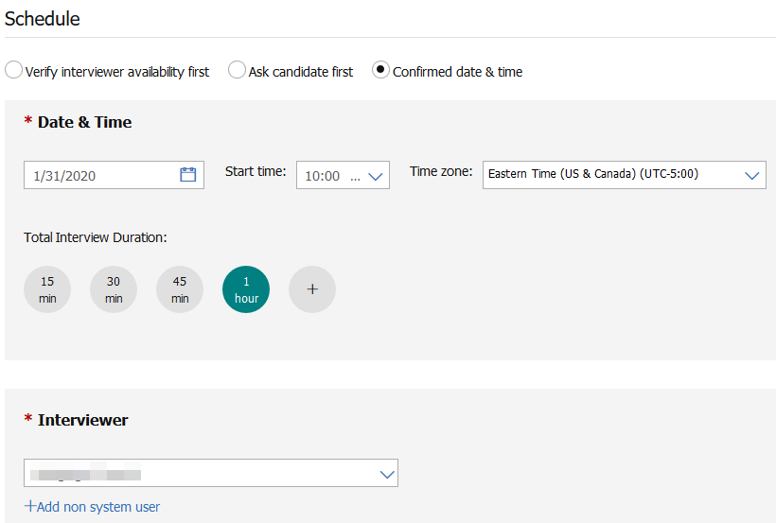
Overview of Interview Manager
Interview Scheduling Type Workflows
Confirmed Date & Time (already decided ) - Schedule has already been worked out with the candidate and interviewer. The candidate and interviewer still need to confirm the interview.

Slide 7
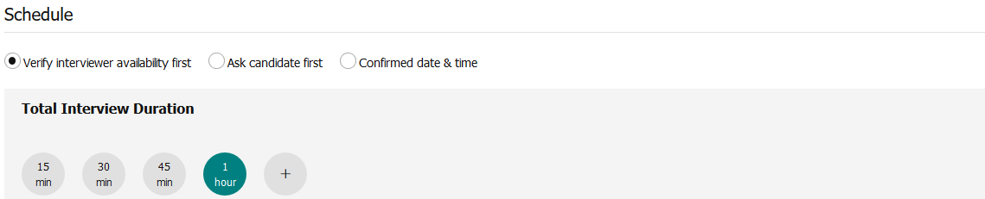
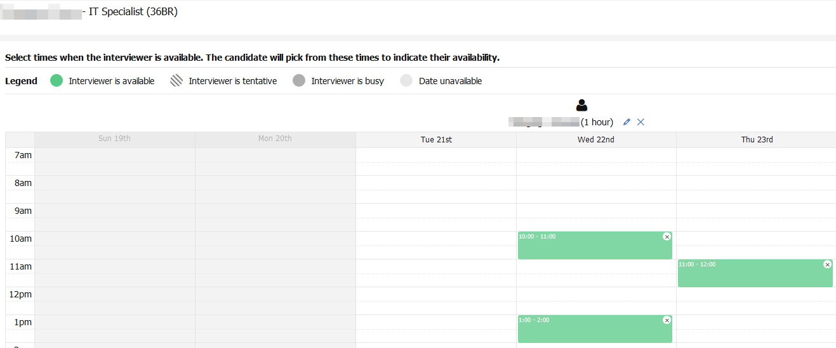
Overview of Interview Manager
Interview Scheduling Type Workflows
Verify interviewers availability first - schedule an interview based on the interviewer’s availability.

Slide 8
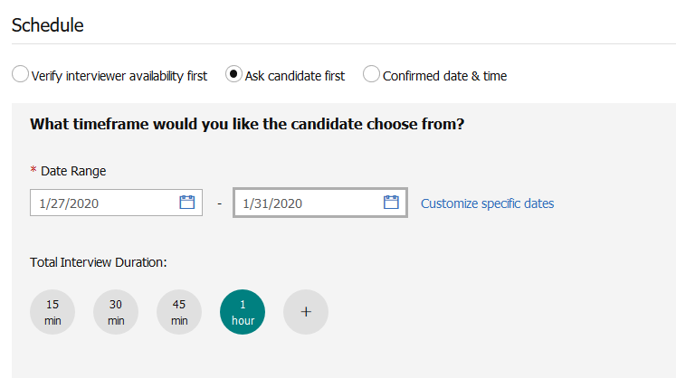
Overview of Interview Manager
Interview Scheduling Type Workflows
Ask for candidate availability first - Provide candidate with a range of dates and times to select specific one that works best for them.

Slide 9

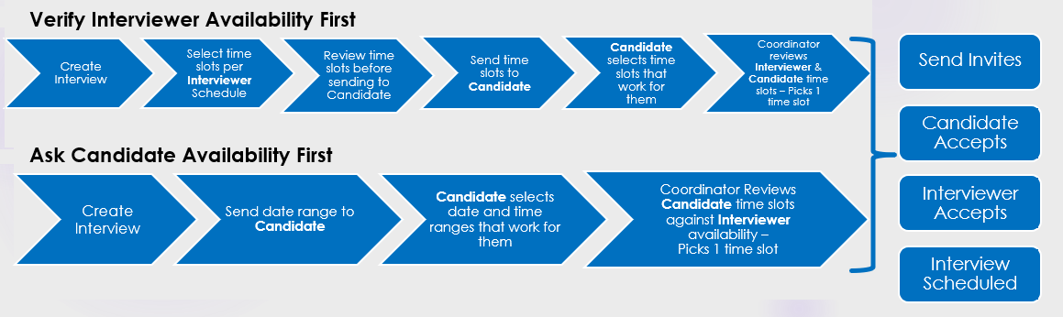
Overview of Interview Manager
Scheduling Type Workflows

Slide 10
Interview Manager – Admin Experience
Communication Templates
Used to send communication from Interview Manager to candidates and interviewers about interviews.
Recommended communication templates (available on https://documentation.infinite.com/docs/interview-tokens-and-communication-templates):
    Candidate Availability Request
    Candidate Invitation
    Interviewer Invitation
Communication templates must contain at least 1 interview standard field token so that it is available for selection in the Send Invites window.
Instructions should be part of the candidate communication to direct them to select the Interview Link and to confirm their attendance.
Communication template can include other links (e.g. Candidate Zone) and/or forms (to complete or view).

Slide 11
Interview Manager – Admin Experience
Communication Templates
When sending the communication from Interview Manager, the user can add an attachment (not part of the communication template) to the candidate and/or interviewer.
An attachment can also be included when sending a communication to a candidate or an interviewer from the send communication page of the Interview Manager.
Candidates and Interviewers will receive an automated meeting invitation as soon as they accepted the interview request. This meeting invitation allows the recipients to add it to their calendars directly (if supported) or download the ics attachment and add it manually to their calendar.
If an interview communication was not received, the user can resend the invitation.
Both, the candidate and interviewer must confirm their attendance to the interview to update the interview status to Interview Scheduled.

Slide 12
Interview Manager – Admin Experience
Communication Templates
Interview Manager Communication Standard Field Tokens:
Candidate Interview Request Link | Interview Date & Time
Interview Description | Interview Duration
Interview Format | Interview Format Details
Interview Style | Interviewer Interview Request Link
Interviewer Names | Interviewer Names & Schedules
Interviewer Salutation First Name | Lead Coordinator Email
Lead Coordinator Name

Slide 13
Demo
–
Create Communication Template

Slide 14
Interview Manager – Admin Experience
User Type Access
By default, all BrassRing users have access to create interviews for candidates in ‘My Req’.
If the user is part of the Interview Team (i.e. interview creator, lead coordinator, coordination team) then they have access to Manage Interviews.
Interviewer can be BrassRing user or non-system user.
New User Type Function: Interview Manager.
New User Type Privileges:
    Restrict Interview Creation
    Restrict Manage Interviews for ‘My Reqs’
    View – ‘All Req’ Interviews

Slide 15
Interview Manager – Admin Experience
User Type Access
New User Type Privileges:
    Restrict Interview Creation - Users are not able to create interview
        By default all users with access to My Reqs will be able to Create Interviews.
        This privilege will turn OFF the privilege to Create Interviews.
        The default state of this privilege: Turned OFF (i.e. no restriction to create My Req interviews)
    Restrict Manage Interviews for ‘My Reqs’ - Users are not able to manage interviews for ‘My Reqs’ association
        By default all users with access to My Reqs will be able to Edit/Manage Interviews.
        This privilege will turn OFF the privilege to Edit/Manage Interviews.
        The default state of this privilege: Turned Off (i.e. No restriction to Edit/Manage My Req Interviews)
    View – ‘All Req’ Interviews - gives users permission to view interviews that are part of ALL the reqs that the user has access to (based on the ALL Req privilege)
        The default state of this privilege: Turned OFF (i.e. Cannot View All Req Interviews)

Slide 16
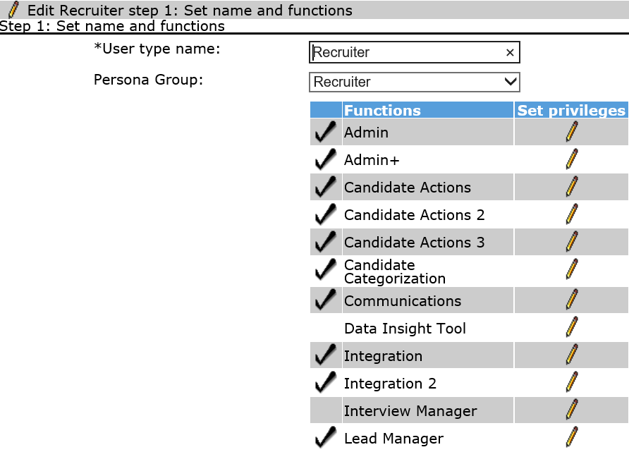
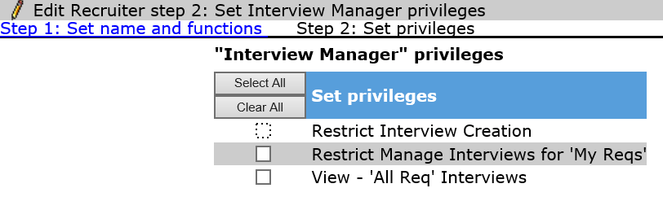
Interview Manager – Admin Experience
User Type Access
Workbench > Tools > Users > User Types > Edit Type permissions for User Type

Slide 17
Demo
–
Manage User Type Access

Slide 18
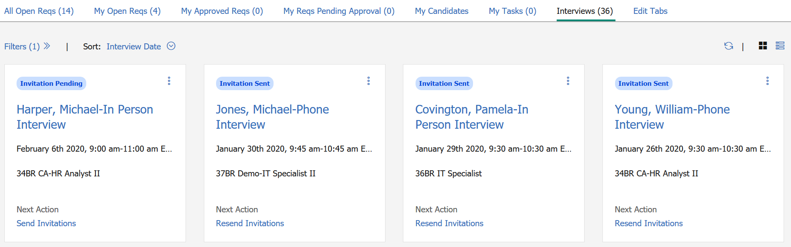
Interview Manager – Admin Experience
Home Page Tab
The Interview Tab is available on the BrassRing home page.
The Interview Tab can be configured in Workbench for each persona.
New users (users who are accessing BrassRing for the first time) can have the tab automatically appear on their home page.
Existing users will need to add the tab to their home page from the Edit Tab.

Slide 19
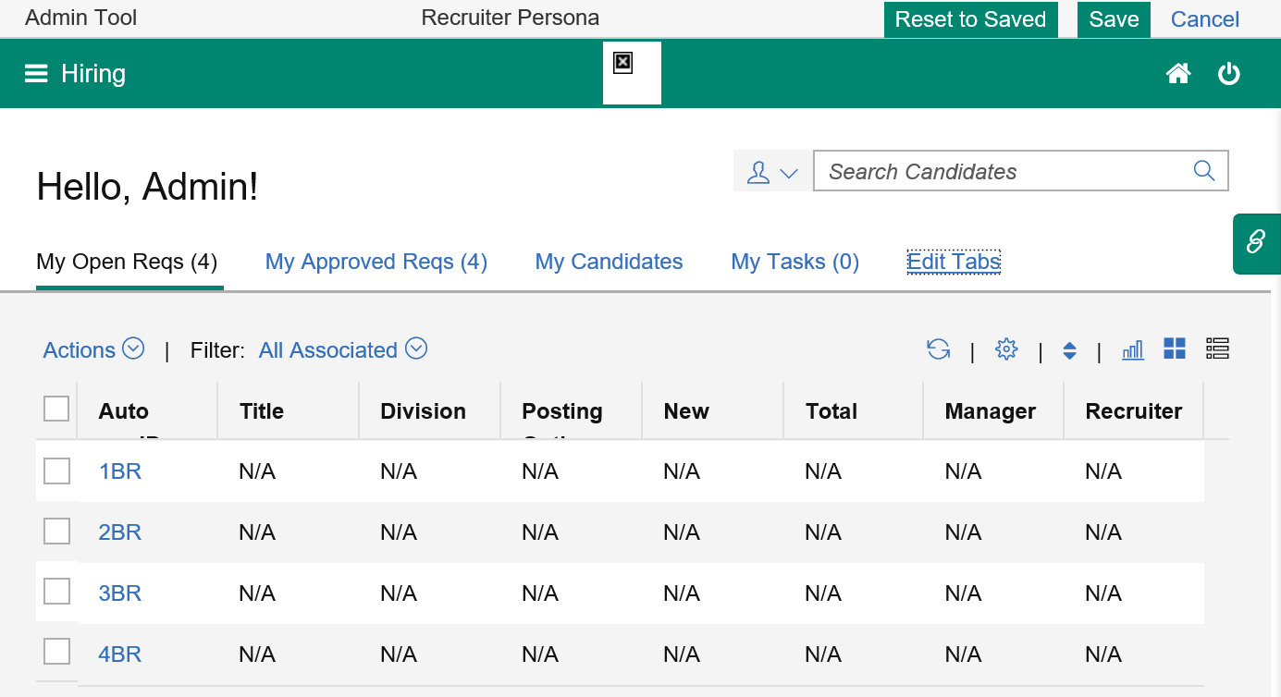
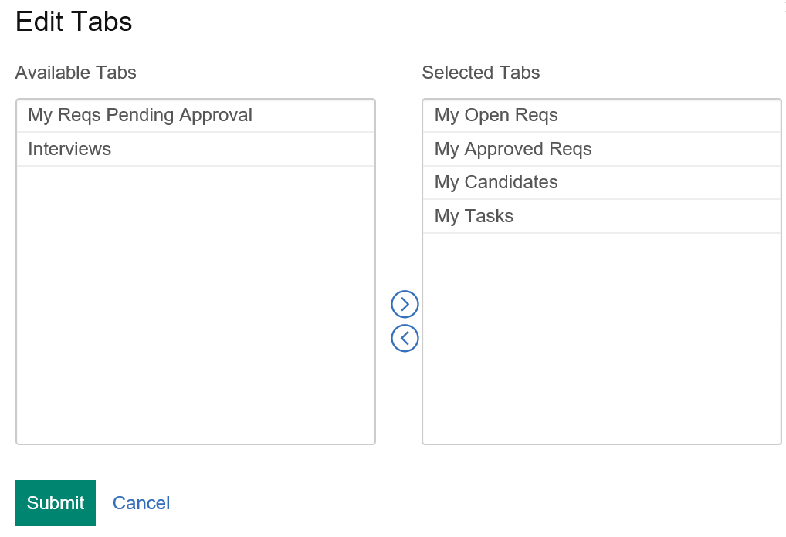
Interview Manager – Admin Experience
Home Page Tab
Workbench > Settings > Home page administration > Select Administer Homepage for specific Persona
Note: Use the configure display icon to choose the fields that should display in the grid view.
Select the Interviews tab and use the arrow key to add the tab to the Selected Tabs section. Click Submit.

Slide 20
Demo
–
Set-up Home Page Tab

Slide 21
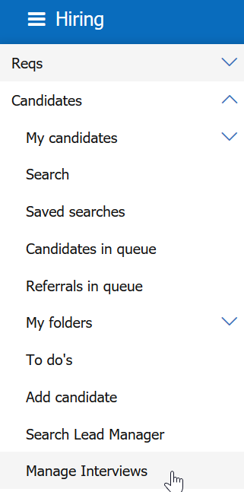
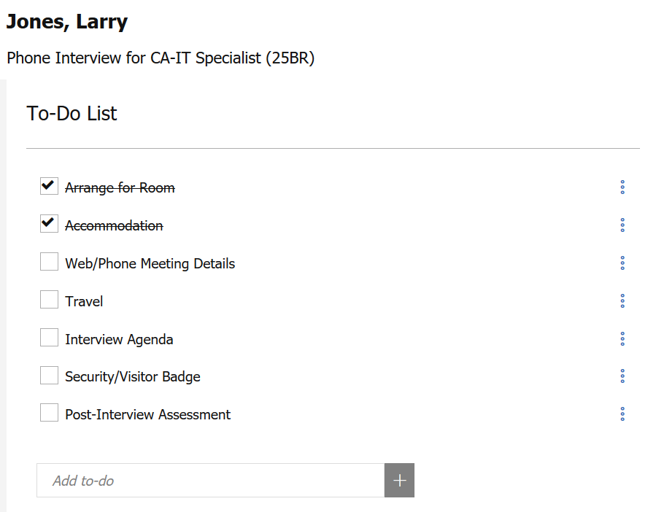
Interview Manager – Admin Experience
To-dos
A user can create, manage, and track To-Dos associated with each interview.
      BrassRing > Candidates > Manage Interviews
Default To-Do list:
    Arrange for Room
    Accommodation
    Web/Phone Meeting Details
    Travel
    Interview Agenda
    Security/Visitor Badge
    Post-Interview Assessment
The To-Do list can be customized.

Slide 22
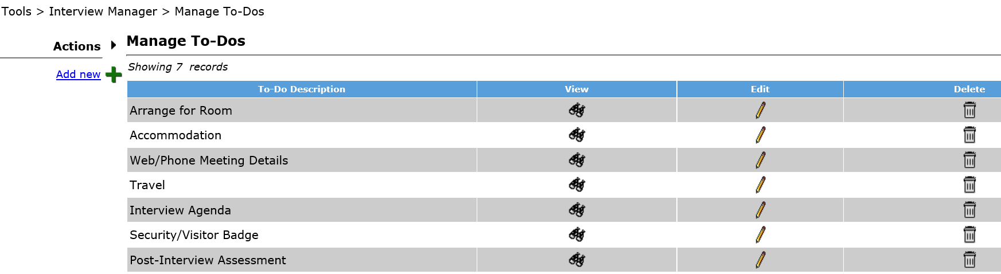
Interview Manager – Admin Experience
To-dos
To customize the To-Dos list so that we can optimize our interview manager workflow:
      Workbench > Tools > Interview Manager > Manage To-Dos

Slide 23
Demo
–
Configure To-Dos

Slide 24
Interview Manager – Admin Experience
Calendar Integration
The Interview Manager allows users to look up the real-time availability of BrassRing users based on their calendars.
Coordinators are able to view if interviewers are scheduled for other interviews from within BrassRing.
The Calendar Integration can be configured in Workbench for Office 365 and Google.
The Calendar Integration is not required in order to use Interview Manager.
Three different Calendar Integration options in Workbench:
    None – No access to users’ calendars.
    Basic - BrassRing provides an inbuilt Office 365 or Google app to validate the integration. For Staging use, it is only intended for testing and validating the integration by connecting to the organization’s Office 365 or Google calendar, giving consent to the BrassRing app, and getting the free or busy schedule of the users in their organization.
    Advanced - For Production use, clients should register their own app in Microsoft Azure Portal and then enter the App Key and App Secret in Workbench. With the Advanced configuration, the client has an option to decide between User Consent or Admin Consent for the app.

Slide 25
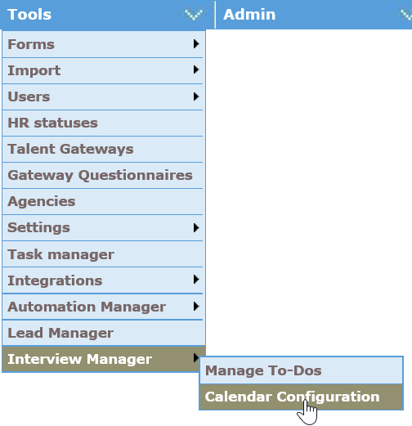
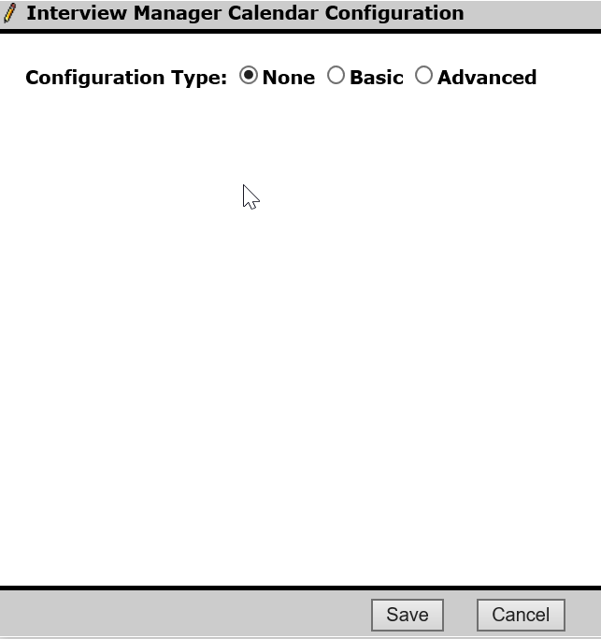
Interview Manager – Admin Experience
Calendar Integration
Workbench > Tools > Interview Manager > Calendar Integration

Slide 26
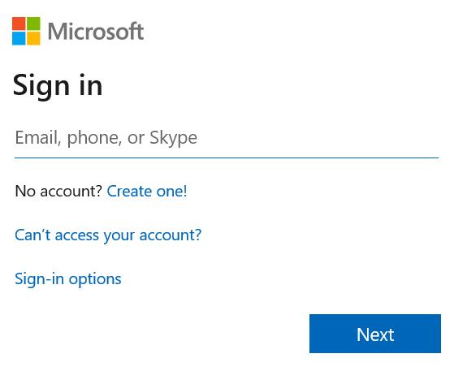
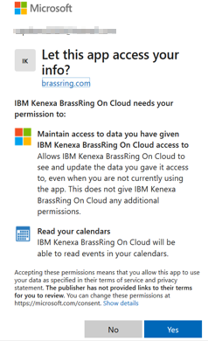
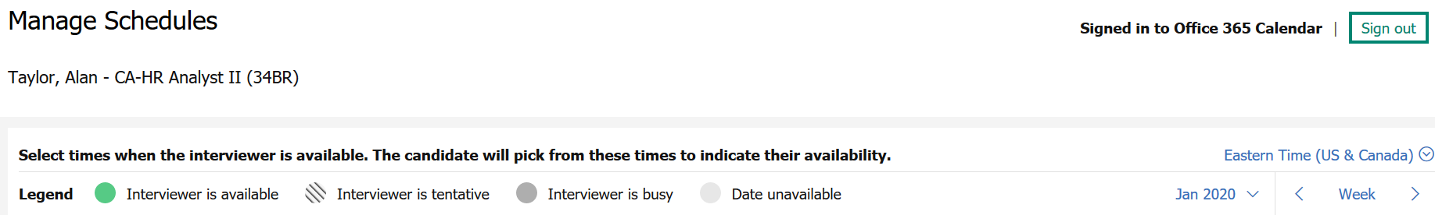
Interview Manager Admin
Calendar Integration – Basic (for Office 365)
1.
User logs in using Office 365 credentials. This login URL can be configured in Workbench with the Advanced configuration.
2.
User gives consent to allow to read calendar from BrassRing.
Connect your calendar label changes to Signed in to Office 365 Calendar.
3.

Slide 27
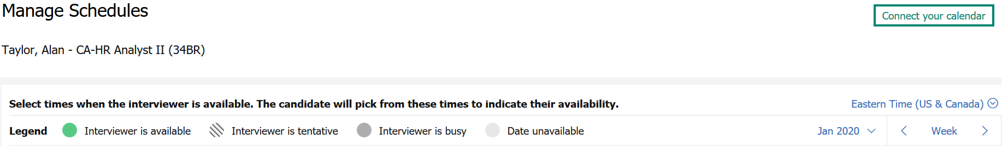
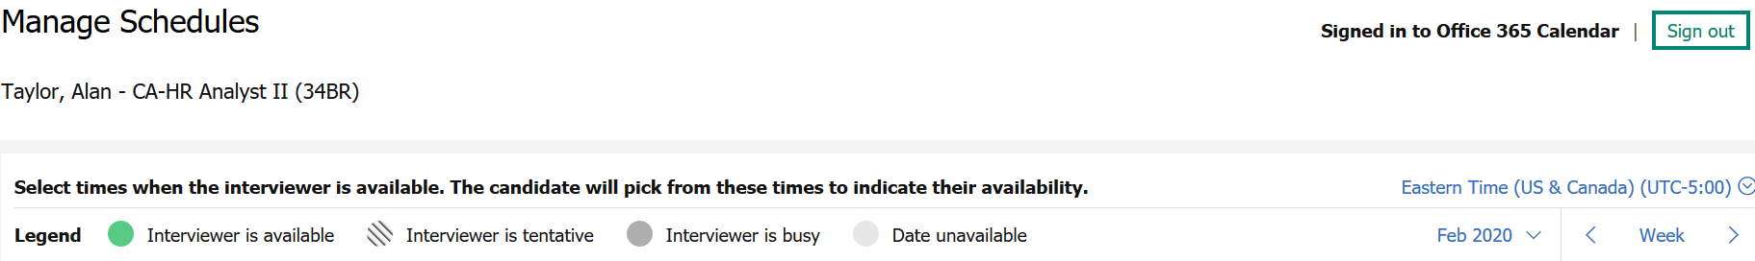
Interview Manager – Admin Experience
Calendar Integration
Example of Basic Calendar Integration set-up:
The “Connect your calendar” link from the Manage Schedules page allows the users to access their
account (Office 365 or Google) and give consent to the BrassRing application to access their calendars.

Slide 28
Demo
–
Configure Calendar Integration

Slide 29
Resources
Interview Management
https://documentation.infinite.com/docs/interview-management
Interview Manager Configuration
https://documentation.infinite.com/docs/interview-manager
Interview Manager FAQs
https://documentation.infinite.com/docs/interview-manager-faqs

Slide 30
February VIRTUAL TRAINING SESSIONS
Client-facing training schedule
Check your skills
Sunday | Monday | Tuesday | Wednesday | Thursday | Friday | Saturday
2 | 3 | 4 Client: Interview Manager – User Session (11:00 AM EST) | 5 | 6 Client: Interview Manager – Admin Session (11:00 AM EST) | 7 | 8
9 | 10 Client: Assess New User Training (11:00 AM EST) | 11 | 12 | 13 Client: BrassRing 20.02.10 and Onboard Release (4 AM EST; 11 AM EST) | 14 | 15
16 | 17 Client: Assess Transitioning to the New UI – Phase 4 (11:00 AM EST) | 18 Client: Interview Manager – User Session (11 AM EST) | 19 | 20 | 21 | 22
23 | 24 Client: Assess New Features and Updates (11:00 AM EST) CANCELLED | 25 Client: TA Roadmap (11:00 AM EST) | 26 | 27 | 28 | 29
Interview Manager Release in Staging

Slide 31
Future Enhancements
Rules Automation Manager
Reporting (Metrics Dashboard and DIT)
Talent Record Action Log

Slide 32
Questions?

