Slide 1
Social Media
BrassRing ATS
—
Client Enablement Session
April 16th, 2019

Slide 2
Agenda
–
Overview of Social Media Features
Recruiter Social Media Features (within BrassRing)
Candidate Social Media Features (within the Talent Gateways)
Configuration

Slide 3
Overview
–

Slide 4
Overview
—
Types of Social Media Features Available:
  BrassRing User Features: (LinkedIn, Facebook, Twitter)
    Posting jobs
    View Social Media profile from BrassRing Talent Record
    Recruiter Referral email
  Candidate Features:
    Share jobs on Social Media Networks (LinkedIn, Facebook, Twitter)
    Login with Social Media account (LinkedIn, Facebook, Twitter, Google)
    Profile Builder (LinkedIn, Facebook)
    Upload Attachments/Resumes (Google Drive, Dropbox)
    Search jobs via Facebook App
Social Referral (Will not cover during this presentation. Click HERE to view more information about this feature.)

Slide 5
Recruiter Social Media Features
–

Slide 6
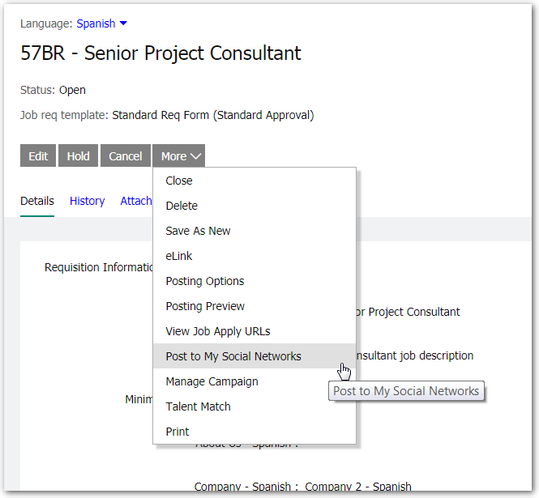
BrassRing User Feature: Post Reqs
BrassRing users with the appropriate privileges can post jobs to their personal Social Media accounts (LinkedIn, Facebook, and/or Twitter).
Appropriately privileged users can also post to Company Facebook or Twitter accounts.
Reqs must be:
In an OPEN status
Currently posted to a Talent Gateway that has the Social Media integration enabled on it.

Slide 7
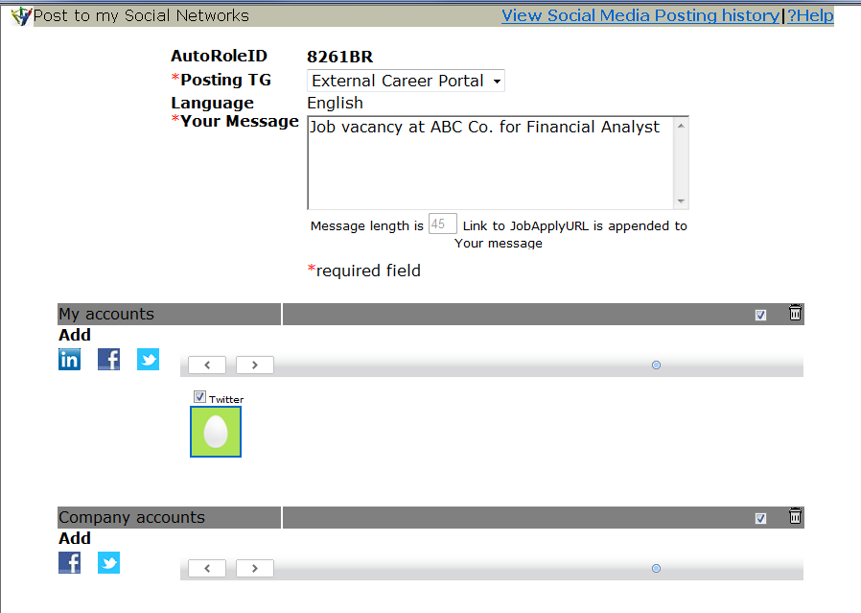
BrassRing User Feature: Post Reqs
Post to My Social Networks screen:
Shows user where they’ve already posted
Message that will display on Social Media site. Default text is configurable in the Talent Gateway settings.
Apply URL will be appended to the posting. This setting determines to which TG the candidate will be taken to apply
Users will be able to post to a maximum of 25 personal & 25 company accounts
Select all/Deselect all check box + Trashcan icon to delete all authorized accounts.
Image displayed in the thumbnail is the profile image on the social media account

Slide 8
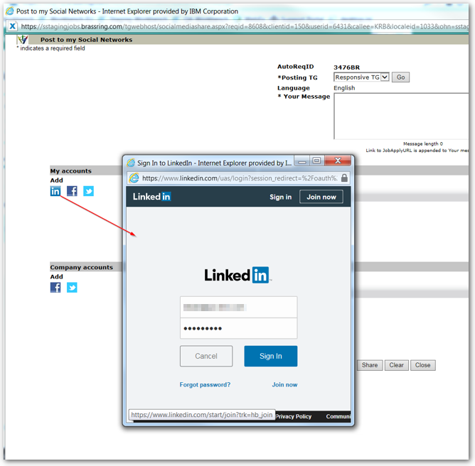
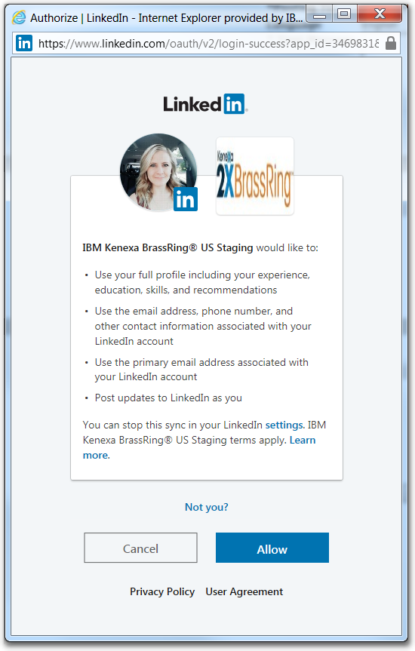
BrassRing User Feature: Post Reqs
Selecting the LinkedIn icon will require the user to log into their LinkedIn account and provide authorization.

Slide 9
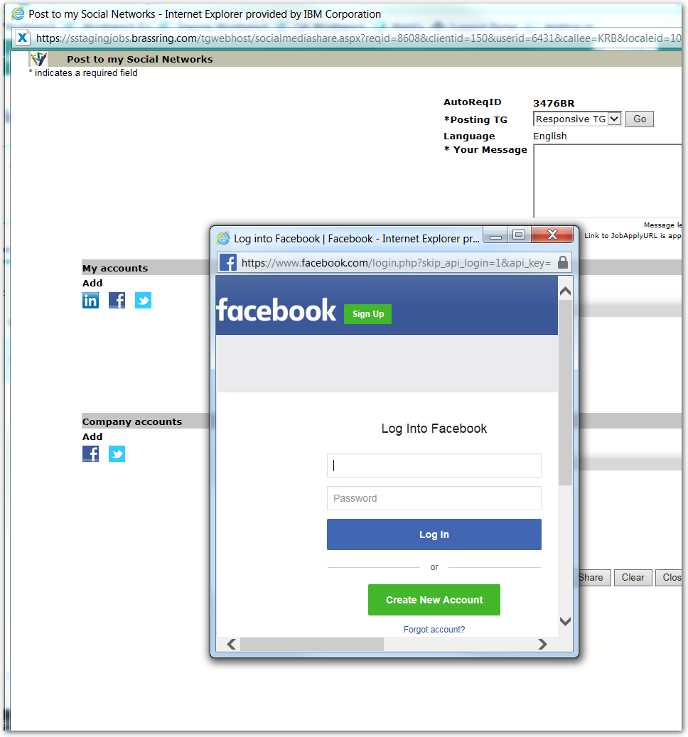
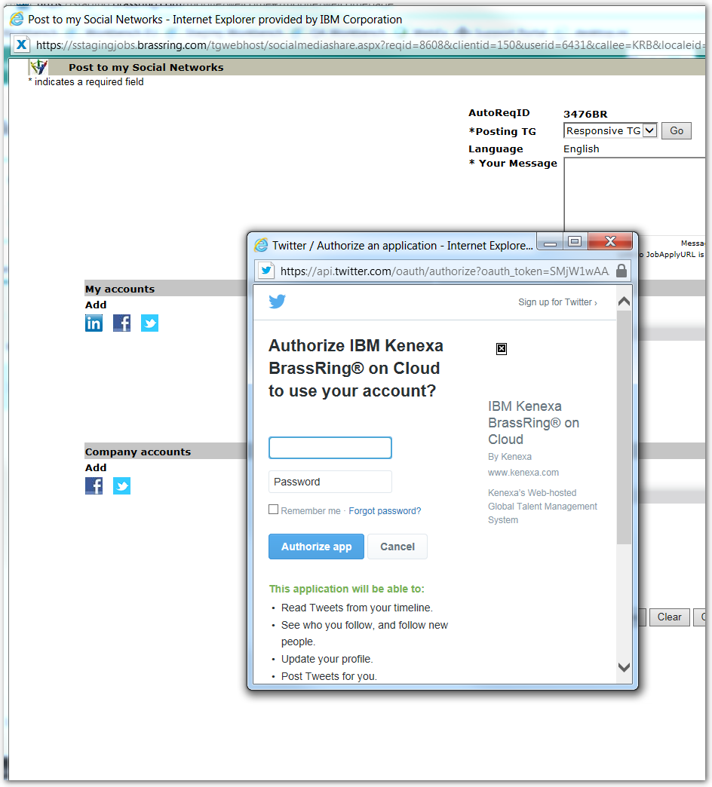
BrassRing User Feature: Post Reqs
Selecting the Facebook or Twitter icons will require the user to log into their profiles.

Slide 10
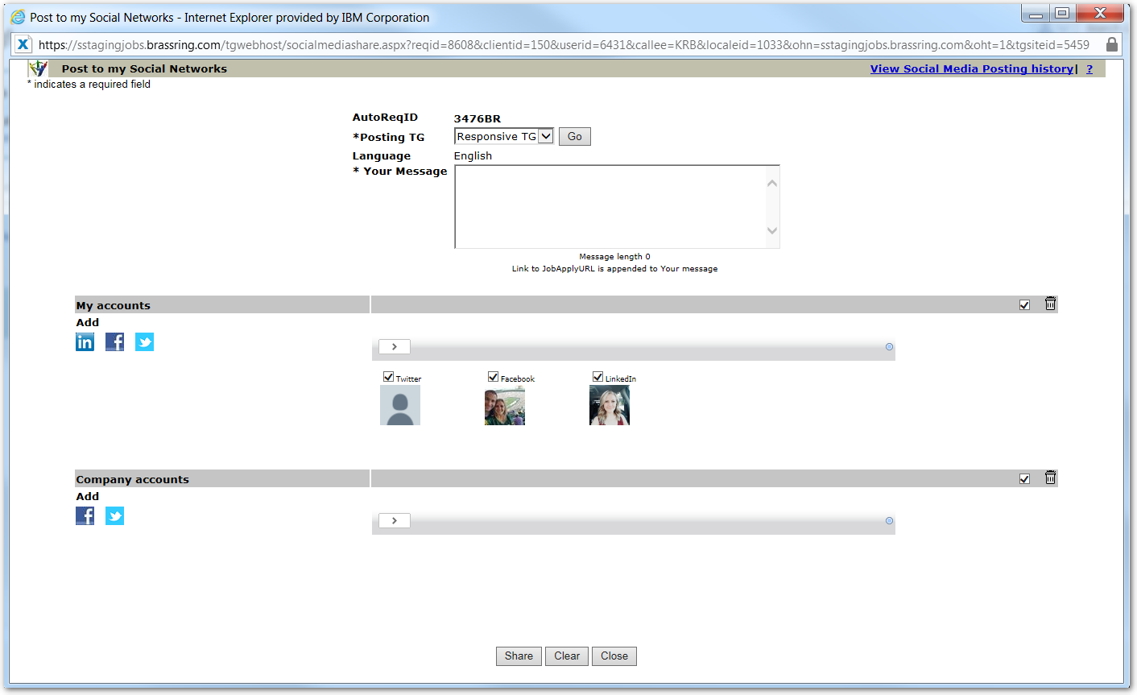
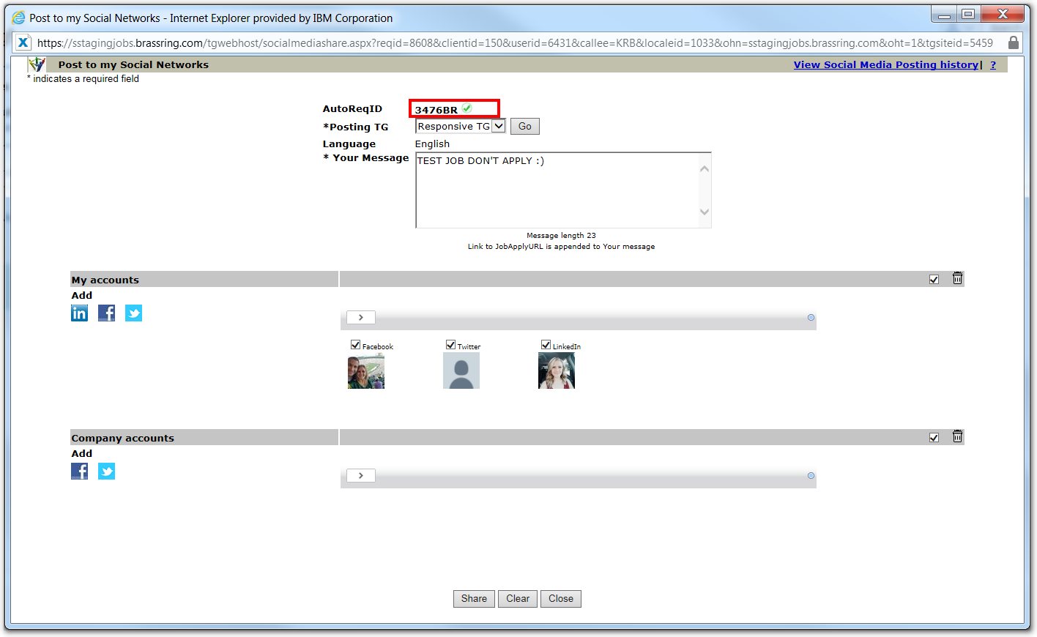
BrassRing User Feature: Post Reqs
After the user logs into their social media profile(s) they will select the Share button. A green checkmark displays next to the AutoReqID field.

Slide 11
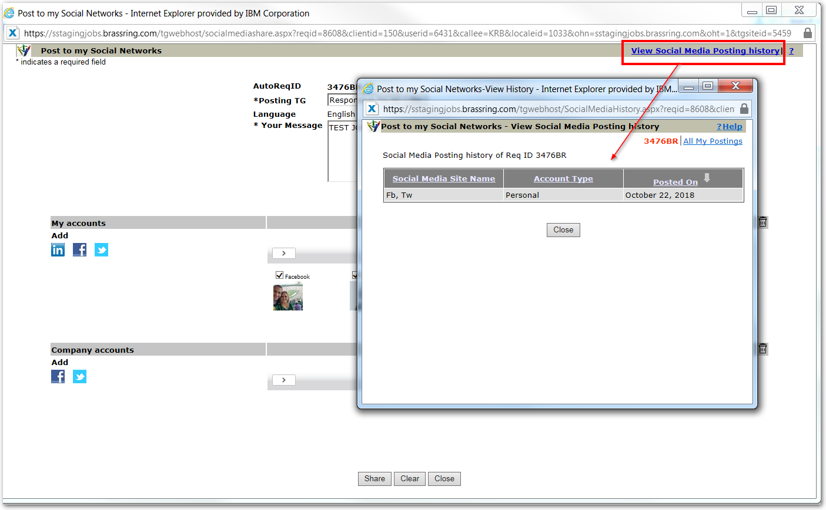
BrassRing User Feature: Post Reqs
To view the posting history of reqs to the social media accounts, select the link View Social Media Posting history.

Slide 12
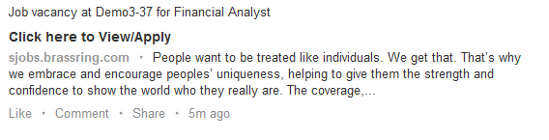
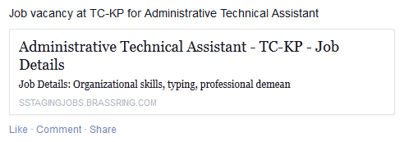
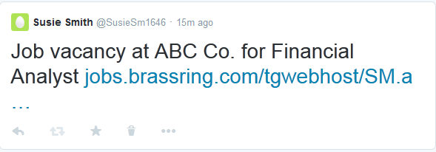
BrassRing User Feature: Post Reqs
Where do they go & what do they look like:
LinkedIn
Social Media Channel | Where it appears
LinkedIn
Personal account | Network update
Facebook
Personal page | Wall posting
Company page | Wall posting
Twitter
Personal account | Tweet
Company account | Tweet
Facebook
Twitter

Slide 13
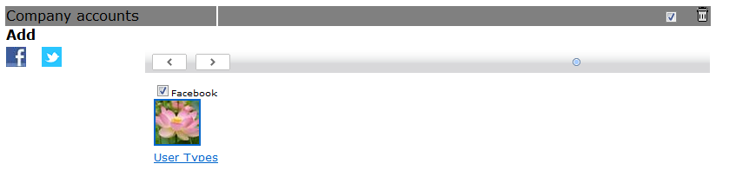
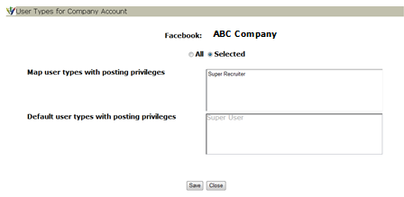
BrassRing User Feature: Post Reqs
Authorizing Company Accounts
Users with the user type privilege “Social Networks – Authorize Company Accounts” will see the Add button along with the Facebook/Twitter icons on the Post to my Social Networks page.
Once the user clicks an icon & enters the credentials to authorize the account, the site will appear as added & the user should click the “User Types” hyperlink to indicate which user types should have access to post to the company account.
Note: LinkedIn took away the option to allow our users the option to post requisitions to their Company Accounts. Therefore, you will not see a LinkedIn option in the Company Accounts section.

Slide 14
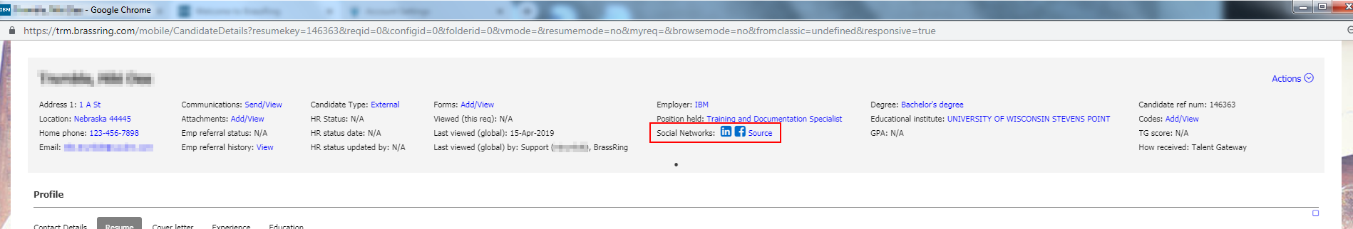
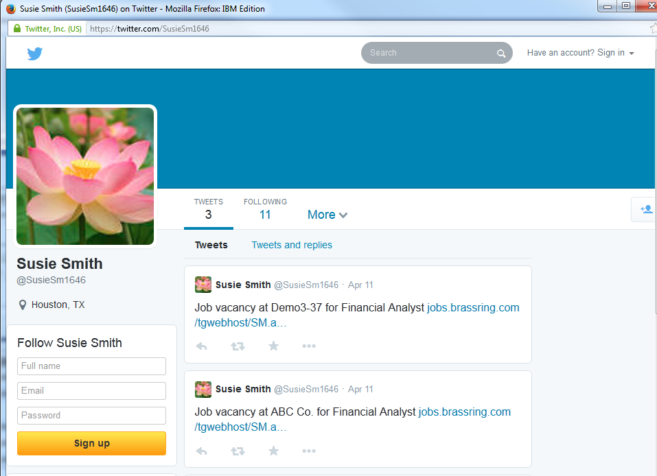
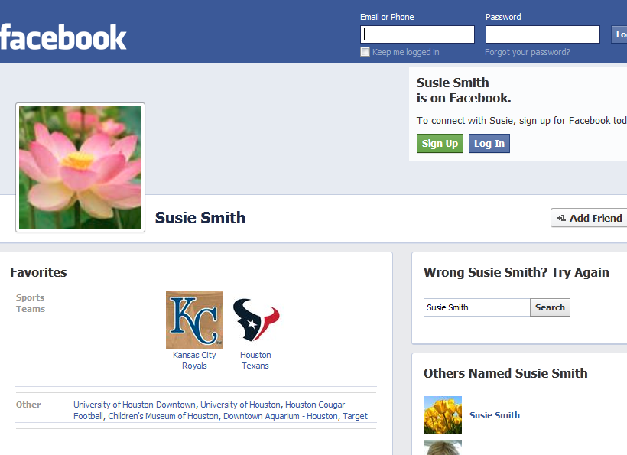
BrassRing User Feature: View Social Media Profile
View social media profiles from the BrassRing Talent Record Social Networks icons.
The LinkedIn option in the Talent Record is called: LinkedIn Cross System Awareness.
(Note: LinkedIn has deprecated the LinkedIn Cross System Awareness code and will be replacing it with another API. There is no ETA on implementing with their new API yet.)

Slide 15
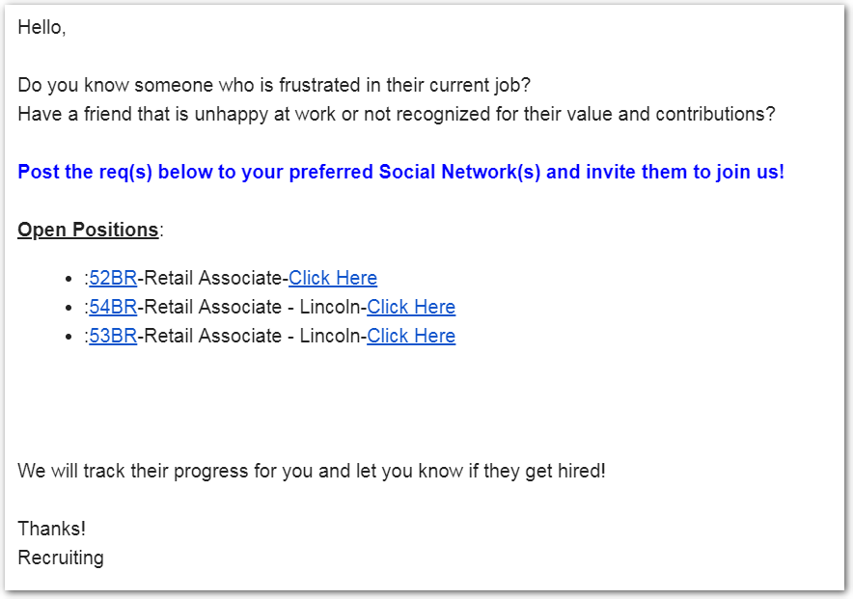
BrassRing User Feature: Recruiter Referral Email
“Social Referral” email: Allows recruiters to expand to a broader network by having employees and others easily share jobs on their social networks.
Easily send one email to your internal employees and others allowing them to spread the word about opportunities at your organization on their social networks.
Recipients can view job details and then share openings on their social networks or just post the jobs directly.
Email recipients can be system or non-system users.
Allows clients to capture and report on social media source information in candidates’ Talent Records for all candidates successfully completing job submissions. Candidate social media source data can then be included in Data Insight Tool reports.
The below screenshot shows the email that may be received by employees within the client’s organization.

Slide 16
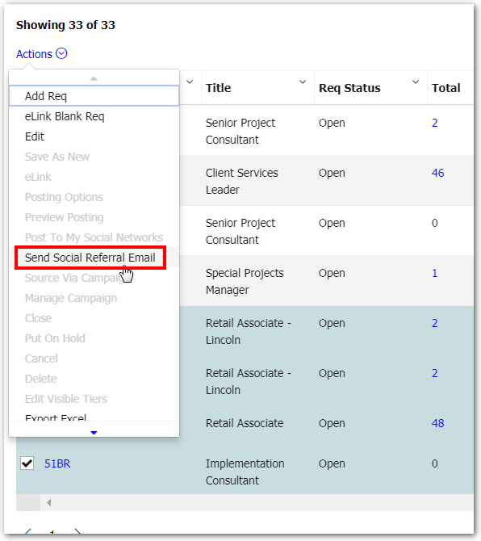
BrassRing User Feature: Recruiter Referral Email
From the All/My Open Reqs list, choose up to five currently posted reqs & select “Send Social referral e-mail” from the actions menu:

Slide 17
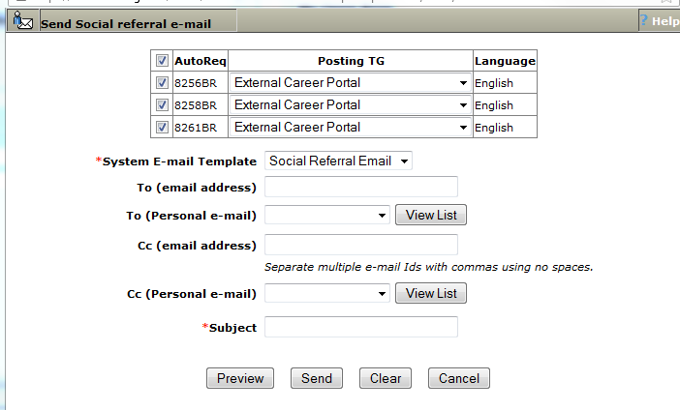
BrassRing User Feature: Recruiter Referral Email
Sending the “Social Referral” email:
These are email lists created in BrassRing under Admin+ > Personal e-mail lists

Slide 18
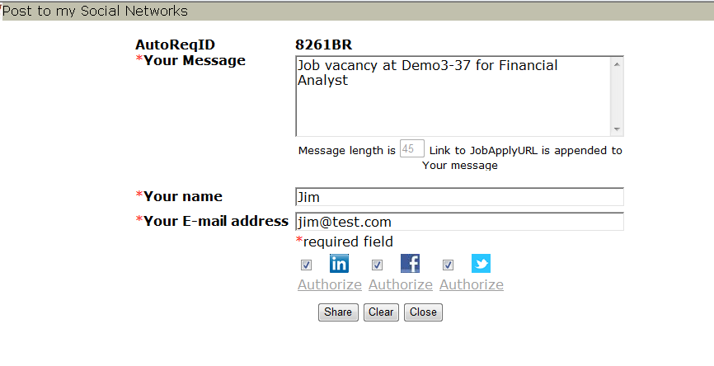
BrassRing User Feature: Recruiter Referral Email
Employees can post a req directly to their Social Media profile from the “social referral” email using the “click here” link:
Recipient must enter name & email address & authorize 1 or more sites. Can optionally enter a custom message

Slide 19
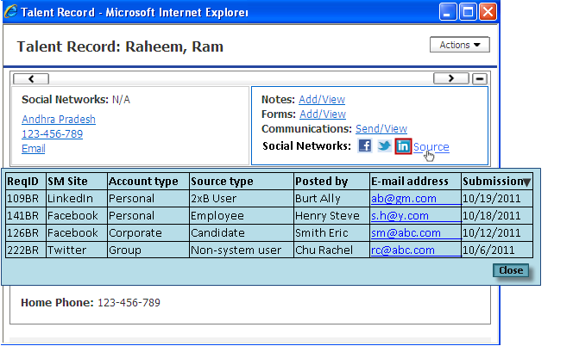
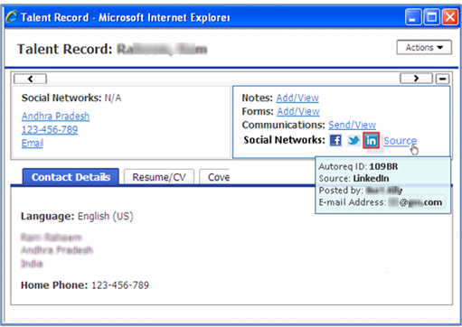
BrassRing User Feature: Recruiter Referral Email
Candidate Source
When candidates apply from the link shared to Social Media sites from the Social Referral email, this information is tracked and displayed in BrassRing.
Hovering over the “source” link displays condensed social media information for the latest apply.
Clicking the “source” link on the Talent Record ribbon provides details/results from social referral emails for candidate applies

Slide 20
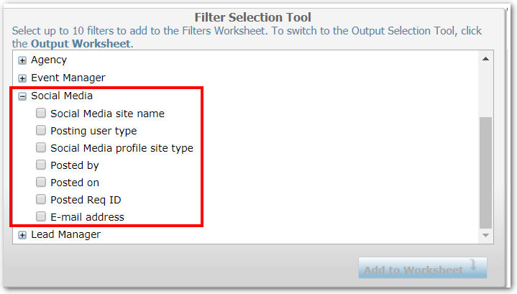
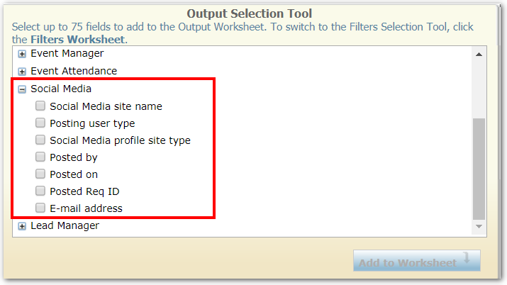
BrassRing User Feature: Recruiter Referral Email
Candidate Source – Data Insight Tool
The information from the “Source” link is also available for reporting in the DIT allowing clients to determine the effectiveness of social referral campaigns.
These fields can be used as filters or pulled in as output fields of the DIT reports.

Slide 21
BrassRing User Feature: Recruiter Referral Email
DIT Social Media Field Definitions
Field | Definition
Social Media site name | Social media site (LinkedIn, Facebook, Twitter)
Posting user type | User types that posts to social mediate site (BrassRing user, employee, candidate, non-system)
Social Media profile site type | The user account type of the posting user (Personal or corporate)
Posted by | Name of the person who posted the job to social media site(s)
Posted on | Date on which the job was posted to social media site(s)
Posted Req ID | Requisition ID of the job posted to social media site(s)
E-mail address | E-mail address of person posting the job (candidate, BR user, employee, non-system user)

Slide 22
Candidate Social Media Features
–

Slide 23
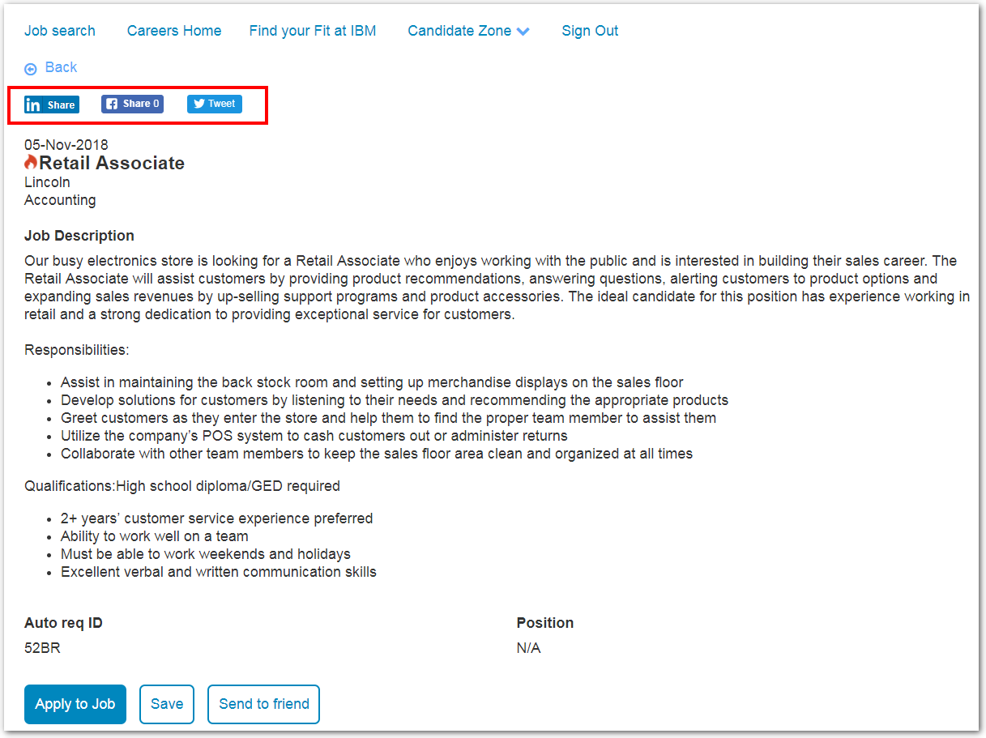
Share Buttons
Candidate can Share jobs on their networks by using the social media “share” buttons on the Job Details page of the Responsive Talent Gateways.
Candidate Features: Share Job Posting

Slide 24
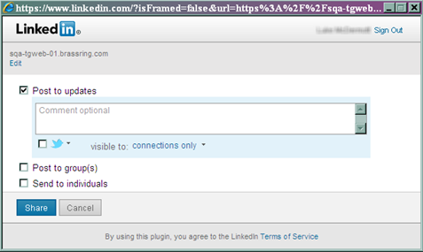
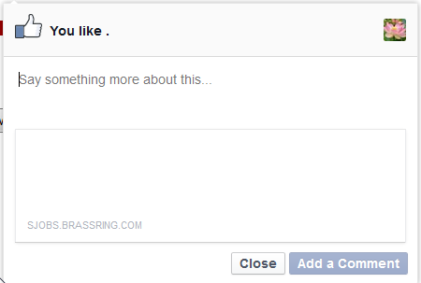
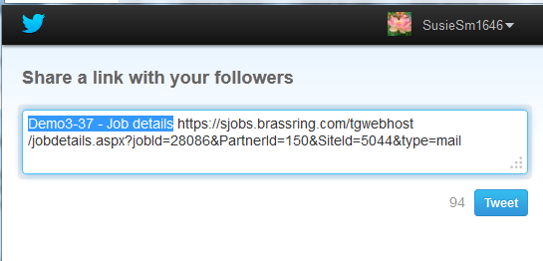
Share Buttons
Upon clicking one of the buttons, the candidate must login to their Social Media account & can optionally add a custom message.
Candidate Features: Share Job Posting

Slide 25
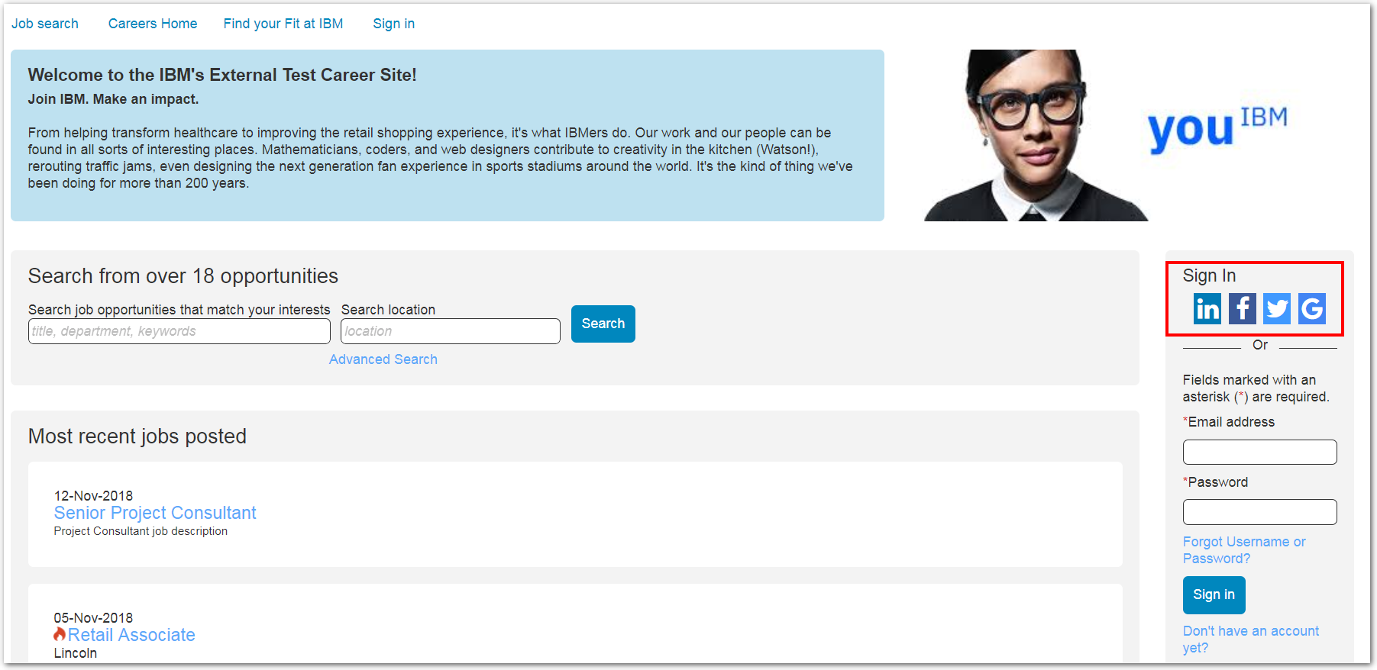
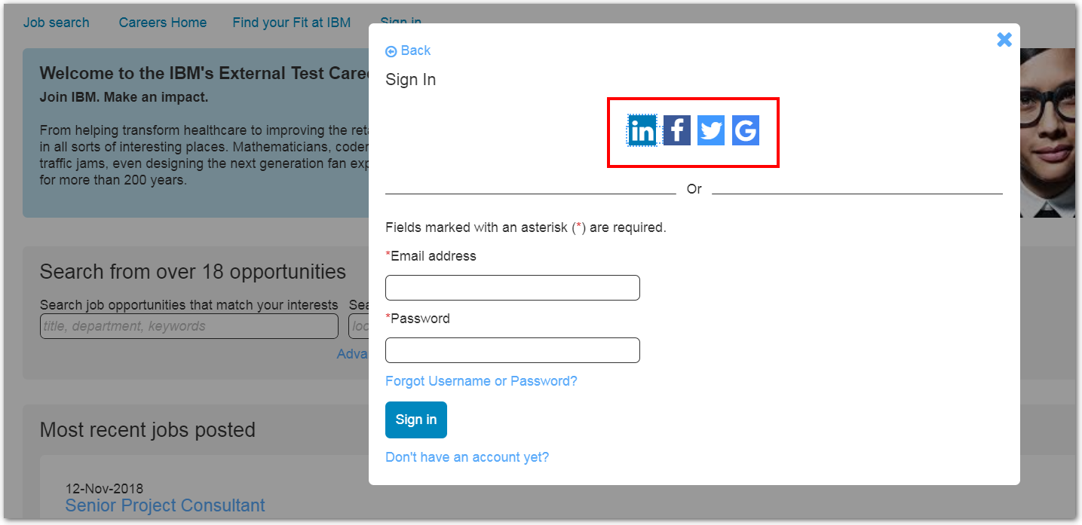
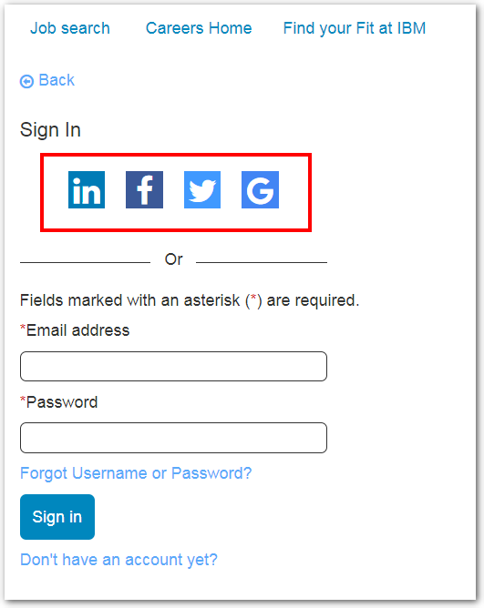
Login using Social Media accounts:
Reduces the need for candidates to remember their Talent Gateway login. Options are dependent on Social Media sites that are configured.
Candidate Features: Sign In

Slide 26
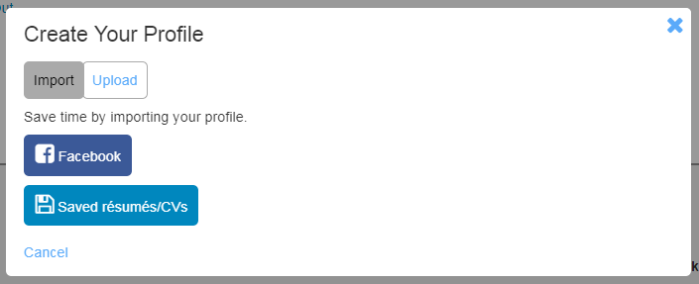
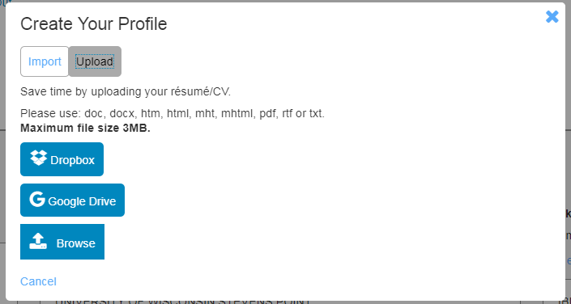
Import Profile:
Candidates import their profile from Facebook or upload their resume from Dropbox, Google Drive, or from their desktop.
This populates candidate contact/profile information with information from these various sources.
Candidate Features: Import Profile

Slide 27
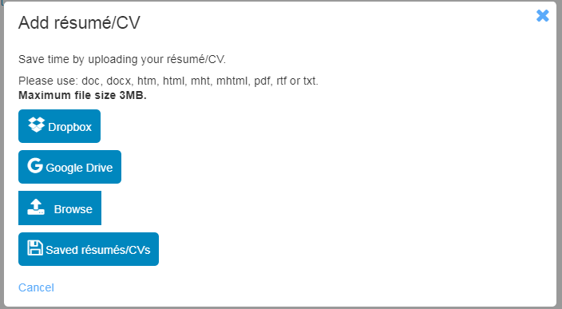
Resumes/CVs and Attachment Uploads:
Candidates can upload a resume or add attachments from Dropbox, Google Drive, or their desktop.
Candidate Features: Resume/CV Upload

Slide 28
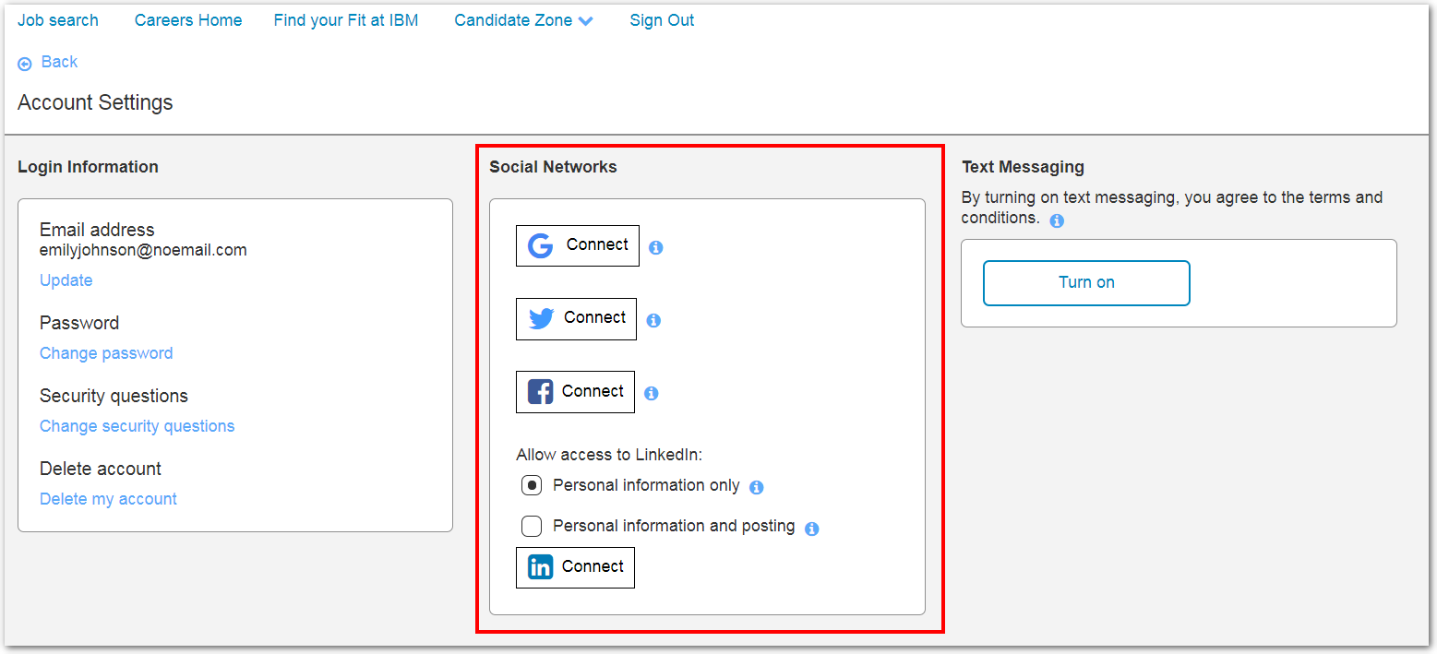
Viewing & Changing Social Media Mappings:
Candidates can view and change their social networking authorizations from within their TG accounts by selecting Candidate Zone > Account Settings.
This option allows candidates to authorize, block/unblock the viewing of public information, and allow/not allow the use of social media credentials for Login.
Candidate Features: Social Media Authorizations

Slide 29
Candidate Features: Facebook App Job Search
Facebook Job Search App
Clients can configure a Facebook widget to pull job listings from a BrassRing Talent Gateway for display on their company’s Facebook page. This provides an inexpensive way to post jobs, with a simple interface for passive or active job seekers to see if there is a job opening for them.
You can set up keyword search and filter options that people viewing your Facebook page can use to find and apply to interesting jobs.
You configure a Facebook app for placement on company pages.
Job seekers can search for jobs by four different categories, and view job description without leaving Facebook
The application process can be initiated from Facebook and BrassRing will track the candidate source as coming from the Facebook app

Slide 30
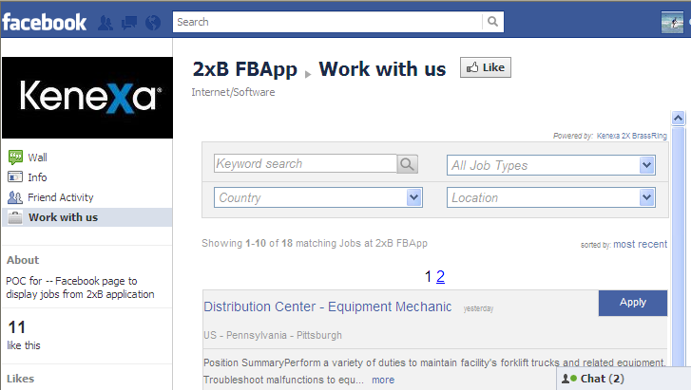
Candidate Features: Facebook App Job Search
Client name is used when displaying long listings.
Job Title, Description, and Date Posted always display
“Sorted by” gives viewers the option to sort on: Most recent - sorted based on posting date OR Alphabetic (A-Z) – sorted based on Job Title in ascending order
Clicking the Job Title hyperlink or the “more” hyperlink takes the viewer to the Job Details page, right on Facebook
“More” hyperlink displays if the job description is greater than 140 characters long and has been truncated. The complete field displays on the Job Details page

Slide 31
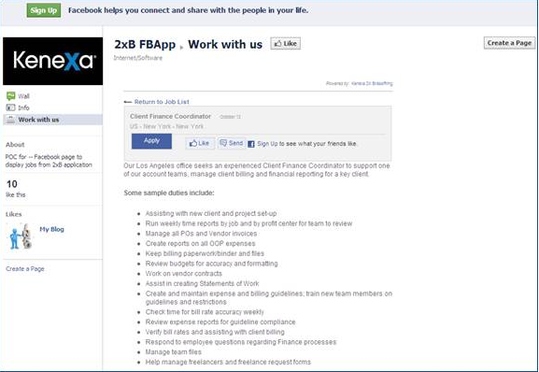
Candidate Features: Facebook App Job Search
Return to Job List” hyperlink takes the viewer back to the Job listing page
Clicking Apply from the Job Details page opens a pop-up to the destination configured for the job display widget. That is either the TG login page or the TG Job Details page for the selected job

Slide 32
Social Media Configuration
–

Slide 33
(1) Create APPs/APIs in Social Media sites.
(2) Enable Client Setting(s)
Signal Labs Task
(3) Create Source Codes
(4) Enter Social Media API Keys
Social Media Configuration Steps
(5) Enable Talent Gateway Settings
(6) Enable User Type Privileges
(7) Talent Record Updates

Slide 34
(1) Create APPs/APIs in Social Media sites.
Please Note: Signal Labs does not control the vendor’s site or API functionality, therefore if you have questions about the API set up, please reach out to that vendor.

Slide 35
Configuration: Redirect URLs
Domain | Type | Redirect URLs
US Production | Akamai | https://xjobs.brassring.com/TGWebHost/SocialMediaIntegration.aspx https://xjobs.brassring.com/tgwebhost/SocialMediaIntegration.aspx https://xjobs.brassring.com/TGWEbHost/SocialMediaIntegration.aspx
 | Non-SSL | http://jobs.brassring.com/TGWebHost/SocialMediaIntegration.aspx http://jobs.brassring.com/tgwebhost/SocialMediaIntegration.aspx http://jobs.brassring.com/TGWEbHost/SocialMediaIntegration.aspx
 | SSL | https://sjobs.brassring.com/TGWebHost/SocialMediaIntegration.aspx https://sjobs.brassring.com/tgwebhost/SocialMediaIntegration.aspx https://sjobs.brassring.com/TGWEbHost/SocialMediaIntegration.aspx
 | Vanity | Client set vanity URL/TGWebHost/SocialMediaIntegration.aspx Client set vanity URL/tgwebhost/SocialMediaIntegration.aspx Client set vanity URL/TGWEbHost/SocialMediaIntegration.aspx
US Staging | Akamai | https://xjobs-staging.brassring.com/TGWebHost/SocialMediaIntegration.aspx https://xjobs-staging.brassring.com/tgwebhost/SocialMediaIntegration.aspx https://xjobs-staging.brassring.com/TGWEbHost/SocialMediaIntegration.aspx
 | Non-SSL | http://stagingjobs.brassring.com/TGWebHost/SocialMediaIntegration.aspx http://stagingjobs.brassring.com/tgwebhost/SocialMediaIntegration.aspx http://stagingjobs.brassring.com/TGWEbHost/SocialMediaIntegration.aspx
 | SSL | https://sstagingjobs.brassring.com/TGWebHost/SocialMediaIntegration.aspx https://sstagingjobs.brassring.com/tgwebhost/SocialMediaIntegration.aspx https://sstagingjobs.brassring.com/TGWEbHost/SocialMediaIntegration.aspx
 | Vanity | Client set vanity URL/TGWebHost/SocialMediaIntegration.aspx Client set vanity URL/tgwebhost/SocialMediaIntegration.aspx Client set vanity URL/TGWEbHost/SocialMediaIntegration.aspx

Slide 36
Configuration: Redirect URLs
Domain | Type | Redirect URLs
EU Production | Akamai | https://krb-xjobs.brassring.com/TGWebHost/SocialMediaIntegration.aspx https://krb-xjobs.brassring.com/tgwebhost/SocialMediaIntegration.aspx https://krb-xjobs.brassring.com/TGWEbHost/SocialMediaIntegration.aspx
 | Non-SSL | http://krb-jobs.brassring.com/TGWebHost/SocialMediaIntegration.aspx http://krb-jobs.brassring.com/tgwebhost/SocialMediaIntegration.aspx http://krb-jobs.brassring.com/TGWEbHost/SocialMediaIntegration.aspx
 | SSL | https://krb-sjobs.brassring.com/TGWebHost/SocialMediaIntegration.aspx https://krb-sjobs.brassring.com/tgwebhost/SocialMediaIntegration.aspx https://krb-sjobs.brassring.com/TGWEbHost/SocialMediaIntegration.aspx
 | Vanity | Client set vanity URL/TGWebHost/SocialMediaIntegration.aspx Client set vanity URL/tgwebhost/SocialMediaIntegration.aspx Client set vanity URL/TGWEbHost/SocialMediaIntegration.aspx
EU Staging | Akamai | https://stagingkrb-xjobs.brassring.com/TGWebHost/SocialMediaIntegration.aspx https://stagingkrb-xjobs.brassring.com/tgwebhost/SocialMediaIntegration.aspx https://stagingkrb-xjobs.brassring.com/TGWEbHost/SocialMediaIntegration.aspx
 | Non-SSL | http://stagingkrb-jobs.brassring.com/TGWebHost/SocialMediaIntegration.aspx http://stagingkrb-jobs.brassring.com/tgwebhost/SocialMediaIntegration.aspx http://stagingkrb-jobs.brassring.com/TGWEbHost/SocialMediaIntegration.aspx
 | SSL | https://stagingkrb-sjobs.brassring.com/TGWebHost/SocialMediaIntegration.aspx https://stagingkrb-sjobs.brassring.com/tgwebhost/SocialMediaIntegration.aspx https://stagingkrb-sjobs.brassring.com/TGWEbHost/SocialMediaIntegration.aspx
 | Vanity | Client set vanity URL/TGWebHost/SocialMediaIntegration.aspx Client set vanity URL/tgwebhost/SocialMediaIntegration.aspx Client set vanity URL/TGWEbHost/SocialMediaIntegration.aspx

Slide 37
(2) Enable Client Setting(s)
Client Setting | Definition
Enable Social Media Integration | Turns on the overall settings for social media features. Clients can choose to enable one or more. Facebook, Google, LinkedIn, LinkedIn Referrals, Twitter
Enable social media integration with Talent Record | Enables clients to view a BrassRing candidate's most current talent profile side-by-side with their most current social media profile on the candidate's Talent Record. Note: clients need to have their social media keys configured prior to using this feature. this must be set to “yes” in order for users to view social media profiles from the Talent Record and for LinkedIn Cross-system awareness
Enable Social Media Integration-maximum allowed company accounts(1-25) | Allows client to configure what is the maximum number of company accounts that can be used from within Brassring. (Signal Labs recommends 6.)
Enable Social Media Integration-maximum allowed personal accounts(1-25) | Allows client to configure what is the maximum number of personal accounts(per user) that can be used from within Brassring (Signal Labs recommends 6.)
Client Setting | Definition
Dropbox Access for Mobile | Enables the ability for candidates to select attachments/resumes from their Dropbox account. Enabling this setting enables Dropbox across ALL Talent Gateways.
Dropbox App Key | Clients need to provide their unique Dropbox app key
Dropbox App Secret | Clients need to provide their unique Dropbox app secret key
Google - enable access for Google Drive & Google account (limited to Responsive Talent Gateways) | Enables the ability for candidates to select attachments/resumes from their Google Drive account AND login with their Google profile.
Google API Key | Unique key given by Google for clients to be able to attach files from their Google drives. This is needed for BrassRing to authenticate and access files.
Google Client ID | Unique client ID provided by Google. Required along with API Key & secret key.
Google Secret Key | Unique Secret key provided by Google. Required along with API Key & Client ID.

Slide 38
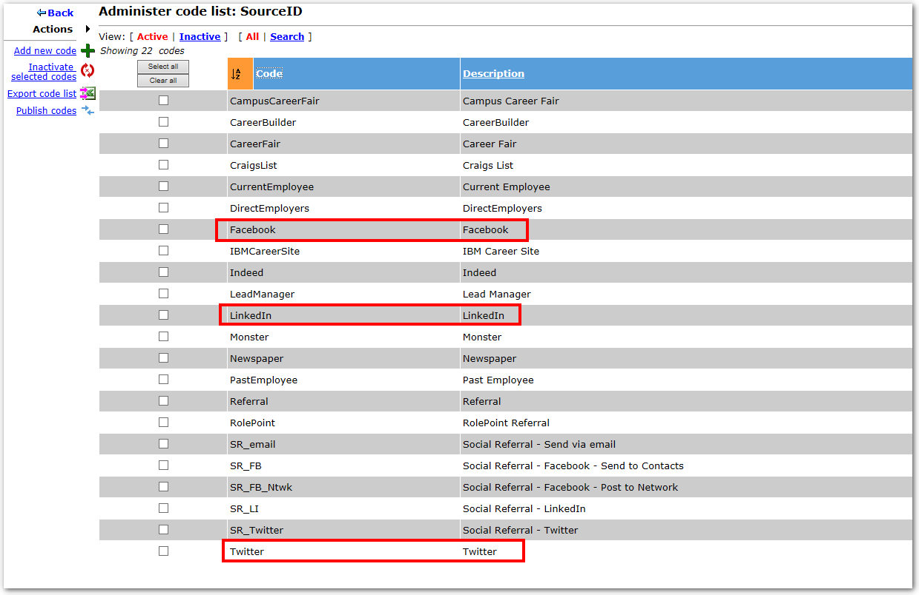
Configuration: Source Codes
(3) Source Codes
Create Source Codes for the social media sites the client will be using. Most clients will already have a Source Code created for the Social Media sites.
Tools > Settings > Code types > Administer Code List for the Source Code type.

Slide 39
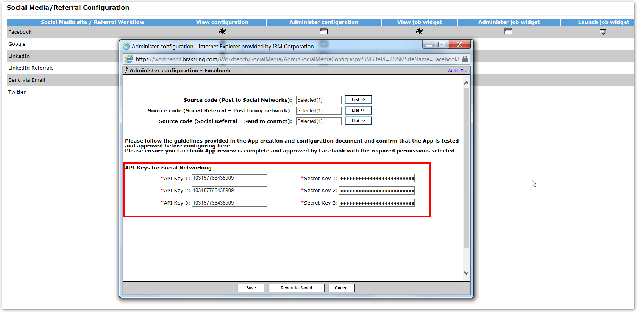
Configuration: API Keys
(4) Social Media API Keys
Tools > Settings > Social Media Configuration
Best practice: create 3 different pairs of API Key & Secret Key combinations per environment.
Clients must create their own keys using the company accounts. This may require coordination with the social media site owner for your organization.
Creation of the API key for LinkedIn is required in order to use the LinkedIn Cross-system Awareness feature.
Once the keys are obtained, they need to be entered into Workbench.
Notes:
Clients can leave the API fields blank for Facebook and/or Twitter to use the Signal Labs default keys.
LinkedIn keys are required.
The social media keys for Google and Dropbox are configured in the Workbench Client Settings. Client Settings can only be edited by Signal Labs team members.

Slide 40
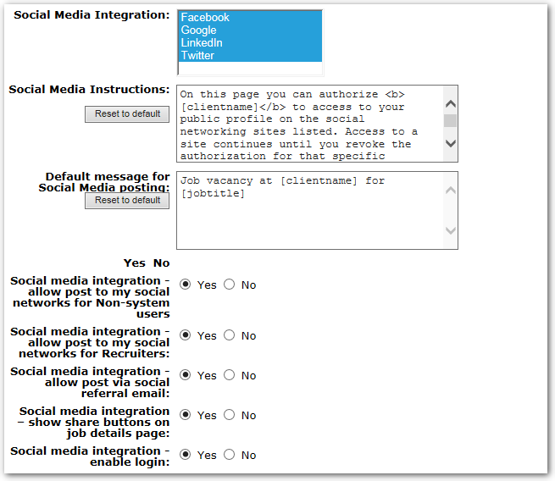
Configuration: Talent Gateway Settings
(5) Talent Gateways
Tools > Talent Gateways > edit the TG for which you want to enable Social Media
Depending on the features the client elects to use, one or more of the following settings must be enabled on the Talent Gateway.

Slide 41
Configuration: Talent Gateway Settings
Setting Name | Definitions
Social Media Integration | Facebook/LinkedIn/Twitter/Google – determines which social media sites you want to post jobs to or allow candidates to use those features. The client setting for the social media site must be enabled first
Social Media Instructions | This text appears on the talent gateway when the candidate clicks “Social networking information” to manage their social networks (map/unmap, show/hide public profile, etc.)
Default message for Social Media posting | The text which will be posted along with the apply URL when recruiters, candidates or others post jobs from the gateway to a social media site. This can be customized at the time of posting/sharing.
Social media integration – allow post to my social networks for non-system users | This setting is used in conjunction with the social referral email functionality. If you decide to use that feature, this setting should be set to “yes.”
Social media integration – allow post to my social networks for Recruiters | This setting must be enabled if you want to allow recruiters to post open reqs to their personal and/or company accounts/pages. Enabling this setting will also turn on the ability for candidates to use their LinkedIn or Facebook profiles to create their profile on the talent gateway
Social media integration – allow post via social referral email | This setting must be enabled in order to send jobs posted to this talent gateway via the social referral email
Social media integration – show share buttons on job details page | Enable this setting to allow candidates to share jobs on their social media sites using the buttons.
Social media integration – enable login | This setting allows candidates to use their social media credentials to log into the TG instead of needing to remember their TG credentials

Slide 42
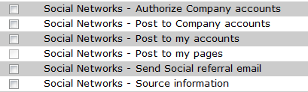
Configuration: User Type Privileges
(6) User Type Privileges
Tools > Users > User Types > edit type permissions the user type > Reqs 2
Depending on the features the client elects to use, one or more of the following user type privileges must be enabled for each user type by your Workbench self-service user
Feature | Description
Social Networks – post to my accounts | Allows users to post jobs on social media sites to their personal accounts.
Social Networks – post to my pages | Allows users to post jobs to their personal pages created on Facebook
Social Networks – send social referral email | Allows users to send the social referral email (this action becomes available in the Requisition Actions menu
Social Networks – Source Information | Allows users to view the source information associated with the social referral email. This privileges makes the “source” link on the talent record ribbon viewable for users.

Slide 43
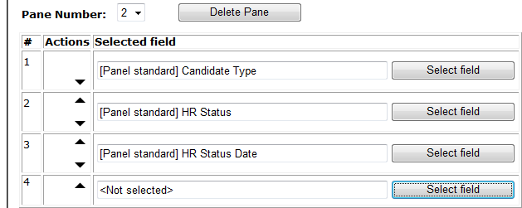
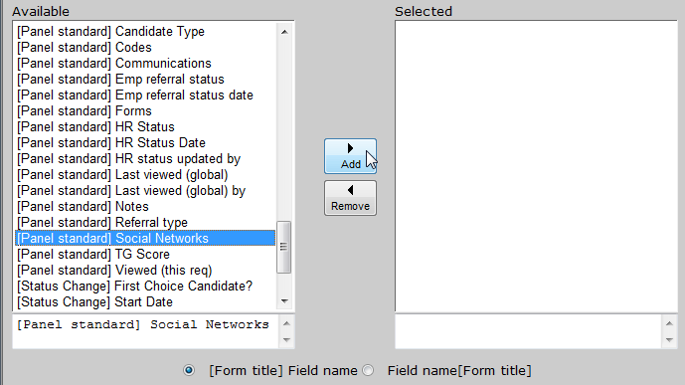
Configuration: User Type Privileges
(7) Talent Record Updates
Tools > Users > User Types > select the user type for which you want to modify the ribbon > screen display defaults action > Click “Select field” to add the new ribbon item: [Panel Standard] Social Networks)
Workbench Admin will need to add the “Social Networks” field to the Talent Record ribbon for the appropriate user types in Workbench.

Slide 44

Configuration: Recruiter Referral Email
(7) Recruiter Referral Email (Optional)
Users > User Types > edit user type > Communications
Signal Labs enables the client setting for “E-mail type configuration”
Client’s Workbench admin will enable the Communications privilege for “System E-Mail templates – administer/view” for the appropriate BrassRing administrator user type (ex. Super User or System admin)

Slide 45
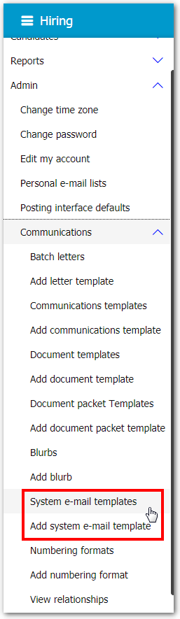
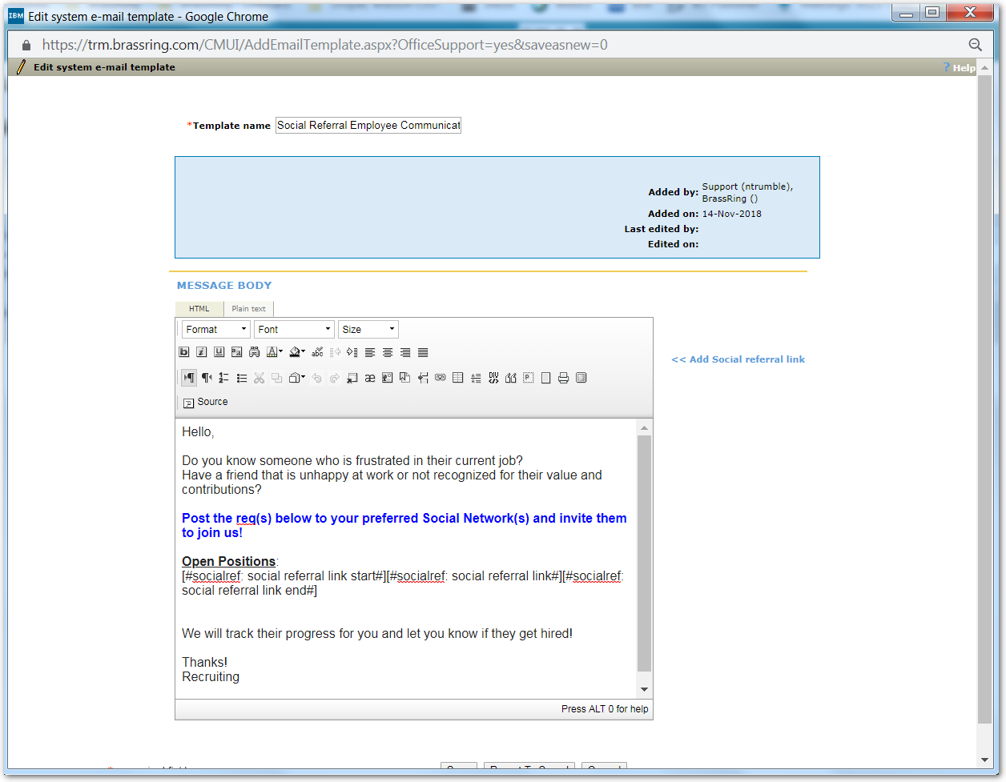
Configuration: User Type Privileges
(8) Recruiter Referral Email Configurations
BrassRing > Admin > Communications > Add system e-mail template
Client’s BrassRing system administrator will need to add the communication template:
Be sure to include the token for the social referral link

Slide 46
Questions?

