Slide 1
BrassRing ATS
Migrating to the Responsive Talent Gateways
—
Client Training and Enablement
February 19th, 2019

Slide 2
Agenda
–
Why migrate?
Demo of the Responsive Talent Gateways
Example Project Timeline and Preparation
Roles and Responsibilities
High-level Configuration Steps
FAQs
Resources
Notes:
Ask your questions on the Support Community Discussions Post between now and the February 26th Q&A session!

Slide 3
IBM sunset support for Classic Talent Gateways and the classic apply process (“Classic experience”) on December 31st, 2017. Although did not shut off Classic Talent Gateways, as of that date, no longer works on bug fixes specific to Classic experience. Also, no longer ensures accessibility standards on anything other than the Responsive Talent Gateways and the Responsive Apply process (“Responsive experience”). All new features and functionality has been and will only be available in the responsive experience.
We want to make you aware that although the Classic experience has remained functional over the last 13 months despite being unsupported, technology has and will continue to advance to the point that they may stop working as our product progresses. Since these are no longer supported, they will not be enhanced or updated to work with new technology.

Slide 4
Why Migrate to the Responsive Talent Gateways?
The new responsive apply modernizes and streamlines your application process. It provides your candidates with a mobile experience that does not differ from their phone, tablet, or desktop. The user interface is clean, easy to use, and can be customized by your organization to match your corporate branding needs.
The Responsive Talent Gateways also include:
Use of question branching within the same page.
CSS capabilities to brand and customize your site
Responsive TGs autosave as your candidates progress through the application via the continue button.
The progress bar shows the candidate their progression through the application process.
A responsive Candidate Zone that allows candidates to view their status, sign offer/contract documents, upload files, and fill out additional forms.
Use of type-ahead option lists.
Show jobs on landing page based on proximity to candidate's location.

Slide 5
Demo

Slide 6
Example Project Timeline and Preparation
Source: If applicable, describe source origin
3. Configuration
Workbench admin configures GQs and TGs.
5. Go Live
Reqs are updated and go live tasks are completed.
Self-service implementation
Pull in additional teams/vendors that will be critical to completion of the project (listed on following slide)
Which Talent Gateways do you have to convert?
Where do your external BrassRing ATS Talent Gateways connect with your corporate site? How are your internal Talent Gateways accessed?
What vendors currently scrape your Talent Gateway(s)?
1. Kickoff and Prep
Branding discussion and review of current set up.
Week 1
Week 2
Week 3
Week 4
Week 5
Week 6
2. Design/Branding
Branding worksheet is completed or CSS is developed.
4. UAT
Testing is completed in Staging.
Do you use iFrames?
Do your Classic Talent Gateways have any tracking codes on them?
Do you use a posting partner?
Do you currently use the Classic referral functionality?
Notes:
Master Draft 1
Master Draft 1
6

Slide 7
Example Steps to Implement
Kick-off call:
    Discuss any configuration items you noticed during prep
    Discuss roles and responsibilities – including who is responsible for configuration, branding, testing, go-live activities, etc.
    Discuss high-level timelines
    Provide design sheet to have the marketing/corporate communications team. Make your legal team aware of the review they will be asked to complete. Start reaching out to your vendors that may be scraping your Talent Gateway(s).
Marketing team to provide branding details for Talent Gateways (via the design sheet)
WB Admin will complete the initial configuration in Workbench. Additional feedback may be needed by the Recruitment and Marketing teams during configuration.
Initial review will be completed by all teams and configuration changes will be completed by the WB Admin.
Test reqs should be posted to the Responsive Talent Gateways to allow for testing to occur.

Slide 8
Example Steps to Implement
User Acceptance Testing
    Recruitment team will be responsible for UAT testing the Responsive Talent Gateways and apply process (Responsive Gateway Questionnaires).
    Marketing/corporate communications team will be responsible for reviewing the branding on the Talent Gateways. (URLs should be sent to these teams for review.)
    Vendors that scrape the Talent Gateway(s) will want to test the Jobs API
    Configuration changes will be completed as needed throughout the UAT step.
    UAT sign-off
    Go-live date is set

Slide 9
Example Steps to Implement
Go-live
  WB Admin will complete configurations in Production. (Example go-live checklist below)
    (Pre go-live) Enable client setting for Responsive GQs
    (Pre go-live) Move Responsive GQs to Production
    (Pre go-live) Configure Responsive Layout Page in WB
    (Day of go-live) Enable TG settings (Responsive Setting, etc)
    (Day of go-live) Activate GQs (Update associations if the client is already using GQs)
    (Day of go-live) Remove Default Questions (if needed)
    (Day of go-live) Configure branding in Visual Branding Tool
    (Day of go-live) Refresh/Repost reqs postings
    Client’s marketing/corporate communications teams will complete URL changes if necessary.
  Vendor(s) start utilizing the jobs API to pull jobs.

Slide 10
Roles and Responsibilities
Project Team
Workbench Admin
–
  Will be responsible for configuration throughout the project. This includes the Responsive Gateway Questionnaires and Responsive Talent Gateways.
Recruitment / Talent Acquisition Team
–
  Provide insight on process improvements during User Acceptance Testing and may want to provide feedback on current functionality.
Legal
–
  Review the application process, especially the VEVRAA and 503 Disability forms (if presented to candidates during the submission process).
Marketing / Corporate Communications / Vendor
–
  Will be responsible for providing branding details (including potential CSS), will review the gateways to ensure branding compliance, and may be needed to make the appropriate corporate career site changes.
Job Board Vendors that may be scraping the Talent Gateway(s)
–
  Scraping is not supported on the Responsive Talent Gateways. Vendors that scrape will need to move to the Jobs API to pull requisition information.

Slide 11
Configuration Steps
–
1. Configure Responsive Gateway Questionnaires
2. Configure Responsive Layout for Talent Gateway
Synchronize your Talent Gateways!
3. Enable Responsive setting on Talent Gateway
4. Configure Branding for the Talent Gateway
Synchronize your Talent Gateways!
5. Update GQ associations or repost requisitions.
Convert your existing Talent Gateways, do not create new Talent Gateways.
Configure and test your Responsive Talent Gateways in Staging before you make changes to your Production Talent Gateways.
Don’t forget to map your HR Statuses to the appropriate HR Status Categories.

Slide 12
Config Demo

Slide 13
Responsive Gateway Questionnaires
Responsive apply requires that you create and use a responsive Gateway Questionnaire (GQ). Responsive GQs have the following features.
One-column layout - The layout for a responsive GQ is one column. Headers and footers dynamically adjust based on the device viewing them.
Improved Preview - The Gateway Questionnaire Preview functionality has been improved to show the responsive layout and allows for candidates to click directly into the section they would like to edit before submitting.
New Sections/Pages - Saving a classic questionnaire as new or creating a new responsive GQ adds four new standard sections and three visible text widgets. The new sections and widgets are required for all responsive questionnaires, and cannot be removed or deleted.
Responsive Gateway Questionnaires are differentiated from Classic Gateway Questionnaires by the responsive icon next to the GQ name in workbench.

Slide 14
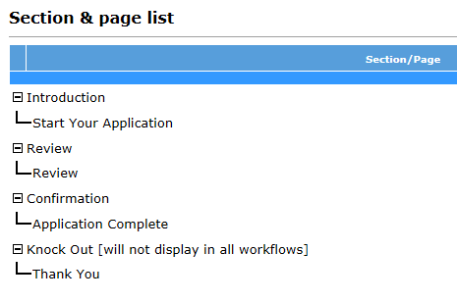
Responsive Gateway Questionnaires
The 4 new standard sections of the Responsive Gateway Questionnaires are:
Introduction > Start Your Application (which must always be first)
Review > Review (Review page doesn’t include a widget)
Confirmation > Application Complete
Knock Out > Thank You
These sections and pages are automatically added when the “Responsive” setting is enabled on the GQ Properties page.

Slide 15
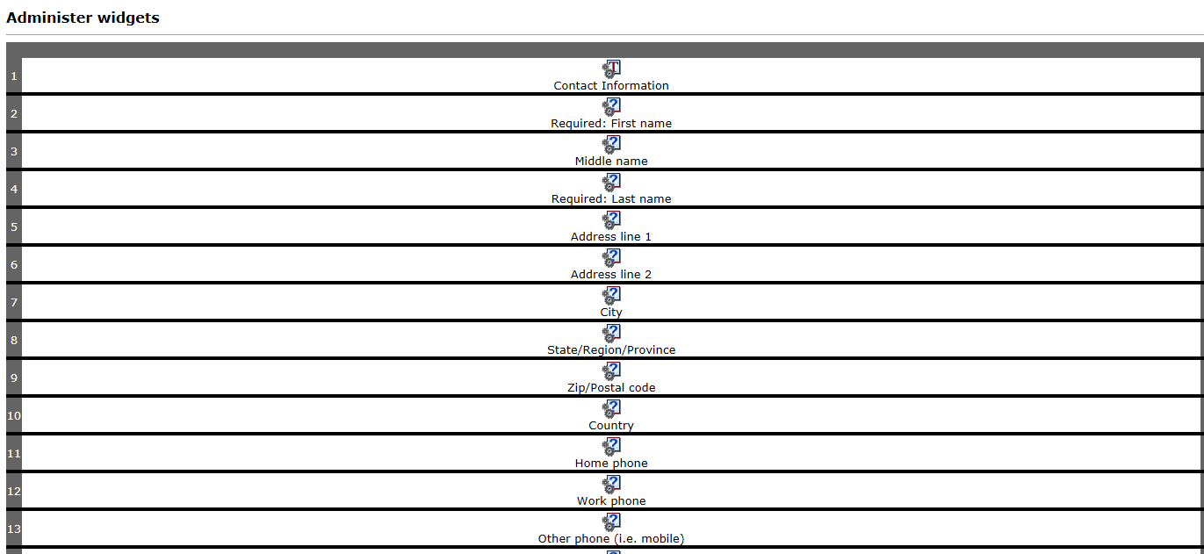
Responsive Gateway Questionnaires
Widgets within the pages are now all in a single column, to accommodate responsive screens of smaller devices without horizontal scrolling.
When you add or delete a widget, it now automatically adds or deletes the row – no more need to create a row, then the widget.
You can cut-and-paste widgets before or after the selected widget.

Slide 16
Responsive Gateway Questionnaires
Text widgets - Text widgets attributes have been streamlined to only have two attributes, with a single descriptive text box (to be used for both single and multiple reqs). The “Use as subheading” setting allows the text to be used as a subheading, under which any widgets that follow are grouped (until the next subheading text widget or end of page).
Complex widgets - The following complex widgets can be used in Responsive Apply:
  Resume upload
  Cover letter upload
  Education builder
  Experience builder (including Skills)
  Job Specific questions
Question widgets – The classic question widget formatting attributes such as font style and alignment have been removed. The formatting of these fields are handled by the responsive design.
Attachment widgets – The attachment widget can now be added to the responsive apply gateway questionnaire to allow candidates to upload and attach documents to their application. Only 1 attachment widget is allowed per page, but you can configure multiple categories within an attachment widget.

Slide 17
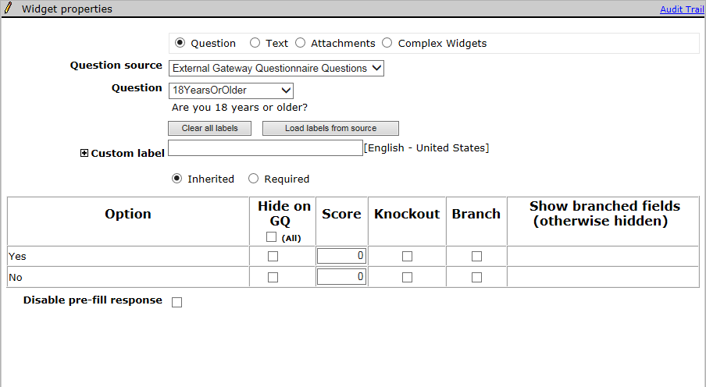
Responsive Gateway Questionnaires
The scoring, knockout, and branching functionality are all configured on the Widget properties page for the Question widgets.
The Disable pre-fill setting is hidden for candidate contact fields. In classic GQs, you can disable pre-filling of fields with responses from prior applications for any question widget, including contact fields. In Responsive Apply, you can disable pre-filling for candidate form questions only. This restriction improves the candidate experience by pre-filling more of the candidate’s information from their current application.

Slide 18
Responsive Gateway Questionnaires
Notes:
To avoid confusion for BrassRing ATS users, have one page per section for responsive questionnaires, and use the same title for both section and page. Standard sections/pages can have different name. Since BrassRing ATS users see only section titles, and candidates see only page titles in the candidate experience, keep the names the same to minimize confusion.
The “Introduction/Start Your Application” section/page MUST be the first section/page of the Responsive Gateway Questionnaire.
The “Estimate time to complete” field on the “Start Your Application” page sets the time estimate that the candidate sees before they start filling out their application. Leave this field blank to have the system calculate the estimate time using an advanced algorithm based on the number and type of questions and widgets in the application. You can also enter your own estimate manually, should you prefer that method.

Slide 19
Responsive Gateway Questionnaires
Notes:
The Review page is where the candidate can edit and review their responses prior to submitting their application. There is no configuration needed on this page.
The Application Complete page:
  Is the confirmation page that lets the candidate know their application has been successfully submitted.
  The text on this page can be customized.
  Select the “show TG HR Status link (“View your status”)” setting if you would like your candidates to be able to go directly to the submission check page.
  Select the “show TG Search link (“Start a new search”)” setting if you would like your candidates to be able to return to the Welcome/Search page to start a new job search.
Responsive Gateway Questionnaires are limited to 1 knockout page for the entire GQ.

Slide 20
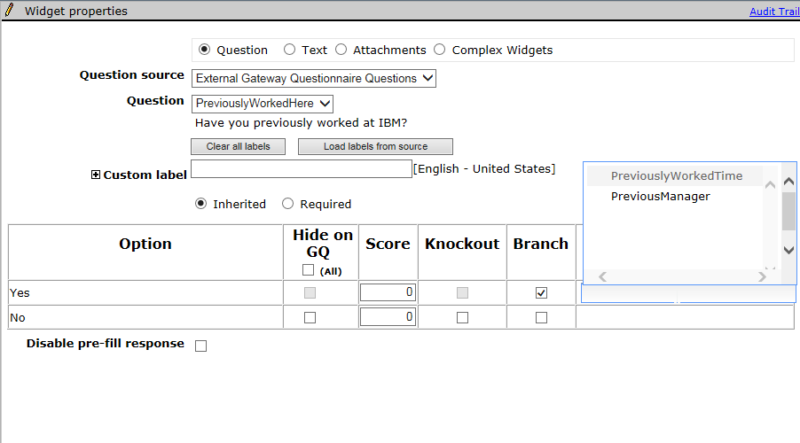
Responsive Gateway Questionnaires
Branching Configuration:
Add all questions that may be branching questions or questions that will need to be shown as a result of a selection to the page.
In the widget properties page for the ‘parent’ question choose the fields that will show based on the option selected. Select “Branch” for the option you want to show the branched fields, then under the “Show branched fields” section select the fields you want to be visible if the option is selected. The Show branched fields section will autocomplete as you type. Fields shown are the database field names so it is important to know which field you are selecting.

Slide 21
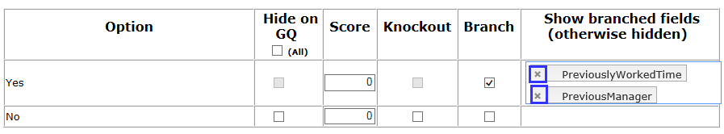
Responsive Gateway Questionnaires
Branching Business Rules
You can branch only from question to question – you cannot branch to a text widget. However, to display variable text, you can create a label for that text in the candidate form, and branch to that label – and the corresponding text.
Branching must be linear. You cannot branch to a widget that precedes the question widget in the widget order. Thus, if you select the first widget on the page, you can choose to branch to any of the following fields on the page. If you select the last widget on the page, no fields will be available to branch to.
A child field can’t be reused on the same page as the branched-to field after being used on the page already for a different widget.
You can branch across forms, as long as the fields are pulled on to one GQ page.
Classic GQ page-level branching is not inherited when you create a responsive GQ. Branching must be re-configured.
To remove branches, select the X in the branch label tag.

Slide 22
Responsive Gateway Questionnaires
The following high-level steps should be followed if your organization is NEW to using the Gateway Questionnaire functionality:
Determine how many Responsive GQs you will need. This could be based on:
  The number of Responsive Talent Gateways you have. (One GQ per TG)
  The number of different application workflows you have. (One GQ per Job Family/Position)
  The number of countries your organization operates in. (One GQ per country.)
Map out your application process/flow. Most organizations that have not used GQs in the past will implement one GQ per TG. Examples: Internal, External
In Workbench, go to Tools > Gateway Questionnaires > Add new Gateway Questionnaire > Name your GQ (we recommend you use versioning such as “External v1”) > Set your other GQ properties > Save
The 4 standard responsive sections will automatically be visible. Next, add the Sections, Pages, and Widgets that will make up your application process.
Activate the Responsive Gateway Questionnaire
While posting your requisitions to the Responsive Talent Gateway, be sure to select your Responsive Gateway Questionnaire.

Slide 23
Responsive Gateway Questionnaires
The following high-level steps should be followed if your organization is NOT NEW to using the Gateway Questionnaire functionality:
In Workbench, go to Tools > Gateway Questionnaires > Click the Active tab > Select the Classic GQ you’d like to turn into a responsive GQ > “Save Gateway Questionnaire as New” > Name your GQ and make sure the “Responsive” setting is selected > Click OK
The 4 standard responsive sections will automatically be added to your existing GQ sections. Some reconfiguration may be required to ensure your application process flows properly.
  Pages have been updated to the 1 column format which may require you to re-configure the order of your questions.
  Branching and knock-out questions will have to be reconfigured.
  Text throughout the Gateway Questionnaire should be re-reviewed.
Activate the Responsive Gateway Questionnaire
Select your existing Classic Gateway Questionnaire > Click “Update Gateway Questionnaire associations” > Select your new Responsive Gateway Questionnaire > Inactivate the old/classic GQ.

Slide 24
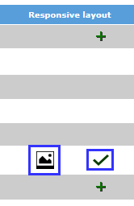
Responsive Talent Gateways
Responsive job search and apply can be enabled in Workbench for Full and Global Talent Gateways that are WCAG compliant. Basic Talent Gateways cannot be converted to responsive.
Visual Branding Tool:
  Screen fonts, colors, images, and Advanced CSS are controlled via the Visual Branding Tool launched from within Workbench. The Visual Branding Tool will be covered in a subsequent webinar.
“Responsive Layout”:
  Configured per Talent Gateway with sections that allow you to edit the header, footer, links, verbiage of the site, filters, and fields.

Slide 25
Visual Branding Tool
With the Visual Branding Tool (VBT), you can change and save branding elements for responsive Talent Gateways and Gateway Questionnaires: colors, fonts, and stored images. Gateways must be:
Full or Global WCAG-enabled Talent Gateways
Have saved responsive layout (indicated by pencil or checkmark icons)
Be synchronized if new or if responsive layout was recently configured.
To Access the VBT you can select Tools > Talent Gateways >

Slide 26
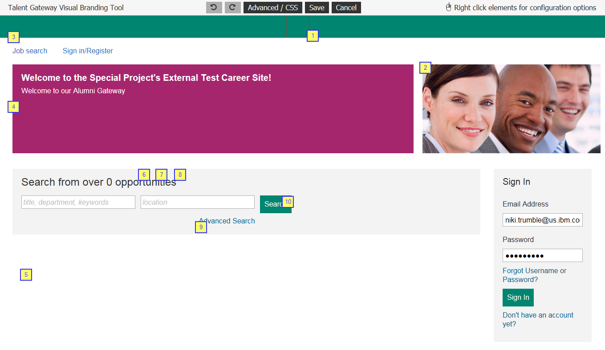
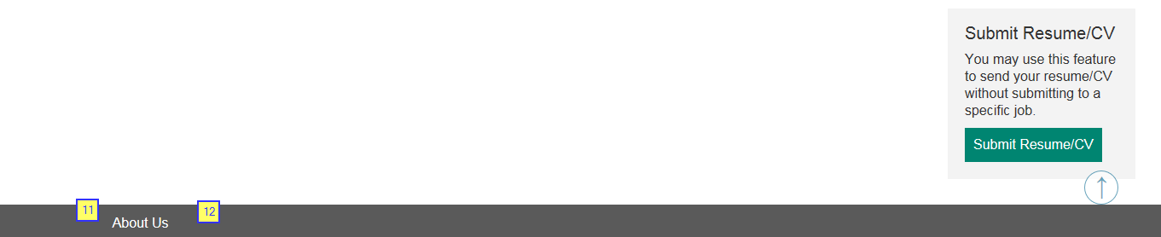
Visual Branding Tool
VBT opens in configuration mode, where you can right-click to change the different elements.
1: Logo – Will appear in the header. Must be a URL and HTTPS hosted. Height 50px, Width 130px, Size 50kb
2: Branded Image – Must be a URL and HTTPS hosted. Height 400px, Width 1100px, Size 600kb
3: Header Link Color
4: Foreground Color
5: Background Color
6: Base Font Size – 16px default
7: Base Font Color
8: Base Font Style: Helvetica Neue/Arial, Verdana, Times New Roman, Tahoma
9: Page Link Color
10: Button Background Color
11: Footer Font Color
12: Footer Background Color

Slide 27
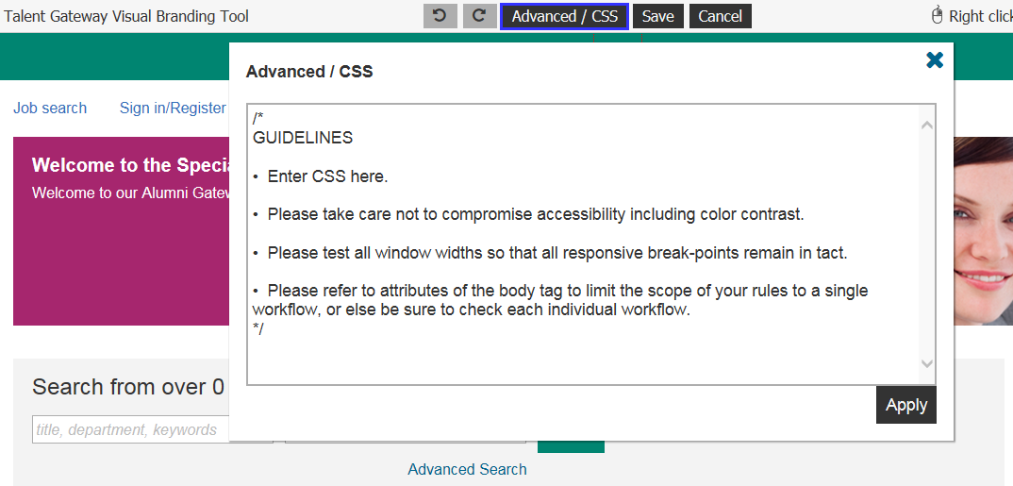
Visual Branding Tool
At a very high level, CSS (Cascading Style Sheets) replaces the formatting of certain HTML tags in page content; you could make a special icon appear for any use of the <li> bullet tag, or you can control the colors of certain elements universally. CSS normally can be used in-page or as a separate HTML document called for each page. To learn more about CSS, you can access this online source.
The Advanced / CSS feature in the visual branding tool was created to allow clients granular control over branding through the direct input of CSS code. Advanced CSS allows you to add CSS scripts to change the look and feel of the responsively designed pages.

Slide 28
Visual Branding Tool
The Advanced CSS feature is very powerful, and as you manipulate the CSS on a page, you may negatively affect the responsiveness or the accessibility of the application pages, so please make sure the CSS script entered is done by someone with deep expertise in CSS. The candidate experience has been coded to adhere to numerous global standards and to accommodate virtually all devices through responsive design. In addition to solid knowledge of CSS, the Advanced CSS option of the visual branding tool requires great care to avoid adversely affecting all of the following:
  Responsive breakpoints
  General usability
  Accessibility
The tool is not intended to re-write the entire CSS, it's intended use is for specific changes that need to be made.

Slide 29
Visual Branding Tool
What It Can Do: The Advanced CSS option can control the presentation of every element in the user interface: header, footer, and main body. Such as:
Control colors and fonts
Hide content
Resize content
Reposition content
Add background images
Add and remove scroll bars
Add some content (text, icons, images, etc.) within limitations
Show content that was otherwise hidden
Change the number of columns displayed (within some limitations, excluding IE < 10 and Opera Mini)
What It Cannot Do
It cannot always single out a single element in the user interface to restyle without affecting similar elements
It generally cannot divide content or make any changes that require changes to markup
It generally cannot control user interaction or make any changes that require changes to script.
Note: IBM does not support questions about CSS. CSS should be developed by your internal marketing/branding teams if you would like to use it on your Responsive Talent Gateways. However, we do have some common CSS examples.

Slide 30
Do Add Candidate/Contact (basic) Gateways need to be migrated to responsive?
Not currently. This exercise is only for FULL TGs. IBM is currently working on an option that will replace Basic Talent Gateways. For the time being, if clients share a basic TG URL with their candidates to fill complete, they can create a Responsive Standalone Gateway Questionnaire instead and provide that link to the candidates.
Frequently Asked Questions
Does IBM still support the resolution of bug fixes for our Classic Talent Gateways?
IBM sunset support for Classic Talent Gateways and the classic apply process (“Classic experience”) on December 31st, 2017. Although did not shut off Classic Talent Gateways, as of that date no longer works on bug fixes specific to Classic experience.
We want to make you aware that although the Classic experience has remained functional over the last 13 months despite being unsupported, technology has and will continue to advance to the point that they may stop working as our product progresses. Since these are no longer supported, they will not be enhanced or updated to work with new technology.
Does IBM guarantee accessibility compliance for our Classic Talent Gateways?
No longer ensures accessibility standards on anything other than the Responsive Talent Gateways and the Responsive Apply process (“Responsive experience”). More importantly, all new feature functionality has been and will only be available in the responsive experience.
Why do my users have to select a Gateway Questionnaire now when posting a req?
With Release 19.02.11 all reqs that a BrassRing ATS user attempts to post (or update a posting) to a Responsive Talent Gateway will require a GQ to be included/selected.

Slide 31
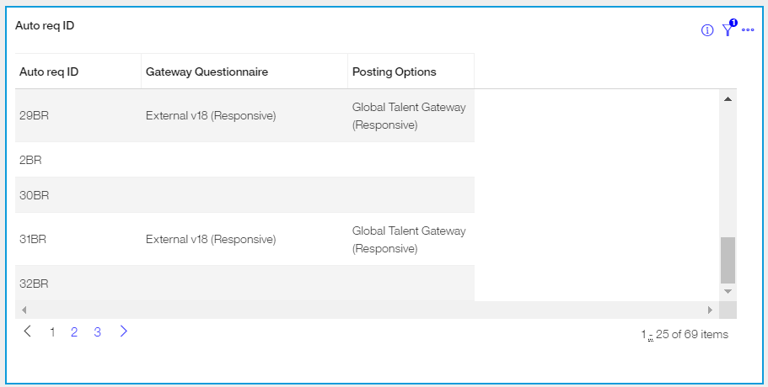
Do you have to select a Responsive Gateway Questionnaire when posting to a Responsive Talent Gateway?
It is not currently a requirement however selecting a Classic GQ results in a bad candidate experience.
Frequently Asked Questions
How can I tell what reqs do not have a Gateway Questionnaire selected on the posting options page?
We recommend utilizing the BrassRing ATS Metrics Dashboard to build a visualization to pull this information. An example visualization would be:
Table Chart type
Columns: Auto Req ID, Gateway Questionnaire, Posting Options
Optional Filter: Req Status
If you haven’t yet enabled the Metrics Dashboard, we recommend you do!
What should I test when migrating my Talent Gateways to Responsive?
Testing should include (at a minimum): Header and footer links, advanced search fields, job description layout, field branching within the application, WOTC/Assessments/APIs (where applicable), Social Media functionality (Google Drive, Drop box, LinkedIn, Facebook, Twitter), Candidate Zone pages.

Slide 32
Our organization has an Employee Referral TG for our internal employees. This TG houses all reqs that are eligible for referral. This is a TG solely for searching for jobs and referring someone to them. The TG is not used for internal applicants to apply to jobs. What should we do?
The old/classic Employee Referral functionality is not supported on the Responsive TGs. You will need to implement our Social Referral functionality; which is supported on the Responsive TGs. If you do not want internals to apply to jobs on the TG you can use CSS to hide the Apply button. Example CSS for this can be found on our Advanced CSS document.
Frequently Asked Questions
Our organization has a WOTC (Work Opportunity Tax Credit) TG – we need to post reqs to this ‘hidden’ TG in order to collect WOTC information after the initial apply process. What should we do once the requirement is put in place that a GQ is required (we do not currently select a GQ for this TG)?
You are able to create a GQ with a WOTC widget included. When BrassRing ATS requires a GQ at posting, you will want to have a GQ (that has a WOTC widget) created for your users to select.

Slide 33
If testing the Saved Search functionality in Staging, please note that emails are not sent.
If your Attachments widget page does not have an upload option, this is most likely because you do not have attachment categories selected on your GQ.
Things to Know
It is recommended that you place the education and experience widgets on the same page as the contact fields. The resume/CV widget should follow on the next page. The Import Profile button is what is used to prefill/parse the candidate’s information into the contact fields and education/experience widgets.
Job Cards will drop off of a candidate’s submitted applications page if the Req Status = Closed (Cancelled or Deleted) and the candidate’s HR Status hasn’t been updated in 90 days.
On the Candidate Zone, the “Last Update” date is based on the HR Status Category date change not the date the HR Status was changed.

Slide 34
If you are interested in tracking traffic on your Talent Gateways, please reach out to your representative and they can provide information about our Digital Analytics tool.
Welcome text color is limited to ensure that it contrasts with the color of the foreground color.
Things to Know
CSS is very powerful. As you manipulate the CSS on the page, you may negatively affect the responsiveness or the accessibility of the application pages. Please make sure the CSS entered is done by someone with expertise in CSS. The candidate experience has been coded to adhere to numerous global standards and to accommodate virtually all devices through responsive design.
The signature widget that was available in Classic GQs is not supported in the responsive GQs. Electronic signatures have not changed with Responsive Apply. Most clients are using a combination of a checkbox and text box for the candidate to type their name. The drawn signature that was available in Classic is not supported in Responsive.

Slide 35
Videos can be added, by using HTML, to the Candidate Zone via the HR Status Category descriptions.
HR Status Categories are displayed to candidates within the Candidate Zone. These HR Status Categories can be customized per Responsive Talent Gateway.
Things to Know
Tracking pixels are supported but only on during the submission process at this time. If a vendor provides you a tracking pixel to add to your gateway, please reference the “Responsive Apply Tracking Codes for Apply Process” document on the Responsive Overview, Configuration, and Documentation Support Portal page.
Jobs pushed to a third party, through a Job Board Aggregator or through the Jobs API, should not be impacted.

Slide 36
If your organization currently uses a Vanity URL, these should not be negatively affected by the conversion to Responsive.
If you would like to remove certain options from a field on the Advanced Search page, edit the Talent Gateway and select the “Choose field options” field.
Things to Know
If your organization currently uses iFrames, please be aware that iFrames are not technically supported on Responsive Talent Gateways. Adding custom CSS and coding does not guarantee that the Responsive Talent Gateway will render properly on mobile devices. Also, an attempt to implement an iFrame may result in the iFrame taking up too much screen space when candidates are on smaller devices. This then leads to a less than optimal candidate experience.
The “more” option on the job search results page will not render HTML from the formatted descriptions

Slide 37
Resources
IBM Knowledge Center
Overview, Configuration and Documentation
  Project overview
  Configuration overview
  Responsive Apply Design Sheet: This document is referenced in the Project Process Overview and Visual Branding Tool Overview webinars. It is recommended to use this document to collect pertinent information from your Marketing or Corporate Communications team.
  Responsive Upgrade LOE Assessment: This spreadsheet helps you estimate the number of hours that are needed by your Workbench Administrator to make the move to Responsive Apply.
  Advanced CSS Snippets
  Responsive Apply Tracking Codes for Apply Process
Ask your questions on the Support Community Discussions Post between now and the February 26th Q&A session!

Slide 38
Questions?

