Slide 1
Non-TG Application Process
External Training and Enablement Session
June 15th, 2021

Slide 2
Agenda
Overview
Workbench Settings
Communication Template
BrassRing Usage
Things to know
Q&A

Slide 3
Overview
The Non-TG Application Process provides BrassRing customers with a way to create a Talent Gateway profile for candidates that did not come through the traditional Talent Gateway application process.
  Manually Added Candidates (through Add Candidate)
  Agency Manager Candidates
  Candidates sent through a candidate import integration
Benefits
  Candidates can login to see the status of their application.
  Candidates can be presented forms and documents to fill out/sign.
  More secure way of collecting additional information.

Slide 4
Workflow
Candidates (Agency, Manually added, Sent via Integration, etc.)
Added to BrassRing system directly
No Direct access to TG
BrassRing
1
Recruiter posts forms/documents to TG
Talent-Gateway
Notify candidate of login process via comm
3
2
Candidate logs in to TG and views the info
Candidate

Slide 5
Workbench Settings:
Talent Gateway:
Workbench > Tools > Talent Gateways > Edit a TG (Member and/or Full TG)
HR Status:
Workbench > Tools > HR Statuses > Edit > Talent Gateway & Agency Manager settings
Client Settings: (please reach out to IBM for client setting changes)

Slide 6
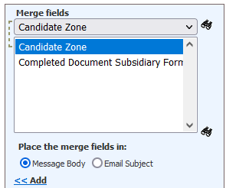
Communication Template:
Create a communication template that can be sent to candidates with the below details:
Pre-defined username – as per client setting
Pre-defined password – as per client setting
Candidate Zone URL merge token.
Suggested not to mention the configured “username” or “password” directly in the template.
Let candidates enter the data during login.
Once successfully logged in, system will ask them to re-set/create a new password for themselves.

Slide 7
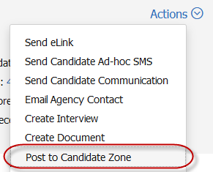

BrassRing Process
In order to access the TG, a document/form has to be posted to candidate zone from the candidate’s Talent Record.
Users can post a form/document via “Actions-Post to Candidate Zone”
Once posted, on the same page or at a later time, the configured communication templates can to be sent to the candidate.
Candidate receives the e-mail and logs into the TG.

Slide 8
Things to know
A member Talent Gateway of a Global TG or a Full TG can be configured as a “Default site for Candidate Portal access” for each locale separately.
A document or form must be posted onto the TG, before the candidate can login using pre-defined login credentials.
Once posted, the system automatically creates a TG profile for the candidate.
It is a recommended best practice to include instructions in the candidate’s email directing them to select either the documents or forms tab, depending on your process.
Once logged in, system will prompt the candidate reset/create a new password for security purpose.
Multiple options are available to choose as pre-defined username and/or password.

Slide 9
Resources
Post to Candidate Zone Overview:
https://documentation.infinite.com/docs/post-to-the-candidate-zone-overview
Candidate Zone:
https://documentation.infinite.com/docs/the-candidate-zone
Candidate Experience with Talent Gateway
https://documentation.infinite.com/docs/candidate-experience-with-talent-gateway
Client Settings:
https://documentation.infinite.com/docs/client-settings-a-to-c

Slide 10
Questions?

