Slide 1
New User Interface (UI)
BrassRing ATS
—
Client Training and Enablement Session
Watson Talent
July 16th ,2019

Slide 2
Agenda
Overview and Benefits
Demo (Homepage, Candidate Searches, Req Folder, Talent Record, Visualization)
FAQ
Timeline / Coming Soon
Resources

Slide 3

Overview and Benefits
What is the New UI?
Released in February 2015
Responsive design means that the new experience can be used on any device including smart phones, tablets, and laptops/desktops.
This UI is available via:
    ‘Rocket Ship’ icon in stand-alone BrassRing
    ‘Enhanced Experience’ option in Talent Suite.
May 2019 – Default settings for all user types was updated to the new UI in Staging.

Slide 4
Overview and Benefits
Why use the New UI?
Smoother recruiter experience while being away from the office/work space.
Offers a clean and fast approach to BrassRing functions.
New features and functionality improvements will be done only in the New UI.
Ability to brand the pages and set defaults per persona.

Slide 5
Demo
–
BrassRing New UI

Slide 6
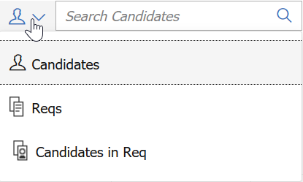
Candidate Search: Quick Search
Quick Search functionality allows the end user a streamlined search for candidates (if access permits), requisitions, or an option of candidates within a req.
Ability to search for candidate against a requisition and be able to take immediate requisition related actions
The search bar’s default search option is candidate search.
With the quick search feature in the New UI, users can access all advanced features. While using the New UI search, users can save their search criteria for future usage. Saved searches can be easily accessed at a later point of time.

Slide 7
Candidate Search
The New UI offers all new search functionality with a host of features. Users can perform searches on candidates and requisitions and further, sort them based on their choice of headers. Users can compare candidates directly from search results to find the best match for the requisitions.
Can be configured to ensure OFCCP Compliance. Search information can be logged based on configuration.
Responsive and accessible
Facetted filter options
Type-ahead text functionality
Updated search engine
Search bar allows for AND and OR Boolean string searches
Overnight Search and Talent Match are not currently available in the New UI.

Slide 8
Candidate Search: OFCCP
If your company requires OFCCP requisition selection or search reasons, the system will manage this two ways:
    When using the search bar, if the user enters anything other than candidate name or candidate reference number to search upon, once they press enter on the search, the OFCCP screen will come up before they have access to the search results.
    If electing to start from the Menu – Candidate Search, the filters will be locked. The user will be required to enter their OFCCP information prior to having access to the search criteria.

Slide 9
Candidate Search: Boolean
AND – Narrows the results
  The candidate’s resume/CV must contain both words to be part of the search results.
  Example: UNIX AND Java
OR – Broadens search by returning candidate’s resume/CV that have either word specified.
  Example: UNIX OR Java
NOT – Allows to exclude candidate’s resume/CV with certain words.
  Example: UNIX NOT Java
“” - Use parentheses to group keywords and phrases together with Boolean terms.
  Example: “Software Engineer” and “Financial Analyst”

Slide 10
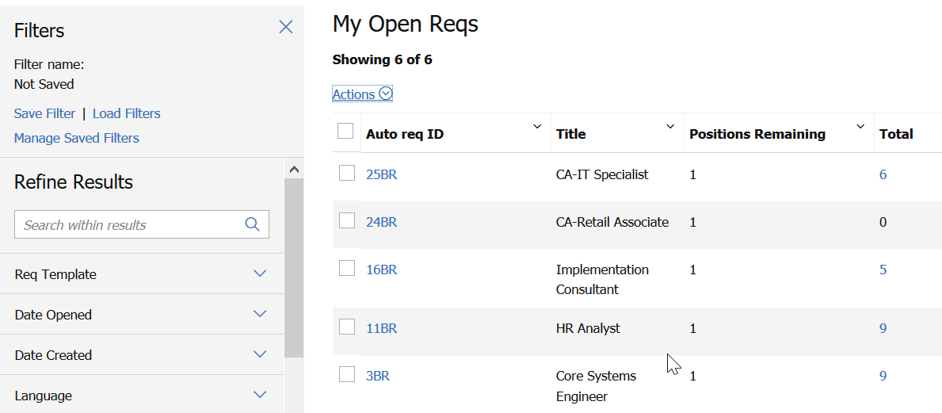
Working with Reqs
Requisition forms carry over the New UI look and feel and actions are based on user type permissions.
Filtering set results is available, with the ability to save your filters for future use. Filters persist from the last use.

Slide 11
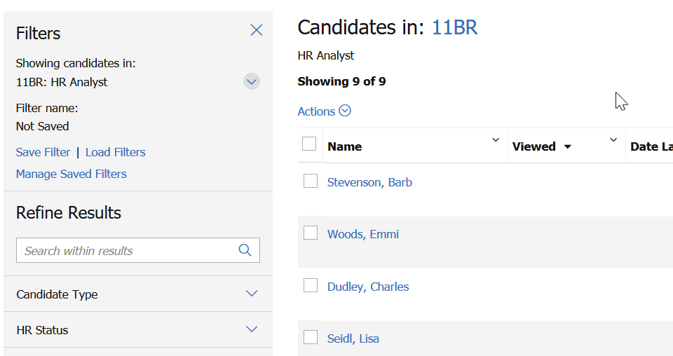
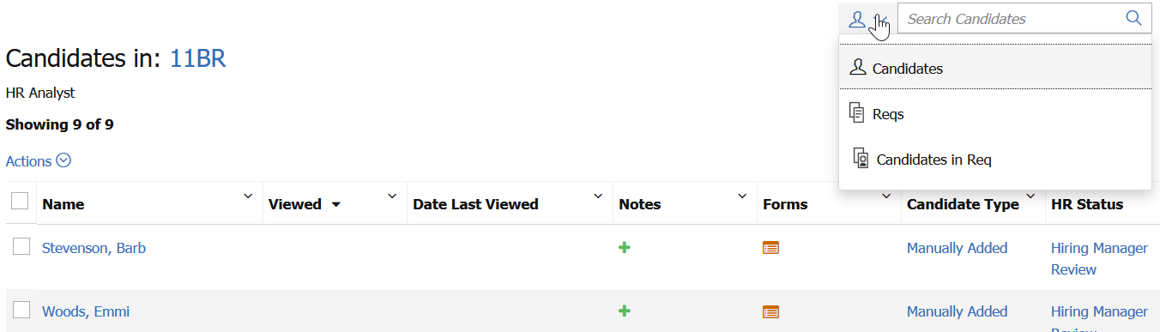
Working with Reqs: Req Folder
The Candidate Results grid includes advanced filtering capabilities as well as the ability to save filters for future use. The filters persist to the next use.
The improved quick search allows to search for candidates directly within the Req folder.

Slide 12
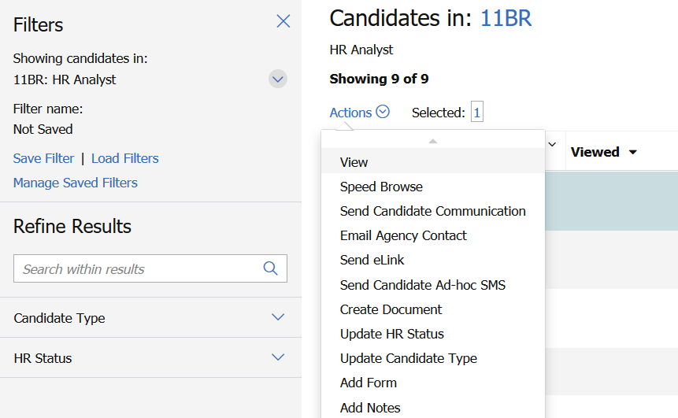
Working with Reqs: Req Folder
All appropriate actions are available in the actions drop down.

Slide 13
Talent Record
The talent record is streamlined and viewable on any device.
When on a mobile device, the click to call and email is available directly from the talent record.
All other appropriate actions based on user permissions are available.

Slide 14
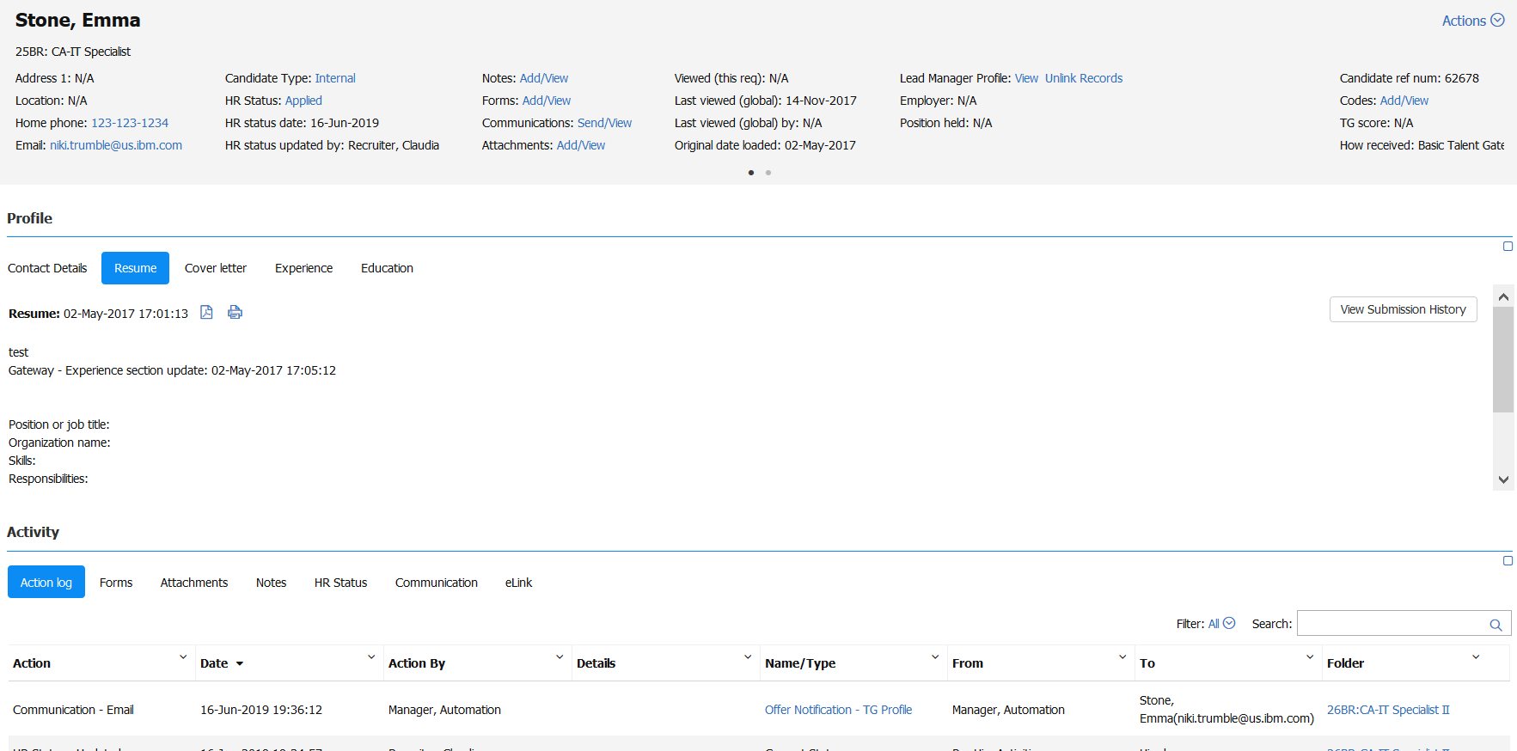
Talent Record
The Talent Record is enhanced from being the display of the category based action log to display of full Action Log.
Users can search the Action Log, which can also be used to filter the log by requisition number.

Slide 15

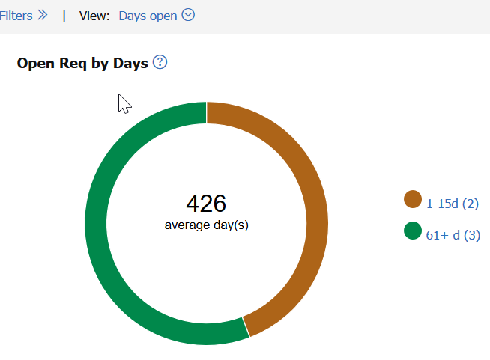
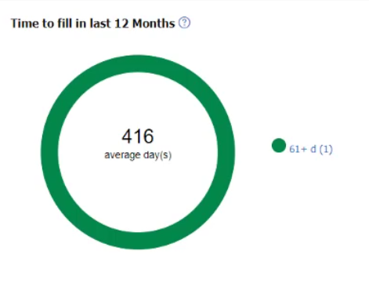
Visualizations
Req Visualization
Open Reqs by Days
Time to fill in the last 12 months

Slide 16
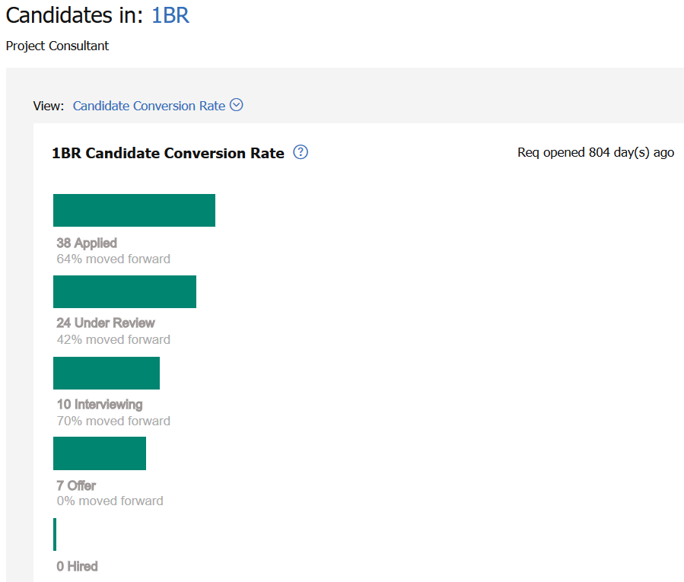
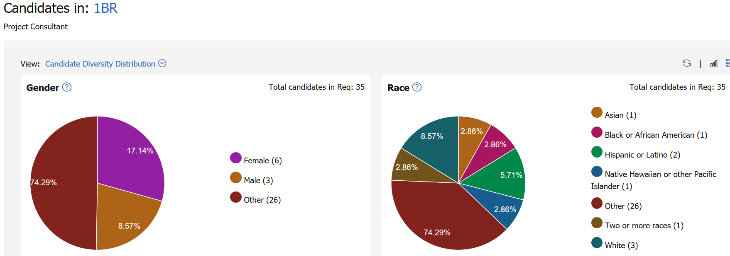
Visualizations
Candidate Visualization (Based on HR Status Categories)
Candidate Conversion Rate Distribution
Candidate Diversity Distribution

Slide 17
FAQs
Will the classic UI be retired?
  Yes, after February 2020, the class UI will not longer be available.
Is there a limit of requisition pending to approve that appear in the My tasks tab?
  No, there is no limit of the number of reqs you will see in the My Tasks tab. Only reqs and candidate forms pending your approval will show, not all of your ‘my’ reqs/candidate forms pending approval will show.
Can you export your ‘My Open Reqs’ to excel?
  Yes. this can be done from the grid view under the Actions menu.
Does the My Tasks tab include reqs/forms that use Custom Workflow Approval (Smart Approval)?
  Yes.
Can you create new/custom tabs that can be selected in the edit tabs option?
  No, you cannot create any additional tabs.
Notes:
Disposition Email Trigger
Auto Disposition Triggers
Evergreen Push - A common evergreen push example is where the client would like to push candidates to open hiring reqs (store and position specific) as they apply to evergreen reqs. This has the effect of the candidate applying to one or more broader evergreen reqs, and then immediately getting copied or moved into matching hiring reqs that are open at the time the candidate applies. Candidates are usually matched based on location preferences and position type preferences. Identification of the reqs to copy or move the candidate to is evaluated by two layers of conditions. (1) Matching values input by the candidate (on candidate form fields) to req field values of any open hiring reqs. (2) Matching values on evergreen req fields to field values on any open hiring reqs
Evergreen Pull - A common evergreen pull example is where the client would like to open a hiring req (store and position specific) when a hire is needed. To get qualified candidates more quickly into the hiring req, it pulls candidates that are sitting in existing evergreen reqs. Candidates are usually matched based on location preferences and position type preferences. Those candidates that meet the criteria are pulled into the hiring req, and would be considered hirable for the newly opened job. Identification of the candidates is done by three layers of conditions.
Eligibility Check- Another common example among retail and high-volume clients is where the client would like to conduct a series of eligibility checks before the candidate is added to the req. If they fail one of these checks, they are automatically dispositioned, resulting in an applicant pool, which consists of candidates who are all eligible. All eligibility checks that are not req specific, should be completed on the evergreen req and non-eligible candidates should be dispositioned.

Slide 18
FAQs
Can a Recruiter can still search all open reqs (or candidates)?
  Yes, if the Recruiters have the user permissions that allow you to access all open reqs or candidates, they will still be able to search in the New UI.
As a system administrator, am I not able to view all reqs that are created in the system? Only reqs that I'm associated with?
  The homepage is specifically designed for recruiters and managers to see the reqs they are associated to. Administrators can access all reqs (ones they’re not associated to) from Hiring > Reqs > View Open.
Is the option for "update same status“ available in the New UI?
  You can absolutely update same status in the New UI. To do this, select the boxes next to the candidate names and either select the HR Status link (and it will update) or you can go to the Actions menu. All candidates need to be in the same status in order to update to the next.
Notes:
Disposition Email Trigger
Auto Disposition Triggers
Evergreen Push - A common evergreen push example is where the client would like to push candidates to open hiring reqs (store and position specific) as they apply to evergreen reqs. This has the effect of the candidate applying to one or more broader evergreen reqs, and then immediately getting copied or moved into matching hiring reqs that are open at the time the candidate applies. Candidates are usually matched based on location preferences and position type preferences. Identification of the reqs to copy or move the candidate to is evaluated by two layers of conditions. (1) Matching values input by the candidate (on candidate form fields) to req field values of any open hiring reqs. (2) Matching values on evergreen req fields to field values on any open hiring reqs
Evergreen Pull - A common evergreen pull example is where the client would like to open a hiring req (store and position specific) when a hire is needed. To get qualified candidates more quickly into the hiring req, it pulls candidates that are sitting in existing evergreen reqs. Candidates are usually matched based on location preferences and position type preferences. Those candidates that meet the criteria are pulled into the hiring req, and would be considered hirable for the newly opened job. Identification of the candidates is done by three layers of conditions.
Eligibility Check- Another common example among retail and high-volume clients is where the client would like to conduct a series of eligibility checks before the candidate is added to the req. If they fail one of these checks, they are automatically dispositioned, resulting in an applicant pool, which consists of candidates who are all eligible. All eligibility checks that are not req specific, should be completed on the evergreen req and non-eligible candidates should be dispositioned.

Slide 19
FAQs
Can you add filters to a req folder?
  Yes, the filter functionality is available within the req folders.
How do you filter the action log by the current req?
  The talent record has a search box within the Activity log that can be used for this purpose.
Is there a guide for the New UI?
  There are eLearning modules and user guides on the Knowledge Center.
Can all users see the Candidate Conversion visualization?
  Yes - the HR Status conversion visualization is available to all users. If you are accessing reqs from the homepage, select a req and go into the req filter where you will see the candidate list - the visualization icon is available on the top right above the grid.
Where can you find the Candidate Conversion visualization?
  From the candidate results grid select the Visualize icon. This will show the candidate conversion visualization if your organization has mapped the HR Status Categories.
Notes:
Disposition Email Trigger
Auto Disposition Triggers
Evergreen Push - A common evergreen push example is where the client would like to push candidates to open hiring reqs (store and position specific) as they apply to evergreen reqs. This has the effect of the candidate applying to one or more broader evergreen reqs, and then immediately getting copied or moved into matching hiring reqs that are open at the time the candidate applies. Candidates are usually matched based on location preferences and position type preferences. Identification of the reqs to copy or move the candidate to is evaluated by two layers of conditions. (1) Matching values input by the candidate (on candidate form fields) to req field values of any open hiring reqs. (2) Matching values on evergreen req fields to field values on any open hiring reqs
Evergreen Pull - A common evergreen pull example is where the client would like to open a hiring req (store and position specific) when a hire is needed. To get qualified candidates more quickly into the hiring req, it pulls candidates that are sitting in existing evergreen reqs. Candidates are usually matched based on location preferences and position type preferences. Those candidates that meet the criteria are pulled into the hiring req, and would be considered hirable for the newly opened job. Identification of the candidates is done by three layers of conditions.
Eligibility Check- Another common example among retail and high-volume clients is where the client would like to conduct a series of eligibility checks before the candidate is added to the req. If they fail one of these checks, they are automatically dispositioned, resulting in an applicant pool, which consists of candidates who are all eligible. All eligibility checks that are not req specific, should be completed on the evergreen req and non-eligible candidates should be dispositioned.

Slide 20
FAQs
Can more options be added to the Folder list in Quick Links?
  Yes, users can add extra folders to the Quick Links section to allow for personal organization.
Are Quick Links set-up for individual use only or can they be set up for everyone to use?
  Workbench Admins can configure default Quick Links per persona and, if permissions allow, users can add or edit their own Quick Links that persist from login to login.
Will the "results shown by page" (5-10-25) section will have an "ALL" option soon?
  This is currently not planned.
What are the different search options available in the Quick Search field?
  In Name searches just the candidate name fields on the Talent Record.
  In Resume searches the candidate contact fields and the candidate’s resume for the search terms that are entered.
  Boolean operators of AND and OR can be used but they must be capitalized. Parentheses can also be used in the quick search.
Notes:
Disposition Email Trigger
Auto Disposition Triggers
Evergreen Push - A common evergreen push example is where the client would like to push candidates to open hiring reqs (store and position specific) as they apply to evergreen reqs. This has the effect of the candidate applying to one or more broader evergreen reqs, and then immediately getting copied or moved into matching hiring reqs that are open at the time the candidate applies. Candidates are usually matched based on location preferences and position type preferences. Identification of the reqs to copy or move the candidate to is evaluated by two layers of conditions. (1) Matching values input by the candidate (on candidate form fields) to req field values of any open hiring reqs. (2) Matching values on evergreen req fields to field values on any open hiring reqs
Evergreen Pull - A common evergreen pull example is where the client would like to open a hiring req (store and position specific) when a hire is needed. To get qualified candidates more quickly into the hiring req, it pulls candidates that are sitting in existing evergreen reqs. Candidates are usually matched based on location preferences and position type preferences. Those candidates that meet the criteria are pulled into the hiring req, and would be considered hirable for the newly opened job. Identification of the candidates is done by three layers of conditions.
Eligibility Check- Another common example among retail and high-volume clients is where the client would like to conduct a series of eligibility checks before the candidate is added to the req. If they fail one of these checks, they are automatically dispositioned, resulting in an applicant pool, which consists of candidates who are all eligible. All eligibility checks that are not req specific, should be completed on the evergreen req and non-eligible candidates should be dispositioned.

Slide 21
Timeline
May 2019 – Default settings for all user types was updated to the new UI in Staging.
August 2019 – Default settings for all user types will be updated to the new UI in Production.
Through February 2020, users are able to switch back and forth from classic UI to new UI.
After February 2020 BrassRing Release, classic UI is no longer available.
Notes:
Disposition Email Trigger
Auto Disposition Triggers
Evergreen Push - A common evergreen push example is where the client would like to push candidates to open hiring reqs (store and position specific) as they apply to evergreen reqs. This has the effect of the candidate applying to one or more broader evergreen reqs, and then immediately getting copied or moved into matching hiring reqs that are open at the time the candidate applies. Candidates are usually matched based on location preferences and position type preferences. Identification of the reqs to copy or move the candidate to is evaluated by two layers of conditions. (1) Matching values input by the candidate (on candidate form fields) to req field values of any open hiring reqs. (2) Matching values on evergreen req fields to field values on any open hiring reqs
Evergreen Pull - A common evergreen pull example is where the client would like to open a hiring req (store and position specific) when a hire is needed. To get qualified candidates more quickly into the hiring req, it pulls candidates that are sitting in existing evergreen reqs. Candidates are usually matched based on location preferences and position type preferences. Those candidates that meet the criteria are pulled into the hiring req, and would be considered hirable for the newly opened job. Identification of the candidates is done by three layers of conditions.
Eligibility Check- Another common example among retail and high-volume clients is where the client would like to conduct a series of eligibility checks before the candidate is added to the req. If they fail one of these checks, they are automatically dispositioned, resulting in an applicant pool, which consists of candidates who are all eligible. All eligibility checks that are not req specific, should be completed on the evergreen req and non-eligible candidates should be dispositioned.

Slide 22
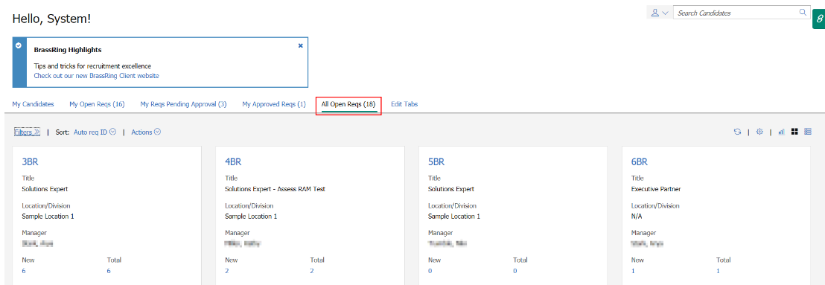
Timeline
New Functionality available Release 19.07.15 in Staging Only: All Open Reqs Tab
Notes:
Disposition Email Trigger
Auto Disposition Triggers
Evergreen Push - A common evergreen push example is where the client would like to push candidates to open hiring reqs (store and position specific) as they apply to evergreen reqs. This has the effect of the candidate applying to one or more broader evergreen reqs, and then immediately getting copied or moved into matching hiring reqs that are open at the time the candidate applies. Candidates are usually matched based on location preferences and position type preferences. Identification of the reqs to copy or move the candidate to is evaluated by two layers of conditions. (1) Matching values input by the candidate (on candidate form fields) to req field values of any open hiring reqs. (2) Matching values on evergreen req fields to field values on any open hiring reqs
Evergreen Pull - A common evergreen pull example is where the client would like to open a hiring req (store and position specific) when a hire is needed. To get qualified candidates more quickly into the hiring req, it pulls candidates that are sitting in existing evergreen reqs. Candidates are usually matched based on location preferences and position type preferences. Those candidates that meet the criteria are pulled into the hiring req, and would be considered hirable for the newly opened job. Identification of the candidates is done by three layers of conditions.
Eligibility Check- Another common example among retail and high-volume clients is where the client would like to conduct a series of eligibility checks before the candidate is added to the req. If they fail one of these checks, they are automatically dispositioned, resulting in an applicant pool, which consists of candidates who are all eligible. All eligibility checks that are not req specific, should be completed on the evergreen req and non-eligible candidates should be dispositioned.

Slide 23
Coming Soon
Client Training & Enablement Session on Tuesday, July 30th, 2019 @ 11 am ET:
  BrassRing New UI Admin Configuration
  Please register for the session
Quick Reference Guides specific to New UI will be posted on the Knowledge Center.
Notes:
Disposition Email Trigger
Auto Disposition Triggers
Evergreen Push - A common evergreen push example is where the client would like to push candidates to open hiring reqs (store and position specific) as they apply to evergreen reqs. This has the effect of the candidate applying to one or more broader evergreen reqs, and then immediately getting copied or moved into matching hiring reqs that are open at the time the candidate applies. Candidates are usually matched based on location preferences and position type preferences. Identification of the reqs to copy or move the candidate to is evaluated by two layers of conditions. (1) Matching values input by the candidate (on candidate form fields) to req field values of any open hiring reqs. (2) Matching values on evergreen req fields to field values on any open hiring reqs
Evergreen Pull - A common evergreen pull example is where the client would like to open a hiring req (store and position specific) when a hire is needed. To get qualified candidates more quickly into the hiring req, it pulls candidates that are sitting in existing evergreen reqs. Candidates are usually matched based on location preferences and position type preferences. Those candidates that meet the criteria are pulled into the hiring req, and would be considered hirable for the newly opened job. Identification of the candidates is done by three layers of conditions.
Eligibility Check- Another common example among retail and high-volume clients is where the client would like to conduct a series of eligibility checks before the candidate is added to the req. If they fail one of these checks, they are automatically dispositioned, resulting in an applicant pool, which consists of candidates who are all eligible. All eligibility checks that are not req specific, should be completed on the evergreen req and non-eligible candidates should be dispositioned.

Slide 24
Resources
Client Training & Enablement Sessions
  Recordings, presentations, and Q&A doc from past BrassRing New UI sessions
    June 18th, 2019 – BrassRing New UI – Client Panel
    June 19th, 2019 – BrassRing New UI
    July 16th, 2019 @ 11 am ET
    Coming up July 30th, 2019 @ 11 am ET – BrassRing New UI Admin Configuration

Slide 25
Resources
Self Service BrassRing New User Fundamentals (NUF) Training
  Self-paced BrassRing NUF training at no cost to the client
  User can achieve digital badge when successfully completing the course

Slide 26
Questions?

