Slide 1
New User Interface (UI) Admin Configuration
BrassRing
—
Client Training and Enablement Session
July 30th ,2019

Slide 2
Agenda
User Type and Persona Management
HR Statuses and HR Status Categories
Branding Configuration
Working with Reqs: Req Folder
Talent Record
Timeline
Resources
Q&A

Slide 3
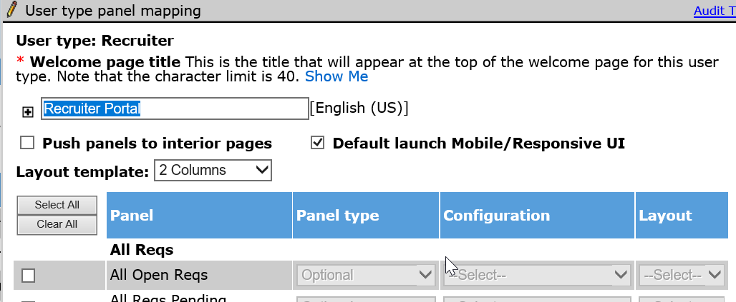
User Type and Persona Management
Default Settings
Since May 2019, the default settings for all user types was updated to the new UI in Staging.
We are anticipating that on August 19th, the default settings for all user types will be updated to the new UI in Production.
To set the default settings now in Workbench:
    Tools > Users > User Types > Select User Type to set up.
    Actions > User Type panel mapping
    Select Default launch Mobile/Responsive UI

Slide 4
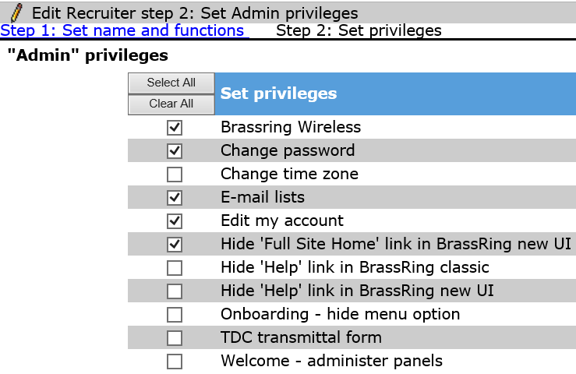
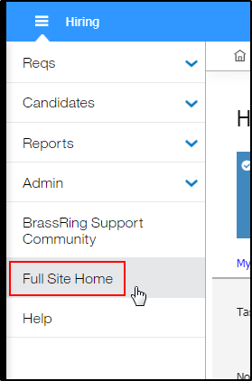
User Type and Persona Management
Permanently Hide Classic UI Toggle
To permanently enable the New UI where the user can no longer toggle between Classic UI and New UI, enable the following User Type privileges:
  Tools > Users > User Types > Select User Type > Edit Type Permission
  Select Function: Admin > Set Privilege “Hide ‘Full Site Home’ link in BrassRing new UI”
These actions hide this toggle in the BrassRing New UI.

Slide 5
User Type and Persona Management
The BrassRing user home page is mobile responsive and improves how you work in BrassRing. Its user experience is based on persona designation. There are five different personas:
    Recruiter
    HR User
    Hiring Manager
Additional personas cannot be created/added.
The BrassRing user homepage is designed to display cards, grids, visualization, and welcome messages specific to the five personas.
Each persona provides the user with the view of the data that works best for them, but the users can also personalize their view.
Only Workbench Administrators can configure Persona Groups by setting defaults that are configured (to regulate what new users can see):
    Reporting/Analytics
    Administrator
Grid and Card Fields | Welcome Message
Quick Links (incl. folder name) | Default Tabs and Order (first tab is set as default tab)

Slide 6
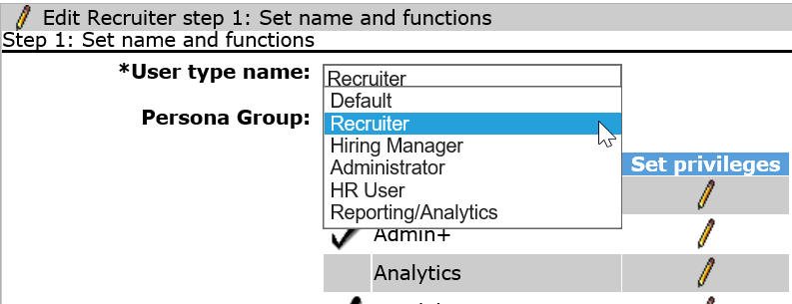
User Type and Persona Management
To assign a Persona to a User Type:
    Tools > Users > User Types > Select Edit Type Permission for User Type
    Select the appropriate Persona Group to assign to the User Type.

Slide 7

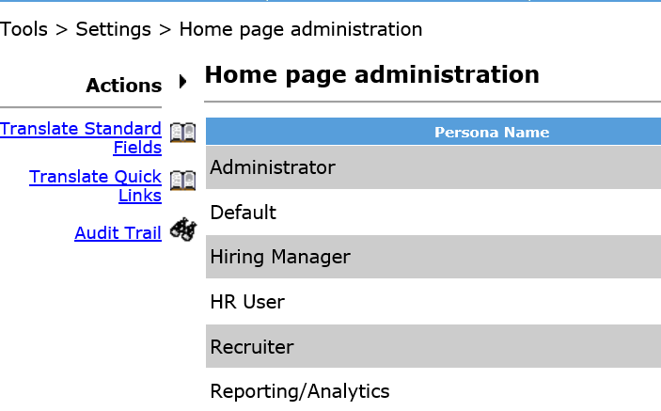

User Type and Persona Management
To configure Persona Groups by setting defaults:
Tools > Settings > Home page administration
Configure client-specific welcome message and choose to display, or not display, the IBM defined welcome message.
Configure defaults for Grid fields, Card fields, Quick Links, and Tab order.
Note: Persona defaults only affect NEW users going forward, except the Quick Links. If you add/edit the Quick Links it will affect ALL users.

Slide 8
Demo
–
User Type and Persona Management

Slide 9
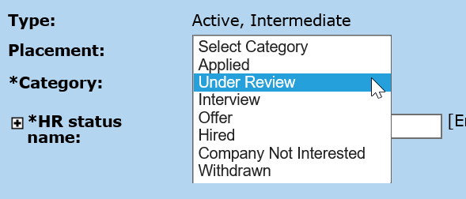
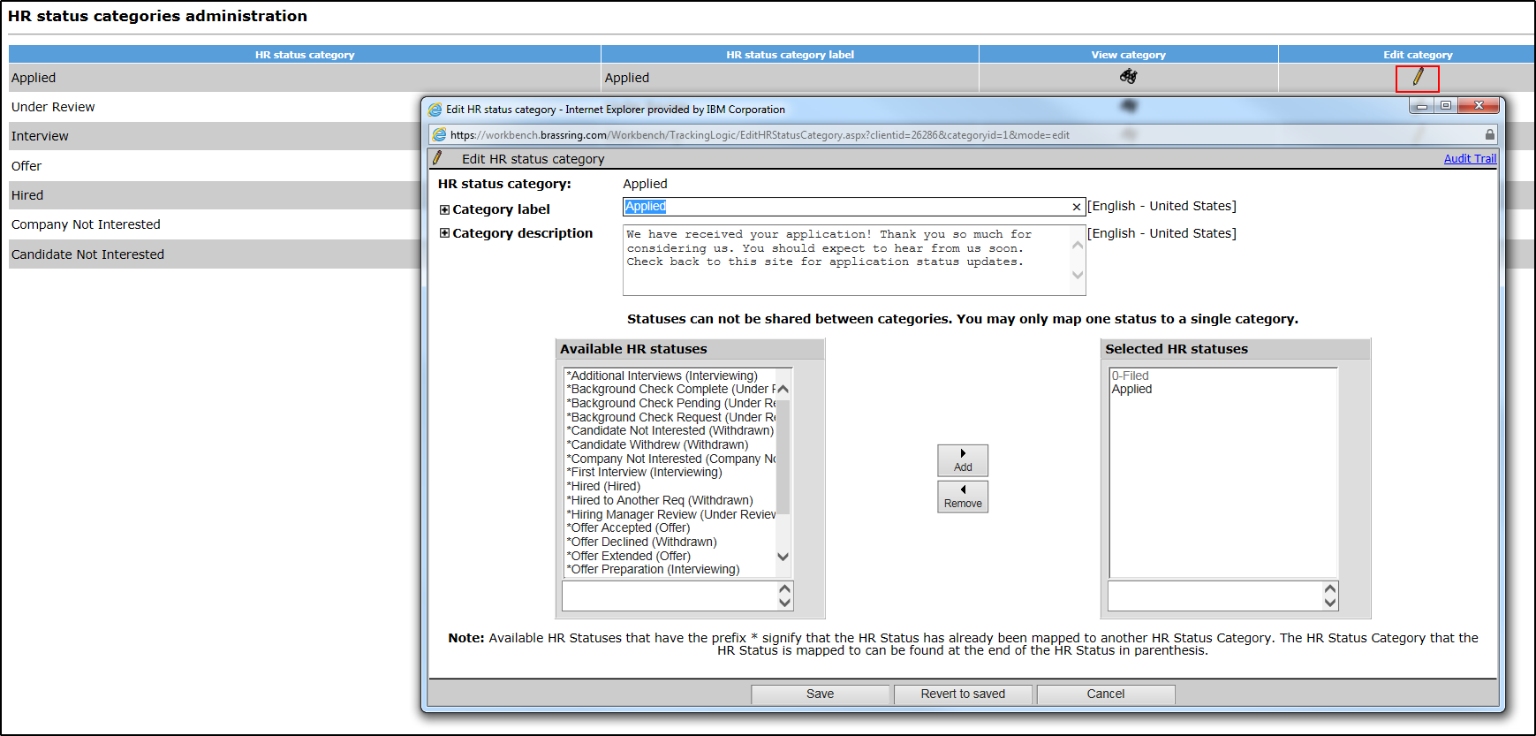
HR Statuses and HR Status Categories
Visualizations will only display if your HR Statuses are mapped to the appropriate HR Status Categories.
To map HR Statuses one at a time:
  Tools > HR Statuses > Edit status for specific HR Status
  Select Category to assign to HR Status
To map multiple HR Statuses at a time:
  Tools > HR Statuses > Actions > HR Status Categories
  Select to Edit a specific HR Status Category
  From the Available HR Statuses select the HR Statuses you want to associate to the category > Add > Save.
*Note: No additional HR Status Categories can be added.

Slide 10
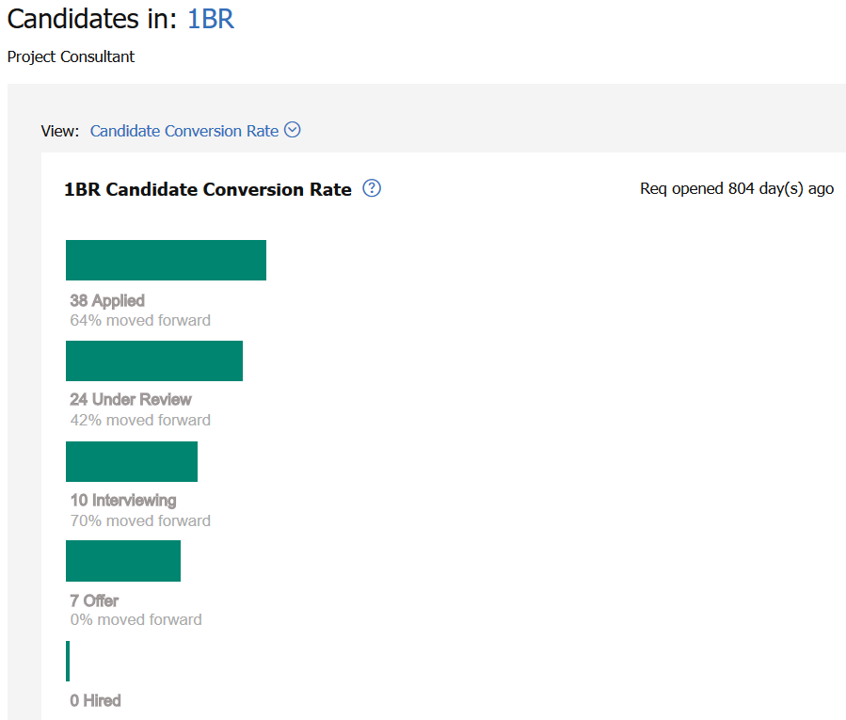
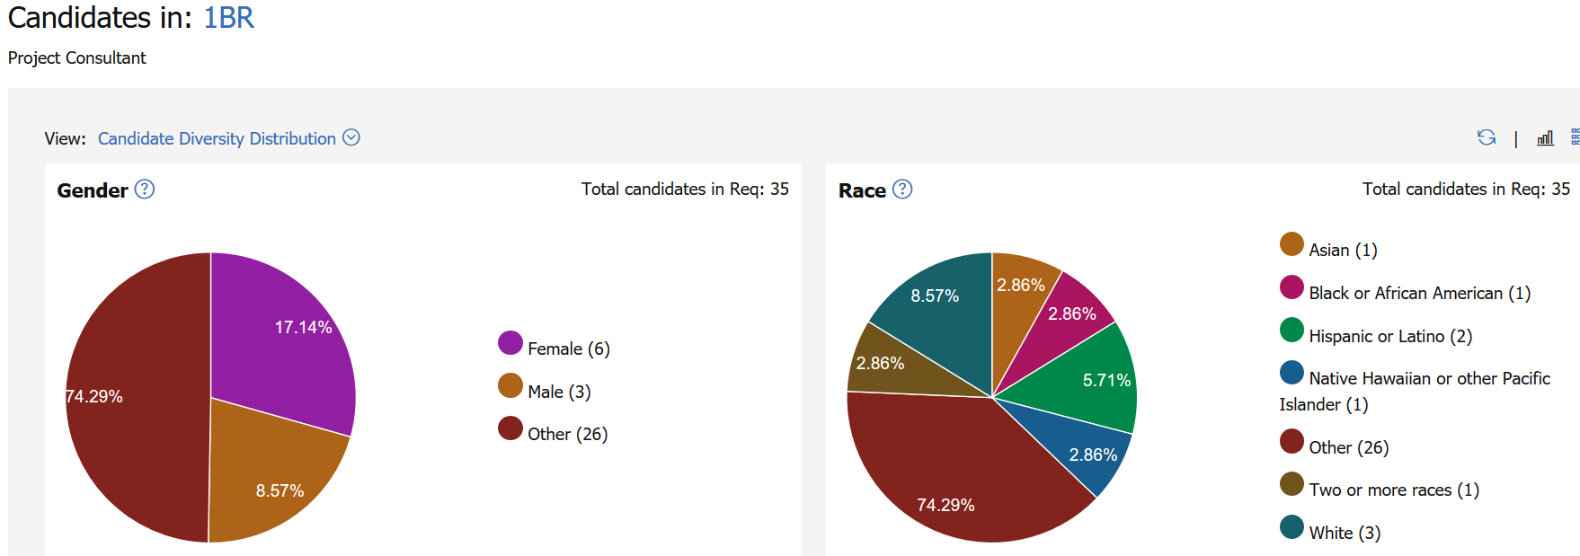
Visualizations
Candidate Visualization (Based on HR Status Categories) – All HR Statuses must be mapped to an HR Status Category to see these visualizations.
Candidate Conversion Rate Distribution
Candidate Diversity Distribution
Steps to configure the Diversity Distribution can be found on HERE on the Knowledge Center.
The Diversity Distribution visualization is per req. If you would like to see these statistics across your organization, please use the Metrics Dashboard.

Slide 11
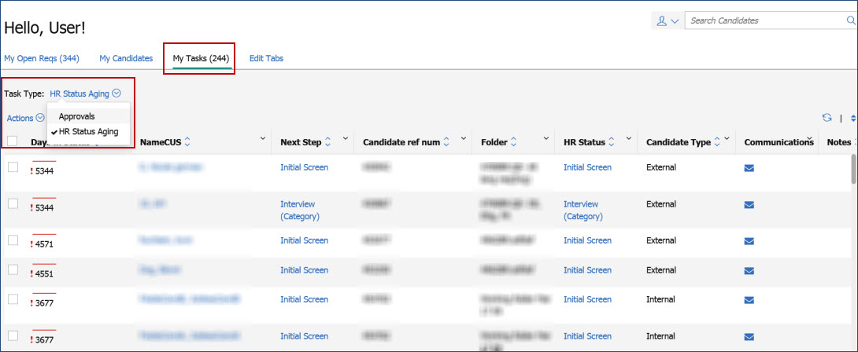
HR Statuses
My Tasks
The My Tasks tab on the Homepage, now provides users a view into their HR Status Aging if the HR Status Aging is configured and the My Tasks panel is enabled.

Slide 12
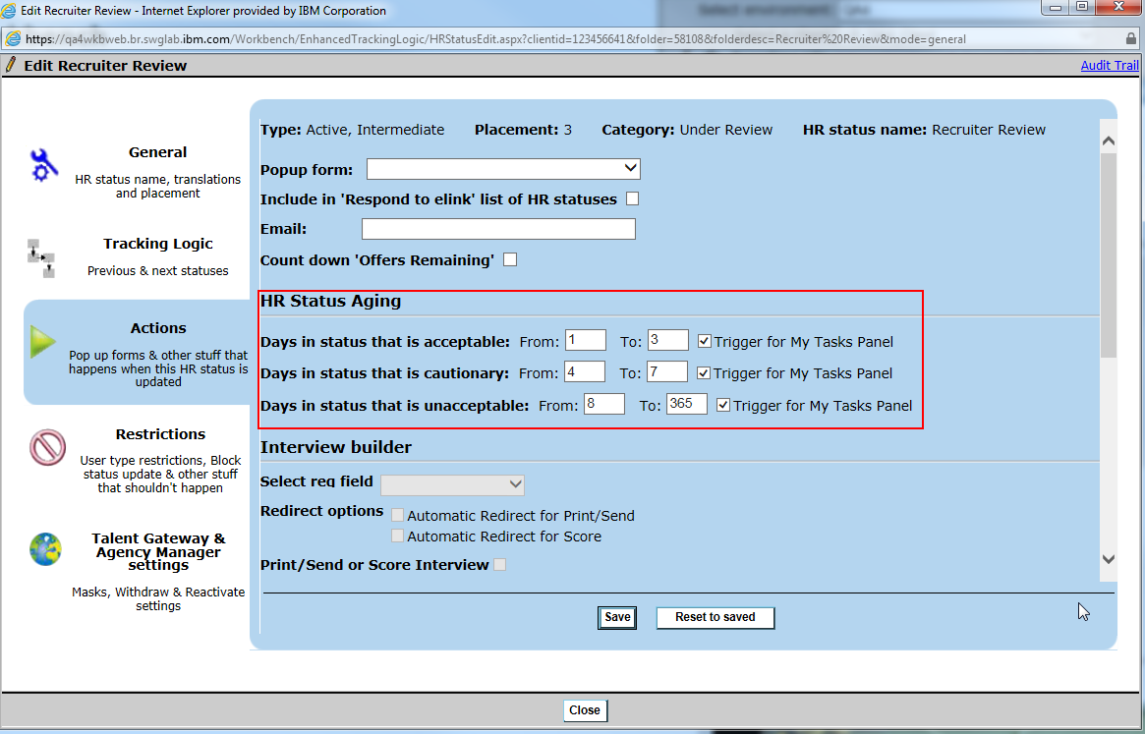
HR Statuses
My Tasks
(1) To configure the HR Status Aging per HR Status:
Tools > HR Statuses > Edit Status > Actions > HR Status Aging

Slide 13
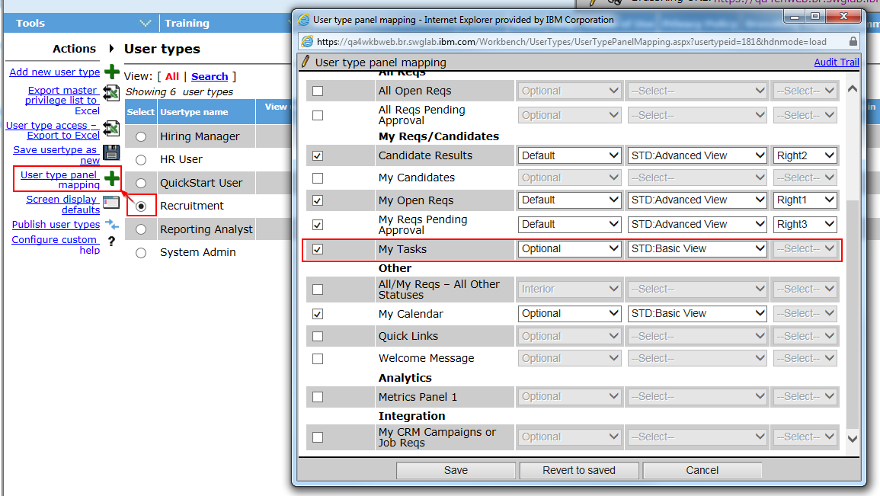
HR Statuses
My Tasks
(2) To enable the My Task panel in Panel Configuration:
Tools > Users > User Types > Select User Type > User Type Panel Mapping
Enable My Task tab > Select Basic View under the Configuration dropdown > Save.

Slide 14
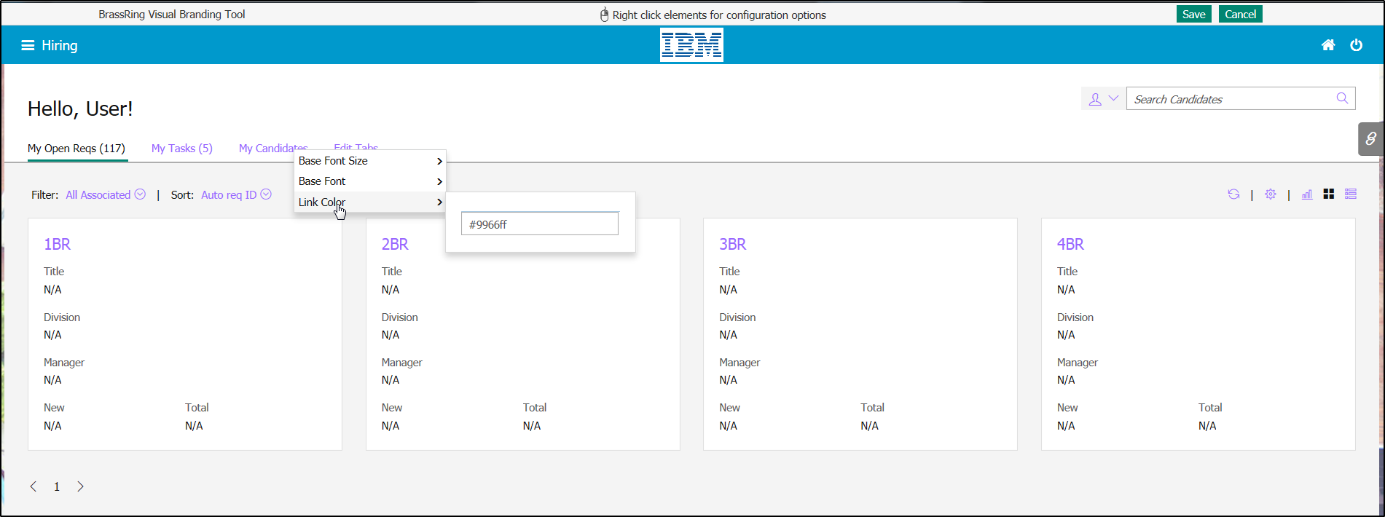
New UI Branding Configuration
Branding can be configured for the BrassRing New UI. If you are a client that uses BrassRing within Talent Suite, some branding will be done in Workbench and some will be done in the Talent Suite Admin section. If you are a client that does not use BrassRing within Talent Suite then you will configure all of your branding in Workbench.
Tools > Settings > BrassRing UI Colors > Select Responsive Recruiter Branding > Select Launch > Right-click on elements of the page to update > Save

Slide 15
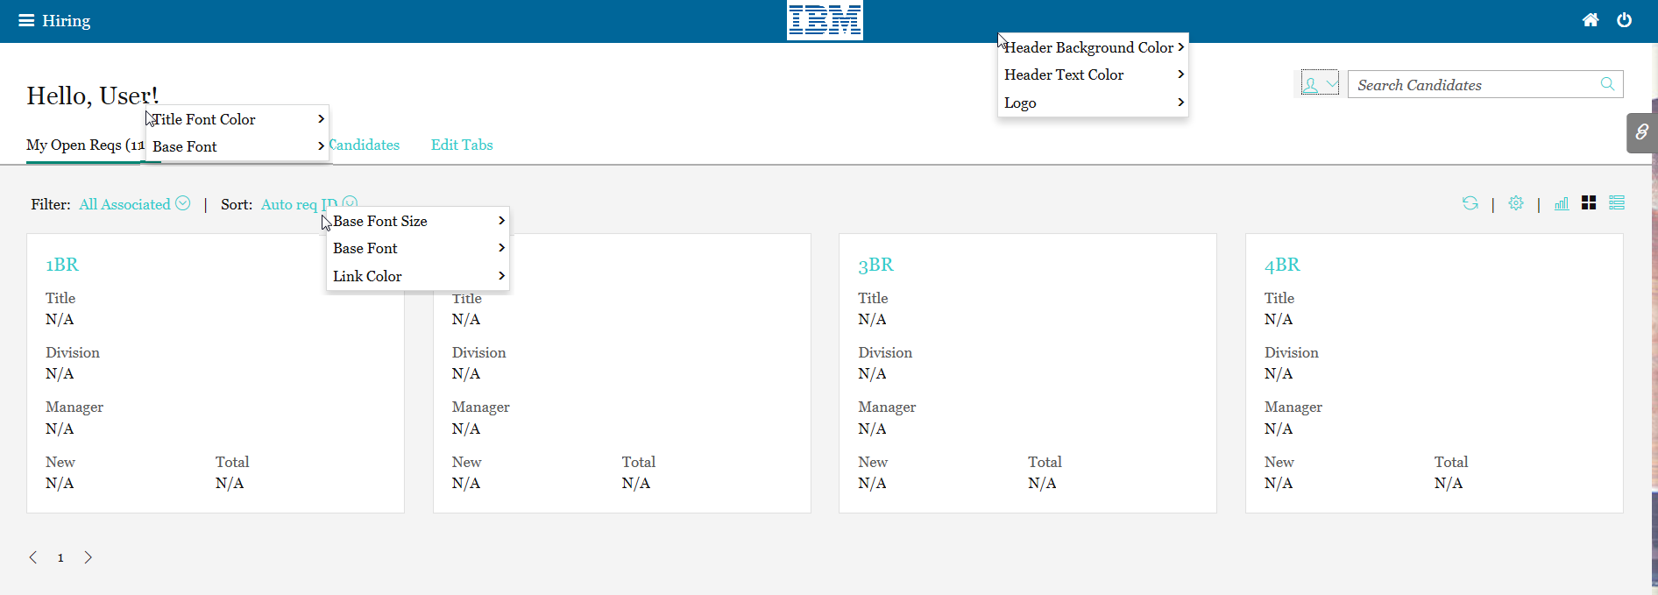
New UI Branding Configuration
Page Element | Talent Suite Clients | Non-Talent Suite Clients
Base Font Size | Workbench | Workbench
Base Font | Workbench | Workbench
Link Color | Workbench | Workbench
Header Background Color | Talent Suite Admin | Workbench
Header Text Color | Talent Suite Admin | Workbench
Logo | Talent Suite Admin | Workbench
Background Image | No longer applicable | No longer applicable
Title Font Color | Workbench | Workbench

Slide 16
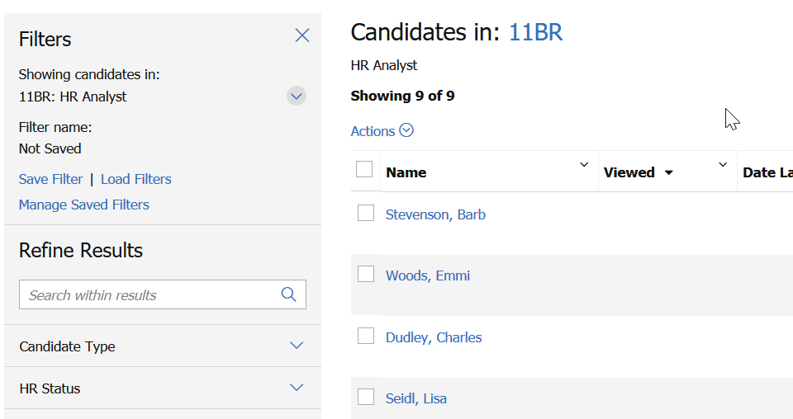
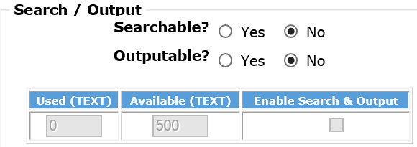
Working with Reqs: Req Folder
The Candidate Results grid includes advanced filtering capabilities as well as the ability to save filters for future use. The filters persist to the next use.
Custom fields need to be enabled as searchable fields in order to be used as a filter.
Tools > Forms > Reqs > Req forms > Define custom req fields
Edit field attribute > Save and continue > Select Yes for Searchable

Slide 17
Talent Record
The talent record is streamlined and viewable on any device.
When on a mobile device, the click to call and email is available directly from the talent record.
All other appropriate actions based on user permissions are available.

Slide 18
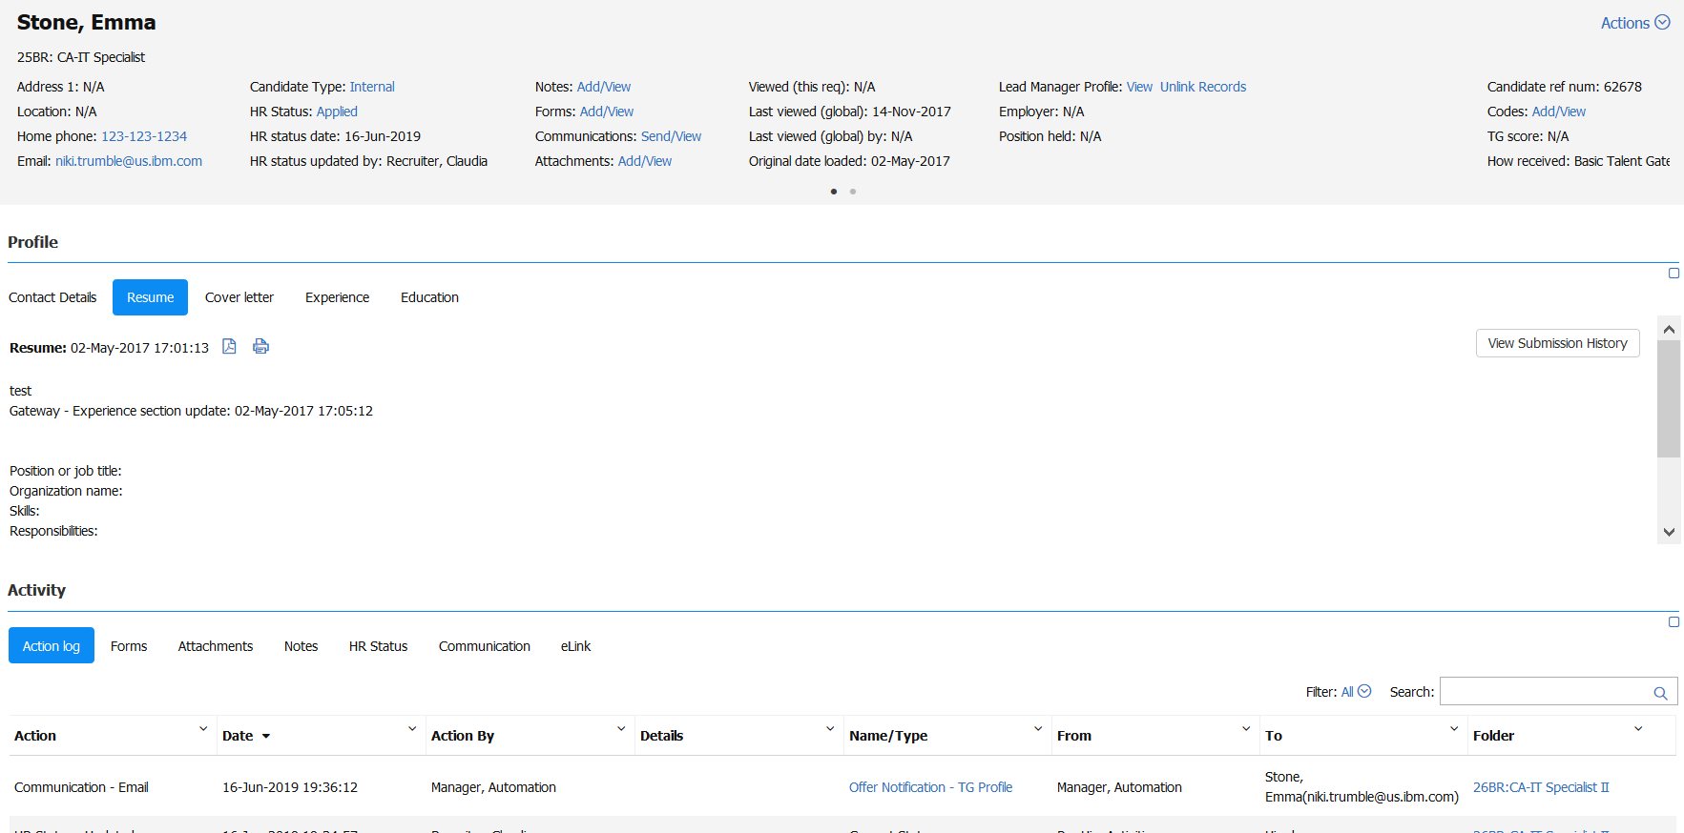
Talent Record
The Talent Record is enhanced with the display of the category based action log and display of full Action Log.
Users can search the Action Log, which can also be used to filter the log by requisition number, my actions, or my reqs.

Slide 19
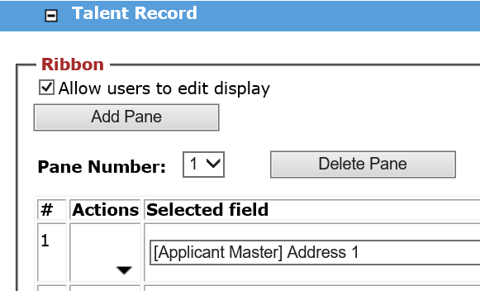
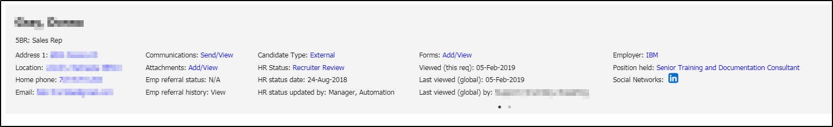
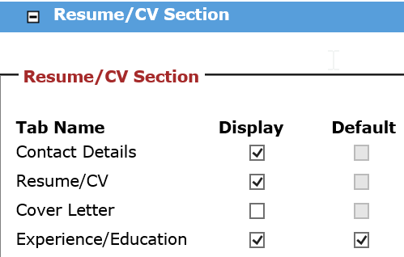
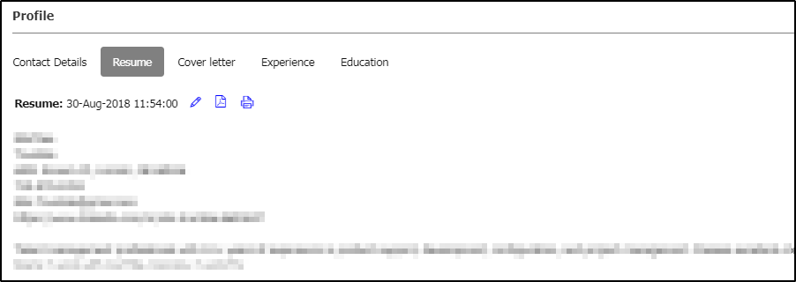
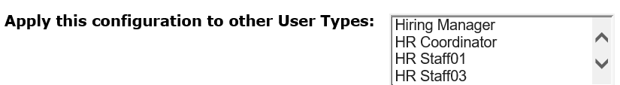
Talent Record
You can customize the following screen display for the Ribbon and Resume/CV section of the Talent Records by user type.
Tools > Users > User types > Select a user type to change the display
Click Screen Display Defaults in the Actions list.
Talent Record section allows you to customize the ribbon by being able to select up to 4 fields to display in a pane and the number of panes to display.
Resume/CV section allows you to customize what tables are displayed and what tab should display as default.
You can also apply the configuration to other user types from the Display Defaults screen.

Slide 20
Demo
–
HR Statuses, HR Status Categories, Branding, Req folder, and Talent Record

Slide 21
Timeline
August 2019 – Default settings for all user types will be updated to the new UI in Production. (Current estimate date is August 19th. Watch for the release communication for confirmation!)
Through February 2020, users can switch back and forth from classic UI to new UI.
After the February 2020 BrassRing Release, classic UI is no longer available.
Notes:
Disposition Email Trigger
Auto Disposition Triggers
Evergreen Push - A common evergreen push example is where the client would like to push candidates to open hiring reqs (store and position specific) as they apply to evergreen reqs. This has the effect of the candidate applying to one or more broader evergreen reqs, and then immediately getting copied or moved into matching hiring reqs that are open at the time the candidate applies. Candidates are usually matched based on location preferences and position type preferences. Identification of the reqs to copy or move the candidate to is evaluated by two layers of conditions. (1) Matching values input by the candidate (on candidate form fields) to req field values of any open hiring reqs. (2) Matching values on evergreen req fields to field values on any open hiring reqs
Evergreen Pull - A common evergreen pull example is where the client would like to open a hiring req (store and position specific) when a hire is needed. To get qualified candidates more quickly into the hiring req, it pulls candidates that are sitting in existing evergreen reqs. Candidates are usually matched based on location preferences and position type preferences. Those candidates that meet the criteria are pulled into the hiring req, and would be considered hirable for the newly opened job. Identification of the candidates is done by three layers of conditions.
Eligibility Check- Another common example among retail and high-volume clients is where the client would like to conduct a series of eligibility checks before the candidate is added to the req. If they fail one of these checks, they are automatically dispositioned, resulting in an applicant pool, which consists of candidates who are all eligible. All eligibility checks that are not req specific, should be completed on the evergreen req and non-eligible candidates should be dispositioned.

Slide 22
Resources
BrassRing Responsive User Interface FAQs
https://documentation.infinite.com/docs/brassring-responsive-user-interface-faq
Persona Group Management
https://documentation.infinite.com/docs/persona-group-management
User Interface Configuration
https://documentation.infinite.com/docs/user-interface-configuration
BrassRing Quick Reference Guide (QRG)
https://documentation.infinite.com/docs/brassring-quick-reference-guide

Slide 23
Resources
Client Training & Enablement Sessions
  Recordings, presentations, and Q&A doc from past BrassRing New UI sessions
    June 18th, 2019 – BrassRing New UI – Client Panel
    June 19th, 2019 – BrassRing New UI
    July 16th, 2019 – BrassRing New UI
    Today, July 30th, 2019 – BrassRing New UI Admin Configuration
  You can access the recordings from:
Knowledge Center (KC) >> BrassRing on Cloud >> Past Events

Slide 24
Resources
Self Service BrassRing New User Fundamentals (NUF) Training
  Self-paced BrassRing NUF training at no cost to the client
  User can achieve digital badge when successfully completing the course
https://documentation.infinite.com/docs/brassring-and-workbench-badge-courses

Slide 25
Questions?

