Slide 1
Mapping Tool
BrassRing on Cloud
—
Client Training and Enablement Session
August 20th, 2019

Slide 2
AUGUST VIRTUAL TRAINING SESSIONS
Client-facing training schedule
Sunday | Monday | Tuesday | Wednesday | Thursday | Friday | Saturday
 |  |  |  | 1 Client: New Assess UI Demo (Phase 3 – 11am EDT) | 2 | 3
4 | 5 | 6 | 7 | 8 Client: New Assess UI Q&A (Phase 3 – 11am EDT) | 9 | 10
11 | 12 Client: How to use Assess (11am EDT) | 13 Client: Onboard Release Enablements (4am EDT & 11am EDT) | 14 | 15 | 16 | 17
18 | 19 | 20 Client: BrassRing Mapping Tool Integrations (11am EDT) | 21 | 22 Client: New Assess UI Q&A (Phase 3 – 11am EDT) Client: BrassRing 19.08.12 Release Enablements (4am EDT & 11am EDT) | 23 | 24
25 | 26 Client: Assess New Features and Updates (11am EDT) | 27 | 28 | 29 | 30 | 31

Slide 3
SEPTEMBER VIRTUAL TRAINING SESSIONS
Client-facing training schedule
Sunday | Monday | Tuesday | Wednesday | Thursday | Friday | Saturday
1 | 2 | 3 | 4 | 5 | 6 | 7
8 | 9 Client: How to use Assess (11am EDT) | 10 Client: BrassRing Knockout and Scoring Questions (11am EDT) | 11 | 12 | 13 | 14
15 | 16 Client: New Assess UI Demo (11am EDT) | 17 Client: BrassRing Admin Functionality (11am EDT) | 18 | 19 Client: BrassRing and Onboard Release (4am EDT & 11am EDT) | 20 | 21
22 | 23 Client: New Assess UI Demo (9am EDT) | 24 | 25 | 26 Client: New Assess UI Q&A (11am EDT) | 27 | 28
29 | 30 Client: Assess New Features and Updates (11am EDT)

Slide 4
New Client Networking Slack Channel!
We’re excited to remind you that we have created a Customer Slack channel just for you! By joining this channel, you'll be able to network and connect with each other, as well as receive reminders for product updates and releases, Training and Enablement Sessions, and more!
We understand that not everyone will be able to join this channel due to security limitations, so rest assured this is not intended to replace any of our existing communication channels, only to supplement them.

Slide 5
Agenda
Types of Integrations
Services Offered vs. Self-Service Options
Demo of Building a Candidate Export Integration
Resources
Q&A

Slide 6
Types of Integrations - Imports
BRASSRING
Foundation Data (Req or Candidate Form)
Req Import
Job Code Default Data (JCDD)
User Import (Non-Talent Suite)
Candidate Import
Req Field Association (RFA)
Candidate Field Association (CFA)
HR Status Updates
Candidate Form Import
An import is when data is sent INTO BrassRing.
The integrations in this image can be built in the BrassRing Mapping Tool.

Slide 7
Types of Integrations
Standard Data Import (Inbound)
Requisition Import – used to create and/edit Requisitions directly from your HRIS
Candidate Form Import - used to add or update data into a pre-existing Candidate Form
Foundation Import - used to keep your BrassRing field options (on Req or Candidate forms) in sync with your ever changing HRIS field options
Candidate Import - used to add or update candidate profile data within BrassRing
JCDD Import – used to associate certain Req fields to a Job Code. Once associated the field data will always appear when creating a Req with that Job Code
RFA Import - used to create and maintain field associations within your Reqs
HR Status Import (Change) - used to update a Candidates HR Status from an outside source.
TG Profile Import - to create profile of internal employees on Internal Talent Gateways... this is to enhance employee experience.
User Import - used to Add, Edit and Inactivate BrassRing User Profile information

Slide 8
Types of Integrations
Standard Data Import (Inbound)
These imports are configured using Mapping Tool – We’ll demo one import.
Imports are real time in nature and pushed through by implementing APIs.
Customer’s IT team implement those APIs based on BrassRing proprietary XML.
API documents available on the Knowledge Center https://documentation.infinite.com/docs/integrations-and-apis-integrations

Slide 9
Types of Integrations - Exports
BRASSRING
Candidate Export (includes req, form, etc data)
RAM Trigger (Using “Send to External System” action in RAM)
Data Warehouse
An export is when data is sent OUT OF BrassRing.
Of the integrations included on this image, only the Candidate Export can be built in the Mapping Tool.
Pull Integrations
(requested by vendor but sent out from BrassRing)
Get Candidate API
Talent Gateway API

Slide 10
Types of Integrations - Miscellaneous
Single Sign-on
Pre-Configured Workday integrations
Premium/custom integrations
Non-XML (flat file) integrations (sent to SFTP/FTP site)
Data Insight Tool > SFTP site
Common Service Integrations (Background Check, Video Interview, WOTC, Assessment, Job Board Aggregator)

Slide 11
Types of Integrations
There are two overall types of integrations that can be mapped using the Mapping Tool:
Standard Candidate Data Export (Outbound from BrassRing)
    Allowing clients to export Candidate, Requisition, Candidate Form, etc. data into an HRIS system.
    There is no need to design something from scratch in BrassRing because the XML format is predefined in the mapping tool (proprietary XML format), you just have to select the fields to send.
    Data export is triggered using an HR Status change.
    Data is sent to client/vendor hosted web-service.
    Real time and success/failure is shown on the BrassRing User Interface instantly.
Standard Data Import (Inbound to BrassRing)
    Allowing clients to import data (req, candidate, form, etc.) from an external system into BrassRing to achieve certain business needs.
    There is no need to design something from scratch in BrassRing because the XML format is predefined in the mapping tool, you just have to select the fields that are being sent.

Slide 12
What is the Mapping Tool?
The BrassRing Mapping Tool offers you the ability to configure flexible, secure XML integration. Below are a few additional highlights:
  Self-service and no special training is required.
  Once an integration is configured in the Mapping Tool, changes can be made by your team at any time. (Unless the integration is premium/custom.)
  Use of versioning tracks changes that are made.
  The Mapping Tool can be used by any team member with access (Tier 0+), however, we highly recommend a technical resource completes or assists with the completion of the configuration.

Slide 13
Mapping Tool Limitations
  The Mapping Tool does not support the following:
  Mapping Tool cannot be used for Non-XML Integrations (FTP).
  XML does not support full/initial Loads. recommends that you complete these via Workbench Import prior to turning on your integration.

Slide 14
Services Provided
Workbench users can build integrations via self service method with no assistance. No cost associated.
Workbench users can build integrations via self service method. If questions arise and guidance is needed a case can be entered with the Product Experts. No cost associated.
If the client is not comfortable with or does not have the resources to build the integration using the mapping tool then services can be purchased. Services would be scoped.
If the client’s vendor cannot work with the pre-defined XML in the mapping tool and needs a custom solution then a premium or custom integration can be built. Services would be scoped.
If the integration desired is outside of XML then assistance will be needed. Services would be scoped.

Slide 15
Mapping Tool Workflow
Create Project
These are the high level steps to creating and publishing an integration in the Mapping Tool.
Note: All integrations must be created and edited in Staging first and then published to Production.
Create a Draft, add Integration, and
Map the Fields
Save the Draft and
Make Version
Configure (activate) the
Integration(s) in Staging and test
Publish the
Integration(s) to Production
Configure (activate) the
Integration(s) in Production

Slide 16
Services Offered vs. Self-Service
Mapping Tool – Real time Data Integration
Tools > Integrations > Mapping Tool
Create a Project
Add Candidate Export Integration
Receive End-point URL from Client (Export Only) & Set-up properties
Map Required Fields
Create Version
Configure Integration in Staging and Test
Publish Integration in Production

Slide 17
Demo
–
Mapping Tool – Candidate Export Integration

Slide 18
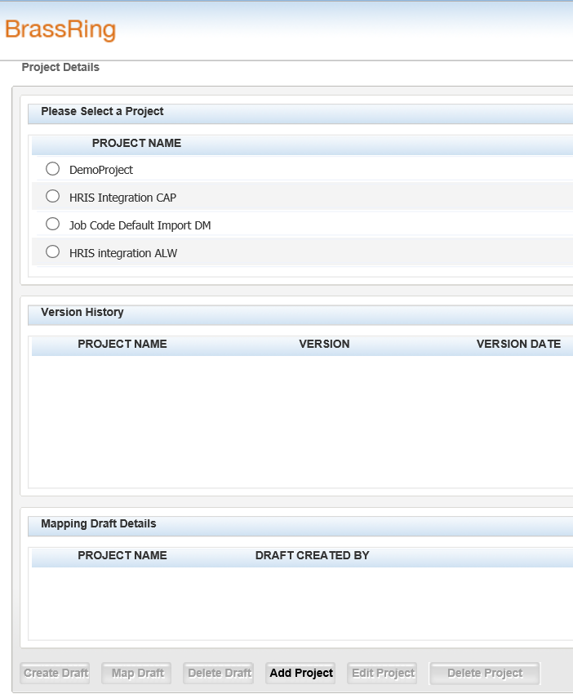
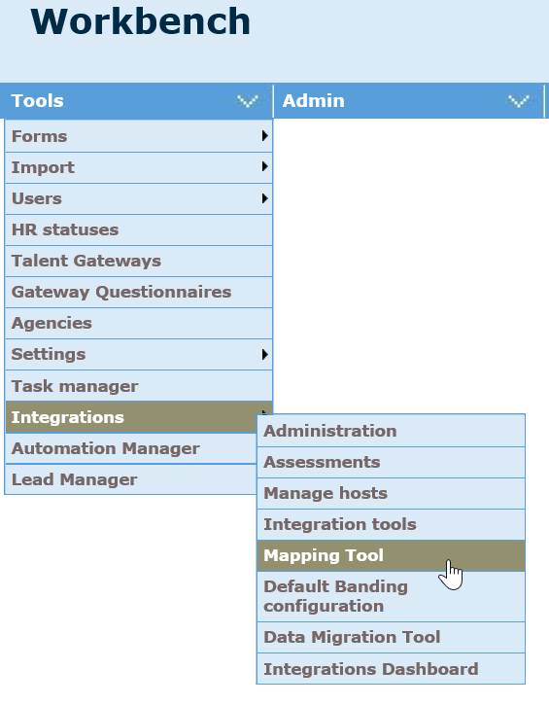
Create Project
Tools > Integrations > Mapping Tool

Slide 19
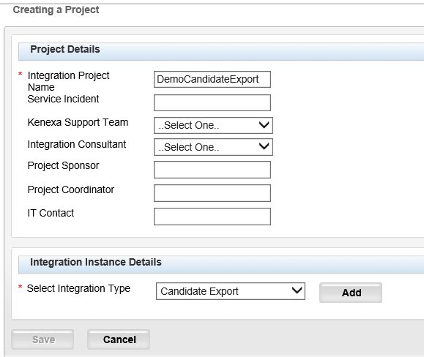
Create Project
Enter Project Details

Slide 20
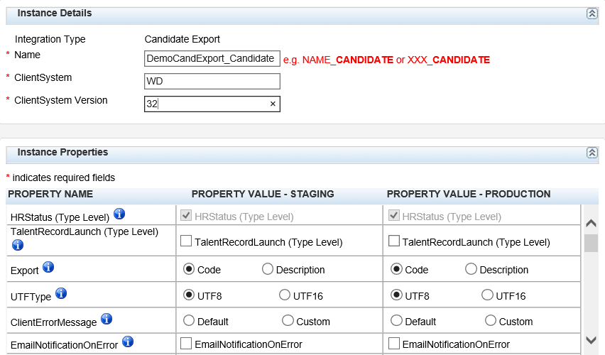
Create Project
Add Properties

Slide 21
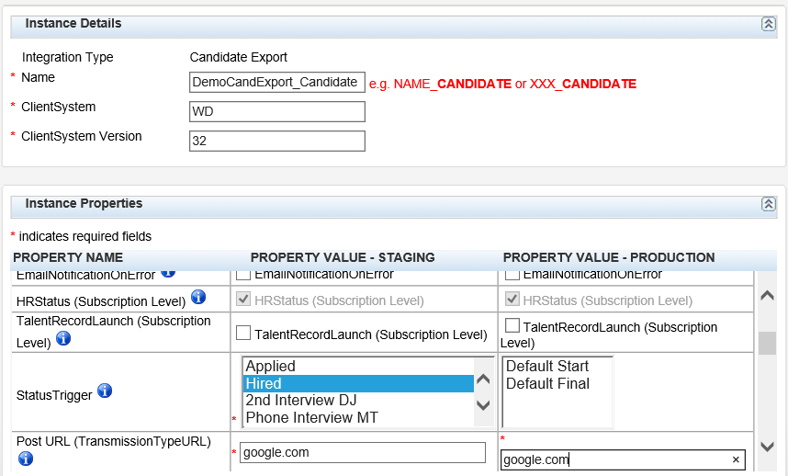
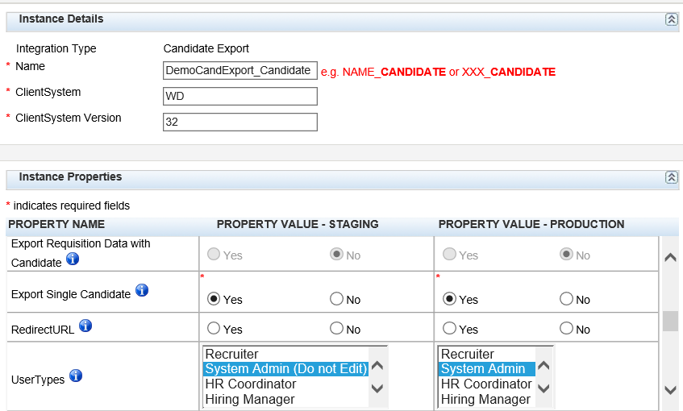
Create Project
Add Properties

Slide 22
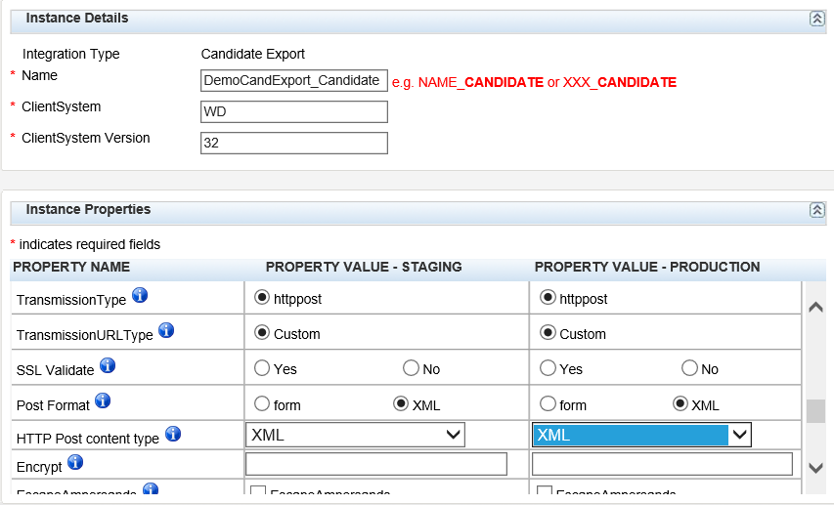
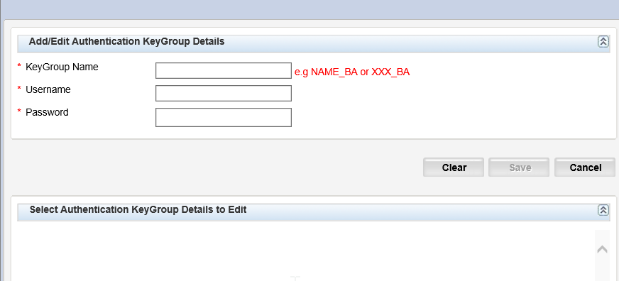
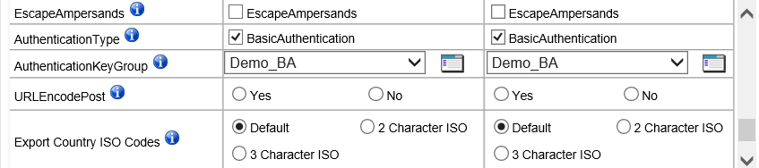
Create Project
Add Properties

Slide 23
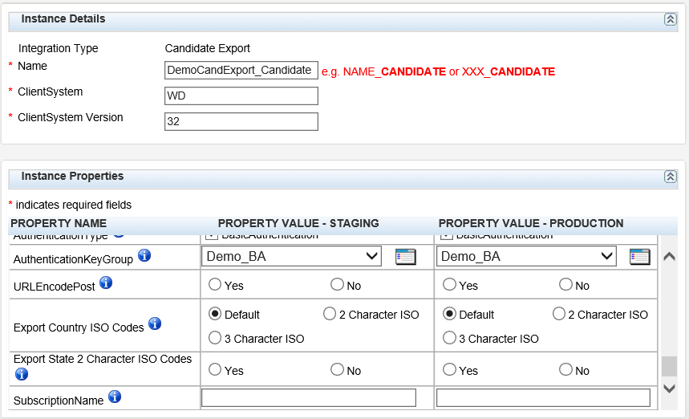
Add Project
Add Properties and Save the Draft

Slide 24
Properties
Property | Definition
HRStatus (Type Level) | Always selected for Candidate Exports. Indicates that the integration is triggered by an HR Status.
TalentRecordLaunch (Type Level) | If talent record will have submit button for this subscription (export will just be triggered manually by recruiter).
Export | Code or Description Export either the code or description of option list fields pulled into the integration.
UTFType | UTF8 or UTF16 Defaulted to UTF8 and should be left unless UTF16 is needed by vendor
ClientErrorMessage | No longer used
EmailNotificationOnError | No longer used
HRStatus (Subscription Level) | Always selected for Candidate Exports. Indicates that the integration is triggered by an HR Status.
Property | Definition
TalentRecordLaunch (Subscription Level) | No longer used
Status Trigger | Defines which HR Status triggers the integration to run. Multiple HR Statuses can be selected.
Post URL (Transmission Type URL) | Target URL where the Candidate Export XML will be sent (vendor’s endpoint).
Export Requisition Data with Candidate | Tied to client setting “IntegrationExpReqWithCandidate” and should be changed with utmost CAUTION (client settings can only be edited). The change will impact ALL candidate export integrations in your account. The setting drives if req form fields should be mapped into the integration. If it is required to change this setting, please make sure to test ALL candidate export integrations after making the update.

Slide 25
Properties
Property | Definition
Export Single Candidate | No longer used
RedirectURL | No longer used
UserTypes | Lists all User Types in the client’s account. User types selected are allowed to trigger the candidate export integration. If no user type is selected, then ANY user type can trigger the integration.
TransmissionType | Only option/protocol is httppost. If endpoint does not support httppost the Mapping Tool cannot be used.
TransmisionURL Type | Only option is Custom.
SSL Validate | No longer used
Post Format | Options include “form” or “XML” Ask the vendor which option should be used. Form or XML works most of the time.
HTTP Post content type | Options included: form, XML, SOAP 1.1, SOAP 1.2, UTF-8. Ask the vendor which option should be used. If vendor doesn’t know what format should be used each should be tested until a successful test is received.
Property | Definition
Encrypt | No longer used
Escape Ampersands | Escape the ampersands to make the XML safe for the vendor. Removes the “&” character that is not supported in XML.
AuthenticationType | Available option = Basic Authentication Can be used if you’d like to use basic authentication to secure the integration (e.g. username and password).
AuthenciationKeyGroup | Keygroup Name for basic authentication. Select icon to name the Keygroup and define the Username and Password, then select that Keygroup in the dropdown.
URLEncodePost | No longer used
Export Country ISO Codes | Options included: Default, 2 Character ISO, 3 Character ISO. Sends 2 or 3 ISO codes for the country name when using the standard country option lists in BrassRing. (Default sends the entire country name.)
Export State 2 Character ISO Codes | If yes is selected then the 2 character ISO code for the state is sent (if using the standard state option list in BrassRing. (This only works for US States. International states will still send full name.) If no is selected then the entire state name is sent.
SubscriptionName | Name of the integration.

Slide 26
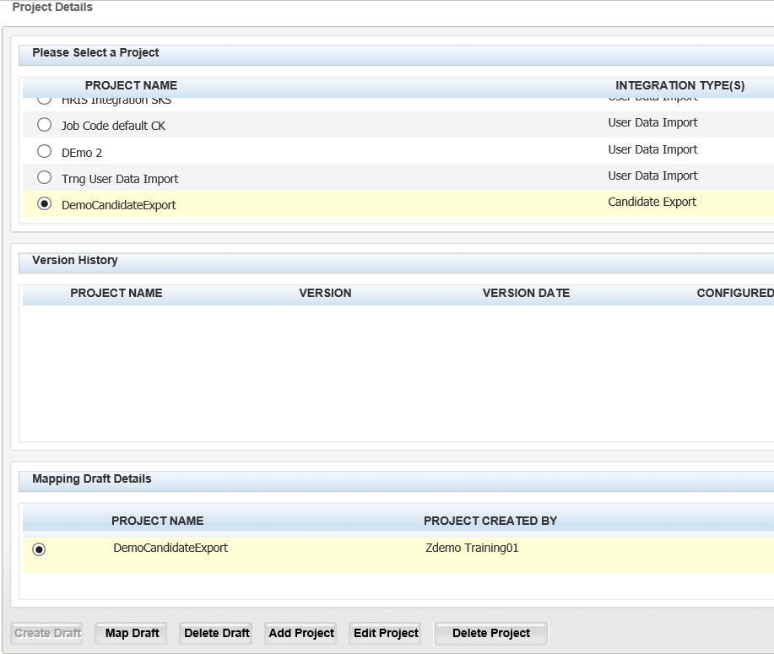
Create Draft and Make Version
Create Draft

Slide 27
Create Draft and Make Version
Map Draft

Slide 28
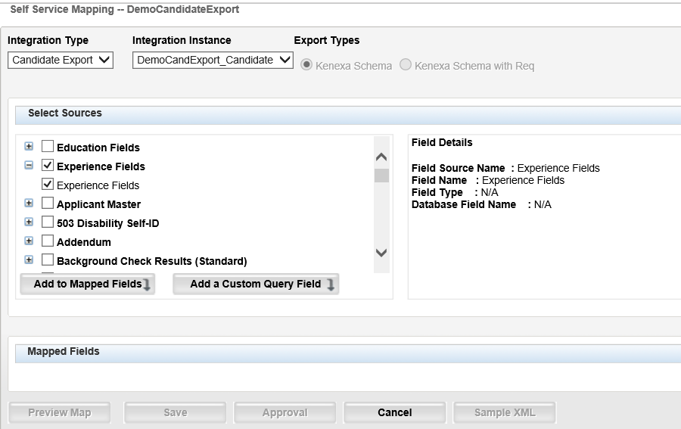
Create Draft and Make Version
Map the Fields

Slide 29
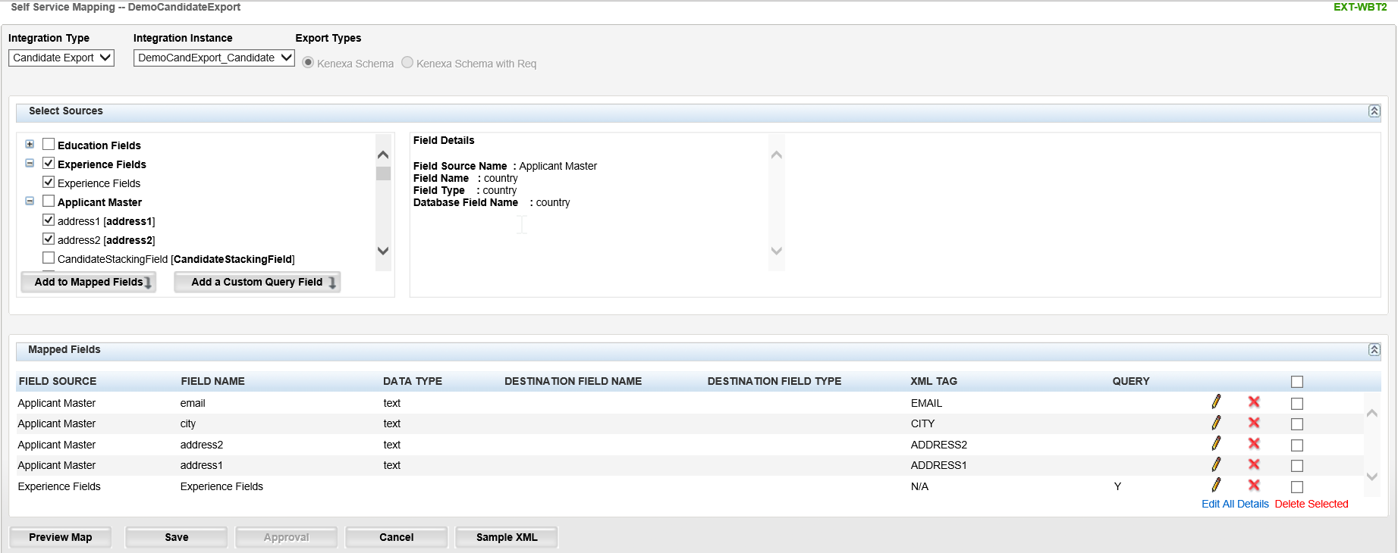
Create Draft and Make Version
Map the Fields

Slide 30
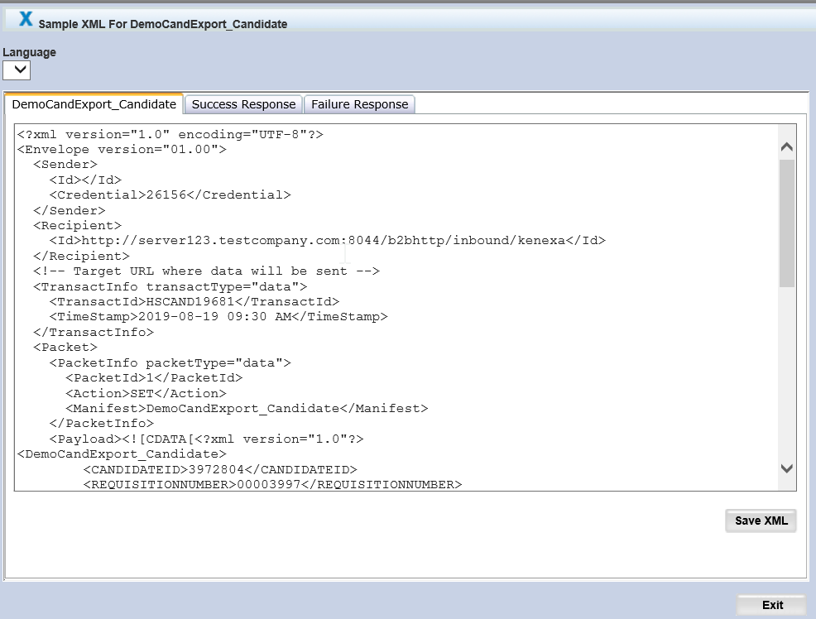
Create Draft and Make Version
Sample XML

Slide 31
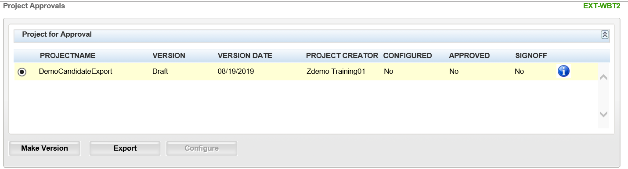
Create Draft and Make Version
Make Version

Slide 32
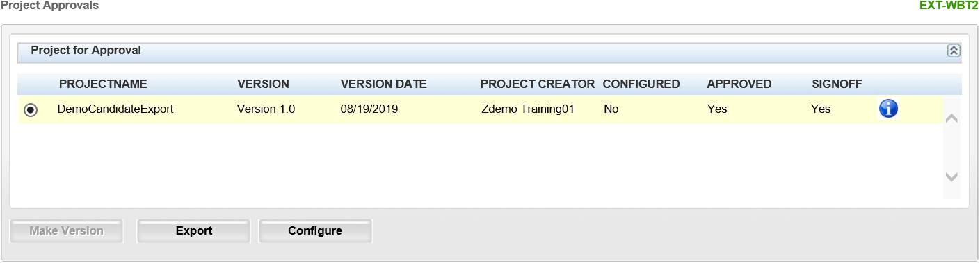
Create Draft and Make Version
Export and Configure Version to activate the Integration in Staging

Slide 33
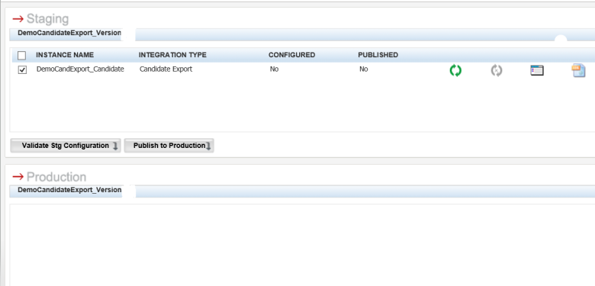
Configure (activate) the Integration(s) in Staging and test
Configuration
1.0
1.0

Slide 34
Publish the Integration(s) to Production
Configuration
1.0
1.0

Slide 35
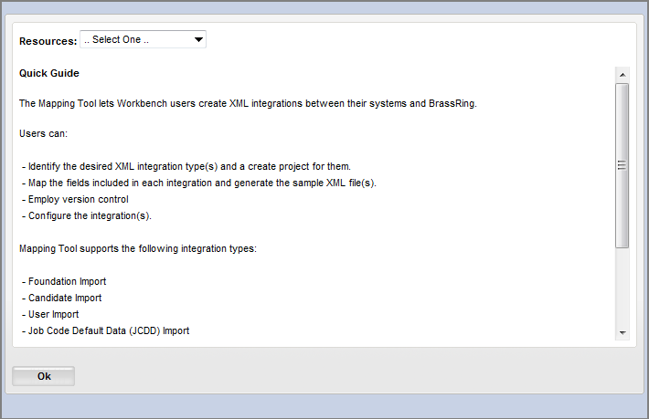
Mapping Tool Resources
  The following resources can be found in the Mapping Tool under the Resources link on the top right of the page.
  XML Test Harness
  IP Addresses
  Integration Post URLs
  Mapping Tool Offerings

Slide 36
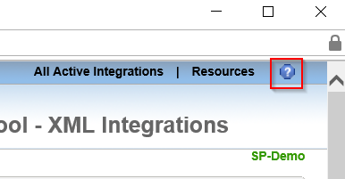
Mapping Tool Resources
BrassRing on Cloud Integration API and App Documentation
https://documentation.infinite.com/docs/integrations-and-apis-integrations
Help section within the Mapping Tool.

Slide 37
Questions?

