Slide 1
BrassRing Knockout Questions, Scoring, and Default Application Questions
BrassRing
—
Client Training and Enablement Session
September 10th, 2019

Slide 2
Agenda
BrassRing Screening Options
Manually Scoring Questions
Knockout Questions - Soft
    Default Questions and Scoring
    Configuring Scoring via Gateway Questionnaires (GQs)
    Viewing Score on Talent Record
True Knockout Questions
    Configuring Scoring via Gateway Questionnaires
Resources
Q&A

Slide 3
BrassRing Screening Options
BrassRing Screening Options
You can use Pre-qualifying Questions and Scoring to screen your candidates in BrassRing.
Manually Score Questions in BrassRing included in the application process.
    Assign a score for each answer the candidate provides to the question.
    Assign a specific HR Status based on how the candidate scores.
Knockout Questions
    Soft Knockout Question
        Add a question in BrassRing to the application process
        Allows the candidate to continue with the application process (candidate record is added to BrassRing)
        Assigns a final HR Status based on an unfavorable answer the candidate provides.
    True Knockout Question
        Set-up via Gateway Questionnaire (GQ)
        Ends the application process
        Candidate is not added to BrassRing.

Slide 4
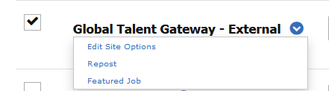
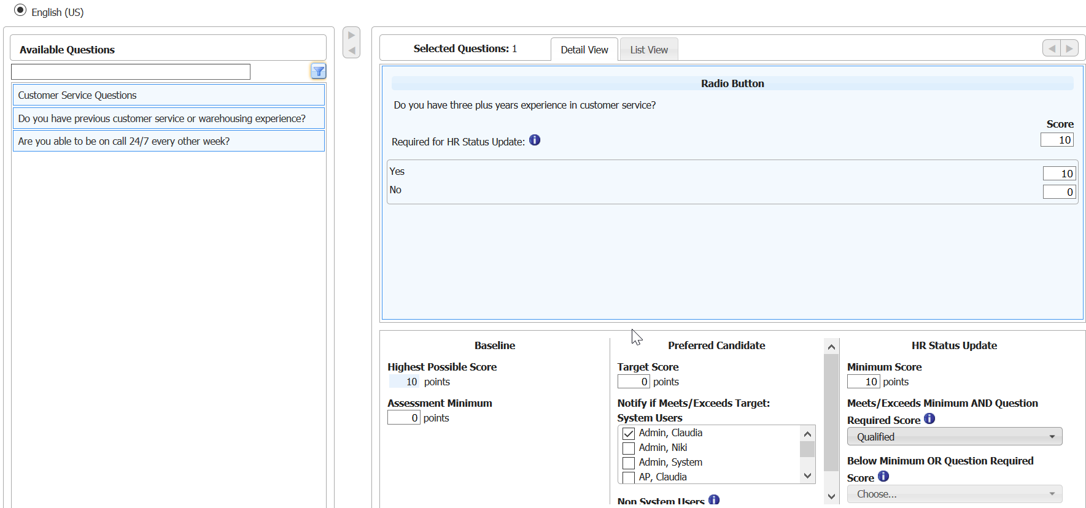
Manually Scoring Questions
Manually Scoring Questions
User can manually add a score to a question in the application process during the posting process in BrassRing. Example: Initial HR Status of Applied is assigned to candidate
BrassRing > Open Req > Posting Options > Select Edit Site Options for TG
Candidate’s Talent Record is added to Req folder at HR Status of Qualified.
Note: Pre-qualifying question must be part of the Talent Gateway form in Workbench to appear in the list of available questions in BrassRing.

Slide 5
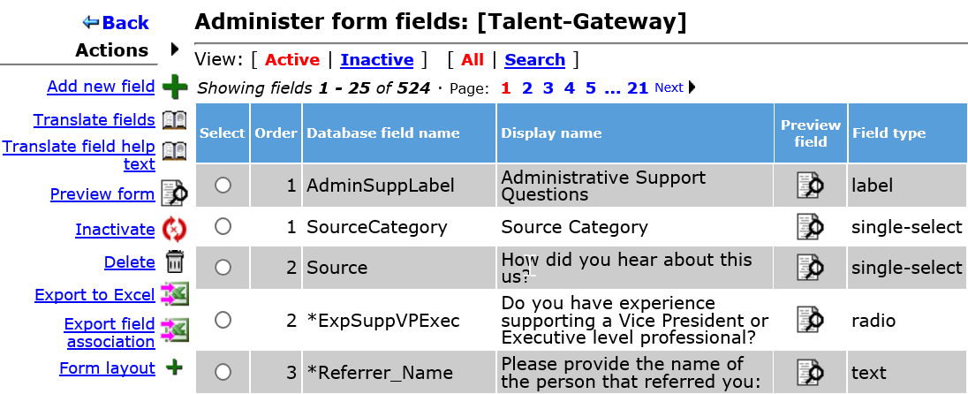
Manually Scoring Questions
Manually Scoring Questions
The question must be part of the Talent Gateway form in Workbench in order to appear in the question library in BrassRing
Workbench > Tools > Candidate Forms > Talent Gateway Form > Administer Form Fields

Slide 6
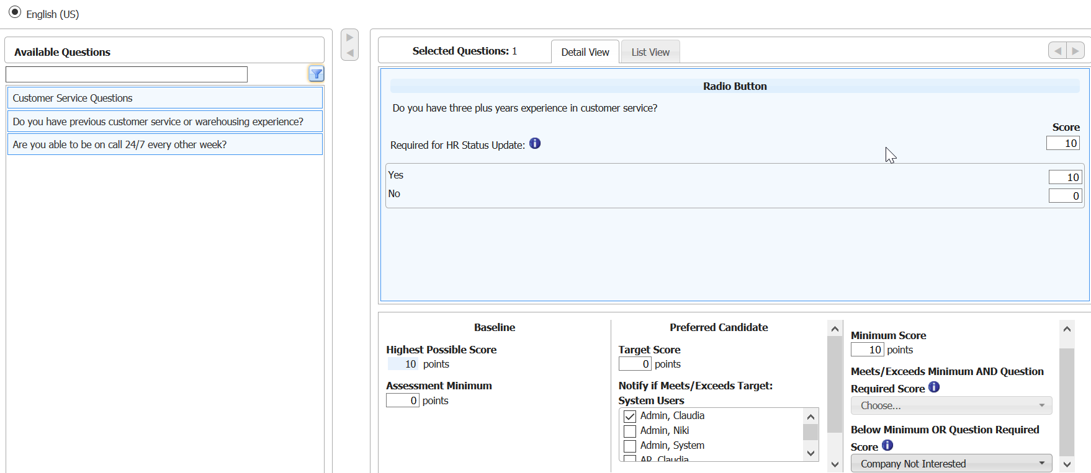
Knockout Questions - Soft
Soft Knockout Questions
Based on unfavorable answer from candidate, soft knockout questions allow candidate to continue with application process but are assigned to a final HR status.
Example: Final HR Status of Company Not Interested is assigned to candidate.
BrassRing > Open Req > Posting Options > Select Edit Site Options for TG
Candidate’s Talent Record is added to Req folder at HR Status of Company Not Interested.

Slide 7
Demo
–
Manually Scoring Questions and Soft Knockout Questions

Slide 8
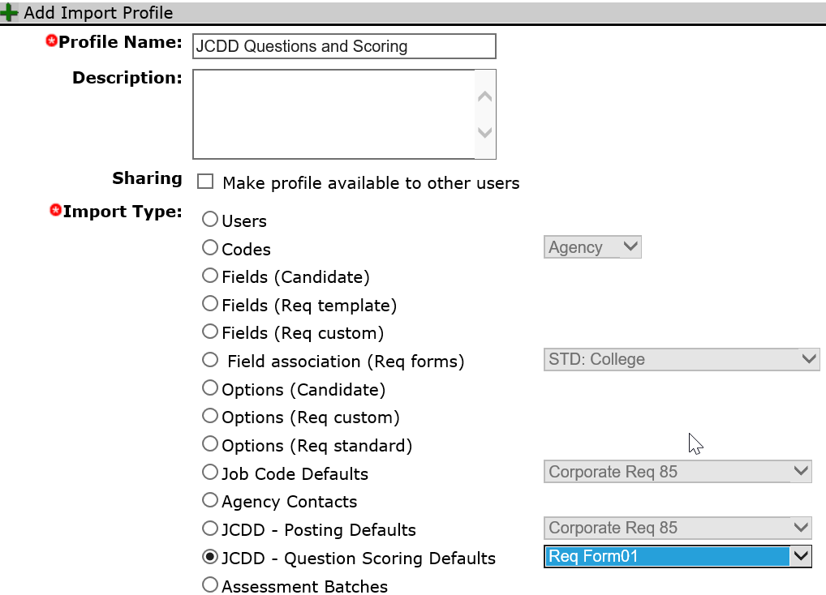
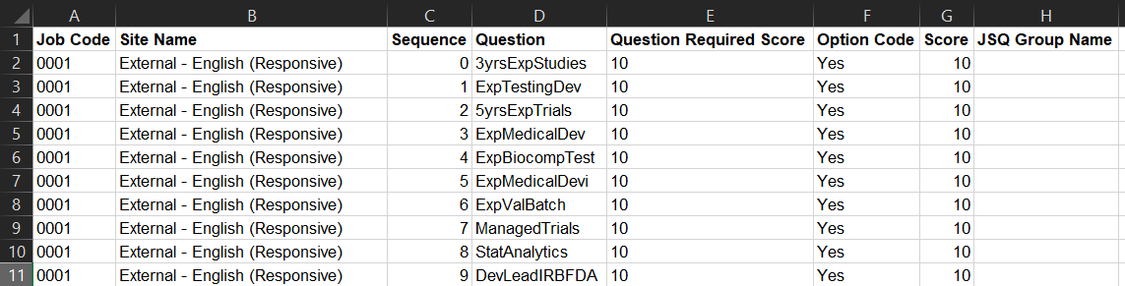
Default Question and Scoring
Default Questions and Scoring via TG
You can identify default questions from the TG Details page:
Workbench > Tools > Talent Gateways > Edit > Default Questions
To set default scores for these default questions, you can use the import for JCDD – Question Scoring Defaults: WB > Tools > Import > Profiles > Create Profile for JCDD – Question Scoring

Slide 9
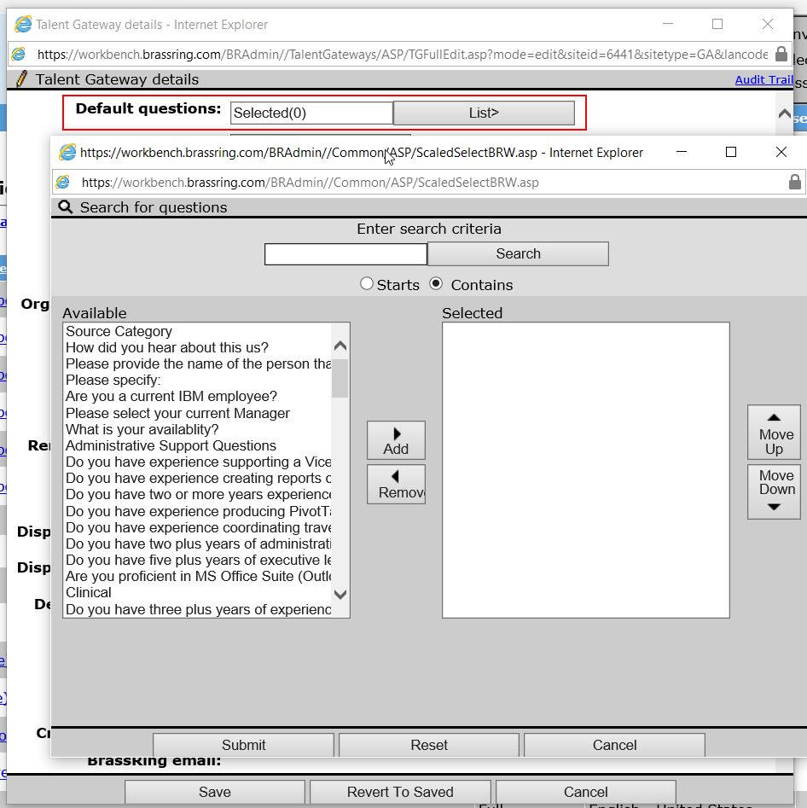
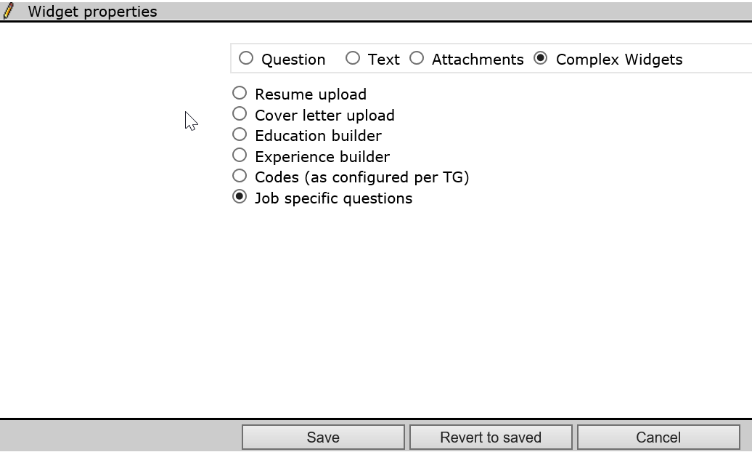
Default Question and Scoring
Default Questions and Scoring via TG and GQ
The default questions you selected on the TG Details page, will appear automatically in the GQ by adding a complex widget of Job Specific Questions (JSQ).
Workbench > Tools > Gateway Questionnaires > Administer sections/pages > Add new widget > Complex widget: Job Specific Question
This will place the default questions identified on the TG Details page where you added the complex widget within the GQ.

Slide 10
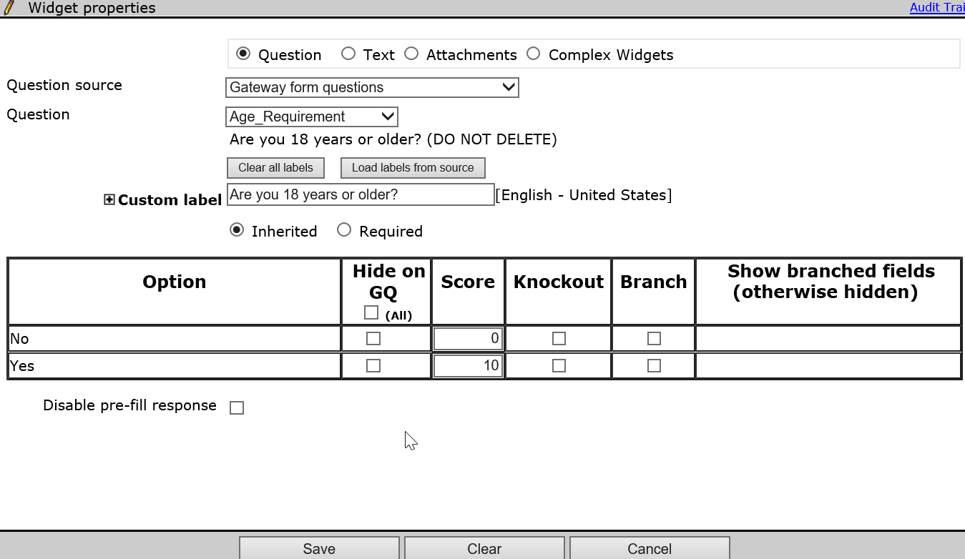
Configuring Scoring via Gateway Questionnaires (GQs)
Scoring via GQ
You can also use Gateway Questionnaires (GQs) to score questions. The scoring is configured on the Widget properties page for the Question widgets.
Workbench > Tools > Gateway Questionnaires > Administer sections / pages > Administer widget > Add widget > Question

Slide 11
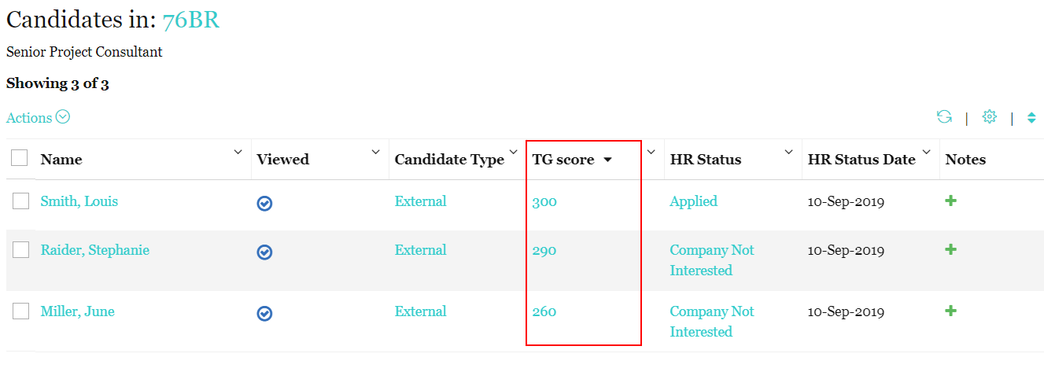
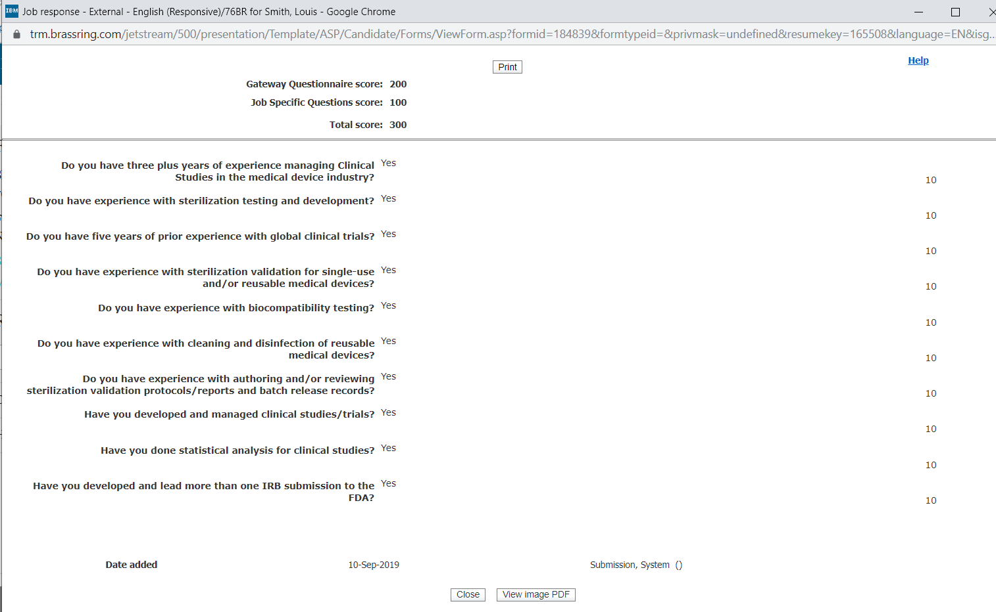
Viewing the TG Score on Candidate Talent Record
A candidate’s Talent Gateway (TG) score can be viewed from the candidate grid. This is a total of the scored Talent Gateway questions and the questions scored on the Gateway Questionnaire.
A breakdown of the score can be found on the Job Response candidate form.

Slide 12
Demo
–
- Default Questions and Scoring via TG and GQ
- Configuring Scoring via GQ

Slide 13
Knockout Questions - True
True Knockout Questions
Set-up via Gateway Questionnaire (GQ) to end the application process and candidate’s submission is not added to BrassRing.
Example of true knockout questions:
  Are you 18 years of age or older?
  Are you a citizen of the country you are applying?
  Are you proficient in Spanish?

Slide 14
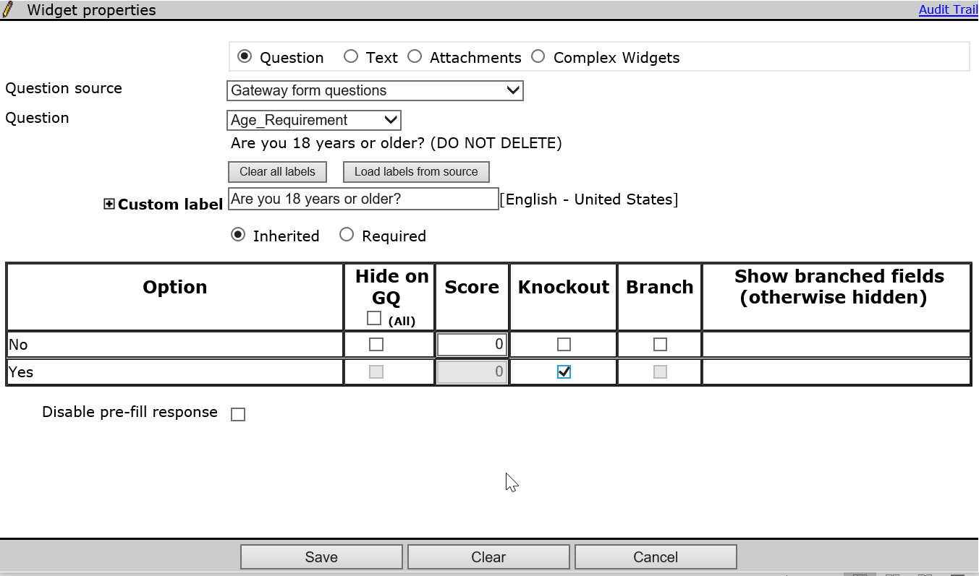
Configuring Scoring via Gateway Questionnaires (GQs)
Configuring Scoring of True Knockout Question via GQ
The knockout question in the GQ will end the application process for the candidate.
Workbench > Tools > Gateway Questionnaires > Administer sections / pages > Administer widget > Edit widget.

Slide 15
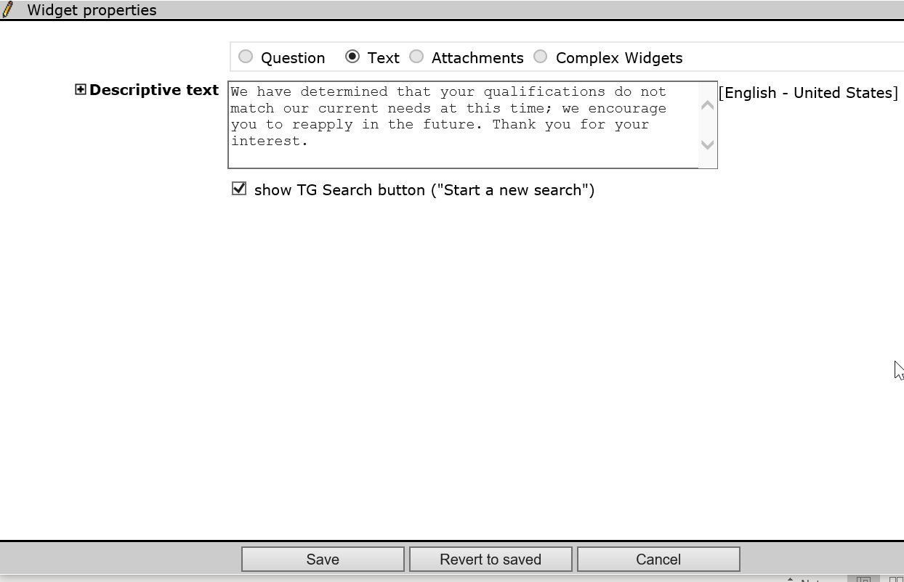
Configuring Scoring via Gateway Questionnaires (GQs)
Configuring Scoring of True Knockout Question via GQ
The text that displays to the candidate after a knockout question was answered and the application process ended needs to be generic as it is used for any knockout questions in the GQ.
WB > Tools > Gateway Questionnaires > Administer sections / pages > Administer widget for Thank you page > Edit widget.

Slide 16
Demo
–
- Configuring Scoring via GQs of True Knockout Questions

Slide 17
Resources
Gateway Questionnaires
https://documentation.infinite.com/docs/overview-of-gateway-questionnaires
Administer Gateway Questionnaires Widgets
https://documentation.infinite.com/docs/administer-gateway-questionnaire-widgets
Add Pre-qualifying Questions
https://documentation.infinite.com/docs/adding-editing-and-viewing-answers-to-pre-qualifying-questions

Slide 18
Questions?

