Slide 1
BrassRing Interview Manager – User Experience
IBM Kenexa BrassRing on Cloud
—
Client Training and Enablement Session
IBM Watson Talent
February 18th,2020

Slide 2
Agenda
Overview of Interview Manager
How to use Interview Manager – User Experience
Resources
Client Training & Enablement Sessions
Future Enhancements
Q&A

Slide 3
Overview of Interview Manager?
The Interview Manager is a new feature in BrassRing that allows both BrassRing users and candidates to efficiently and effectively schedule interviews.
Available now in Staging only for all BrassRing on Cloud clients with February Release – Monday, February 10th, 2020.
Part of standard feature in BrassRing and requires some configuration.
No additional cost for client to use Interview Manager.
Early client adopter phase completed.
Interviews can be created by BrassRing users who have access to Candidates within My Reqs. Interview Participants cannot choose to set-up their own interviews.
Easy access to interviews that are scheduled, in process, or that need to be scheduled.
By default all BrassRing users have access to create Interviews (My Reqs); user permissions determine the additional access or restriction.
Does not replace Event Manager but rather is used with the single candidate experience.

Slide 4
Overview of Interview Manager?
New Tab on Home page with card and grid view, filtering options and refresh icon.
Multiple interview styles:
    1:1 Interview - single candidate and single interviewer
    Series Interview - single candidate and multiple interviewers, one interview after another
    Panel Interview – single candidate and team of interviewers in the same time slot
Multiple interview formats:
    Phone – interview over the phone
    Video – video call interview where the candidate is required to appear on-screen
    Text/Chat – text only interview that uses a text service
    In person – candidate must attend on site for interview
    Other – other type of interviews where the format of the interview can be entered into the Interview Details
Note: The details of the interview differ depending on the interview format selection.

Slide 5
Overview of Interview Manager?
Calendar integration with Outlook 365 and Google+ allows for checking and scheduling interviewers’ shared calendars.
Candidates and Interviewers will receive an automated meeting invitation as soon as they accept the interview request. This meeting request allows the candidates to add it to their calendars directly (if supported) or download the ics attachment and add it manually to their calendars.
Multiple interview scheduling type:
    Confirmed date & time (already decided) – the timeslot has already been worked out with the candidate and interviewer.
    Verify interviewers availability first – interviewer’s availability is checked first and candidates are provided with the timeslots to pick from based on interviewer’s availability.
    Ask for candidate availability first – provide candidate with a range of dates and times to select specific timeslot that works best for them.

Slide 6
Demo
–
Interview Manager User Experience

Slide 7
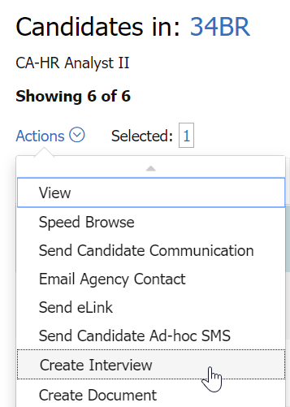
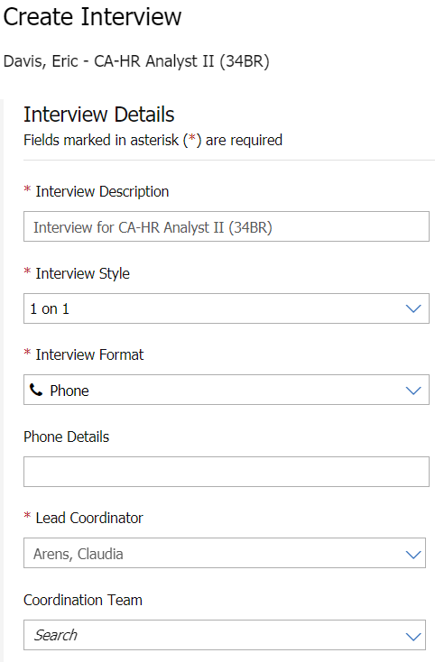
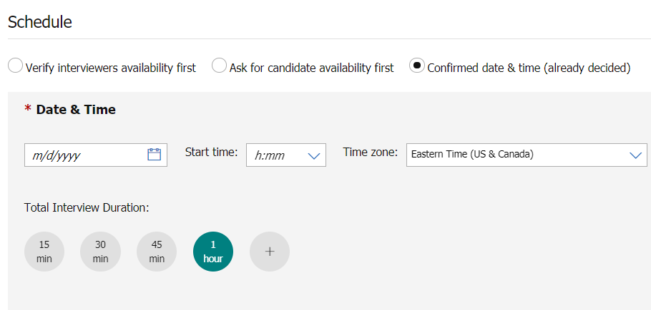
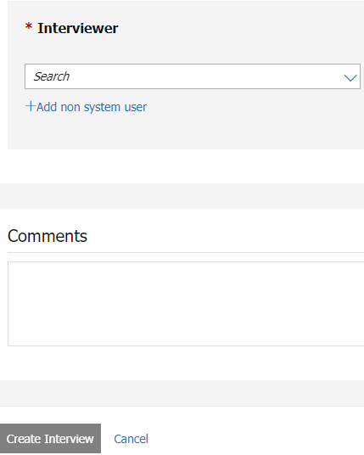
How to use the Interview Manager – User Experience
Create Interview
BrassRing > My Open Reqs > Select Candidate > Action: Create Interview
1.
2.
3.
4.

Slide 8
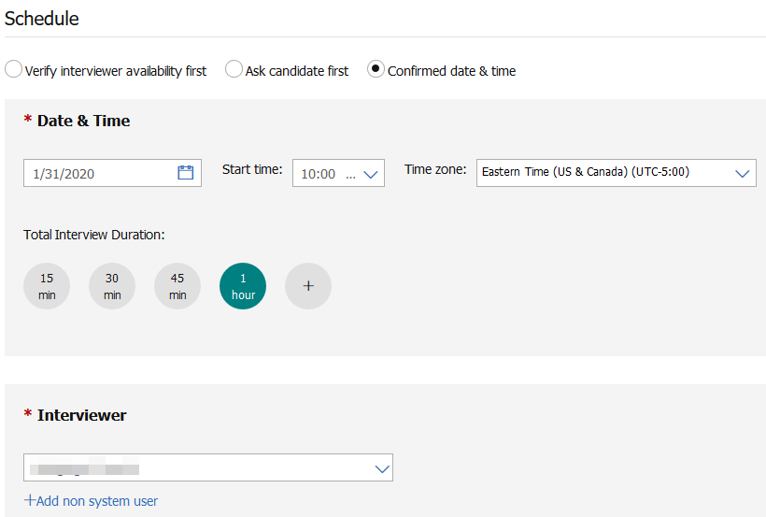
Overview of Interview Manager
Interview Scheduling Type Workflows
Confirmed Date & Time (already decided ) - Schedule has already been worked out with the candidate and interviewer. The candidate and interviewer still need to confirm the interview.

Slide 9
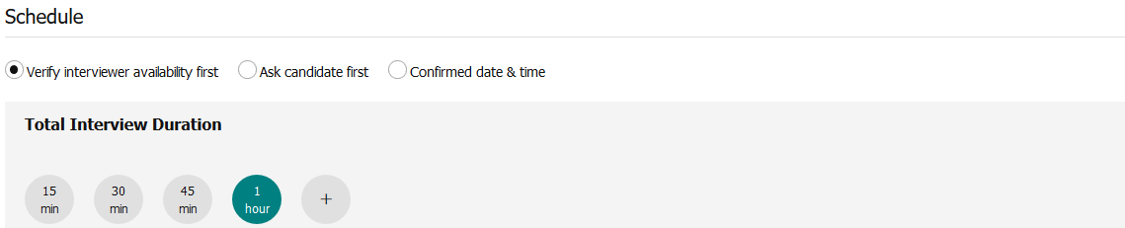
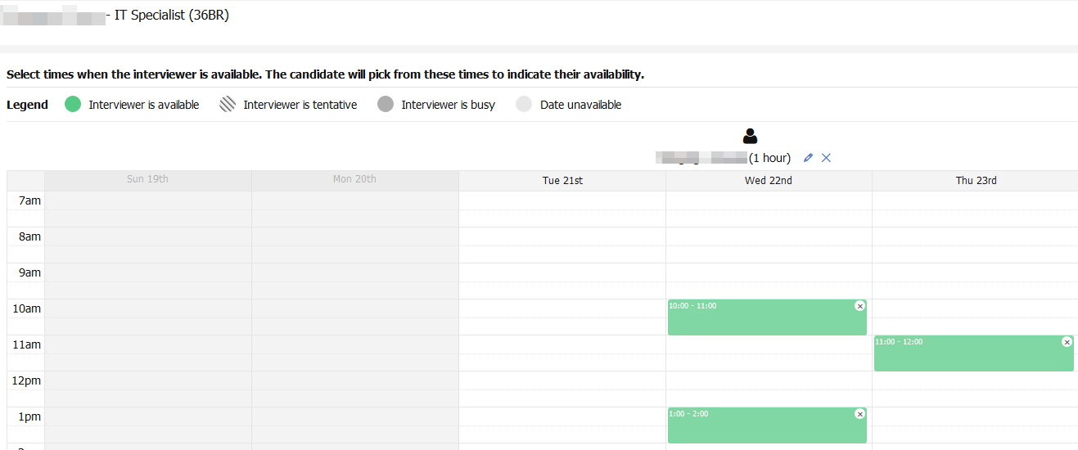
Overview of Interview Manager
Interview Scheduling Type Workflows
Verify interviewers availability first – interviewer’s availability is checked first and candidates are provided with the time slots to pick from based on interviewer’s availability.

Slide 10
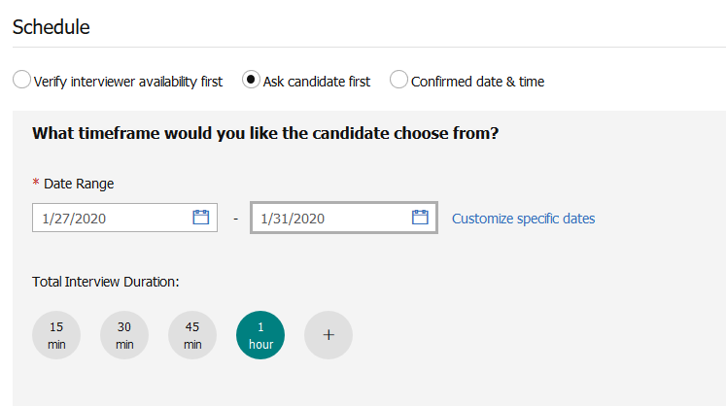
Overview of Interview Manager
Interview Scheduling Type Workflows
Ask for candidate availability first - Provide candidate with a range of dates and times to select specific one that works best for them.

Slide 11

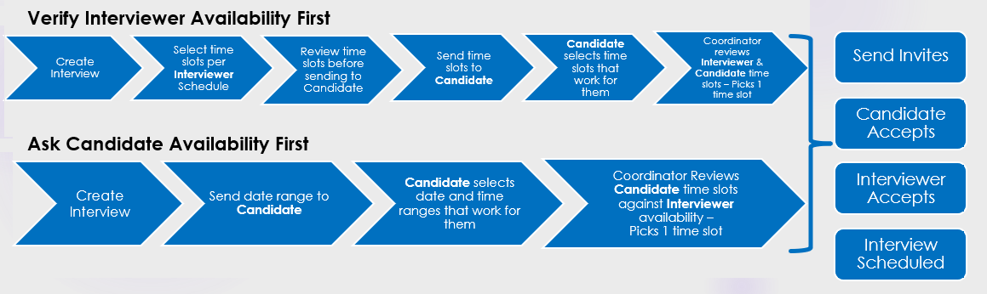
Overview of Interview Manager
Scheduling Type Workflows
Ask Candidate First

Slide 12
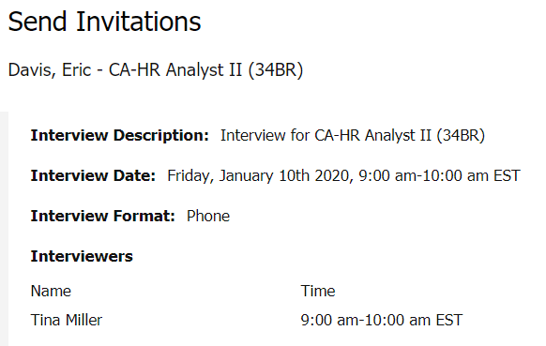
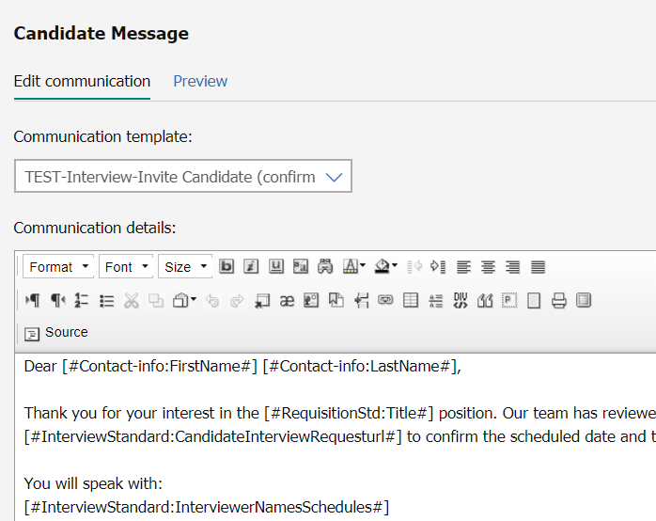
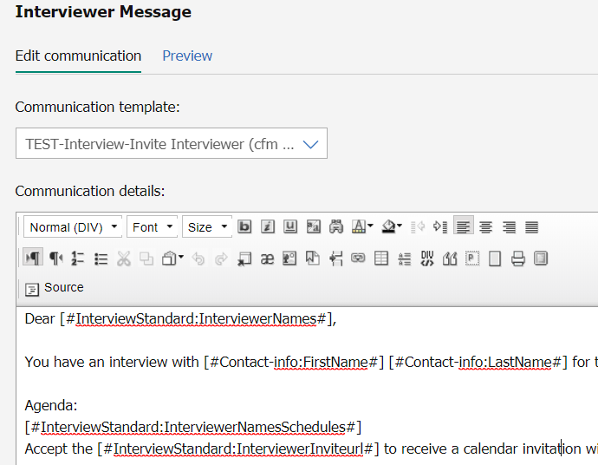
How to use the Interview Manager – User Experience
Send Communication
After creating the interview, the user can send a communication to the candidate and interviewer.

Slide 13
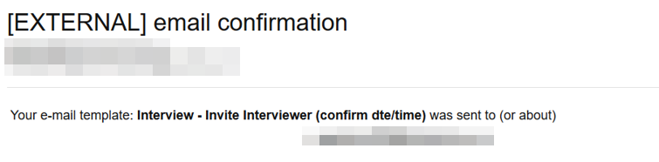
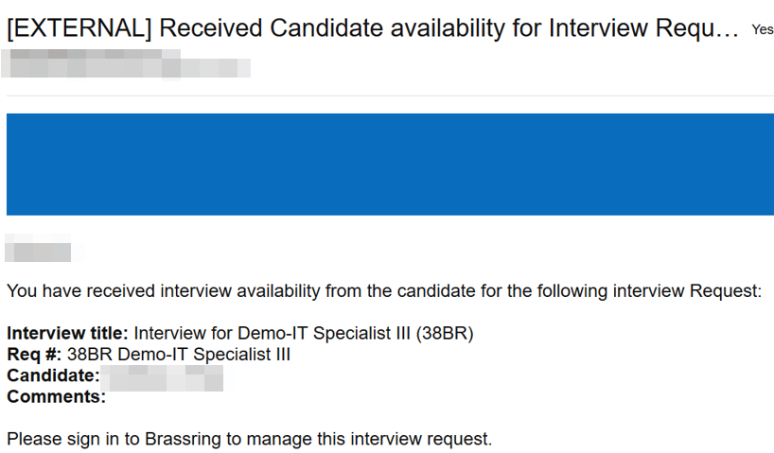
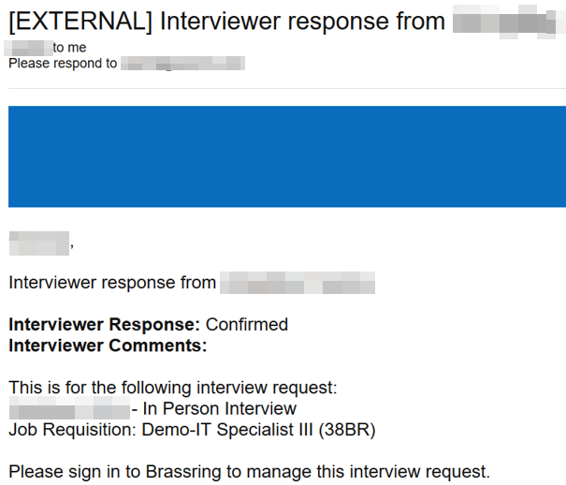
How to use the Interview Manager – User Experience
Send Communication
Examples of Interview Manager Confirmations to Lead Coordinator

Slide 14
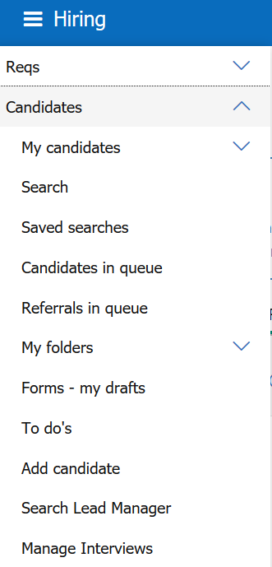
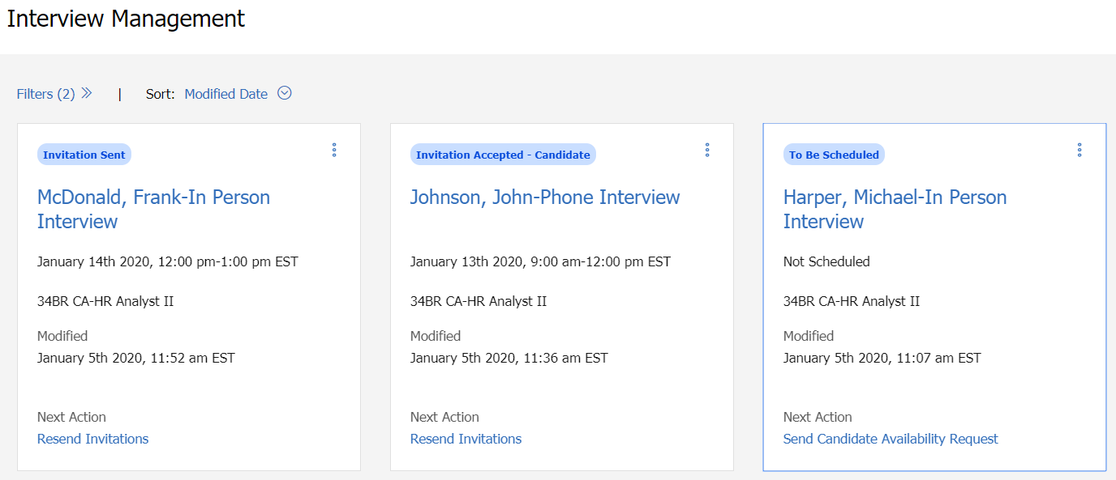
How to use the Interview Manager – User Experience
Manage Interviews
Provides details of the Interviews in a card view (interview status, interview date and time, etc.)
      BrassRing > Candidates > Manage Interviews

Slide 15
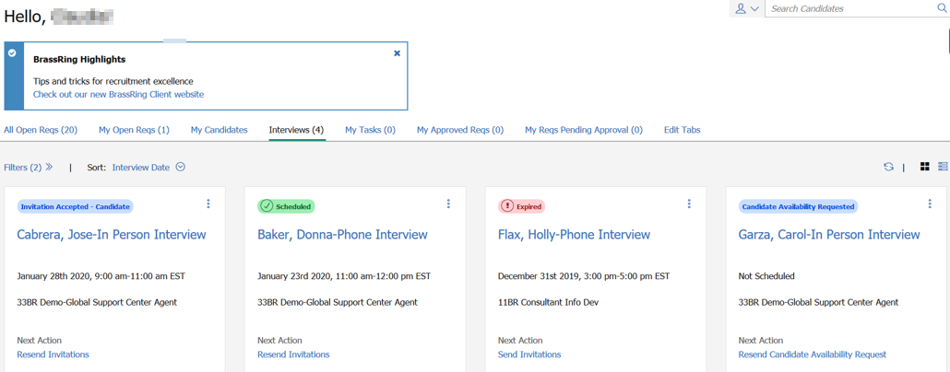
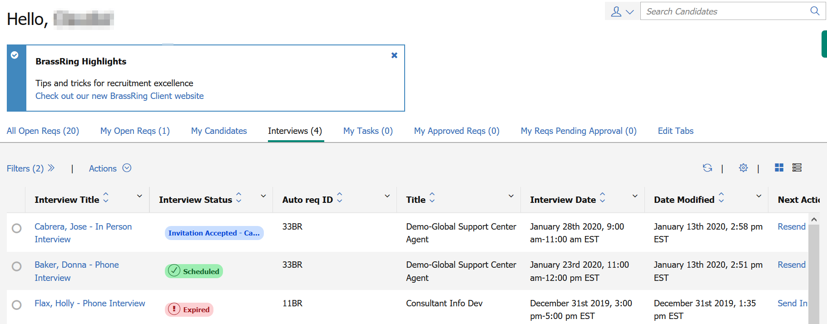
How to use the Interview Manager – User Experience
Home Page
Interview Tab is available on the Home Page – Card View or Grid View

Slide 16
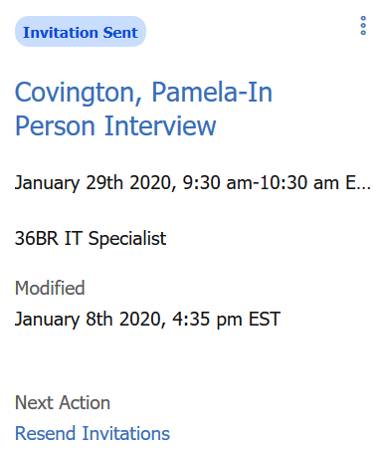
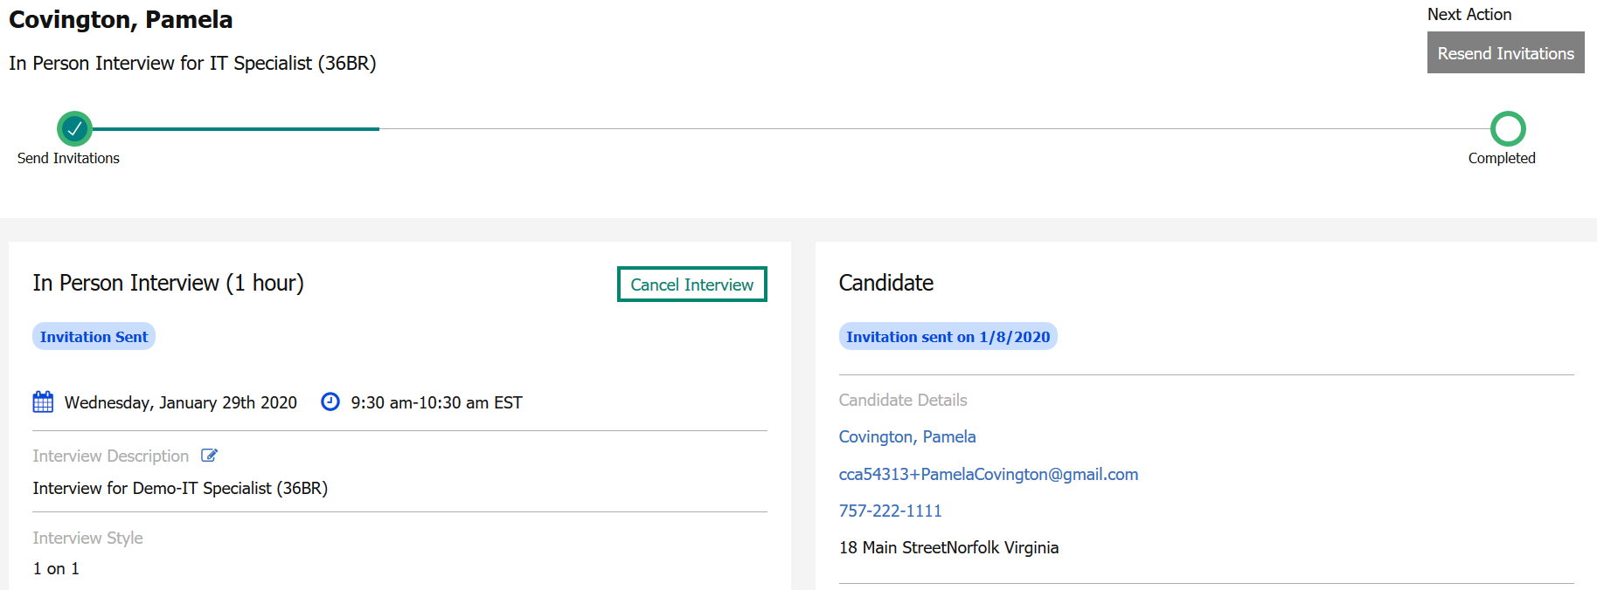
How to use the Interview Manager – User Experience
Manage Interviews
Click on the Candidate’s Name hyperlink to access the Interview Details Page
User can edit basic interview details; view, edit, and cancel interviews; send and resend communication; manage to-dos

Slide 17
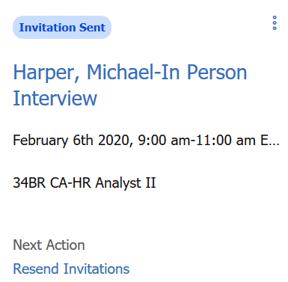
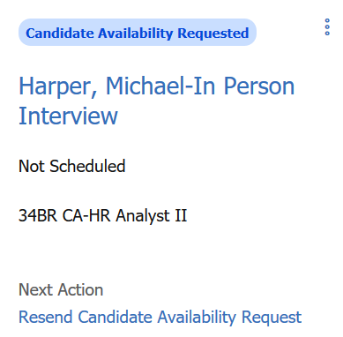
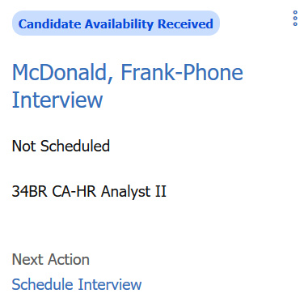
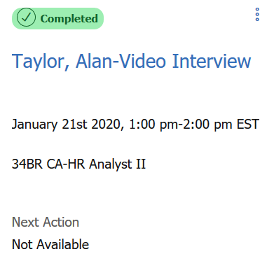
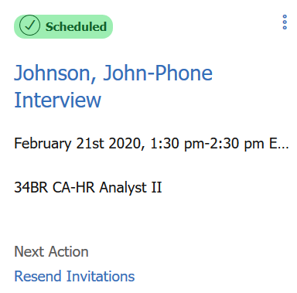
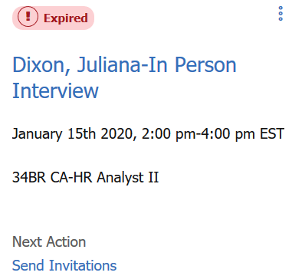
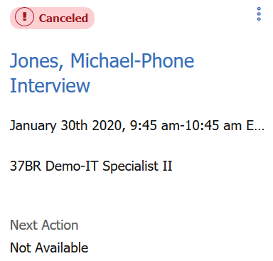
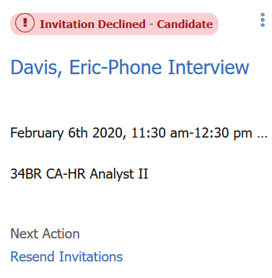
How to use the Interview Manager – User Experience
Interview Status
Each interview is assigned to an interview status depending on where it is in the interview process. The status appears in green – accepted/completed, red – expired/canceled/declined, and blue – pending.
Examples:

Slide 18
Resources
Interview Management
https://www.ibm.com/support/knowledgecenter/SSEUFV/16_InterviewManagement/top.html
Interview Manager Configuration
https://www.ibm.com/support/knowledgecenter/SSEUFV/2_Configuration/17_ConfiguringIM/top.html
Interview Manager FAQs
https://www.ibm.com/support/knowledgecenter/SSEUFV/1a_FAQs/9_InterviewManagerFAQ.html

Slide 19
February VIRTUAL TRAINING SESSIONS
Client-facing training schedule
Check your skills
Sunday | Monday | Tuesday | Wednesday | Thursday | Friday | Saturday
2 | 3 | 4 Client: Interview Manager – User Session (11:00 AM EST) | 5 | 6 Client: Interview Manager – Admin Session (11:00 AM EST) | 7 | 8
9 | 10 Client: Assess New User Training (11:00 AM EST) | 11 | 12 | 13 Client: BrassRing 20.02.10 and Onboard Release (4 AM EST; 11 AM EST) | 14 | 15
16 | 17 Client: Assess Transitioning to the New UI – Phase 4 (11:00 AM EST) | 18 Client: Interview Manager – User Session (11 AM EST) | 19 | 20 | 21 | 22
23 | 24 Client: Assess New Features and Updates (11:00 AM EST) CANCELLED | 25 Client: TA Roadmap (11:00 AM EST) | 26 | 27 | 28 | 29
Interview Manager Release in Staging

Slide 20
March VIRTUAL TRAINING SESSIONS
Client-facing training schedule
Sunday | Monday | Tuesday | Wednesday | Thursday | Friday | Saturday
1 | 2 | 3 Client: Interview Manager – User Session (11:00 AM EST) Client: Talent Frameworks Content Updates (2:00 PM EST) | 4 | 5 Client: Talent Frameworks Content Updates (11:00 AM EST) | 6 | 7
8 | 9 Client: Assess New User Training (11:00 AM EST) | 10 Client: Interview Manager – Admin Session (11:00 AM EST) | 11 | 12 Client: BrassRing 20.03.09 and Onboard Release (11:00 AM EST) | 13 | 14
15 | 16 | 17 Client: Talent Frameworks Content Updates (11:00 AM EST) | 18 | 19 | 20 | 21
22 | 23 | 24 Client: Talent Suite – Manage Email Templates (11:00 AM EST) | 25 | 26 | 27 | 28

Slide 21
Client Training & Enablement Sessions
  Register for Client T&E Session on the IBM Knowledge Center (KC):
    IBM Kenexa BrassRing on Cloud >> BrassRing and Workbench Enablement Sessions >> Upcoming Training and Enablement Sessions
      https://www.ibm.com/support/knowledgecenter/SSEUFV/14_Training/1UpcomingEnablements.html
  Access the recordings, presentations, and FAQs from past Client T&E Sessions:
    IBM Kenexa BrassRing on Cloud >> BrassRing and Workbench Enablement Sessions >> Past Training and Enablement Sessions
    https://www.ibm.com/support/knowledgecenter/SSEUFV/14_Training/2EnablementSessions.html

Slide 22
Future Enhancements
Rules Automation Manager
Reporting (Metrics Dashboard and DIT)
Talent Record Action Log

Slide 23
Questions?

