Slide 1
BrassRing Interview Manager
BrassRing
—
Client Training and Enablement Session
January 14th, 2020

Slide 2
January VIRTUAL TRAINING SESSIONS
Client-facing training schedule
Sunday | Monday | Tuesday | Wednesday | Thursday | Friday | Saturday
 |  |  | 1 | 2 | 3 | 4
5 | 6 | 7 Client: Interview Manager – Client Panel (11:00 AM EST) - Cancelled | 8 | 9 | 10 | 11
12 | 13 Client: Assess New User Training (11:00 AM EST) | 14 Client: Interview Manager – User Session (11 AM EST) | 15 | 16 Client: BrassRing 20.01.13 & Onboard Release (4 am EST; 11 am EST) | 17 | 18
19 | 20 Client: Assess Transitioning to the New UI (Phase 4) (11 AM EST) | 21 Client: Interview Manager – Admin Session (11 AM EST) | 22 | 23 | 24 | 25
26 | 27 Client: Assess New Features and Updates (11 AM EST) | 28 | 29 | 30 | 31

Slide 3
February VIRTUAL TRAINING SESSIONS
Client-facing training schedule
Sunday | Monday | Tuesday | Wednesday | Thursday | Friday | Saturday
2 | 3 | 4 Client: Interview Manager – User Session (11:00 AM EST) | 5 | 6 Client: Interview Manager – Admin Session (11:00 AM EST) | 7 | 8
9 | 10 Client: Assess New User Training (11:00 AM EST) | 11 | 12 | 13 Client: BrassRing 20.02.10 and Onboard Release (4 AM EST; 11 AM EST) | 14 | 15
16 | 17 Client: Assess Transitioning to the New UI – Phase 4 (11:00 AM EST) | 18 Client: Interview Manager – User Session (11 AM EST) | 19 | 20 | 21 | 22
23 | 24 Client: Assess New Features and Updates (11:00 AM EST) | 25 Client: TA Roadmap (11:00 AM EST) | 26 | 27 | 28 | 29

Slide 4
Agenda
What is the Interview Manager?
How to use Interview Manager – User Experience
FAQs
Resources
Client Training & Enablement Sessions
Future Enhancements
Q&A

Slide 5
What is the Interview Manager?
The Interview Manager is a new feature in BrassRing that allows both BrassRing users and candidates to efficiently and effectively schedule interviews. It is part of a standard feature in BrassRing and requires some configuration. There is no additional cost.
We started with an early adopter phase.
Ready to launch with February Release in Staging for all BrassRing on Cloud clients.
Flexible, easy to use feature.
Easy access to interviews scheduled, in process, or that need to be scheduled.
Interviews can be created by BrassRing users who have access to Candidates within My Reqs. Interview Participants cannot choose to set-up their own interviews.
User permissions determine the type of access (view, edit, or create interviews)
It does not replace Event Manager but rather is used with the single candidate experience.

Slide 6
What is the Interview Manager?
New Tab on Home page with card and grid view, filtering options and refresh icon.
Multiple interview styles:
    1:1 Interview - single candidate and single interviewer
    Series Interview - single candidate and multiple interviewers, one interview after another
    Panel Interview – single candidate and team of interviewers in the same time slot
Multiple interview scheduling type:
    Interviewer Availability – gives access to check interviewers calendar to send specific times for the candidate to select from
    Candidate Availability – gives the candidate a time frame to select what works best
    Specific (Confirmed) date and time – when the schedule has already been worked out

Slide 7
What is the Interview Manager?
Calendar integration with Outlook 365 and Google+ allows for checking and scheduling interviewers shared calendars.
Candidates will receive an automated meeting invitation as soon as they accept the interview request. This meeting request allows the candidates to add it to their calendars directly (if supported) or download the ics attachment and add it manually to their calendars.
Multiple interview formats:
    Phone – interview over the phone
    Video – video call interview where the candidate is required to appear on-screen
    Text/Chat – text only interview that uses a text service
    In person – candidate must attend on site for interview
    Other – other type of interviews where the format of the interview can be entered into the Interview Details
Note: The details of the interview differ depending on the interview format selection.

Slide 8
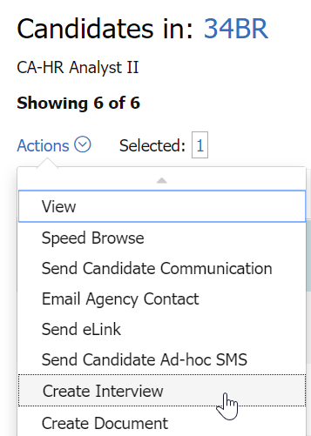
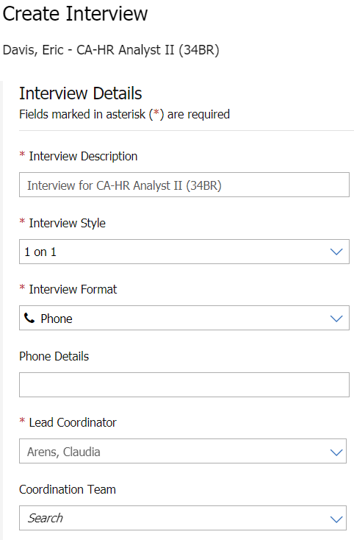
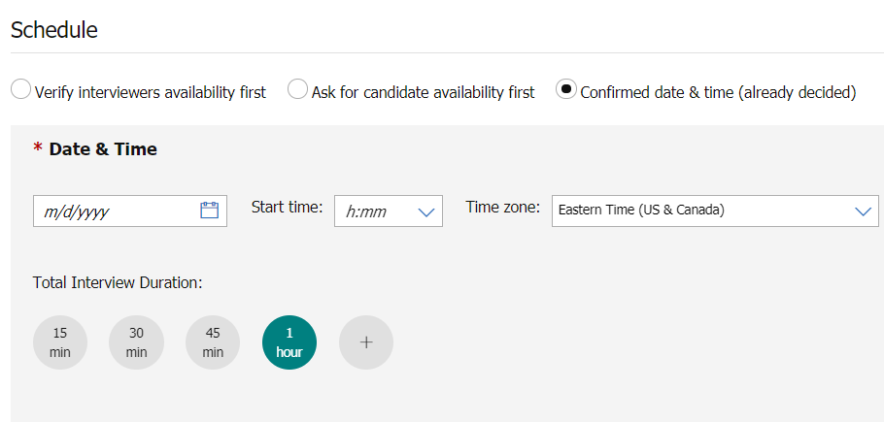
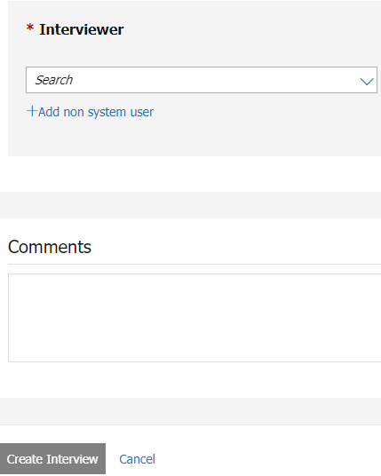
How to use the Interview Manager – User Experience
Create Interview
BrassRing > My Open Reqs > Select Candidate > Action: Create Interview
1.
2.
3.
4.

Slide 9
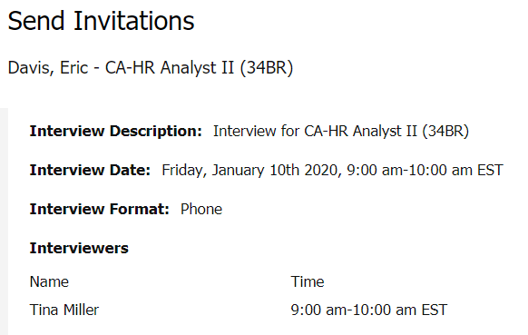
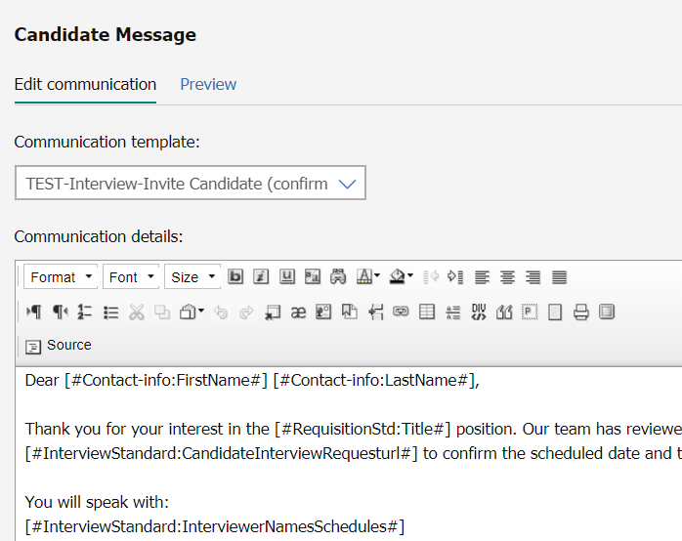
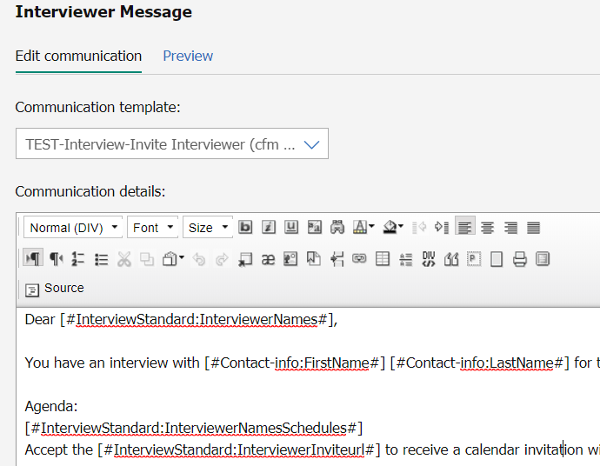
How to use the Interview Manager – User Experience
Send Communication
After creating the interview, the user can send a communication to the candidate and interviewer.

Slide 10
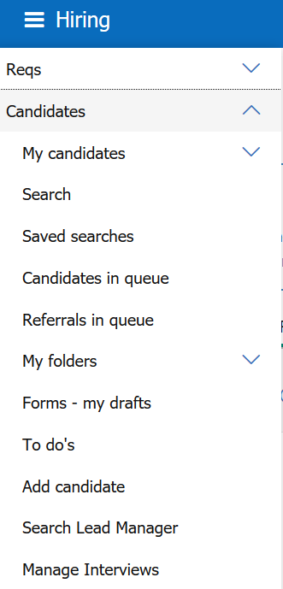
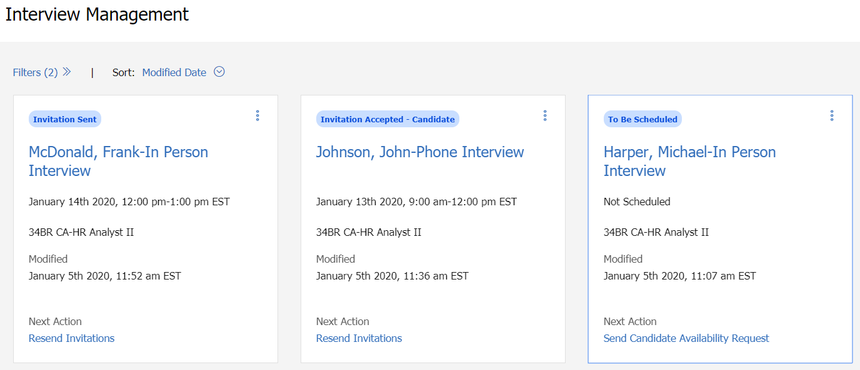
How to use the Interview Manager – User Experience
Manage Interviews
Provides details of the Interviews in a card view (interview status, interview date and time, etc.)
      BrassRing > Candidates > Manage Interviews

Slide 11
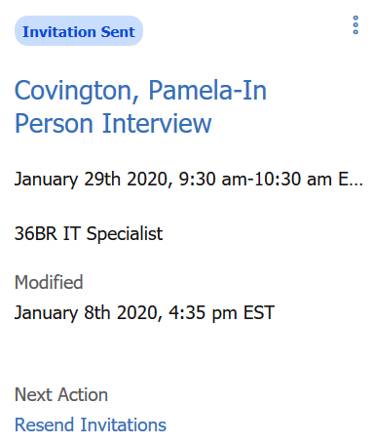
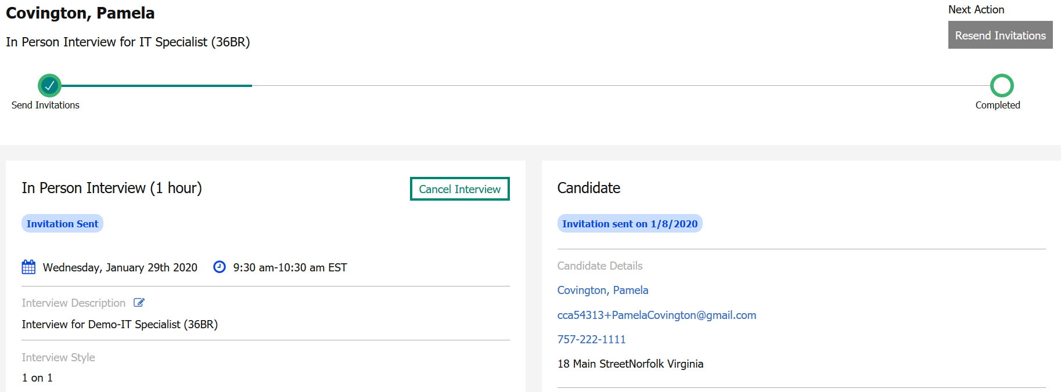
How to use the Interview Manager – User Experience
Manage Interviews
Click on the Candidate’s Name hyperlink to access the Interview Details Page
User can edit basic interview details; view, edit, and cancel interviews; send and resend communication; manage to-dos

Slide 12
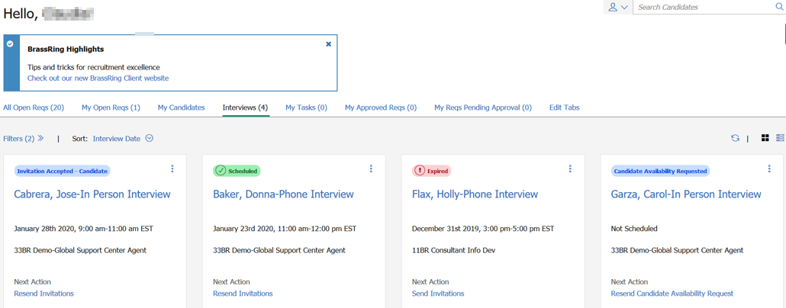
How to use the Interview Manager – User Experience
Home Page
Interview Tab will be available on the Home Page – Card View

Slide 13
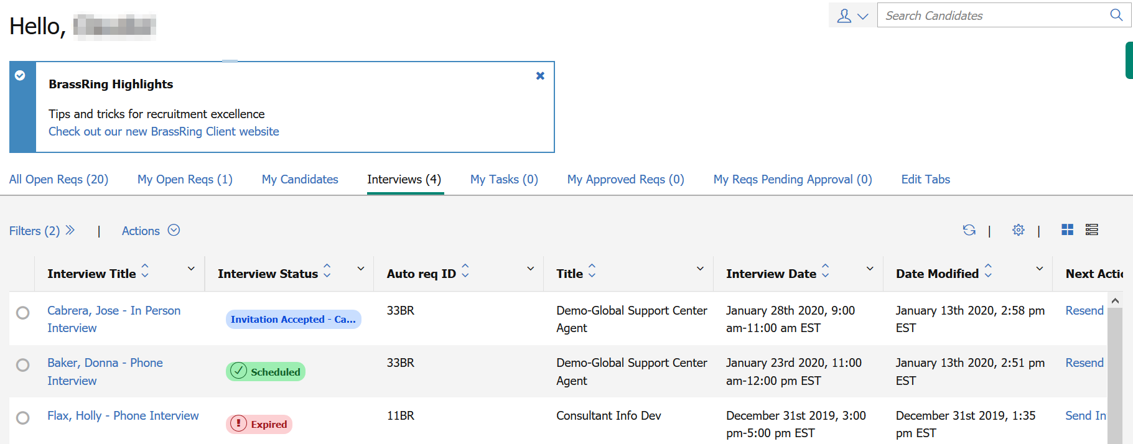
How to use the Interview Manager – User Experience
Home Page
Interview Tab will be available on the Home Page – Grid View

Slide 14
Demo
–
Interview Manager User Experience

Slide 15
FAQs
Can the email that goes to the interviewer/manager include a link to the resume? Yes, you can include a link to the talent record in the communication template.
  Can the user include in the interview invite any candidate forms that need to be completed by the candidate prior to the day of the interview? Yes, you can include candidate forms in the communication template.
  If it’s a video interview, can all the Skype or Zoom details be included in the interview details? Yes, you can include the details for Skype or Zoom video interviews.
  Will this be integrated with Office 365 to reflect a meeting on calendars? Yes - Office 365 and Google calendars are included in this project.
Does the feature include rescheduling? Rescheduling is not part of Phase I but we are planning on including it in the next phases.
Will we have the ability to have reports that can track all the interviews for the company? These details are being worked out so that Interview Manager data is available in the DIT and Metrics Dashboard.
Does the Interview Manager have any capabilities to adjust according to time zones and locations? Yes, you can select time zones when creating an interview.
Who is part of the list of Lead Coordinators? All BrassRing users.

Slide 16
FAQs
Will the email to the hiring manager include the ability to add the interview to the calendar? Yes, the attachment will be available for all scheduling communications, allowing the user to import it into their calendar.
Can the user customize the interview details fields? No, these are standard fields.
How are BrassRing users designated as "Interviewers"? At this time, all users in the system will show in the drop down. The type ahead and "Recently Used" section will allow for common ones to be easily found.
Can you have more than one "interviewer" but all at the same time (not a series)? Yes, the panel interview is the option that allows for an interview team.
Does the Interview Manager allow us to book rooms? No, not at this time. We are considering this for future phases.
Can you preview the email before sending? Yes, a preview option is available.
Do candidates have to "accept" in the candidate zone? or can you set the system up so they do not have to "accept"? Meaning we have already confirmed the time so we don't need the candidate to accept. Candidates can accept either from the Candidate Zone or the email with the invitation link. But they will have to still accept, even for the Confirmed Date & Time.

Slide 17
FAQs
Can we add external Interviewers that are not in the system or will the interviewer need to be an existing user in the system? Yes, in the "Interviewers" section on the interview set up screen, there is an option to add an external interviewer.
Can we default the communications so that users do not need to select the correct template? Not at this time, but we are considering this for future phases.
Will the Interview Manager replace Event Manager? No. The Interview Manager is not used with mass scheduling of interviews but rather with single candidate experience.
Is there documentation available that shows the various steps in each of the different workflow options? We will have details documentation available on the Knowledge Center once the feature is released.
How does this work with agency candidates? Does the email go to the candidate or to the recruitment agency? It is going to pull the email attached to the Candidate Record.
Can users set up their personal time slots in advance without creating an interview? Not at this time, but we are considering this for future phases.
Does the Interview Manager integrate with Lotus Notes? No, it integrates with Outlook 365 and Google.
What determines the date format of the Interview Manager? The date format reflects the logged in user’s locale.

Slide 18
Resources
Interview Management
https://documentation.infinite.com/docs/interview-management
Interview Manager Configuration
https://documentation.infinite.com/docs/interview-management-configuring-interview-manager

Slide 19
Future Enhancements
Rules Automation Manager
Reporting (Metrics Dashboard and DIT)

Slide 20
Questions?

