Slide 1
BrassRing Interview Manager – User Experience
BrassRing
—
Client Training and Enablement Session
Talent
March 3rd,2020

Slide 2
Agenda
Overview of Interview Manager
How to use Interview Manager – User Experience
Resources
Future Enhancements
Client Training & Enablement Sessions
Other Important Information
Q&A

Slide 3
Overview of Interview Manager?
The Interview Manager is a new feature in BrassRing that allows both BrassRing users and candidates to efficiently and effectively schedule interviews.
Available now in Staging only for all BrassRing clients (since February Release – Monday, February 10th, 2020). Moved to Production tentatively with March Release.
Part of standard feature in BrassRing and requires some configuration.
No additional cost for client to use Interview Manager.
Interviews can be created by BrassRing users who have access to Candidates within My Reqs. Interview Participants cannot choose to set-up their own interviews.
Easy access to interviews that are scheduled, in process, or that need to be scheduled.
By default all BrassRing users have access to create Interviews (My Reqs); user permissions determine the additional access or restriction.
Does not replace Event Manager but rather is used with the single candidate experience.

Slide 4
Overview of Interview Manager?
New Tab on Home page with card and grid view, filtering options and refresh icon.
Multiple interview styles:
    1:1 Interview - single candidate and single interviewer
    Series Interview - single candidate and multiple interviewers, one interview after another
    Panel Interview – single candidate and team of interviewers in the same time slot
Multiple interview formats:
    Phone – interview over the phone
    Video – video call interview where the candidate is required to appear on-screen
    Text/Chat – text only interview that uses a text service
    In person – candidate must attend on site for interview
    Other – other type of interviews where the format of the interview can be entered into the Interview Details
Note: The details of the interview differ depending on the interview format selection.

Slide 5
Overview of Interview Manager?
Calendar integration with Outlook 365 and Google+ allows for checking and scheduling interviewers’ shared calendars.
Candidates and Interviewers will receive an automated meeting invitation as soon as they accept the interview request. This meeting request allows the candidates to add it to their calendars directly (if supported) or download the ics attachment and add it manually to their calendars.
Multiple interview scheduling type:
    Confirmed date & time – the timeslot has already been decided on with the candidate and interviewer.
    Verify interviewers availability first – interviewer’s availability is checked first and candidates are provided with the timeslots to pick from based on interviewer’s availability.
    Ask candidate first – provide candidate with a range of dates and times to select specific timeslot that works best for them.

Slide 6
Demo
–
Interview Manager User Experience

Slide 7
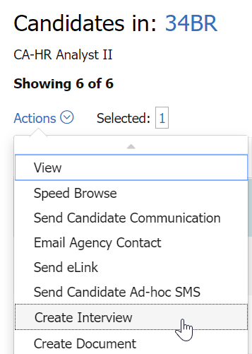
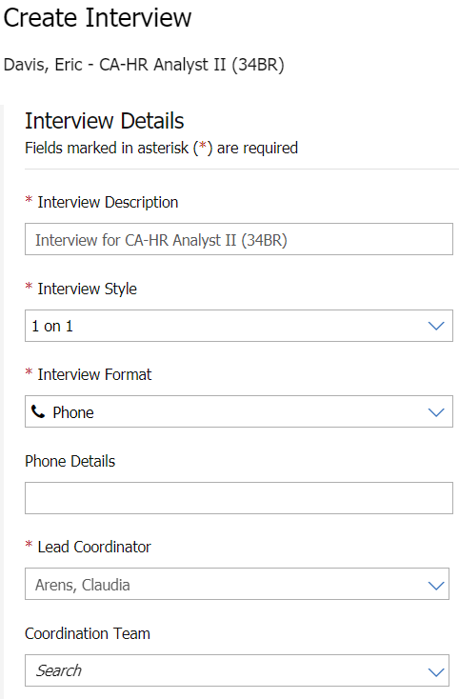
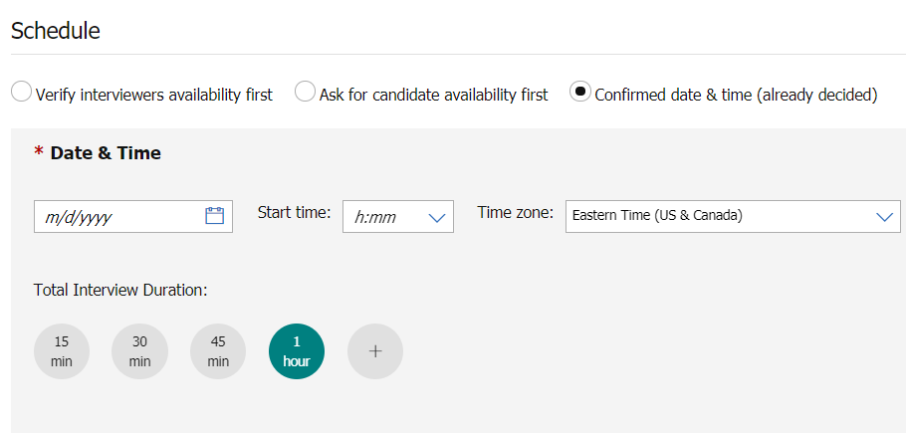
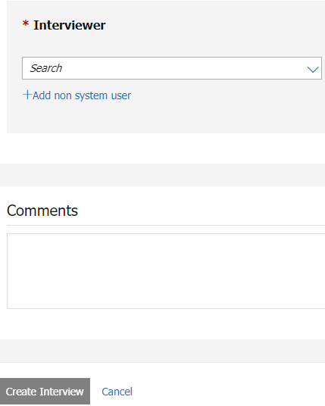
How to use the Interview Manager – User Experience
Create Interview
BrassRing > My Open Reqs > Select Candidate > Action: Create Interview
1.
2.
3.
4.

Slide 8
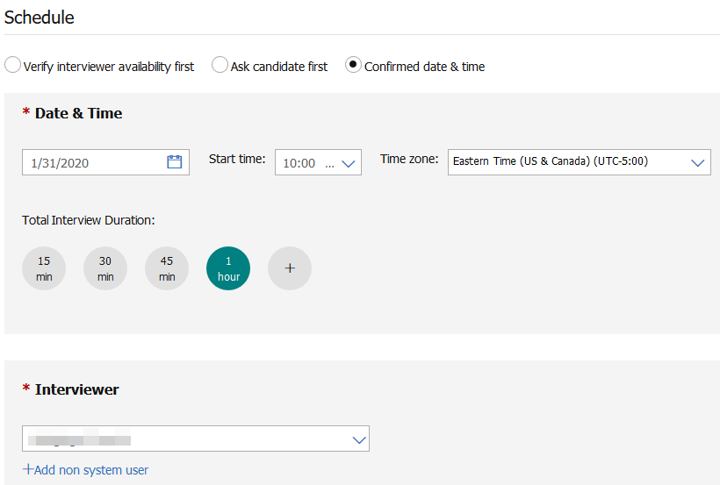
Overview of Interview Manager
Interview Scheduling Type Workflows
Confirmed Date & Time (already decided ) - Schedule has already been worked out with the candidate and interviewer. The candidate and interviewer still need to confirm the interview.

Slide 9
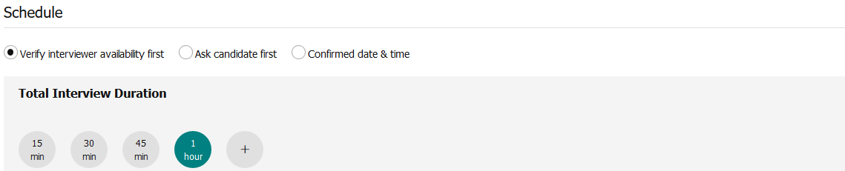
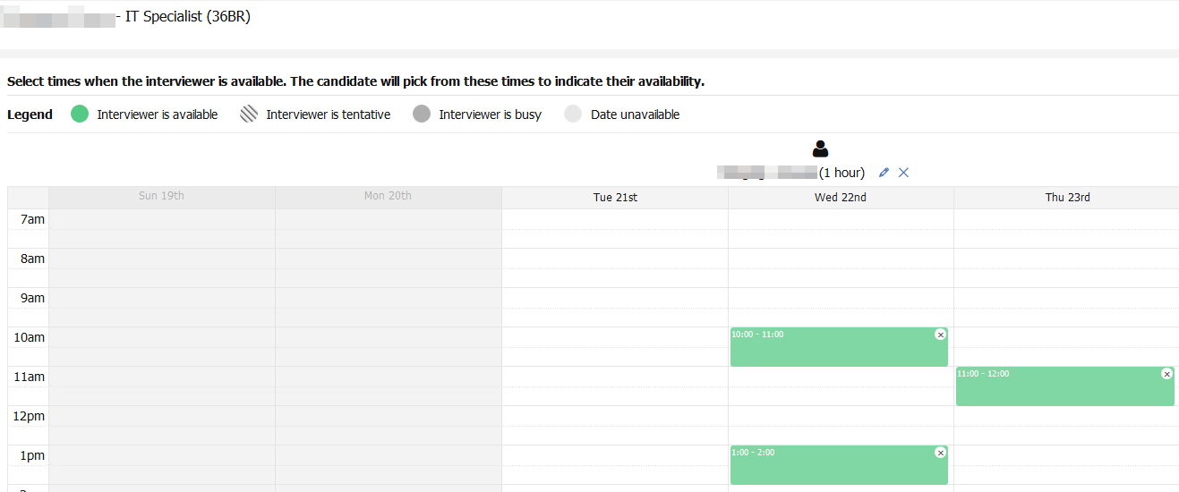
Overview of Interview Manager
Interview Scheduling Type Workflows
Verify interviewers availability first – interviewer’s availability is checked first and candidates are provided with the time slots to pick from based on interviewer’s availability.

Slide 10
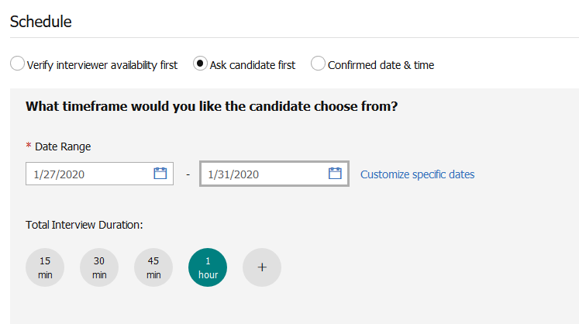
Overview of Interview Manager
Interview Scheduling Type Workflows
Ask for candidate availability first - Provide candidate with a range of dates and times to select specific one that works best for them.

Slide 11

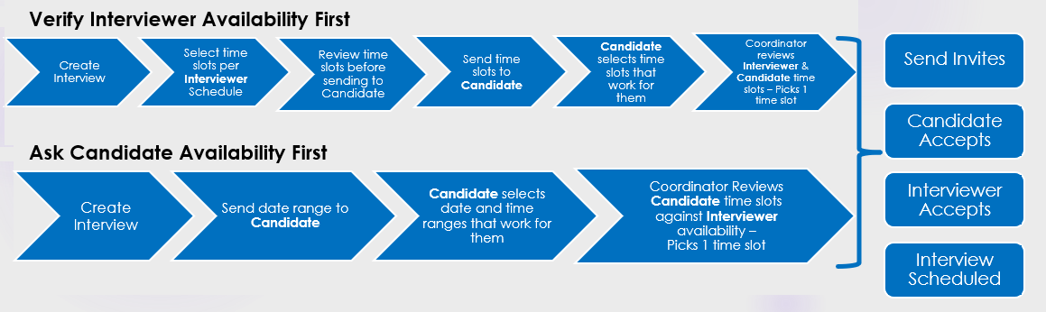
Overview of Interview Manager
Scheduling Type Workflows
Ask Candidate First

Slide 12
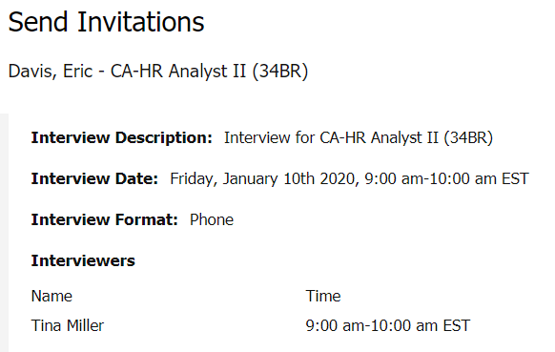
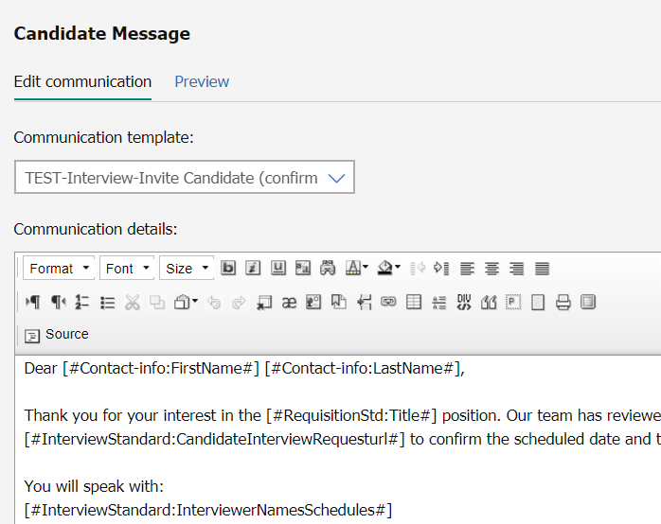
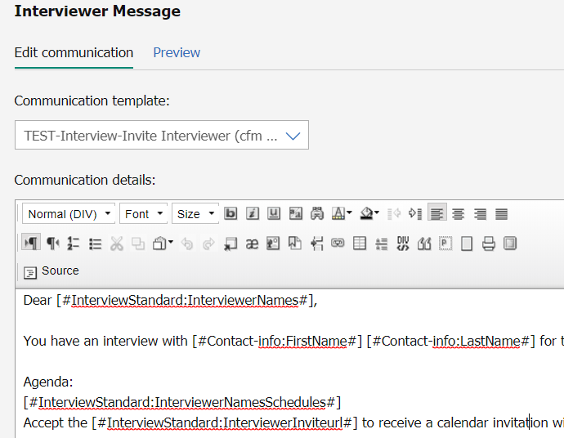
How to use the Interview Manager – User Experience
Send Communication
After creating the interview, the user can send a communication to the candidate and interviewer.

Slide 13
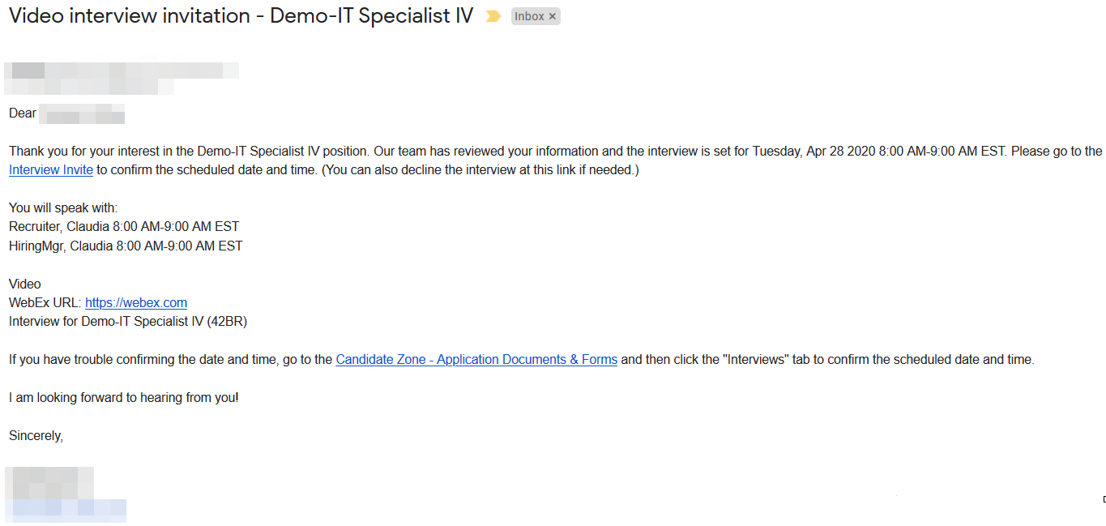
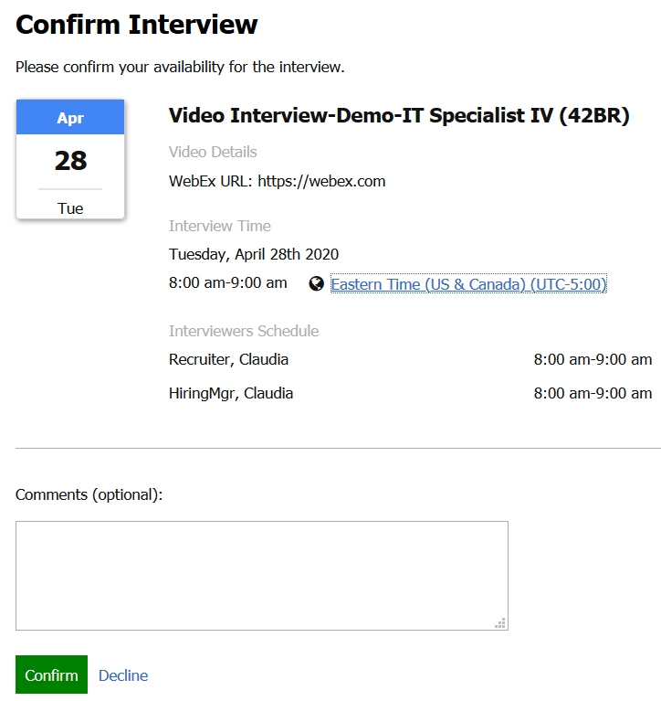
How to use the Interview Manager – User Experience
Receive Communication and Accept Invitation - Candidate
After receiving the email, the candidate can accept or decline the interview invite

Slide 14
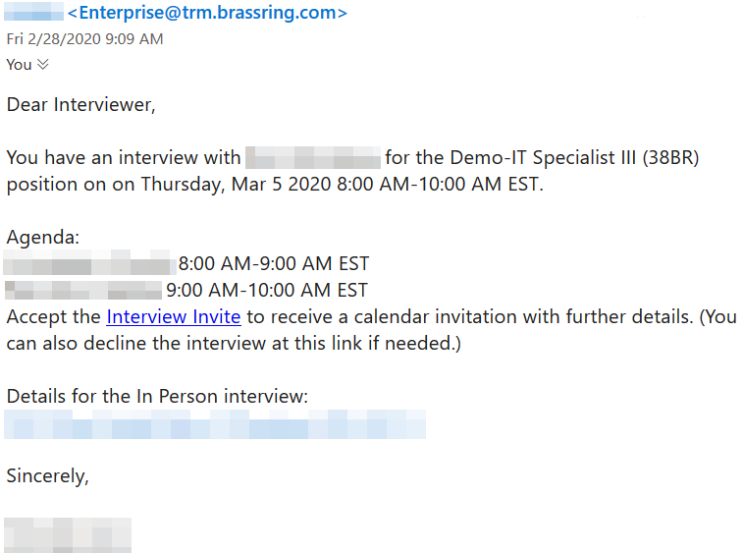
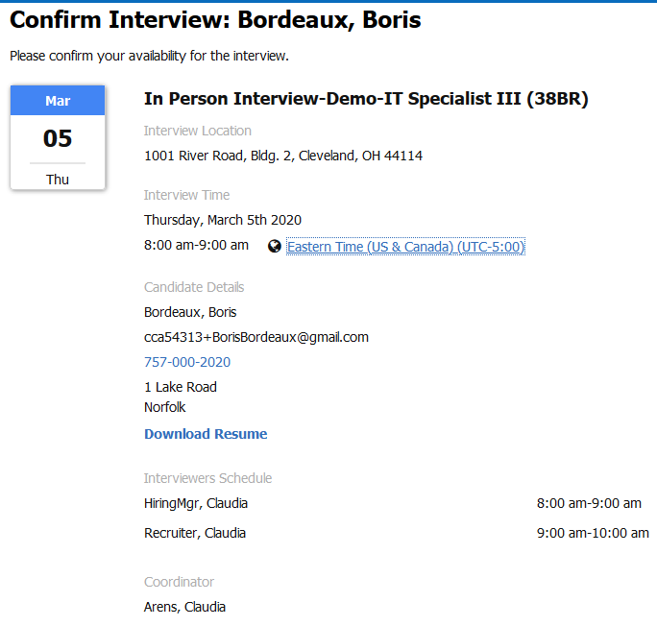

How to use the Interview Manager – User Experience
Receive Communication and Accept Invitation - Interviewer
After receiving the email, the interviewer can accept or decline the interview invite

Slide 15
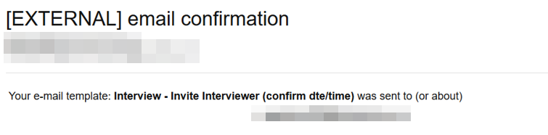
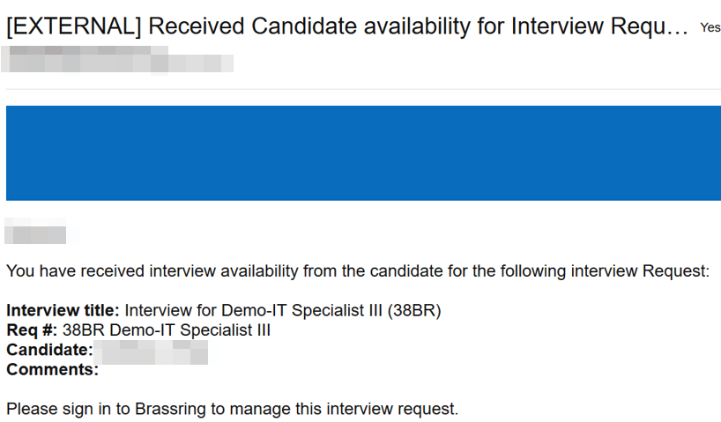
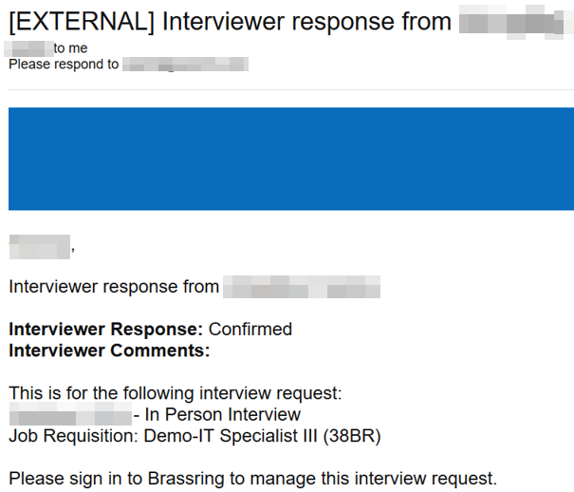
How to use the Interview Manager – User Experience
Send Communication
Examples of Interview Manager Confirmations to Lead Coordinator

Slide 16
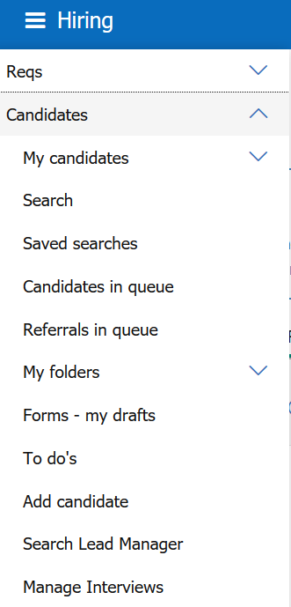
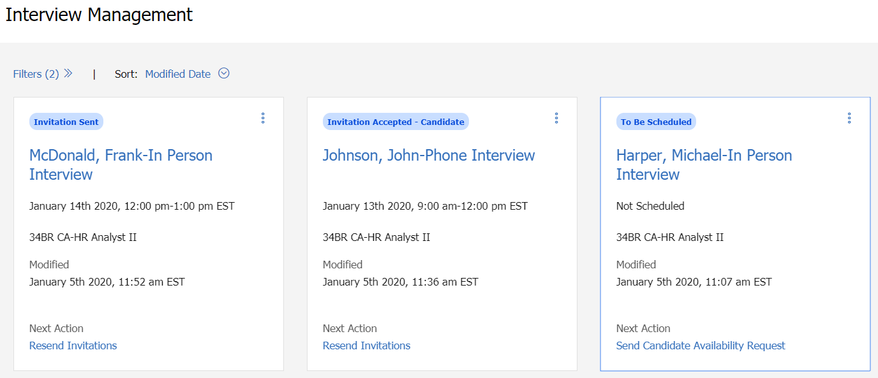
How to use the Interview Manager – User Experience
Manage Interviews
Provides details of the Interviews in a card view (interview status, interview date and time, etc.)
      BrassRing > Candidates > Manage Interviews

Slide 17
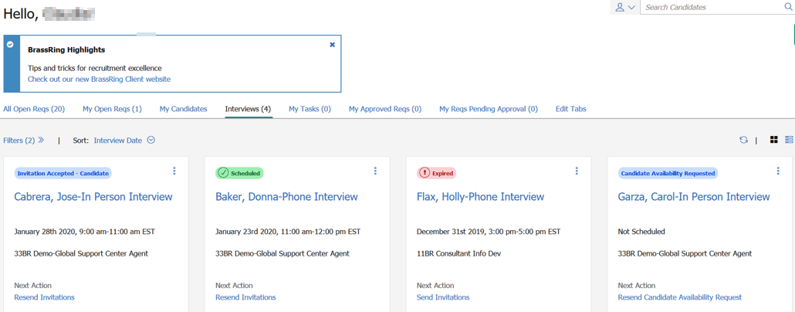
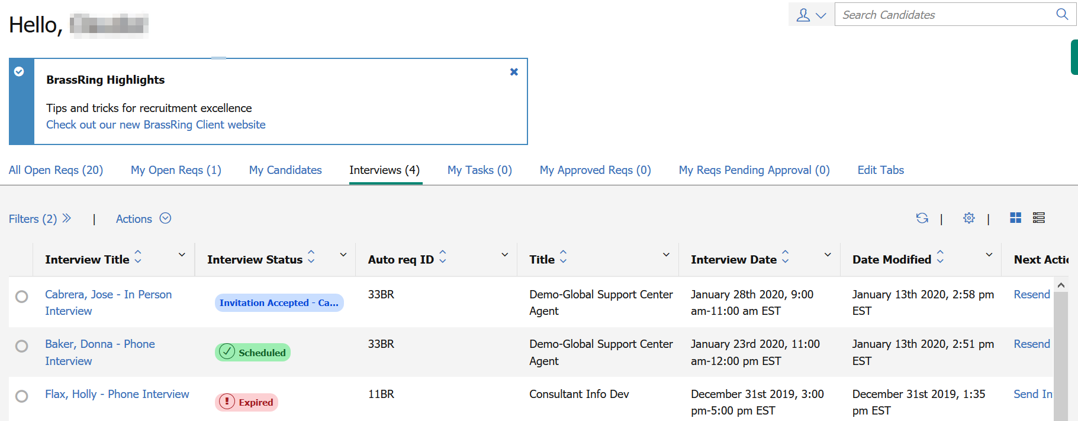
How to use the Interview Manager – User Experience
Home Page
Interview Tab is available on the Home Page – Card View or Grid View

Slide 18
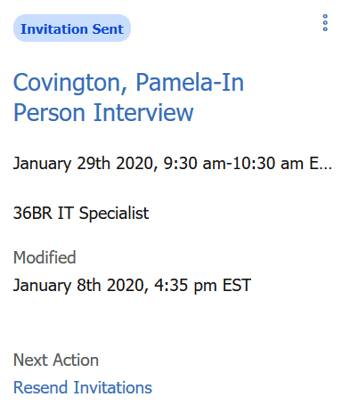
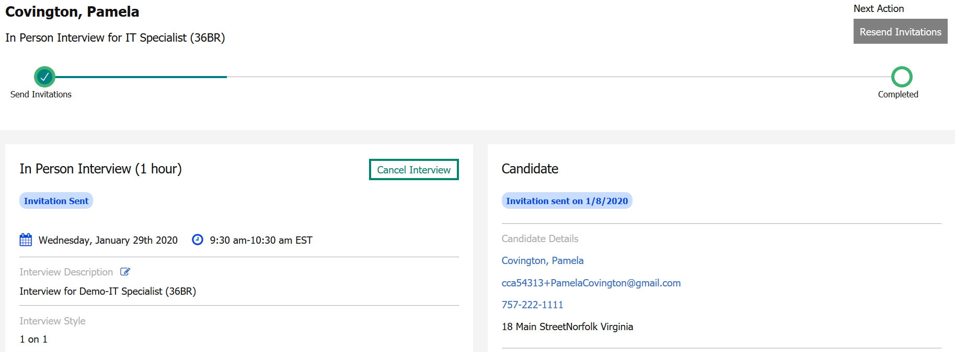
How to use the Interview Manager – User Experience
Manage Interviews
Click on the Candidate’s Name hyperlink to access the Interview Details Page
User can edit basic interview details; view, edit, and cancel interviews; send and resend communication; manage to-dos

Slide 19
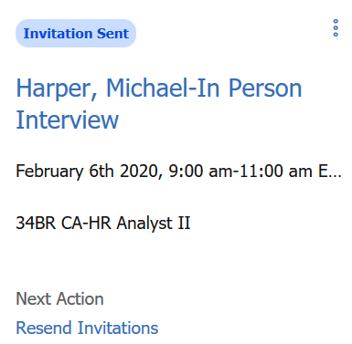
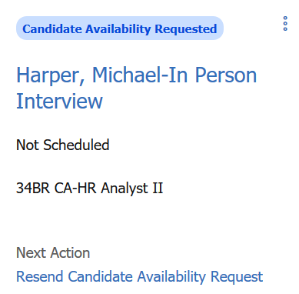
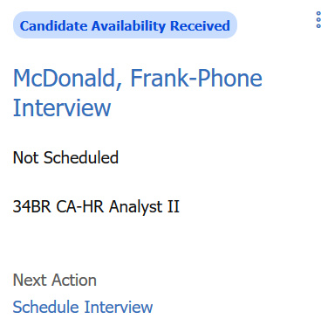
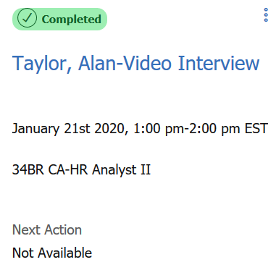
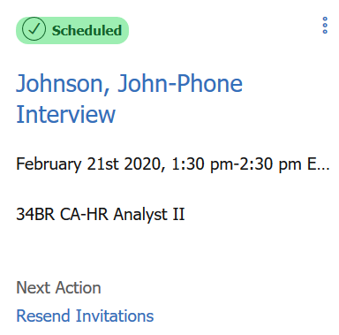
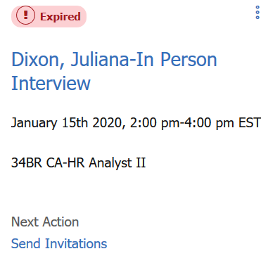
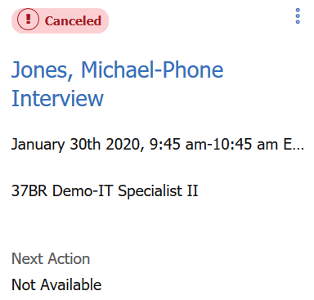
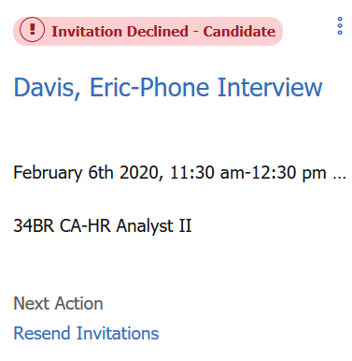
How to use the Interview Manager – User Experience
Interview Status
Each interview is assigned to an interview status depending on where it is in the interview process. The status appears in green – accepted/completed, red – expired/canceled/declined, and blue – pending.
Examples:

Slide 20
Resources
Interview Management
https://documentation.infinite.com/docs/interview-management
Interview Manager Configuration
https://documentation.infinite.com/docs/configuring-interview-manager
Interview Manager FAQs
https://documentation.infinite.com/docs/interview-manager-faqs

Slide 21
Future Enhancements
Rules Automation Manager
Reporting (Metrics Dashboard and DIT)
Talent Record Action Log

Slide 22
March VIRTUAL TRAINING SESSIONS
Client-facing training schedule
Check your skills here
Sunday | Monday | Tuesday | Wednesday | Thursday | Friday | Saturday
1 | 2 | 3 Client: Interview Manager – User Session (11:00 AM EST) Client: Talent Frameworks Content Updates (3:00 PM EST) | 4 | 5 Client: Talent Frameworks Content Updates (12:00 PM EST) | 6 | 7
8 | 9 Client: Assess New User Training (11:00 AM EST) | 10 Client: Interview Manager – Admin Session (11:00 AM EST) | 11 | 12 Client: BrassRing 20.03.09 and Onboard Release (11:00 AM EST) | 13 | 14
15 | 16 | 17 Client: Talent Frameworks Content Updates (11:00 AM EST) | 18 | 19 | 20 | 21
22 | 23 | 24 Client: Talent Suite – Manage Email Templates (11:00 AM EST) | 25 | 26 | 27 | 28
Interview Manager Release in Production

Slide 23
US Production Maintenance
US Production maintenance was originally scheduled for March 14th (1 week earlier than our normal cadence), but has been moved back to March 21st, 2020.
A maintenance reminder from the status page will go out.
The customer facing maintenance page reflects the change https://status.brassring.com/
https://documentation.infinite.com/docs/brassring-maintenance-calendar-2026
This document outlines the targeted monthly maintenance dates in 2020 for the following products:
      Talent Acquisition Suite
      BrassRing on Cloud
      Assess on Cloud
      Talent Insights

Slide 24
Workbench Digital Badge Course
We are relaunching the BrassRing Workbench digital badge course.
The new digital badge course has been redesigned from the ground up with new simulations and videos.
Any clients who are taking the current course, please know that the current course will be retired on
March 30th, 2020. After that date, only the new course will be available. This means that any course in progress will be lost when the course is retired.
If a user has not started or is in the early stages of the old course, we recommend that they take the new course instead.
Details and links to the courses can be found on the KC here:
https://documentation.infinite.com/docs/brassring-and-workbench-badge-courses

Slide 25
Questions?

