Slide 1
Intelligent Formatting is Now
Note Compose
Training-Ready Screenshots for nVoq Voice iOS Users
Right click on any image to copy and then paste into your training documents

Slide 2
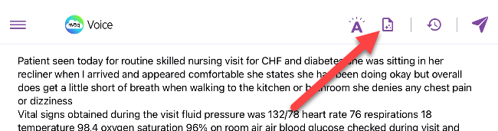
Voice for iOS Note Compose
Intelligent Formatting has a new name: Note Compose.
You’ll notice the updated name throughout the application.
As part of this update, the Apply button has been renamed to Run.
Everything else stays the same, including the “sparkle paper” icon used to launch it on iPad.
Be sure to update any training materials or documentation to reflect the new name, Note Compose, and the updated button label (from Apply to Run).

Slide 3
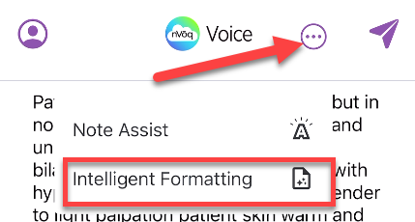
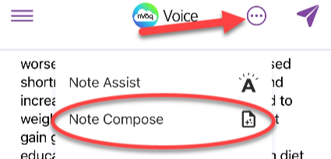
Voice iOS – iPhone (Voice Menu)
Current Name
New Name

Slide 4
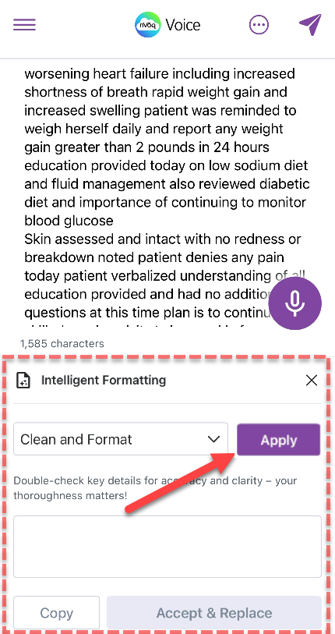
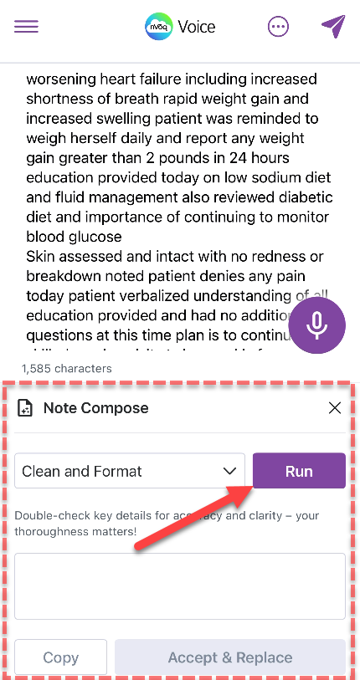
Voice iOS – iPhone
Current Name
New Name
New Label

Slide 5
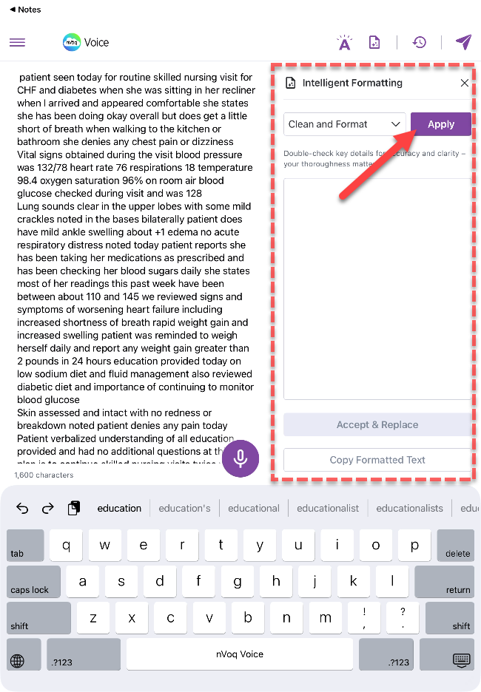
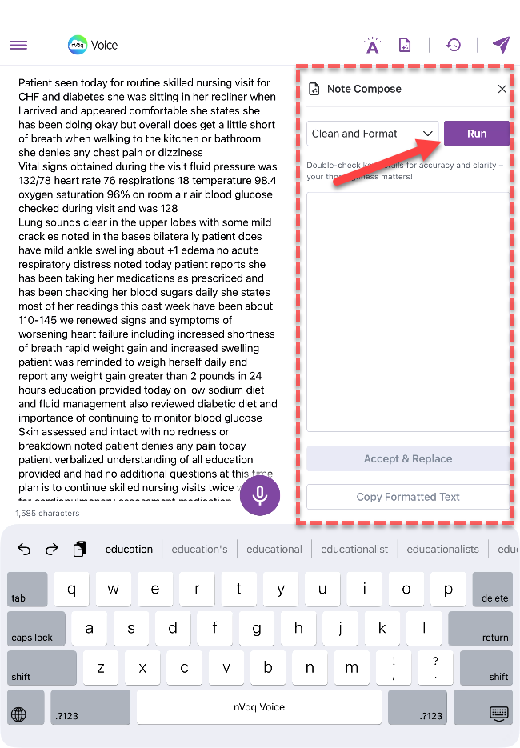
Voice iOS – iPad
Current Name
New Name
New Label

