Slide 1
Intelligent Formatting is Now
Note Compose
Training-Ready Screenshots for nVoq Voice Windows Users
Right click on any image to copy and then paste into your training documents

Slide 2
Voice for Windows Note Compose
Intelligent Formatting has a new name: Note Compose.
You’ll notice the updated name throughout the application, while the hotkey used to launch it remains the same.
Be sure to update any training materials or documentation to reflect the new name.

Slide 3
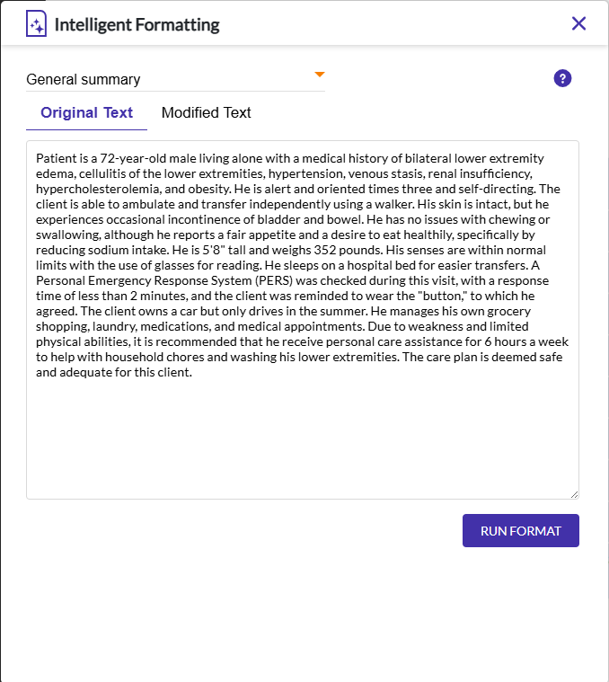
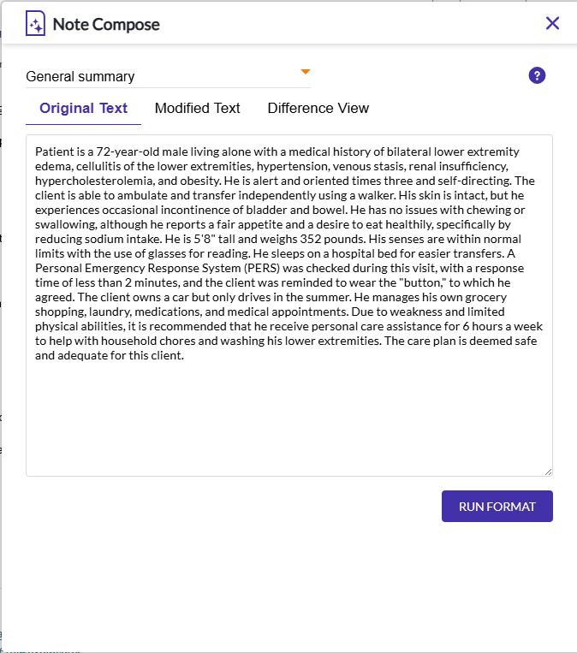
Voice Windows – Original Text Screen
Current Name
New Name

Slide 4
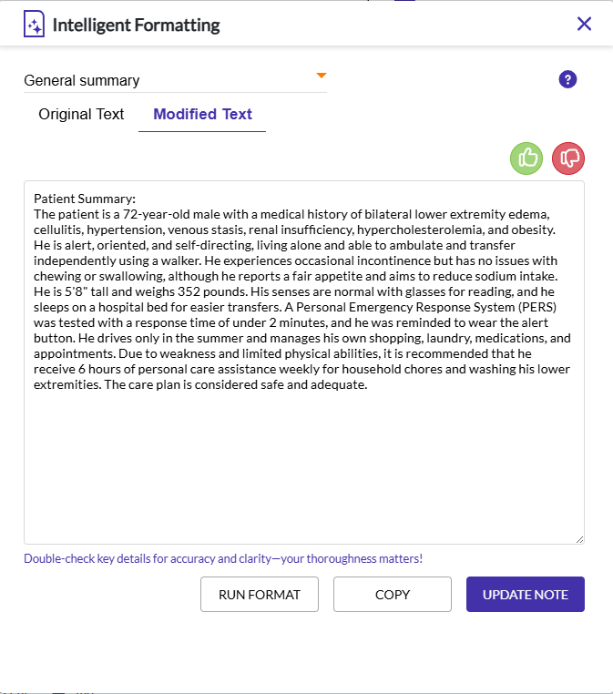
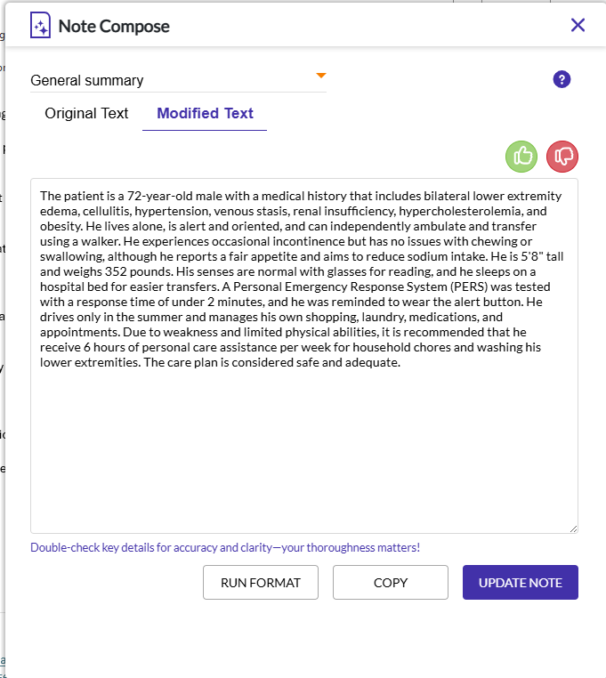
Voice Windows – Modified Text Screen
Current Name
New Name

