Slide 1
Intelligent Formatting is Now
Note Compose
Training-Ready Screenshots for nVoq Voice Android Users
Right click on any image to copy and then paste into your training documents

Slide 2
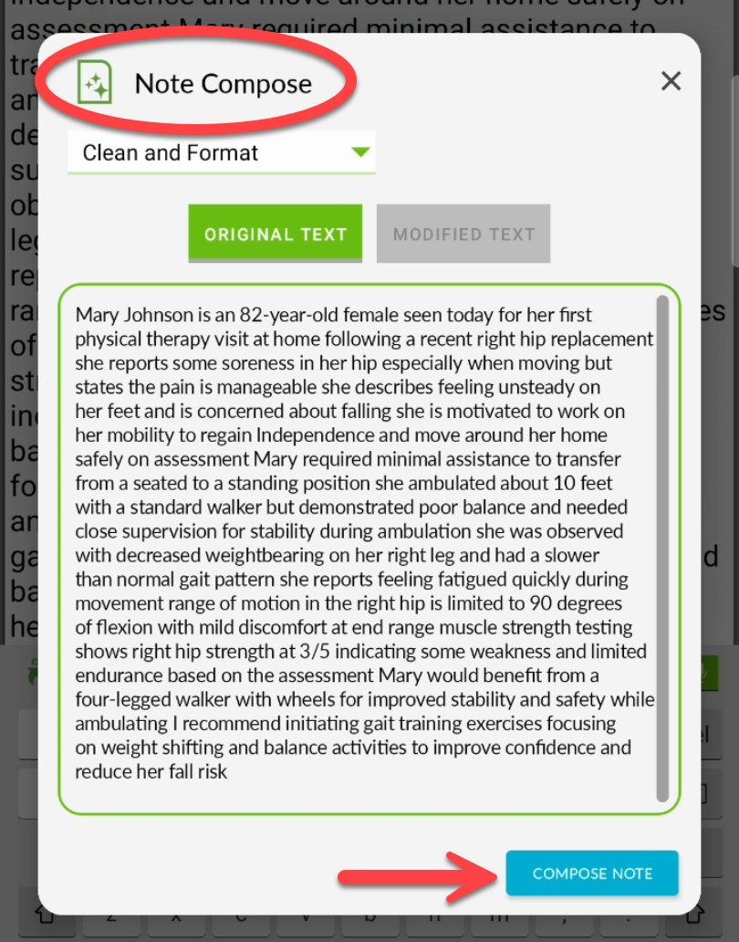
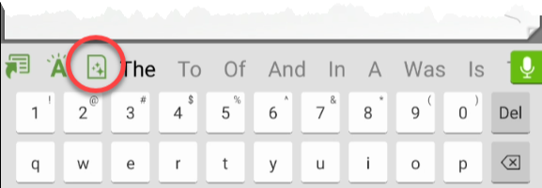
Voice for Android Note Compose
Intelligent Formatting has a new name: Note Compose.
You’ll notice the updated name throughout the app, while the button icon remains the same for easy recognition.
As part of this update, the Run Format button is now labeled Compose Note.
Everything else stays the same, this is just a simpler name for a feature you already know and use.
Be sure to update any training materials or documentation to reflect the new name, and the updated button label (from Run Format to Compose Note).

Slide 3
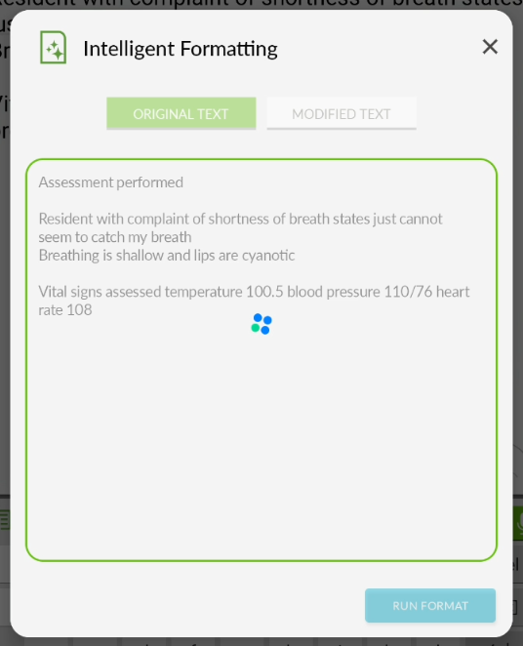
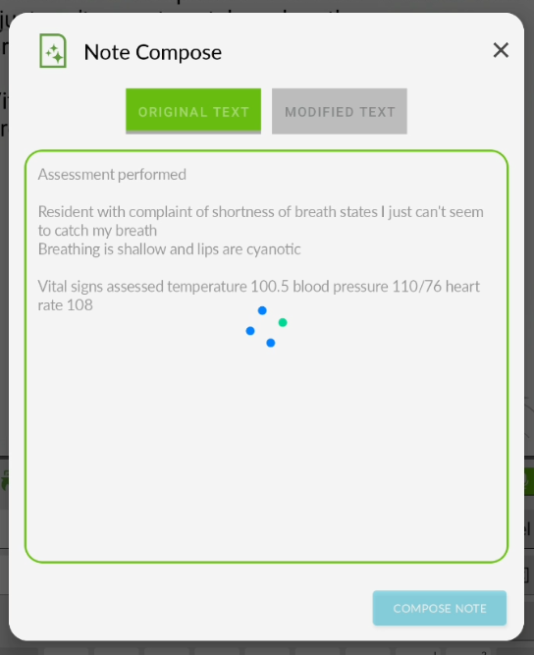
Voice Android – Original Text Screen
Current Name
New Name
New Label

Slide 4
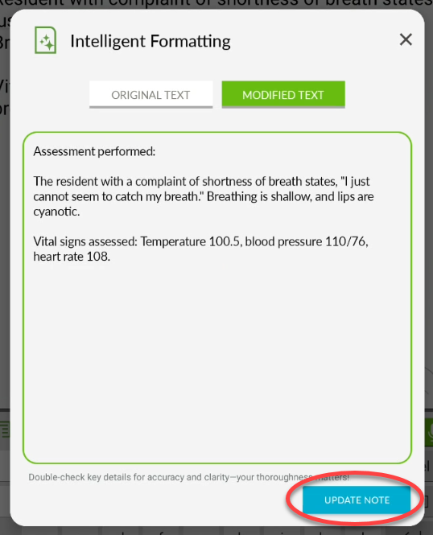
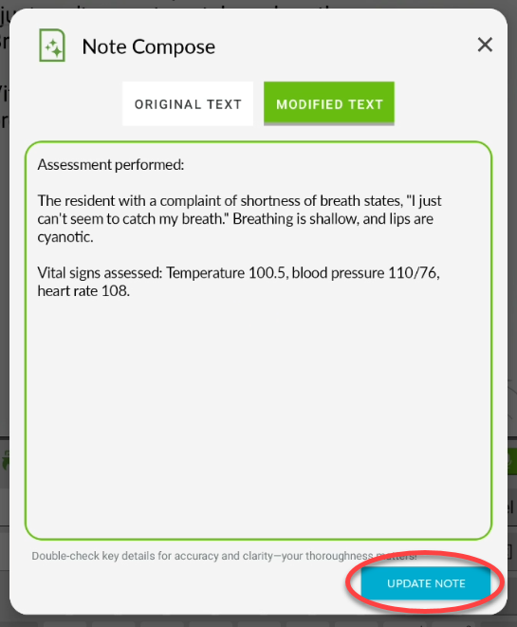
Voice Android – Modified Text Screen
Current Name
New Name

