Slide 1
Intelligent Formatting is Now Note Compose Training-Ready Screenshots for nVoq Administrator Users
Right click on any image to copy and then paste into your training documents

Slide 2
nVoq Administrator Note Compose
Intelligent Formatting has a new name: Note Compose.
You’ll notice the updated name throughout nVoq Administrator, including on the:
Sidebar navigation menu
Intelligent Formatting Designer page (now Note Compose Designer)
Add/Edit Account page
Update Accounts page (a.k.a. Mass Update)
Be sure to update any training materials or documentation to reflect the new name.

Slide 3
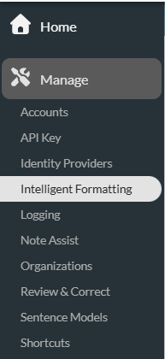
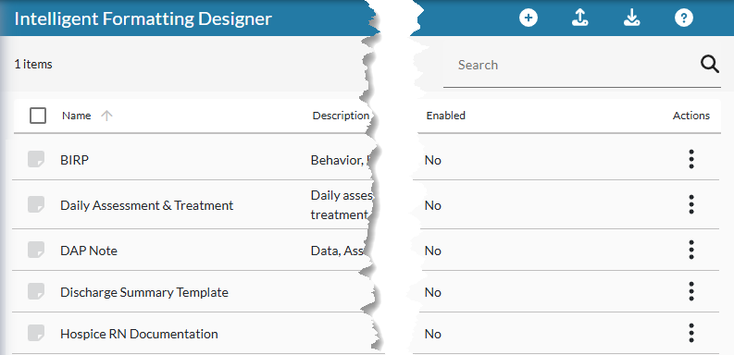
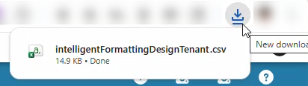
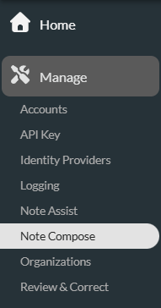
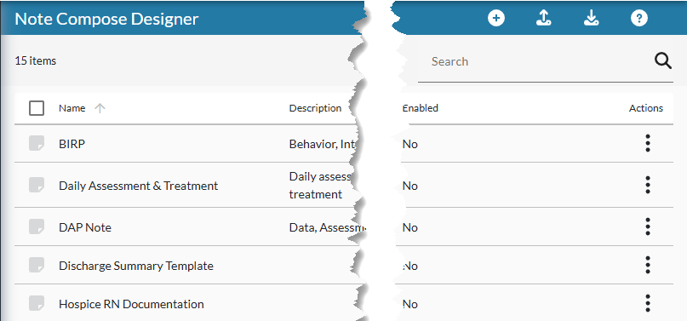
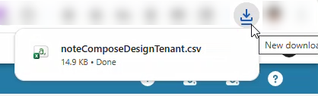
Administrator – Note Compose Designer (Home)
Current Name
When you download designs the download file name has also been renamed.
Current Name
New Name
New Name

Slide 4
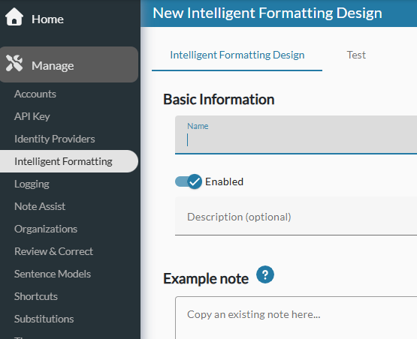
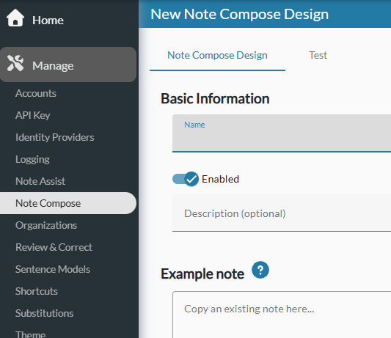
Administrator – Note Compose Designer (Create New)
Current Name
New Name

Slide 5
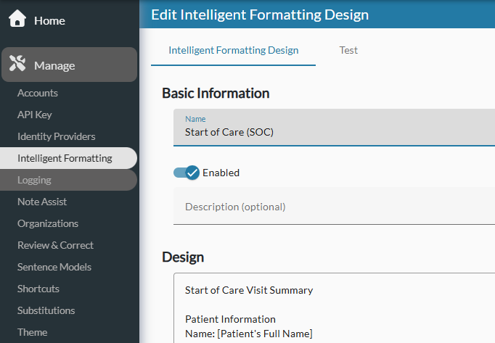
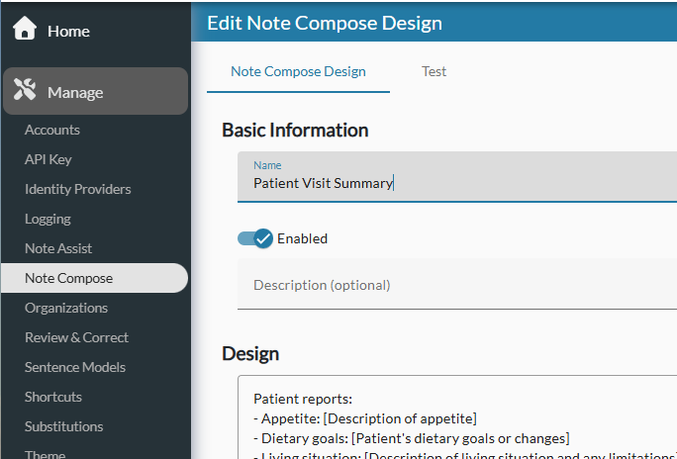
Administrator – Note Compose Designer (Edit)
Current Name
New Name

Slide 6
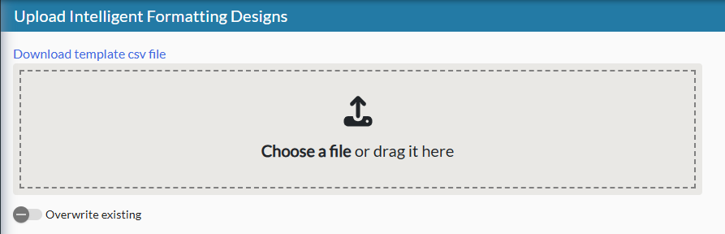
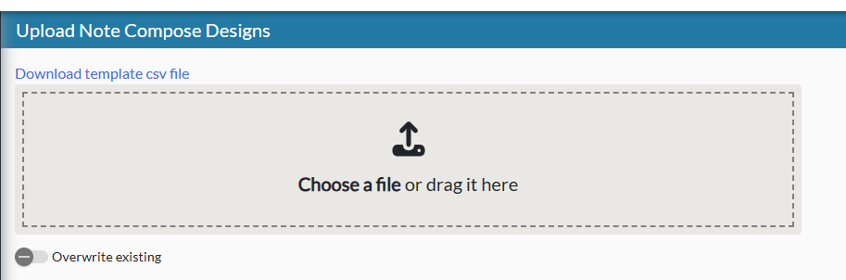
Administrator – Note Compose Designer (Upload)
Current Name
New Name

Slide 7
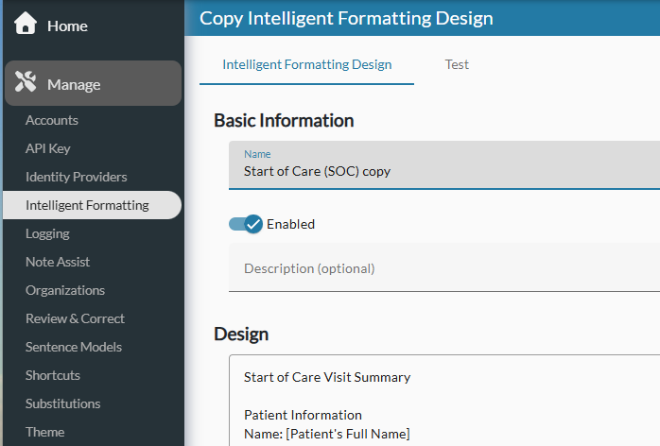
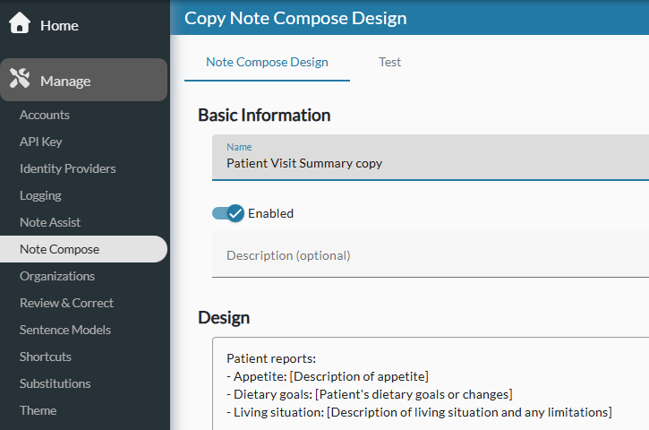
Administrator – Note Compose Designer (Copy)
Current Name
New Name

Slide 8
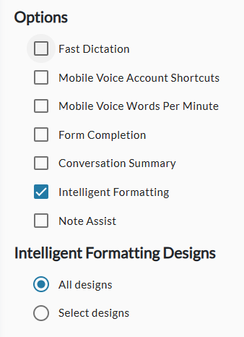
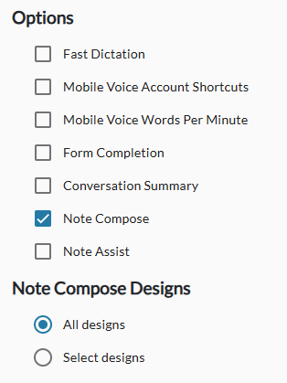
Administrator – Add/Edit Account
Current Name
New Name

Slide 9
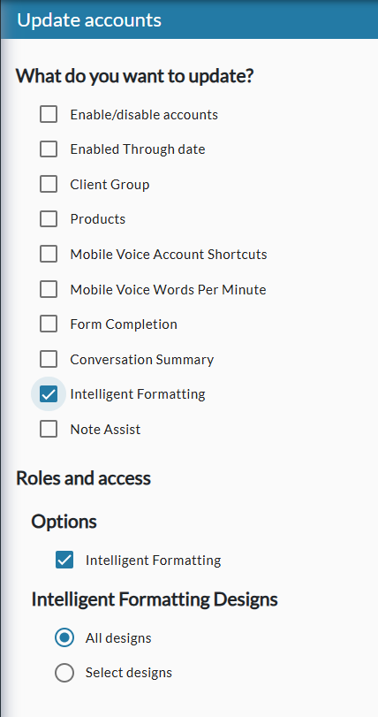
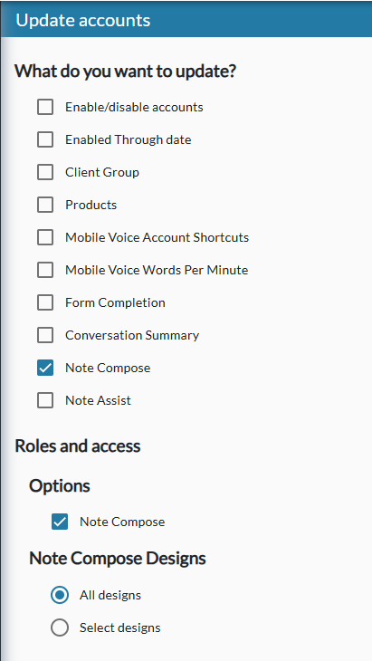
Administrator – Update Accounts (Mass Update)
Current Name
New Name

